Slide 1
Coastal Texas Water Resources
Utilizing NASA Earth Observations to Assess Estuary Health and Enhance Management of Water Resources in Coastal Texas through Land Cover and Precipitation Mapping
Elaina Gonsoroski (Project co-Lead)
Rodrigo Pereira da Silva
Tyler Lynn (Project co-Lead)
Ryan Schick
Georgina Crepps
Notes:
We are the Coastal Texas Water Resources team from NASA DEVELOP’s Mobile County Health Department node and this is our project exploring the relationship between mesquite trees, water, and the salinity levels of the Laguna Madre.

Slide 2
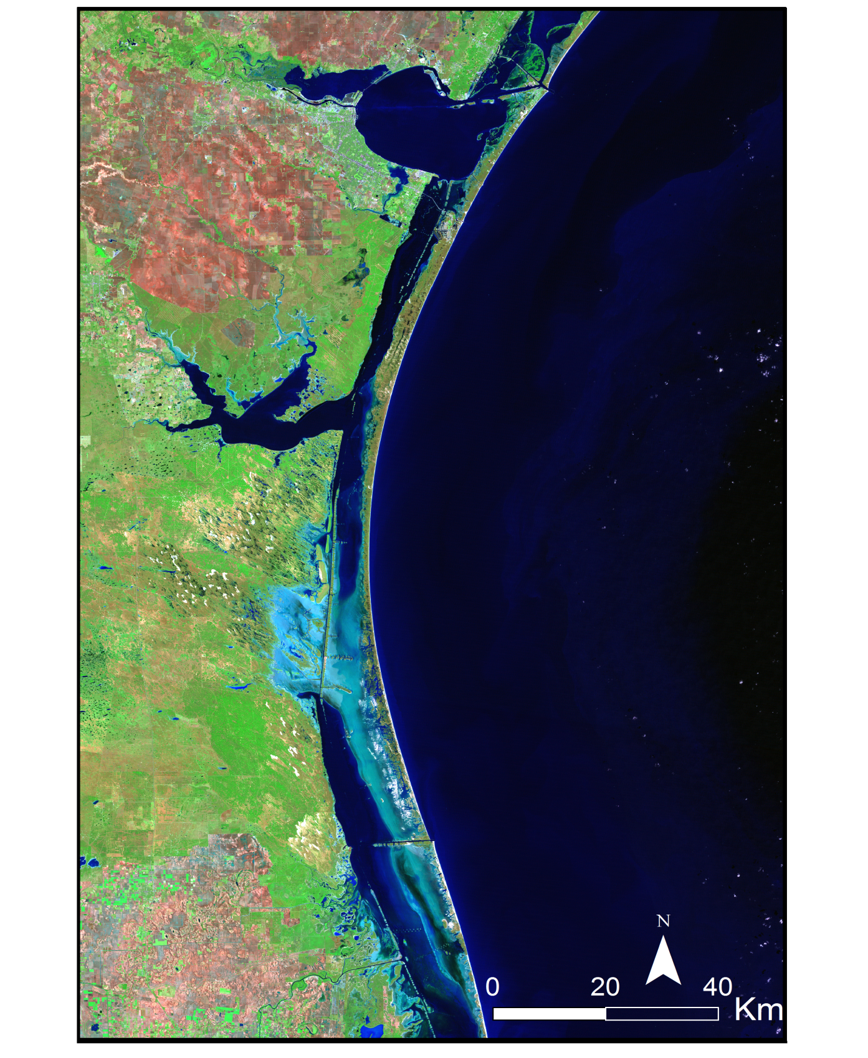
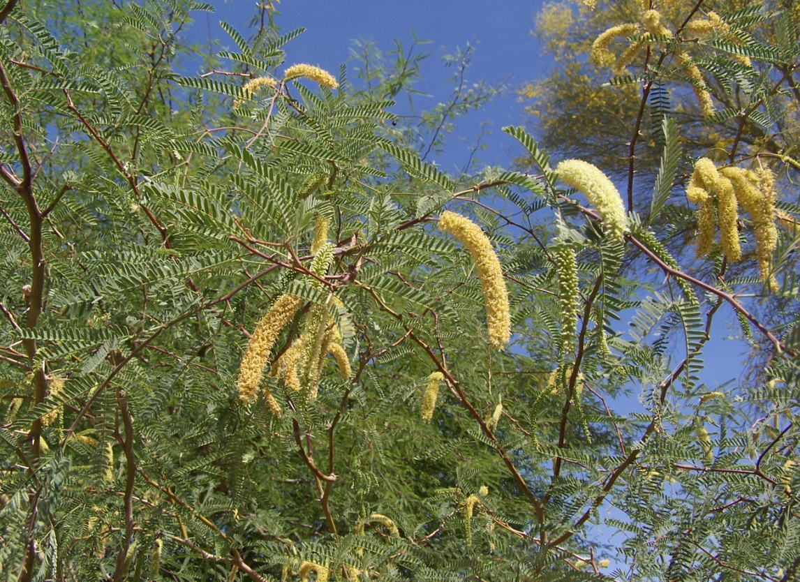
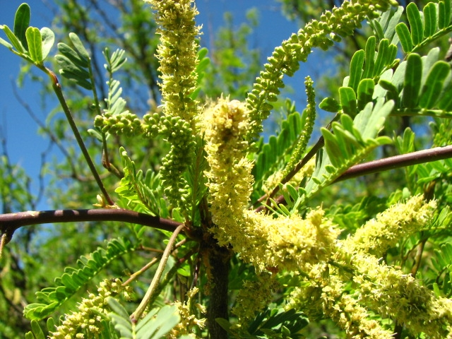
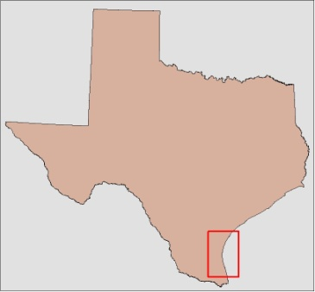
Landsat 5 Imagery from 27 December 2006
Honey mesquite tree (mage Credit: National Park Service)
Study Area & Background
Laguna Madre, Padre Island National Seashore
Hypersaline estuary
Salinity once lower
Hypothesis: Salinity increase due to expansion of mesquite trees
Study Period: 2000 - 2015
Laguna Madre
Notes:
The Laguna Madre is a shallow estuary in the Padre Island National Seashore, located on the southern coast of Texas. The Laguna is the only hypersaline estuary in North America. However, historically it has not always been that way. It is hypothesized the increase in salinity is due to an increase in the occurrence of the native prosopis glandulosa, commonly known as the honey mesquite tree. The long taproots of these trees, often extending 12 meters in depth, can reach groundwater, while the shallower roots of nearby grasses cannot. If this is occurring, then the trees may be preventing groundwater from reaching the lagoon, resulting in the increased salinity. To study this, the team looked at data from 2000 to 2015.
-----------
The study area focused on the Laguna Madre of Padre Island National Seashore on the southern coast of Texas. Latitude lines 27.6 N and 26.2 N were used for the northern and southern boundaries of the study area, respectively. The western boundary extended just past US Highway 77, or 97.8 W while the eastern boundary stretched offshore into the Gulf of Mexico.
The Laguna Madre is a shallow (0.25 m depth), hypersaline estuary, meaning its salt concentration is higher than that of the ocean. However, historical evidence suggests the salinity was once lower.
The increase is hypothesized to be due to an increase in the occurrence of the native honey mesquite tree in the surrounding area.
Data for the project were acquired between 2000 and 2015.

Slide 3
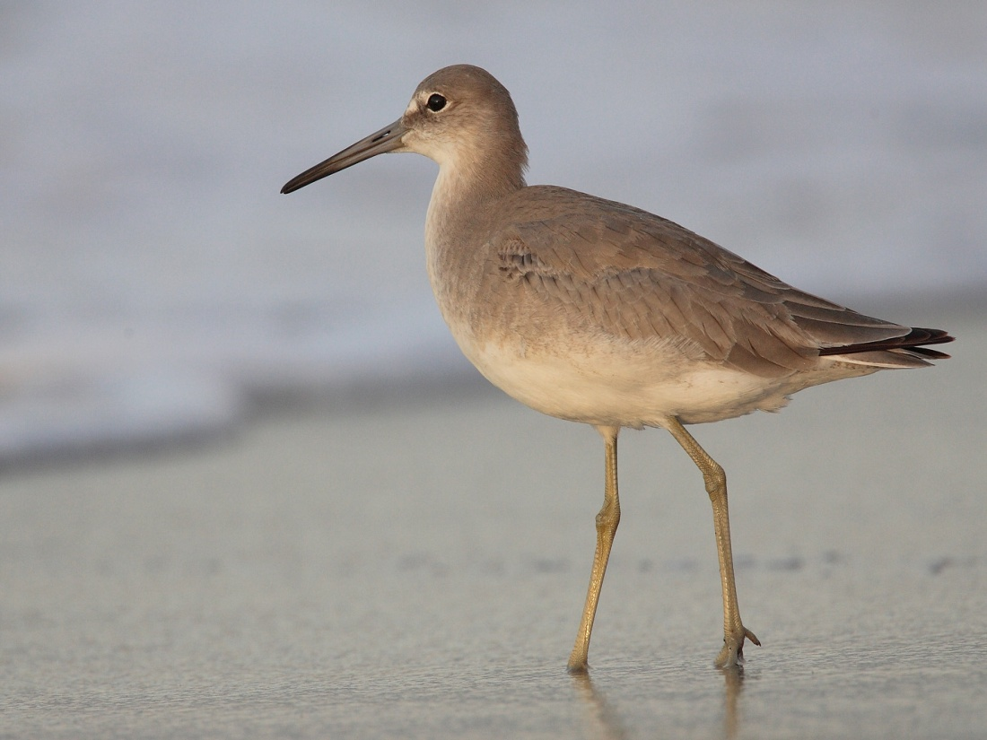
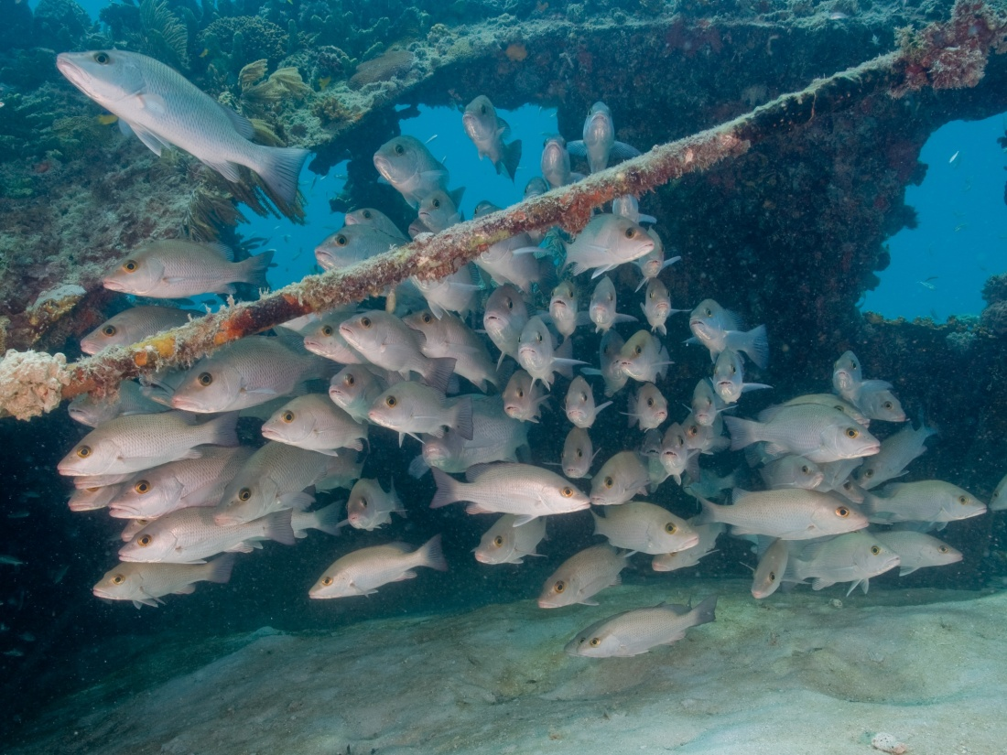
Community Concerns
Home to threatened species
Productive fishery
Estuary important to ecosystem and economy
Salinity changes may disrupt current ecosystems
Image Credit: National Park Service
Notes:
The estuary is also important both ecologically and economically. It serves as a habitat for many birds and fish, it is used for recreation, and is a productive fishery, important to the local economy. However, the increasing salinity threatens to disrupt the ecosystem of the lagoon, including causing the loss of important seagrasses.
---------
The Laguna Madre is home to a number of threatened species including seagrasses and sea turtles.
The lagoon is also one of the most productive fisheries in Texas and serves as a recreational area that sees 650,000 visitors annually.
The increasing salinity threatens both the ecosystem and economy.

Slide 4

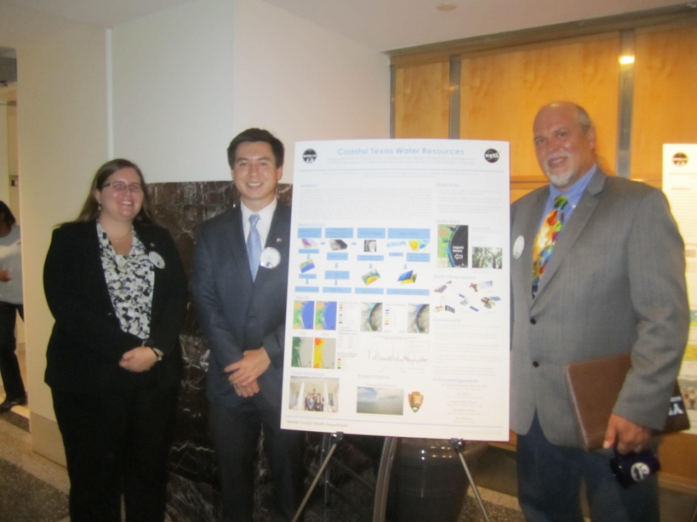
Partners
Padre Island National Seashore
Joe Meiman
Hydrologist
Southeast Region
Notes:
This project partners with the National Park Service at the Padre Island National Seashore. The team worked with Joe Meiman, a hydrologist with the park.
---------
The project partnered with the National Park Service.

Slide 5
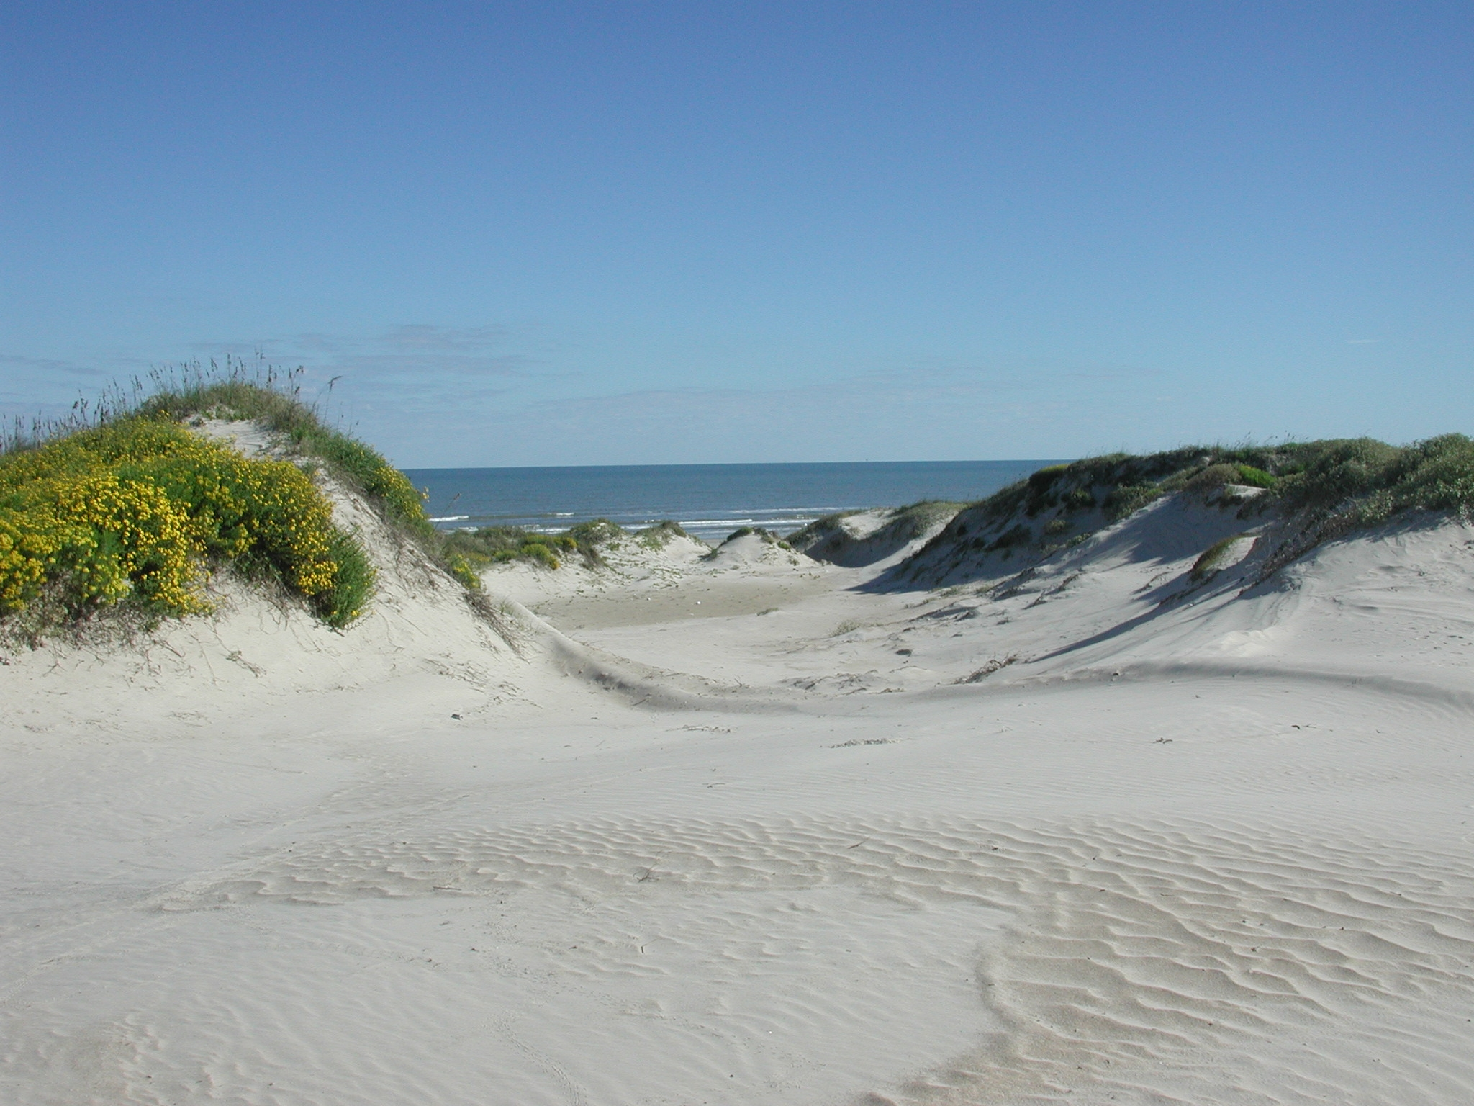
Objectives
Use NASA data to help compile land use/land cover maps to analyze changes in mesquite tree coverage over time
Conduct analysis of precipitation and root zone soil moisture content
Identify thermal anomalies of groundwater inflow to the lagoon
Develop a systematic method for studying these relationships to aid in future land management decisions
Sand Dunes within Padre Island National Seashore (Image Credit: National Park Service)
Notes:
The objectives of this project were:
Create land use/land cover maps to see the change in mesquite trees over time
Analyze the relationship between precipitation and root zone soil moisture content
Look at the surface temperature of the lagoon to identify groundwater inflow
And to create a systematic method for studying these relationships to aid in future land management decisions.

Slide 6

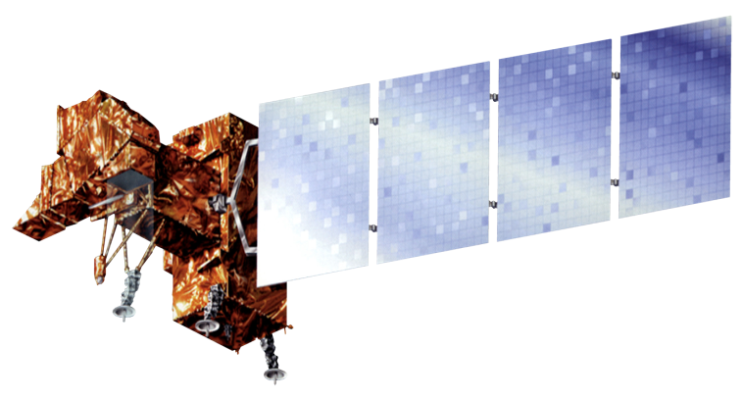

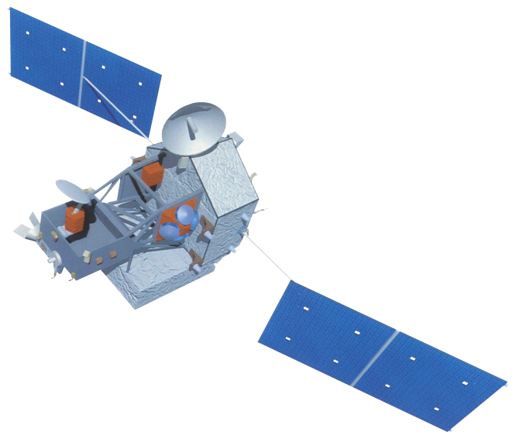
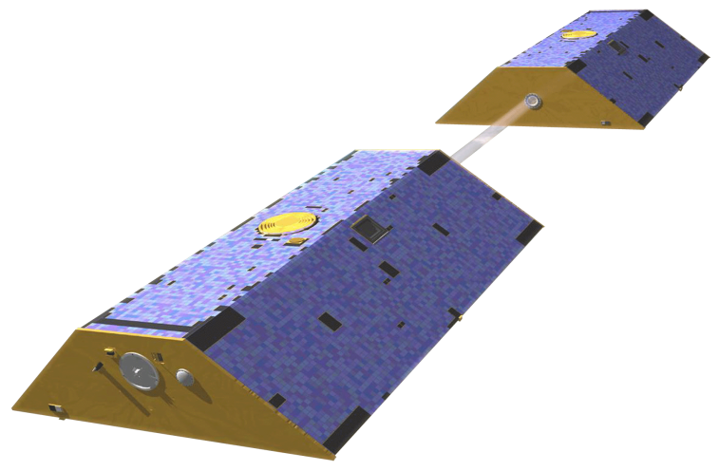
Earth Observations Utilized
Landsat 5
Landsat 7
Landsat 8
TRMM
GRACE
Notes:
To complete our analyses, the team utilized data from five satellites:
Landsat 5, 7, and 8 were used for the land cover, NDII, and thermal maps.
Data from TRMM were used to analyze precipitation. And GRACE derived
data were used to analyze changes in root zone soil moisture content.

Slide 7
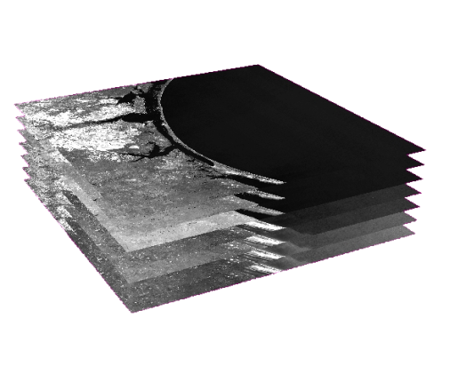
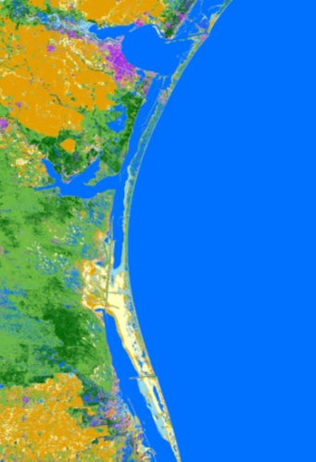
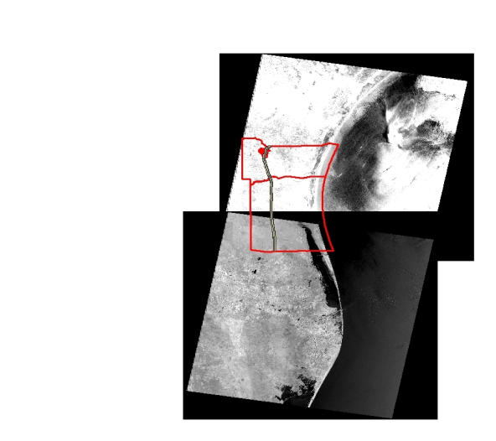
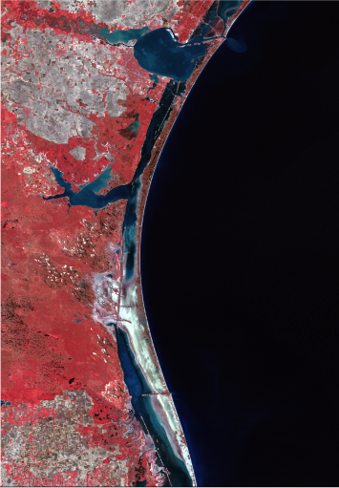
Land Use / Land Cover Methodology
Accuracy Assessment
Landsat 5, 7, and 8 data
Unsupervised and supervised classifications
TOA reflectance applied to correct data, clipped, mosaiced
Stacked for infrared visualization
Notes:
A land cover Analysis was done using Landsat 5, 7 and 8 data. Four maps were created with fall data for every four years from 2002 to 2014. The Top of atmosphere reflectance was applied to remove atmospheric interference. The data were clipped, mosaicked and stacked for infrared visualization. In other words, we used infrared, red and green bands as red, green and blue. The water mask was created using the unsupervised classification. After masking the water out from our study area, 70 classes were created in the unsupervised classification and more classes were created in the supervised classification to distinguish classes with similar spectral signature. For example, the mesquite trees and the urban areas with trees and grass. The last step was to run the accuracy assessment.

Slide 8
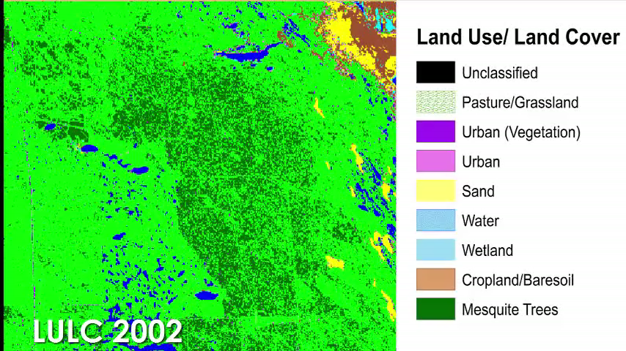
Land Use / Land Cover Results
Notes:
Our analysis showed that the number of mesquite trees increased from 2002 to 2014.

Slide 9
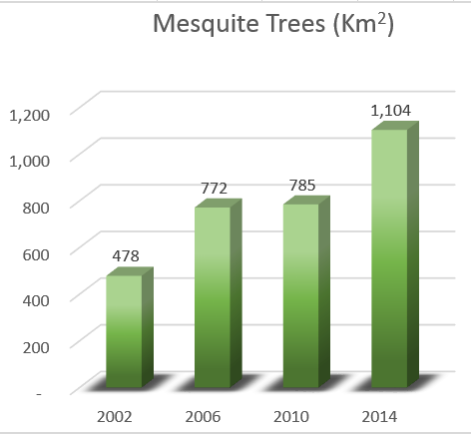
Mesquite Tree Coverage over Time
Notes:
This graphic shows the mesquite tree coverage over time. The mesquite trees went from 478 Km² in 2002 to 1,104 Km² in 2014.

Slide 10
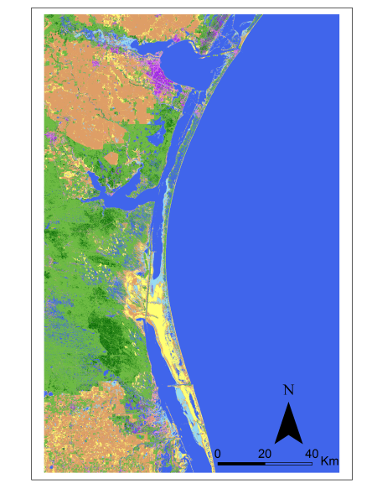
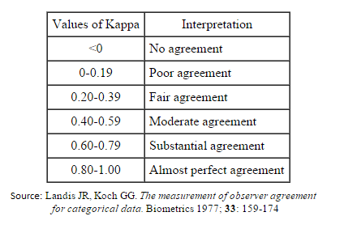
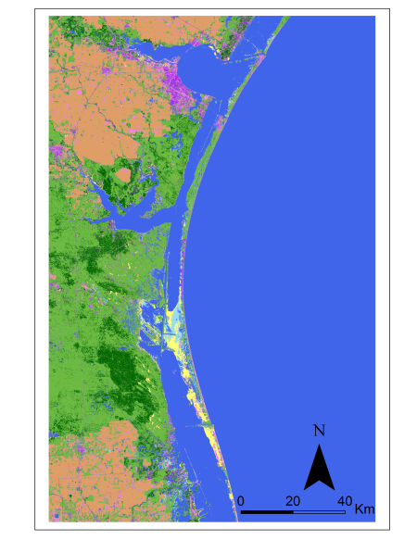
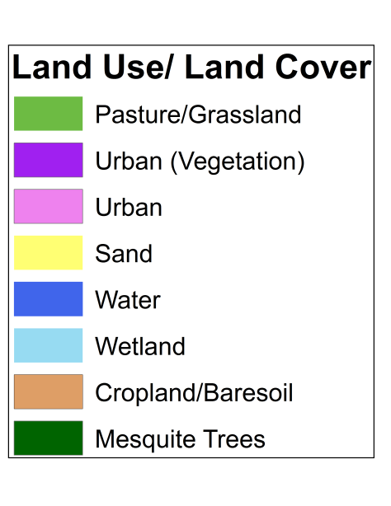
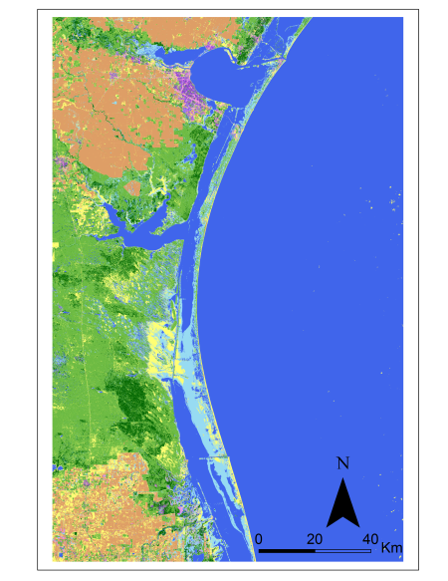
LULC Accuracy Assessment #1
LULC - Accuracy Totals - 200 Samples Equalized Random
 |  |  | Mesquite tree Class (25 Samples)
 | Overall Classification Accuracy | Overall Kappa Statistics | Mesquite Tree Producers‘ Accuracy | Mesquite Tree Users' Accuracy | Mesquite Tree Kappa Statistics
2002 | 82.0% | 0.79 | 71.9% | 88.5% | 0.86
2006 | 86.0% | 0.84 | 85.7% | 96.0% | 0.95
2010 | 89.0% | 0.87 | 80.7% | 100.0% | 1.00
2014 | 85.0% | 0.83 | 88.5% | 92.0% | 0.91
Notes:
Two hundreds samples were created in the first methodology of LULC accuracy assessment. The 200 samples were equally distributed for the eight classes. The overall classification accuracy ranges from 82 percent to 89 percent. In the accuracy report we have the overall kappa statistics and the kappa statistics for each class. Since the mesquite tree is the most important class of our project, it is relevant to show its values. Every value of overall and mesquite tree kappa statistics is within the substantial agreement or almost perfect agreement categories.

Slide 11
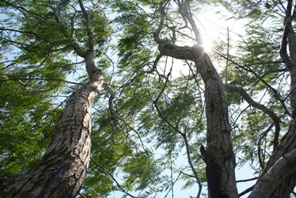
LULC Accuracy Assessment # 2
Honey mesquite tree (mage Credit: National Park Service)
LULC - Accuracy Totals - 100 Samples (50 samples for mesquite class)
 | All Classes (50 Samples - Equalized) |  | Mesquite tree Class (50 points)
 | Overall Classification Accuracy | Overall Kappa Statistics | Mesquite Tree Producers'Accuracy | Mesquite Tree Users' Accuracy | Mesquite Tree Kappa Statistics
2002 | 85.0% | 0.79 | 92.0% | 92.0% | 0.84
2006 | 91.0% | 0.88 | 95.8% | 92.0% | 0.85
2010 | 94.0% | 0.92 | 97.9% | 92.00% | 0.85
2014 | 85.0% | 0.79 | 95.7% | 90.0% | 0.81
Notes:
The second methodology of accuracy assessment focused on the most important class of our project, the mesquite trees. A hundred samples were created. Fifty samples were distributed for the mesquite tree class. The other 50 samples were equally distributed for the other classes. Once again, every value of overall and mesquite tree kappa statistics is within the substantial agreement or almost perfect agreement categories.

Slide 12
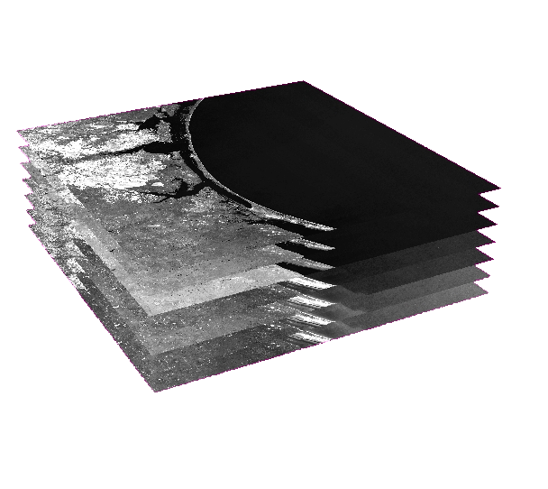
Normalized Difference Infrared Index (NDII) Methodology
NIR - SWIR
NDII =
NIR + SWIR
Landsat 5, 7, and 8 data
Indication of water content in vegetation
Satellite | NIR | SWIR
Landsat 5 | Band 4 (0.76-0.90 µm) | Band 7 (2.08-2.35 µm)
Landsat 7 | Band 4 (0.77-0.90 µm) | Band 7 (2.09-2.35 µm)
Landsat 8 | Band 5 (0.85-0.88 µm) | Band 7 (2.11-2.29 µm)
Notes:
Following the land cover classification, the team calculated the Normalized Difference Infrared Index (NDII). We used the same Landsat data as was used for the land cover classification. The NDII is an indicator of water content in vegetation and is defined as the ratio of the difference between the Near Infrared Reflectance (NIR) and the Short Wave Infrared Reflectance (SWIR) over the sum of these values. We used the NIR and SWIR bands from each satellite, as shown in the table, to calculate this ratio.
Notes:
The Landsat 5, 7, and 8 data used for to calculate NDII were from the same scenes used in the land cover analysis
The NDII is the ratio of the difference between the NIR and the SWIR divided by the sum of these values.
NIR = Near Infrared Reflectance and
SWIR = Short Wave Infrared Reflectance
Bands 4 and 7 were used for Landsat 5 and 7 data. Band 4 is the NIR band and band 7 is the SWIR band.
For Landsat 5 the wavelength for band 4 was 0.76 – 0.90 micrometers and for band 7 was 2.08 – 2.35 micrometers.
For Landsat 7 the wavelength for band 4 was 0.77 – 0.90 micrometers and for band 7 was 2.09 -2.35 micrometers.
For Landsat 8 the wavelength for band 5 was 0.85 – 0.88 micrometers and for band 7 was 2.11 – 2.29 micrometers.
Bands 5 and 7 were used for Landsat 8 with band 5 being the NIR band and band 7 being the SWIR band.
Higher NDII values indicate there is a higher water content and vegetation is less stressed.

Slide 13
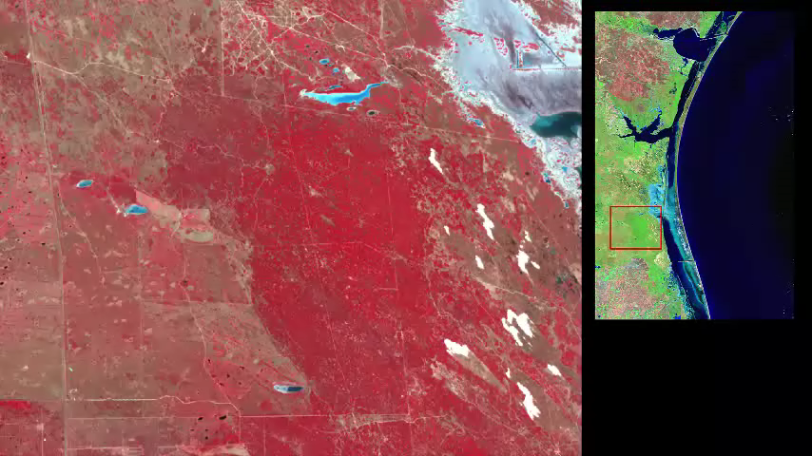
NDII Results
Notes:
Here we have an example of the NDII map from December of 2006 along with 2 other maps. The first is the raw Landsat 5 data. The second is the land cover map where mesquite tree coverage is shown in dark green. The third map is the NDII where high values indicate higher foliar water content and lower stressed vegetation. The areas of high NDII values approximately align with the mesquite tree coverage identified in the land cover map suggesting the mesquite trees are able to obtain water when other nearby vegetation cannot.
Notes:
The Landsat 5, 7, and 8 data used for to calculate NDII were from the same scenes used in the land cover analysis
The first map shows raw data from Landsat. The second map shows the LULC for December 2006.
Finally, the third map shows the NDII from December 2006. Comparison between the NDII and LULC map shows the areas of moister vegetation approximately aligned with the area of mesquite tree coverage as identified by the LULC map.

Slide 14
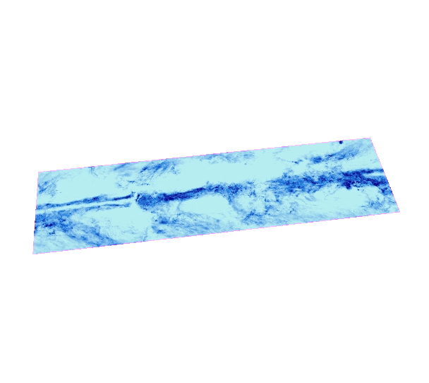

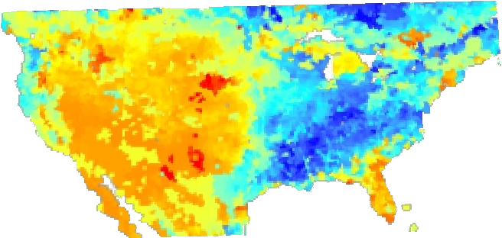
Precipitation/ Root Zone Soil Moisture Content Methodology
Calculated yearly and monthly averages and monthly anomalies
TRMM Precipitation Data
Oversampled,
Reprojected,
Clipped to study area, &
Resampled to original resolution
Analyzed TRMM and GRACE data
GRACE Root Zone Soil Moisture Content
Notes:
The team also analyzed monthly precipitation data from the TRMM satellite and monthly root zone soil moisture content (RZSMC) data derived from GRACE. We calculated monthly and yearly averages as well as monthly anomalies for each dataset. However, although both data had the same resolution of 0.25 degrees, the pixels did not line up. So we oversampled both datasets by a factor of 50, reprojected them into the correct coordinate system, clipped the rasters to our study area and then resampled both datasets back to their original resolution. Then we could analyze and compare the GRACE derived and TRMM data.
Notes:
Monthly GRACE derived data containing information about root zone soil moisture content and TRMM data containing precipitation were downloaded. Both were converted to TIFF files.
Both had resolutions of .25 degree.
Monthly and yearly averages and monthly anomalies were calculated through python scripts.
To ensure the pixels from GRACE and TRMM lined up within our study area, both data sets were oversampled by a factor of 50, reprojected, clipped to our study area using a shapefile and then resampled back to the original resolution using python script.
The area the data were clipped to excluded the pixels for which root zone soil moisture content had no data (over water).
The results of GRACE derived data and TRMM precipitation data were graphed and compared.
Weather data, specifically periods of drought, were added to the graph as well.
The Pearson’s correlation coefficient between the data was calculated in Excel.

Slide 15
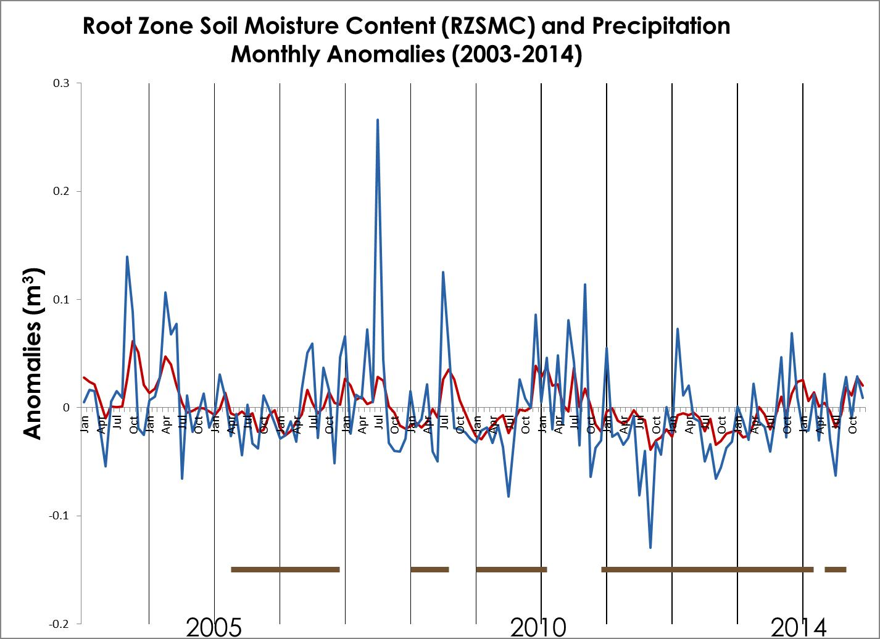
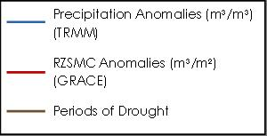
Precipitation/Root Zone Soil Moisture Content Comparison Results
TBD
Notes:
This graph shows the monthly anomalies in precipitation and RZSMC from 2003 through 2014. Precipiation anomalies are shown in blue while RZSMC anomalies are shown in red. Additionally, we added periods of drought, as identified by the US Drought Monitor, to the graph. These are shown in brown. We calculated Pearson’s correlation coefficient and got a value of 0.60 which was moderately strong.
Notes:
This graph shows the monthly anomalies from 2003 through 2014 of precipitation in blue and of root zone soil moisture content in red.
TRMM precipitation data was given in mm/hr and was converted to m³/m² to be compared with the RZSMC (m³/m³)
Periods of drought, as identified by the US Drought Monitor, are shown in brown.
The correlation coefficient between these data was moderately strong at 0.60 (p-value=8.882e-16). The p-value was calculated in R

Slide 16

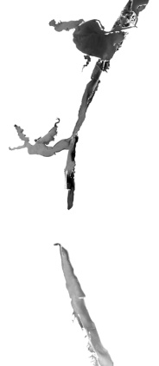
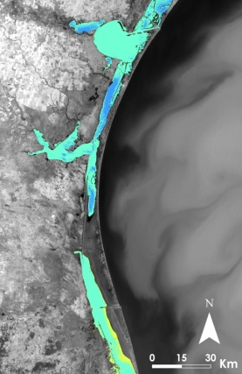
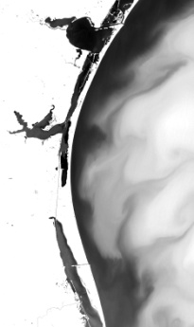
Thermal Mapping Methodology
Conversion from Digital Numbers to Top of Atmosphere Radiance (TOAr)
Atmospheric Corrections applied
Landsat 5, 7, and 8 data
Atmospheric corrected radiance converted to Kelvin
Cloud and Land Mask
Extracted Laguna Madre from Gulf of Mexico
Kelvin to Celsius
Notes:
To identify anomalies of warm, fresh groundwater inflow into the cool, salty lagoon, we calculated the surface temperature of the lagoon for the winter months between 2000 and 2015. To do this we used thermal bands from Landsat 5, 7, and 8. The data were first cloud masked and then clipped and mosaiced to the study area. The data were then land masked and the Laguna Madre was extracted from this data in order to focus on thermal anomalies within the lagoon. Next, the Digital numbers of the data were converted to radiance and atmospheric corrections were applied. The atmospherically corrected data was then converted to Kelvins and lastly Celsius.

Slide 17
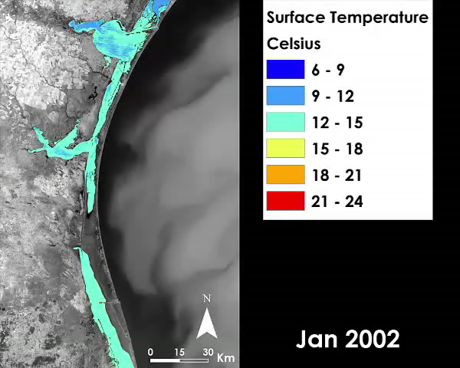
Thermal Mapping Results
Notes:
To better analyze the surface temperature of the lagoon a common scale was created. Cooler areas of the lagoon are shown in dark blue whereas the warmer areas are shown in red and orange.

Slide 18
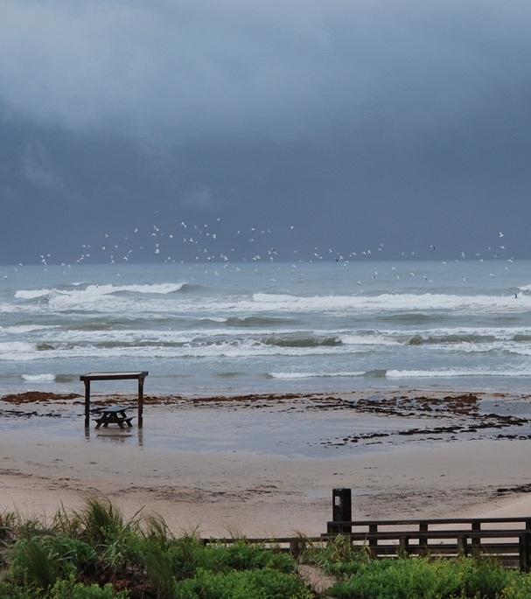
Errors & Uncertainty
LULC maps accurate but with some error
Spatial resolution of GRACE and TRMM
Spatial resolution and study period for thermal mapping
Padre Island National Seashore (Image Credit: National Park Service)
Notes:
- Errors and uncertainties arose from the accuracy of the land cover maps, which were affected by the 30 meter resolution of the Landsat satellites. The resolution of the data resulted in errors for pixels that had more than one cover type present.
- The resolution of TRMM data and GRACE derived data was 0.25 degrees. The coarse resolution of this data resulted in few pixels of data within the boundaries of the study area.
- The resolution of the Landsat thermal data varied between 60 and 120 meters before being resampled to 30 meters. Even this resolution may not have allowed for the identification of potential smaller scale thermal anomalies. Additionally, thermal anomalies due to changes in groundwater inflow may have occurred prior to our study period.

Slide 19
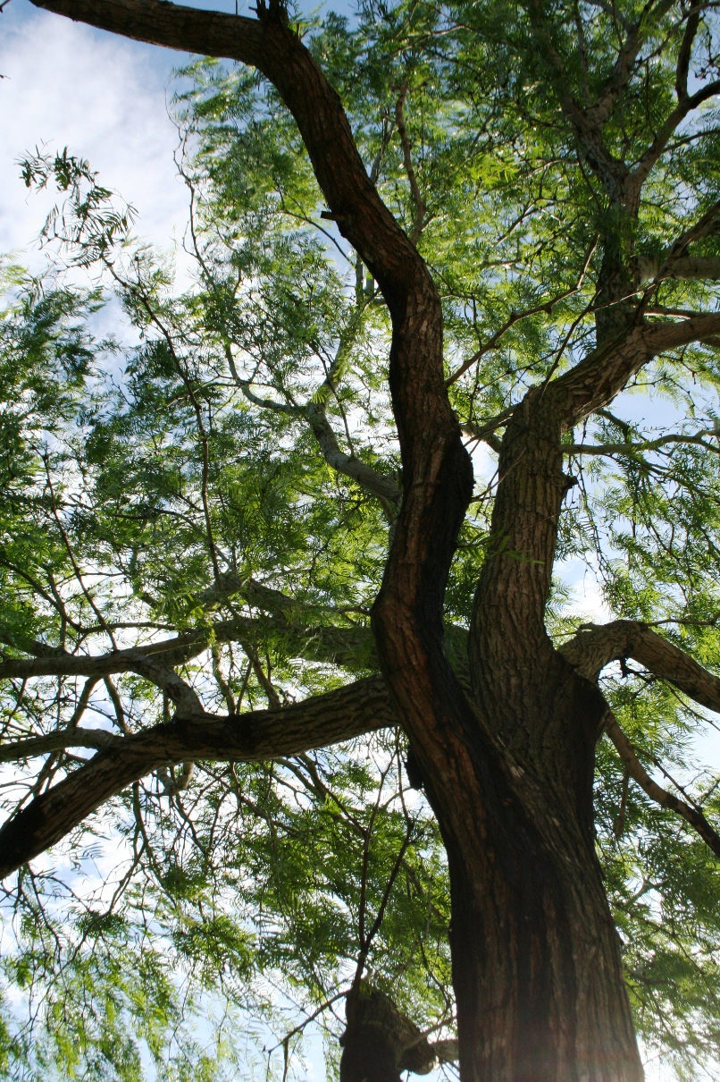
Honey mesquite tree (mage Credit: National Park Service)
Conclusions
Mesquite coverage increased from 2002 - 2014
Mesquite mapped in LULC typically co-located with low stress vegetation in NDII
Correlation between GRACE derived and TRMM data was moderately strong
Useful thermal anomalies were not identified
Notes:
- So to conclude, the occurrence of mesquite trees increased from 2002 to 2014 and the locations of mesquite tree coverage in the land cover maps were usually co-located with vegetation shown to have higher water content, and thus lower stress, in the NDII maps.
- The Pearson’s Correlation Coefficient between the GRACE derived root zone soil moisture content and the TRMM precipitation data was moderately strong with a value of 0.6.
- No useful thermal anomalies could be identified but thermal mapping and analyses will continue…

Slide 20
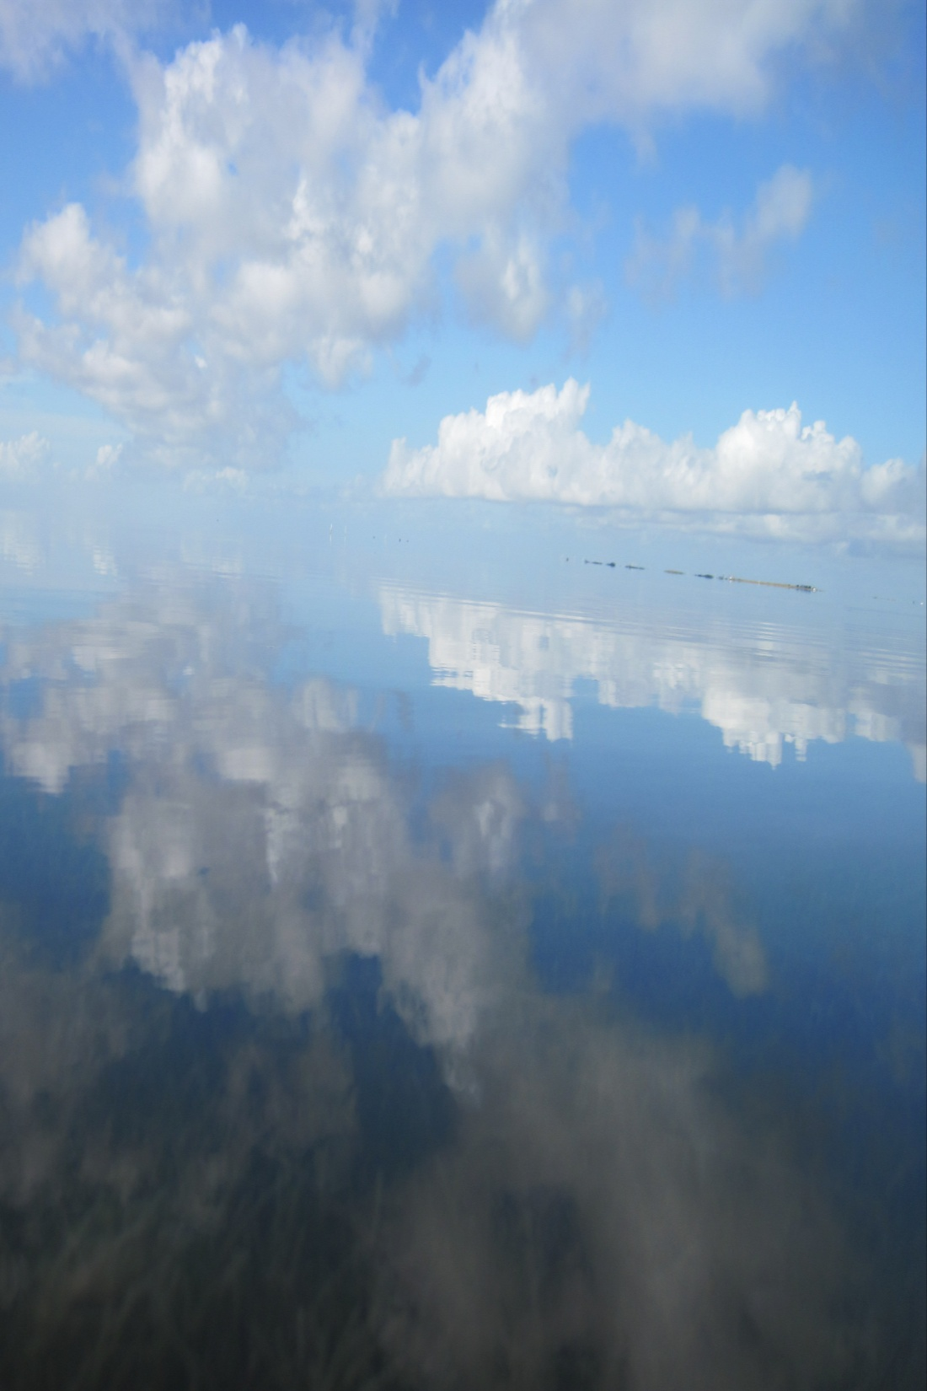
Future Work
Extend study period for longer-term trend analysis
Additional precipitation analysis & data sources
Estimate evapotranspiration rates from LULCs’ mesquite tree coverage
Laguna Madre (Image Credit: Joe Meiman, National Park Service)
Notes:
- …which leads to future work on this project.
- The study period will be extended so that longer term trends can be analyzed.
- As mentioned, thermal data will continue to be analyzed to look for anomalies.
- Further precipitation analyses will be done by calculating the total amount of precipitation for the study area using data from the TRMM precipitation radar and additional data sources.
- Evapotranspiration rates, calculated by our partner based on mesquite tree coverage indicated in the land cover maps, will be subtracted from the calculated amount of precipitation in the study area.
- This should give us an estimate of the groundwater recharge to the study area.
- Studying these trends of mesquite tree coverage and precipitation over time can provide a better understanding of how the environment around the Laguna Madre has changed and what effects these changes are having on the lagoon and its water quality.

Slide 21
Advisors
Joe Spruce (NASA Stennis Space Center)
James “Doc” Smoot (NASA Stennis Space Center)
Partners
Joe Meiman (National Park Service)
Mentors
Bernard Eichold, M.D., Dr. PH (Mobile County Health Department)
Notes:
- We would like to thank our Science Advisors and Partner, as well as our Mentor, for their help and support during the course of this project.

Slide 22
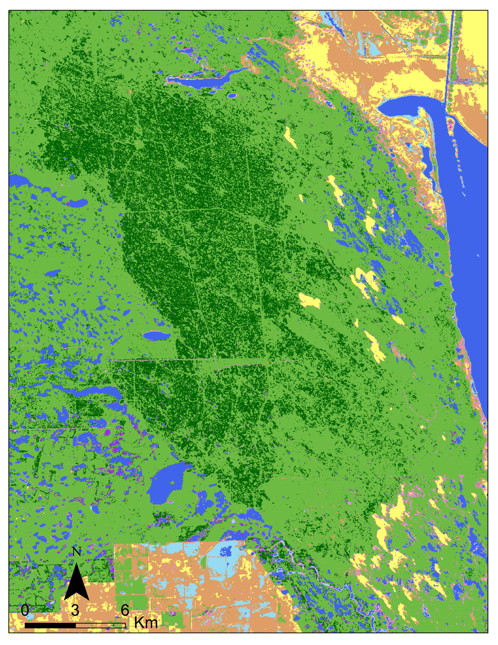
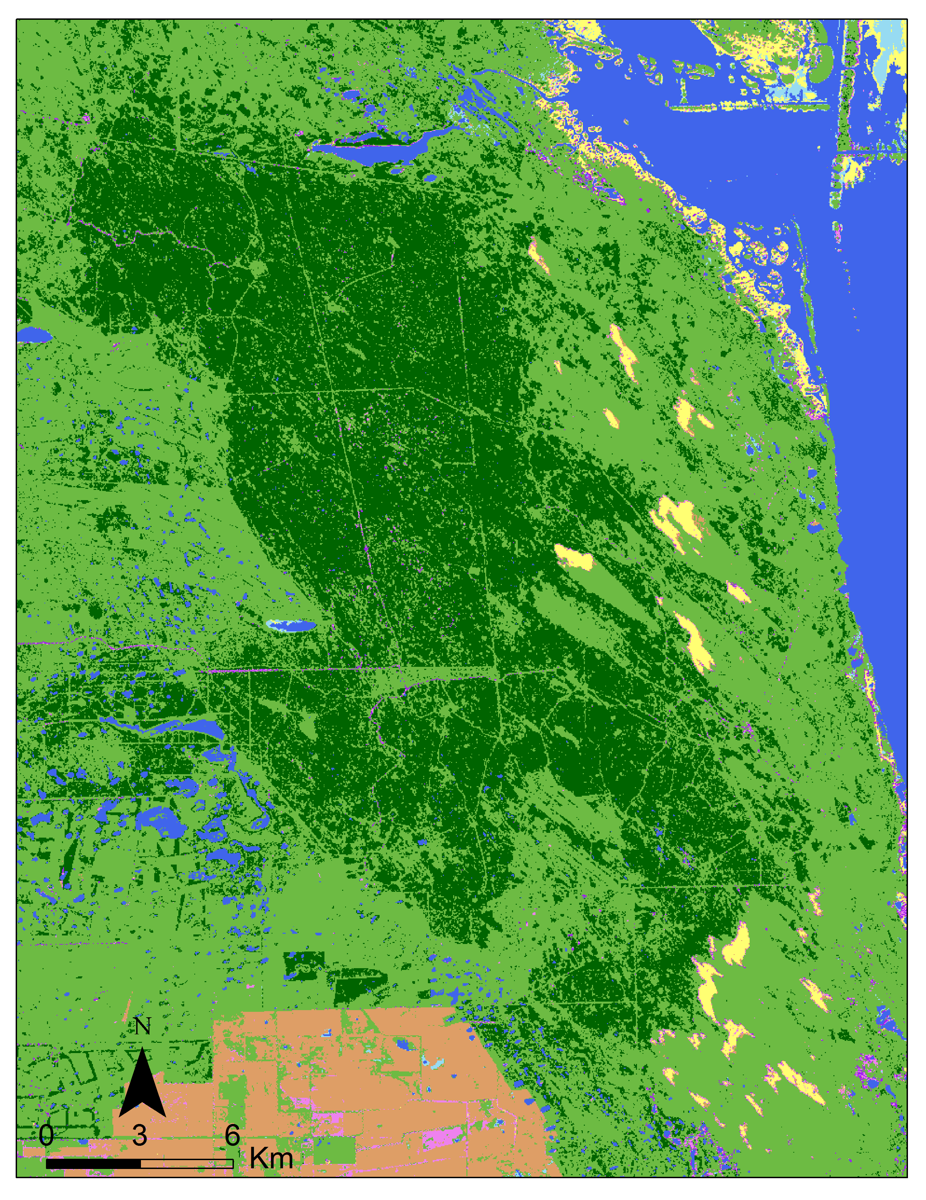

Land Use / Land Cover Results
LULC October 2014
LULC November 2002
Notes:
---If the .mov file doesn’t work for this slide, this is an animation version----
These LULC maps show the change in mesquite changes from November 2002 to October 2014.

Slide 23
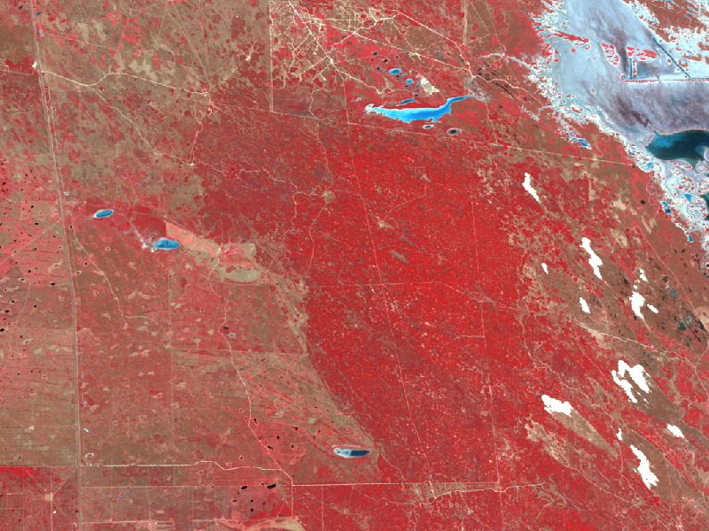
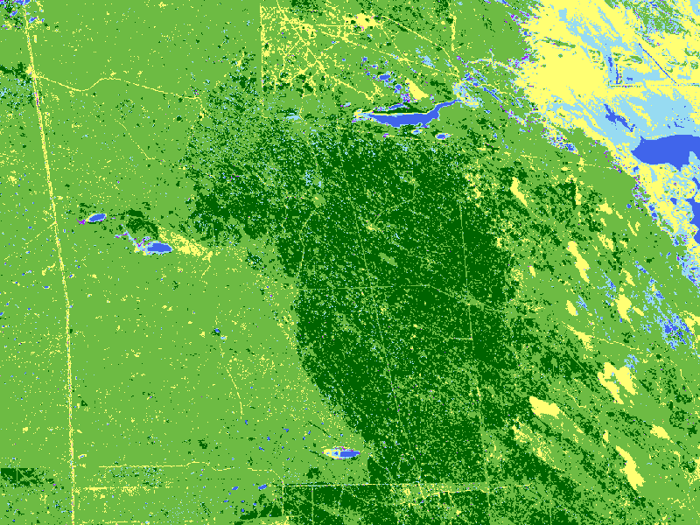
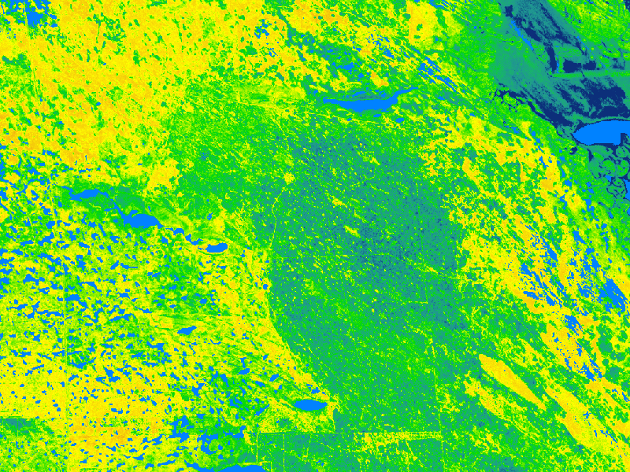

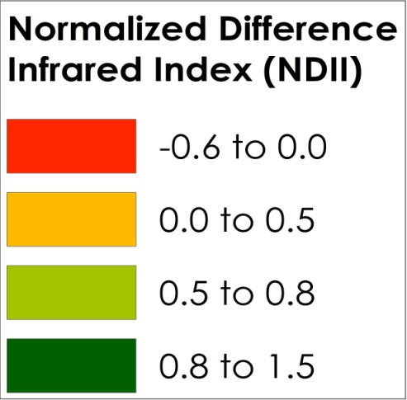
NDII Results
LULC for December 2006
Raw Landsat 5 data for December 2006
NDII for December 2006
Notes:
---If the .mov file doesn’t work for this slide, this is an animation version----
The Landsat 5, 7, and 8 data used for to calculate NDII were from the same scenes used in the land cover analysis
The first map shows raw data from Landsat. The second map shows the LULC for December 2006.
Finally, the third map shows the NDII from December 2006. Comparison between the NDII and LULC map shows the areas of moister vegetation approximately aligned with the area of mesquite tree coverage as identified by the LULC map.

Slide 24
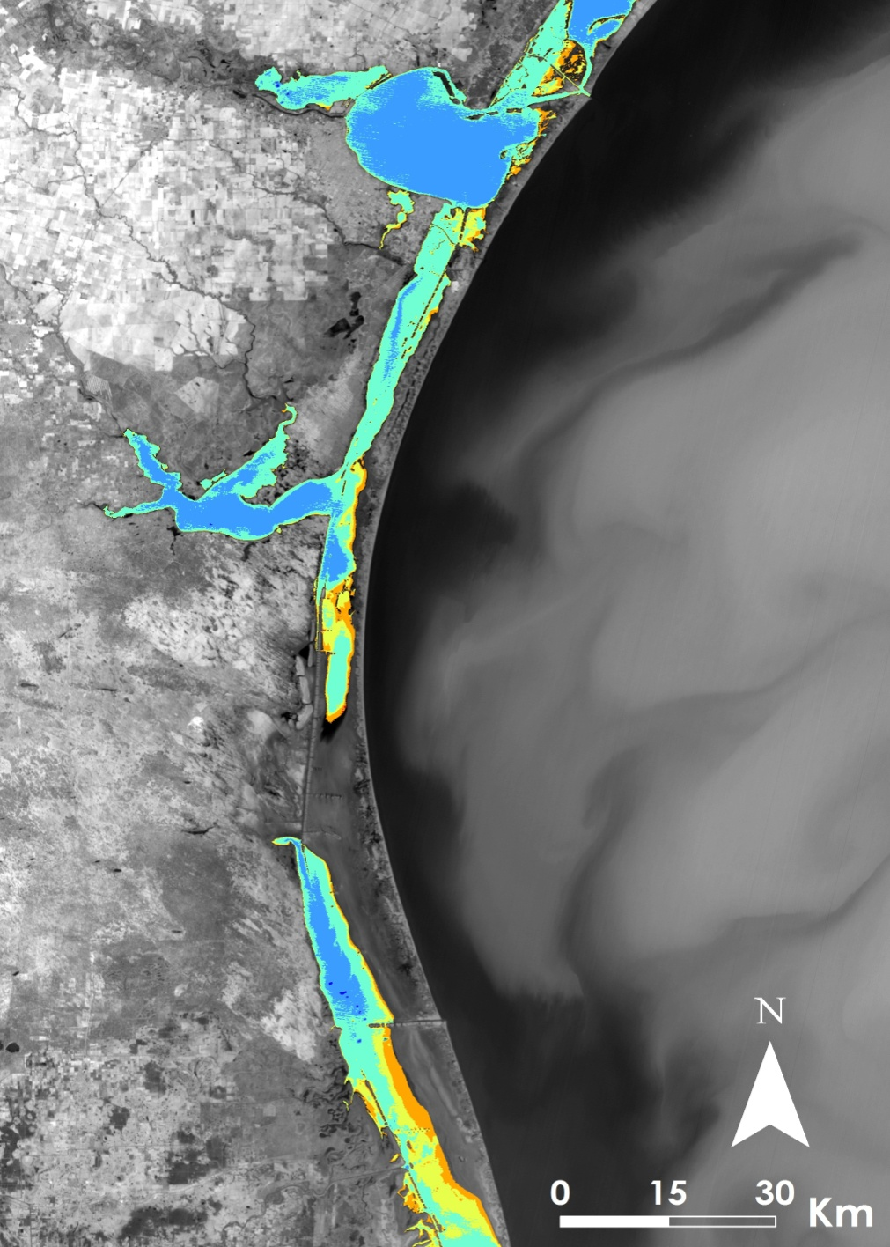
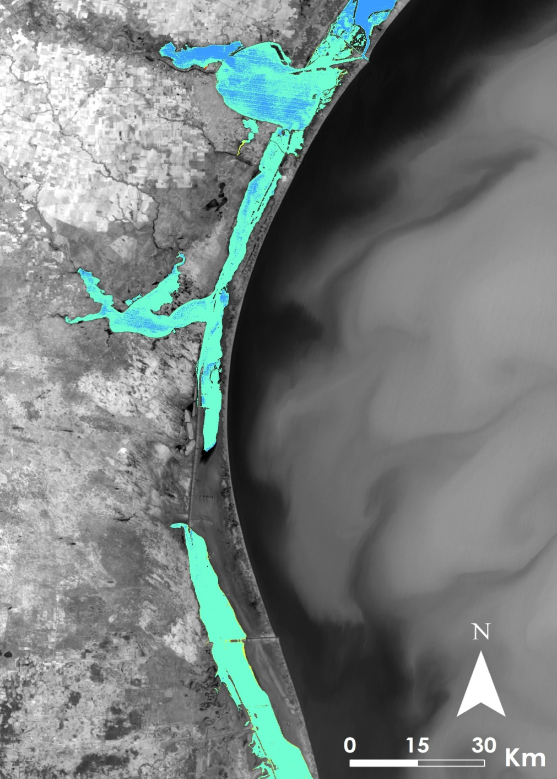

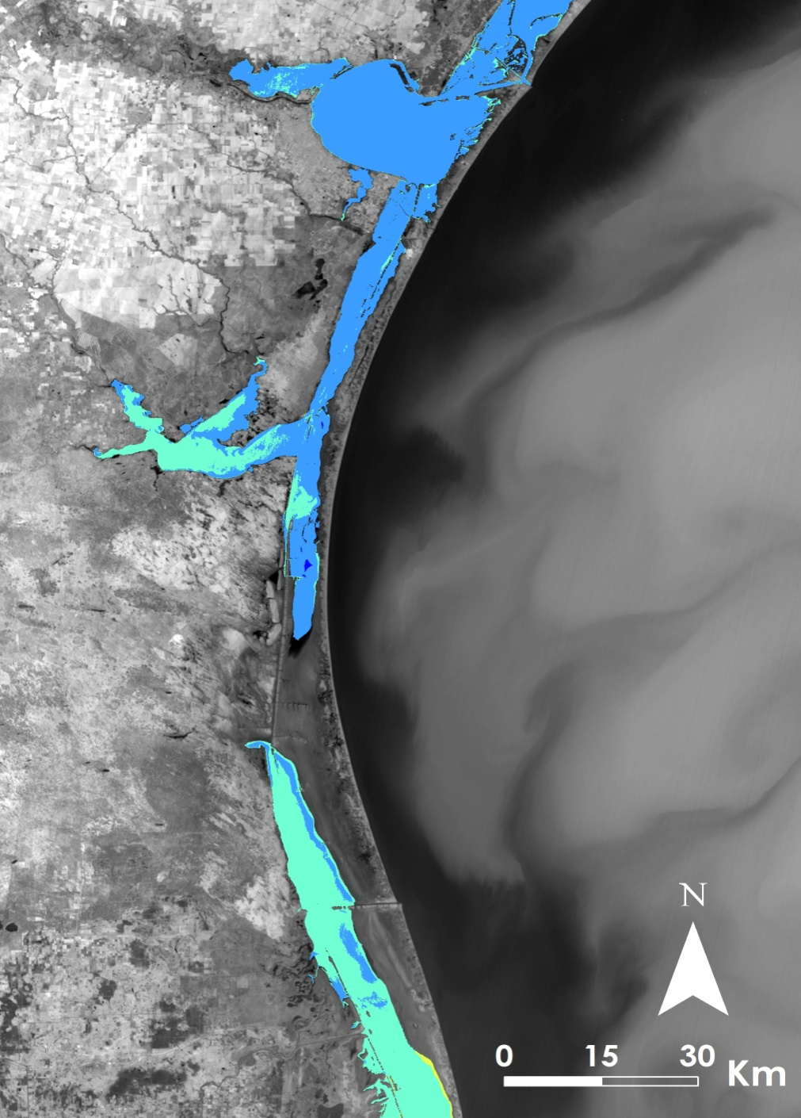
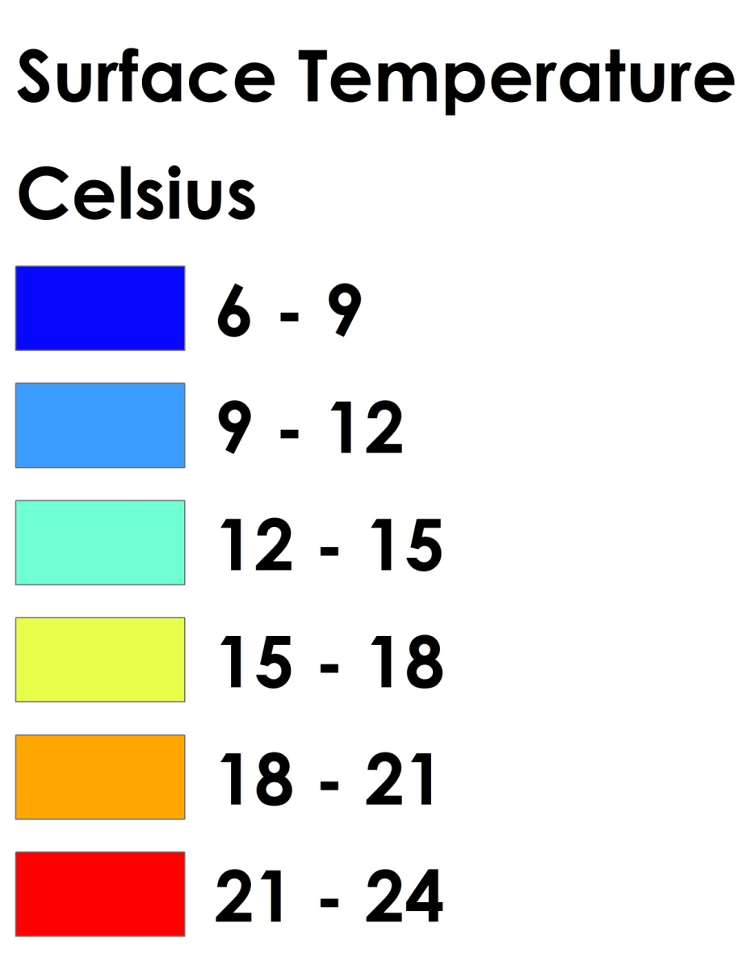
Thermal Mapping Results
Landsat 8 Imagery
February 2011
January 2014
February 2003
January 2002
Notes:
---If the .mov file doesn’t work for this slide, this is an animation version----
The Laguna Madre was analyzed to identify anomalies of warm, fresh groundwater inflow into the cool, salty lagoon in the winter months between 2000 and 2015. This time series shows the water surface temperature for winter months of 2002, 2003, 2011 and 2014.

