Slide 1
Project Strength Index
A Brief Overview

Slide 2
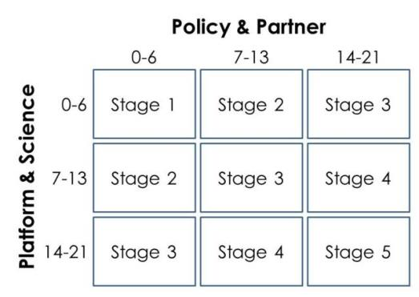
What is the PSI?
A means to objectively evaluate and track the progress of projects
Provides a score based on the applied science & capacity building principle
Stage 1 – Stage 5
Broken into two sections:
Policy & Partner
Platform & Science

Slide 3
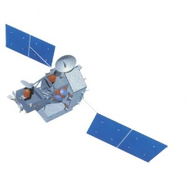
PSI Sections
Policy & Partner (P&P):
Platform & Science (P&S)
How did the project help the partners?
How involved were the partners?
How did the project use Earth observations?
How rigorous was the science?

Slide 4
Collection: Survey
Survey
Follow-up Questions
Sent out every interim
One month deadline
15 points possible for each section
2nd interim after project
CL complete P&P
Fellow complete P&S
6 points possible for each section

Slide 5
Calculation
15 pts from survey + 6 pts from Follow-up = 21 pts total
See PSI guide
Helpful Materials Folder

Slide 6
Dissemination
PSI scores are calculated in the master list
Scores are sent to the individual nodes
Each node has their own excel sheet

Slide 7
Main Tasks
Update DEVELOPedia PSI page
Update PSI Guides
Send out survey link
PSI survey link & guide go to center leads
Answer questions as necessary
Follow-up Questions
Send P&P questions to CLs
Answer P&S questions
Collection of responses
See PSI Calculation Guide for more info

