Slide 1
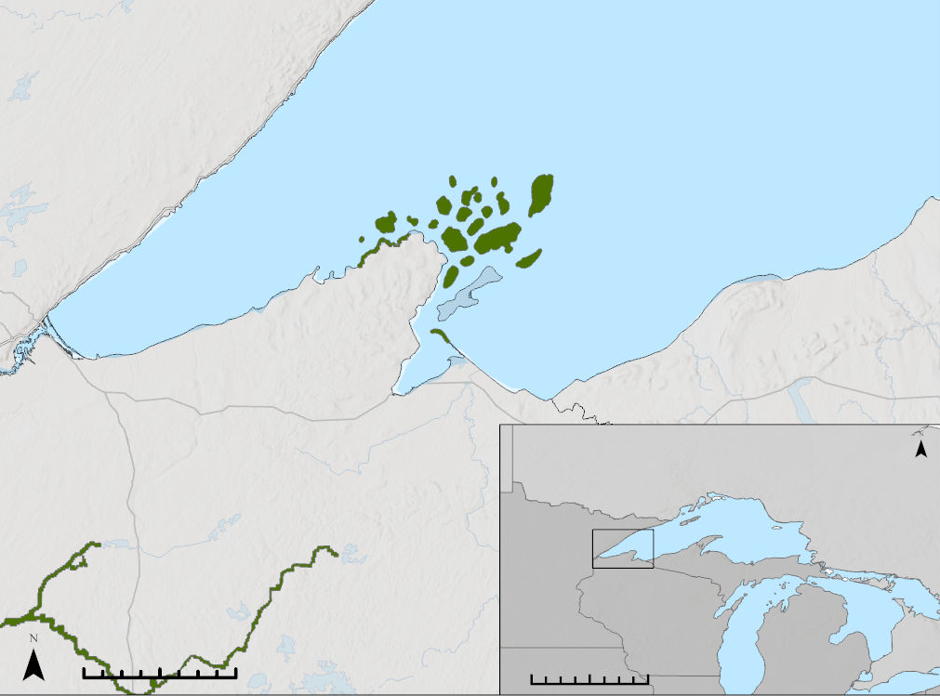
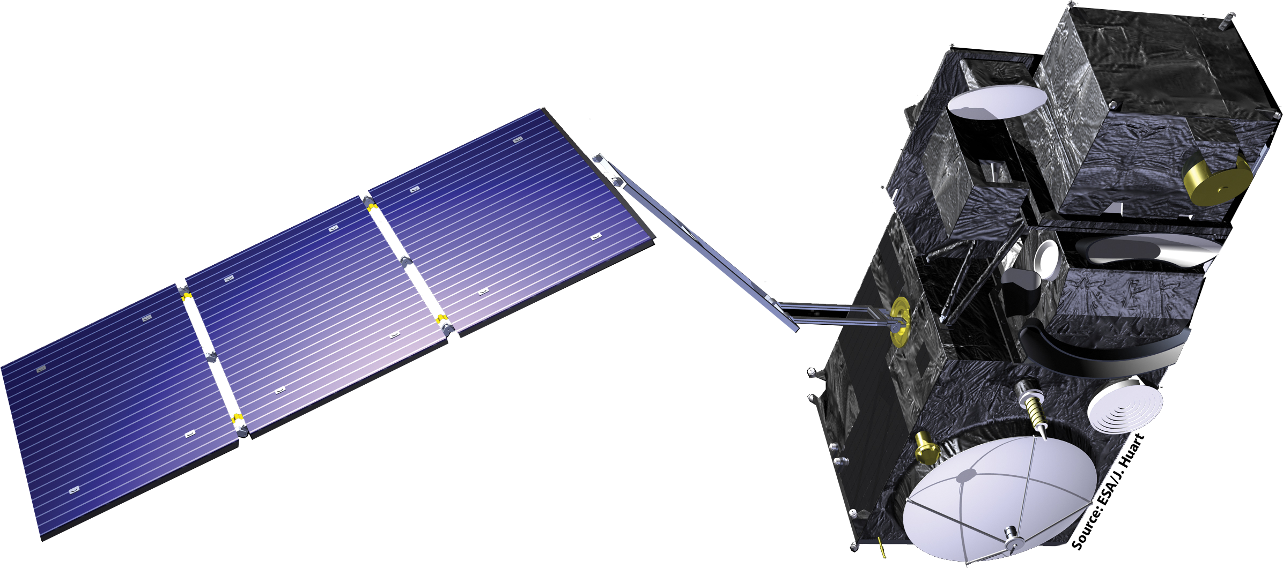
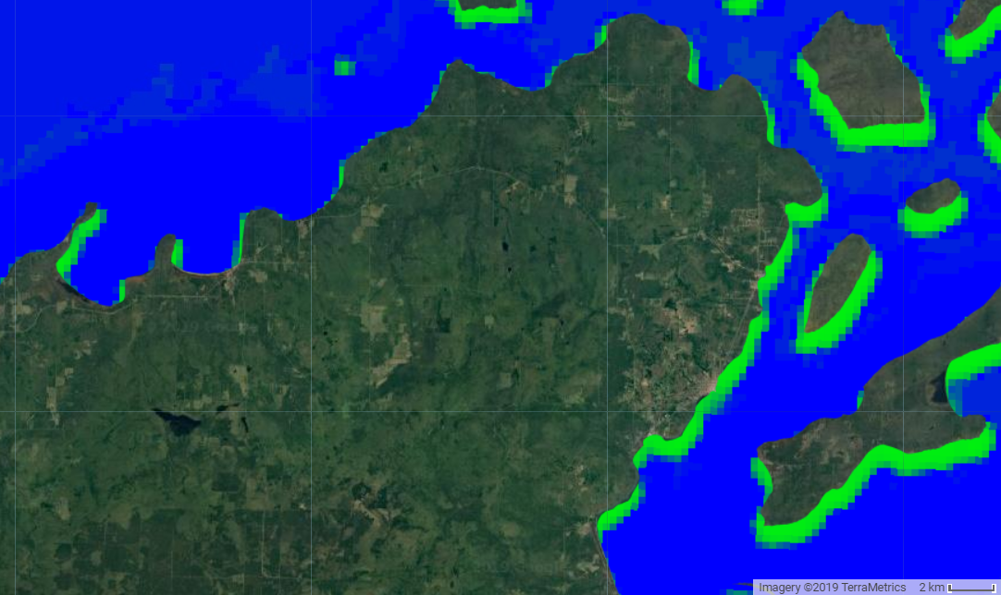
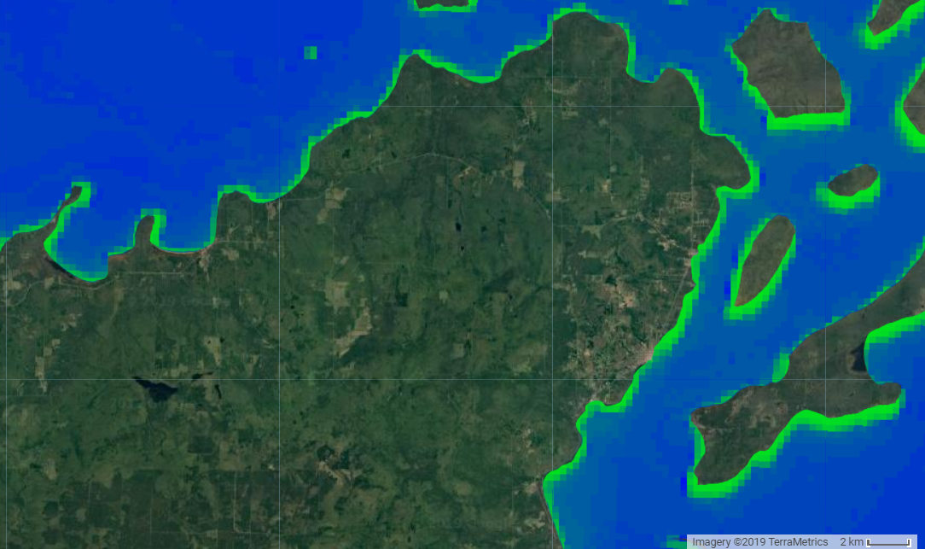
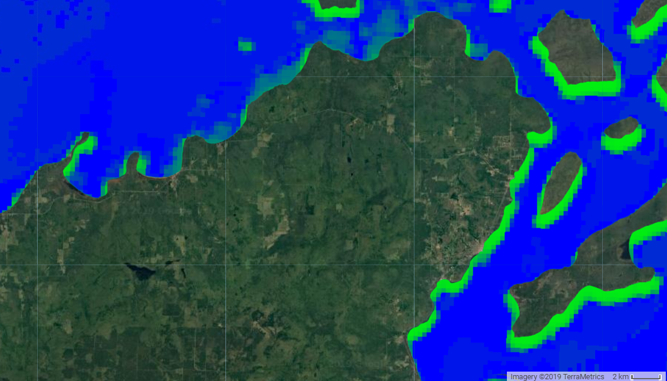
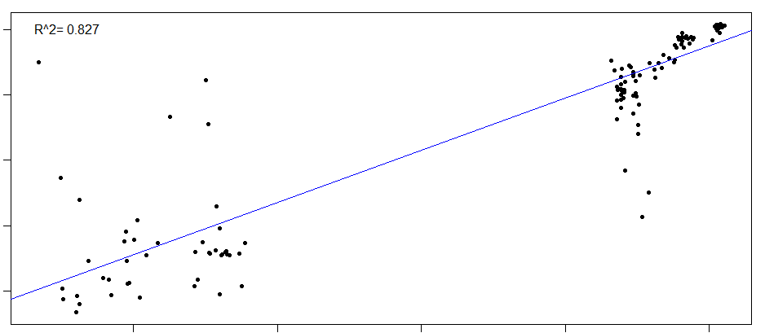
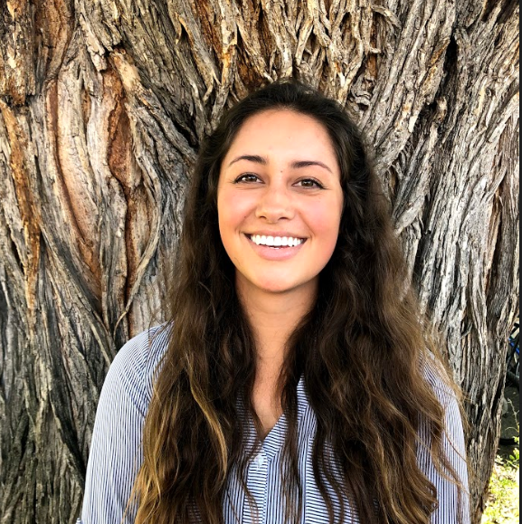
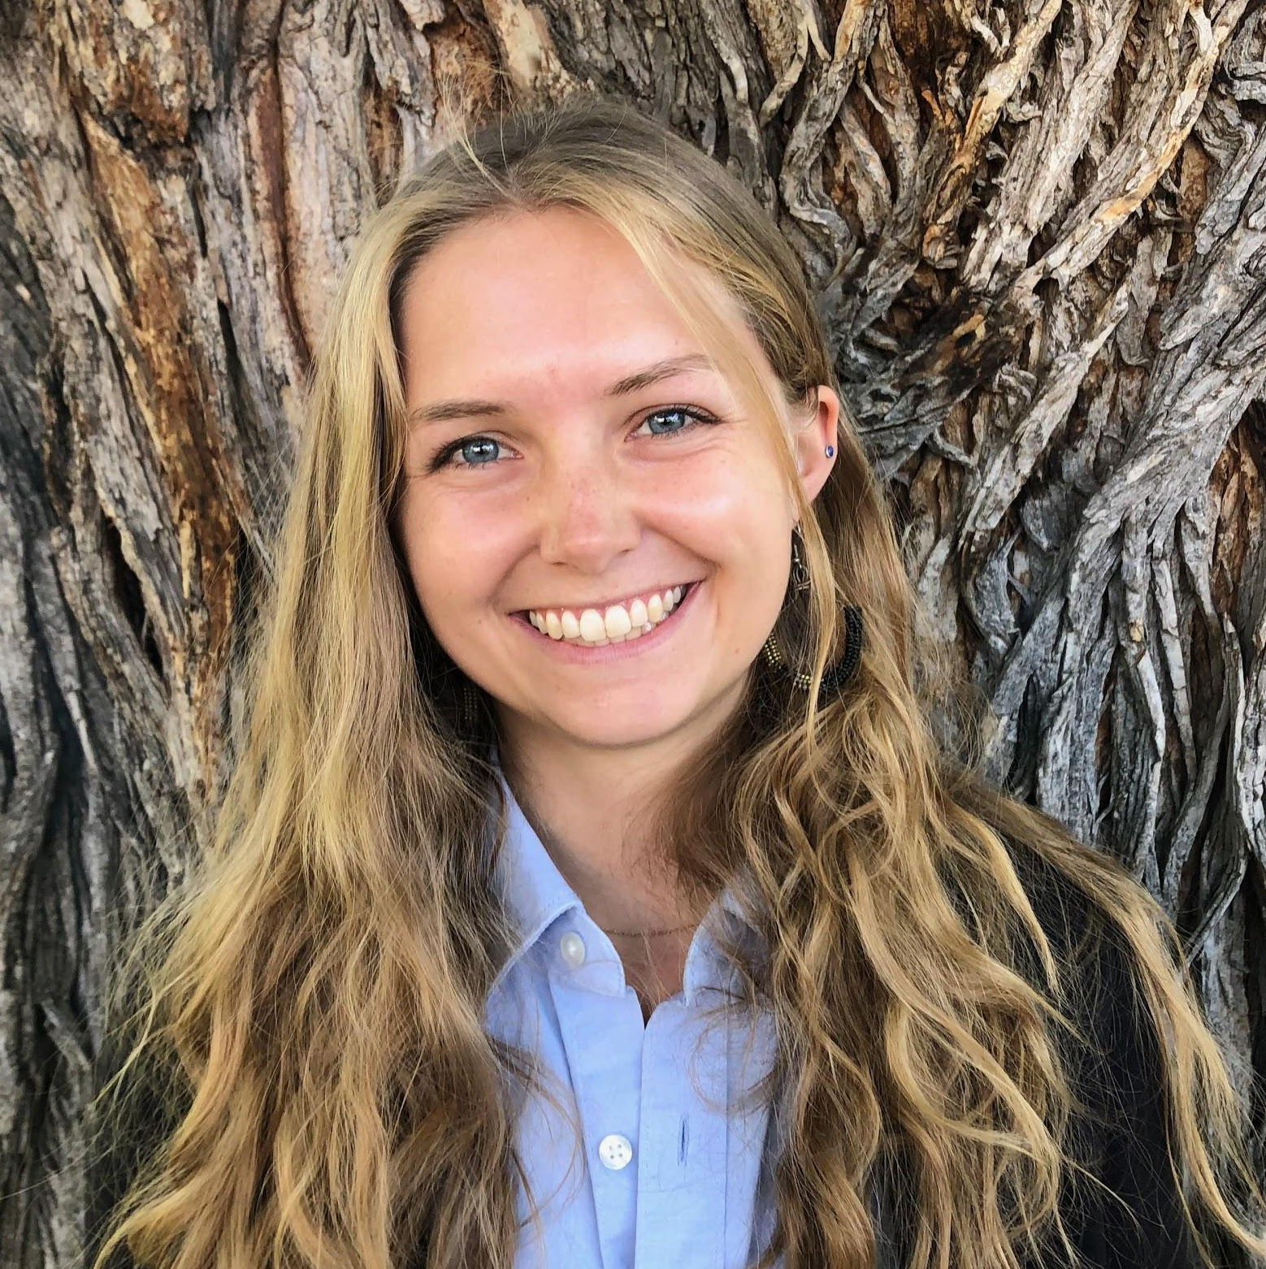
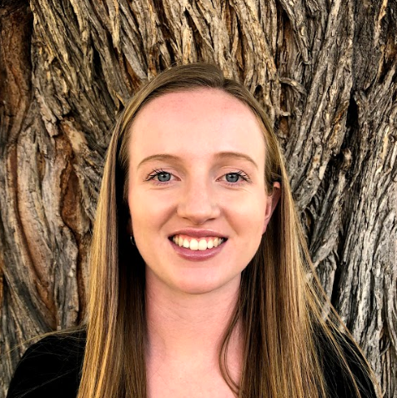
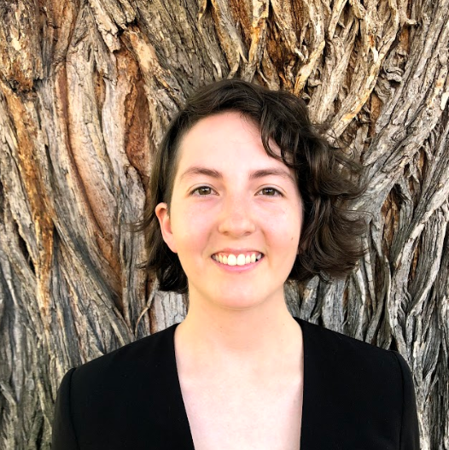
Mapping Sediment Plumes and Algal Blooms using Earth Observations at the Apostle Islands National Lakeshore
Abstract
Objectives
Perceived increases in the occurrence of sediment plumes and algal blooms following storm events have raised concerns about water quality within western Lake Superior. Increases in algal productivity and suspended sediment concentration may have negative impacts on wildlife, human health, and recreation. Altering phenomena are of critical concern for the Water Resources Division of the National Park Service (NPS). Researchers at the NPS and the University of Minnesota Duluth, Large Lakes Observatory (UMD LLO) first identified algal blooms in western Lake Superior in 2012. They currently only incorporate Moderate Resolution Imaging Spectroradiometer (MODIS) Earth observations in a limited capacity, but to this point have not been utilizing MODIS in conjunction with in situ data. The Apostle Islands Water Resources team partnered with the NPS and UMD LLO to develop a methodology utilizing Aqua MODIS, Terra MODIS, and Sentinel-3 Ocean and Land Colour Instrument (OLCI) observations to better understand the dynamics of sediment plumes and algal blooms within western Lake Superior during summer months (June to August) from 2011 to 2019. Results indicated success in incorporation of remote sensing technology for the detection of sediment plumes and the potential for the remote detection of algal blooms with expanded field data collection. The use of Earth observations will aid project partners in implementing effective mitigation strategies and improving public communication surrounding issues of water quality within the Apostle Islands National Lakeshore.
Assess the feasibility of monitoring sediment plume and algal bloom presence, extent, and duration using remote sensing in the Apostle Islands National Lakeshore
Determine which ESA and NASA Earth Observing satellites are appropriate for monitoring sediment plumes and algal blooms
Analyze the most effective indices for remote detection of sediment plumes and algal blooms using transmissivity and chlorophyll-a as proxies for water quality
Apply top performing remote sensing indices to generate a model to map sediment plumes in the western arm of Lake Superior
Study Area
Earth Observations
Apostle Islands National Lakeshore
Terra MODIS
Aqua MODIS
National Park Service Boundary
0 20 40 km
0 300 600 km
Sentinel-3 OLCI
Methodology
Figure 1.0 Study Period: June-August, 2018-2019.
Results
Determine appropriate sensors for remote water quality monitoring of sediment plumes and algal blooms
Algal Bloom Events
Figure 2.1
2018/08/11 (During Bloom)
Figure 2.2
2018/08/30 (After Bloom)
Figure 2.0
2018/07/07 (Before Bloom)
Sediment Plumes
Algal Blooms
Acquire Aqua MODIS and Terra MODIS imagery using GEE
Acquire Sentinel-3 imagery using GEE
High chlorophyll-a values
Low chlorophyll-a values
High chlorophyll-a values
Low chlorophyll-a values
High chlorophyll-a values
Low chlorophyll-a values
Apostle Islands Water Resources
Compile indices for detecting transmissivity and apply within GEE
Compile indices for detecting chlorophyll-a and apply within GEE
From left to right, an index highlights chlorophyll-a concentrations before, during, and after an algal bloom event. Increases in chlorophyll-a concentration is especially noticeable hugging the shoreline of the lakeshore.
Visual evaluation
Correlate index outputs to field data
Sediment Plume Events
Visual evaluation
90
R²=0.827
Select top performing indices
Select top performing indices
80
Develop model using top performing indices
Compare index outputs before, during, and after bloom
70
Predicted
Apply model to detect extent of sediment plumes within western Lake Superior
Perform image differencing to reinforce qualitative analysis
60
50
50
60
Observed
70
80
90
Figure 3. Random Forest Model utilizing top performing plume indices (Wang 3, Wang 21, Wang 6) for events on 6/19.
Conclusions
Project Partners
High temporal resolution of satellite imagery is necessary for water quality remote sensing
The highest correlated plume index of satellite image to in situ transmissivity values was a polynomial equation of Aqua MODIS Band 1, or the red band
Sentinel-3 bands 8 and 12, or the red and NIR bands respectively, showed the most promise in detecting algal blooms based on a visual evaluation
Random Forest approach with multiple indices forms a model with the strongest predictive power
University of Minnesota- Duluth,
Large Lakes Observatory
Dr. Bob Sterner
Director
National Park Service (NPS),
Water Resources Division
Dr. Brenda Moraska Lafrancois
Midwest Region Aquatic Ecologist
Team Members
Acknowledgements
A special thanks to everyone at the Fort Collins node for their support and guidance.
Dr. Paul Evangelista (Colorado State University, Natural Resource Ecology Laboratory)
Dr. Catherine Jarnevich (United States Geological Survey – Fort Collins Science Center)
Nicholas Young (Colorado State University, Natural Resource Ecology Laboratory)
Tony Vorster (Colorado State University, Natural Resource Ecology Laboratory)
Peder Engelstad (Colorado State University, Natural Resource Ecology Laboratory)
Kristen Dennis (NASA DEVELOP, Fellow).
Sarah Wingard
Project Lead
Lea Davidson
Erin Johnson
Brandy Nisbet-Wilcox
Colorado – Fort Collins | Fall 2019

