Slide 1
NORTHEAST US CROSS-CUTTING
Developing Annual, Seasonal, and Monthly Temperature Indices over the Northeast United States to Represent Recent Temperature Trends using NASA and NOAA Datasets
Lilian Yang
Laurel Mahoney
Team Lead
Shannan Hurley
North Carolina – NCEI
2017 Fall
Notes:
Script: Hello everyone thank you for being here today. My name is Lilian, my name is Laurel, and my name is Shannan, and we are the Northeast Cross-Cutting team from NCEI.
Our project focuses on developing Annual, Seasonal, and Monthly Temperature Indices over the Northeast United States to Represent Recent Temperature Trends using NASA and NOAA Observations and Datasets.
Image Source: Created by NASA DEVELOP Team

Slide 2
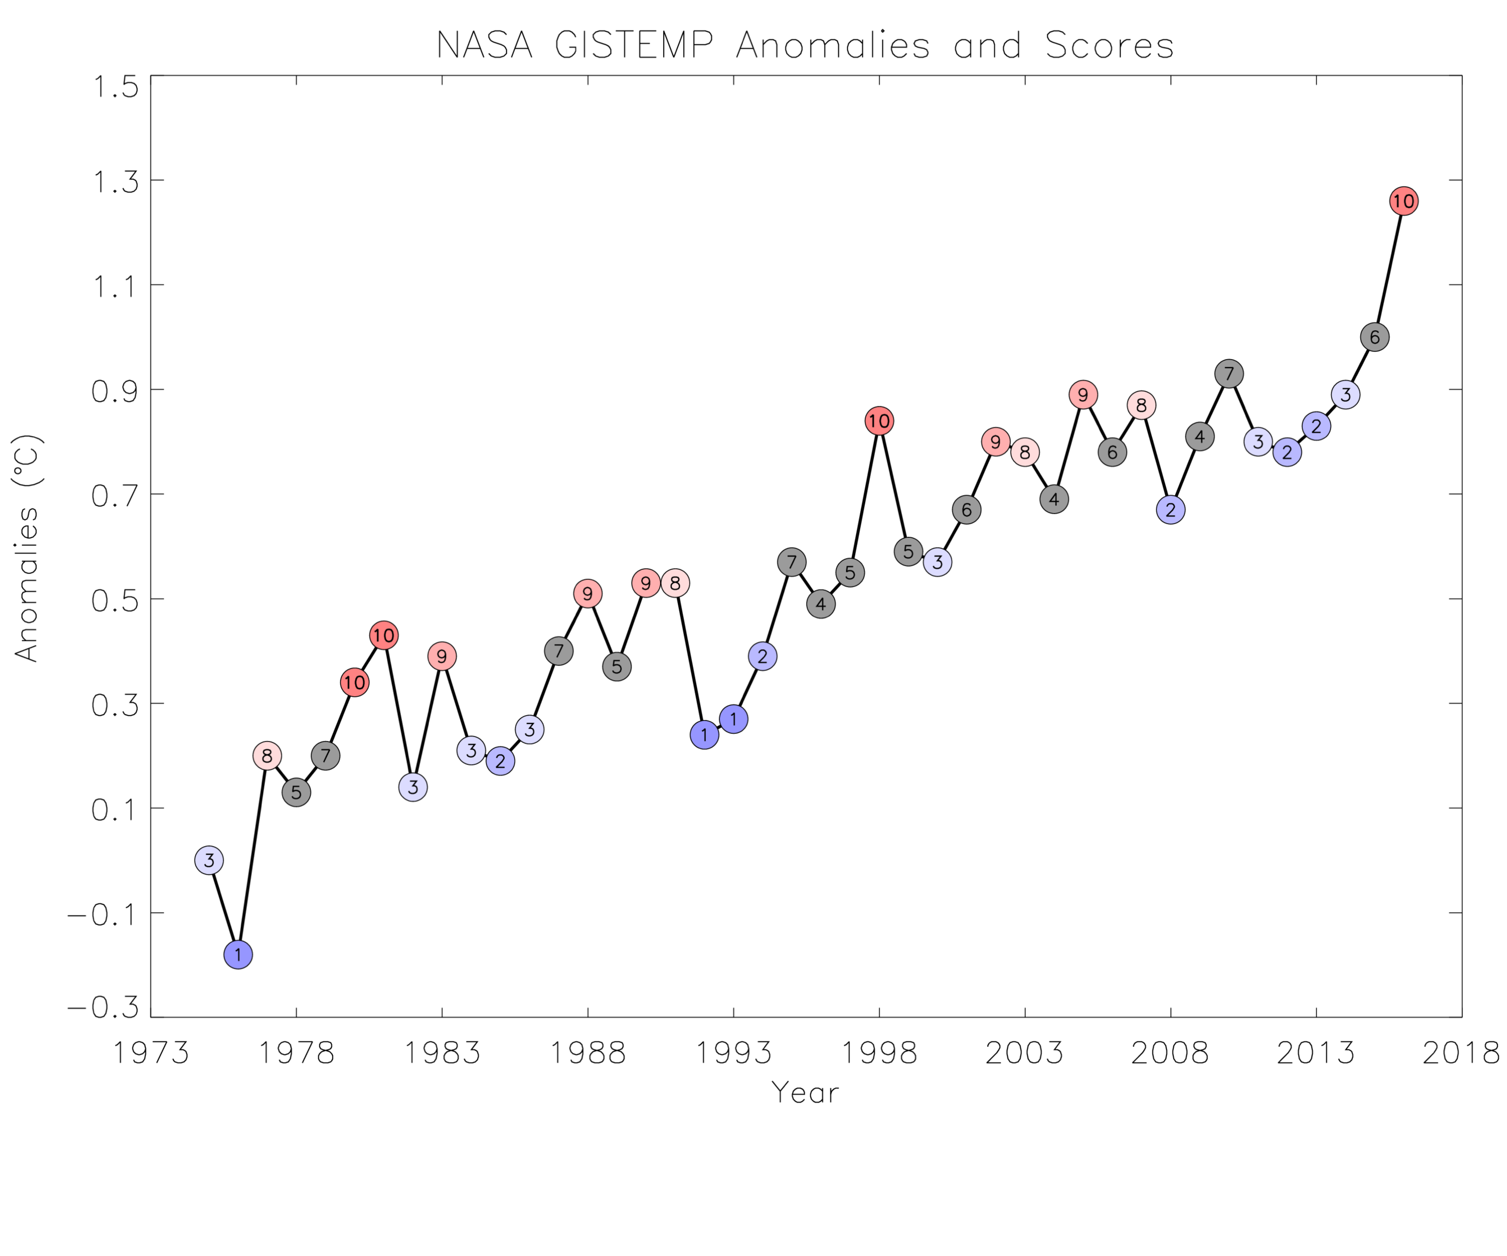
Climate Facts
The year 2016 was recently determined to be the warmest year on record
Since 1977, every year has been in the top 10 warmest years on record when first ranked
Globally, 2012 was cooler than surrounding years, ranking as the 9th warmest year on record
Regionally, in the Northeast United States, 2012 was ranked the hottest year on record
Notes:
Script: Some of you may not know, but the year 2016 was recently determined to be the warmest year on record by both NASA and NOAA. Since 1977, every year has been in the top ten warmest years on record when first ranked. Specifically, 2012, globally, was significantly cooler than surrounding years such as 2010 or 2013, ranking as the 9th warmest year on record by NASA. But, regionally, in the Northeast United States, 2012 was ranked the hottest year on record.
Image Source: Created by NASA DEVELOP Team

Slide 3
Community Concerns
The need within climate monitoring agencies, such as NOAA and NASA, to better differentiate the relative warmth or coolness within the secular trend
The need within agencies for higher quality climate data
The need to determine how to respond to possible impacts of temperature trends and variability within the energy and agricultural sectors
Pixabay
Pixabay
Notes:
Script: These facts created concerns among the community, globally and regionally, which helped to establish this project. These concerns include: the need within climate monitoring agencies, such as NASA and NOAA, to better differentiate the relative warmth or coolness of individual years, seasons, months from the secular trend; the need for high quality climate data at a higher spatial resolution that is of ample length; and the need to determine changes over time in climate data for practical usage in determining how to respond to possible impacts of temperature trends and variability within the energy and agricultural sectors.
Image Source: https://pixabay.com/en/power-plant-industry-chimney-2411932/
Image Source: https://pixabay.com/en/field-countryside-sunset-sky-984142/

Slide 4
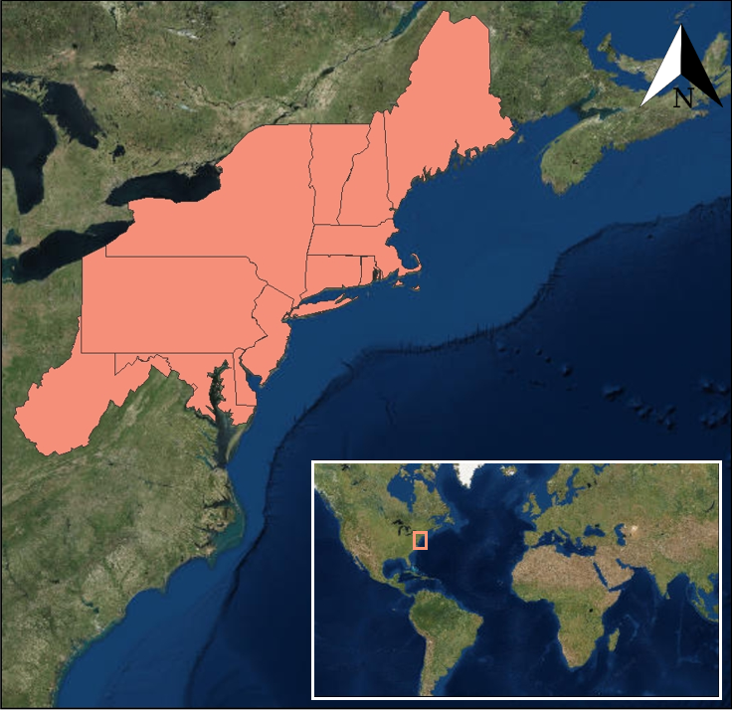
Study Area
Northeast United States as defined by the National Climate Assessment, as requested by partners.
Study Periods:
1975 – 2016 Temperature Scores
2002 – 2017 Degree Days
Notes:
Script: Our project consisted of two parts. The study area for both parts of the project focused on the Northeast United States as defined by the National Climate Assessment. The first study period was from 1975 – 2016 and the second study period was from 2002 - 2017.
Image Credit: Created by NASA DEVELOP Team

Slide 5
Project Partners
NOAA’s Regional Climate Services Eastern Region Director,
Ellen Mecray
NOAA NCEI’s Climate Monitoring Branch Meteorologist,
Karin Gleason
Notes:
Script: The project partners associated with this project are NOAA’s Regional Climate Services Eastern Region Director and NOAA NCEI’s Climate Monitoring Branch. These project partners currently only use in situ data to analyze temperature anomalies and calculate temperature reports. Our partners aim to improve and expand the current data extraction process by utilizing remote sensing data, NOAA datasets, and NASA satellites.
Image Credit: NOAA NCEI https://www.ncei.noaa.gov

Slide 6
Project Objectives
Provide a multitude of end users with an easily digestible perspective of how temperature trends have changed
Utilize information from a variety of global temperature data and NASA satellite datasets
Develop high spatial resolution temperature products specific to the Northeastern United States
Compute heating, cooling, and growing degree days using daily LST data and in situ temperature data
Create a product for partners that has the potential to expand to a diverse set of end-users to utilize the data
Notes:
Script: The objectives for the development of this project were to provide a multitude of end users with an easily digestible perspective of how temperature trends have changed to better prepare and plan for future temperatures,
to utilize information from a variety of global temperature data and NASA satellite datasets,
develop a temperature index specific to the Northeastern United States with a higher spatial resolution than other indices currently being utilized,
compute heating, cooling, and growing degree days using daily LST data and in situ temperature data,
and finally, create a product for partners that has the potential to expand to a diverse set of end-users to utilize the data.

Slide 7
NASA Satellites and Sensors
NASA GISTEMP
Monthly surface temperature data for the global temperature scores
nClimgrid
Monthly surface temperature data for the regional temperature scores
Daily LST values were extracted from the Terra MODIS and Aqua MODIS platforms for degree days
MODIS LST
Climate Reference Network
Network used to calibrate the data, adjusting LST temperatures to measure as if recorded 2 meters above the surface
Notes:
Script: For the first part of the project, the team utilized NASA GISTemp to create the global temperature scores and NOAA nclimgrid to create the Northeast US regional temperature scores. For the second part of the project, the team utilized land surface temperatures (or LST) acquired from Terra and Aqua MODIS satellites. The Climate Reference Network was also used to supplement the LST data.
Image Source: http://www.devpedia.developexchange.com/dp/index.php?title=List_of_Satellite_Pictures

Slide 8
Temperature Score Methodology
NASA GISTEMP
NOAA nClimgrid
Data Acquisition
Data Analysis
Further Analysis
End Products
Process algorithm through IDL, specifically using OLS regression
Create temperature scores and graphs
Create z-scores based on Gaussian distribution
Notes:
Script: For the temperature score methodology, we first acquired monthly data from NASA GISTemp and NOAA nClimGrid. Next, we removed the long-term trend 1880-1974 from the time series to just 1975-2016. Then, we used two different types of statistical analysis for the two different time periods, 1880-2016 and 1975-2016. Next, we divided the residuals by the group standard deviation to arrive at values analogous to z-scores.

Slide 9
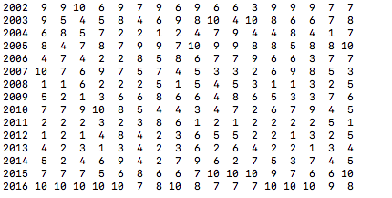
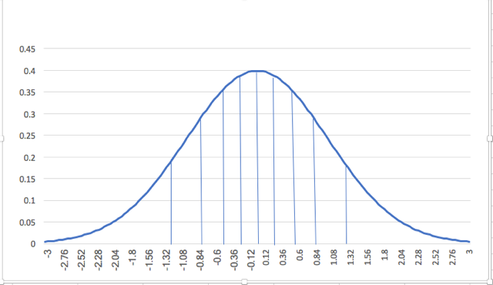
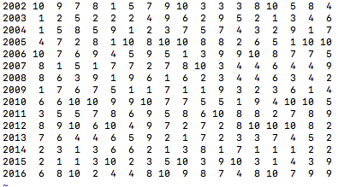
Temperature Scores
Distance from the trend line to the anomaly defines the score
Temperature Scores
Monthly
Annual
Seasonal
Global Temperature Scores
Northeast US Regional Temperature Scores
Notes:
Script: Temperature score explanation: the z-scores were transformed to a scale from 1 to 10, such that each score has a 10% probability of occurrence based on the cut-off values of the Gaussian distribution.This is an example of a Gaussian distribution, synonymous to what we used for the methodology. To the right are samples of our temperature scores for the globe and northeast. Red represents months from January, February, and so on. Green represents annual, and blue represents seasons beginning with winter, spring, summer to fall. 10 means that that respective month, year, or season, is much warmer than usual, and 1 means that it is colder than usual. So for example, the January of 2003 is a 1 for the northeast temperature score, so that month is much colder than other Januarys of other years. We can also see that, as we said before, 2016 is the warmest year on record, which is validated in our temperature score because it has a 10 on the global temperature score, and also 6 out of 12 months rank as a 10.
Image Source: Created by NASA DEVELOP Team

Slide 10
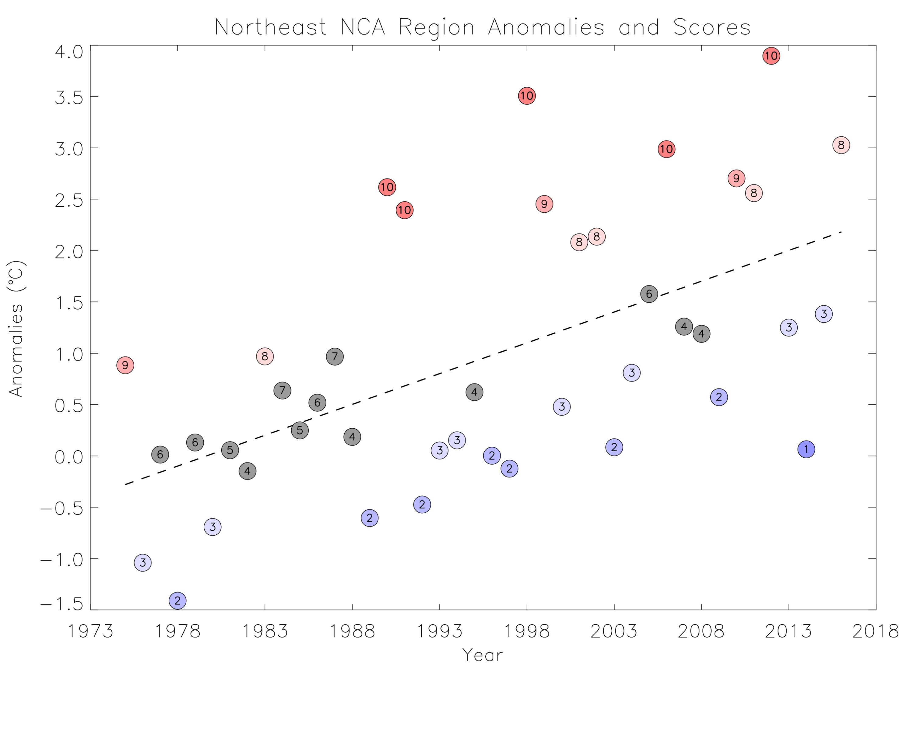
Results
Notes:
Script: These are some of the results of our temperature scores for the globe and the Northeast United States. The first graph shows a color gradient of the global temperature scores, with 1 being a colder year in blue and 10 being a hotter year in red. From this we can see that there is an upward temperature trend. The second graph shows the temperature scores of the Northeast US with the same methodology of the first graph. As seen from these graphs, the Northeast and global temperature scores are not trending in unison.
Image Source: Created by NASA DEVELOP Team

Slide 11
Degree Day Methodology
Data Acquisition
NASA Terra & Aqua MODIS
Climate Reference Network
Data Analysis
Further Analysis
End Product
Extract LST values from MODIS at 4 overpass times per day
Create degree day maps for cooling, heating, and growing degree days
Fill gaps using an annual cycle from algorithm
Calibrate LST using CRN
Notes:
Script: For the degree days methodology, we first extracted MODIS Land Surface Temperatures for both Terra and Aqua Satellites during four overpass times. Due to cloud coverage, there was missing data for some overpasses, which we filled in using an annual cycle model. After filling in the missing data, we employed an algorithm derived from our mentor, Anand Inamdar, which was used to obtain LST values. Next, monthly temperature averages from in situ data acquired from the Climate Reference Network were then used to calibrate the land surface temperatures, adjusting them to read as if measured 2 meters above the surface temperature. Finally, we created monthly maps of heating, cooling, and growing degree days using ArcMap.

Slide 12
Results
Degree Days in the Northeast United States
Base Mean Temperature (F) | Degree Days
Below 65 º | Heating Degree Days equates to a greater amount of houses or buildings using heaters or gas.
Above 65 º | Cooling Degree Days equates to a greater amount of houses or buildings using air conditioners or fans.
Base Mean Temperature (F) | Growing Degree Day Crops
41 º | Alfalfa
50 º | Corn
35 º | Onion
Pixabay
Pixabay
Pixabay
Notes:
Script: A degree is defined by the measure minus the base temperature or crop threshold. The degree days created using daily LST data show temperature thresholds in relation to both the energy and agricultural sectors. Specifically for agriculture, northeast crops: alfalfa, corn, and onion were used. To verify our maps, we compared them to the degree day maps created by the Northeast Regional Center, and they were synonymous to each other.
Image Source: https://pixabay.com/en/sprout-germinated-alfalfa-lucerne-1663477/, https://pixabay.com/en/corn-natural-ripe-harvest-fall-1751321/, https://pixabay.com/en/onion-bulbs-food-fresh-healthy-84722/

Slide 13
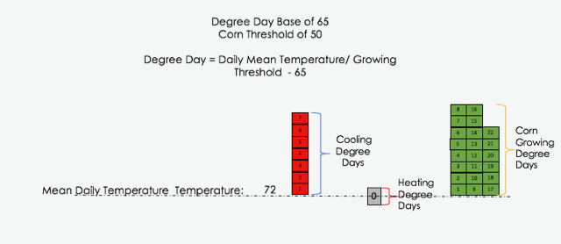
Degree Days
Notes:
Script: For example, if a day has an mean temperature of 72, there will be 7 cooling degree days because it is 7 degrees higher than the base of 65, and there will be 0 heating days. Depending on the base temperature, there can be more or less cooling and heating degree days. Corn has a growing threshold at 50 degrees Fahrenheit, so it can only grow when it is above 50 degrees. At a mean daily temperature of 72, so there will be 22 growing degree days because 72 is 22 degrees higher than 50 degrees.
Image Source: Created by the NASA DEVELOP Team

Slide 14
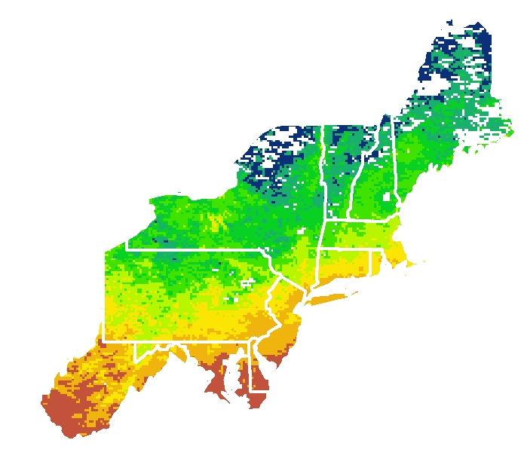
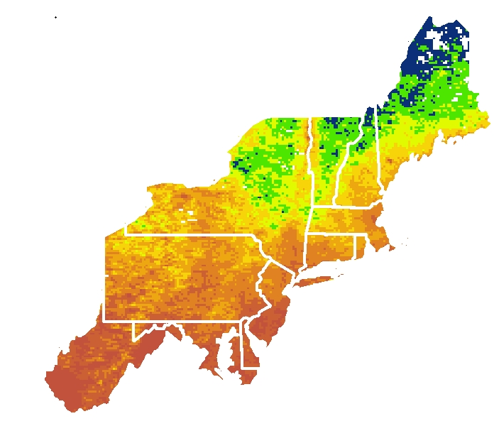
Results
Heating Degree Days January 2003
Heating Degree Days January 2017
1865
1865
1058
1058
Heating Degree Days January 2003
Heating Degree Days January 2003
Notes:
Script: These are maps we created of heating degree days of the Northeast Region for January 2003 and January 2017, highlighting the change in heating degree days in the Northeast in relation to the temperature trend throughout our study period. From these images, you can see that our methodology with the LST satellite data provides high spatial resolution.
Image Credit: Created by NASA DEVELOP Team

Slide 15
Notes:
Script: This animation of maps was created from the cooling degree days of the Northeast Region from August 2002 to August 2017. This shows the change in the temperature trend towards an increase in relation to the amount of days that require cooling.
Image Source: Created by NASA DEVELOP Team

Slide 16
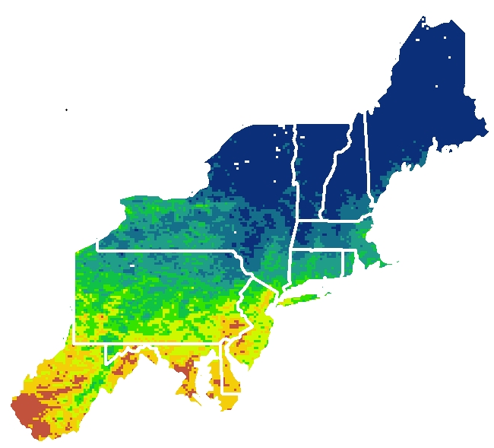
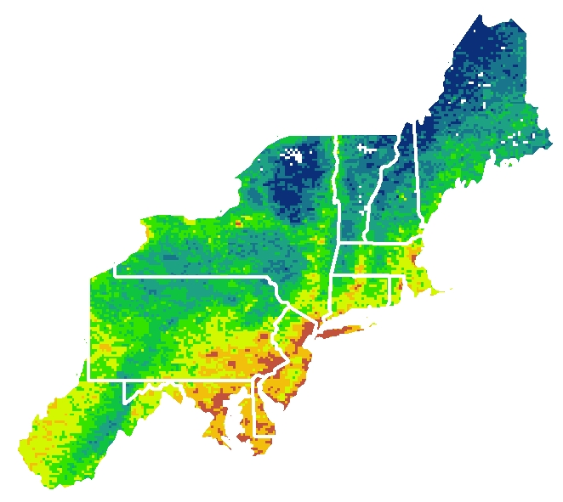
Results
Onion Growing Degree Days March 2017
Onion Growing Degree Days August 2017
396
1257
9
869
Notes:
Script: These are maps of growing degree days of the Northeast Region for onions, specifically for March and August of 2017. With onions having a threshold base temperature of 35 degrees fahrenheit, you can see the difference of growing degree days between these two months, with March having fewing growing degree days than August. Once again, you can see from these images that our methodology with the LST satellite data still provides high spatial resolution.
Image Credit: Created by NASA DEVELOP Team

Slide 17
Conclusions
Recent Northeast temperature trends as characterized by the running ranks and temperature scores have exhibited a great degree of oscillation between two extreme readings rather than clustering near the median
Land Surface Temperature data from MODIS is capable of providing higher spatial resolution temperature information than currently being done
End users will use temperature scores for context and future state of the climate reports
Degree days will also be operationalized within the agriculture and energy sectors
Notes:
Script: In conclusion to our project: Recent Northeast temperature trends as characterized by the running ranks and temperature scores have exhibited a great degree of oscillation between two extreme readings rather than clustering near the median. Land Surface Temperature data from MODIS is capable of providing higher spatial resolution temperature information. End users will use temperature scores for context and future quarterly state of the climate reports. Degree days will also be operationalized within agriculture and energy sectors.

Slide 18
Future Work
As for future work, temperature scores may be used for research in other parts of the scientific realm, such as El Niño, La Niña, and the North Atlantic Oscillation. Degree day future work will include adding more variables to the algorithm such as proximity to the coast or vegetation index, as well as expanding the application to other sectors. Both parts of the project may extend to other regions within the United States.
Notes:
Script: As for future work, temperature scores may be used for research in other parts of the scientific realm, such as el nino, la nina, and the North Atlantic Oscillation. Degree day future work will include adding more variables to the algorithm, such as proximity to the coast or vegetation index, as well as expanding the application to other sectors. Both parts of the project may extend to other regions within the United States.

Slide 19
Acknowledgements
Anthony Arguez, NOAA National Centers for Environmental Information (Science Advisor)
Anand Inamdar, Cooperative Institute for Climate and Satellites – NC, NOAA National Centers for Environmental Information (Science Advisor)
Karin Gleason, NOAA National Centers for Environmental Information, Climate Monitoring Branch, Meteorologist (End User)
Ellen Mecray, NOAA Regional Climate Services, Eastern Region Director (End User)
Derek Arndt, NOAA National Centers for Environmental Information, Climate Monitoring Branch Chief
Alec Courtright, Center Lead
Jonathan O’Brien, Center Lead
Notes:
Script: Finally, we would like to thank everyone who was a part of this project and contributed towards its success. Thank you all so much for listening, we would now like to hear your questions.

