Slide 1
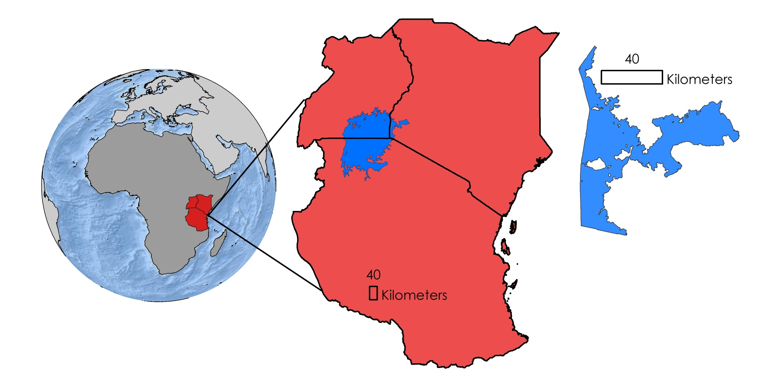
Lake Victoria Water Resources II
Developing an Automated and Near Real-Time System to Monitor Eichhornia Crassipes over the Winam Gulf in Lake Victoria
Jeanné le Roux (Project Lead), Daryl Ann Winstead, Christina Fischer, Sara Amirazodi, Dwight Tigner
DEVELOP National Program at NASA Marshall Space Flight Center
Abstract
Objectives
Place holder
Develop the Surface Aquatic Vegetation Detection Tool (SAVDT) to automate data download and hyacinth detection over the Winam Gulf.
Assess the accuracy of the Surface Aquatic Vegetation Detection Tool (SAVDT).
Study Area
Uganda
Kenya
Tanzania
Winam Gulf, Kenya
Create Script
Automate data download
Test Script
Troubleshoot and streamline script to run effectively and efficiently
Data Analysis
Assess accuracy of algorithm
Automate hyacinth detection
Lake Victoria
Methodology
Earth Observations
Landsat 8 OLI & TIRS
Results
Conclusions
TBD
TBD.
Team Members
Project Partners
Acknowledgements
Africa Flores and Dan Irwin, NASA SERVIR Coordination Office at MSFC
Dr. Robinson Mugo, SERVIR - Eastern and Southern Africa Hub
James Wanjohi Nyaga, Regional Centre for Mapping of Resources for Development (RCMRD)
Dr. Anthody Gidudu, Makerere University Department of Geomatics and Land Management
We would also like to thank the following for their guidance and support throughout this project:
Dr. Jeffrey Luvall, NASA at NSSTC
Dr. Robert Griffin, University of Alabama in Huntsville
Leigh Sinclair, NASA DEVELOP
Timothy Klug, University of Alabama in Huntsville
Austin Vacek, University of Alabama in Huntsville
Dr. Joseph Ortiz and Dulci Avouris, Kent State University
From left to right: Christina Fischer, Jeanné le Roux, Dwight Tigner, Daryl Ann Winstead, Sara Amirazodi
NASA Marshall Space Flight Center

