Slide 1
Wyoming Ecological Forecasting
Mapping Cheatgrass Phenology and Distribution in a Post-Wildfire Landscape in Wyoming’s Medicine Bow National Forest
Darin Schulte(Project Lead)
Chandra Fowler
Stephanie Krail
Oliver Miltenberger

Slide 2
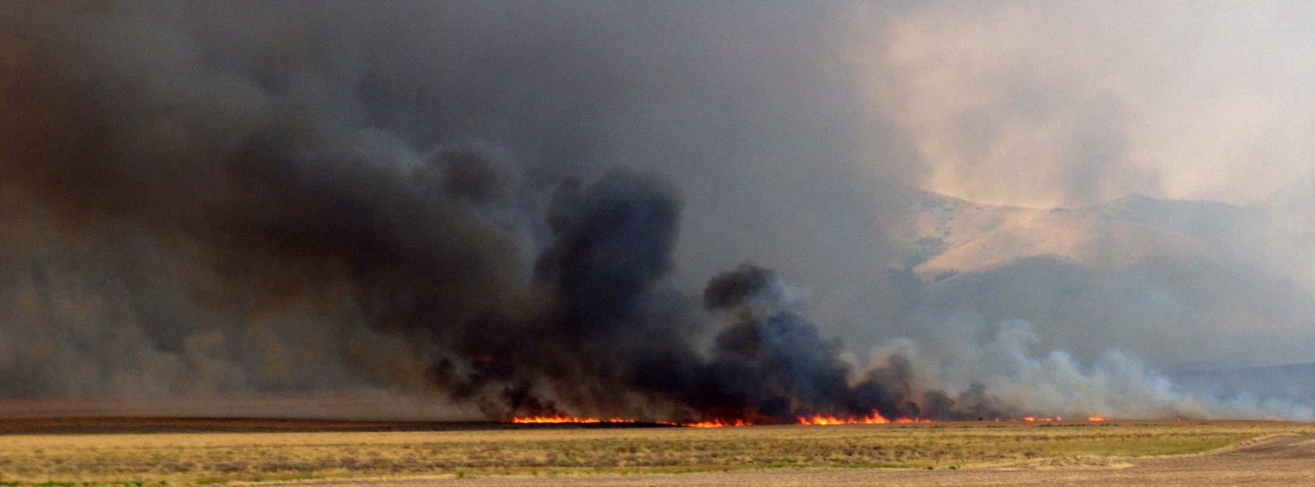
Arapaho Fire 2012
Source: SLV Nature
Cheatgrass is a problematic invasive species known to alter hydrologic and nutrient regimes and outcompete native plant species
~22 million hectares in US affected by cheatgrass (2005)
Mitigation can be extremely expensive & labor intensive
Highly accurate maps needed for targeted management
Community Concerns
Notes:
Ecological effects of cheatgrass invasion
- alter hydrologic and nutrient cycles
- outcompete native grasses
- colonize post-burn areas
- increase fire intensity by providing abundant flammable material
-As of 2005, an estimated 22.5 million ha in the US were affected by cheatgrass
-Once established cheatgrass becomes a long-term and expensive management concern
-Field surveys are currently the only estimation method for cheatgrass distribution
-The Arapahoe Fire of 2012 burned over 40,000 ha in Medicine Bow National Forest, Wyoming, opening swaths of land to cheatgrass encroachment
-Little to no data exists of current state of cheatgrass in and around the burn area from the Arapahoe Fire.
-Highly accurate maps of cheatgrass cover and phenology are needed in order to effectively target locations and timing of mitigation efforts.
Image Source: Creative Commons

Slide 3
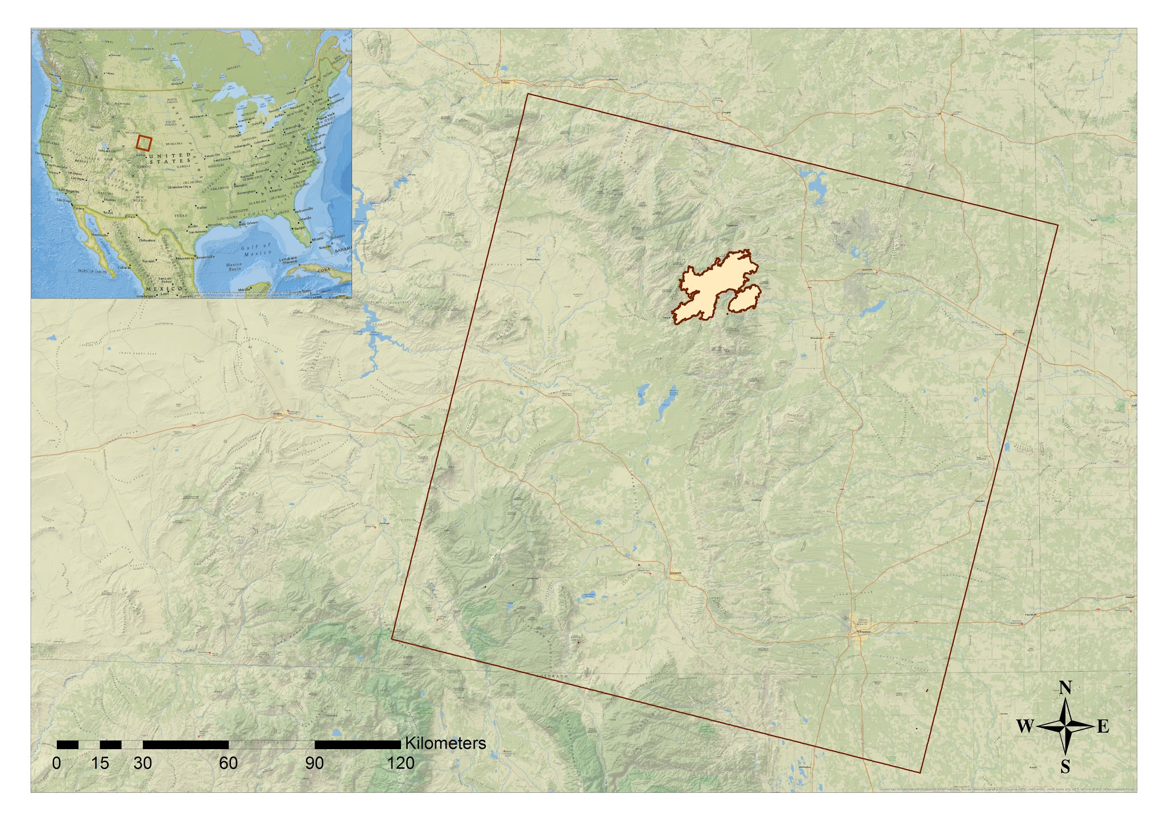
Legend
WRS Outline of
Path 34 Row 31:
Arapahoe Wildland
Fire Boundary:
Study Area
Notes:
Study area
-Consists of the site of the 2012 Arapaho Wildland Fire (42.201° N latitude, -105.49° W longitude) in Medicine Bow National Forest, southeastern Wyoming, WRS2 Path 34 Row 31
-Includes over 98,115 Acres of burned area that originally ignited from a lightning strike and burned from June 27th to August 23rd, 2012
-Consists of ponderosa pine forest and sagebrush steppe ecosystems and ranges from 1519 to 3106 meters in elevation
Study period
-Current distribution of cheatgrass (May-September 2015)
Base Map Source: National Geographic, Esri, DeLorme, HERE, UNEP-WCMC, USGS, NASA, ESA, METI, NRCAN, GEBCO, NOAA, increment P Corp.

Slide 4
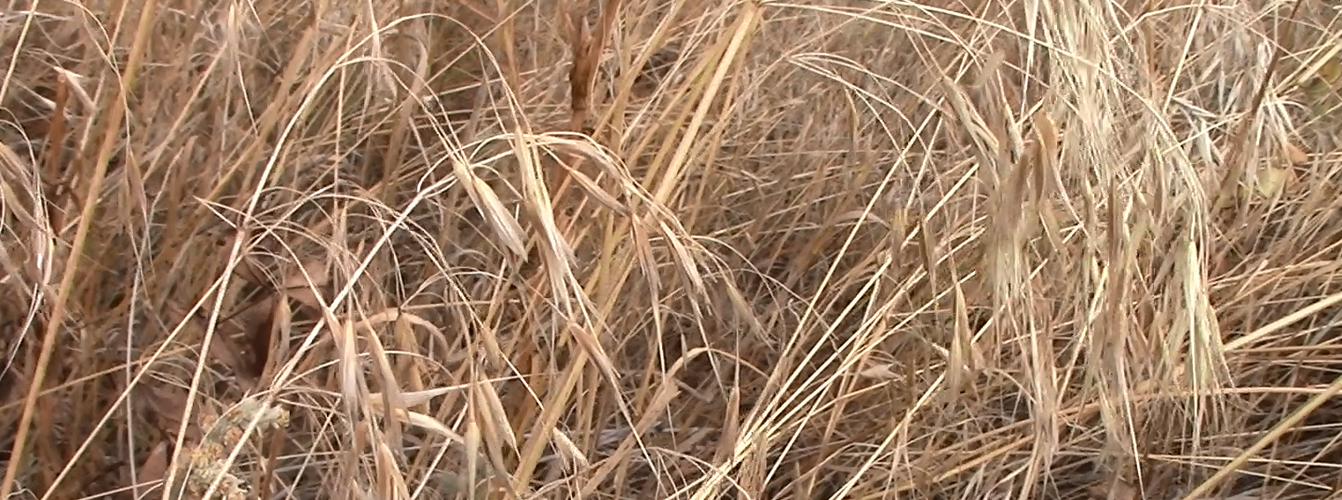
Species Distribution Model (SDM) for mapping cheatgrass cover
Assess phenological characteristics of areas with predicted cheatgrass cover
Inform targeted mitigation of cheatgrass populations for Project Partners
Objectives
Notes:
Species Distribution Mapping
-Used here to make predictive maps of cheatgrass presence
-Performed in the Software for Assisted Habitat Modeling (SAHM) developed by the USGS
Phenological Characteristics
-Use MODIS data with the TIMESYNC software program to assess the timing of green-up and senescence within pixels identified as having cheatgrass present.
-Cheatgrass is a winter annual that tends to green-up earlier in the Spring than many native plant species
Targeted Mitigation
-This spatial and temporal information will be used to time herbicide applications
-Project partners: Wyoming Game and Fish & US Forest Service
Image Source: Wyoming Ecoforecasting DEVELOP team

Slide 5

Data Acquisition
Data
Processing
Modeling
Results
Landsat 8
OLI and TIRS
Vegetation Indices
Species Distribution
Model
Cheatgrass
Cover Map
SRTM
Topographic Indices
Phenological Characterization Map
MODIS
Phenology Product
Clip to
Study Area
Methodology
Notes:
Workflow
-Our workflow consisted of four main stages:
-Data Acquisition
-Data Processing
-Modeling
-Results / Analysis
-We had two key processes which can be tracked from left to right in the diagram
-Process 1:
-We used Landsat 8 OLI data to derive a series of vegetation indices SRTM data to derive topographic indices
-These indices combined with field data in a species distribution model (SDM) within SAHM to produce a cheatgrass cover map for our area of study
-Process 2:
-We used the MODIS data in the TIMESYNC software program to track green-up and senescence of areas predicted to have cheatgrass present by the SDM
-This information was used to produce a phenological characterization map
The Following slides walk through each of these four components in more detail

Slide 6
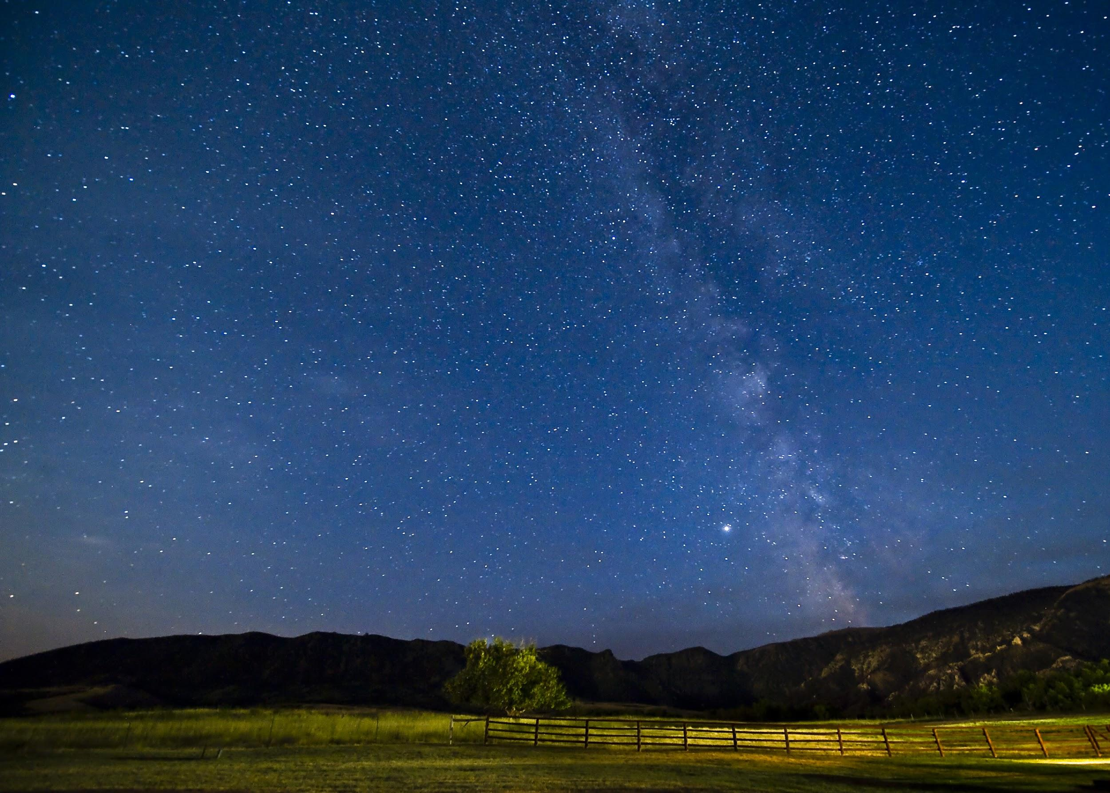
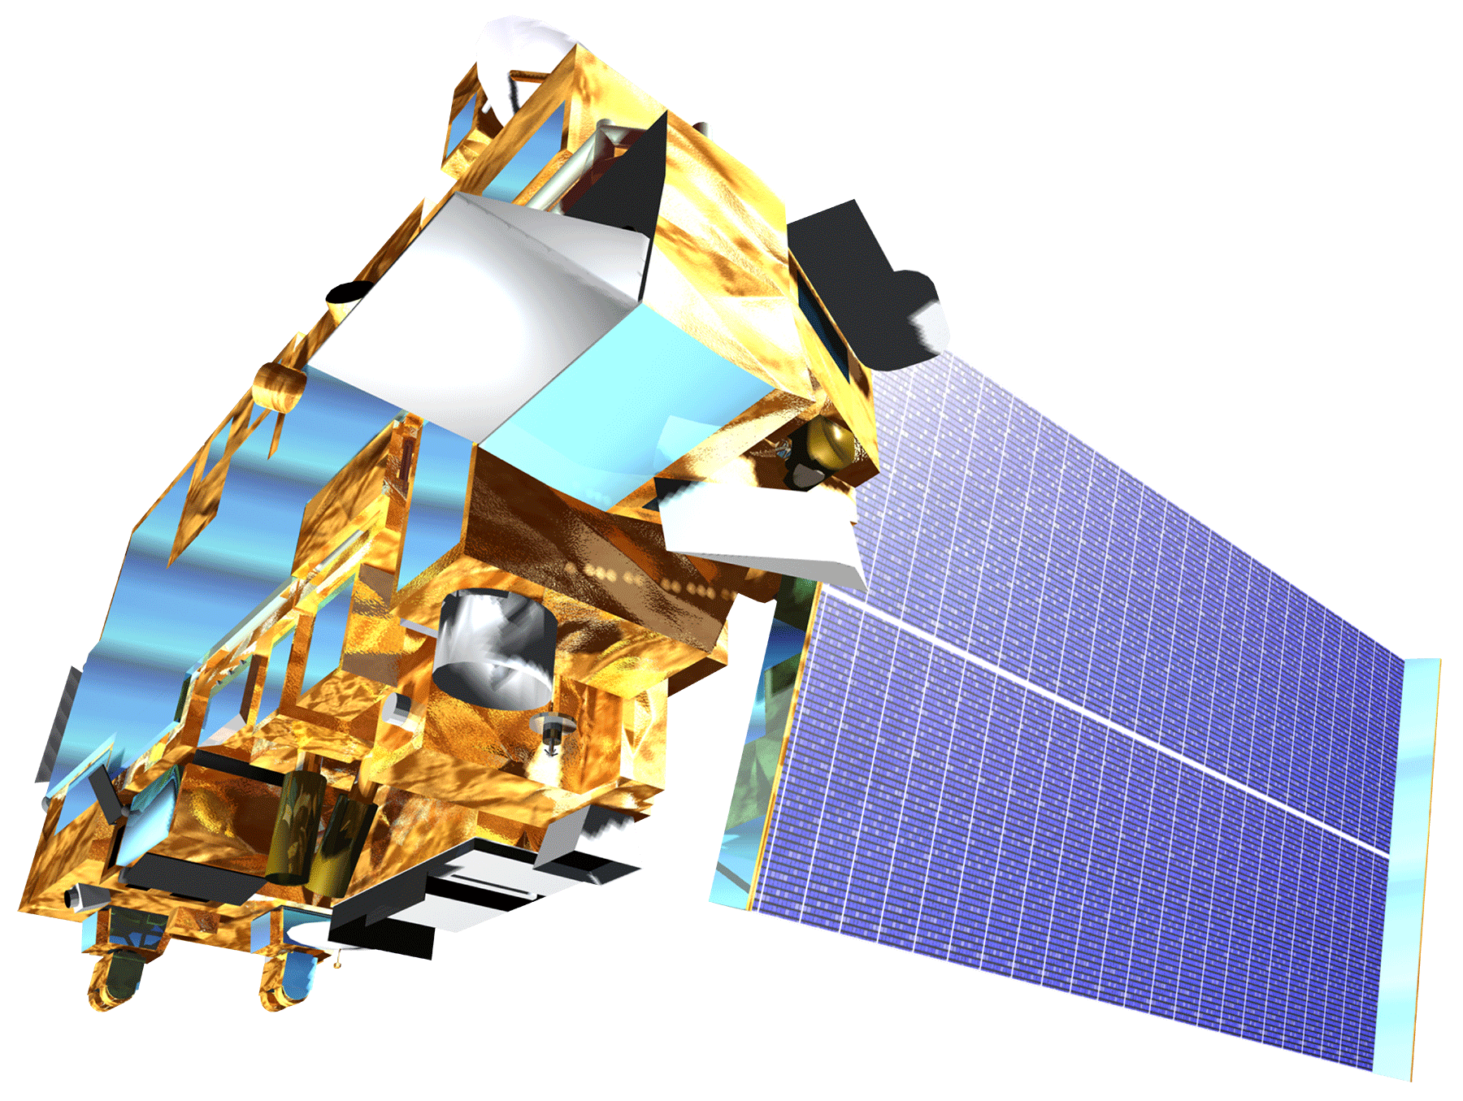

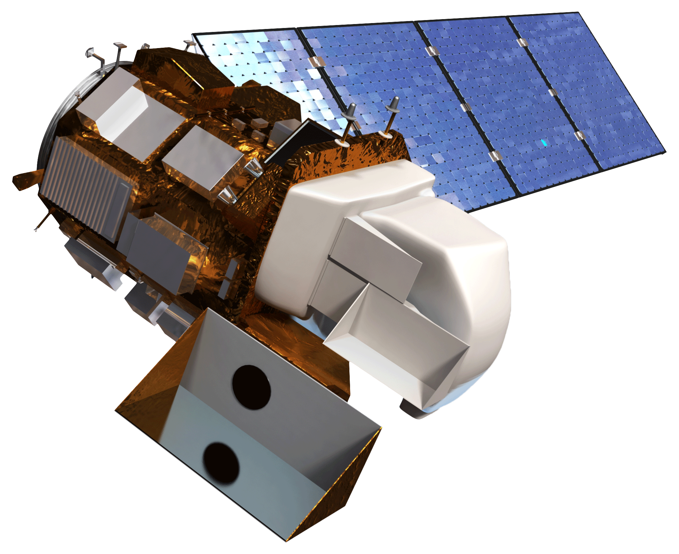
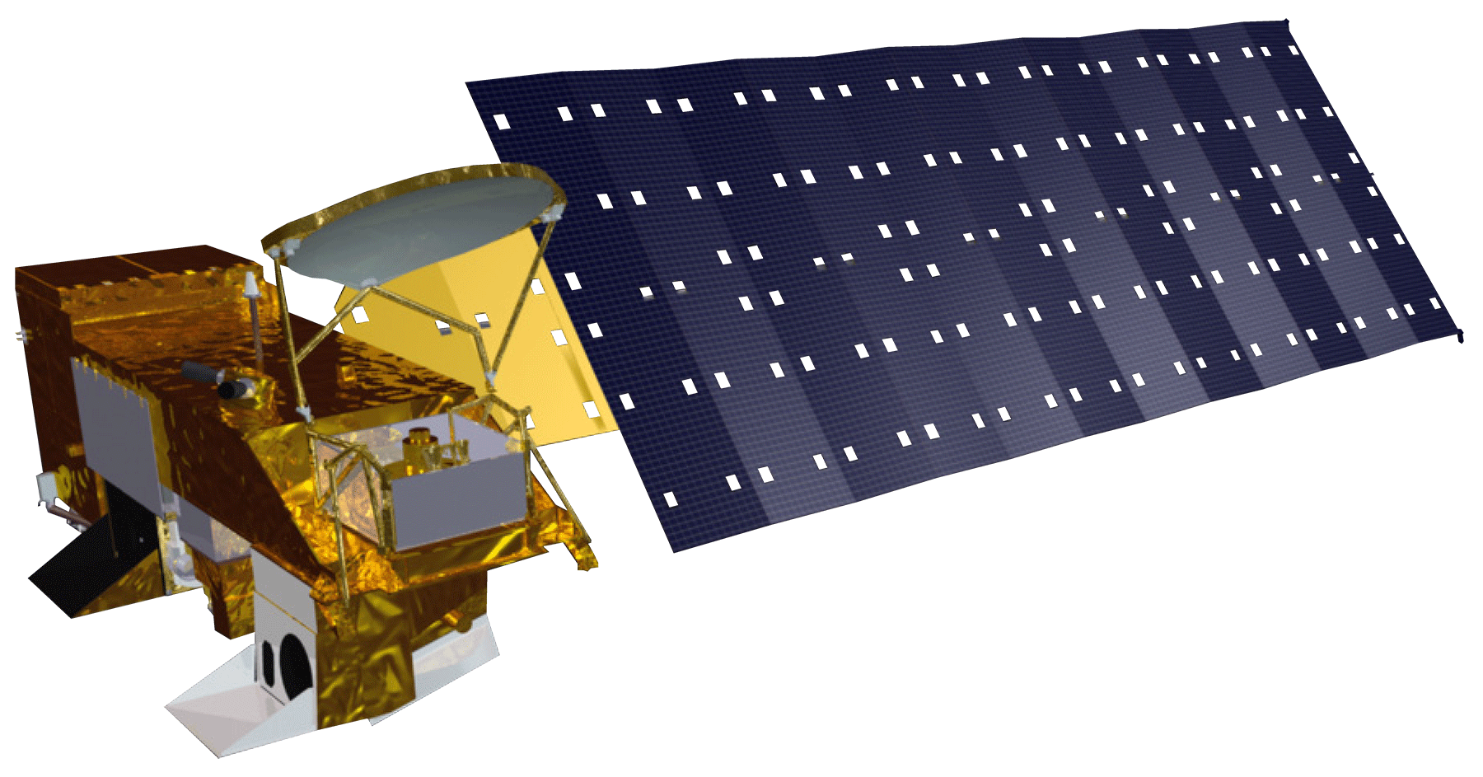
Aqua
Landsat 8
SRTM
Terra
)
Earth Observations
Photo Credit: Gary Elsasser
Notes:
Geospatial data and imagery came from Landsat 8, Aqua, Terra, Shuttle Radar Topography Mission (SRTM)
Image Source: http://www.devpedia.developexchange.com/dv/index.php?title=List_of_Satellite_Pictures

Slide 7
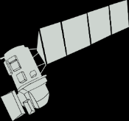
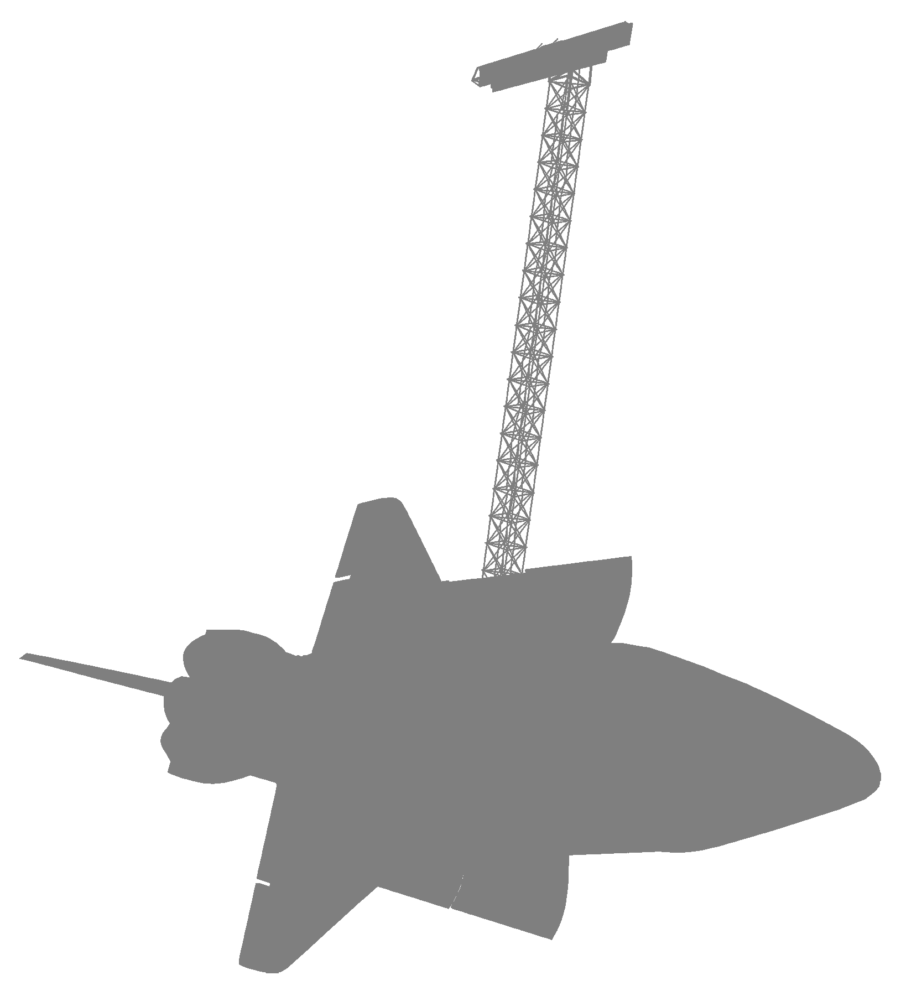


Results
6
1
3
Landsat 8 scenes (OLI & TIRS data)
SRTM Digital Elevation Model (DEM)
Years of MODIS MOD09A1
reflectance data
Data Acquisition
Notes:
Data Acquisition
[Note 1: These are placeholder values & descriptions, and will be finalized for the final draft]
[Note 2: This slide has the same information as the next slide. We will decide on one for the final draft]
Landsat 8 Imagery
-We collected six cloud-free Landsat 8 scenes for the study period between May & September 2015
-OLI & TIRS data were collected for use in calculating vegetation indices and use in the SDM
SRTM Digital Elevation Model
-We downloaded a 30 m Digital Elevation Model from USGS Earth Explorer
MODIS MOD09A1 Reflectance Data
-We downloaded three years worth of MODIS MOD09A1 reflectance data for analysis in the TIMESYNC software program (phenology analysis)

Slide 8
9
8
Vegetation
indices
Topographic
indices
Phenology timeseries
Data Processing
Notes:
Data Processing
[Note 1: These are placeholder values & descriptions, and will be finalized for the final draft]
Vegetation Indices
-Derived ______________ vegetation indices for use in the SDM
-Vegetation indices were derived from Landsat 8 OLI data
Topographic Indices
-Derived _______________ topographic indices also for use in the SDM
-Topographic indices were derived (or explicitly provided by) SRTM data
Phenology Timeseries
-The phenology timeseries was performed in the TIMESYNC software program

Slide 9
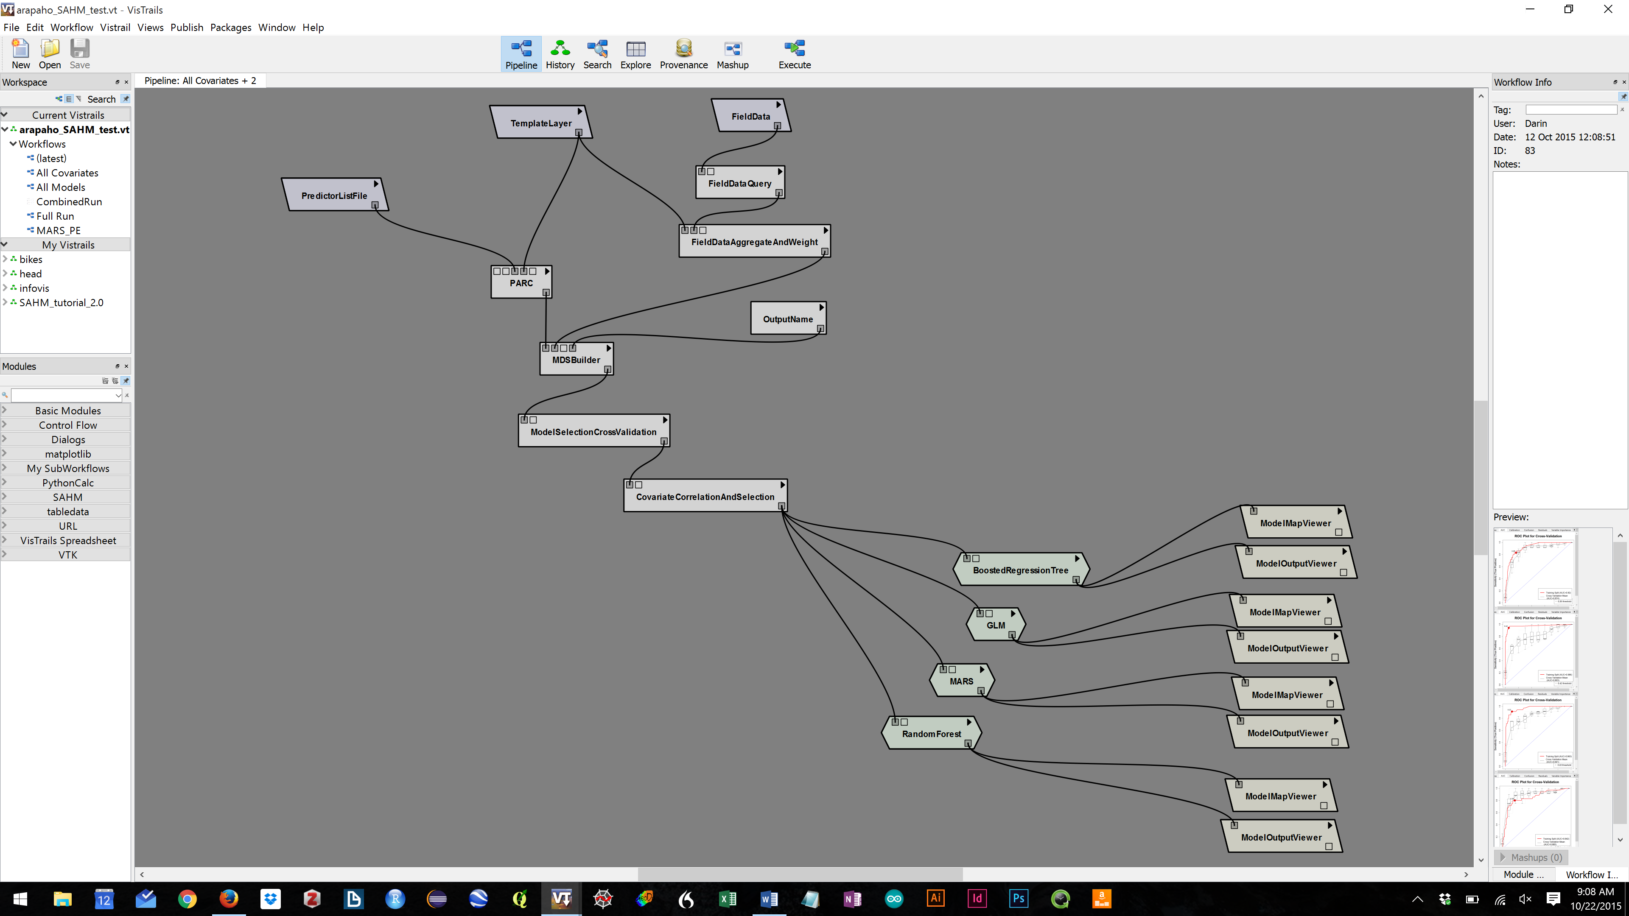
Results
Modeling
Notes:
Modeling
[Note 1: These are placeholder values & descriptions, and will be finalized for the final draft]
Species Distribution Model (SDM)
-A SDM was run in the Software for Assisted Habitat Modeling (SAHM)
-Vegetation and topographic indices were used as predictor variables (covariates)
-Field data consisted of both presence and absence data
-# of presence points: _____________
-# of absence points: _____________
-Four SDMs were run
-Generalized Linear Model (GLM)
-Multivariate Adaptive Regression Splines (MARS)
-Random Forests (RF)
-Boosted Regression Trees (BRT)

Slide 10
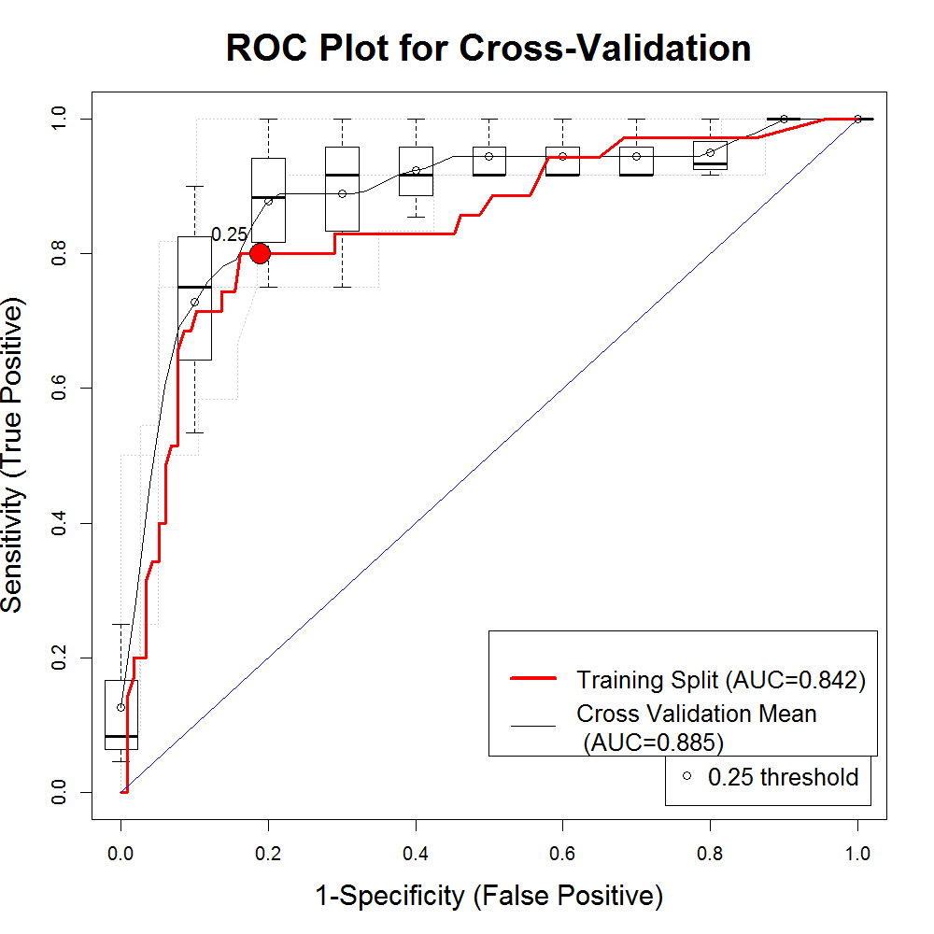
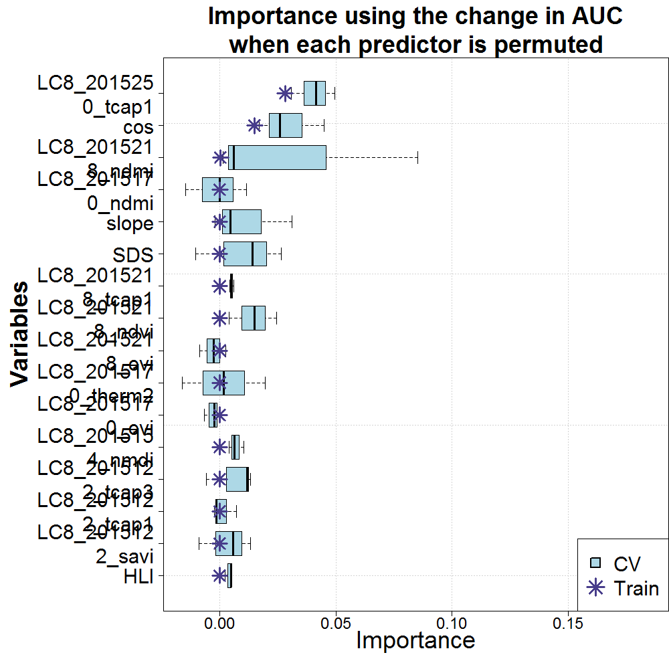
Results
Modeling
Notes:
Modeling
[Note 1: These are placeholder values & descriptions, and will be finalized for the final draft]
Model Diagnostics
-Series of evaluation metrics for each of the models allows for comparison among model fits
-Pictured here is the AUC plot for the Random Forests Model, as well as the variable importance plot

Slide 11
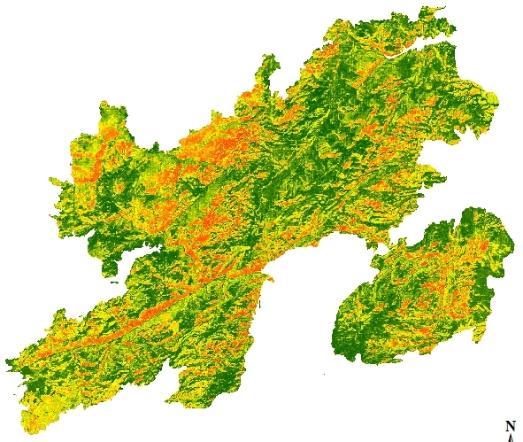
High
Results
Low
Modeling – Probability Maps
Notes:
Modeling
[Note 1: These are placeholder values & descriptions, and will be finalized for the final draft]
Model Outputs
-1) Probability Maps illustrating the predicted probability of cheatgrass cover
(Continued on next slide)

Slide 12
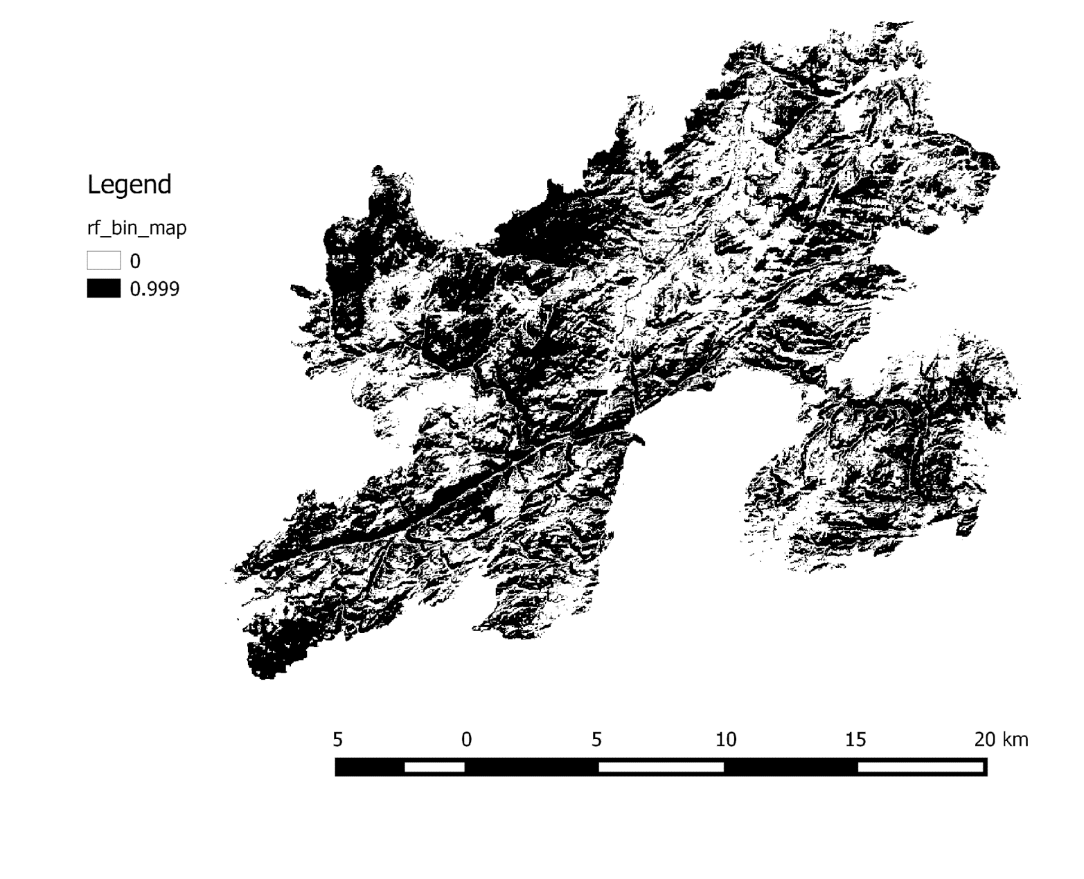
Present
Absent
Modeling – Binary Maps
Notes:
Modeling
[Note 1: These are placeholder values & descriptions, and will be finalized for the final draft]
(Continued from previous slide)
-2) Binary presence / absence maps
-Default threshold of sensitivity = specificity shown here

Slide 13
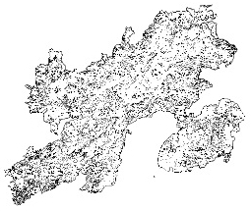
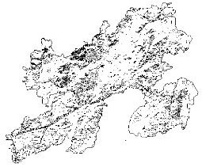
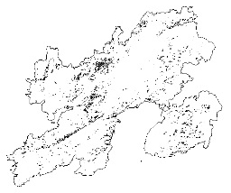
0.4-0.6
High
8862.93 ha
Results
0.6-0.8
Low
7495.56 ha
0.8-1.0
Results
2191.5 ha
Notes:
Results
[Note 1: These are placeholder values & descriptions, and will be finalized for the final draft]
Probability Map
-The large map displays the probability of Cheatgrass cover through the study area on a continuous scale
-The regions in red have the highest probability and the dark green regions have the lowest probability of having Cheatgrass
Area Estimates by Probability
-The smaller maps on the right focus on specific probability categories of where Cheatgrass cover exists
-Each map displays a probability category, 0.4-0.6, 0.6-0.8, and 0.8-1.0, the pixels that fall within the category, and the area of each category.

Slide 14
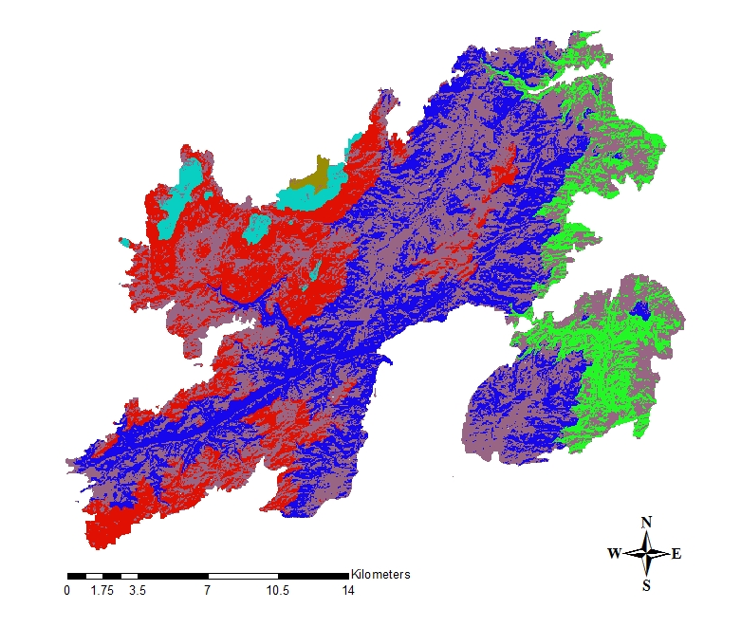
absent
1,519-1,836 m (1)
1,836-2,153 m (2)
2,153-2,470 m (3)
2,470-2,787 m (4)
2,787-3,104 m (5)
Results
Results
Notes:
Results
[Note 1: These are placeholder values & descriptions, and will be finalized for the final draft]
Proportions by elevation
-The map illustrates the locations of each of 5 elevation classes (each of approximately 327 m)
-Bar graph illustrates the proportion of land in each elevation class predicted to have cheatgrass present

Slide 15
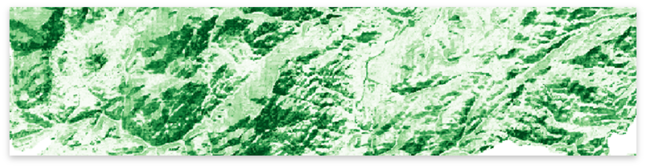
Impact of partial cloud cover on Species Distribution Model
Exploring parameter values within SDM for multiple model types
Need to combine field data from two years
Cheatgrass percent cover threshold
Binary map threshhold
Phenology mapping after recent fires
Errors and Uncertainties
Notes:
Errors and Uncertainties
[Note 1: These are placeholder values & descriptions, and will be finalized for the final draft]
Imagery
Limitations of available data since the fire in 2012
For MODIS data in particular
Cloud cover obscures essential imagery
SAHM
Subjectivity in identifying high correlated covariates and removing one of them
Field work
Potential human error while collecting data
More field data would have led to more successful models
MODIS
Spatial resolution comapred to landsat imagery
Threshold
May be too low too include all areas of cheatgrass
Could be too high and overestimating locations of cheatgrass

Slide 16
Coming soon!
Conclusion & Discussion
Notes:
Conclusions & Discussion
[Note 1: These are placeholder values & descriptions, and will be finalized for the final draft]
Coming soon.

Slide 17
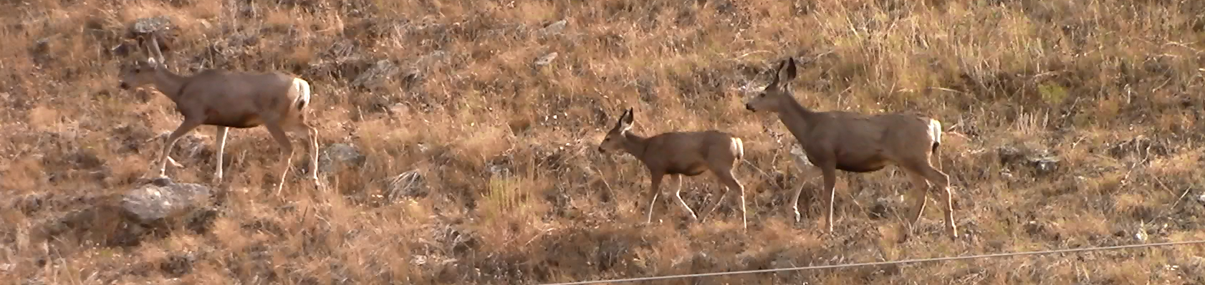
Continued application of SDMs for cheatgrass management in adjacent areas
Additional field data collection and temporal assessment of cheatgrass cover change
Critical mule deer habitat mapping
Future Work
Notes:
Future Work
[Note 1: These are placeholder values & descriptions, and will be finalized for the final draft]
-Apply methodology to another location
-Continue collecting field data in order to assess patterns of post-fire recovery and / or success of cheatgrass management
-Similar approach applied to mapping critical mule deer habitat within the region
Image Source: Wyoming Ecoforecasting DEVELOP team

Slide 18
Advisors
Dr. Paul Evangelista, Natural Resource Ecology Laboratory, Colorado State University
Dr. Amanda West, Natural Resource Ecology Laboratory, Colorado State University
Partners
Wyoming Game and Fish Department
United States Forest Service
Natural Resource Ecology Laboratory, Colorado State University
Others
Ryan Amundson (Wyoming Game and Fish Department)
Ryan Anderson (Natural Resource Ecology Lab, Colorado State University)
Katherine Haynes (US Forest Service)
Brian Woodward NASA DEVELOP

