Slide 1
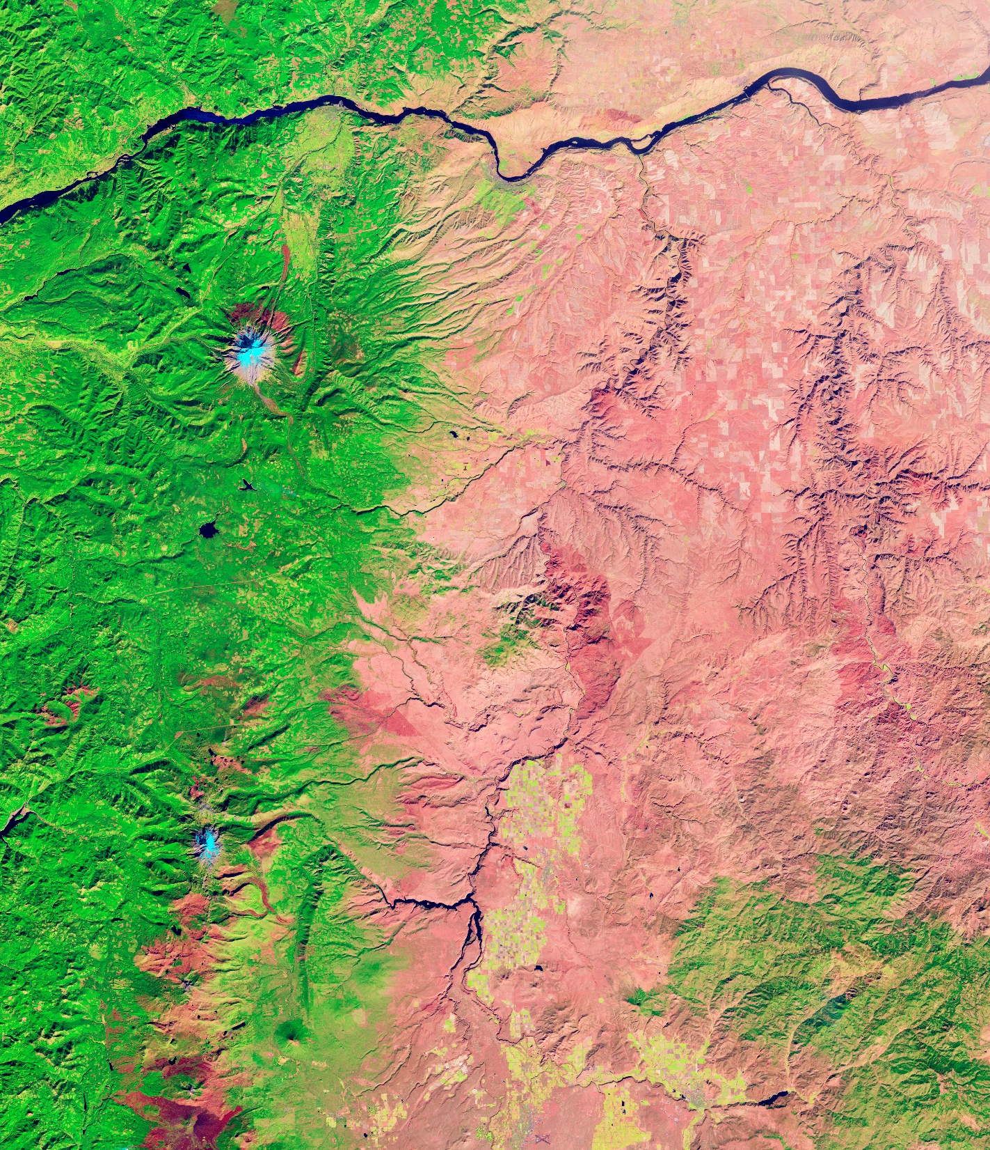
2022 DEVELOP
Enhancing Science Communication of NPS Projects

Slide 2

NPS PROJECT ENHANCED CREATIVE COMMUNICATIONS
Increasing visibility of DEVELOP’s NPS projects
DEVELOP has conducted over 50 projects with the NPS since 2016
The two agencies are exploring ways to increase and expand upon that engagement
In support of this initiative, DEVELOP and NPS would like to increase the utility and visibility of our communication materials for sharing and distribution in parks
DEVELOP’s NPS-partnered projects will tailor their creative communications product to the park’s interests, as well as consider other optional deliverables that might be helpful (if time/workload allows)

Slide 3
NPS PROJECT ENHANCED CREATIVE COMMUNICATIONS
What does this mean to you?
NPS projects will have an elevated focus on the communication materials created by the team
The DEVELOP Comms Team has created a slightly modified menu of options for the NPS projects in 2022
Teams should familiarize themselves with potential options and discuss this with their partners now at the beginning of the term
Make sure that our partners (often scientists in the park) discuss with the communications folks within their park before identifying which communication product should be pursued
  Note: We received the communications POC for each park from the NPS Communications Director and can share that with you in the case your NPS partner doesn’t know who in their park to contact
Report what creative communication type your team will pursue to the Comms Team by end of week 2 (if NPS partners need a small extension to this, reach out to Celeste)

Slide 4
NPS PROJECT ENHANCED CREATIVE COMMUNICATIONS
Primary Creative Communication Options Menu
With your partner, choose a creative communication product that the team will create – it can be something for distribution or sharing in the park or an online product.
In-person/tangible products
Online products
Creative Media Poster
Scientific Poster
Short Videos
One-pager Brochure
Tri-fold Brochure
Esri StoryMap
Note: Only one creative communication product must be selected but the team can choose to make additional products as optional deliverables if workload and time allow (next slide)

Slide 5
NPS PROJECT ENHANCED CREATIVE COMMUNICATIONS
Optional Creative Communication Product Menu
In-person tangibles
Online products
Social media
Creative Media Poster
Short Videos
Social Media Post Series
Scientific Poster
Esri StoryMap
Blog Article
One-pager Brochure
Additional deliverables can be created as workload and time allow – identify partner interests and communication priorities.
Tri-fold Brochure

