Slide 1
DOMINICAN REPUBLIC DISASTERS
Mapping Landslide Susceptibility and Exposure in the Dominican Republic Using NASA Earth Observations
Sarah Aldama
Chelsea Dandridge
Kyung “Robin” Kim
Gigi Pavur
Virginia – Langley | Summer 2019
Notes:
Hello. Thank you all for joining us today.
I’m Sarah Aldama, I graduated from Macalester College with a degree in Geography and Biology.
I’m Chelsea Dandridge, I’m a PhD student at the University of Virginia studying Civil and Environmental Engineering.
I’m Gigi Pavur, I’m a current undergraduate student at Georgia Tech, majoring in Earth and Atmospheric Sciences.
Unfortunately, our fourth team member, Robin Kim, couldn’t be here today.
For our DEVELOP project this summer, we mapped and assessed rainfall-triggered landslide susceptibility and exposure in the Dominican Republic.
It was an incredible opportunity, and we are excited to share it with you.

Slide 2
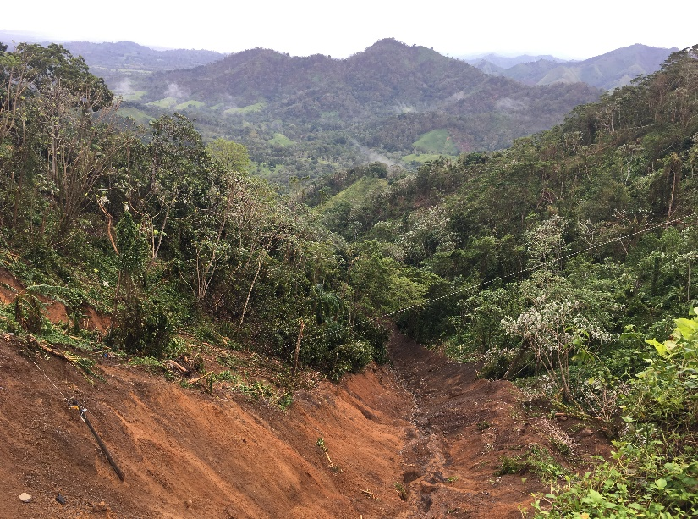
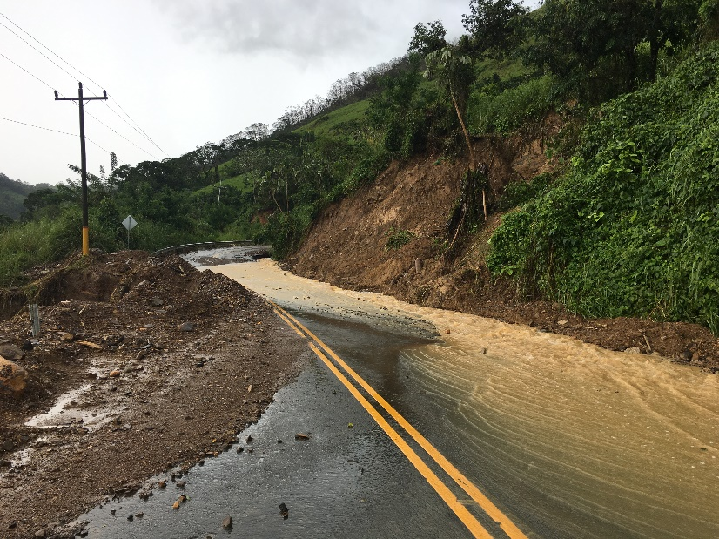
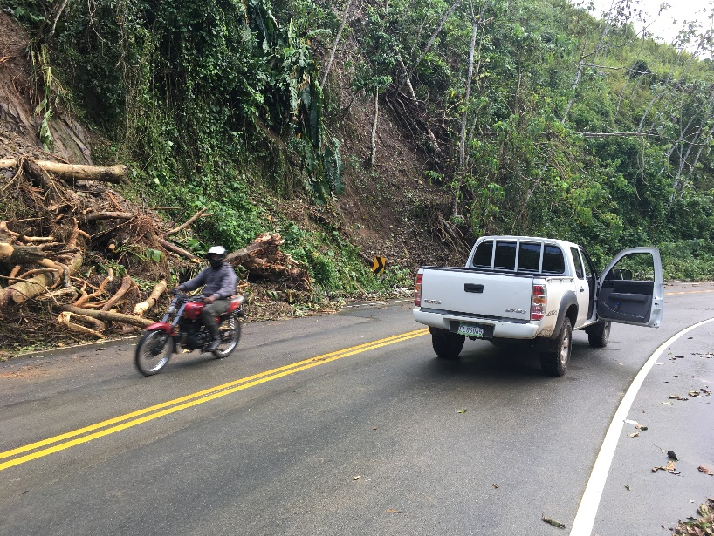
Dominican Republic
Caribbean Small Island Developing State (SIDS)
Hotspot for natural disasters
Rapid and unplanned development since the 1960s
Images: National Geological Service (SGN)
Notes:
In the Caribbean Ocean, the Dominican Republic occupies two-thirds of the Island of Hispaniola. With its modest size, population, and limited access to resources, the Dominican Republic is recognized by the United Nations as a Small Island Developing State. Because of its geographic location in the tropics and within the Hurricane Belt, this area is a hotspot for natural disasters. According to the United Nations Development Program, up to 80 percent of the Dominican Republic’s population may be at risk of suffering directly or indirectly from natural disasters. Rapid and unplanned land development since the 1960s makes understanding disaster risk and improving resilience a high priority for the Dominican Republic. The region would benefit from reliable disasters monitoring.
___________________________________________
Picture Credits:
Provided by our partners at SGN

Slide 3
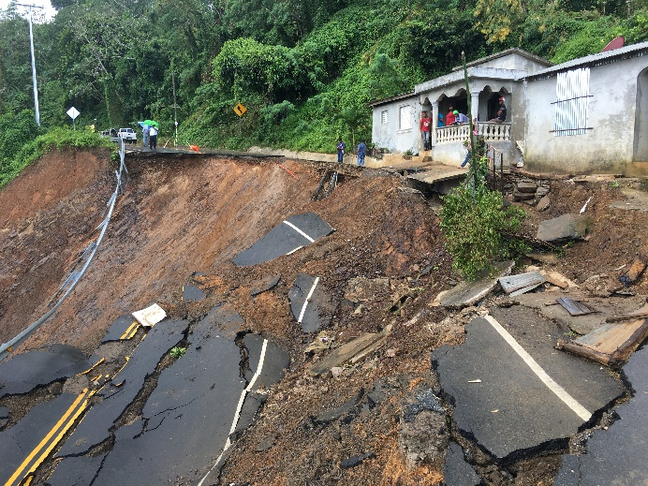
Community Concerns
Loss of life and property
Wet climate and geology
Tropical storms
Inconsistent landslide monitoring
Images: Rawpixel, Wikimedia, Goodfreephotos, SGN
Notes:
With the predicted increase in frequency and intensity of tropical storms, many areas in the Dominican Republic are also at increased risk for rainfall-triggered landslides during these events. However, landslides are also induced by the generally wet climate and varying topography within the Dominican Republic. In recent years, there has been an immense loss of life and property due to landslides (which include rock falls, mudslides, and debris flows). Local agencies are in need of consistent and reliable landslide monitoring in order to establish preventative measures against damage from these disasters.
___________________________________________
Image 1: Tropical storm (CC0 License) – rawpixel https://www.rawpixel.com/nasa/showcase?sort=curated&mode=shop&page=1
Image 2: Geology map (Open License) – Wikimedia https://commons.wikimedia.org/wiki/File:Geologic_Map_Dominican_Republic.png
Image 3: Aerial of Santo Domingo (CC0/Public Domain License) – Goodfreephotos https://www.goodfreephotos.com/dominican-republic/santo-domingo/satellite-image-from-space-of-santo-domingo.jpg.php
Image 4: Provided by partners with permission to distribute

Slide 4
PARTNERS
Goddard Space Flight Center
National Geological Service
(SGN)
BGC Engineering Inc.
Langley Research Center
National Office of Meteorology (ONAMET)
Images: Flaticon, Shareicon
Notes:
To help address these community concerns, our team collaborated with a variety of national and international organizations.
We had the opportunity to partner up with two government organizations in the Dominican Republic: the Servicio Geologico Nacional (SGN) and the Oficina Nacional de Meteorologia (ONAMET).
These agencies monitor and issue warnings for landslides across the Dominican Republic at the provincial level. The overarching goal of our project was to provide SGN and ONAMET with tools to improve their landslide monitoring abilities.
Team was also guided by landslide experts at Goddard Space Flight Center and by science advisors here at Langley Research Center.
We also collaborated with a BGC Engineering, a private firm based in Canada, who provided knowledge gathered by their years doing field work in the Dominican Republic.
_________________
Image 1 (landslide): Flaticon Basic License https://www.flaticon.com/free-icon/landslide-danger-triangular-traffic-signal_46295
Image 2 (weather): Shareicon CC 3.0 BY Licence https://www.shareicon.net/weather-raining-just-icons-rain-rainy-cloud-sun-day-symbol-681779

Slide 5
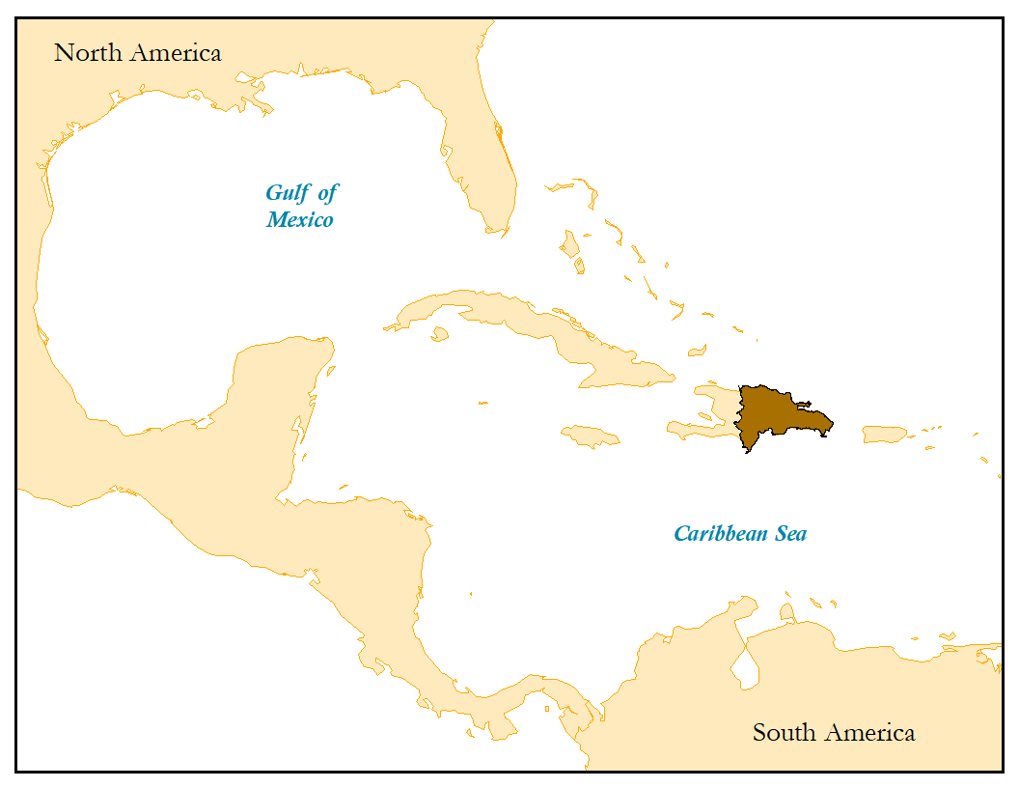
Study Area
Elevation (m)
0
50
100 km
0
1500
3000
Basemap: Esri
Notes:
Our partners identified a region of interest along the Northern coastal region of Cibao, which is outlined in red on this map. This coastal region has varying topography and is highly susceptible to landslides. It also houses various international tourist destinations that attract large populations and infrastructure development, which are at risk for damage from landslides. Our study period was from 2007-2019.
_________________
Reference Map (inset map, right): Esri ArcMap basemap

Slide 6
Objectives
Incorporate local data into landslide model
Produce landslide susceptibility and exposure maps for country and region of interest
Increase partner knowledge and skills in the implementation of Landslide Hazard Assessment for Situational Awareness (LHASA) model
Image: Flaticon
Notes:
Our project objectives were to incorporate local data for the Dominican Republic into a global landslide monitoring tool, known as LHASA, and customize it for the country.
We also wanted to produce landslide susceptibility and exposure maps for regions of interest identified by our partners.
Lastly, we strived to increase partner knowledge and skills so they may independently implementing and operate LHASA for improved landslide monitoring.
______________________________________
(Flaticon Basic License) “Map perspective with a placeholder on it” Image Flaticon. Designed by SimpleIcon from www.flaticon.com.
https://www.flaticon.com/free-icon/map-perspective-with-a-placeholder-on-it_34230#term=local&page=1&position=14
(Flaticon Basic License) “Handshake” Image Flaticon. Designed by Freepik from www.flaticon.com.
https://www.flaticon.com/free-icon/handshake_281428#term=handshake&page=1&position=12

Slide 7
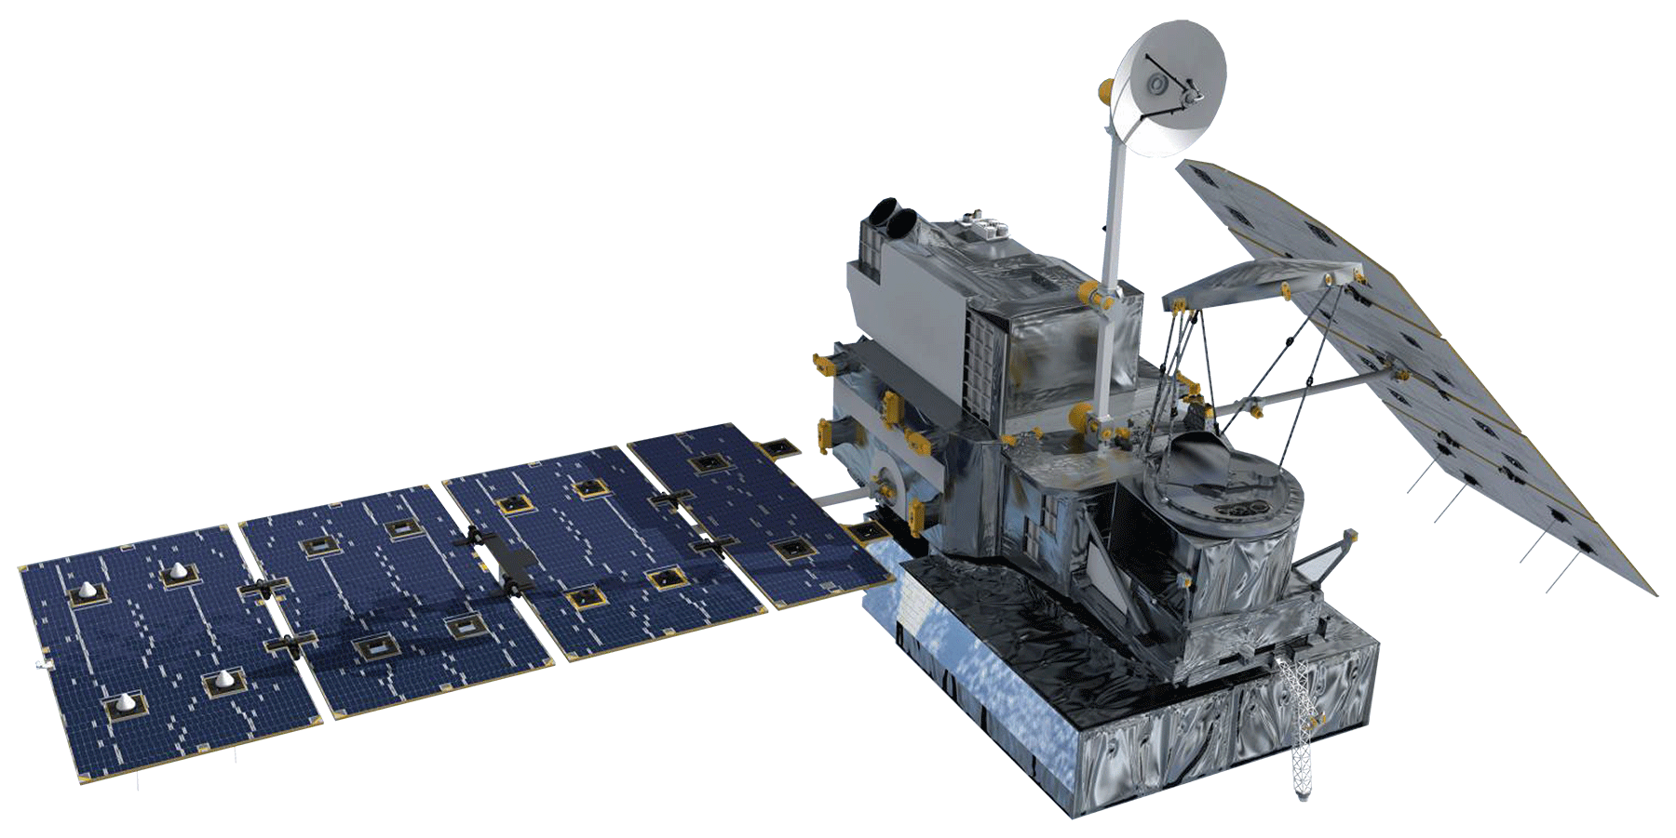
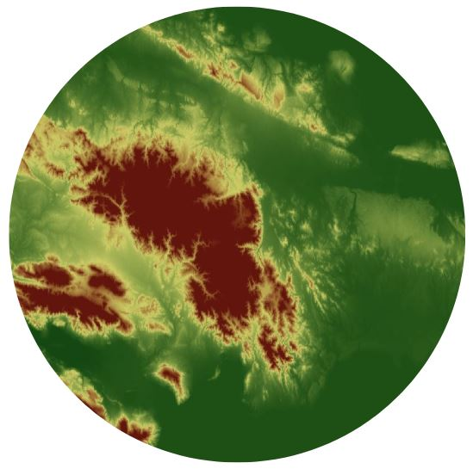
NASA Earth Observations
SRTM
GPM
Image: NASA
Notes:
For our project, we used data from two NASA Earth Observations:
Elevation data from the Shuttle Radar Topography Mission, and rainfall estimates from GPM, the Global Precipitation Measurement Mission, using the new IMERG sensor.
______________________________________
Image Source 1 SRTM: NASA
Image Source 2 Screenshot of Elevation raster data from SRTM in ArcMap
Image Source 3 GPM: NASA
Image Source 4 Screenshot of precipitation estimate raster data from GPM IMERG

Slide 8
Methodology: Overview
LandScan Population
Landslide Exposure
Susceptibility Factors
Landslide Susceptibility
LHASA
GPM IMERG Rainfall
Inputs
Tool
1
Goal
Landslide
Susceptibility
Geology, Slope, Elevation
Forest Loss, Distance to Faults & Roads, Clay %
Fuzzy Overlay & Fuzzy Membership
Where is the highest/lowest landslide potential?
Tool
Inputs
2
Goal
LHASA model
Near real-time Landslide Potential
Susceptibility Map,
GPM IMERG precipitation
Where is there a high/moderate risk for rainfall to trigger a landslide?
Inputs
Goal
3
Tool
Landslide Exposure
Bivariate mapping
Landslide Susceptibility,
Population,
Points of Interest
Who/what is located in areas of high/low landslide potential?
Notes:
Here is an overview of the steps we used to carry out our analysis. We will discuss each component in more detail later in the presentation.
Susceptibility factors, which included a landslide inventory we created, were combined with a Fuzzy Overlay Model to create susceptibility maps for the Dominican Republic. This susceptibility map was combined with LandScan population data and locations of vital infrastructure – such as hospitals, schools, and roads. We also combined the Landslide Susceptibility map with GPM IMERG Rainfall data to create region-specific LHASA outputs for the Dominican Republic.
CHANGE METHODOLOGY FLOWCHART.

Slide 9
Methodology: Overview
LandScan Population
Landslide Exposure
Susceptibility Factors
Landslide Susceptibility
LHASA
GPM IMERG Rainfall
Inputs
Tool
1
Goal
Landslide
Susceptibility
Geology, Slope, Elevation
Forest Loss, Distance to Faults & Roads, Clay %
Fuzzy Overlay & Fuzzy Membership
Where is the highest/lowest landslide potential?
Tool
Inputs
2
Goal
LHASA model
Near real-time Landslide Potential
Susceptibility Map,
GPM IMERG precipitation
Where is there a high/moderate risk for rainfall to trigger a landslide?
Inputs
Goal
3
Tool
Landslide Exposure
Bivariate mapping
Landslide Susceptibility,
Population,
Points of Interest
Who/what is located in areas of high/low landslide potential?
Notes:
Here is an overview of the steps we used to carry out our analysis. We will discuss each component in more detail later in the presentation.
Susceptibility factors, which included a landslide inventory we created, were combined with a Fuzzy Overlay Model to create susceptibility maps for the Dominican Republic. This susceptibility map was combined with LandScan population data and locations of vital infrastructure – such as hospitals, schools, and roads. We also combined the Landslide Susceptibility map with GPM IMERG Rainfall data to create region-specific LHASA outputs for the Dominican Republic.
CHANGE METHODOLOGY FLOWCHART.

Slide 10
Methodology: Overview
LandScan Population
Landslide Exposure
Susceptibility Factors
Landslide Susceptibility
LHASA
GPM IMERG Rainfall
Inputs
Tool
1
Goal
Landslide
Susceptibility
Geology, Slope, Elevation
Forest Loss, Distance to Faults & Roads, Clay %
Fuzzy Overlay & Fuzzy Membership
Where is the highest/lowest landslide potential?
Tool
Inputs
2
Goal
LHASA model
Near real-time Landslide Potential
Susceptibility Map,
GPM IMERG precipitation
Where is there a high/moderate risk for rainfall to trigger a landslide?
Inputs
Goal
3
Tool
Landslide Exposure
Bivariate mapping
Landslide Susceptibility,
Population,
Points of Interest
Who/what is located in areas of high/low landslide potential?
Notes:
Here is an overview of the steps we used to carry out our analysis. We will discuss each component in more detail later in the presentation.
Susceptibility factors, which included a landslide inventory we created, were combined with a Fuzzy Overlay Model to create susceptibility maps for the Dominican Republic. This susceptibility map was combined with LandScan population data and locations of vital infrastructure – such as hospitals, schools, and roads. We also combined the Landslide Susceptibility map with GPM IMERG Rainfall data to create region-specific LHASA outputs for the Dominican Republic.
CHANGE METHODOLOGY FLOWCHART.

Slide 11
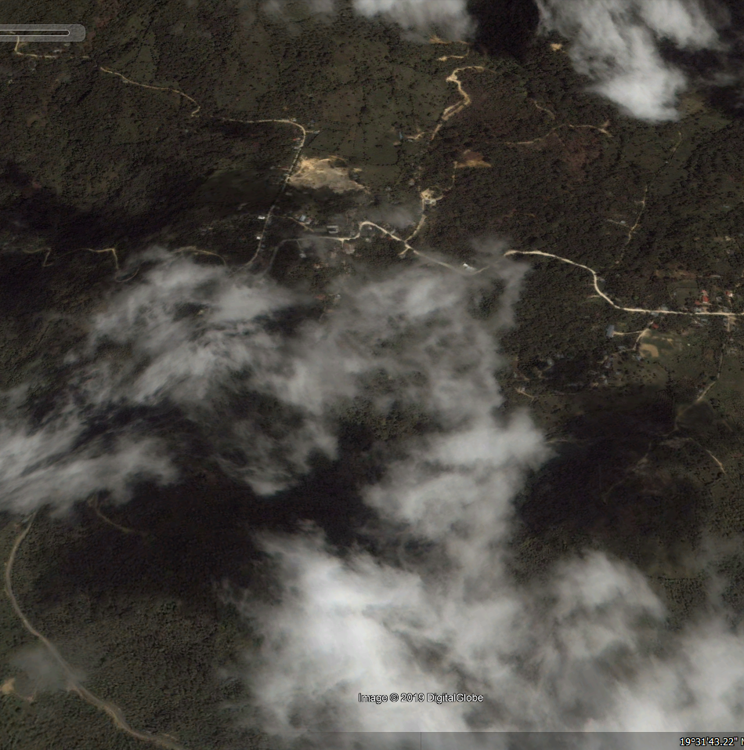
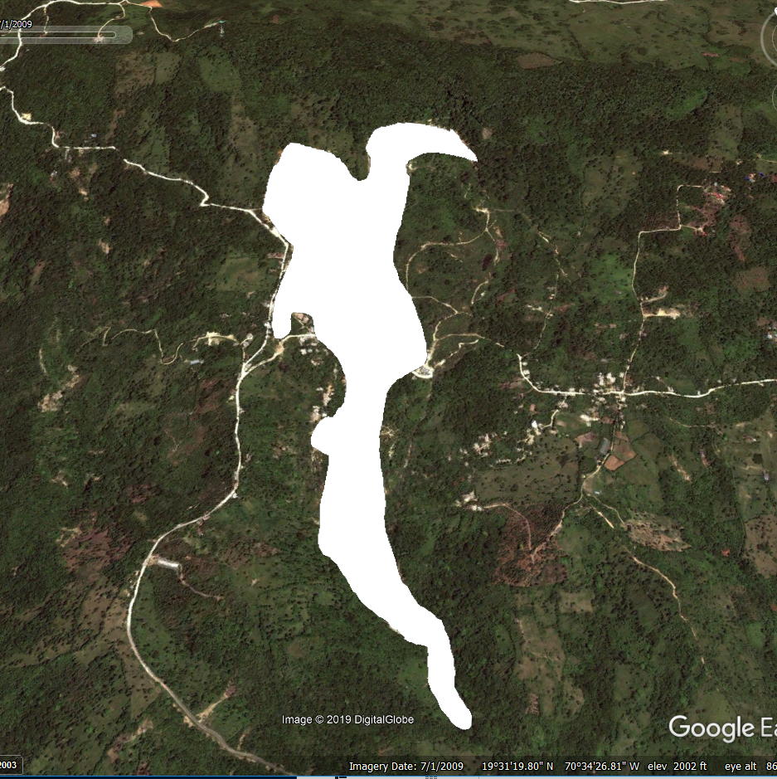
Landslide Inventory
Before (2003)
After (2009)
Image: Google Earth Pro
Notes:
Our partners at SGN provided us with a landslide point inventory, but we quickly realized that the point locations did not correlate with satellite imagery. Because of this, we manually created a landslide inventory for our region of interest using Google Earth Pro.
These satellite images depict a positive landslide detection found when we were creating our landslide inventory. The before satellite image from 2004 shows visible roads and houses in a residential area outside the city of Tamboril. In the after image from 2009, the landslide source location and path of the displaced soil are clearly visible from space. For our inventory, we drew polygons around each landslide we found. Then these polygons were compiled and used for calibration and validation of our susceptibility model. We located over 300 landslides just in our northern study region.
_________________
Image Credit: Google Earth Pro

Slide 12
Methodology: Susceptibility Map
Input
Susceptibility Factors
Elevation
Tool
Output
Slope
Fuzzy Logic
Model
Susceptibility Map
Scaled Lithology
Forest Loss
Distance to Faults
Clay %
Landslide Inventory
Validation
Notes:
To create the susceptibility map, we considered a variety of factors which were identified in previous research. This included slope, scaled lithology, distance to faults, elevation, forest loss, and clay percent. Next, we used a fuzzy logic model to rank if these factors contributed to the susceptibility. This made the susceptibility map, which we then validated it using a Receiver Operating Characteristics Curve, Frequency Ratios Analysis and using our landslide inventory.

Slide 13
Methodology: LHASA
High-Hazard Nowcast
At or Above Threshold
High
Moderate-Hazard Nowcast
Susceptibility Map
Medium
7-day Antecedent Rainfall Index (ARI)
Low
No Nowcast
Below Threshold

Slide 14
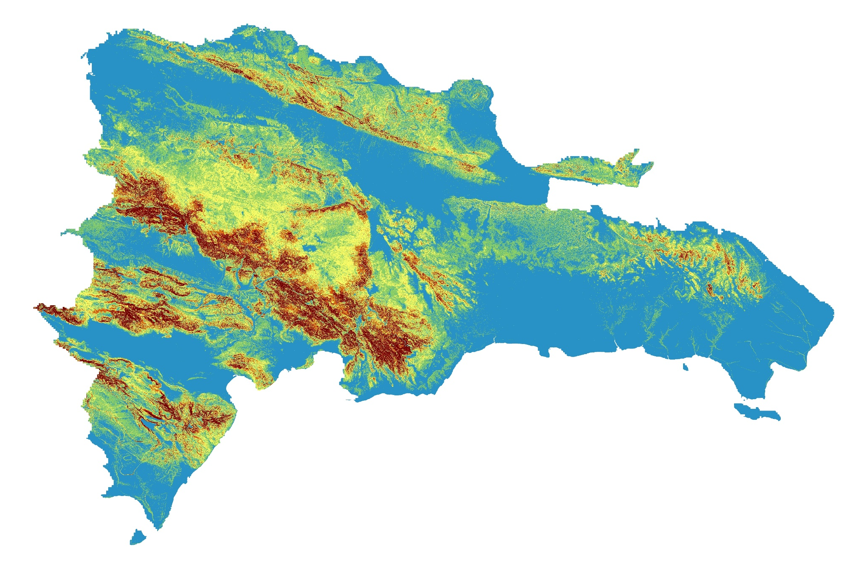
Results: Susceptibility Map
Frequency Analysis
50th - 75th - 90th - 95th Percentiles
High
Frequency Ratio
Susceptibility category
Low
0
50
100
km
N
Notes:
This is our landslide susceptibility map, which was created by incorporating geological and topographical data including:
Elevation, derived from SRTM
Local geology
Slope
Forest Loss
Distance to Faults
and Clay %
Using these variables, we calibrated an existing global landslide susceptibility model for the Dominican Republic. This was done via a Frequency Analysis using the 50th, 75th, 90th, and 95th percentiles.
By doing so, we were able to produce a high resolution susceptibility map of the country.
We were also able to assess our map using the landslide inventory we created in Google Earth Pro, and to compare historical landslide events with the LHASA nowcasts.

Slide 15
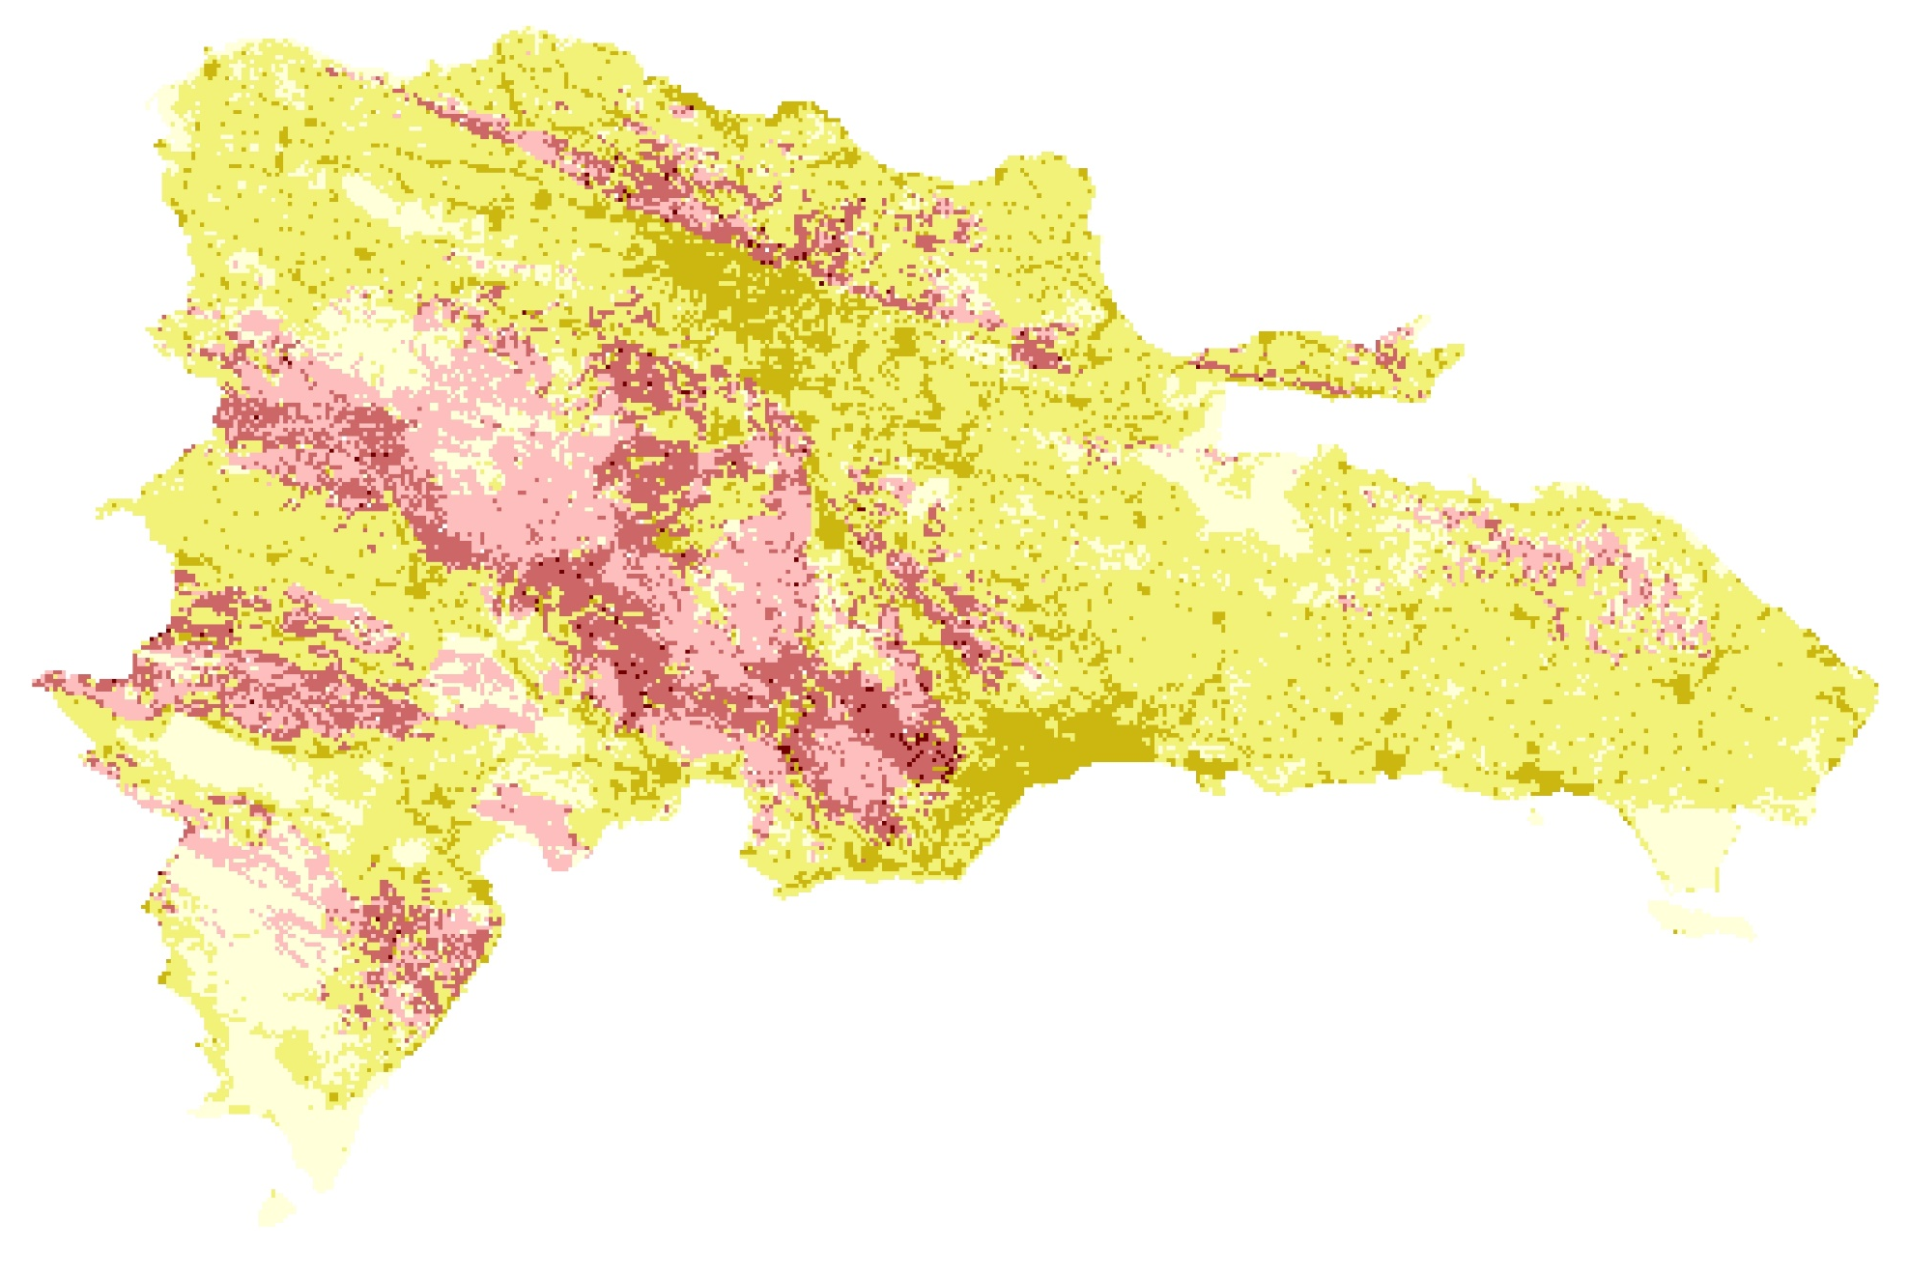
Results: Exposure Map
Susceptibility
High
Low
Low
Med
High
Population
0
50
100
km
N
Notes:
Another product we created was a bivariate map, which helps depict the cross-section of population and susceptibility. In this map, the dark red color represents areas with high population and high landslide susceptibility. Regions like Santio Damingo, Santigo, and Barahona have high population, but low susceptibility which is depicted in the dark gold color. Finally, the central mountain range, the Cordillera Central, high landslide susceptibility, but low population density so it is depicted in the red colors. We also mapped exposure to consider landslide susceptibility in regions with vital infrastructure, such as hospital, roads, schools, etc.

Slide 16
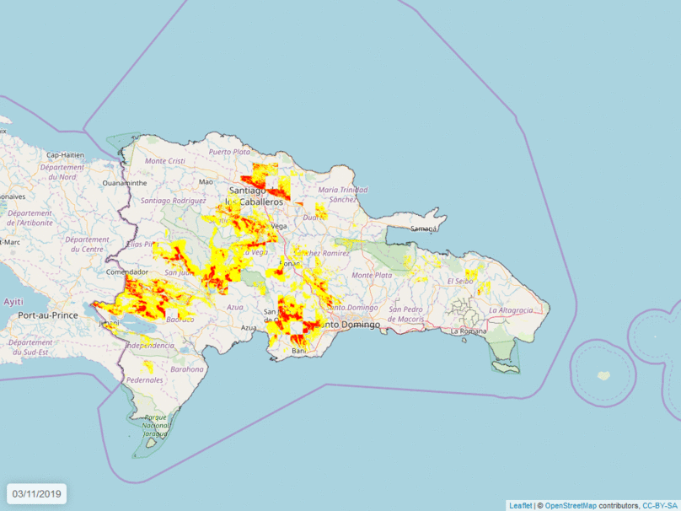
Results: LHASA Nowcasts
Rainfall event from March 20 - March 31, 2019
Landslide potential
High
Moderate
Notes:
The team also implemented a landslide monitoring tool created by landslide experts at Goddard Space Flight Center. It’s called the Landslide Hazard Assessment for Situational Awareness model, or LHASA. LHASA uses near real-time precipitation estimates from GPM IMERG and a landslide susceptibility map as inputs to create landsllide “nowcasts.”
The Nowcasts, shown here in red and yellow, depict areas of high and moderate landslide potential.
Here, we incorporated GPM IMERG data from March of this year and catered the global LHASA model specifically for the Dominican Republic.

Slide 17
Conclusions
Slope was the most influential factor in determining landslide susceptibility in the Dominican Republic
Global LHASA model can be catered to a specific country or region through integration of local data
Bivariate mapping helps depict the intersection of population and susceptibility for heuristic identification of exposed to landslide risk
Notes:
From our project, we concluded that based on a frequency ratio analysis of landslide susceptibility variables, slope was the most influential factor in determining landslide potential.
Additionally, the global LHASA model can be catered to a specific country or region and improved through the integration of local in-situ data. It is also a viable tool for rainfall-triggered landslides in our study region.
Also, bivariate mapping helps to depict the intersection of high population and high susceptibility for heuristic identification of areas of high concern regarding populations living within landslide-prone regions.

Slide 18
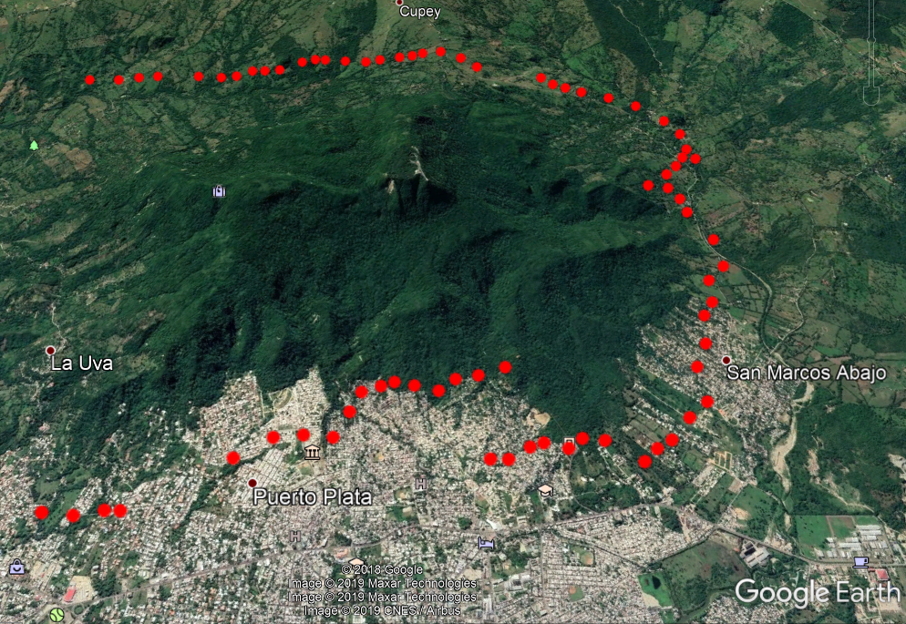
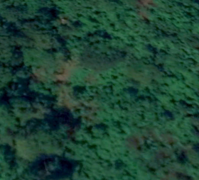
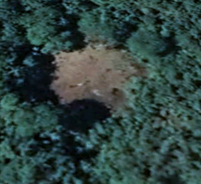
Errors and Limitations
Uncertainty in landslide detection – “Is this a landslide?”
Missing locations and dates of landslide events
Collection methods of local data
Landslide locations
11/2018
12/2018
Image: Google Earth Pro
Notes:
Errors and uncertainties for our project include the following:
One of the challenges with creating a landslide inventory using Google Earth Pro was inherent uncertainty that events were truly landslides as opposed to topographical scarring from deforestation, wildfires, or tornados- all of which could look very similar to landslides through satellite imagery. Because of this, we recorded high, medium, and low confidence level ratings for each landslide detected when creating our inventory.
Next, the team lacked historical dates and locations of landslide events. While satellite imagery could help narrow the timeframe to the year or even month of occurrence, it wasn’t possible to identify the exact day or time of each landslide occurrence. This limited our ability to validate our susceptibility map and the LHASA model.
Finally, susceptibility maps could have been improved with local and high resolution datasets, but this data was not easily available within the time frame of our project.

Slide 19
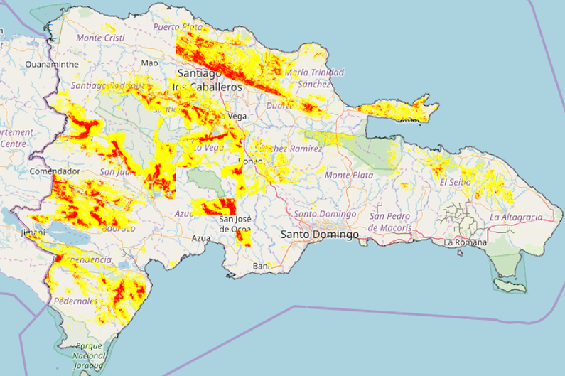
END-USER BENEFIT
High-Resolution Landslide Risk
LHASA Tutorial
Replicable to other countries
Image: NASA Goddard Space Flight Center
Notes:
How can this work benefit our end-users?
By providing our partners with a high resolution susceptibility map, they can have an increased situational awareness of landslide potential in their country.
They will also have access to a LHASA tutorial that we created.
It provides a step-by-step process for how to produce their susceptibility map, run the LHASA model in R, and allows them to independently monitor landslide potential in their country in near real-time.
Lastly, this tutorial has the potential to be implemented across other SICA member countries who face similar challenges.
After all, disasters have no boundaries, and neither does the application of NASA Earth observations.
____________________
Video: NASA Goddard Space Flight Center. Visualization by Helen-Nicole Kostis. http://svs.gsfc.nasa.gov/12897

Slide 20
Future Work
Enhance calibration and validation of the susceptibility model
Incorporate more landslide events
Validate GPM IMERG data with in situ rainfall data
Implement LHASA in other Central American countries
Share information and skills via on-site training
Standardize global landslide data collection
Image: Flaticon
Notes:
Future studies would involve performing enhanced calibration and validation of the susceptibility map by incorporating more landslide events and consistent rain gauge data. Also, the LHASA model can be implemented in other Central American countries which, similar to the Dominican Republic, are at great risk for disasters. Additionally, on-site training can be provided to local agencies to ensure successful capacity building with the partner agencies. Finally, there are current research efforts at Goddard to automate the detection of landslides at a global scale, which could be applied to specific countries.
__________________________________
Image Source (earth): srip on flaticon.com
(Flaticon Basic License) “Location free icon” Image Flaticon. Designed by srip from www.flaticon.com.
https://www.flaticon.com/free-icon/location_1243420#term=globe&page=1&position=43

Slide 21
END-USERS
SCIENCE ADVISORS
Dr. Santiago Muñoz – Director, SGN
Dr. Andrés Campusano – Sub-Director, ONAMET
Dr. Dalia Kirschbaum– Research Physical Scientist, NASA GSFC, Hydrological Sciences Lab
Dr. Kent Ross – National Science Advisor, NASA DEVELOP Virginia – Langley Node
COLLABORATORS
Thomas Stanley – Scientist, NASA GSFC, Hydrological Sciences Lab
Dr. Robert Emberson – Postdoctoral Fellow, NASA GSFC, Hydrological Sciences Lab
Dr. Pakur Amatya – Scientist, NASA GSFC, Hydrological Sciences Lab
Garrett Benz – Intern, NASA GSFC, Hydrological Sciences Lab
Bill Burton – BGC Engineering, Inc. Michael Porter– BGC Engineering, Inc.
Greg Hunchuck– BGC Engineering, Inc. Corey Froese – BGC Engineering, Inc.
SPECIAL THANK YOU
Ricardo Quiroga – NASA Applied Sciences Program
Sydney Neugebauer – Center Lead, NASA DEVELOP Virginia – Langley Node
Notes:
Thank you to our partners, science advisors, and other contributors who made this project possible.

