Slide 1
Southeast Idaho Disasters II
Using Earth Observations to Characterize Juniper Invasion and Assess Changes in Soil Moisture within Cheatgrass Dominated Sites Relative to Wildfire Susceptibility in East Idaho
Jenna Williams (Project Lead)
Cody O’Dale
Kshitiz Shrestha
Ryan Howerton

Slide 2
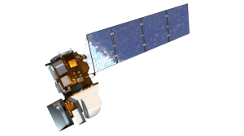
Datasets Used
NASA Earth Observations
SMAP - Radiometer
Landsat 5 Thematic Mapper
Landsat 8 Operational Land Imager
Ancillary Datasets
2009, 2011, 2013, 2015 NAIP imagery
USGS National Land Cover Dataset (NLCD)
Caribou-Targhee NF Existing vegetation map – RSAC
LANDFIRE
Surface Management Agency (SMA)
NASA RECOVER Historic Fire Dataset
AgriMet Weather Data
Images Credit: JPL.NASA
Notes:
Landsat 5 is being used to create a comprehensive history with Landsat 8’s imagery. SMAP data is currently being reviewed.

Slide 3
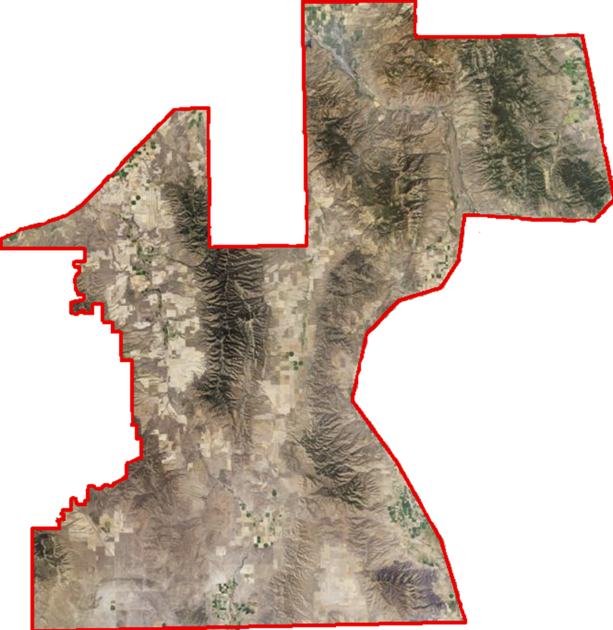
Study Area
Southeast Idaho
Landsat WRS-2 Path 39 Row 30
Landsat WRS-2 Path 39 Row 31
Focused Study Area
A focused study area was provided by the Bureau of Land Management (BLM).
Pocatello
Study Period
Juniper Encroachment
1985 to 2015 in five year increments.
Soil Moisture Analysis
April 1st, 2015 to September 31st, 2015
Holbrook
Notes:
The study area is located south of Pocatello and encompasses agriculture and rangeland.

Slide 4
Courtesy of BLM
Community Concerns
Juniper encroachment
The 2012 Charlotte Fire cost Idaho $211 million dollars in fire suppression expenditures.
In Idaho, juniper species have extended beyond their native habitats and are increasing wildfire severity and duration.
Expanded wildfire regimes significantly alter semi-arid savanna ecosystems.

Slide 5
Community
Concerns Cont.
Invasive species are changing soil moisture availability for native species
The root structure of cheatgrass primarily grows in the winter and can exhaust available soil water at shallow depths when the soil warms up. As a result cheatgrass can limit or stop the germination process of native species by using up available resource.
Cheatgrass has increased the frequency of wildland fires with intervals now less than 5 years on average in certain southern Idaho rangelands.
Courtesy of Idaho Fish and Game

Slide 6
Objectives
Source:abook.org
Characterize juniper encroachment by analyzing 30 meter Landsat imagery from 1985 to 2015.
Assess temporal changes in soil moisture in cheat grass dominated sites and compare that to sagebrush dominated sites over the 2015 growing season; April 1st through September 30th.

Slide 7
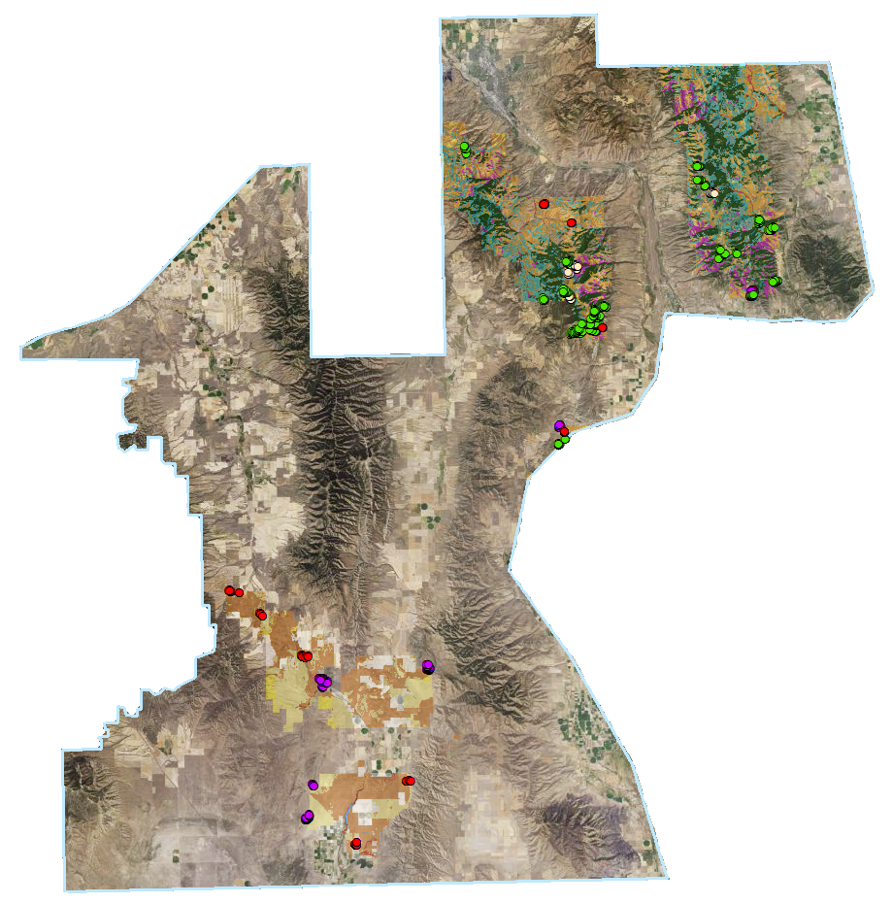
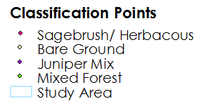
Methods
Classification site creation
Classification points were created in using;
2009, 2011, 2013, 2015 NAIP imagery with a 0.5 meter resolution
Remote Sensing Applications Center (RSAC) data was used to identify different vegetation types
2013 NAIP imagery with classification points
Vegetation Type | 2009 | 2011 | 2013 | 2015 | Total
Sagebrush/ Herbaceous
Bare ground
Juniper Mix
Mixed Forest

Slide 8
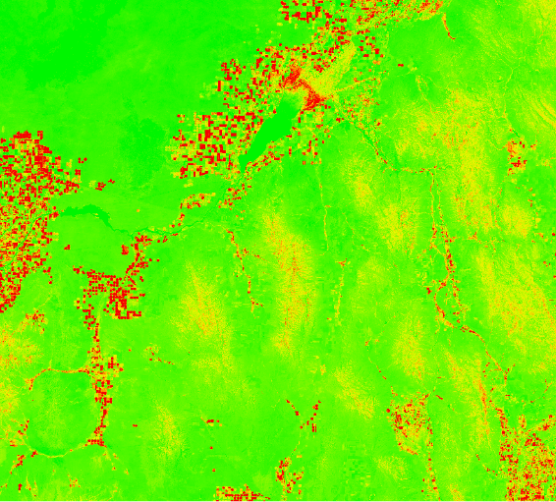
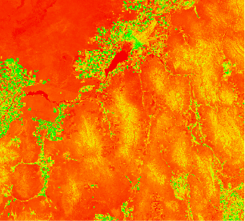
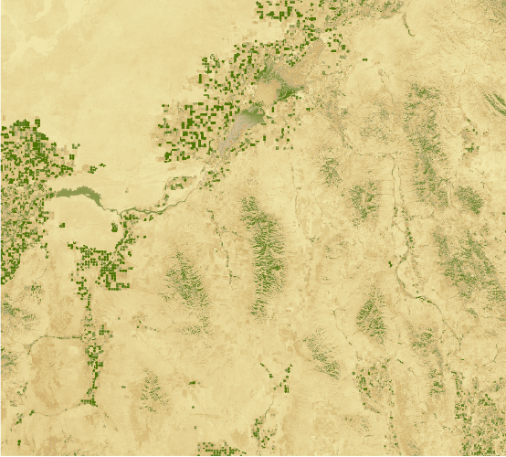
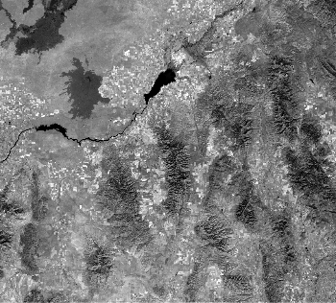
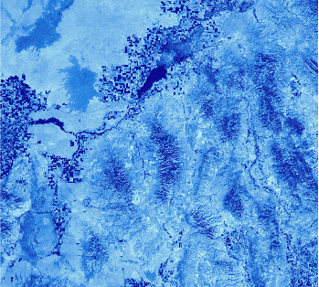
Methods
Image Processing
mSAVI2 and TCT were derived using IDRISI TerrSet VegIndex Modules
NDBSI = (TM6 – TM5) / (TM6 + TM5 + 0.001) * Baraldi et al., 2006
Modified Soil-Adjusted Vegetation Index | Tasseled Cap Transformation | Normalized Differenced Bare Soil Index

Slide 9
Methods
Juniper Encroachment
Classification Tree Analysis was used to differentiate vegetation types for each year in the study period.
CTA Inputs
mSAVI2
Normalized Difference Bare Soil Index
Normalized Difference Vegetation Index
Tassel Cap Transformation
Principle Component Analysis
Training sites

Slide 10
Classification Results
Accuracy Assessment Juniper
Error Matrix Analysis – CTA Results
 | Sagebrush/ Herbaceous | Bare Ground | Juniper Mix | Mixed Forest | Total | ErrorC
Sagebrush/ Herbaceous
Bare Ground
Juniper Mix
Mixed Forest
Total
ErrorO
Kappa coefficient:

Slide 11
Methods
Soil Moisture between sage-brush sites and cheatgrass sites
Compares cheatgrass dominated sites with sagebrush dominated sites.
Sage brush sites provided by the BLM and compared with RSAC
Cheatgrass sites determined using Idaho Disasters III results

Slide 12
Classification Results
Soil Moisture between sage-brush sites and cheatgrass sites

Slide 13
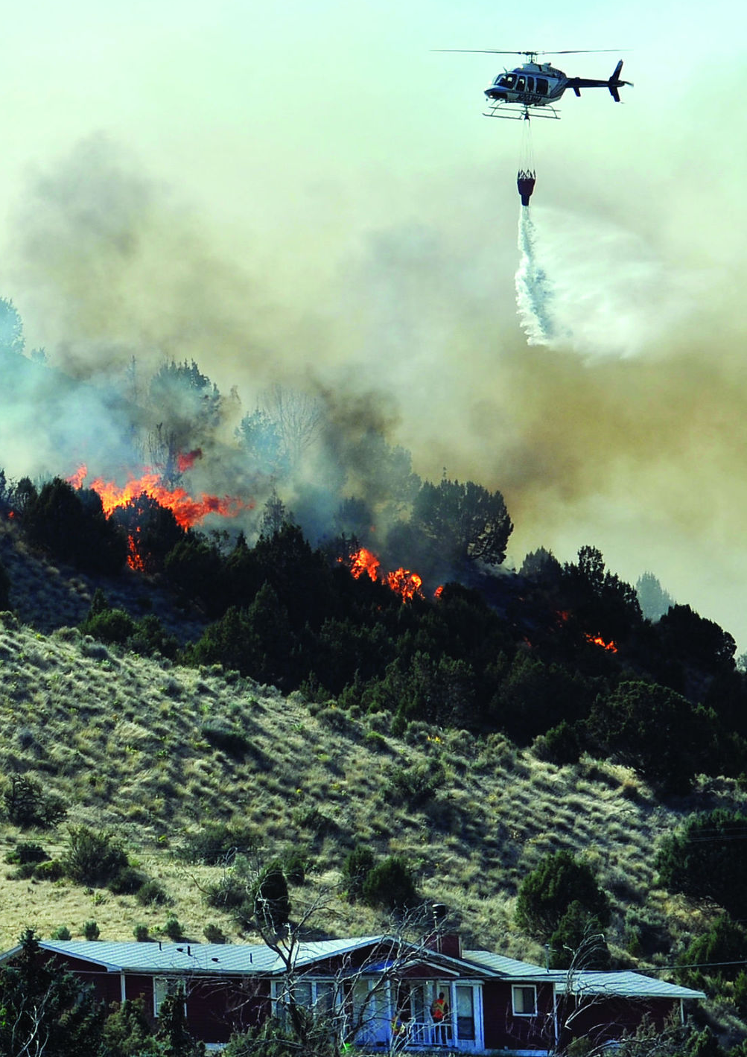
Conclusions
Classification
TBD
Source:abook.org

Slide 14
Results
In Progress

Slide 15
Courtesy of BLM
Errors & uncertainties
In Progress

Slide 16
Future work
In Progress
Courtesy of U.S. Fish and Wildlife (flickr.com)
Notes:
https://www.flickr.com/photos/usfwshq/8598789914/in/photolist-e6R3Ew-B4huWN-4JgL5T-dQtwkr-8jVvsK-6PoQ7x-9thZ1t-dQz6Km-9tkWR3-dQz79E-6PsYC3-9KjVh2-6Ps6Fu-9tkWFE-e2eC1d-8DGsvo-5YD4Wq-8MdrMP-6Ps8mb-6PsYBw-6PoQ8M-5YyPyp-CzoATy-e6Kp8a-awTDM6-awTDr6-awTCk6-awTDDX-6U3qex-AxU6z9-awWmMW-8Nuzse-6whRVM-dQyk2U-8zkWdq-9thYRn-2GFY3R-o6ZyH5-d43Nyf-9Romes-ejxQdg-3N75tc-cmuBb3-3NbnNm-9GTcEy-3N7aEg-8GXEn1-d3QJ8q-cmuB3b-3Nbjff/

Slide 17
Advisors
Keith Weber (GIS Training and Research Center at Idaho State University)
John Schnase (NASA Goddard Space Flight Center)
Mark Carroll (NASA Goddard Space Flight Center)
Partners
Bureau of Land Management, Idaho State Office and Cooperating District Offices (End-User), Mike Kuyper
USDA Forest Service, Caribou-Targhee National Forest (Collaborator), Arik Jorgensen, and Chris Colt
Idaho Department of Fish and Game (Collaborator), Scott Bergen
RECOVER Project at NASA Goddard, (Boundary Organization), John Schnaseand Mark Carroll RECOVER Project at ISU (Boundary Organization), Keith Weber
Others
Zachary Simpson (Past Contributor)
Sara Ramos (Past Contributor)
Kindera Seer, GIS Training and Research Center, Idaho State University
Jeff May, GIS Training and Research Center, Idaho State University
Notes:
Currently, these are the Partners for the Pocatello node.

