Slide 1
Texas Disasters
Utilizing NASA Earth Observations to Assist the Texas Forest Service in Mapping and Analyzing Fuel Loads and Phenology in the Texas Grasslands
Ben Beasley
Alex Holland
Kristen Kelehan

Slide 2
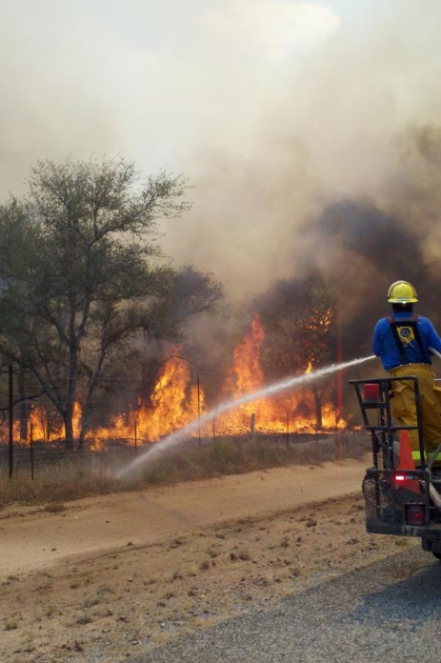
Community Concerns
In 2011 wildfires in Texas scorched 4,000,000 acres and destroyed nearly 3,000 homes
Texas grasslands are highly susceptible to wildfire
Wildfires risk has increased due to climate change and recent urbanization
Source:”

Slide 3
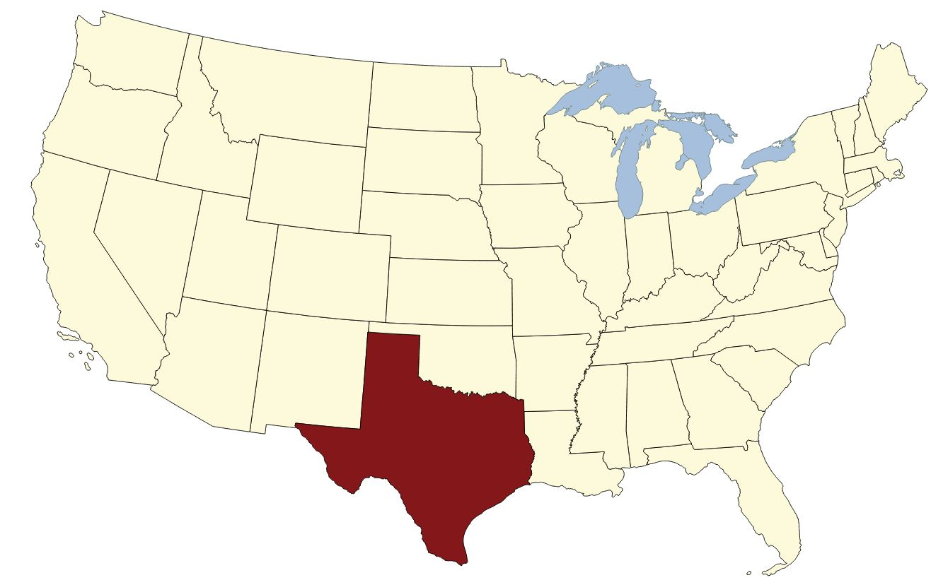
Study Area
The study area covers all of Texas, which consists of 254 counties and 696,200 sq km.

Slide 4
Study Period
2010-2011 fire season (November – April)– Texas experienced some of the worst wildfires in recent history
2014-2015 fire season (November – April)– Current assessment of wildfire fuels.
Source: USGS

Slide 5
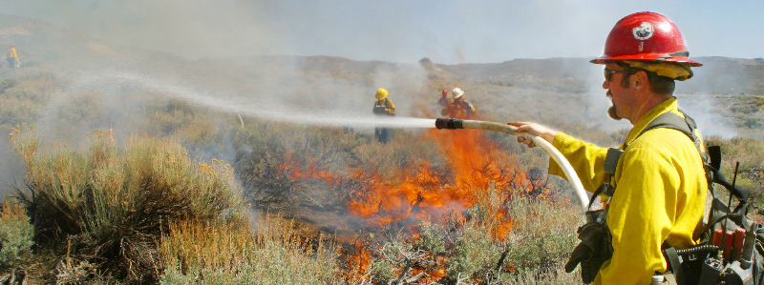
Source: USGS
Objectives
Create up-to-date fuel type maps using Landsat 8 and MODIS data
Create up-to-date fuel load data based upon the fuel type map and MODIS data
Provide the ability to update the fuel load maps based upon MODIS inputs

Slide 6
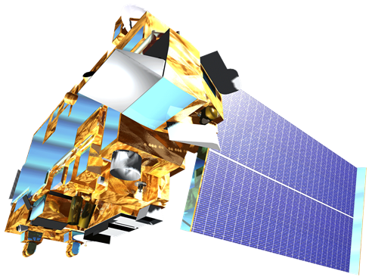
NASA Satellites/Sensors
Sensor | Spatial Resolution | Temporal Resolution
MODIS (Terra) Moderate Resolution Imaging Spectroradiometer | 250 m (bands 1-2) 500 m (bands 3-7) 1000 m (bands 8-36) | 1 Day
Landsat 8 OLI Operational Land Imager | 30 meter | 16 Days
Notes:
Each sensor has an advantage
MODIS – daily repeat rate
Landsat – higher spatial resolution - 30m

Slide 7
DATA
MODIS
2010-2015 Surface reflectance
2010-2015 NDVI
Landsat
Scenes covering high risk wildfire areas
Forwarn
Vegetation Index products
MODIS based cumulative NDVI

Slide 8
Methodology
Methodology
Vegetation
NDVI (Normalized Difference Vegetated Index)
Time Series
Compile and calculate average NDVI values for each fuel type
Fuel Loads
Calculate fuel load maps based on relative NDVI

Slide 9
Methodology
Landsat
Classification of vegetation fuel types at 30 meters
MODIS
Map current fuel types based on Landsat classification
Data Fusion
StarFM tool was used to combine Landsat and MODIS products

Slide 10
Results

Slide 11
Conclusions

Slide 12
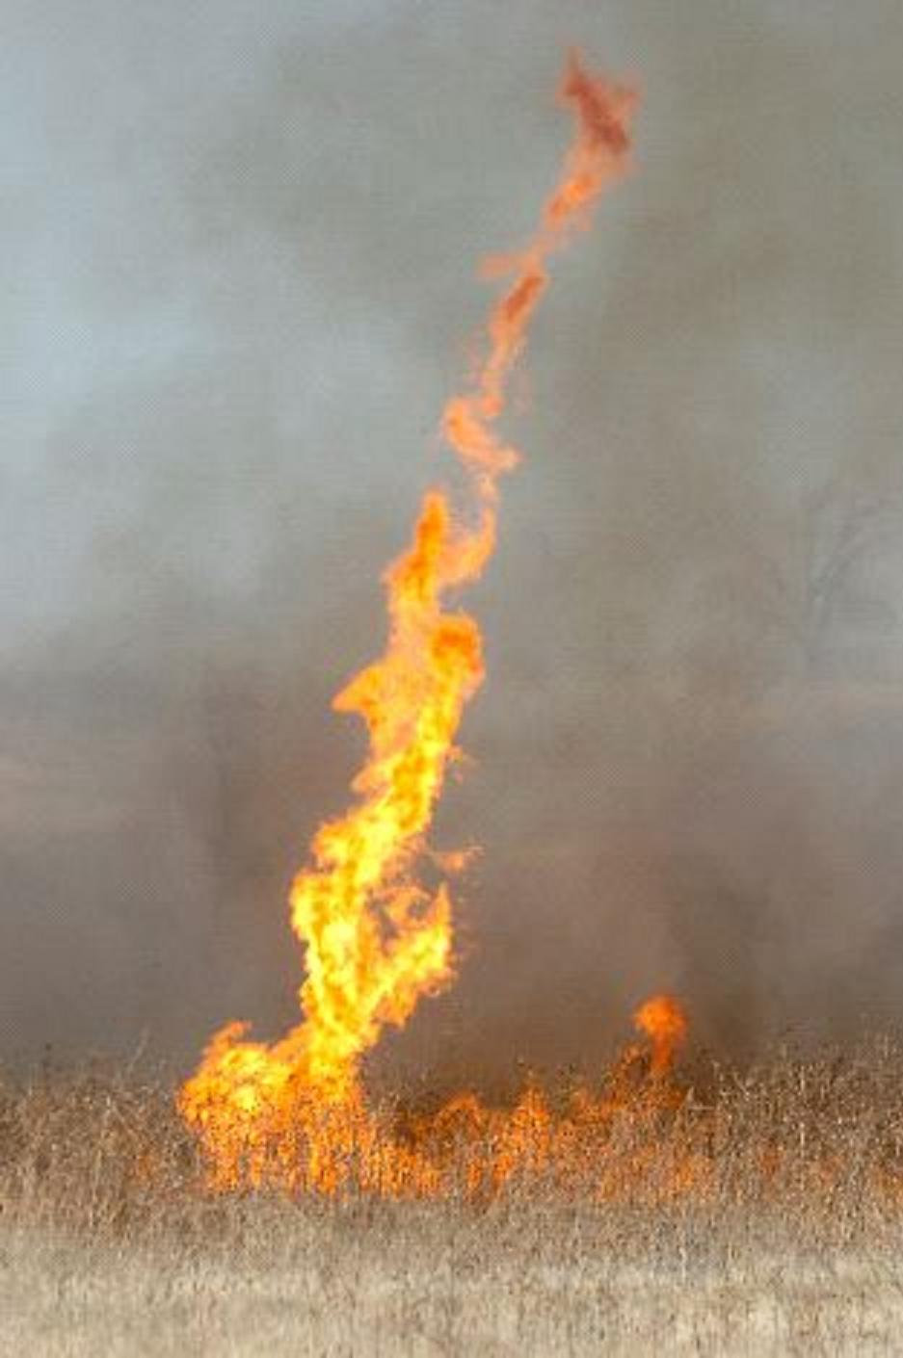
Errors & Uncertainties
Source: NOAA

Slide 13
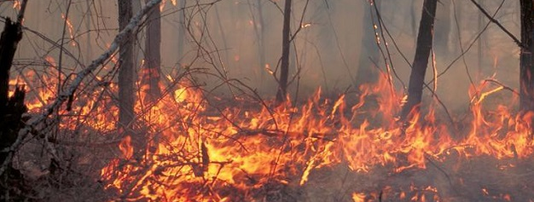
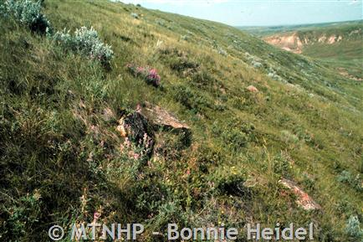
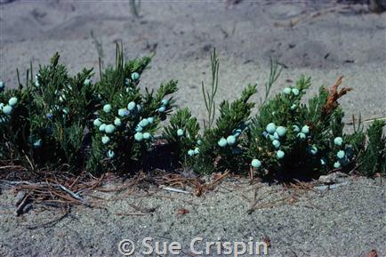
Source: USFS
Future Work

Slide 14
Advisors
Dr. Kenton Ross [NASA DEVELOP National Science Advisor, LaRC]
Joseph Spruce [Senior Scientist and Lead Science Advisor at NASA SSC]
James “Doc” Smoot [Senior Scientist and Assistant Science Advisor at NASA SSC]
Partners
Texas Forest Service; Tom Spencer and Curt Stripling- Predictive Services
USDA Forest Service; William “Bill” Hargrove- ForWarn

