Slide 1
Guatemala & Panama
Urban Development
Evaluating the Effects of Urban Expansion on Social and Environmental Vulnerability in Guatemala and Panama
Aaron Whittemore
Coral del Mar Valle Rodriguez
Jennifer Ruiz
Viviana Lademan
Alabama – Marshall | Fall 2022
Notes:
We are the Fall 2022 Alabama – Marshall MSFC Urban Development team. The team members are Aaron Whittemore, Coral del Mar Valle Rodriguez, Jennifer Ruiz, and Viviana Lademan. Our project is titled Evaluating the Effects of Urban Expansion on Social and Environmental Vulnerability in Mesoamerica.

Slide 2
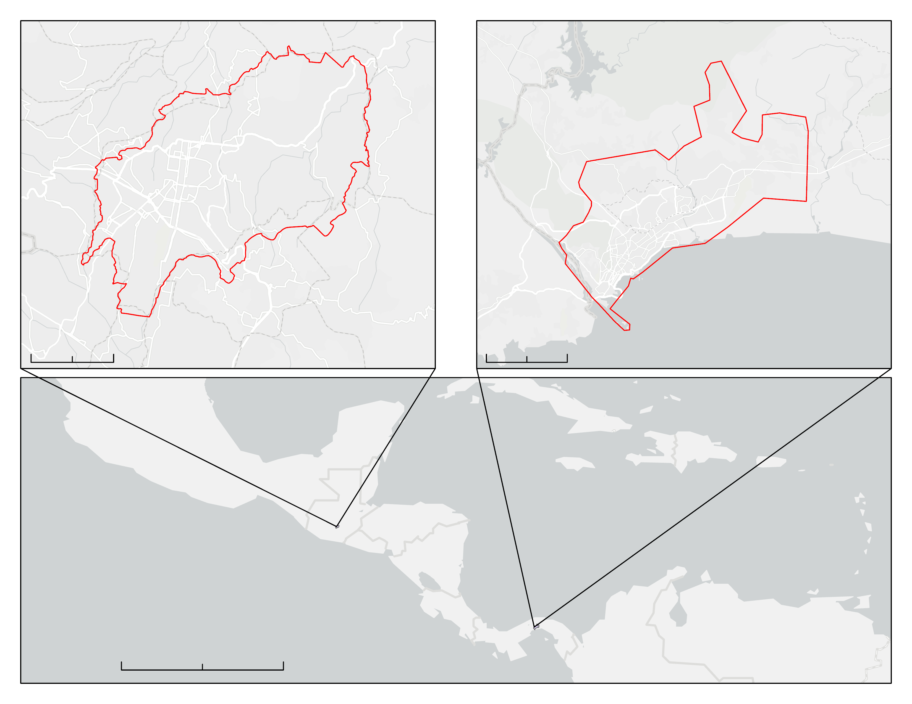
Study Area and Period
The region of Mesoamerica is experiencing rapid urbanization
Guatemala City, Guatemala and Panama City, Panama
January 2002 – October 2022
N
N
Guatemala City
Panama City
Study Area
Study Area
0
3
6 km
0
5.5
11km
Guatemala
N
0
500
1,000 km
Panama
CONANP, Esri, HERE, Garmin, Foursquare, METI/NASA, USGS, IGNTG-ANATI
Notes:
Our study area was broadly centered on Mesoamerica, which is a historical region extending from southern North America across Central America and is known for its highly rich pre-colonial cultural societies. We examined urban expansion and its relation to social and environmental vulnerability for two cities within the region, Guatemala City, Guatemala and Panama City, Panama from January 2002 – October 2022. The analysis we performed for these two cities can be applied to other locales within the region in the future to expand understanding of urbanization trends and associated vulnerabilities in Mesoamerica.
Bottom map base layer: Esri, Garmin, FAO, NOAA, USGS
Top left base layer: CONANP, Esri, HERE, Garmin, Foursquare, METI/NASA, USGS
Top right base layer: IGNTG-ANATI, Esri, HERE, Garmin, Foursquare, FAO, MET/NASA, USGS
Map created by the DEVELOP Team

Slide 3
Project Partners
NASA SERVIR
Addresses resilience and sustainability challenges in developing countries
Centro de Coordinación para la Prevención de los Desastres en América Central y Republica Dominicana (CEPREDENAC)
Prevents, mitigates, and responds to disasters​
Image Credit: Miguel Bruna
Notes:
We had five partners for this project. The first two partners were NASA SERVIR and the Centro de Coordinación para la Prevención de los Desastres en América Central y Republica Dominicana (CEPREDENAC). NASA SERVIR addresses resilience and sustainability challenges while CEPREDENAC prevents, mitigates, and responds to disasters.
------------------------------Image Information Below ------------------------------
•Image Credit: Miguel Bruna
•Image Source: https://unsplash.com/photos/AgkMjv3F-H0
Free to use under the Unsplash License

Slide 4
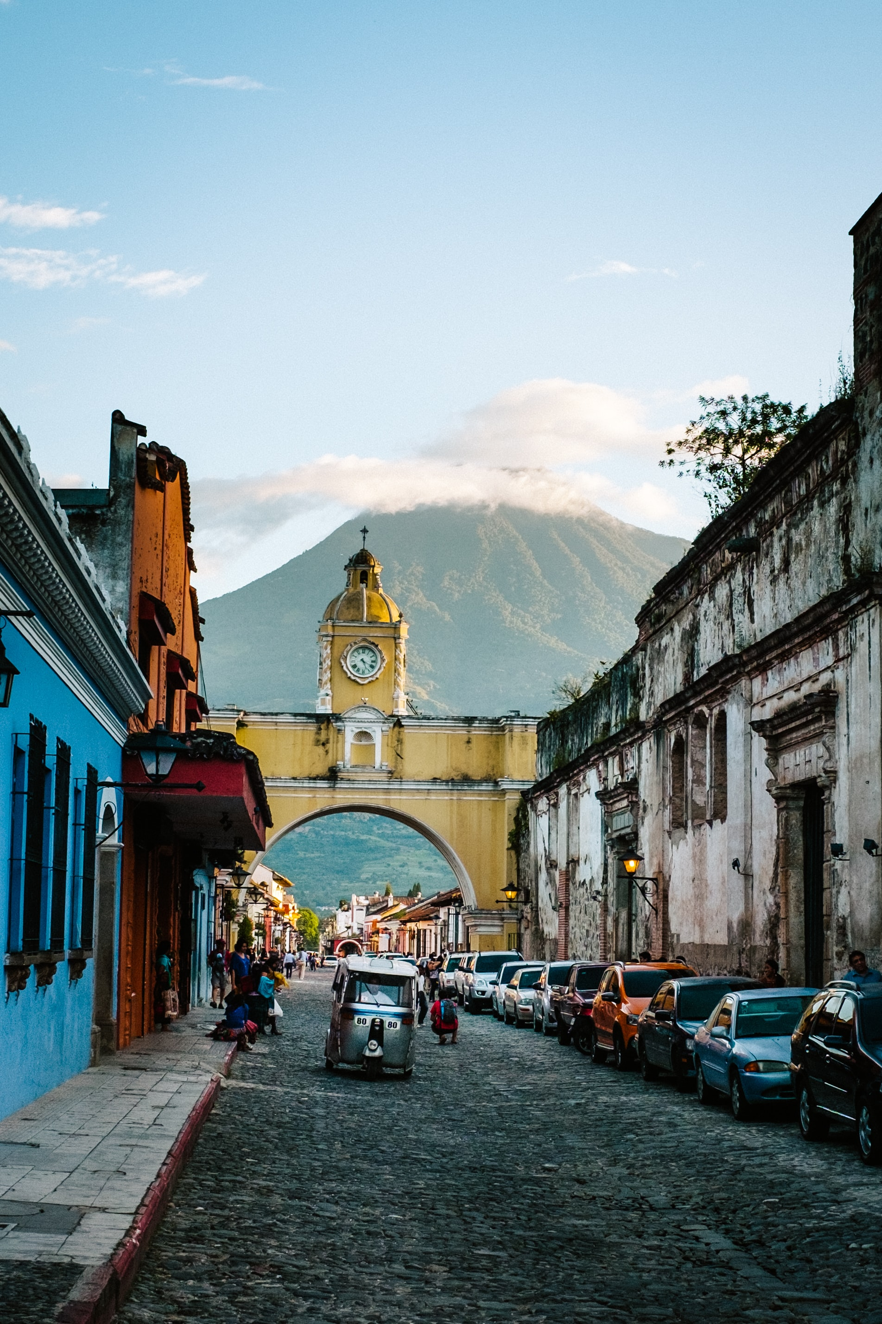
Sistema de la Integración Centroamericana (SICA)
Promotes integration in Central America
Secretariat of Central American Social Integration (SISCA)​​
Coordinates social policies between SICA Member States and integration projects​​
Deutsche Gesellschaft für Internationale Zusammenarbeit (GIZ)
Aids in international sustainable development and education work
Image Credit: Parker Hilton
Notes:
The last three were the Sistema de la Integracion Centroamericana (SICA), the Secretariat of Central American Social Integration (SISCA) and the Deutsche Gesellschaft fur Internationale Zusammenarbeit (GIZ). SICA promotes integration in Central America. SISCA coordinates social policies between SICA member states and integration projects. Finally, GIZ aids in international sustainable development and education work.
------------------------------Image Information Below ------------------------------
•Image Credit: Photo by Parker Hilton on Unsplash
•Image Source: https://unsplash.com/photos/vgBxk5QJZPo
Free to use under the Unsplash License

Slide 5
Objectives
1
Analyze, map, and assess urban expansion trends in the study area
2
Identify infrastructure vulnerability to natural disasters
3
Evaluate the connection between urbanization and community vulnerabilities
Notes:
For this project, we had three primary objectives. The first was to analyze, map, and assess urban expansion trends in Guatemala and Panama City. This was done using a supervised classification on Google Earth Engine (GEE). The second was to identify infrastructure vulnerability to natural disasters by analyzing building materials, disaster occurrence data, and geomorphological data. And finally, the last objective was to evaluate the connection between urbanization and community vulnerabilities using Earth observations and remote sensing data sets.

Slide 6
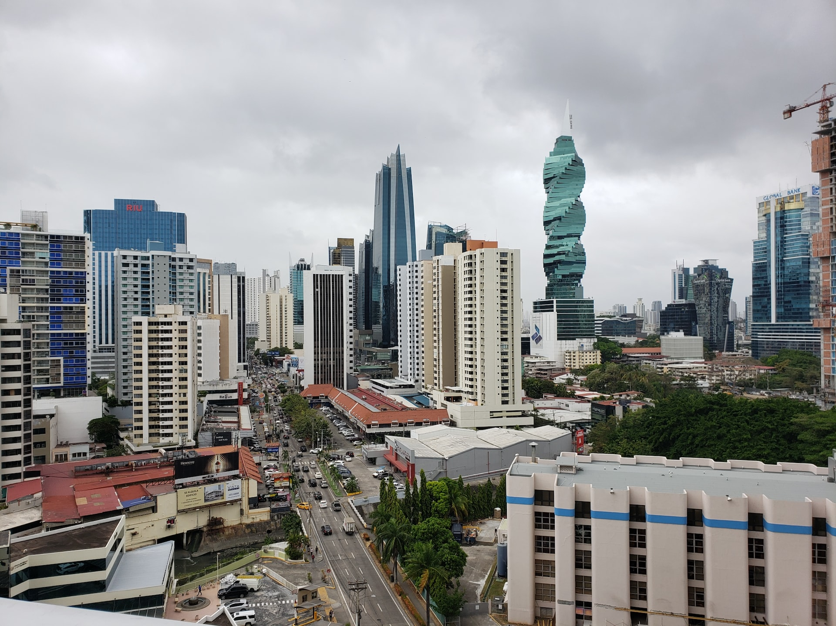
Community Concerns
Image Credit: Darren Miller
Notes:
Urbanization is increasing at unprecedented rates in Mesoamerica, and it is expected to continue increasing in the upcoming decades. This growth poses many concerns such as vulnerability to climate events, unregulated infrastructure, inefficient public services, financial crises, rapid deforestation, and insufficient urban planning compared to the demand. The creation of unregulated infrastructure in order to meet demand in urban areas leads to unsafe homes for lower income communities.
Image Credit: Photo by Darren Miller on Unsplash
Image Source: https://unsplash.com/photos/9_S_-ZWAoPI
Logos are from Microsoft Power Point

Slide 7
Earth Observations
Landsat 5 TM
1999 - 2013
Landsat 7 ETM+
1999 - 2022
Landsat 8 OLI
2013 - 2022
Landsat 9 OLI2
2021 - 2022
Maxar Worldview-2
2021
Maxar Worldview-3
2018 & 2021
Notes:
Our study consisted of two primary tasks that each required two major Earth observations. The first was for mapping urban expansion. We retrieved top of atmosphere reflectance data from Landsat 7 and 8 to create maps for 2002, 2012 and 2022. The second group of Earth observations was retrieved from Maxar Worldview-2 and Worldview-3 satellites. These multispectral images were used to identify infrastructure vulnerability, specifically by identifying the types of roofing materials used on formal and informal settlements.
Logos are from Microsoft Power Point

Slide 8
Ancillary Datasets
USGS SRTM
Elevation data
VIIRS Nighttime Light
Electricity presence
HDX Demographic Data
Population density
SICA Disaster Risk
Natural disaster risk
Notes:
To assess community vulnerability, we included elevation, electricity, population, and disaster risk data in our analyses. The elevation data was retrieved from the U.S. Geological Survey Shuttle Radar Topography Mission, or SRTM, and it was used to derive steepness of slope. The presence of electricity was determined using data from the Visible Infrared Imaging Radiometer Suite, also known as VIIRS, Nighttime Light product. Next, population data was derived from the Humanitarian Data Exchange demographic datasets. Lastly, our partners at SICA provided us with disaster risk data for Guatemala City for various natural disasters such as flooding, earthquakes, landslides, and volcanic disasters.
Logos are from Microsoft Power Point

Slide 9
Methodology
Notes:
After we acquired all of the necessary data and Earth observations, it was time to start our methodology.

Slide 10
Urban Extent – Greatest Disturbance
LandTrendr
Area of Extent
Parameterization
Use LandTrendr greatest disturbance mapping code as base
Upload area of extent shapefile as GEE asset
Alter code to reflect desired parameters
Notes:
To begin, the LandTrendr greatest disturbance mapping code from eMapR Lab was used as a base on Google Earth Engine. Next, the shapefile of the study area was uploaded to GEE as an asset. The asset was then imported into the code to use as a boundary for exportation extent. The code was then slightly altered to reflect the appropriate date range and integrate the area of interest asset. While one greatest disturbance map was exported with all layers in tact, a second was changed to only export the year of disturbance data. After exportation, the data was formatted to be displayed as a formal map using ArcGIS Pro.
Logos are from Microsoft PowerPoint

Slide 11
Urban Extent – GIF
EE-TS-GIF App
Snazzy-EE-TS-GIF App
Download
Create initial GIF using Landsat time series
Add inset map, scale, and year of each frame
Download resulting GIF
Notes:
A GIF was created on Google Earth Engine to display how the study area changed over time. First, the EE-TS-GIF app was used to create a GIF using images from a Landsat time series. After running the code, the app parameters were adjusted to only dates between January 1st 2000 and December 31st 2022. The RGB combo was set to SWIR1/NIR/RED. The frame rate was set to one per second. The animation was then downloaded. Next, the Snazzy-EE-TS-GIF app was used in order to add an inset map, scale, and display the corresponding year of each frame. In order to do this, the previously created GIF was uploaded into the Snazzy app. The parameters were then adjusted to match the parameters used previously. The finalized GIF was then ready for download and use.
Logos are from Microsoft PowerPoint

Slide 12
Urban Extent – RGB and Time Series
LandTrendr
Area of Extent
Parameterization
Use LandTrendr app code as base
Upload study area shapefile as GEE asset
Adjust app parameters to output desired imagery
Notes:
The basic LandTrendr app code was used from openmrv on Google Earth Engine (GEE). The only edit in the code set the default map center to the area of interest. After the code was run, the app was ready to be used to create both RGB and time series imagery. To begin, under the 'LandTrendr Options' tab, the year range was limited to process only from January 1st 1999 to December 31st 2020. All other options were left as default. Next, under the 'Asset Overlay Options' tab, the file path was connected to the area of extent shapefile within GEE assets. This shapefile was uploaded to GEE previously. The layer name was specified to reflect the name of the area of extent and the checkbox under the 'Use first file path as AOI' heading was selected to ensure it would be used as the processing extent. From there the 'RGB Change Options' tab was selected. The red year was set to 2000, the green year was set to 2010, and the blue year was set to 2020. All other options were left as default. To see the results on GEE, first the 'Add RGB Imagery' button was selected to see the RGB imagery. Then, the 'Add Full Time Series Imagery' button was selected to see the time series imagery. Finally, under the 'Download Options' tab, the projection code was left set to default. The file and folder name were both changed to 'RGB_Imagery'. The checkbox next to 'Download RGB Imagery' was also selected. Then the 'Download Data' button was pressed. After that, the parameters were slightly changed to download the timeseries data as well. The folder and file name were changed to read 'TimeSeries_Imagery'. Under the 'Download Selection' heading, the checkbox next to 'Download Full TimeSeries Imagery' was selected before the 'Download Data' button was pressed. After the desired data was downloaded, it was further formatted to be displayed as a formal map using ArcGIS Pro. The time series data was also clipped to the urban extent.
Logos are from Microsoft PowerPoint

Slide 13
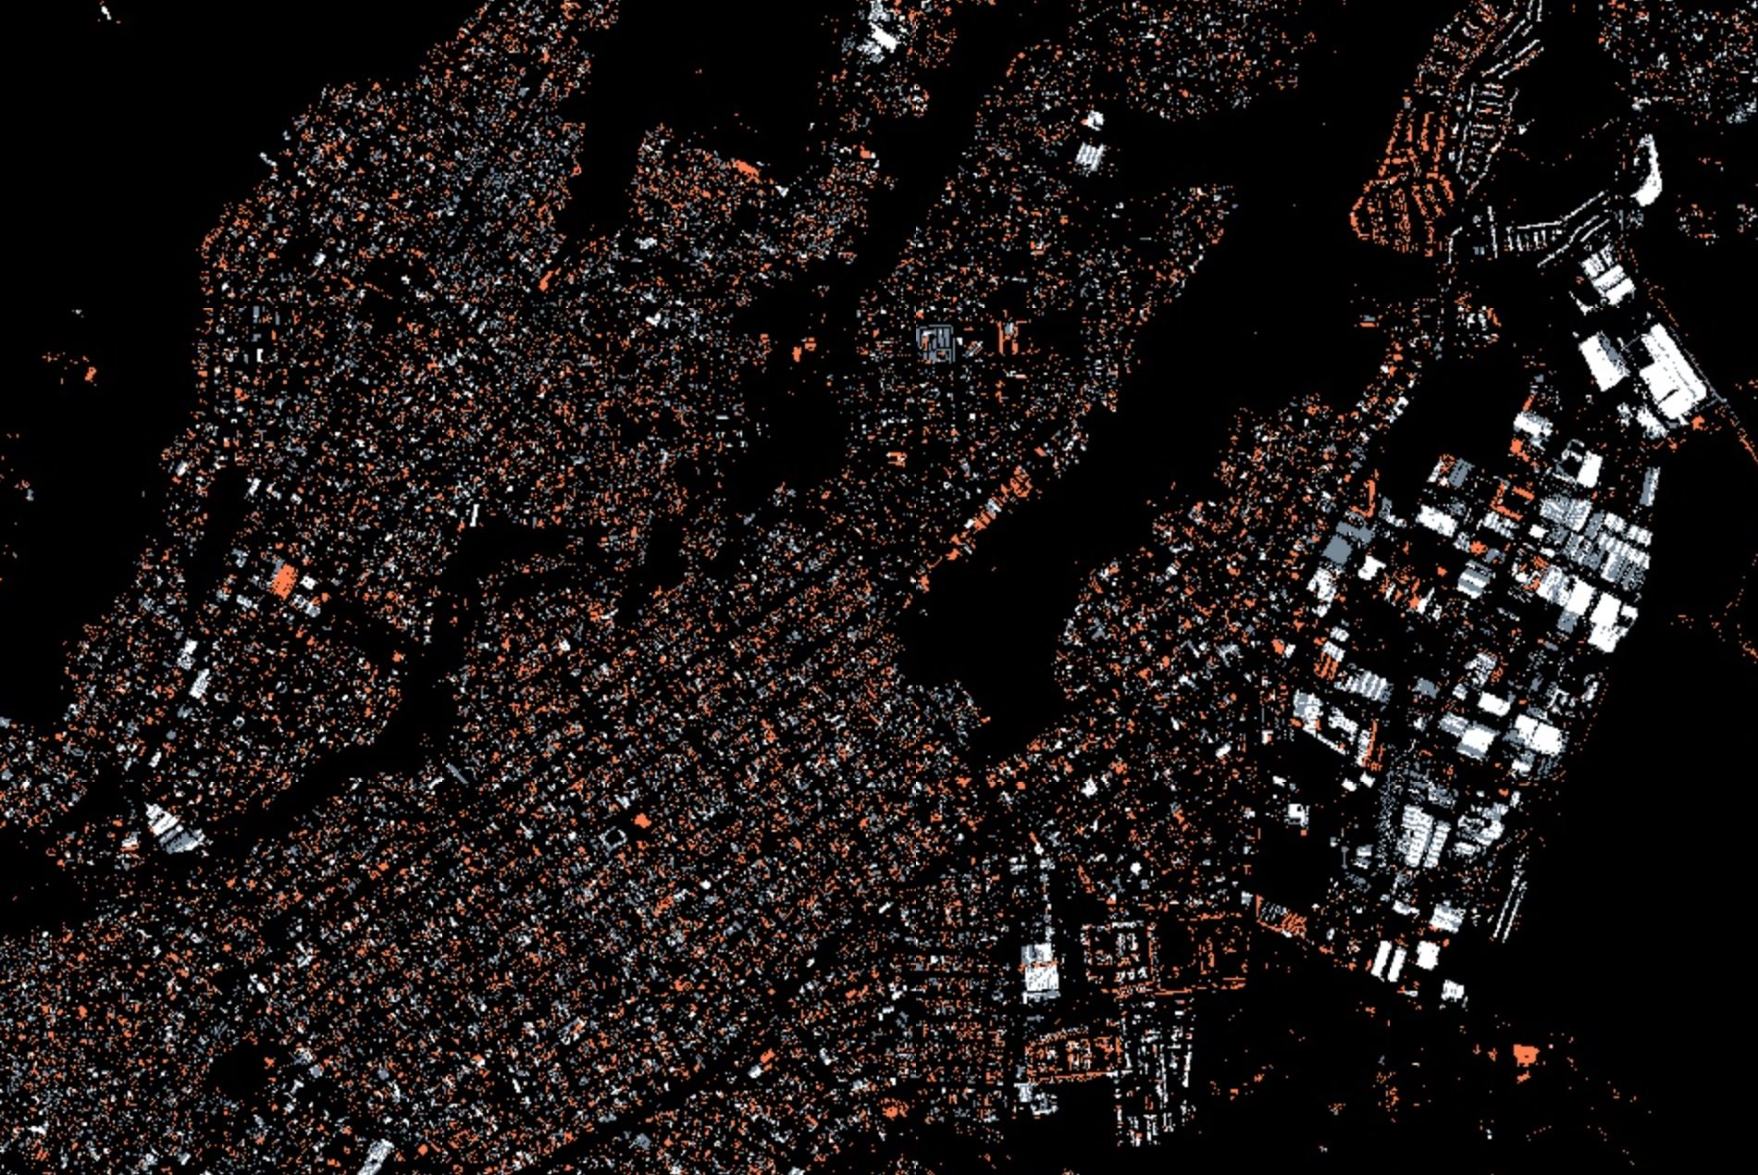
Roofing Materials
©2022 Maxar
1
Obtain Maxar Worldview imagery
2
Train Data
3
Classify roofing materials
Notes:
The team used Maxar Worldview-2 and Worldview-3 to assess roofing material types in each city. For each city, there were four images used to cover the entire study area. The team chose these images based on their low cloud cover values (<9%), low nadir values (<15°), and for being as close to present day (Oct 2022) as possible. Unfortunately, due to a delay in receiving the images, it was not possible to perform roofing material classification for the entire study area. Instead, a single image from Guatemala City was used as an example for future analysis. The single image, which was obtained from the Worldview 03 sensor on January 21, 2022, was chosen because it contained all of the eight available bands within Worldview 03's multispectral imagery and it contained areas of formal and informal settlements. To classify roofing materials, a random forest classifier with 200 decision nodes was used. 100 training points were used for each classification category (tile roofs, metal roofs, slate roofs, vegetation, barren land, dirt roads, and roads). A confusion matrix accuracy test was used to assess model performance. Again, 100 points were chosen for each classification category to test accuracy. Overall accuracy was 94%.
Image Credit: Created by the DEVELOP Team, ©2022 Maxar

Slide 14
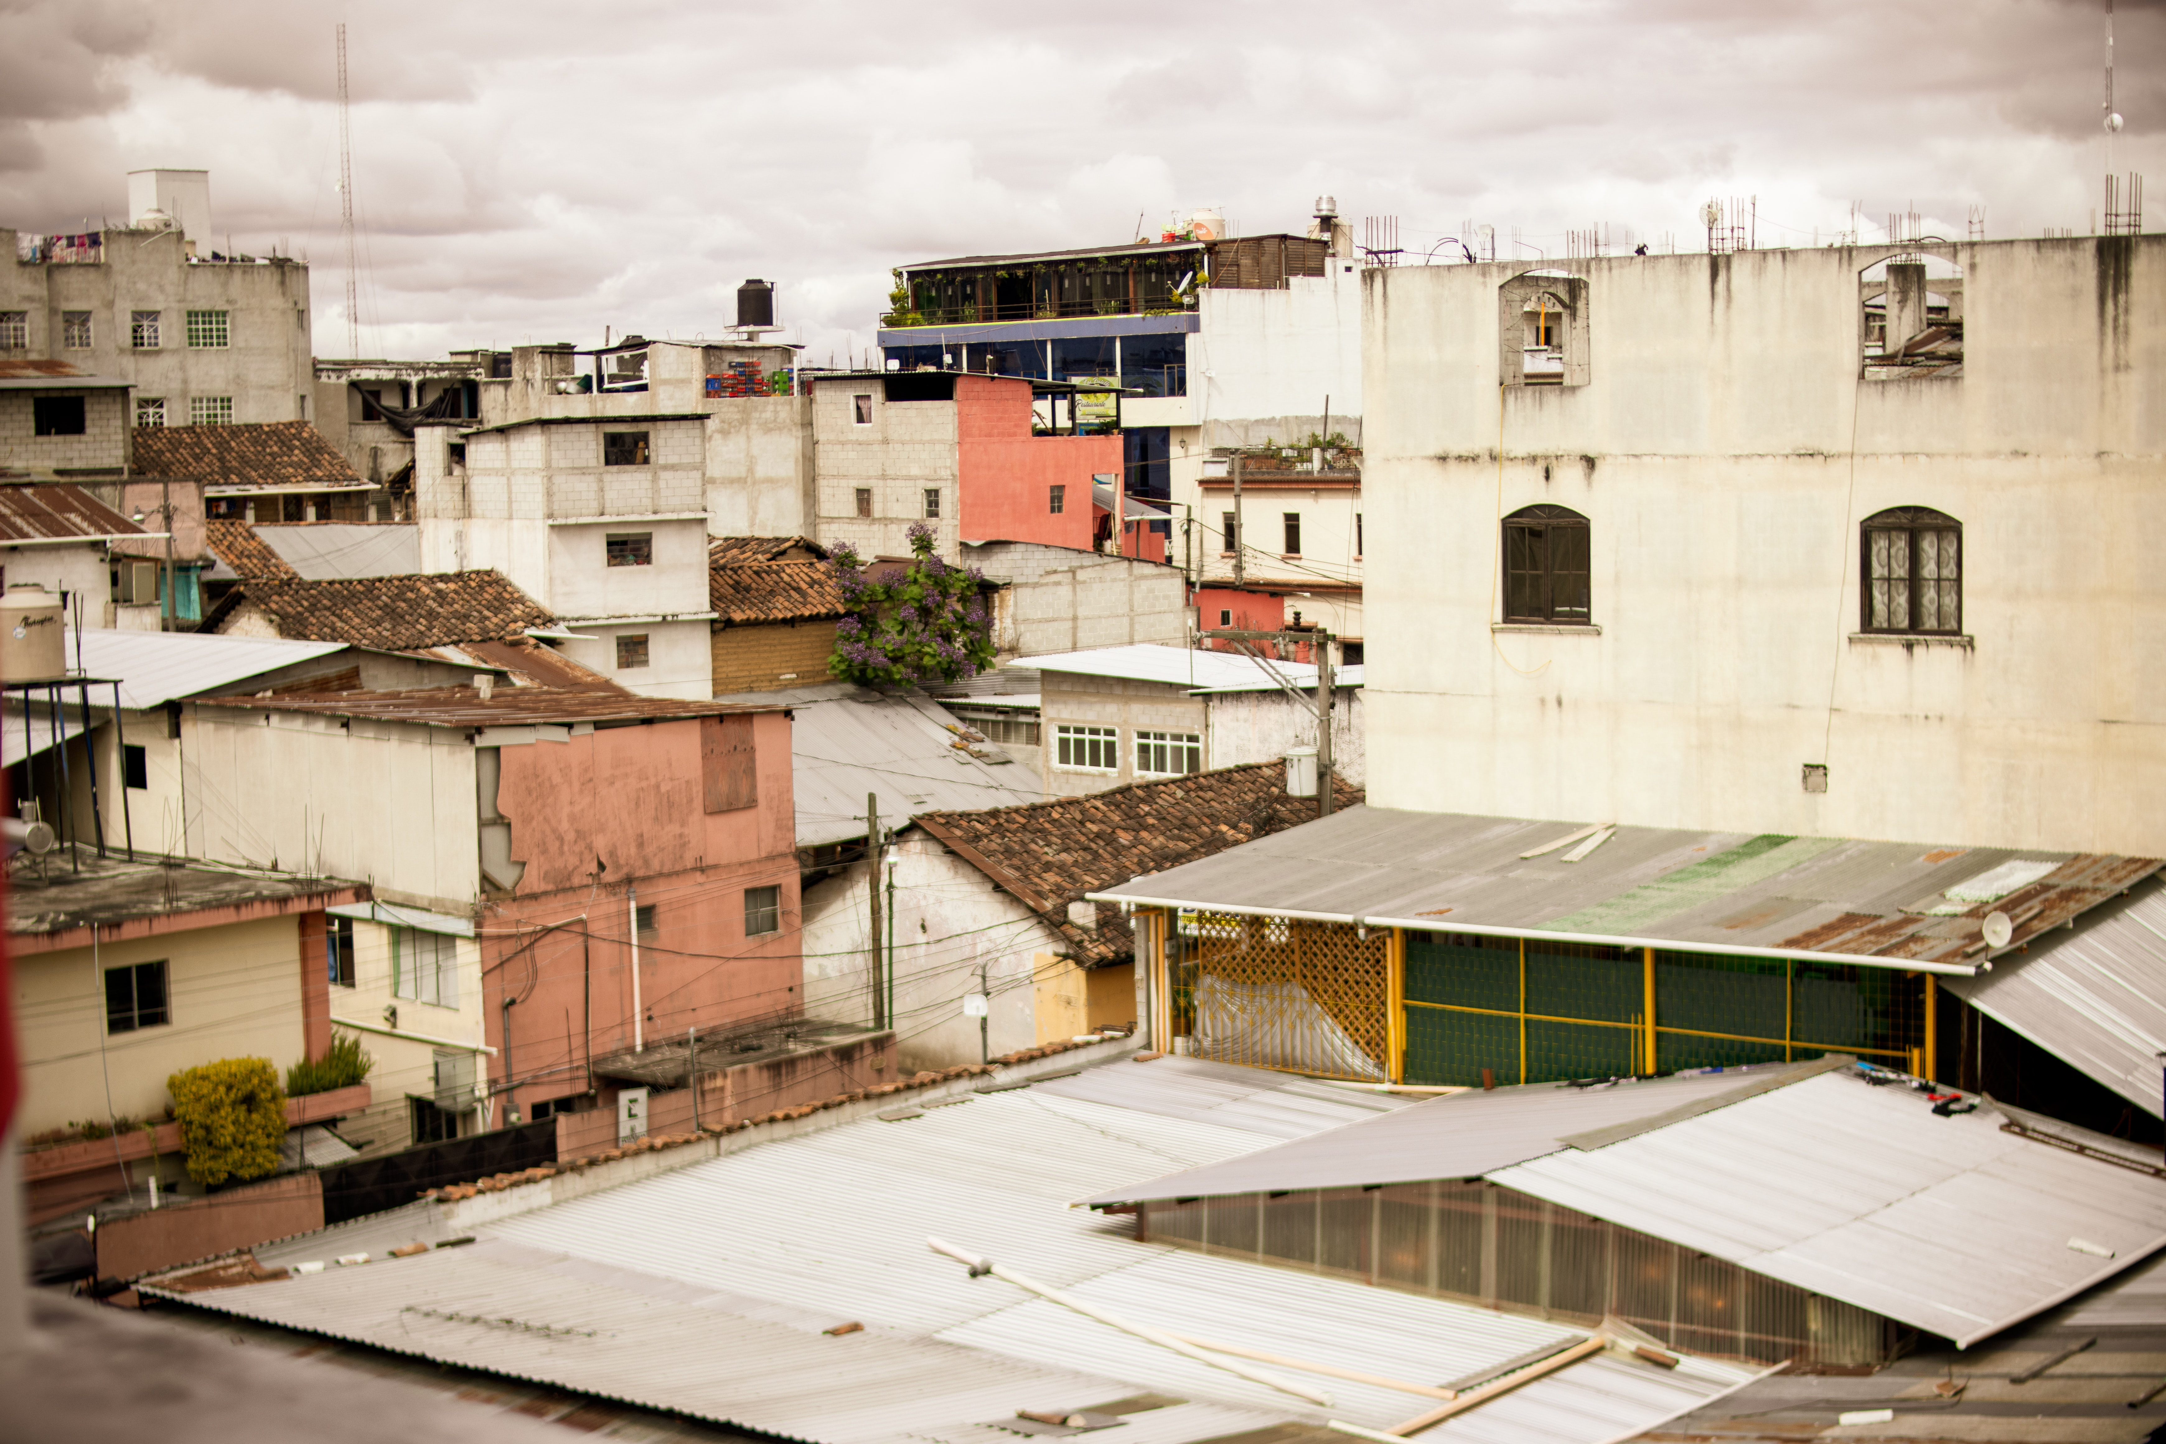
Vulnerability Analysis
Vulnerability assessment based on four equally-weighted factors
1) Steepness of slope
2) Presence of electricity
3) Total population density
4) Elderly population density
Credit: Jacken Holland
Notes:
To assess vulnerability across the two cities, the team performed a weighted cumulative analysis of risk by assigning vulnerability rankings to four different variables and spatially combining the results to yield an overall ranking. The five variables were 1) steepness of slope (acquired from SRTM DEM data), 2) presence of electricity (acquired from the VIIRS Lights-at-Night Grids), 3) total population density (acquired from the Humanitarian Data Exchange), and 4) Elderly population density.
Image Credit
Credit: Photo by Jacken Holland on Unsplash
Source: https://unsplash.com/photos/wYDvmnQWEhQ

Slide 15
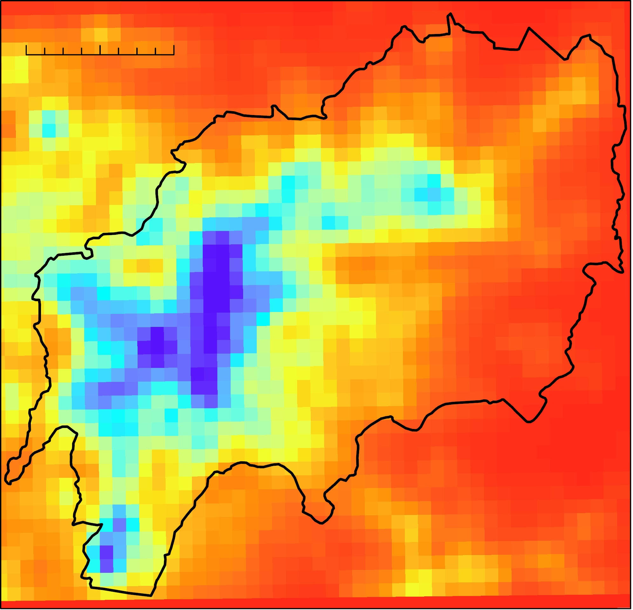
Vulnerability Analysis
Each of the four variables were analyzed in ArcGIS Pro using the steps below
0 2.5 5 km
0 2.5 5 km
0 5.1 km
Study Area
Study Area
Study Area
Rank
102.261
88.276
1
2
3
4
N
0
N
1.898
N
1
2
3
Overlay fishnet, median-reduce data
Reclassify and assign ranks
Import raw data
Notes:
The four variables listed in the previous slide underwent analyses in ArcGIS Pro using the steps shown here. This example shows data from VIIRS Lights-at-Night dataset. First the raw data was imported and clipped to the study area. Next, a 1km by 1km fishnet grip was overlayed onto the study area. At the point the data is median reduced within each cell. Lastly, the fishnet data is reclassified and assigned a rank 1 to 4.
Image Credits
- all images created by the DEVELOP team

Slide 16
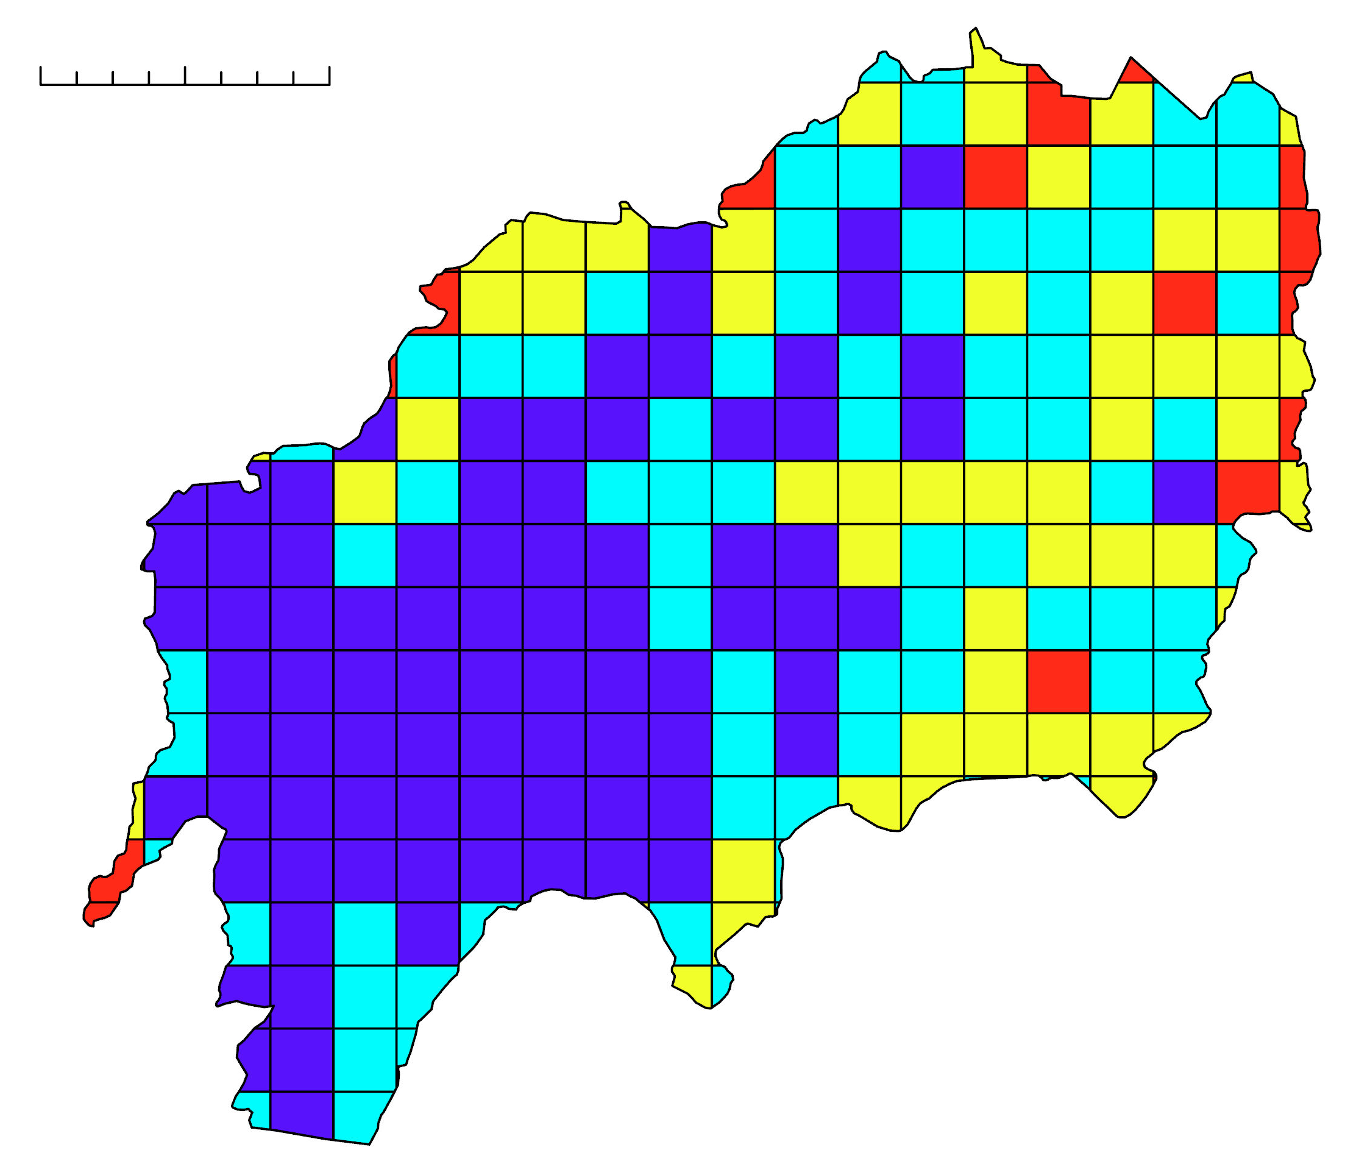
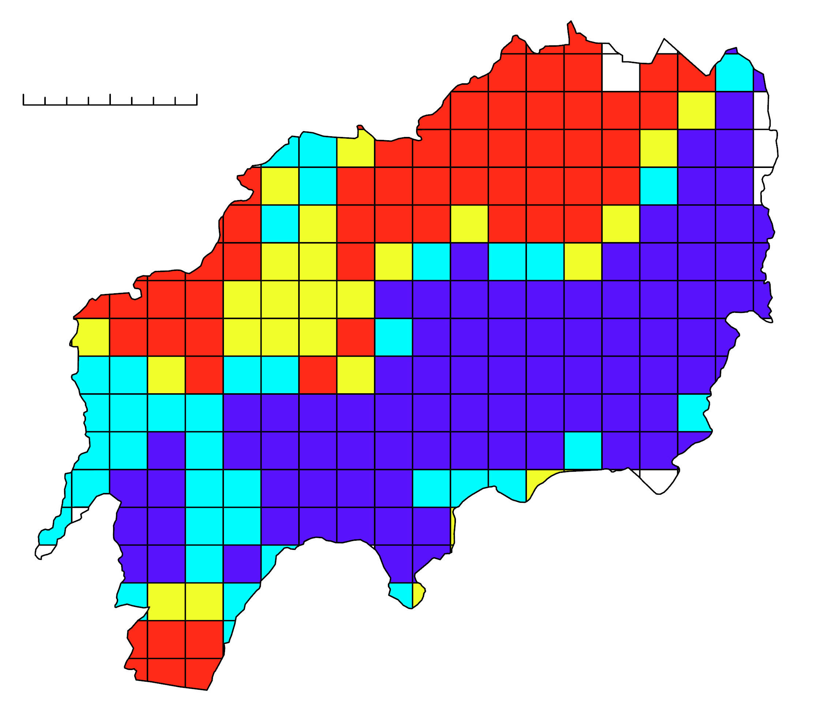
Vulnerability Analysis
0 2.5 5 km
0 5.1 km
0 2.5 5 km
0 5.1 km
Study Area
Study Area
Study Area
Study Area
Rank
Rank
Rank
Rank
1
2
3
4
1
2
3
4
1
2
3
4
1
2
3
4
N
N
N
N
Total Population Density
Elderly Population Density
Slope
Electricity
Ranks for each variable were added together to yield a cumulative vulnerability value, where a higher value signifies greater vulnerability
Notes:
Once all four variables' ranks were calculated, the raster calculator in ArcGIS Pro was used to find the sum of all the ranks in each cell to find a cumulative vulnerability value. The greater the value, the greater the vulnerability within the cell.

Slide 17
Results: Guatemala City
Notes:
We will now take a look at our cumulative analysis for Guatemala City.

Slide 18
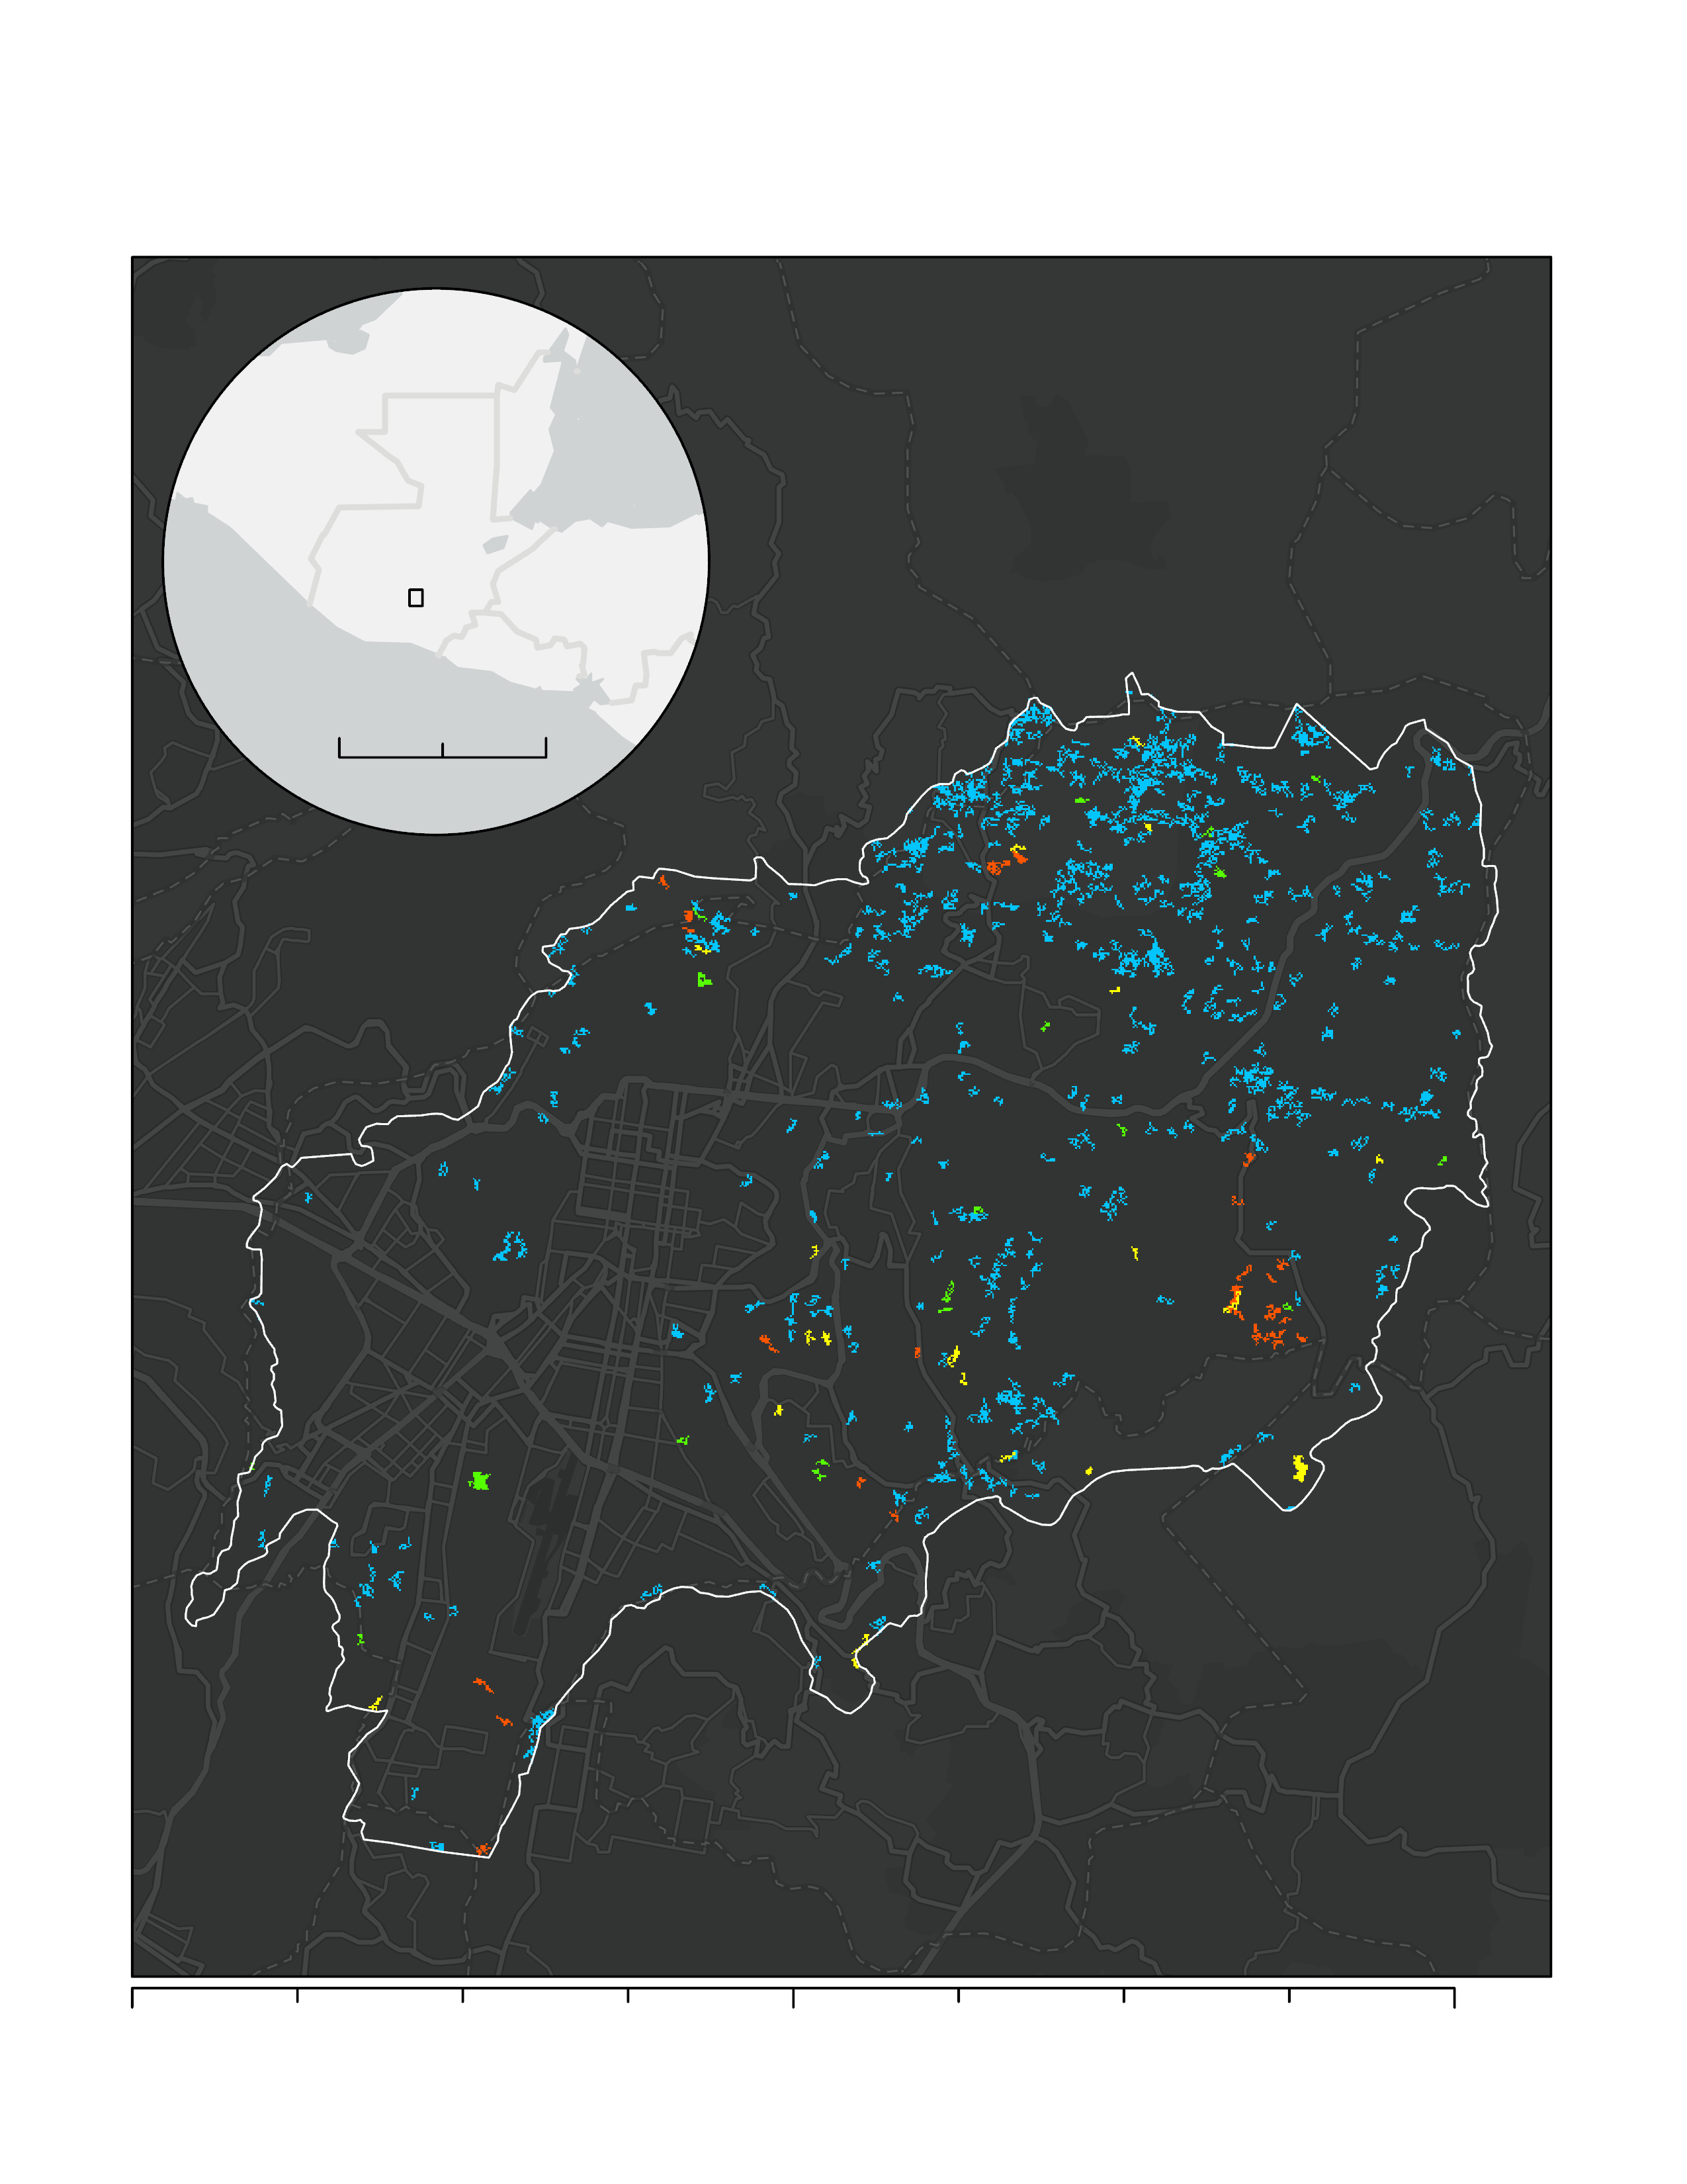
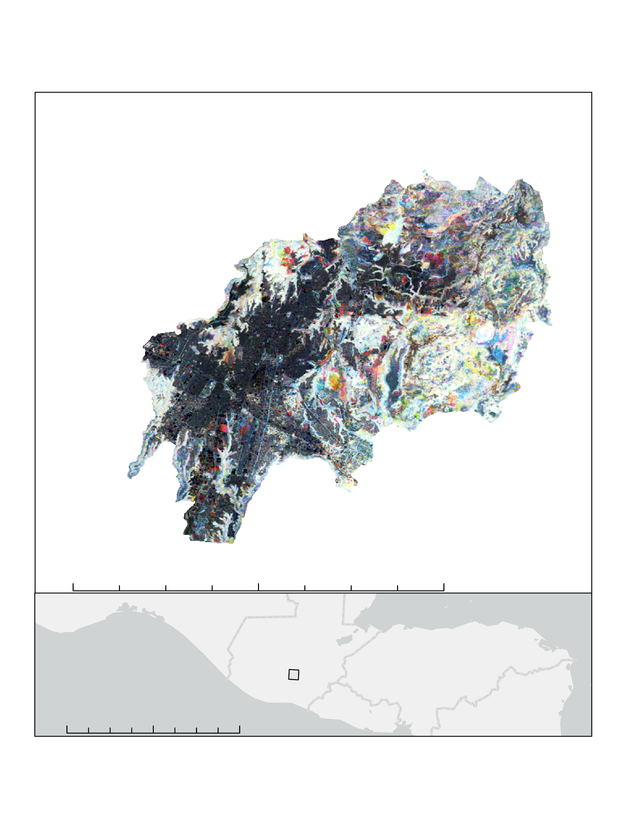
Vegetation Disturbance
Guatemala: Year of Disturbance
Guatemala: RGB Change
Stable High Vegetation
Stable Moderate Vegetation
Stable Low Vegetation
Disturbance in Vegetation between 2010 and 2020
Disturbance in Vegetation between 2000 and 2010
Disturbance in Vegetation between 2000 and 2010 followed by a Recovery
Growth and Recovery in Vegetation throughout Entire Period
Decline in Vegetation throughout Entire Period
N
375 km
0
188
N
0
5
10
19 km
Years of Disturbance
2000-2004
2005-2009
2010-2014
2015-2019
N
N
0
125
250
500 km
0
6
11
22 km
Date: 11/02/2022 | Datum: D North American 1983 | Author: Urban Development Team | Source: LandTrendr Analysis
Date: 11/02/2022 | Datum: D WGS 1984 | Author: Urban Development Team | Source: LandTrendr Analysis
Notes:
As can be seen on the "Year of Disturbance" final map, it looks as though a good amount of vegetation was disturbed in the Northeast section of the City during the 2000-2004 time period. During the 2005-2009 time period, there seems to be a small amount of vegetation disturbance throughout the city. Then from 2010-2014, there is a little disturbance in vegetation mainly on the East side of the city. And finally from 2015 until 2019, there is a bit of disturbance in vegetation mainly in the Southeastern section of the city.
As can be seen from the "RGB Change" map, the Southwestern side of the city is densely urban while the East and Northeastern side of the city extent is rural. Along the outskirts of the city, there is a mix of yellow and red which implies vegetation disturbances between 2000 and 2010 as well as disturbances between 2010 and 2020 respectively. There is a good amount of brown in moderately urban areas signifying a consistent decline in vegetation throughout the entire time period. Finally, cyan can be seen in the predominantly vegetated areas implying that vegetation has been increasing through the entire time period in areas that were already vegetated.
Image Credit: All maps made by the Develop Team.

Slide 19
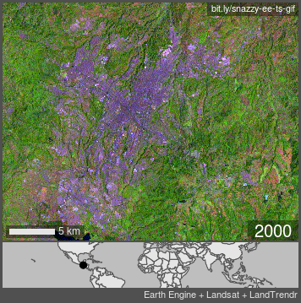
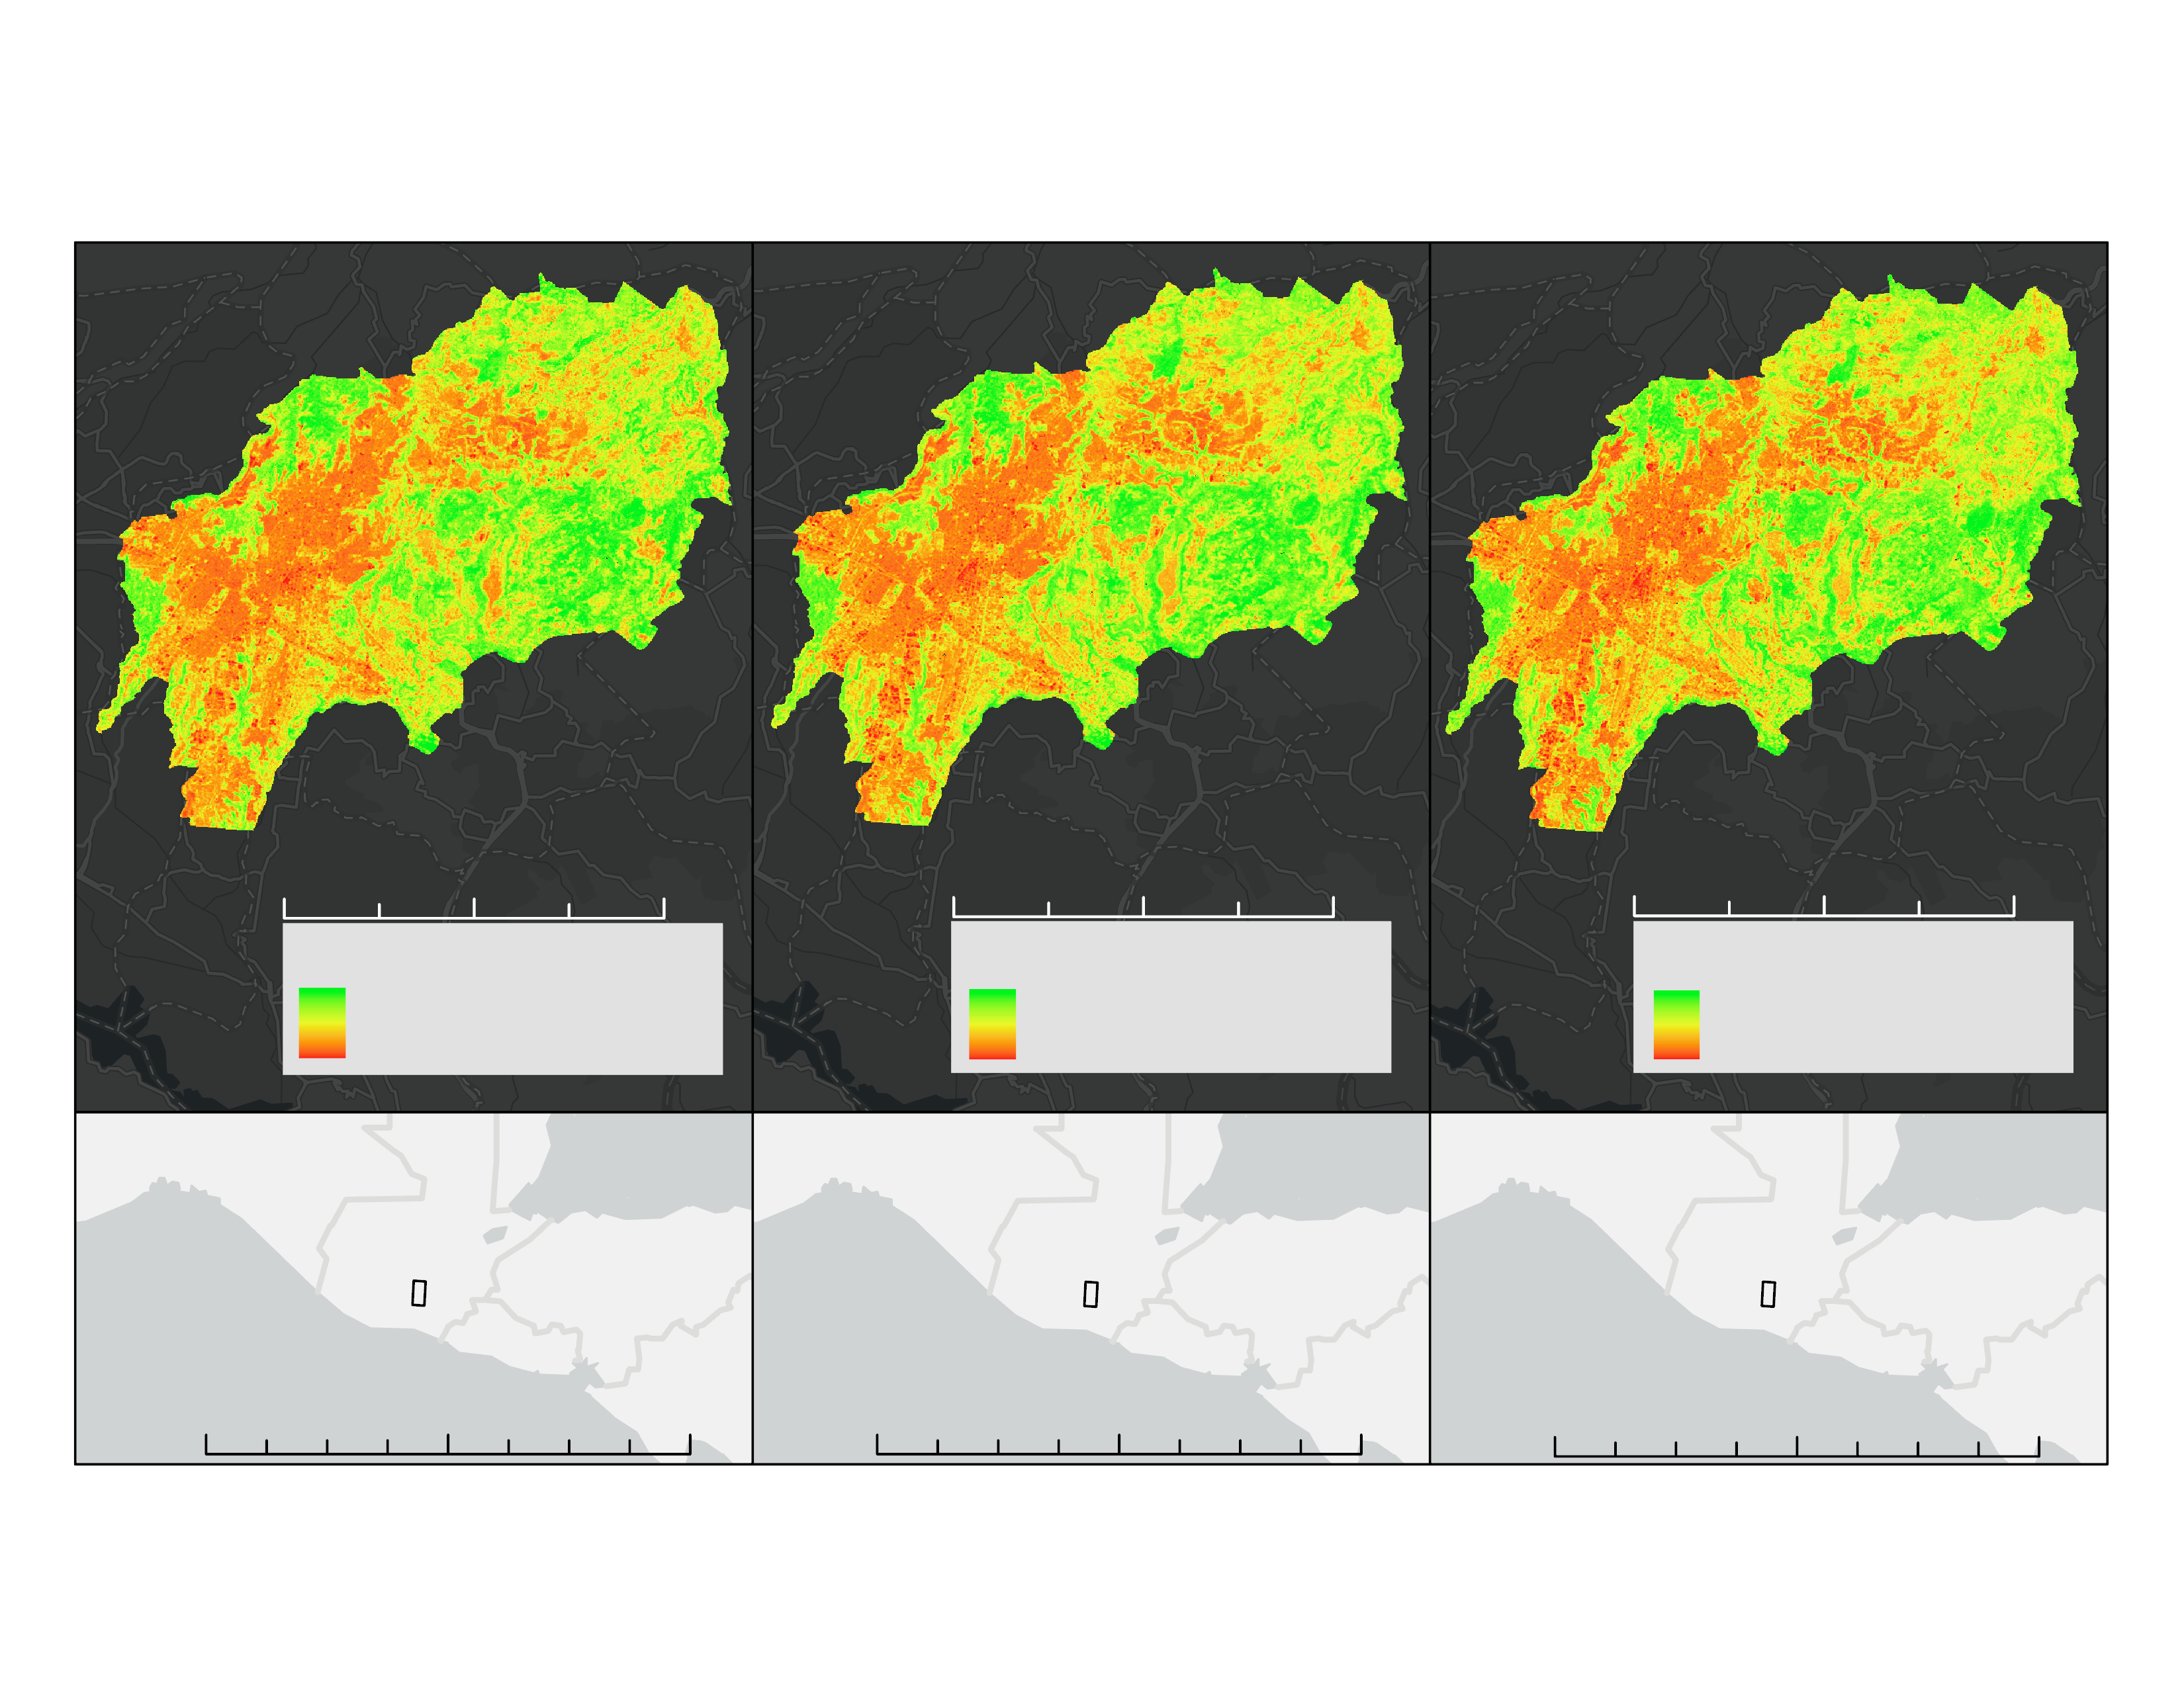
Urban Expansion
Guatemala: Time Series
2000
2010
2020
0
3
7
13 km
0
3
7
13 km
0
3
7
13 km
N
Urban to Vegetation Gradient
N
Urban to Vegetation Gradient
N
Urban to Vegetation Gradient
Vegetation
Vegetation
Vegetation
Urban
Urban
Urban
N
0
230
460
920 km
N
0
230
460
920 km
N
0
230
460
920 km
Snazzy +
Date: 11/02/2022 | Datum: D North American 1983 | Author: Urban Development Team | Source: LandTrendr Analysis
Notes:
This GIF shows how the Guatemala City area extent has changed from 2000 to 2020. The image bands used were SWIR1, NIR, and RED. This band combination makes urban areas look purple while vegetation looks green. As can be seen, the city has been expanding over the specified time period.
When looking at the time series results from 2000, 2010, and 2020, it looks as though the urban areas get more urban. This is shown by the red spot at the center of the urban area which grows over time. Not only that but less settled areas in the Southeast and North seem to increase in urbanization over time as well.
Image Credit: All maps made by the Develop Team.
GIF Credit: GIF made by Snazzy-EE-TS-GIF GEE App.

Slide 20
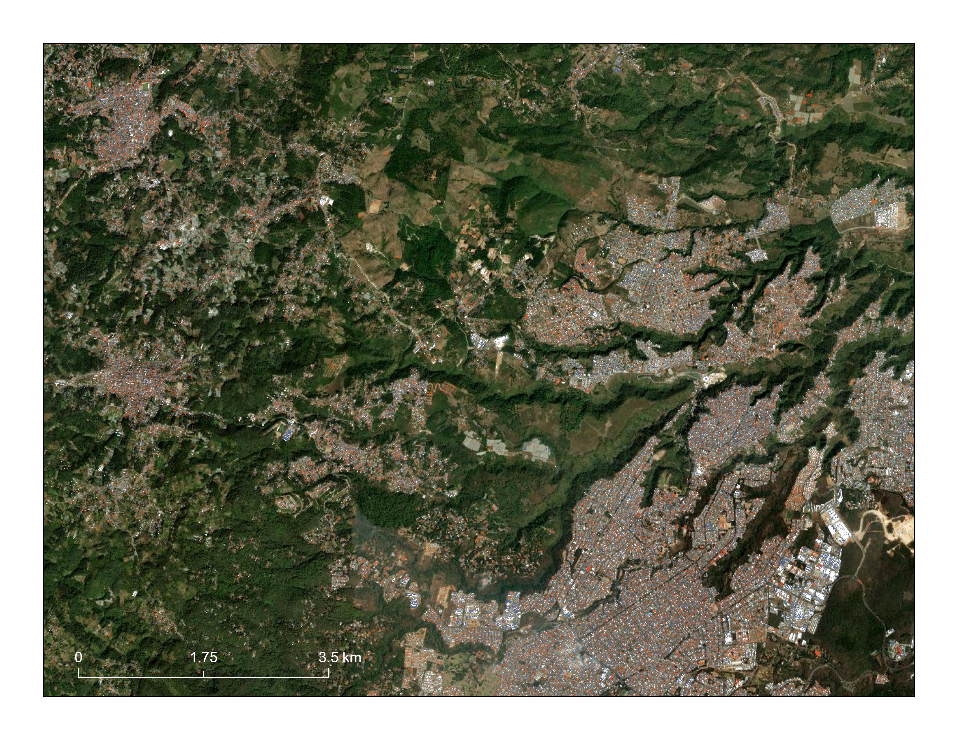
Roofing Materials
©2022 Maxar, Earthstar Geographics
N
Roof type breakdown:
46.7% tile
17.6% metal
35.7% slate
Preliminary classification accuracy: 94%
Classification accuracy for tile, metal, and slate roof type was 99%, 97%, and 97% respectively
Tile Roof
Metal Roof
Slate Roof
Notes:
This map depicts the roofing material classification overlaid on basemap satellite image. Tile roofs appear as orange pixels, metal as white pixels, and slate as blue pixels. All other pixels that were not classified as a roof type were removed from this image. Tile roofs constitute 46.7% of roofs in the area, 17.6% are metal roofs, and 35.7% are slate. Overall classification accuracy was 94%. This shows the majority of the image area, but results are better examined at a larger scale.
Image Credit: ©2022 Maxar, Earthstar Geographics - classified Maxar imagery over Esri basemap
Map created by the DEVELOP Team

Slide 21
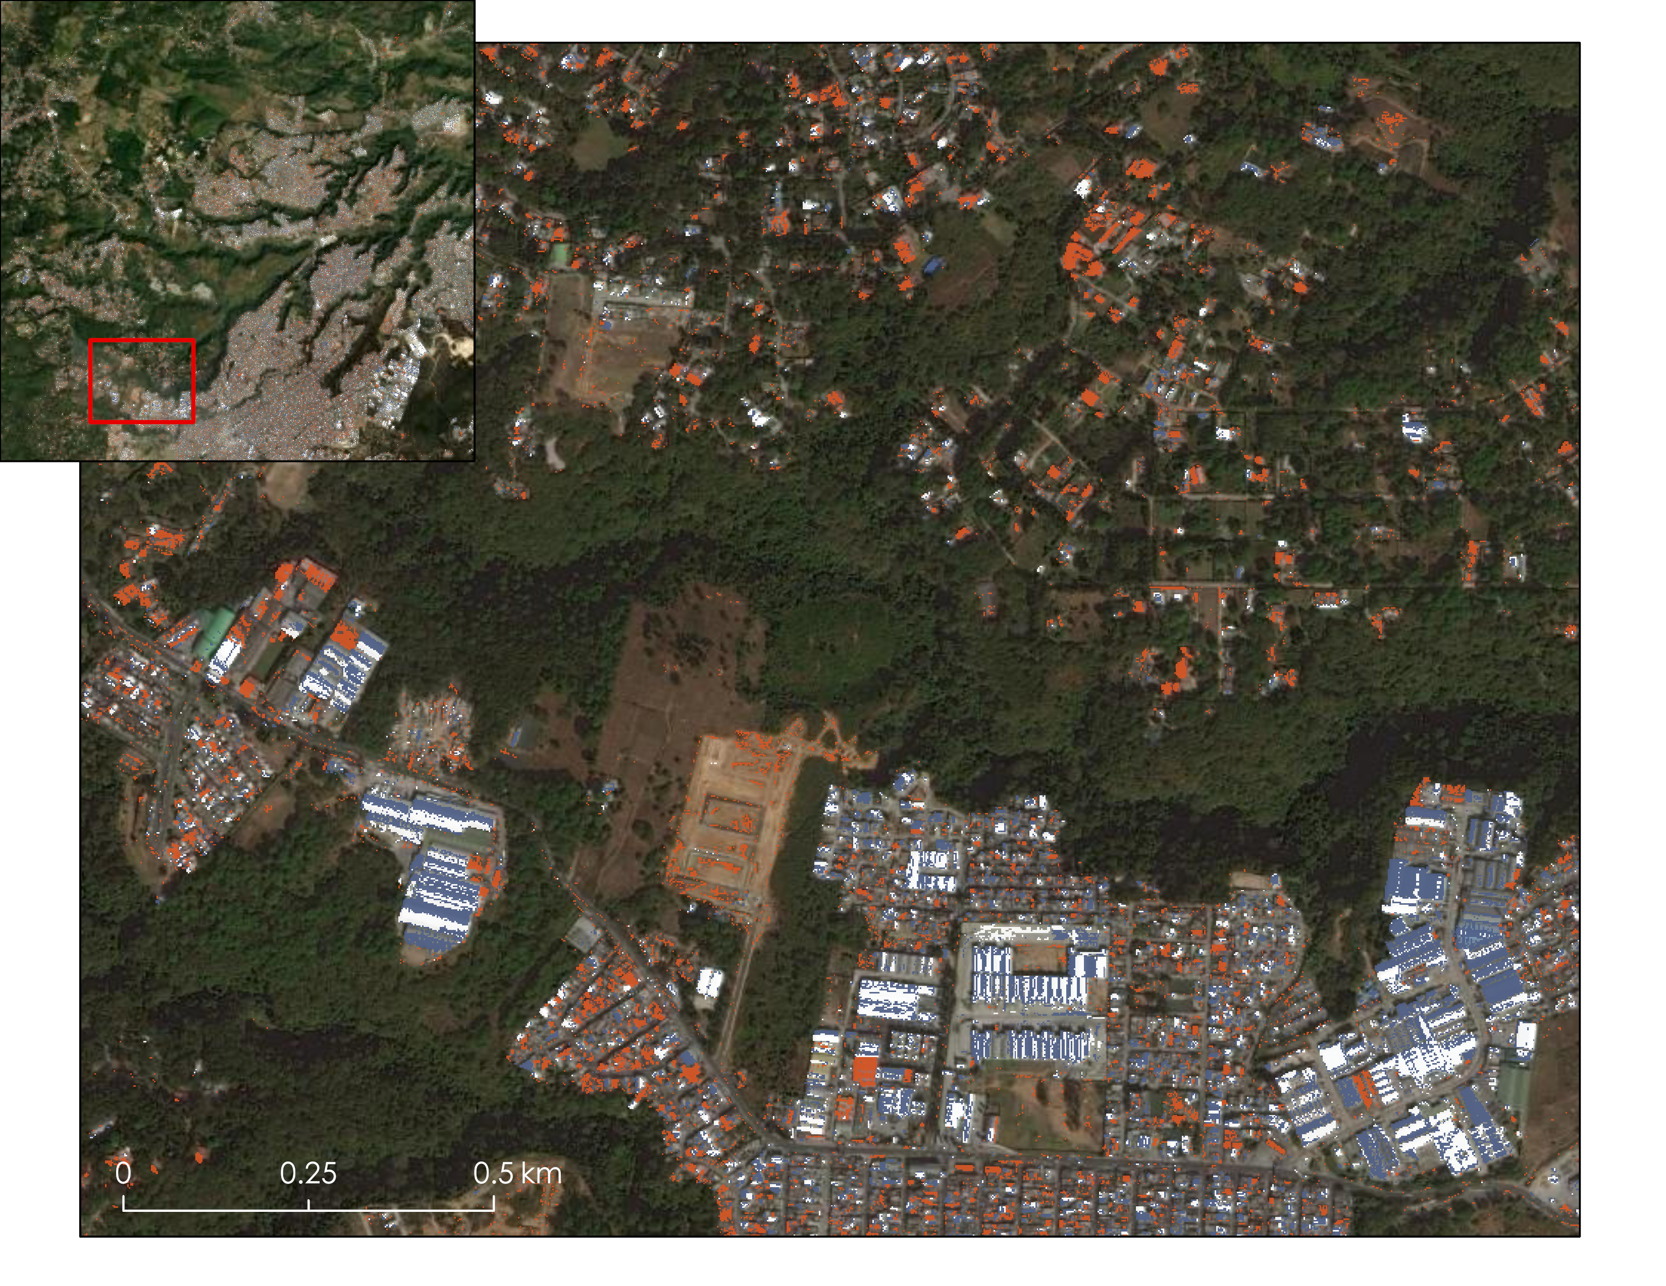
Roofing Materials
©2022 Maxar, Earthstar Geographics
N
Tile Roof
Metal Roof
Slate Roof
Notes:
Here is a zoomed in portion of the previous image. It is easier to see the classification output, including some of its issues. A noticeable amount of barren land pixels are classified as tile roofs. Additionally, some roof tops are split between a metal and slate classification, which is an unlikely occurrence in the real world. This could be due to shadows cast on one side of metal roofs that could cause their reflectance values to more closely align with slate roofs. Still, the classification appears to perform fairly well, especially in differentiating between roofs and non roofs.
Image Credit: ©2022 Maxar, Earthstar Geographics - classified Maxar imagery over Esri basemap
Map created by the DEVELOP Team

Slide 22
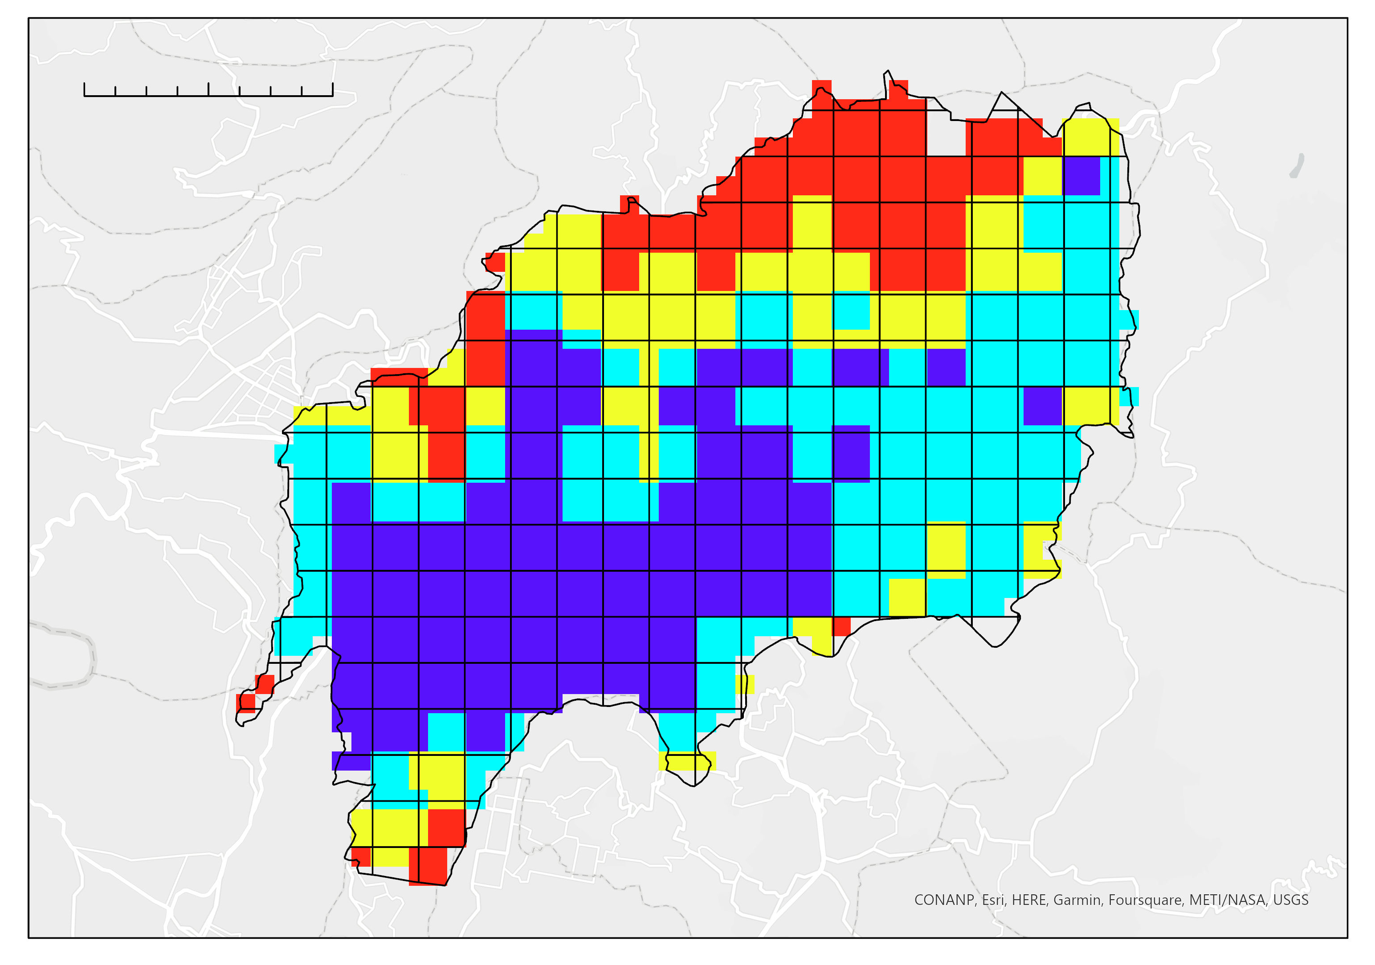
Vulnerability Assessment
0 3 6 km
The northern part of our study area is most vulnerable from an environmental and social perspective
Study Area
Rank
1
2
3
4
N
Notes:
Using slope, electricity, population density, and elderly population density as parameters, we found that the greatest vulnerability in Guatemala city is primarily in the northern part of the study area.
Map created by DEVELOP team

Slide 23
Results: Panama City
Notes:
The following slides will transition to the cumulative results for Panama City.

Slide 24
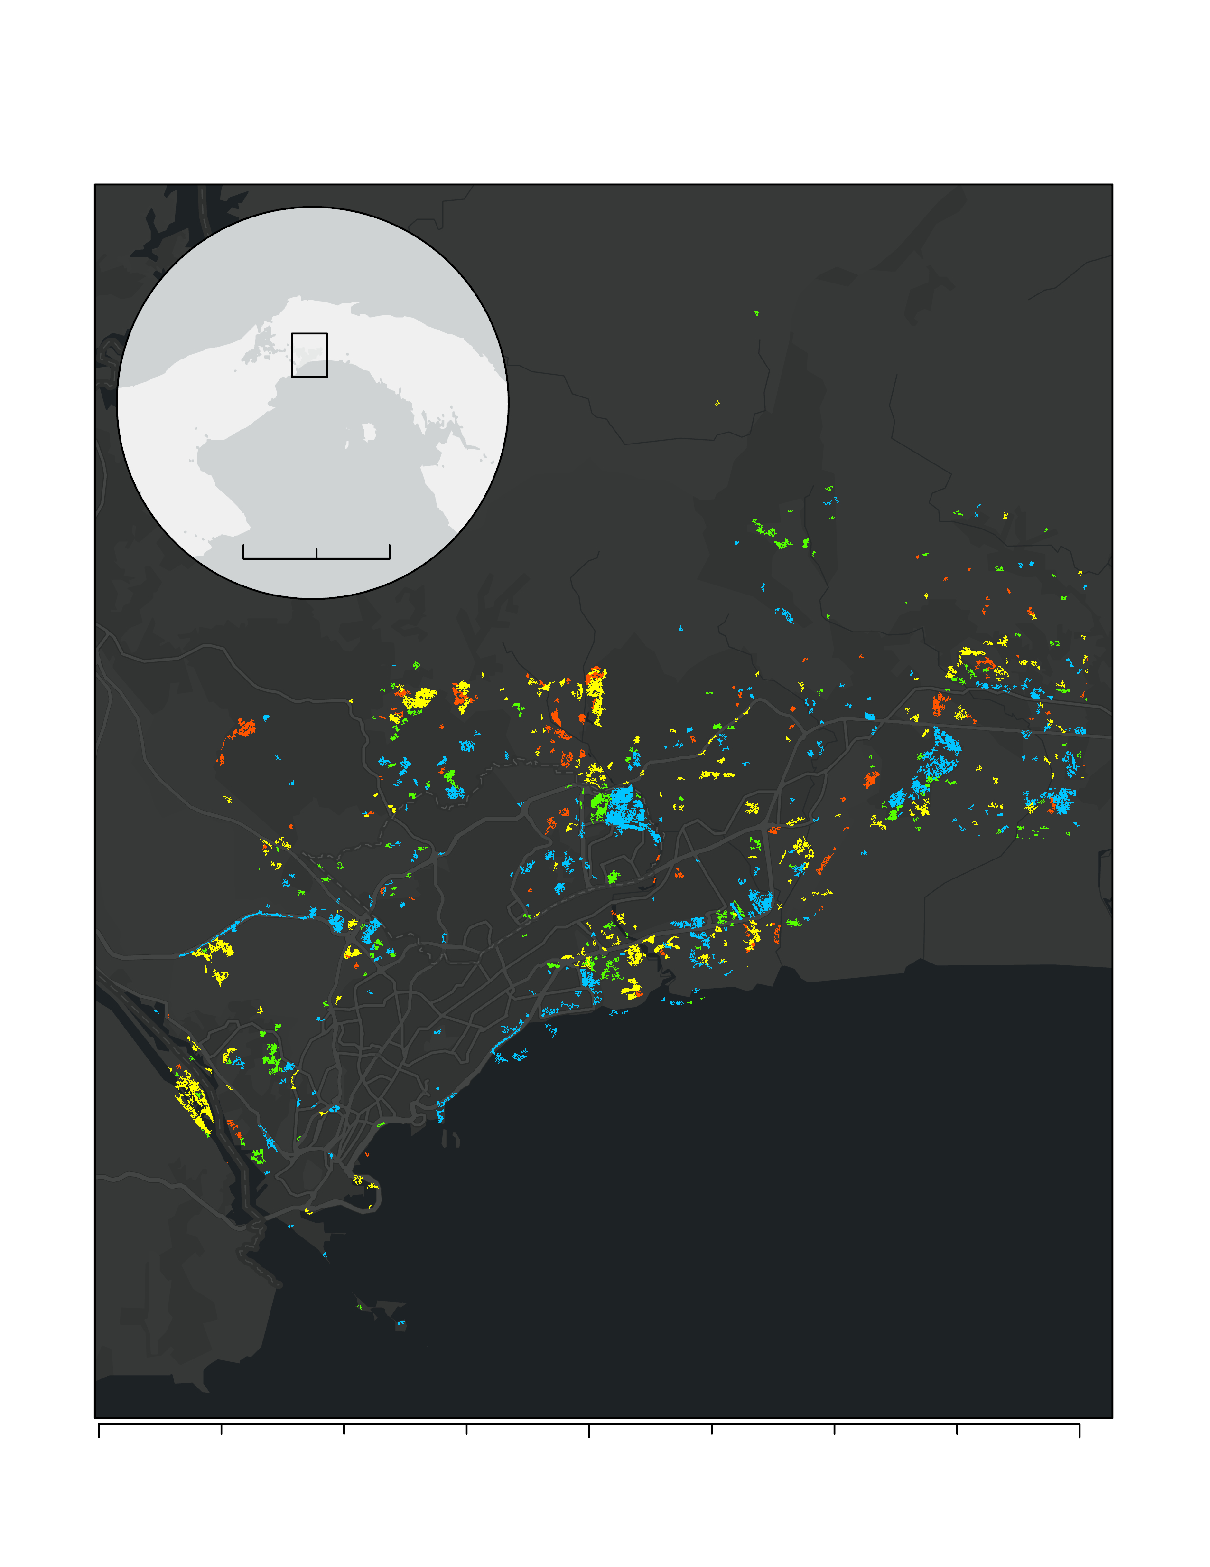
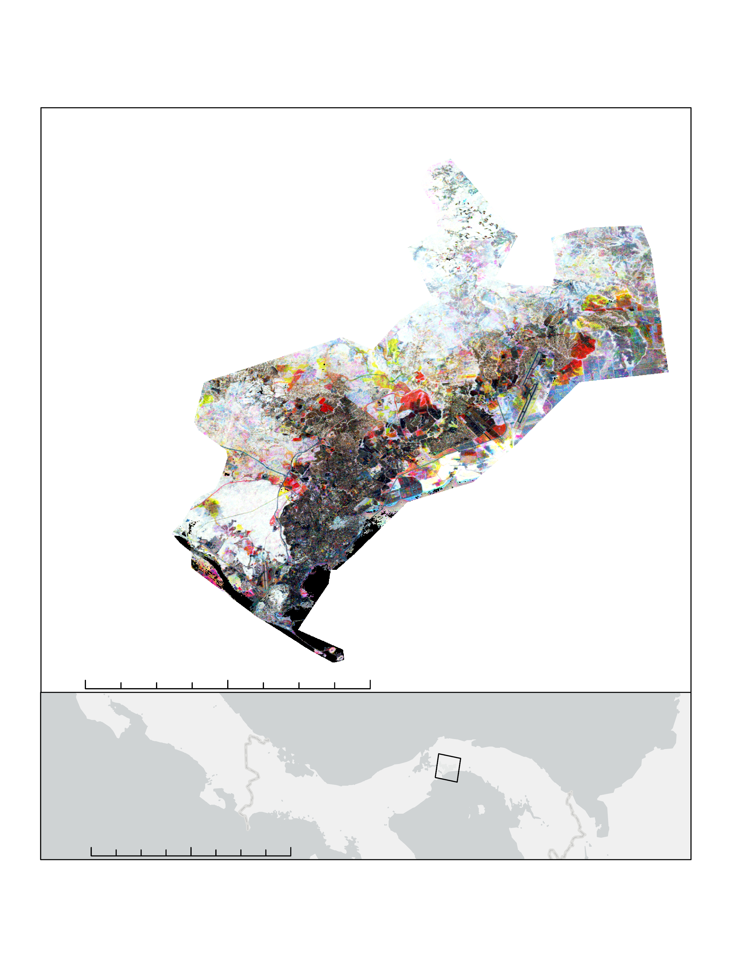
Vegetation Disturbance
Panama: Year of Disturbance
Panama: RGB Change
Stable High Vegetation
Stable Moderate Vegetation
Stable Low Vegetation
Disturbance in Vegetation between 2010 and 2020
Disturbance in Vegetation between 2000 and 2010
Disturbance in Vegetation between 2000 and 2010 followed by a Recovery
Growth and Recovery in Vegetation throughout Entire Period
Decline in Vegetation throughout Entire Period
N
0
2.8
5.2 km
Years of Disturbance
2000-2004
2005-2009
2010-2014
2015-2019
0
5
13.5
20
25 km
Date: 11/02/2022 | Datum: D North American 1983 | Author: Urban Development Team | Source: LandTrendr Analysis
Date: 11/02/2022 | Datum: D WGS 1984 | Author: Urban Development Team | Source: LandTrendr Analysis
Notes:
FOR SCALE – DISTURBANCE insert(delete note when done): 0, 75, 150
FOR SCALE – DISTURBANCE (delete note when done): first is 0, third is 9, five is 18, last is 35
FOR SCALE – RGB top(delete this note when done): the first tic is 0, the third tic is 5, the fifth tic is 10, the last (9th) tic is 20.
FOR SCALE – RGB bottom(delete this note when done): first tic is 0, three is 95, five is 190, nine is 380
In the figure to the left we can see disturbance in Panama City throughout different time periods within the years 2000 and 2020. From this figure we observe that there is an exponential initial disturbance from the 2000-2004 period shown in blue. In subsequent years we can observe that the disturbance mostly happens along or close to the areas where the initial disturbance was recorded, however, its behavior is more scattered. Throughout the third period, within the years 2010-2014, we can observe another exponential increase in disturbance, similar to the extent of the first period. In the second and fourth period, 2005-2009 and 2015-2020, respectively, we can observe that the behavior is scattered but smaller in size compared to the first and third disturbance.
On the figure on the right, we can se the rural concentration focused towards the south facing the ocean, whilst the outskirts and surroundings have a gradient towards a more rural area.
Maps created by DEVELOP team

Slide 25
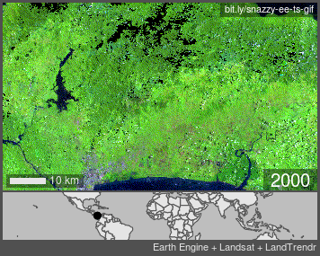
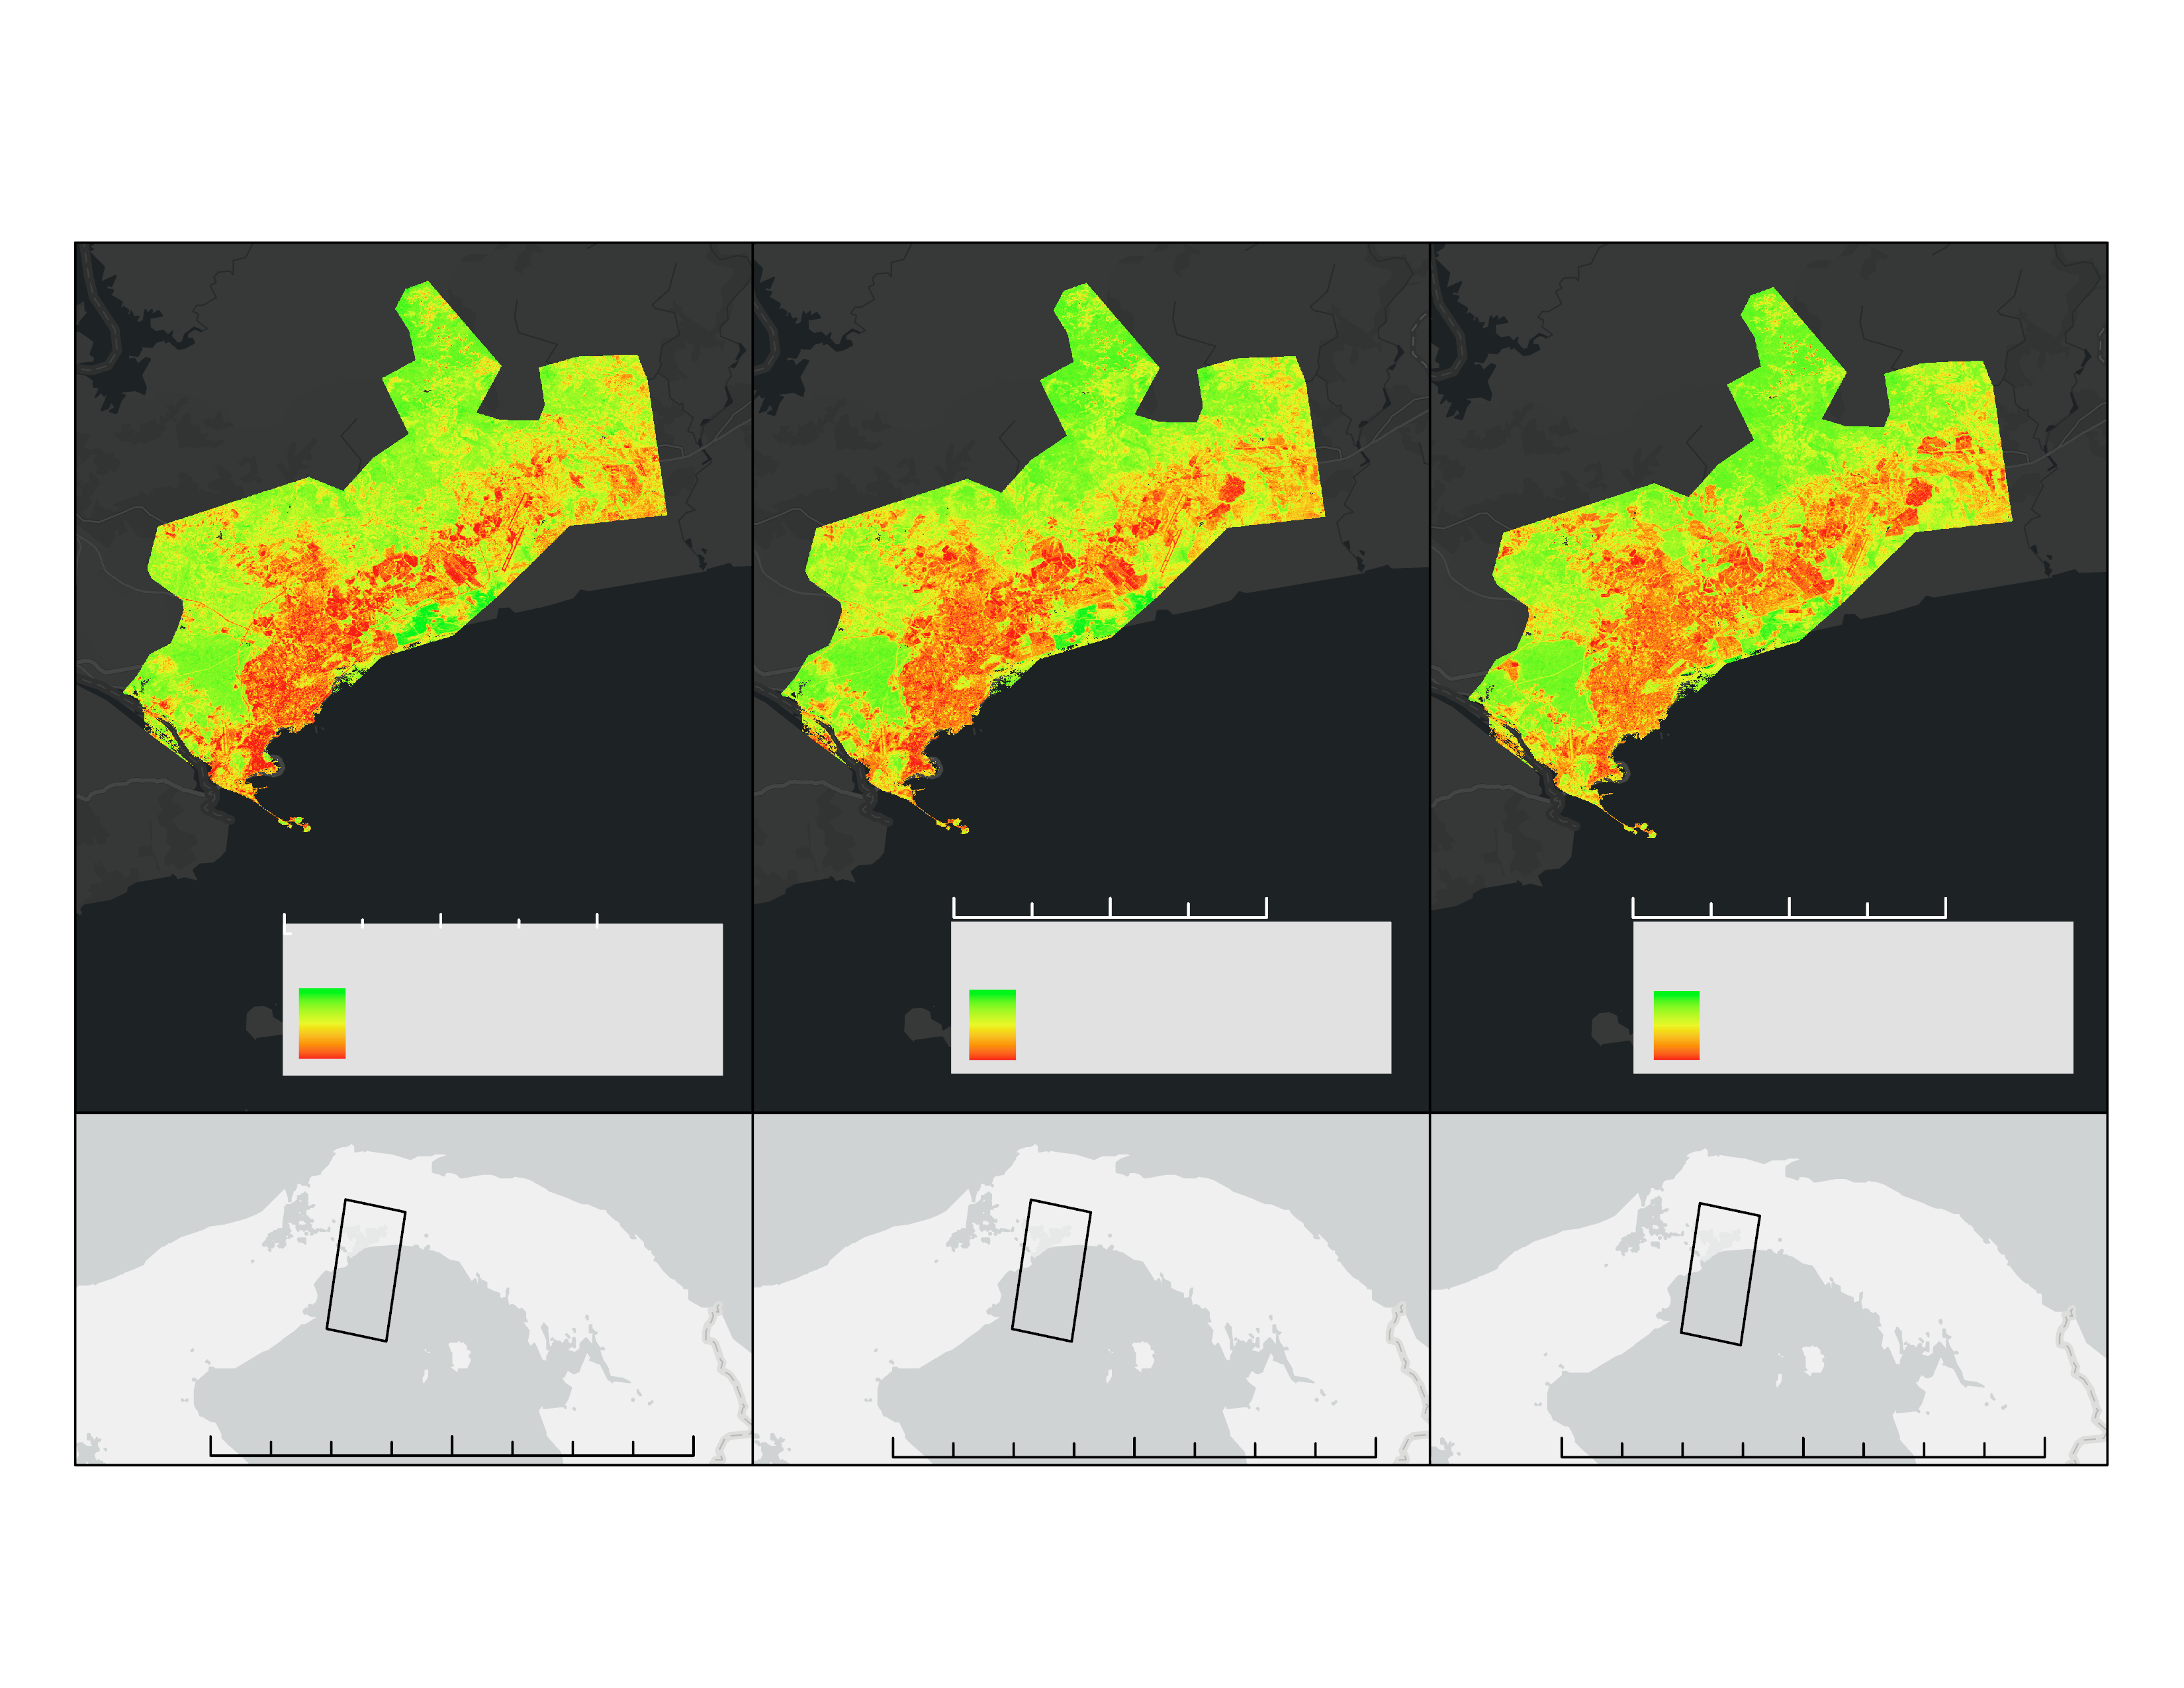
Urban Expansion
Panama: Time Series
2000
2010
2020
Urban to Vegetation Gradient
Urban to Vegetation Gradient
Urban to Vegetation Gradient
Vegetation
Vegetation
Vegetation
Urban
Urban
Urban
Date: 11/02/2022 | Datum: D North American 1983 | Author: Urban Development Team | Source: LandTrendr Analysis
Notes:
(delete when done) FOR SCALE: all top ones: first is 0, second is 5, third is 10, last is 20
(delete when done) FOR SCALE: all bottom ones: first is 0, third is 80, fifth is 160, last is 320
This GIF shows urban extent in Panama City. The image bands used were SWIR1, NIR, and RED. Meaning urban areas look purple and vegetation looks green. This GIF shows that urban expansion after initial is not highly exponential. Meaning, urban areas expand but there doesn't seem to be the creation of new, distant urban areas. Urbanization seems to increase towards the southeast of Panama City near the Pacific ocean .
The image to the right shows a Time Series urban to vegetation gradient expanding from the . This image offers a clearer image on urban expansion. The image shows how urbanization is growing exponentially as an extension of the established urban areas, therefore decreasing vegetative areas.
Image Credit: All maps made by the Develop Team.
GIF Credit: GIF made by Snazzy-EE-TS-GIF GEE App.

Slide 26
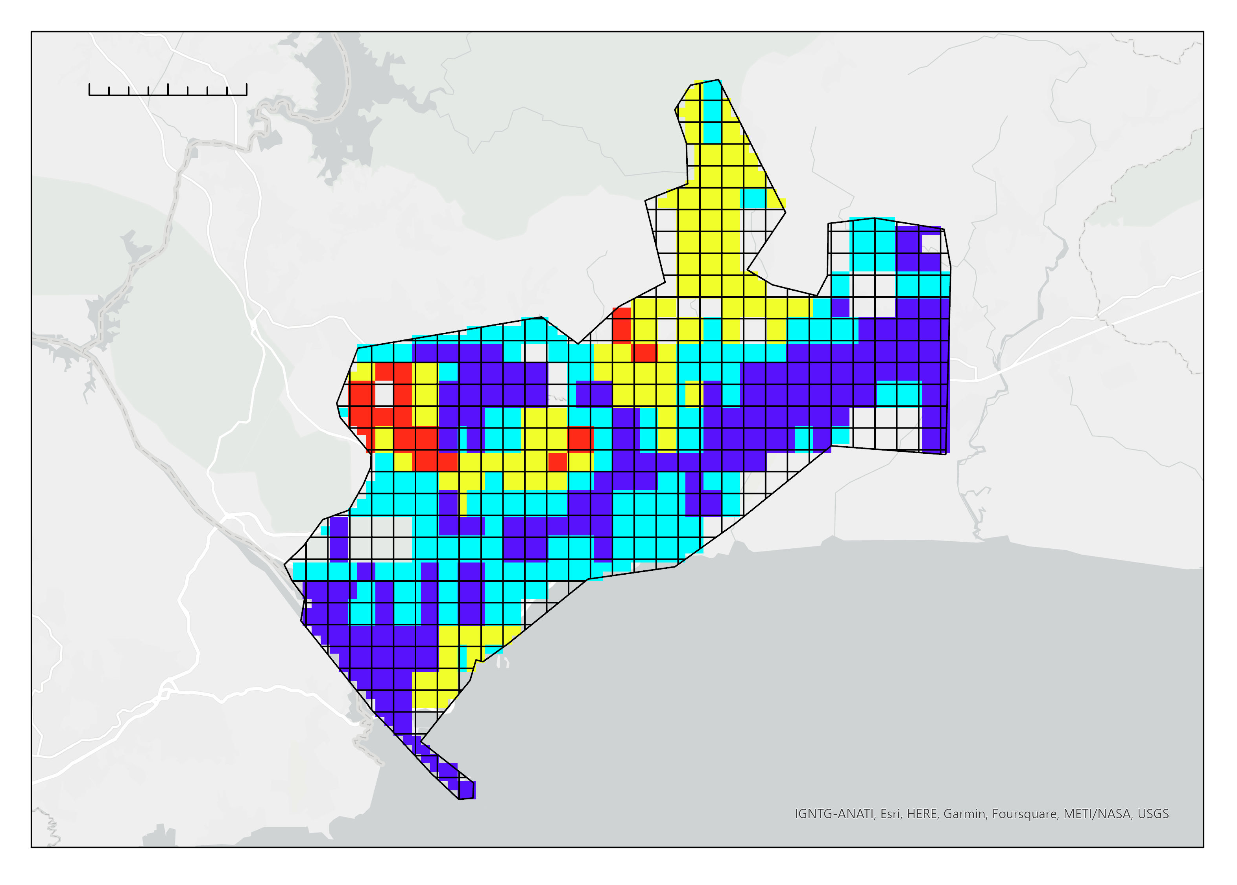
Vulnerability Assessment
0 4 8 km
The northwestern part of our study area is most vulnerable from an environmental and social perspective
Study Area
Rank
1
2
3
4
N
Notes:
Using slope, electricity, population density, and elderly population density as parameters, we found that the greatest vulnerability in Guatemala city is primarily in the northwestern part of the study area.
Esri basemap

Slide 27
Conclusions
1
Guatemala City has expanded outward and become denser since 2000. Panama City has also expanded but not at the same rate as Guatemala City.
2
Greatest vulnerability in Guatemala City and Panama City was found to be in the northern and northwestern parts, respectively.
3
Supervised classification of roofing materials performed well but could be improved with a few future enhancements.
Notes:
1. Overall, vegetation disturbances have occurred over the past twenty years in the Guatemalan city extent. Not only that, but the city has become more dense over time. Expansion is most notable in the North, Northeast and East directions.
2. Greatest vulnerability in Guatemala City and Panama City was found to be in the northern and northwestern parts, respectively.
3. Supervised classification of roofing materials performed well, with an overall classification accuracy of 94%, but could be improved with a few future enhancements including the addition of ground truth data and limiting the classification to only roof tops, or at least only to urban areas.

Slide 28
Errors and Uncertainties
Lack of available ground truth data for roofing materials classification limits the accuracy
Lack of quantitative thresholds for vulnerability ranks
Use of equal weights for the vulnerability variables oversimplifies their significance
LandTrendr analysis limited by quality of Landsat data
Notes:
The lack of quantitative thresholds for the vulnerability assessment ranks limits the accuracy of the assessment, but can be further studied and easily adjusted as necessary.
A lack of available ground truth data for the roofing materials classification limits the accuracy assessment and classification generally.
With the use of equal weights for the variables in our vulnerability analysis, it is possible that the assessment could be oversimplified.
While the LandTrendr analysis provided interpretable results, it was still limited by the quality of the Landsat imagery. Therefore, in order to get higher quality results, it is necessary to use higher quality imagery.

Slide 29
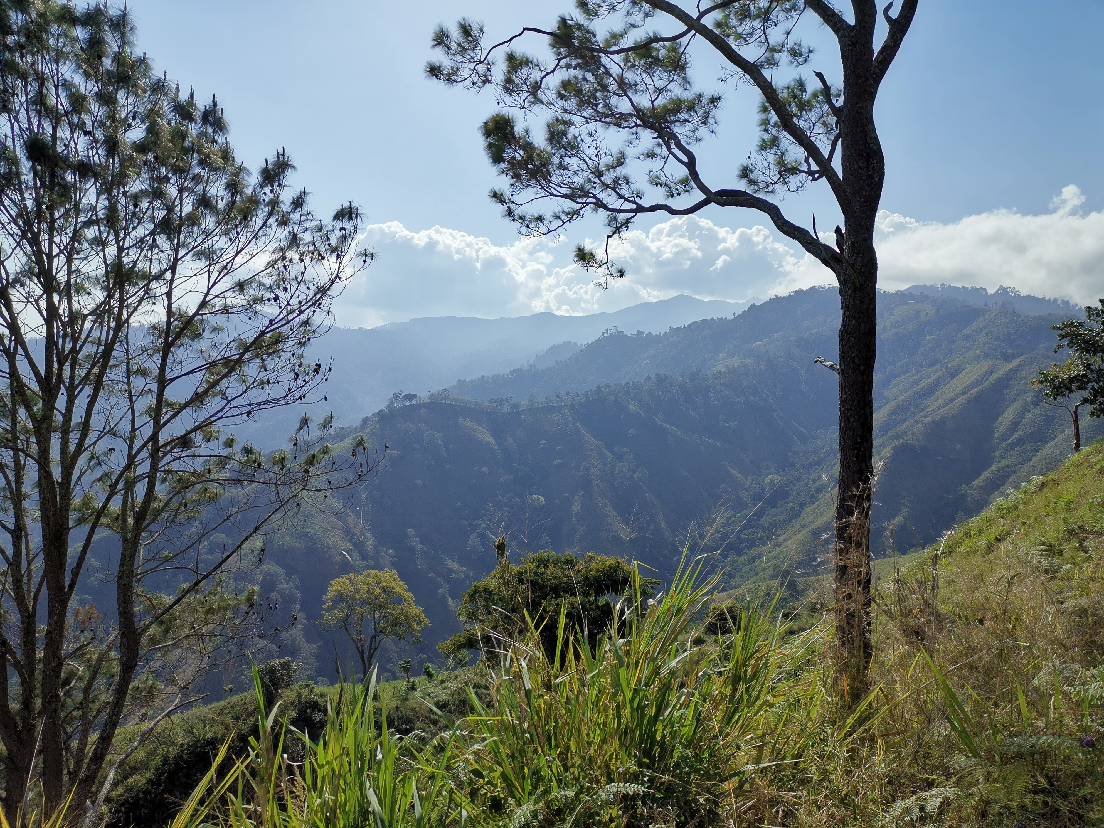
Future Work
Incorporate roof material type and disaster occurrence data into vulnerability assessment
Seasonal analyses to characterize vulnerability to specific natural disasters
Spatial analyses focusing on street width to identify informal vs formal settlements
Separate rooftops from other parts of the land surface prior to classification, and use ground truth data to classify roof types and assess that classification
Image Credit: Jorge Cabrera
Notes:
Partners plan to use methodology for other, specific details how we can advance our project Conduct further analyses using our methodology on other Mesoamerican cities of interest with a focus on the disasters that are unique to the study area.
Incorporate roof material type and disaster occurrence data into vulnerability assessment
Further characterize vulnerability to specific natural disasters by conducting seasonal analyses.
Conduct spatial analyses focusing on street width in rapidly developing urban areas in Mesoamerica to identify informal vs formal settlements.
Use methodology to separate rooftops from other parts of the land surface prior to classification, and use ground truth data to help classify roof types and then assess that classification
Image credit: Jorge Cabrera
Image Source: SICA, project partner

Slide 30
Our sincerest gratitude to our Node Fellow, Mentors, and Science advisors for their guidance and support:
Brianne Kendall (MSFC Node Fellow)
Ricardo Quiroga (NASA Applied Sciences)
Betzy Hernández (NASA SERVIR)
Dr. Emil Cherrington (NASA SERVIR)
Lauren Carey (NASA SERVIR)
Eric Anderson (NASA SERVIR)
Ronan Lucey (NASA Applied Sciences)
Dr. Robert Griffin (U of Alabama Huntsville)
Dr. Jeffrey Luvall (NASA MSFC)
We would also like to give a special thank you to our project partners and collaborators at CEPREDENAC, SICA, SISCA, NASA SERVIR, and GIZ:
Jorge Cabrera
Yanira Quiteño
Dr. Abner Jiménez
Claudia Herrera
DigitalGlobe/Maxar data were provided by NASA’s Commercial Archive Data for NASA investigators (cad4nasa.gsfc.nasa.gov) under the National Geospatial-Intelligence Agency’s NextView license agreement.

