Slide 1
Maldives
Climate
Monitoring Shoreline Changes and Island Loss in Response to Climate Change
Aidan Harvey (Project Lead)
Daniel Lopez
Derek Chin
Mitch Porter
California – Ames | Fall 2022
Notes:
Hello everyone, thanks for tuning into our NASA DEVELOP project presentation! Our team is based out of NASA Ames Research Center in Mountainview, California and comprised of Aidan Harvey (project lead), Daniel Lopez, Derek Chin, and Mitch Porter. The project is focused on Maldives Climate: Monitoring Shoreline Changes and Island Loss in Response to Climate Change.

Slide 2
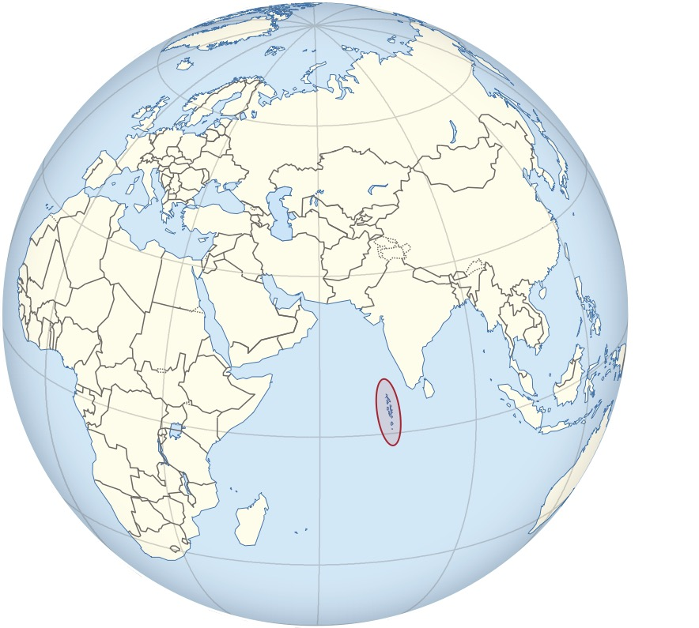
Study Area & Period
Haa Alifu
Haa Daalu
Haa Alifu, Haa Daahlu, and Kaafu Atolls in the Republic of Maldives
Climate: Warm, tropical with distinct dry and wet seasons
Maldives consists of over 1,100 islands
Study Period:
2016– 2022
Kaafu
30 KM
Image Credit: TUBS/Wikimedia commons
Notes:
Derik - The Maldives is an archipelagic nation in the Indian Ocean made up of 1,192 islands. The effects of climate change, especially sea level rise, are a critical concern. Human populations reside entirely on approximately 200 of the islands. As sea levels rise livable land shrinks.
Image Credit: QGIS & TUBS (Wikimedia commons)
Image: https://commons.wikimedia.org/wiki/File:Maldives_on_the_globe_(Afro-Eurasia_centered).svg

Slide 3
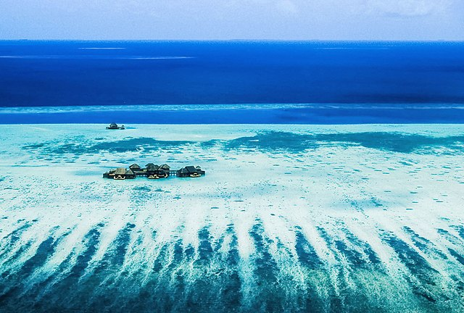
Community Concerns
Climate change has caused erosion of coastline due to sea level rise, leading to less habitable areas
Changes in water conditions may affect reef ecosystems and general community health
Sea level rise threatens fresh water sources
Image Credit: Nattu/Georgfotoart
Image Credit: Wikimedia Commons
Notes:
Daniel - Technical stakeholders in the Maldives are in need of satellite imaging support to better study the effects of climate change on the water and coastlines in the country. Since most of the country is at or near sea level, even small changes in ocean levels have large effects on the inhabitants of the islands.
Land cover of inhabited islands is shrinking. As sea level rises, beaches on the islands erode leading to less space to support human populations.
Freshwater is limited on the islands. As sea levels rise, salt intrusion is a threat to freshwater sources.
Increases in storm severity and temperature can alter conditions of coastal waters such as increases in suspended sediments and chlorophyll-a which have the potential to cause harm for reef ecosystems and general community health
Island countries and communities like the Maldives are some of the most dramatic illustrations of climate change. Studying climate and developing mitigation strategies for the Maldives could be relevant to other islands and coastal areas.
Technical stakeholders are interested in learning to use NASA satellites. The tutorial will give stakeholders in the Maldives a general process to go about using satellite data to quantify shoreline erosion and water quality in areas where data is currently limited
Image Credit: Nattu Adnan
Photo 2008
File:Maldives, a place you want to be - Flickr - nattu.jpg: Nattu from Male', Maldives derivative work: Georgfotoart, CC BY 2.0
Link: https://commons.wikimedia.org/wiki/File:Maldives,_a_place_you_want_to_be_-_Flickr_-_nattu_b.jpg

Slide 4
Objectives
Produce shoreline
maps
Time-series analysis of the change in shoreline over study period
Create a detailed tutorial explaining software and methodology​
Produce maps showing water quality parameters
Time-series analysis of the change in water quality over study period
Notes:
Daniel - Measure and map water quality using NDTI, historical chlorophyll-a, and SST values. Quantify and map coastal erosion using NDWI derived from Earth observations. Timeseries analysis over time will help to observe any possible trends that may have occurred throughout our study period.
Create a tutorial tailored to technical staff in the Maldives Ministry of Environment, Climate Change and Technology so that the Ministry can recreate our analysis for future monitoring.
Image credits: Microsoft PowerPoint

Slide 5
Project Partners
Maldives Ministry of Environment, Climate Change, and Technology​​
U.S. Department of State, Bureau of South-Central Asian Affairs, Office of Bangladesh, Nepal, Sri Lanka, Maldives, and Bhutan
USAID, Maldives Office
Notes:
Daniel -
The Ministry of Environment, Climate Change, and Technology, USAID, Maldives Office, and the US Department of State, Bureau of South and Central Asian Affairs, Office of Bangladesh, Nepal, Sri Lanka, Maldives and Bhutan are all interested in using satellite imagery to assess shoreline erosion and water quality in the Northern region of the Maldives. The project will provide them with the ability assess impacts of development on the surrounding areas of islands and produce time series analyses of shoreline change.
Image credits: Ministry of Environment, Climate Change, and Technology; U.S Department of State; USAID
Image Credits: Ministry of Environment, Climate Change, and Technology (http://www.environment.gov.mv/v2/en/); U.S Department of State (https://www.state.gov/); USAID (https://www.usaid.gov/branding)

Slide 6
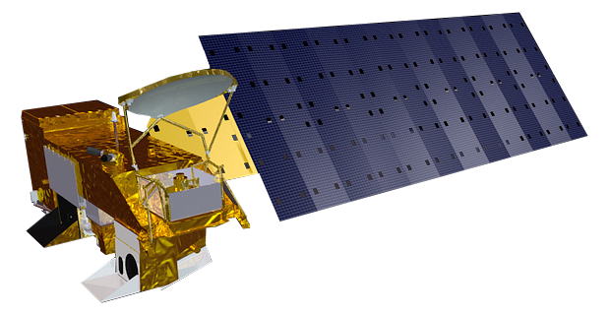
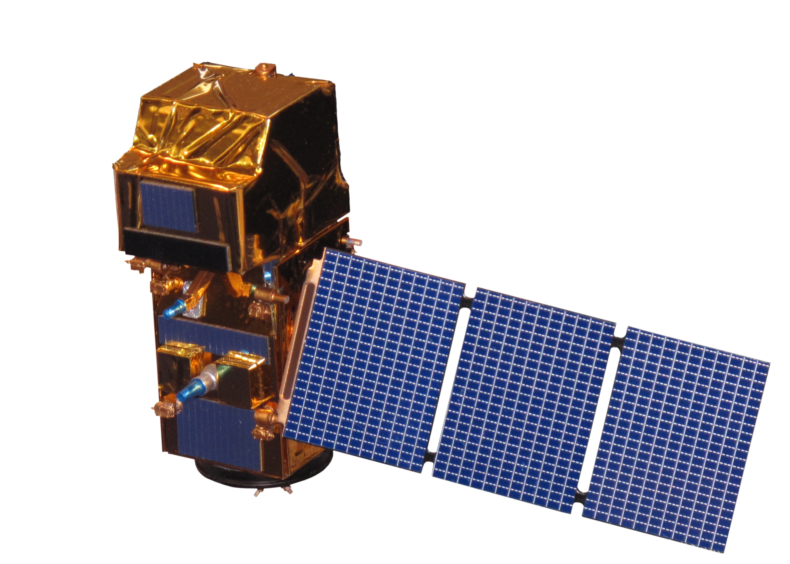
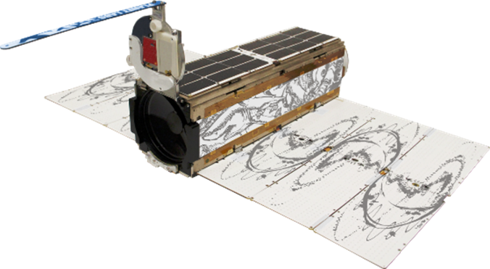
Earth Observations
Landsat 8 OLI
NDWI, MNDWI, NDTI
Sentinel-2 MSI
Chlorophyll-a, turbidity
Aqua MODIS
Chlorophyll-a, SST
PlanetScope
True color, NDWI
Aqua MODIS
Landsat 8 OLI
PlanetScope Dove
Sentinel-2 MSI
Imagery Credit: NASA, ESA, Planet Labs PBC
Notes:
Aidan - Landsat 7-9 imagery was used to produce Normalized Difference Water Indices (NDWI), Modified Normalized Difference Water Indices (MNDWI), and Normalized Difference Turbidity Indices (NDTI) from 200 to 2022
Aqua MODIS and Sentinel-2 data were both analyzed to measure chlorophyll-a using Normalized Difference Chlorophyll Indices (NDCI), as well as to measure turbidity
High resolution PlanetScope Imagery was used to measure shoreline erosion between 2016 and 2022
Image Credit: NASA, ESA, Planet Labs PBC
Images:
https://svs.gsfc.nasa.gov/cgi-bin/details.cgi?aid=10812; https://science.nasa.gov/get-involved/toolkits/spacecraft-icons; Imagery Credit: Planet Lab PBC, used with permission

Slide 7
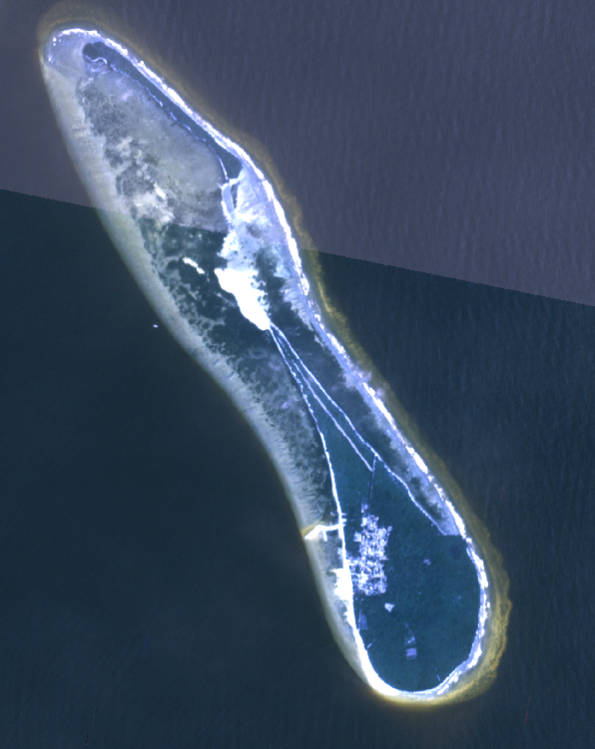
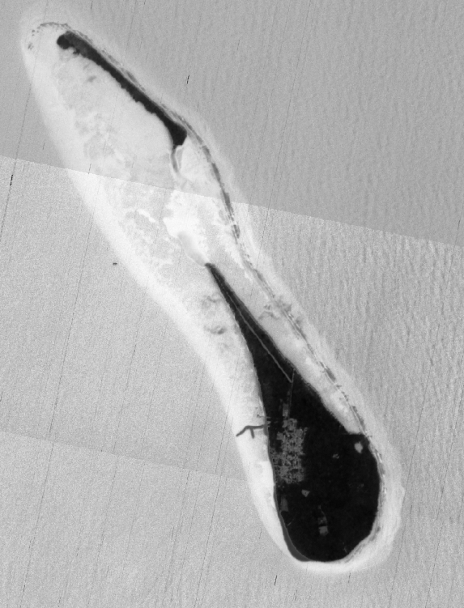
Methods: Shoreline Erosion Monitoring
Mulhadhoo 2020:
PlanetScope imagery
NDWI
NDWI land extraction
Raster to polygon conversion
Polygon to line conversion
Calculate distance and area
0 250 500m
0 250 500m
0 250 500m
N
N
N
Data: Planet Labs
PlanetScope
NDWI
Land Extraction
Notes:
Aidan - For shoreline erosion calculations, PlanetScope (credit: Planet Labs) images were classified into the classes land, and water using NDWI values. This classification was used to generate shoreline data.
From here, total area loss as well as distance in meters was calculated in QGIS using the field calculator, and a plugin called NNJoin

Slide 8
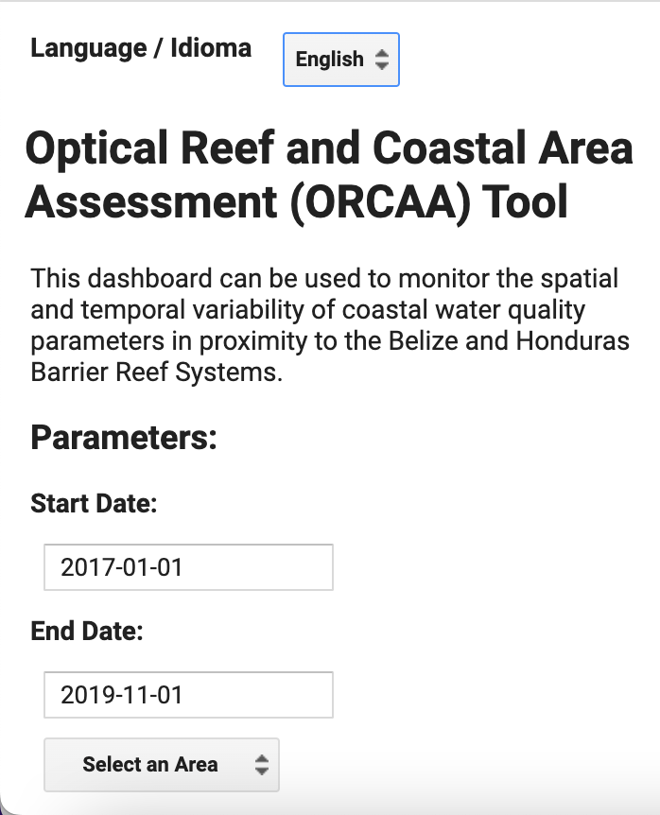
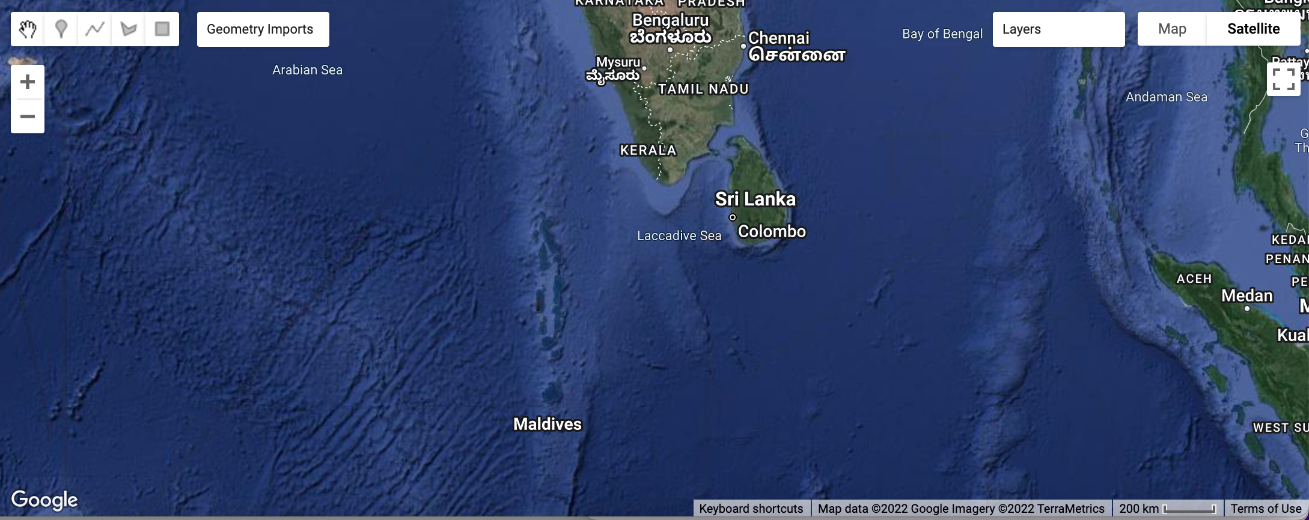
Methods: What is ORCAA?
Notes:
Daniel- The Optical Reef and Coastal Area Assessment (ORCAA) is a tool created by a previous develop team in Google Earth Engine to monitor water quality parameters. While its initial purpose was to assess the coastal waters of Honduras and Belize, our team had utilized the tool to see if it were capable of water quality assessments in the Maldives.
Image Credit: Google Earth Engine

Slide 9
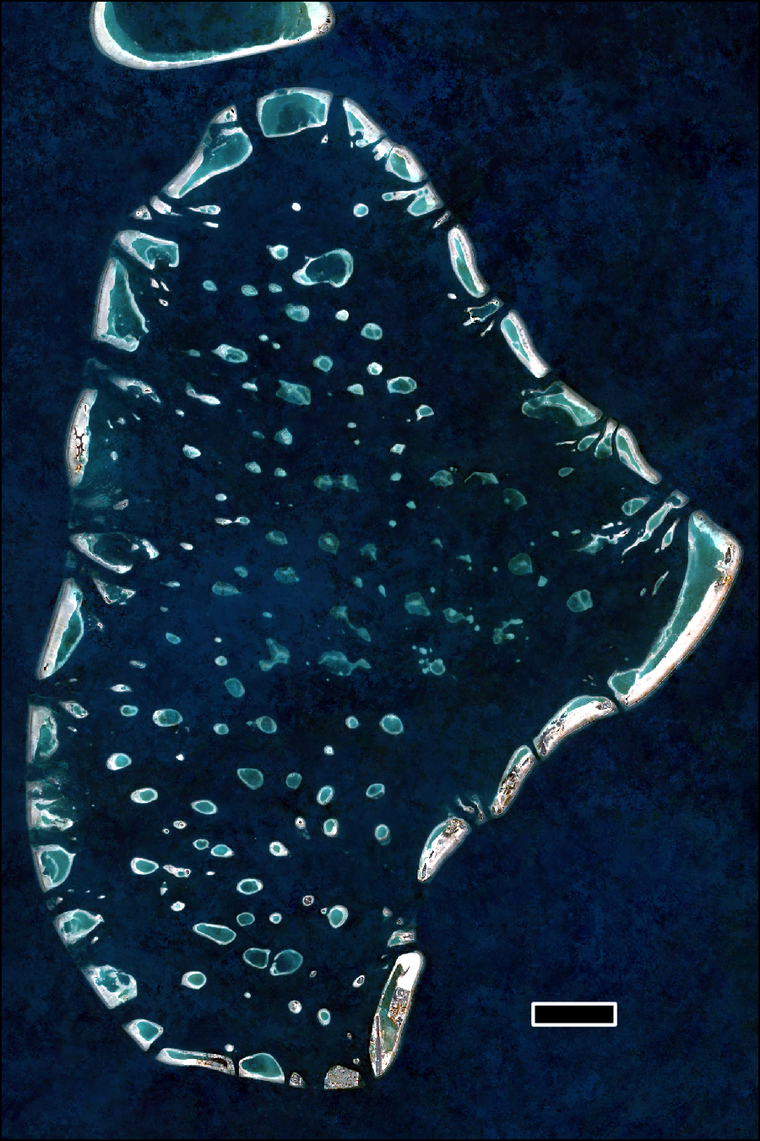
Methods: Water Quality Monitoring
Utilize ORCAA
Import shapefile
Obtain water quality data
Turbidity and Chlorophyll-a
Export TIFF and CSV
Create color palettes
Analyze time series
Kaafu Atoll
5 km
Notes:
Mitch – Our water quality workflow centers around the ORCAA tool in GEE as a way of monitoring water quality parameters. We retrieved Chlorophyll-a from ORCAA, which has a feature that performs a Normalized Difference Chlorophyll Index on Senintel-2 imagery and then uses a formula to convert index values into Chlorophyll concentrations. Similarly, turbidity is retrieved from ORCAA and measurements use both Sentinel-2 MSI and Landsat-8 OLI imagery using the reflectance of near infrared bands. Finally, we exported data from ORCAA in TIFF and CSV formats to analyze imagery and time series.
Image credit: Google Earth Engine

Slide 10
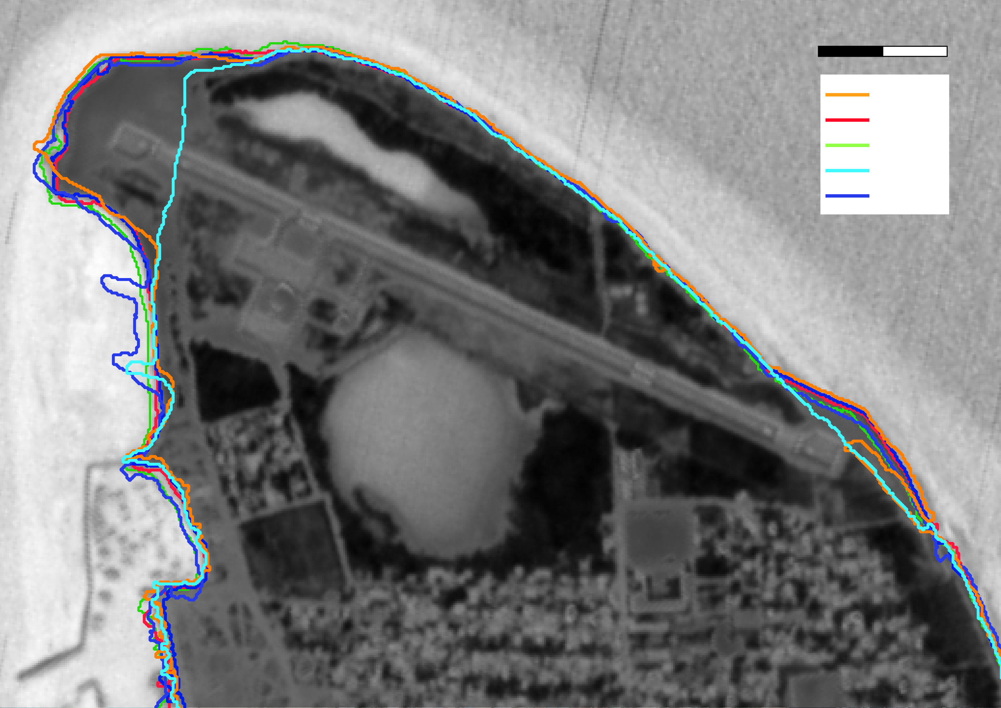
Results: Shoreline Erosion Maps & Graphs - Kulhudhuffushi
0 100 200 m
2017
2018
2019
2020
2021
2022
0 100 200 m N
Data: Planet Labs
Notes:
Aidan- This slide shows NDWI values for one of our target islands: Kulhudhuffushi. With this island we saw an overall increase in island area over our study period.
Shoreline development along with natural effects can lead to an increase in shoreline.
Data credit: Planet Labs

Slide 11
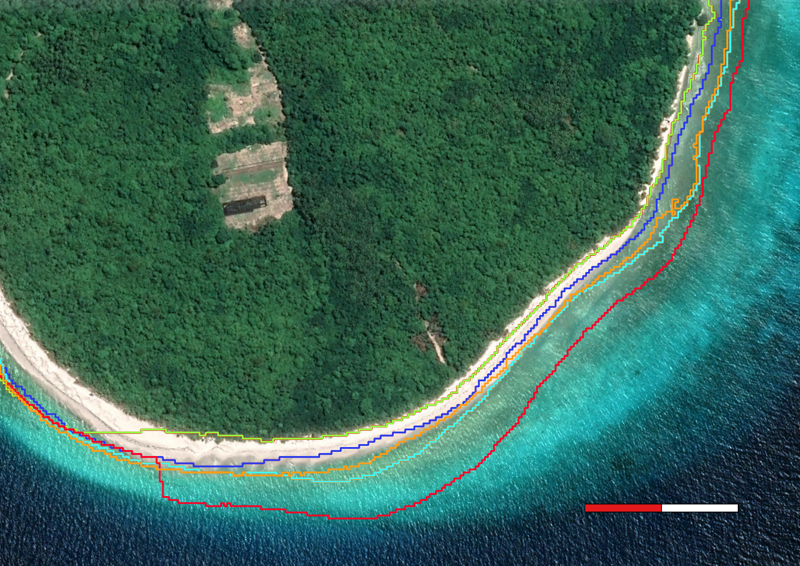
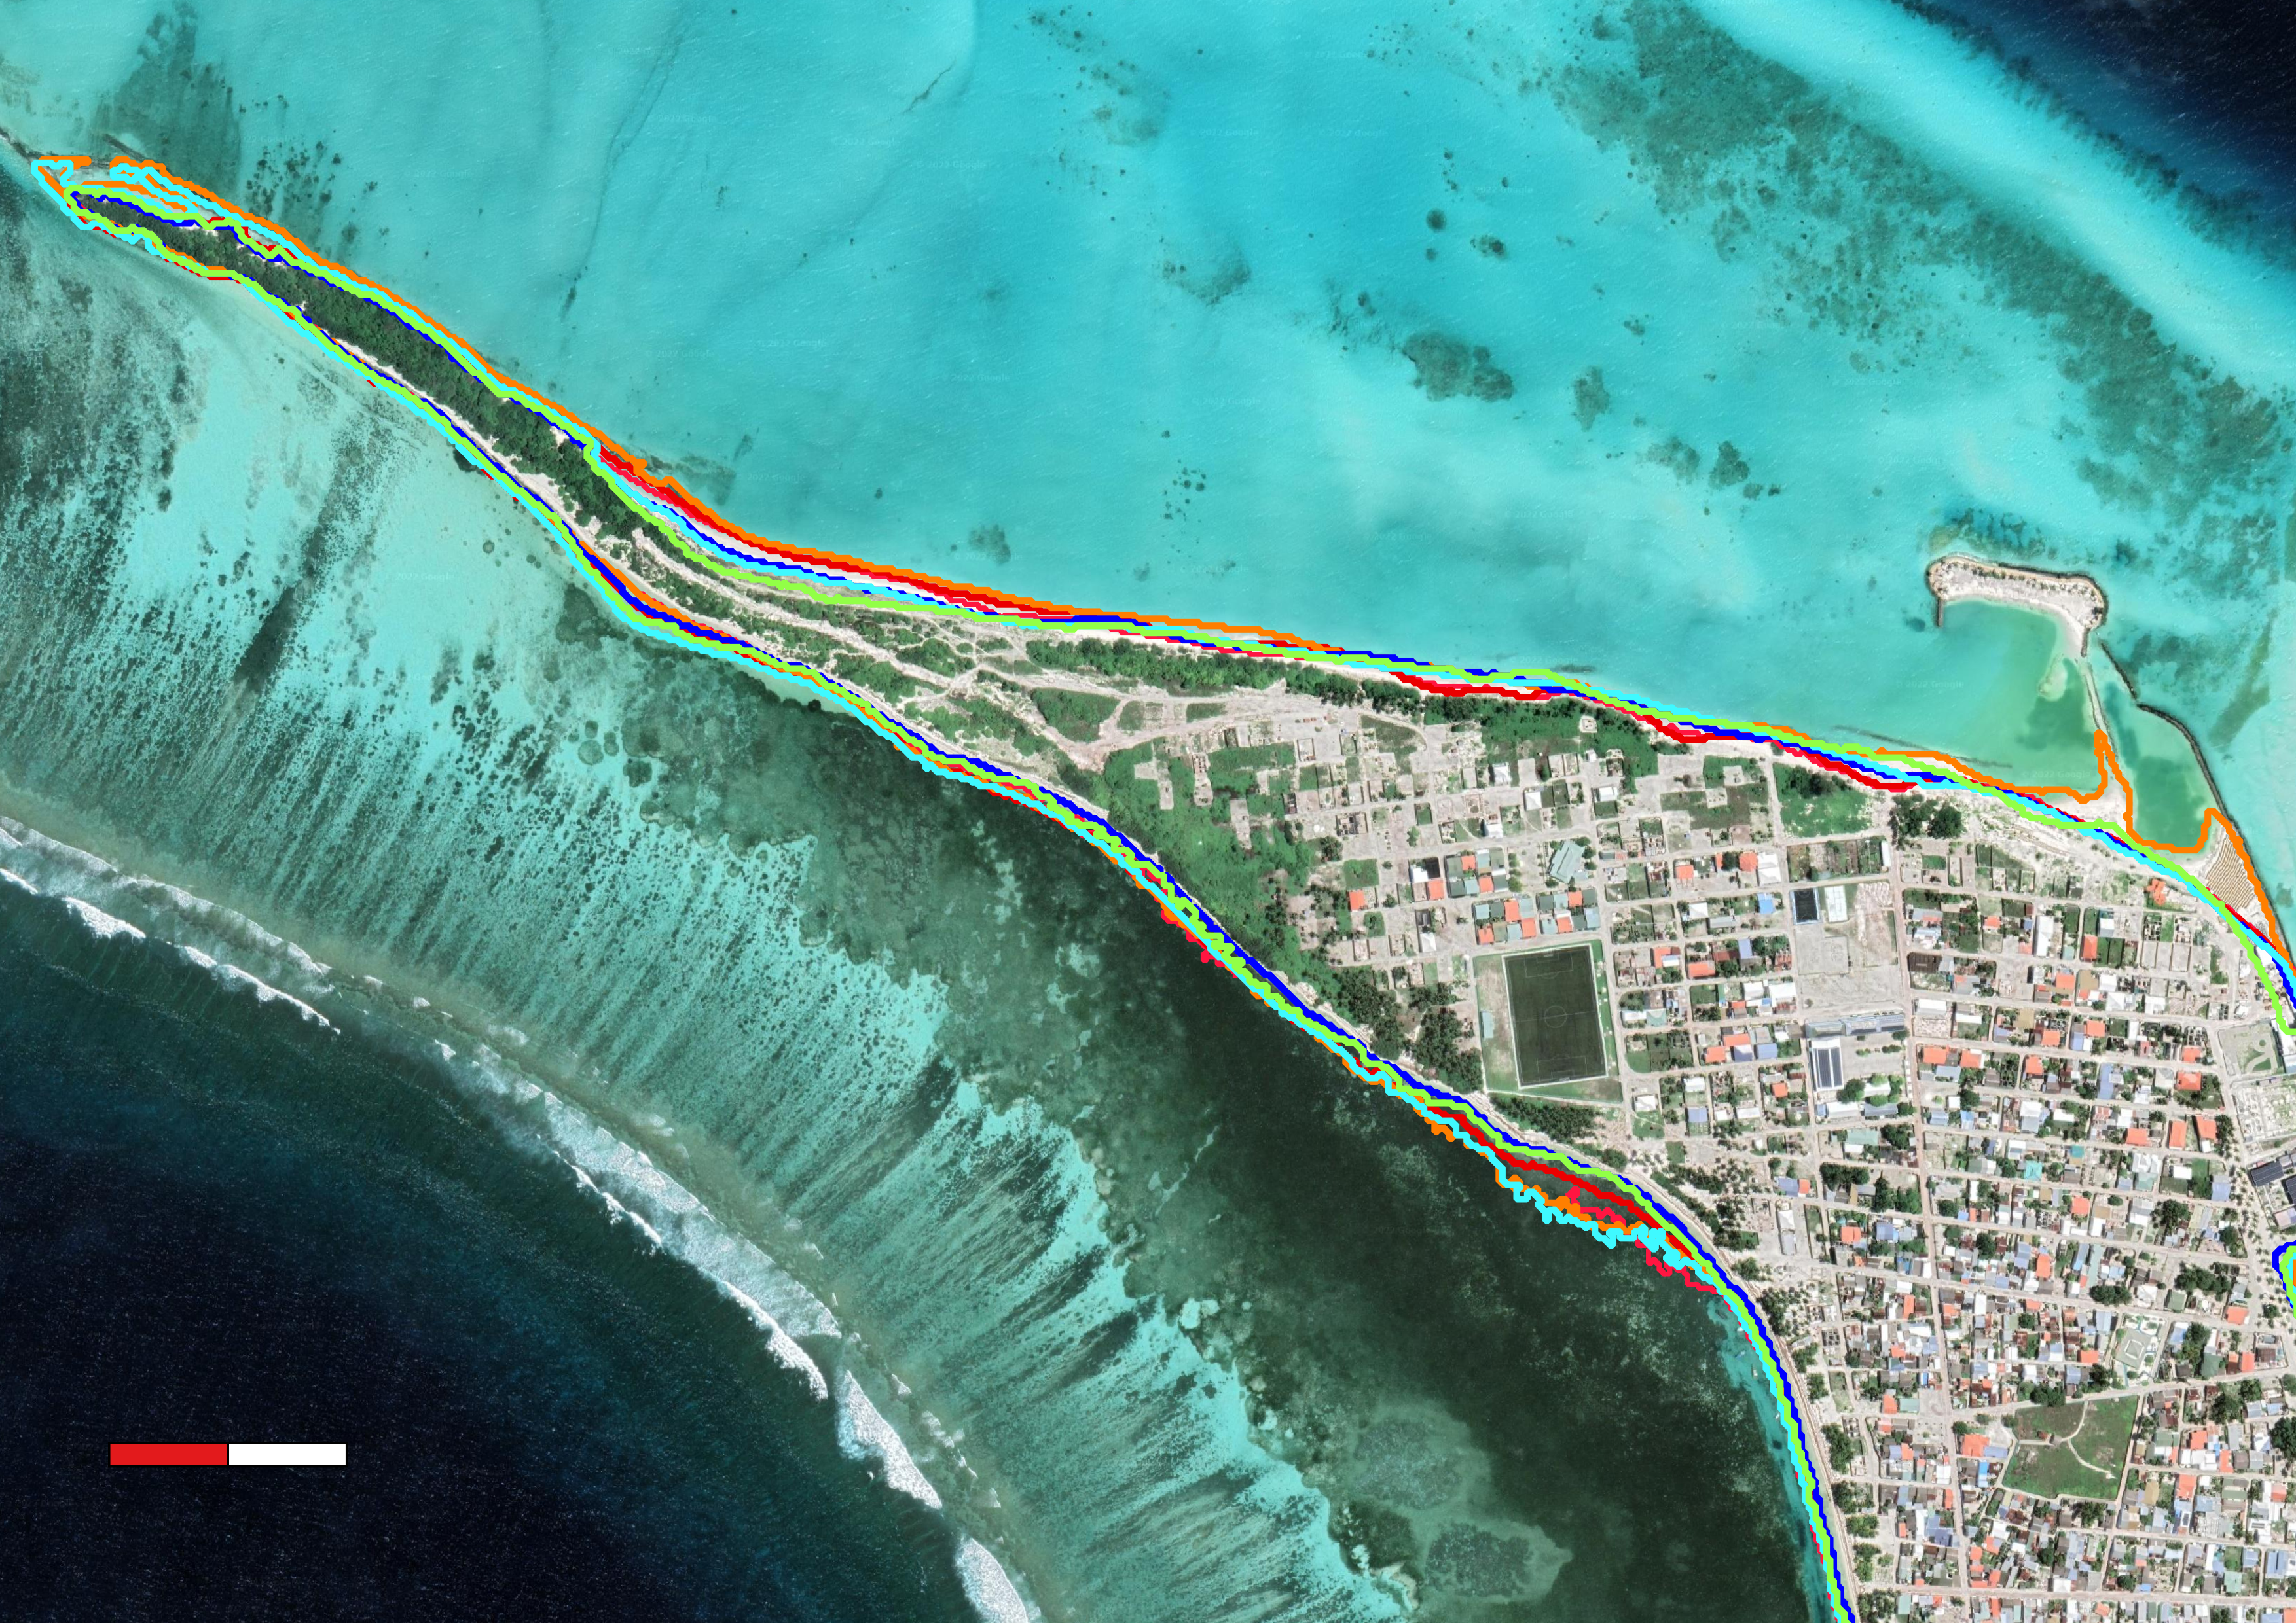
Mulhadhoo
Hoarafushi
0 100 200 m
0 100 200 m
N
N
2018
2019
2020
2021
2022
2017
2018
2019
2020
2021
2022
Large shift in mass along southwest section of island
Development on west of island affected geography
Construction of airport skewed overall change measurements
High level of human development prevented erosion in some areas
Image Credits: Google Satellite Basemap
Notes:
For Mulhadhoo, we saw a steady decrease in shoreline throughout the study period. The sections of the island that were most affected by this tended to have minimal urban development.
On Hoarafushi, we saw minimal change in area until the construction of a large airport between 2019 and 2020. We will review data for these two islands in the following slide
Image Credit: Google Satellite Basemap

Slide 12
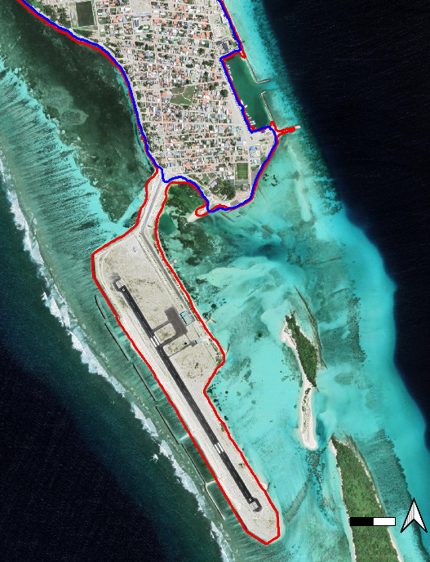
Results: Shoreline Change
1.28
1.26
1.24
1.22
1.2
1.18
1.16
1.14
2019
2020
1.4
1.3
1.2
1.1
1.0
0.9
0.8
0.7
0.6
0.5
Total Area (Km²)
Total Area (Km²)
2018 2019 2020 2021 2022
2017
2018
2019
2020
2021 2022
2018-2019
0 200m
0.4
0.35
0.3
0.25
0.2
0.15
0.1
0,05
0
-0.05
-0.1
2017-2018
2018-2109
2019-2020
2020-2021
0.02
0.01
0
-0.01
-0.02
-0.03
-0.04
-0.05
N
2021-2022
Hoarafushi Airport between 2019 and 2020
Change in Area (Km²)
Change in Area (Km²)
Image Credits: Google Satellite Basemap
Notes:
Aidan – In this slide we can review the total changes in area seen on our other two islands. We can see in the area change graph the sharp in crease in area following the construction of Hoarafushi Airport.
With Mulhadhoo, we see a steady decrease between 2018-2019, with erosion flattening out in 2020. After the initial decrease in area, the island has seen an increase in area size. This is likely due to factors such as weather or human development.
Image Credit: Google Satellite Basemap

Slide 13
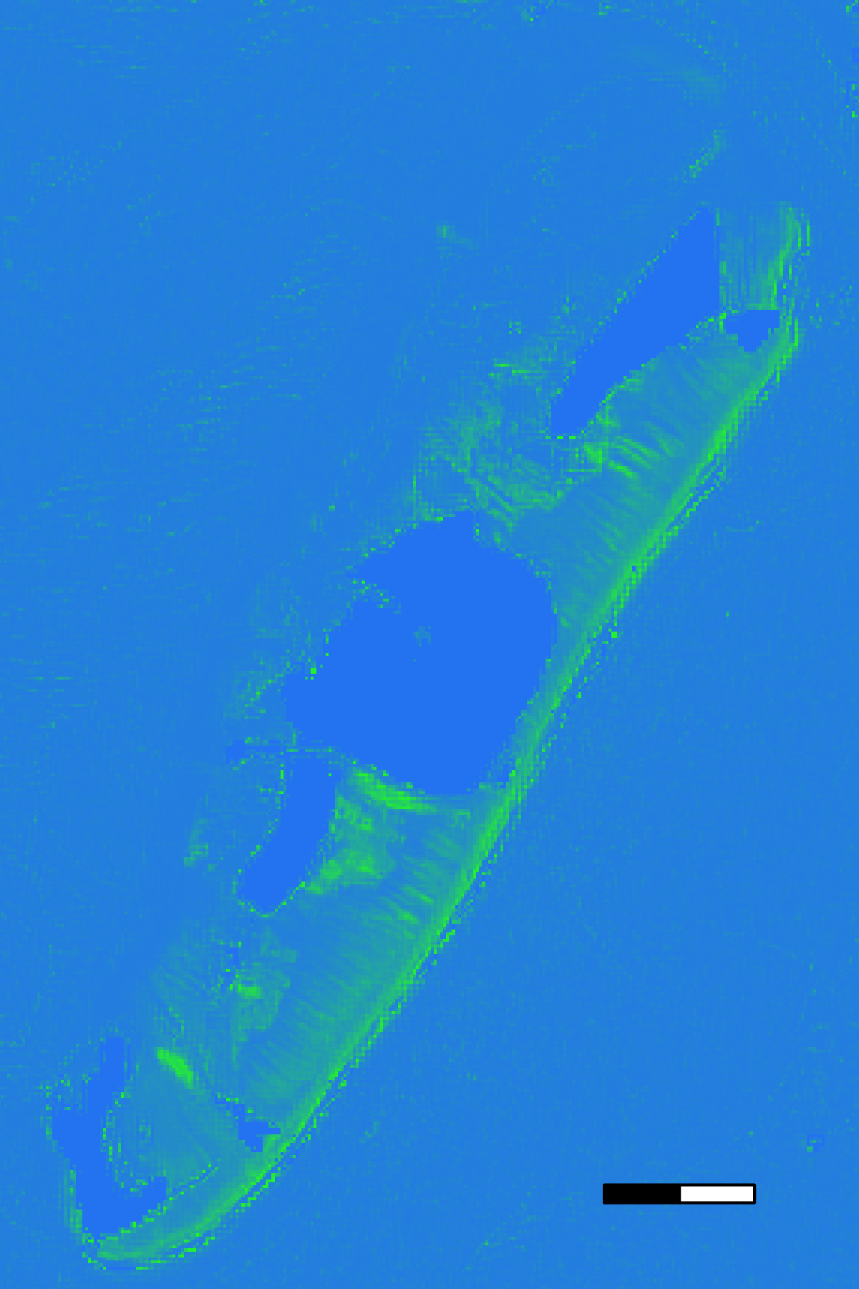
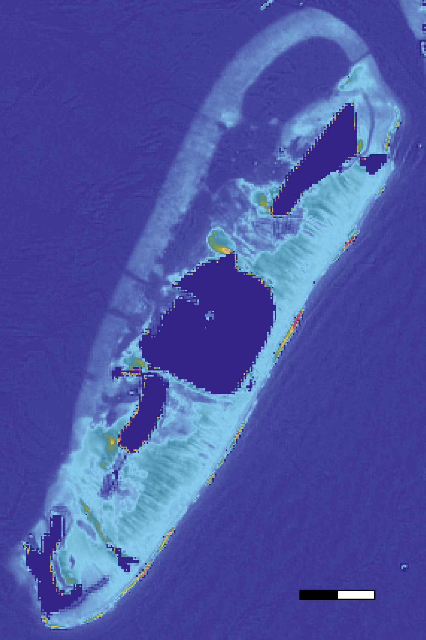
Results: Water Quality Maps & Graphs
12
11
10
9
8
Chlorophyll-a (mg/m³)
7
6
5
4
04/2016
04/2017
04/2018
04/2019
04/2020
04/2021
04/2022
Date
Turbidity (FNU)
0.5 km
0.5 km
Chlorophyll-a (mg/m³)
Turbidity(FNU)
0
50
0
100
04/2016
04/2017
04/2018
04/2019
04/2020
04/2021
04/2022
Date
Notes:
Mitch
We collected imagery from 2016-2022 for chlorophyll-a, turbidity, and SST at the Kaafu Atoll. The images shown display chl-a and turbidity imagery for the month of March 2022. The first thing I want to mention is the difference between Chl-a values in the time series versus the imagery. The time series shows an average value of chl-a concentration for the entire image, while the image shows a specific value at each pixel. This explains why Chl-a values are much higher in regions on the image than they are anywhere on the time series. Additionally, chl-a and turbidity values are impacted by bottom reflectance. Most likely what you are "seeing" in shallow waters is seagrasses or some algae and not Chl-a from the water column. With the lack of in situ validation with bio-optical data collected during the satellite overpass, Chl-a values are most likely overestimated by ORCAA. Usual Chl-a values for such clear reef waters do not go over ~1-3mg/m3. Overall, ORCAA assessments for water quality were inconclusive for accurately detecting seasonal and annual trends for both chlorophyll concentrations and turbidity. However, ORCAA provides valuable imagery at both the island and atoll levels, so ORCAA imagery provides valuable insight for understanding and monitoring water quality.

Slide 14
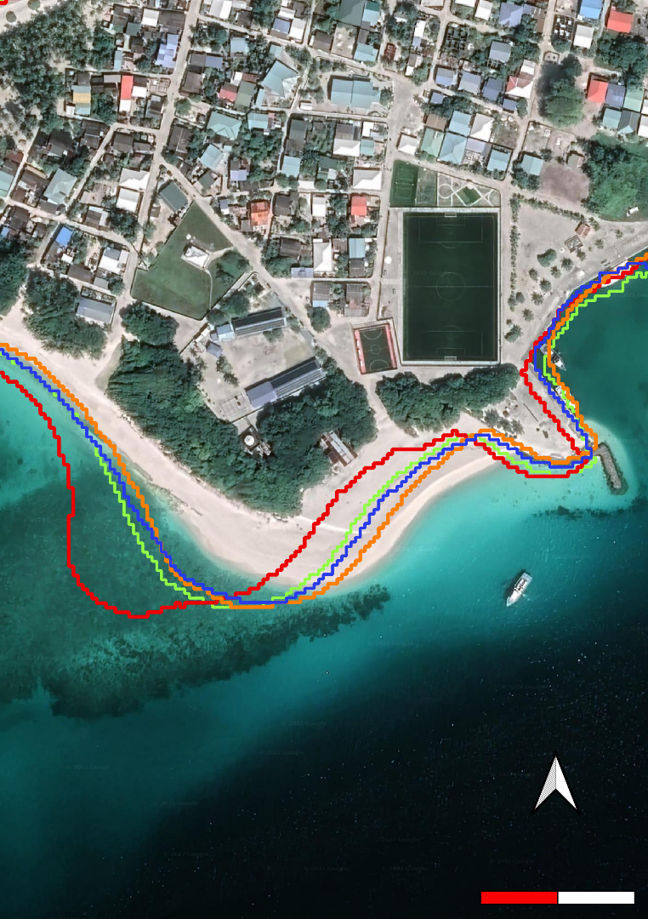
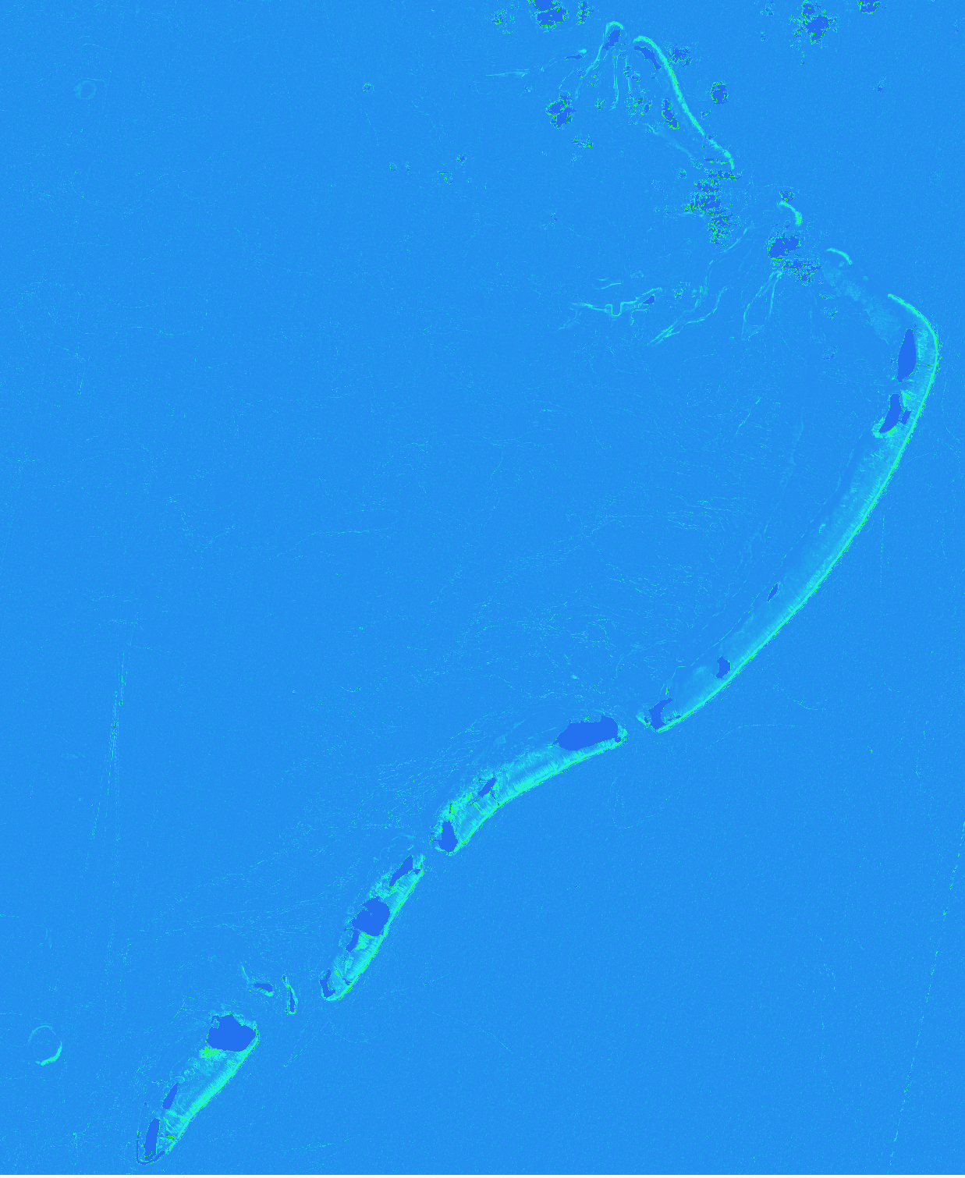
Conclusions
High resolution imagery provided detailed analysis of shoreline change.
Shorelines experience dynamic interannual variability, indicating shoreline extent is highly dependent on both environmental and anthropogenic forces.
ORCAA assessments for water quality were inconclusive for accurately detecting seasonal or annual trends for both chlorophyll concentrations and turbidity.
N
0 100 200m
5 KM
2018
2019
2020
2021
Image Credits: Google Satellite Basemap
Notes:
Mitch
High resolution imagery, particularly from PlanetScope, allowed the team to execute detailed analysis of shoreline erosion in the Maldives. Results indicate that shorelines are highly dynamic and are influenced by both anthropogenic and natural forces. Shoreline erosion analyses highlighted the dynamic nature of atolls in the Maldives, with shorelines decreasing and increasing in extent from year to year. Water quality assessments conducted through ORCAA were inconclusive in detecting long term or seasonal trends in both chlorophyll-a and turbidity, but provide valuable imagery for understanding and monitoring water quality at a monthly time scale.
Image Credit: Google Satellite Basemap

Slide 15
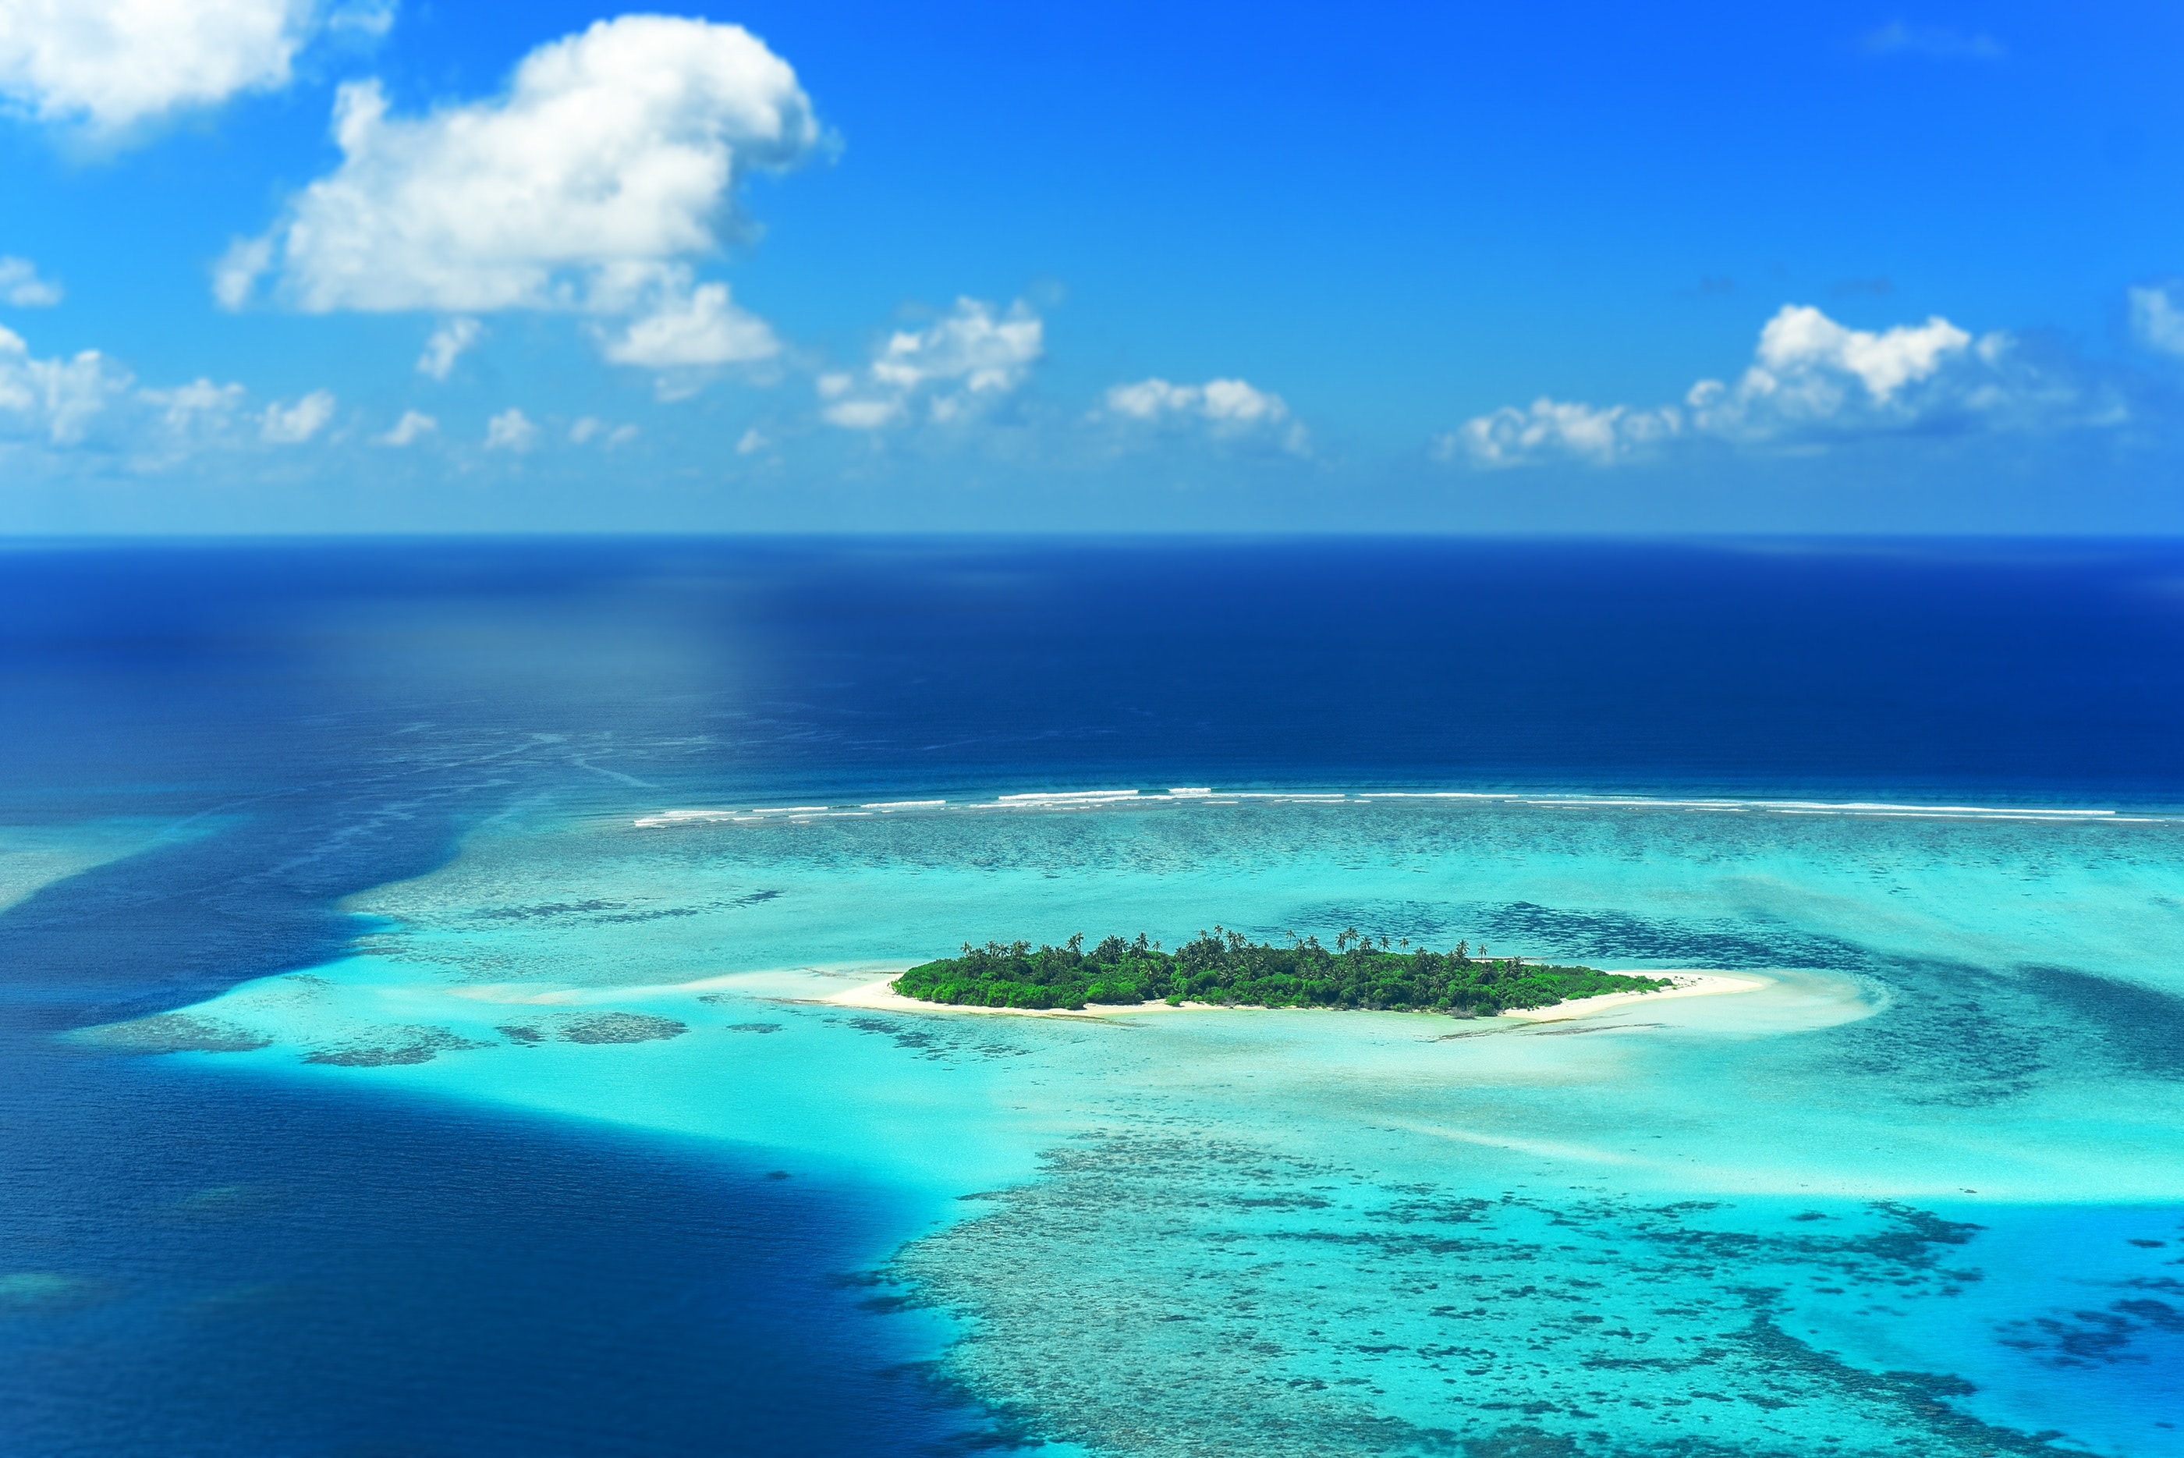
Limitations and Uncertainties
The low resolution of satellite imagery prior to 2016 made accurate shoreline change analysis difficult
Lack of in situ data prevented validation of changes detected
Limited data availability over study area
Uncertainty in chlorophyl-a values and potential influence of bottom reflectance from benthic components
Image Credit: Asad Photo Maldives
Notes:
Aidan - Low resolution was one of the main limitations faced by the team. Additionally, the lack of in situ data prevented us from validating our shoreline change calculations. The clear shallow water found in the Maldives created uncertainty in the water quality values we calculated
Image Credit Asad Photo 2018: https://www.pexels.com/@asadphotography/; https://www.pexels.com/photo/aerial-photography-of-body-of-water-1268860/; free to use

Slide 16
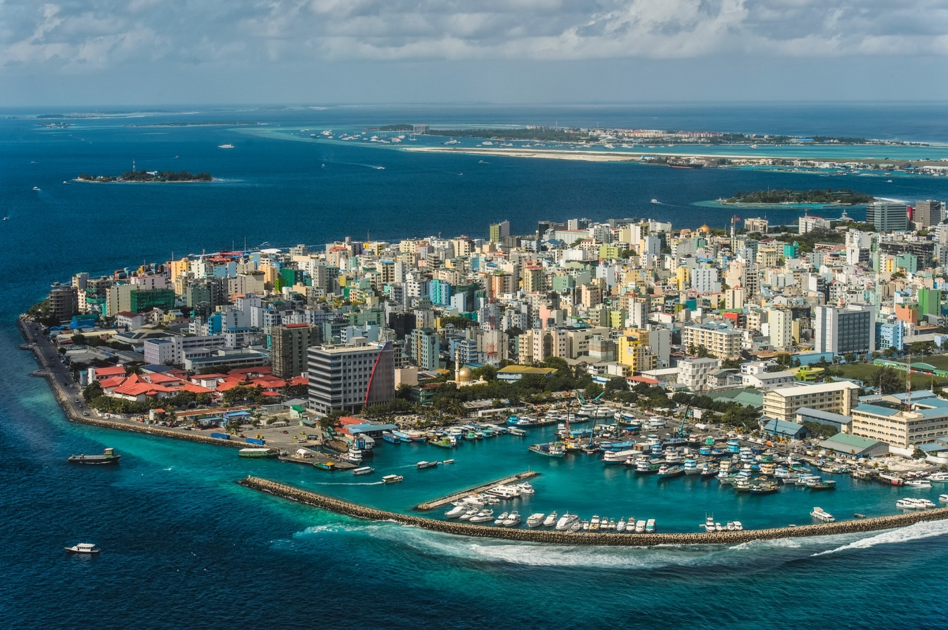
Future Work
Address human development and coastal infrastructure
Expansion on shoreline and water quality results
Land cover classification would benefit end users
Additional incorporation of in situ data
Include more information on the effects of weather on results
Image Credit: US State Department
Notes:
Mitch
The first way that we will expand on this work is through another DEVELOP term this spring focusing on Maldives Climate. The project will highlight human development and coastal infrastructure in the Maldives, with specific study sites coordinated by the upcoming team and partners. Additionally, expanding on both the shoreline erosion and water quality results to further understand the island dynamics is important. Land classification using remotely sensed imagery would be beneficial to end users, as well as incorporating in situ data to add validation values and confidence to results. Finally, including more information on the effects of weather into results would be valuable in understanding the interannual dynamics seen by shoreline erosion results.
Image Credit: US State Department; Image: https://www.state.gov/countries-areas/maldives/
Office 365/Powerpoint Icons

Slide 17
Lisa Tanh (NASA Ames Research Center)
Dr. Juan Torres-Pérez (NASA Ames Research Center)
Dr. Kent Ross (NASA Langley Research Center)
Britnay Beaudry (NASA Ames Research Center)
Partners
Maldives Ministry of Environment, Climate Change and Technology
U.S. Department of State, Bureau of South and Central Asian Affairs, Office of Bangladesh, Nepal, Sri Lanka, Maldives, and Bhutan
USAID, Maldives Office
This material contains modified Copernicus Sentinel data (2016-2022), processed by ESA.
Notes:
Aidan -

