Slide 1



2020 Spring
NATIONAL
ORIENTATION
MODULE 2. About DEVELOP

Slide 2

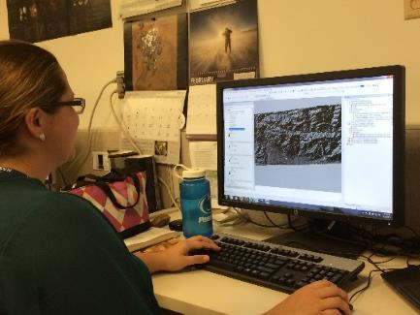
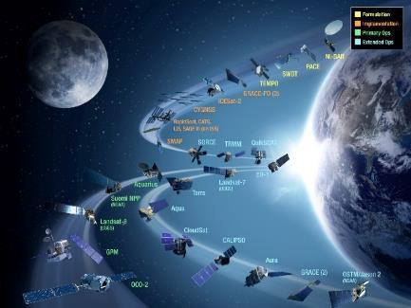
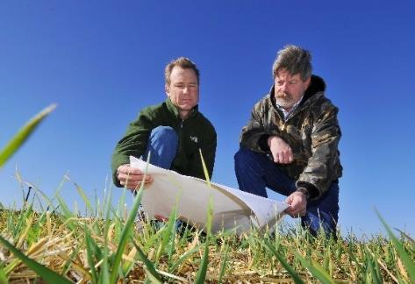

DEVELOP National Program
“Shaping the future by integrating Earth observations into global decision making.”
Participants + Earth Observations + Decision Makers
DEVELOP bridges the gap between NASA Earth Science and society,
building capacity in both its participants and end-user organizations to better prepare them to handle the environmental challenges that face society.
Elevator Speech: DEVELOP, part of NASA’s Applied Sciences’ Capacity Building Program, addresses environmental and public policy issues by conducting interdisciplinary feasibility projects that apply the lens of NASA Earth observations to community concerns around the globe. Bridging the gap between NASA Earth Science and society, DEVELOP builds capacity in both participants and partner organizations to better prepare them to address the challenges that face our society and future generations.

Slide 3
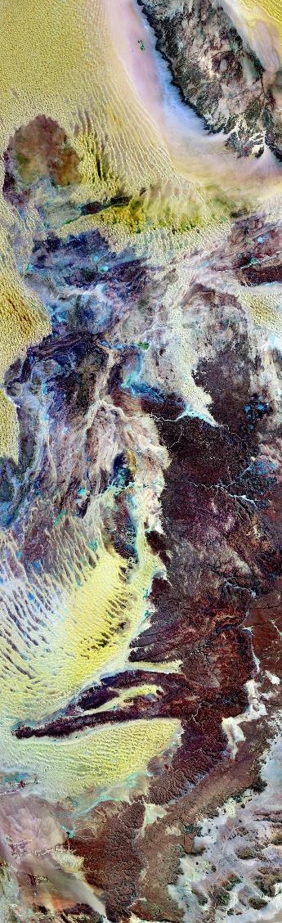
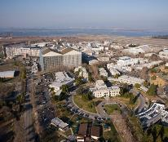
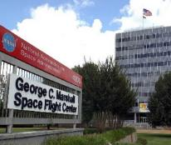
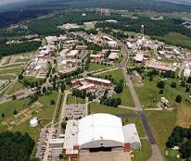
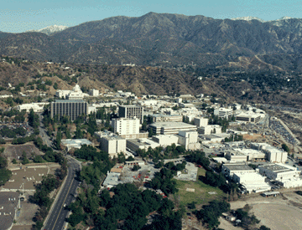
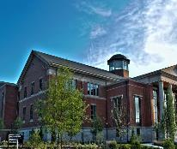
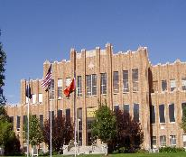
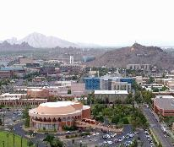
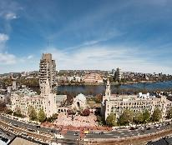
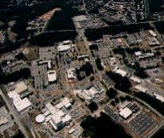
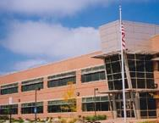
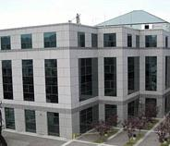
DEVELOP History
In 1998, three interns at NASA Langley Research Center co-authored the white paper “Practical Applications of Remote Sensing.”
At that time, the Digital Earth Initiative, a federal interagency project dedicated to creating a virtual representation of the Earth to further human understanding of the world, was piloting an effort to increase public access to federal information about the Earth and the environment. A proposal combining NASA’s Digital Earth Initiative and the students’ paper advocated the formation of a program, and in 1999 DEVELOP was officially formed.
Beginning in 2001, expansion beyond Langley began and continues to today.
Ames
2003
JPL
2008
Marshall
2008
Pocatello, ID
2015
Boston, MA
2018
Athens, GA
2013
Langley
1998
2004
Goddard
2012
Fort Collins, CO
2014
Asheville, NC
2016
Tempe, AZ
Notes:
Note: a white paper is a government or other authoritative report giving information or proposals on an issue

Slide 4

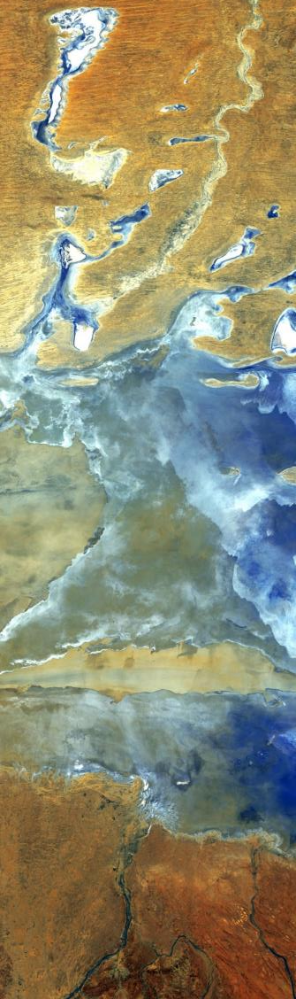
DEVELOP’s Mission & Vision
Mission: Integrating NASA Earth observations with society to foster future innovation and cultivate the professionals of tomorrow by addressing diverse environmental issues today.
Vision: Shaping the future by integrating Earth observations into global decision making.
Core Values:
  Collaboration: Cultivating teamwork, multi-disciplinary solutions, and open communication
  Discovery: Building new skills and exploring the potential of NASA’s investment in Earth science
  Service: Dedicating ourselves to the application of Earth science for societal benefit
  Passion: Pursuing all endeavors with energy and enthusiasm to sustain a high level of excellence
By The Way
NASA’s
core values are:
Safety
Excellence
Teamwork
Integrity
DEVELOP shares these
as well!

Slide 5

DEVELOP Culture
Our approach to teamwork is based on a philosophy that each team member brings unique experience and important expertise to tasks at hand. We encourage and reward vigorous, open flows of communication on all issues, in all directions.
We are committed to creating an environment that fosters teamwork and processes that support continuous learning, innovation, and an openness to new ideas.
We are adaptable, quick to respond, and go where others don’t, providing more service than is expected.
We pursue all endeavors with energy, excitement, and enthusiasm and are committed to maintaining an environment of trust, built upon honesty, ethical behavior, respect, and candor.
DEVELOP nurtures an organizational culture in which individuals make full use of their time, talent, and opportunities to pursue excellence in both the ordinary and the extraordinary.
Collaborative
Dynamic
Innovative
Professional
Service-Oriented
Passionate
Excellent

Slide 6

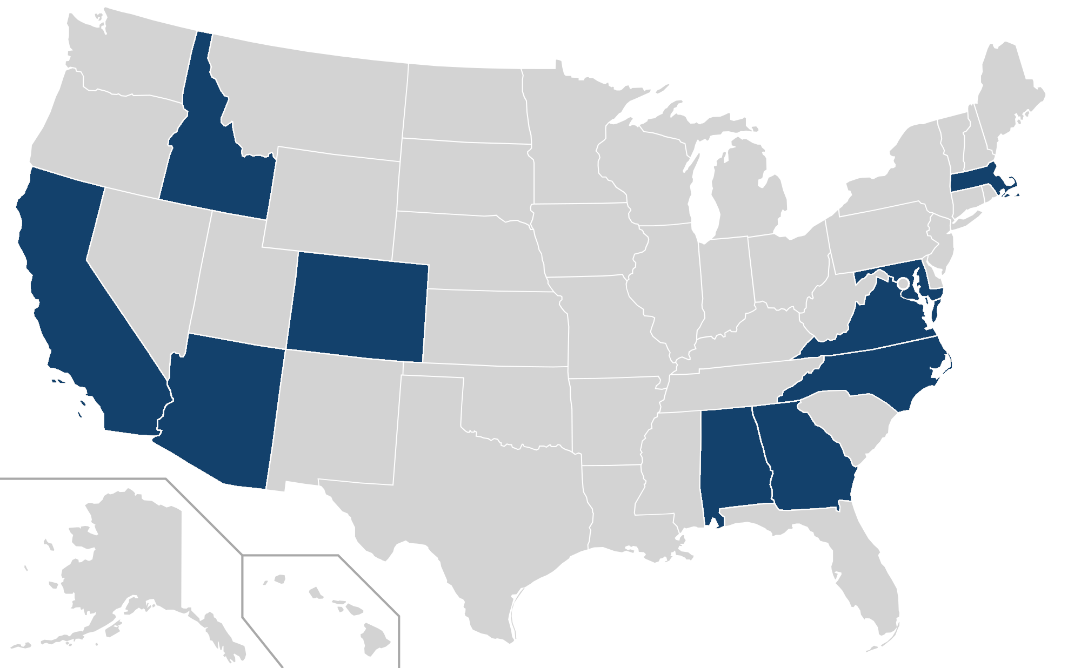
By The Way
DEVELOP locations are also known as “nodes”
DEVELOP Locations
9
7
3
5
8
Alabama – Marshall
Arizona – Tempe
California – Ames
California – JPL
Colorado – Fort Collins
Georgia – Athens
Idaho – Pocatello
Maryland – Goddard
Massachusetts – Boston
North Carolina – NCEI
Virginia – Langley
11
4
10
2
1
6
Notes:
Note:
Blue = NASA Center Nodes
Orange = Regional Nodes

Slide 7
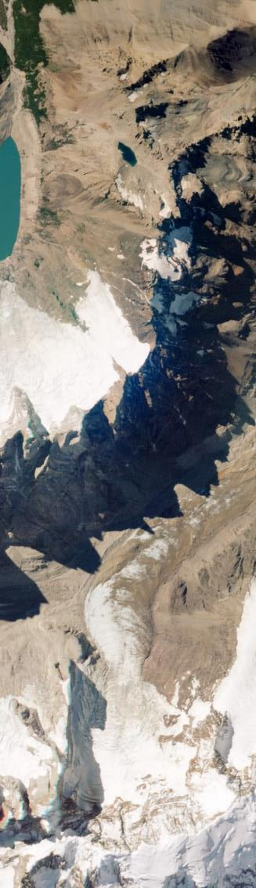
DEVELOP Structure
National Chain of Command
Node Chain of Command
NPO
Senior Fellow
Lead/Fellow
Participant
NPO
Lead/Fellow
Science Advisor & Mentors
Assistant Lead
Project Lead
Team Members
By The Way
While there may be a chain of command, the program is actually very informal and communication is open between all levels. Never hesitate to reach out!

Slide 8
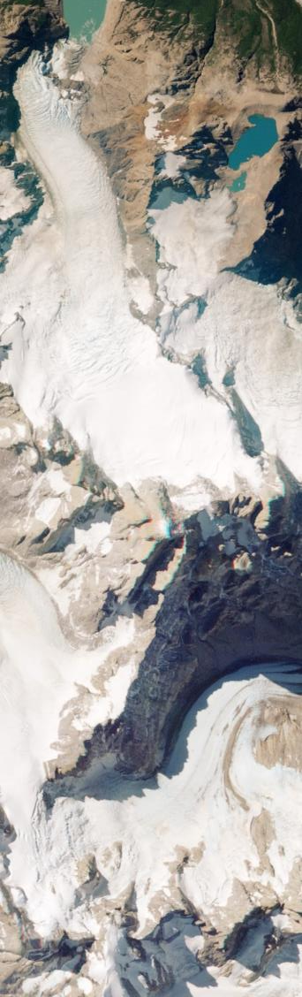
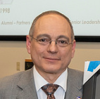
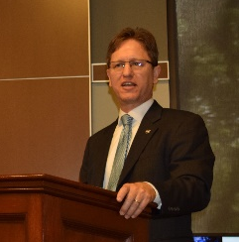
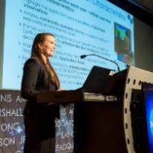
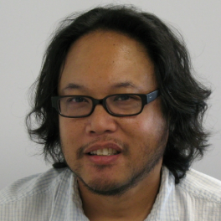
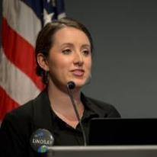
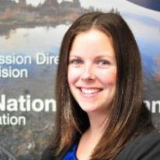
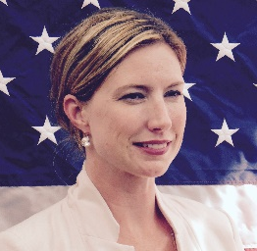
What is the DEVELOP NPO?
DEVELOP’s National Program Office (NPO) is the core leadership team who manage and facilitate all of the various aspects of the program.
The NPO sits at NASA Langley Research Center down the hall from the node participants.
NPO consists of:
Mike Ruiz
Program Manager
Dr. Kent Ross
National Science Advisor
Amanda Clayton
Projects Manager
Danny Mangosing
Web Developer &
Graphic Designer
Lindsay Rogers
Deputy Program Manager
Karen Allsbrook
Financial Lead
Stephanie Burke
SSAI Human Resources
By The Way
They’re normal people too and you are welcome to reach out to them! You will meet them in beginning of term “meet & greets” and they often visit nodes!

Slide 9

National POCs
DEVELOP
NPO
Mike Ruiz
Lindsay Rogers
Dr. Kenton Ross
Karen Allsbrook
Amanda Clayton
Danny Mangosing
Stephanie Burke
Senior Fellow
Danielle Quick
DEVELOP Fellows
Alabama – Marshall
Rochelle Williams
Arizona – Tempe
Crystal Wespestad
Georgia – Athens
Shelby Ingram
Idaho – Pocatello
Mason Bull
Maryland – Goddard
Darcy Gray
Massachusetts – Boston
Celeste Gambino
North Carolina – NCEI
Andrew Shannon
Virginia – Langley
Sydney Neugebauer
California – Ames
Gina Cova
Zach Bengtsson
Colorado – Fort Collins
Kristen Dennis
California – JPL
Cecil Byles

Slide 10
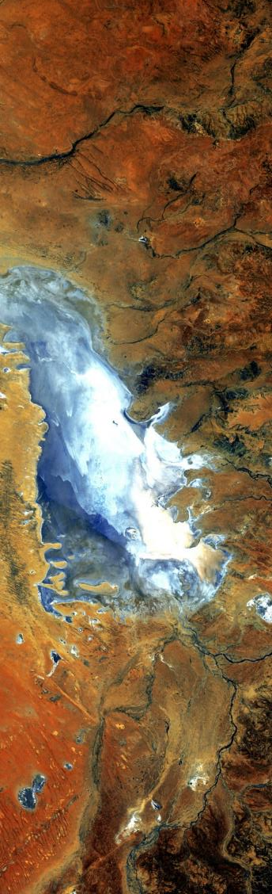


Questions? Contact…
Deliverables, publications, presentations, conferences, deadlines, international work, webinars, partners, project hand-offs, proposals, Fellow positions
Amanda: 757-864-5552 Amanda.L.Clayton@nasa.gov
Contracts, payroll, SSAI systems, travel, schedule adjustments, paperwork, online application system, employment verifications, SSAI
Karen: 757-864-1276 Karen.N.Allsbrook@nasa.gov
Programmatic questions, budget, social media approvals, media requests, NASA
Lindsay: 757-864-7283 Lindsay.M.Rogers@nasa.gov
Impact Analysis Team-related items, tracking metrics, indicators, socioeconomic impact analysis, PSI, participant surveys, alumni survey, using the national telecon line
Danielle: 757-864-5548 Danielle.L.Quick@nasa.gov
DEVELOP Website, software release, interactive mapper, software licenses, IT, communications
Danny: 757-864-3762 daniel.c.mangosing@nasa.gov
Employment status, offer letters, SSAI application, SSAI systems, employment verifications, SSAI POC
Stephanie: 757-864-4498 Stephanie.Burke@ssiahq.com

Slide 11


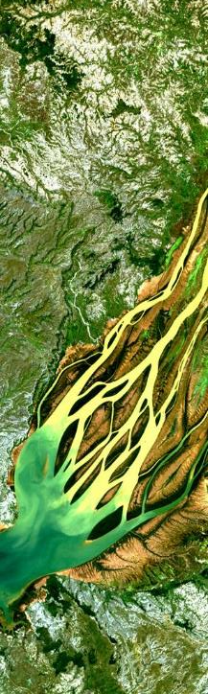


DEVELOP Social Media
DEVELOP National Program: features projects, node highlights & accomplishments, VPS announcements www.facebook.com/developnationalprogram
Once a DEVELOPer, Always a DEVELOPer: job posts
https://www.facebook.com/groups/387243741376125/
Articles & Important Events: Tweet @NASA_DEVELOP or #NASADEVELOP
http://twitter.com/#!/nasa_develop
NASA DEVELOP National Program:
VPS and promotional videos www.youtube.com/user/NASADEVELOP
NASA DEVELOP National Program: job posts, job skills & tips, and important events. This is a private group! Follow the link to join!
www.linkedin.com/groups/4343498
By The Way
Watch time spent on social media. If you are going to be on it, you should probably be on the DEVELOP pages liking and commenting on DEVELOP posts!

Slide 12

Important Things to Note
DEVELOP IS part of NASA’s Applied Sciences Program.
DEVELOP is NOT part of NASA’s Office of Education.
DEVELOP is very different from NASA’s internship opportunities in the way we approach projects, focus on teamwork, the level of responsibility and authority given to participants, the opportunities we provide, and the individuals and organizations we network with. Enjoy it while you are here!
Earth observations and Earth science data are objective, transparent, and policy-neutral.
NASA Earth Science does NOT develop or prescribe policy. Other agencies and organizations use the data and scientific results in their policy analysis and development.
Travel is restricted and carefully managed, meaning that guidelines are in place to gain approval for travel. Travel is a privilege!

Slide 13

Quiz Time!
What year did DEVELOP begin?
How many locations does DEVELOP have?
What is a DEVELOP location called?
What is the DEVELOP NPO?
Who should you contact if you have a project-related question?
Who should you contact if you have a schedule or payroll-related question?

Slide 14

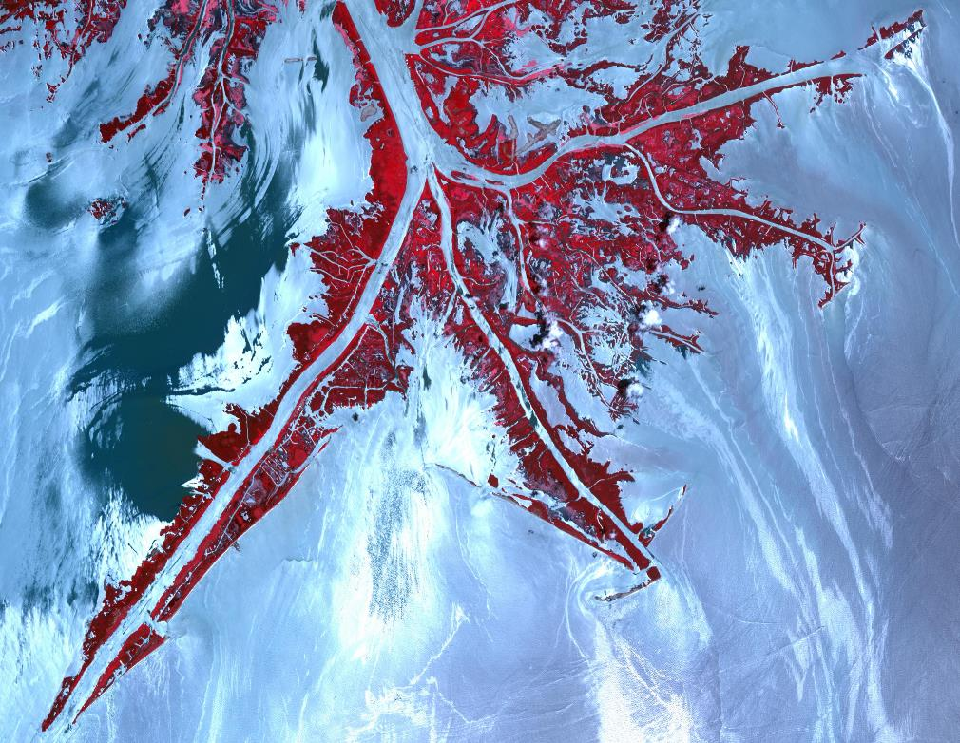

THANK YOU!
You’re welcome for these DEVELOP knowledge bombs that just got dropped on you!

