Slide 1
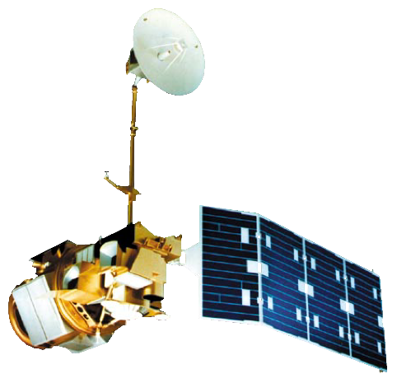
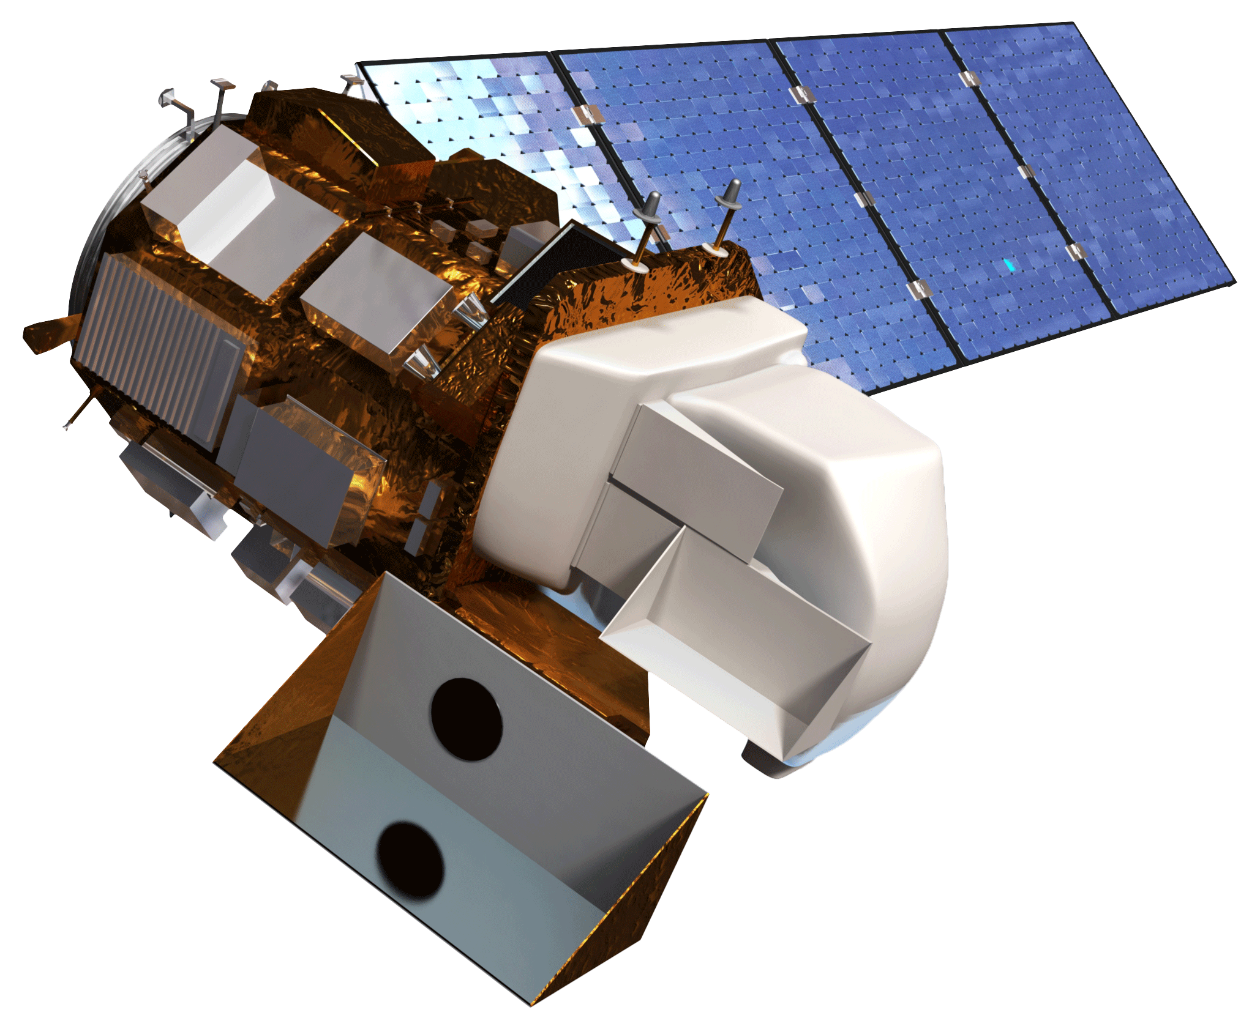
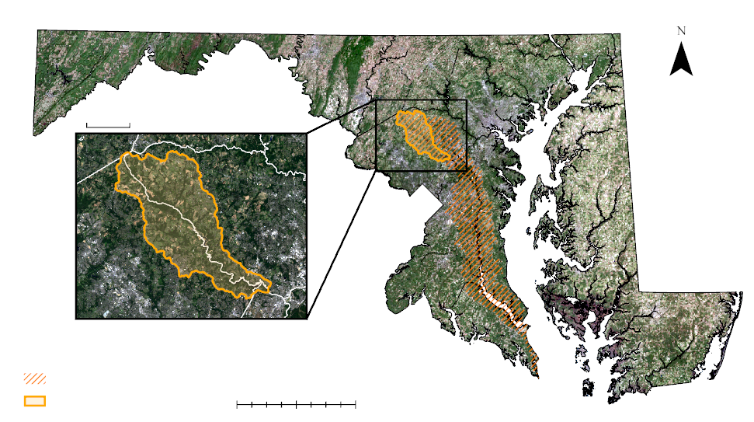
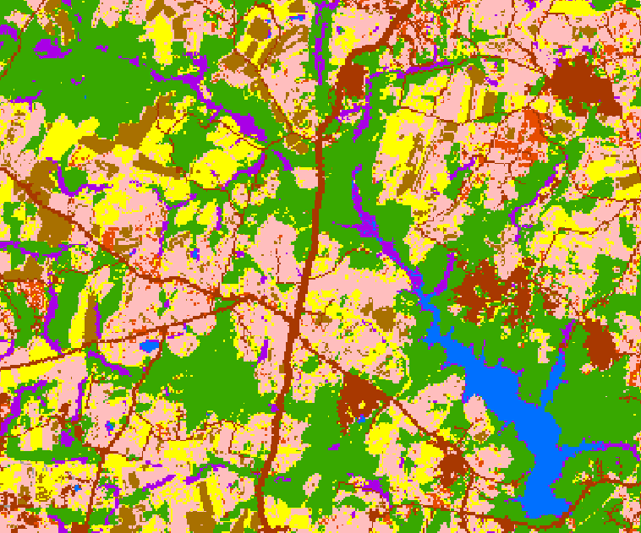
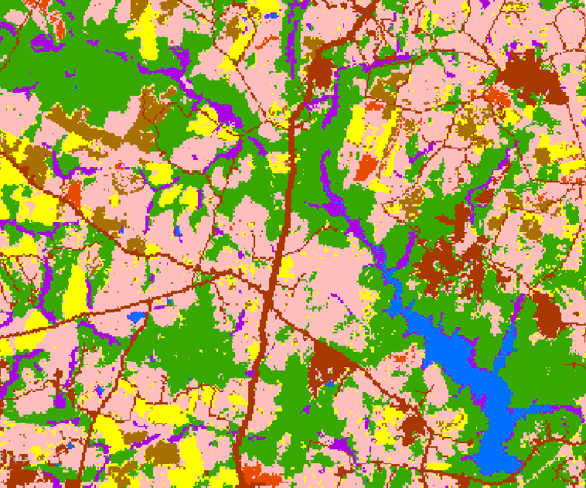
Assessing Land Cover and Land Use Change to Inform Watershed Resource Management
Abstract
Methodology
Patuxent Water Resources
The Patuxent Reservoirs Watershed, in Howard, Montgomery, and Prince George’s Counties in Maryland, is a significant source of water supply for the greater Washington, D.C., metropolitan area. The Patuxent Reservoirs Watershed Protection Group Technical Advisory Committee (PRWPG TAC) monitors water quality and releases annual reports in order to provide management recommendations to policymakers for reducing pollutant loads. However, more comprehensive data is needed to understand the relationship between water quality and land use change, as inconsistent data availability across the municipal boundaries of the watershed inhibits a holistic land use and land cover (LULC) assessment. To address this concern, the team created synthesized LULC raster datasets by aggregating data from the United States Geologic Survey (USGS) National Land Cover Database (NLCD), the National Oceanic and Atmospheric Administration (NOAA) Coastal Change Analysis Program (C-CAP), the United States Department of Agriculture (USDA) Cropland Data Layer (CDL), and NASA Earth observations. The team calculated annual LULC classification trends from 2008 to 2018 and mapped LULC change on five-year intervals from 1996 to 2016 to analyze overall spatiotemporal trends for the watershed. Team members also compared the synthetic LULC dataset to independently generated LULC maps provided by the PRWPG TAC for 2002 and 2010. The new synthetic raster provides greater specificity in terms of agricultural, wetland, and urban land cover classes. The maps allow the PRWPG TAC to assess the relationship between LULC changes and water quality. In addition, this method of map synthesis gives an easy and economical method for creating LULC datasets in the future.
NLCD
CCAP
CDL
Team
LULC
Synthetic Maps
Time Series
TAC
LULC
1996
2001
Compare
2006
2011
Compare
2016
Earth Observations
Acquire Imagery
Assemble Data Sets
Create Training Sites
Clip and Mosaic
Classify by Random Tree
Create Synthetic Map
Landsat 5 TM
Landsat 8 OLI
Assess Accuracy
Land Change Matrices
Results
Team LULC
Synthetic Time Series
Objectives
Incorporate NASA EO into pre-established mapping procedures
Draw on strengths of land cover data provided by NOAA, USGS, and USDA
Produce a time series of coherent, land cover maps
Analyze land use change using land change matrices
Conduct comparative analysis between synthetic products and the TAC
Offer a reproducible methodology to the partners
Study Area
2001
2011
5 miles
Howard County
Montgomery County
P.G.
Corn
Soybeans
Winter Wheat
Other Agriculture
1 Mile
Water
Wetlands
Barren
Forest
Urban
Patuxent Watershed
0
10
20
40 miles
Conclusions
Study Area (132 m²)
Production of synthetic maps results in increased wetland and crop detail and is an efficient alternative to the TAC’s current mapmaking strategies.
Addition of historical data and more persistent coverage into the future will better inform decision-making within the PRWPG TAC.
Shifts from agricultural land use to forested and urban land cover suggest a decline in overall nutrient runoff within the watershed, leading to improved water quality.
Project Partner
Patuxent Reservoirs Watershed Protection Group, Technical Advisory Committee
Team Members
Acknowledgements
The Patuxent Water Resources team would like to thank the following people for their guidance and support throughout our project: Dr. Kenton Ross | DEVELOP Lead Science Advisor, NASA Langley Research Center
Susan Overstreet | Howard County, Maryland
Jean Kapusnick | Montgomery County, Maryland
Steven Nelson | Washington Suburban Sanitary Commission
Patrick Frier | DEVELOP Center Lead, NASA Langley Research Center
Dr. Makhan Virdi | Atmospheric Science Data Center, NASA Langley Research Center
Stephanie Rockwood
Project Lead
Shaifali Prajapati
Connor Holzmann
Kyung “Robin” Kim
Virginia – Langley | Spring 2019

