Slide 1
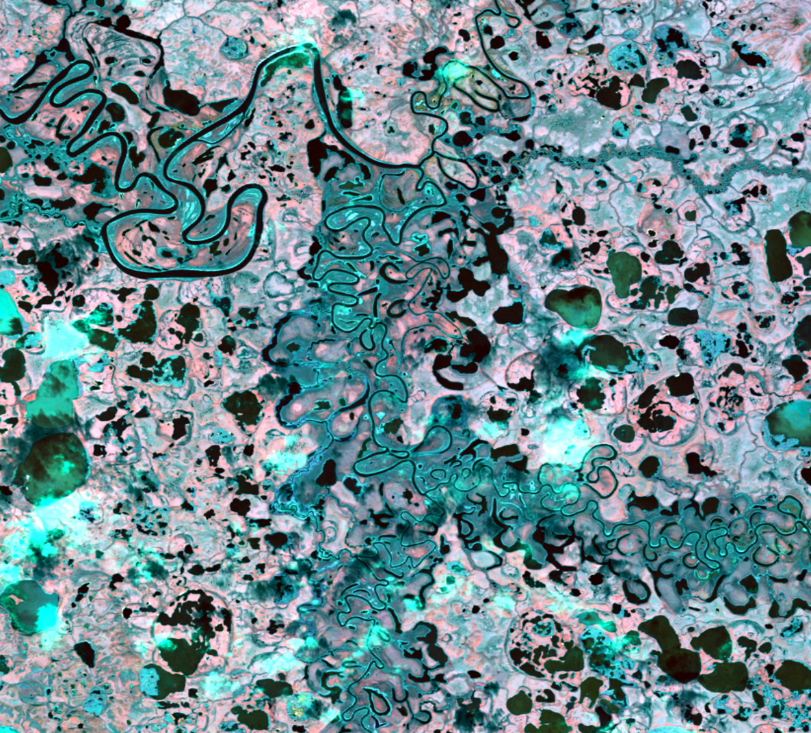
ALASKA ECOLOGICAL FORECASTING II
Semi-Automated Mapping of Alaskan Wetland Inundation by Integrating Synthetic Aperture Radar and Optical Satellite Imagery
Alana Higgins
Roger Ly
Annemarie Peacock
Adam Vaccaro
California – JPL | Spring 2019
Notes:
Website Image created using Landsat 8 imagery of Selawik (study site) with modified NDWI in red band, green band in green, blue band in blue. NDWI, green, blue
Speaker Notes:
Introduce project and team members

Slide 2
Community Concerns
P ! { l U
65% of US wetlands are located in Alaska
Only one-third of Alaska’s wetlands are mapped
Policy and decision making for wetland management
Notes:
Speaker Notes:
- Wetlands are vital ecosystems that provide habitat for plant and animal species, flood control and water filtration.
Alaska contains the majority of the country’s wetlands – about 65% of identified wetlands in the country are in Alaska, and roughly 40% of the land cover in Alaska is considered wetlands.
Having up to date information on wetlands is necessary for monitoring ongoing change. This valuable information could be used to help inform policy and decision makers on potential impacts to these ecosystems.
Current maps are extremely outdated (from 70’s and 80’s), and require manual delineation of wetland features.
Our team has been tackling this issue to update wetland information in Alaska.
Image Source (icons): Made using PowerPoint shapes (created by team)

Slide 3
Project Partners
US Fish and Wildlife Service, National Wetlands Inventory (NWI)
Megan Lang, Chief Scientist
Alaska Satellite Facility (ASF)
Jeremy Nicoll, Deputy Director
Franz Meyer, Chief Scientist
Image Credit: US Fish and Wildlife Service
Notes:
Image Source (U.S. Fish and Wildlife logo): https://commons.wikimedia.org/wiki/File:US-FWS-logo.png (public domain)
Speaker Notes:
We worked with Megan Lang, Chief Scientist of the US Fish and Wildlife Service who maintains the National Wetlands Inventory (acronymed NWI) to create validated wetland maps of Alaska that could be used to enhance the NWI Wetlands Mapper.
The Wetlands Mapper is the NWI’s platform to share wetland data with organizations and the public to aid in resource management
We also collaborated with Jeremey Nicoll, Deputy Director, and Franz Meyer, Chief Scientist, of the Alaska Satellite Facility (ASF) to create a tool that be used with their Hybrid Pluggable
Processing Pipeline (also known as HyP3) – an online platform that processes and distributes synthetic aperture radar (acronymed SAR) data.

Slide 4
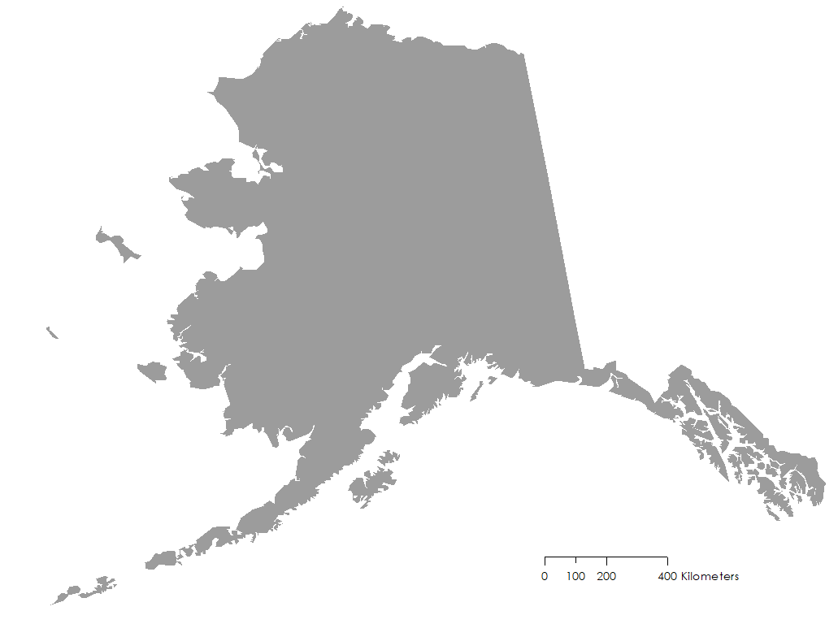
Study Areas
Location
Alaska, USA
NWI has mapped 40% of wetlands in AK
Study Period
Summer 2017 (May to September)
Avoid ice + snow cover
Area 1002
NWI Active Mapping Site
Selawik
NWI Active Mapping Site
Bear Lake
Algorithm Testing Site
0 100 200 400 km
Area 1002
Notes:
Speaker Notes:
-the NWI currently has 40% of the wetlands in AK mapped
-Of these three study sites we mainly focused on Selawik and Area 1002 as they are being actively mapped by the NWI as they have little to no published work on these area
-Bear Lake was a site used to test our algorithm
Selawik’s response to global warming is interesting to observe as permafrost melts and abruptly changes the landscape from increased global temperatures and storm intensity from the ocean to the west.
Area 1002 was opened up for oil drilling in 2017, so monitoring potential change could be important for the near future
-Any results we talk about from Selawik were determined through a draft of Selawik data that our partner sent to us, making it the most recent wetland information we could reference
-The study period was the summer months of 2017, which included May to September, this allowed us to avoid ice interference

Slide 5
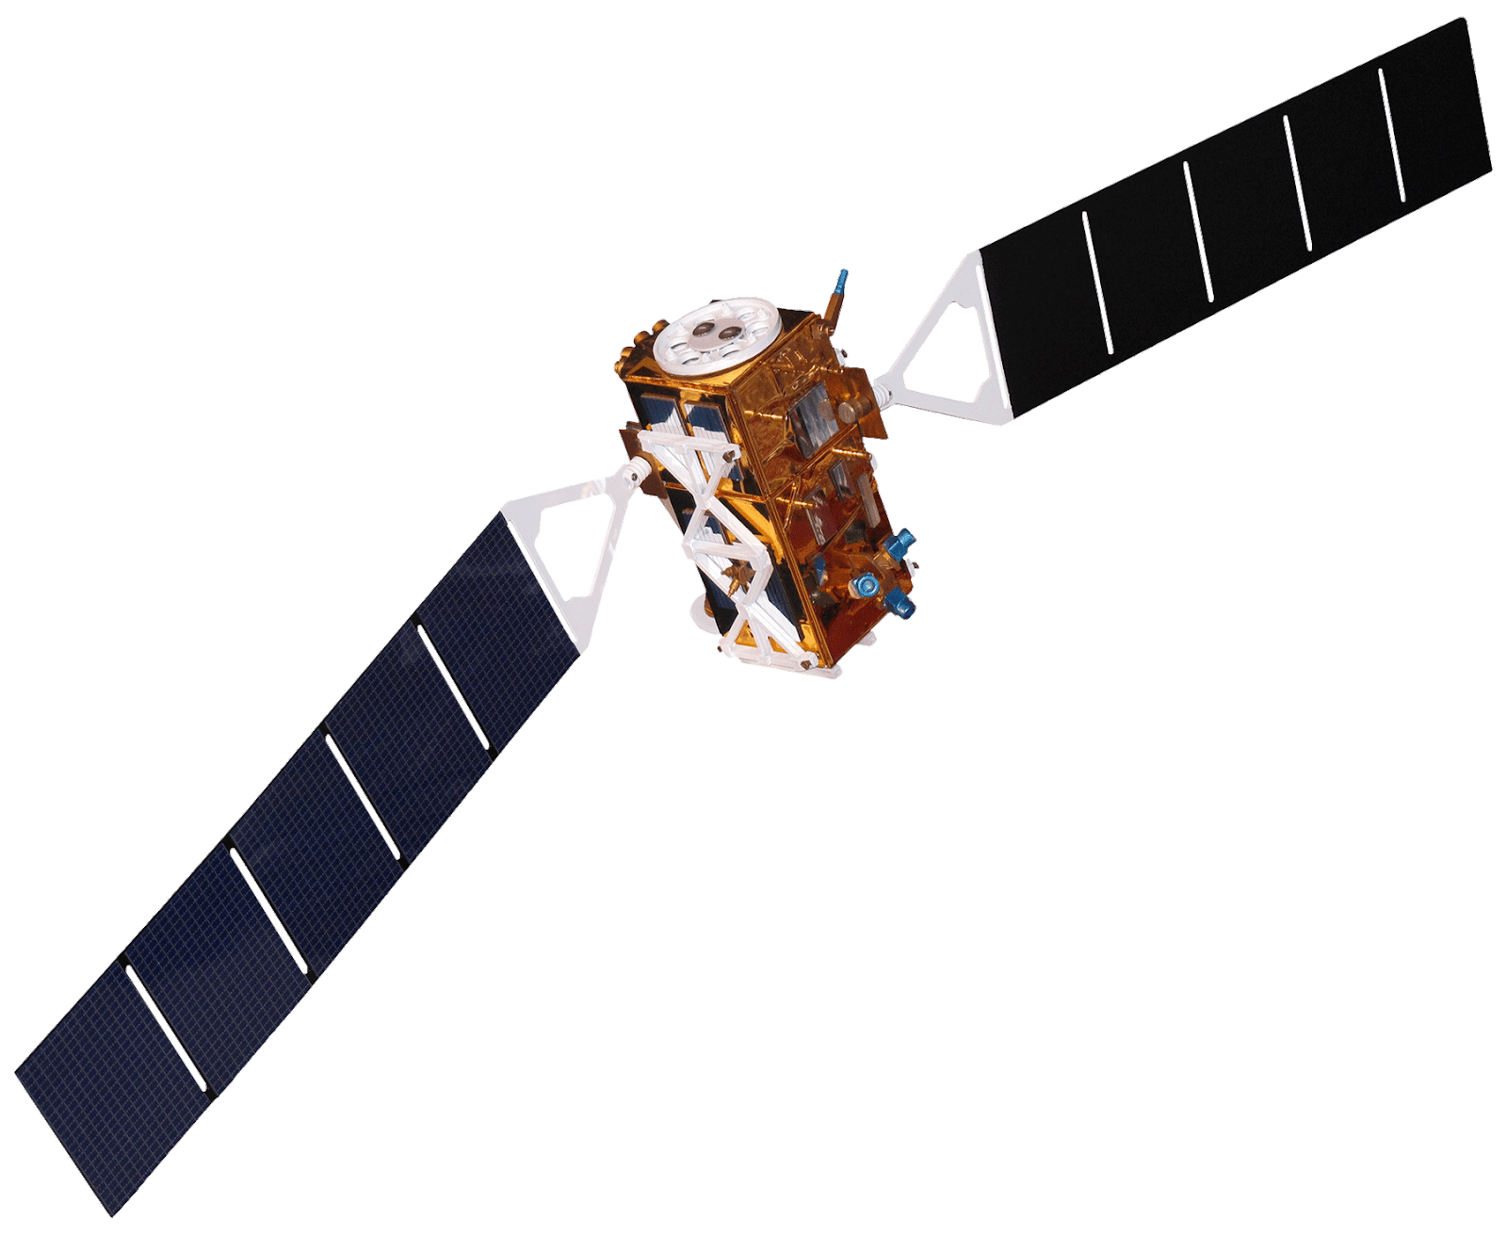
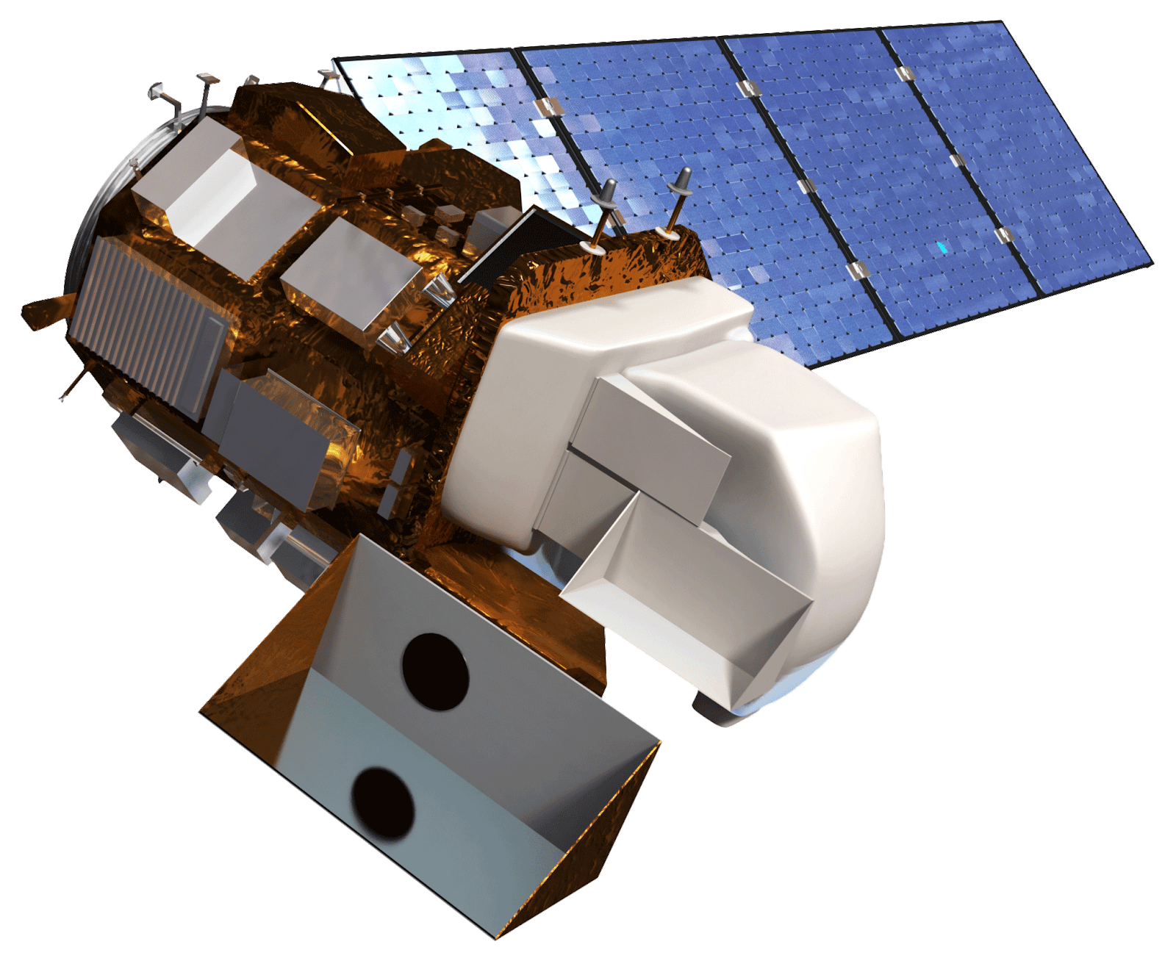
Satellites and Sensors
Landsat 8 Operational Land Imager (OLI)
Sentinel-1 C-Band Synthetic Aperture Radar (C-SAR)
Image Credit: NASA
Notes:
Image Source (Sentinel-1): http://www.devpedia.developexchange.com/dp/index.php?title=File:23_Sentinel1.png (public domain)
Image Source (Landsat 8): http://www.devpedia.developexchange.com/dp/index.php?title=File:03_Landsat8.png (public domain)
Speaker Notes:
we acquired multispectral optical imagery from landsat 8 operational land imager, which was used for validation
we also used C-band SAR (synthetic ap. radar) from the Sentinel-1 satellite for our wetland classification
SAR is unique because of its ability to detect inundation regardless of cloud cover or the time of day

Slide 6
Objectives
1
Build on wetland inundation tool (SWEET) created in the project’s previous term to incorporate a more automated approach to wetland mapping using C-SAR data
2
3
4
Create inundation extent products as a resource for the NWI wetland map production for Alaska
Incorporate NWI water regime reclassification
Validate the accuracy of inundation extent products using published NWI data and Landsat 8 imagery
Notes:
Speaker Notes:
During this term we built on our SAR Wetland Extent Exploration Tool (acronymed as SWEET) to take a more automated approach towards wetland mapping using C-SAR data
We also refined the tool to classify wetland extent based on water regime similar to NWI’s wetland classification.
The goal of our products was to create maps that delineated wetland extent, and that could be used as a resource for wetland map production in Alaska for the NWI
To ensure accurate wetland mapping, we compared our maps to published NWI data from their online mapper and Landsat 8 multispectral imagery.

Slide 7
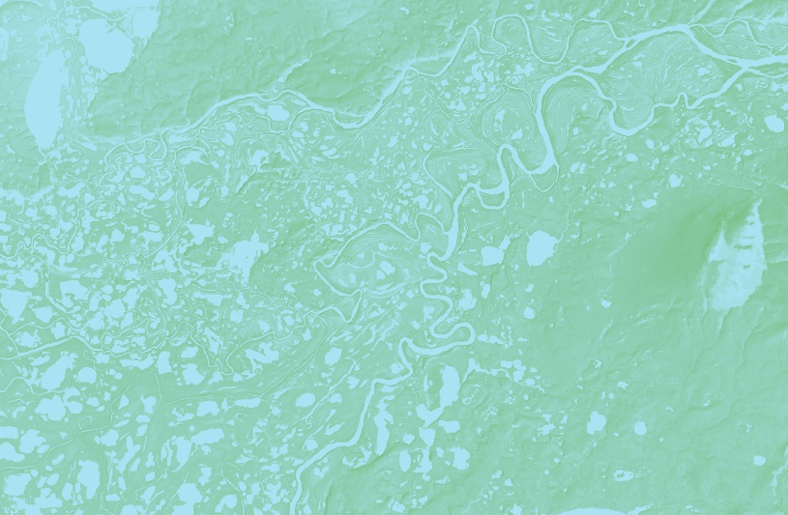
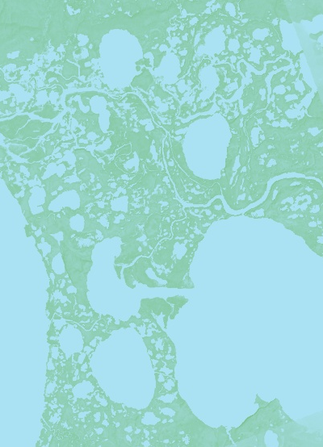
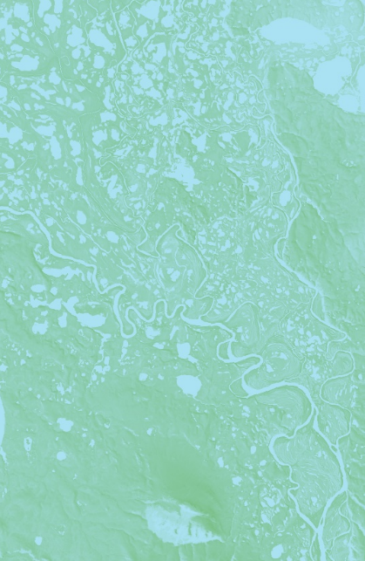
Methodology: Data Acquisition and Processing
Source
Platform
Processing
Sentinel-1
C-SAR
ASF’s Hybrid Pluggable Processing Pipeline (HyP3)
UTM projection and registration
Calibration checks
Thresholding classification
Landsat 8 OLI
Google Earth Engine
Dynamic Surface Water Extent (DSWE) classification
NWI Water Regime reclassification
NWI Wetland Maps
NWI Wetlands Mapper
Notes:
Speaker Notes:
Sentinel 1 C-SAR data was downloaded through ASF’s HyP3 and pre-processed (projection,coregistration,subsetting) before analysis and classification.
We obtained and processed Landsat 8 imagery into a DSWE classification for validation in Google Earth Engine. The classification was based on imagery collected over the same study period
NWI data was downloaded from the NWI online Wetlands Mapper and was pre-processed, reclassified, and rasterized in ArcMap.
Image Source (icons): Made using PowerPoint shapes (created by team)

Slide 8
SWEET Algorithm: Overview
Built inundation classification tool in a Jupyter Notebook
Used Python to create inundation mapping algorithm with thresholding and multi-temporal averages
Inputs: Sentinel-1 C-SAR imagery VV and VH polarization bands
Outputs: Multi-temporal and single-date classifications
Image Credit: Jupyter Notebook interface
Notes:
Jupyter Notebook Interface
Speaker notes:
To give a quick introduction on the SWEET algorithm that was originally created in the first term of the project, it is the tool that is used to produce our wetland maps.
It was coded using the Python programming language in a Jupyter Notebook interface – a web-based platform that allows for interactive development of data and programming projects
The advantages of using a Jupyter Notebook interface is that it is an interactive development environment that can quickly display results and visualize data from a script. This allows us to quickly visualize outputs, and edit our script as we go.
This platform makes it possible for us to create a visual and interactive tool for the users, that displays our classifications, and explains what our tool is doing with markdowns – making reproducibility easier.
We worked with partners at ASF in styling and instruction of our Jupyter Notebook

Slide 9
SWEET Algorithm: Workflow
Processing
Calibration
Classification
Validation
Output
Sentinel-1 C-SAR VV, VH
VV / VH Ratio
Verify Image
Co-registration
VV, VH, VV/VH Thresholds
Avg. Region Brightness
Subset
Classification Per Date
Calibrate
Multi-Temp. Classification
Confusion Matrix
Wetland Inundation Map
Temporal & Spatial Avg.
Refined Classification
Notes:
Speaker Notes:
The National Wetlands Inventory provided wetland maps with over 100 wetland types for Alaska based on vegetation, soil, water regime, and other factors – these wetland types were reclassified into the
water regime classes our tool outputted in order to make a comparison. Our reclassification of the NWI data was checked with the developers of the map as well as with Megan of the National Wetland’s inventory.
The tool analyzed roughly 20 SAR images looking at VV and VH brightness values to classify the study area into 4 classes: Permanent Open Water, Permanent Inundation, Seasonal Inundation, and Not Inundated
These classes were formed based on potential separability found in the SAR image values.

Slide 10
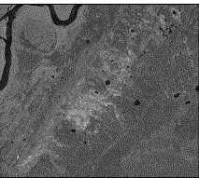
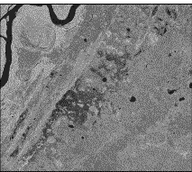
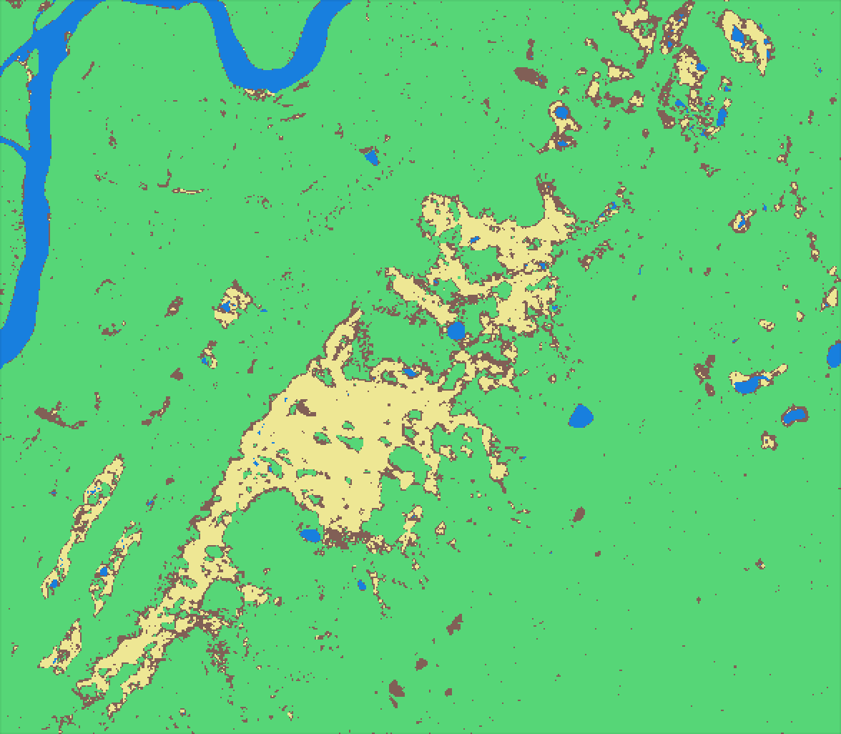
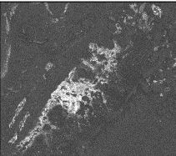
SWEET Algorithm Example Output
Sentinel-1 C-SAR Multi-Temporal Avg.
Multi-Temporal Classification
June 12, 2017 to September 28, 2017
Using VV, VH, VV/VH Thresholds
June 12, 2017 to September 28, 2017
VV Polarization
VH Polarization
Seasonal inundation
Permanent inundated vegetation
Not inundated
VV/VH Ratio
Open water
high
Bear Lake, Alaska
low
Notes:
This shows some example outputs of the SWEET tool. On the left, the SWEET tool finds the multi-temporal averages of the different SAR polarizations

Slide 11
National Wetlands Inventory Classification
NWI wetland classification codes describe:
Wetland system
Vegetation class
Vegetation subclass
Water regime
Example classification code:
P FO 4 E
palustrine
forested
needle-
leaf evergreen
seasonally flooded / saturated
Notes:
Speaker notes:
-The National Wetlands Inventory provided wetland maps with over 100 wetland types for Alaska based on vegetation, soil, water regime, and other factors – these wetland types were reclassified into the water regime classes our tool outputted in order to make a comparison. Our reclassification of the NWI data was checked with the developers of the map as well as with Megan of the National Wetland’s inventory.
-The current methods of the NWI depict wetland type in the from of a 4-8 character code
-they use single-date optical imagery and manual delineation of wetlands, along with field observations, which does not incorporate any seasonal change, which is what our tool does
-In just 1 study site, there could be 70-100 unique codes that we sorted through character by character in order to accurately reclassify the data.

Slide 12
National Wetlands Inventory Reclassification
13 NWI Reclassifications
4 C-SAR Classifications
Frequency | Permanent | Seasonal | Tidal | Saturated
Inundation Type | Open Water | Open Water | Open Water | Forested
 | Inundation | Inundation | Inundation | Low Vegetation
 | Forested Inundation | Forested Inundation | Mixed Inundation
 | Mixed Inundation | Mixed Inundation
Frequency | Permanent | Seasonal
Inundation Type | Open Water | Inundation
 | Inundation
 | Not Inundated
Notes:
Speaker notes:
-From the 100+ water regime codes, we reclassified NWI data into 13 broader classes based on the frequency and type of inundation, and presence and type of vegetation
-Left table shows finalized classes taking into account code modifiers and inundation frequency
-From there, we further aggregated the 13 classes into the same 4 SAR classifications in order to compare the two datasets
Speaker notes:
Using SWEET’s output, we classified wetland types into 5 classes based on frequency or time frame of inundation period and inundation type

Slide 13
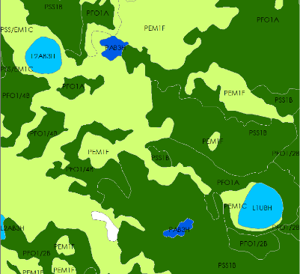
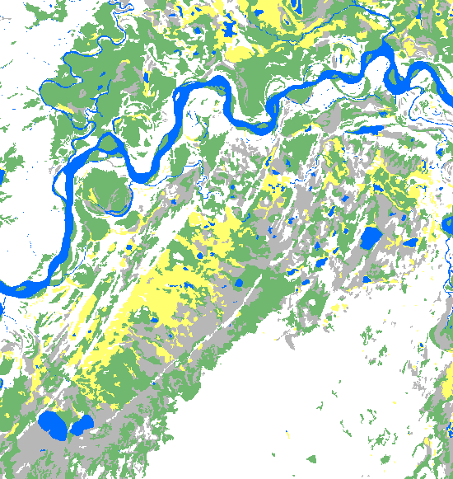
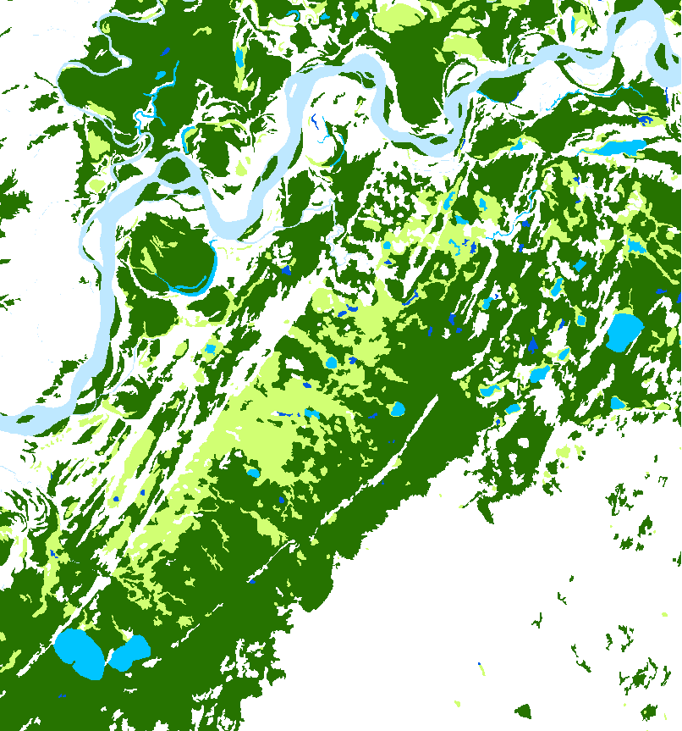
Bear Lake NWI Reclassification
Reclassified NWI
NWI Wetlands Mapper
Estuarine and Marine
Freshwater Emergent
Freshwater Forested/Shrub
Freshwater Pond
Lake
Riverine
No Data
Permanent Open Water
Permanent Inundation
Seasonal inundation
Not Inundated
No Data
0 2.5 5 10 km
0 2.5 5 10 km
Notes:
Speaker Notes:
On the right is an example of what the NWI Wetlands Mapper data looks like when downloaded off the mapper. It contains a variety of codes that indicate significant attributes for each polygon. The color scheme used for this display shows the NWI’s generic wetland types that do not account for water regime or level of inundation.
On the left is an example of what the NWI data looks like after reclassification. This classification simplifies the attribute codes into 4 classes based on inundation seasonality that our tool can detect.
For example the grey area labeled not inundated on the reclassified NWI is labeled as Freshwater Forested/Shrub wetland in the initial wetland type classification, but upon looking further at the code we find that this area contains saturated soil which is not equivalent to inundation.

Slide 14
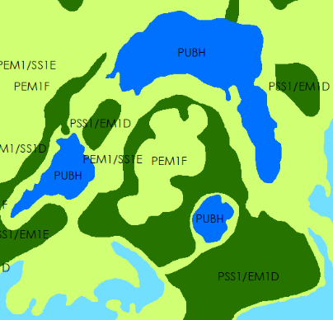
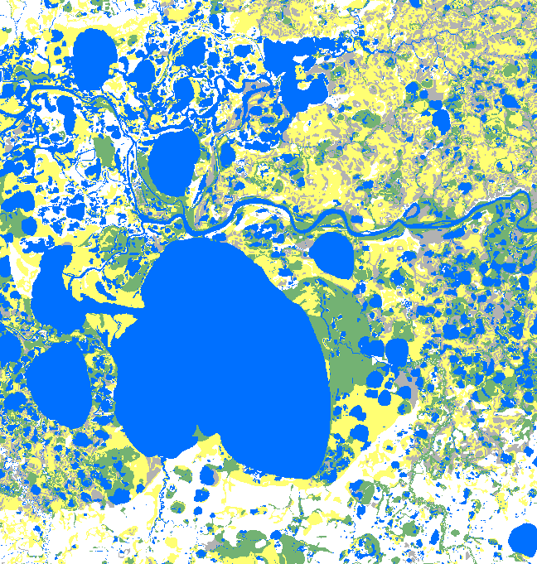
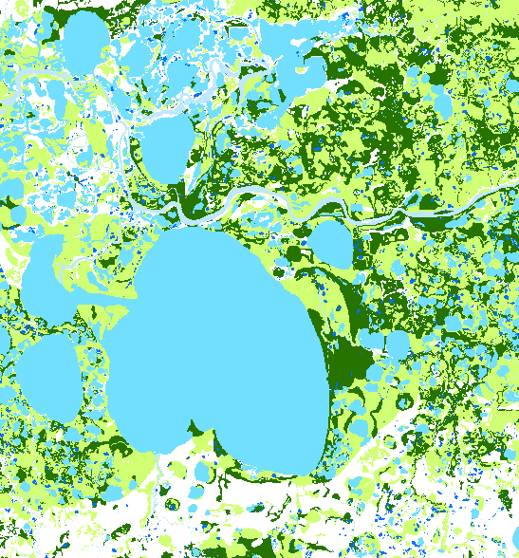
Selawik NWI Reclassification
Reclassified NWI
NWI Wetland Mapper
Permanent Open Water
Permanent Inundation
Seasonal inundation
Not Inundated
No Data
Estuarine and Marine
Freshwater Emergent
Freshwater Forested/Shrub
Freshwater Pond
Lake
Riverine
No Data
0 2.5 5 10 km
0 2.5 5 10 km
Notes:
Speaker Notes:
This same method was applied to the draft NWI data for Selawik. The attribute codes have been reclassified to focus on inundation seasonality.

Slide 15
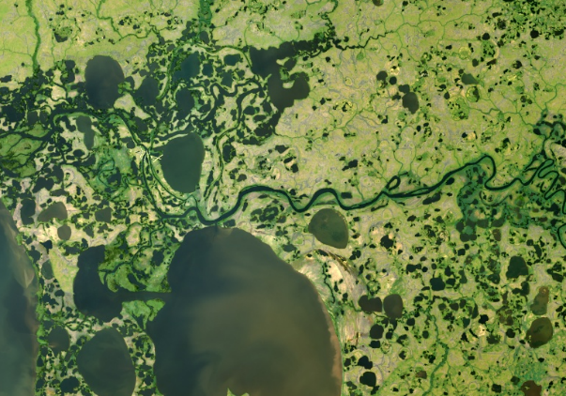
Methodology: Dynamic Surface Water Extent (DSWE) Classification
Landsat Dynamic Surface Water Extent algorithm (John Jones, USGS)
Modified to calculate permanent and seasonal inundation
Implemented in Google Earth Engine to generate maps and validation products
Permanent Open Water
Not Inundated
Permanent Inundation
Seasonal Inundation
0 5 10 km
RGB Landsat 8
Reclassified DSWE
Notes:
Maps created in Google Earth Engine, formatted in ArcMap
Speaker notes:
In addition to the NWI reclassification, Landsat 8 multispectral imagery was also classified using the Dynamic Surface Water Extent algorithm (acronymed as DSWE) to be used as a comparison to our SAR classification.
The DSWE algorithm was modified to calculate inundation frequency. The image on the left shows the original Landsat 8 imagery, and the image on the right shows the water regime classification.

Slide 16
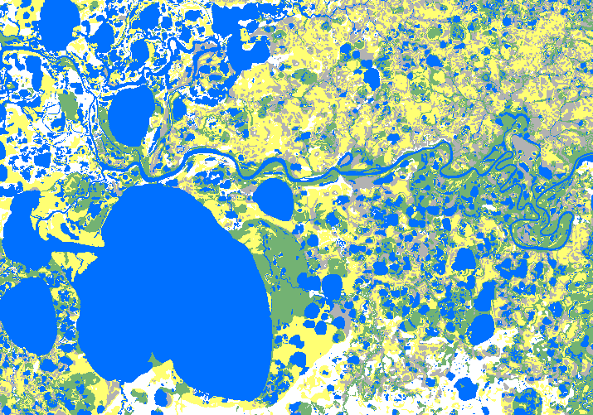
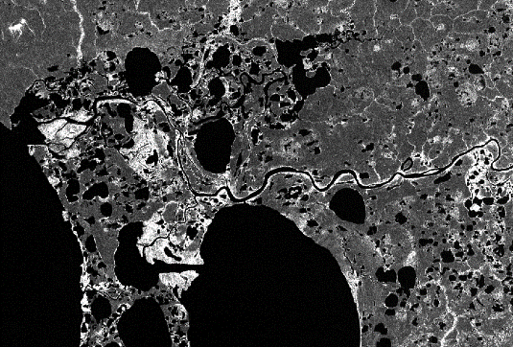
Methodology: Validation
Accuracy assessments with generated confusion matrices
Resampled and overlaid C-SAR, NWI, and DSWE classifications to compare pixel to pixel class agreement
Landsat DSWE
NWI
C-SAR
Notes:
SAR Map: SWEET output
NWI Map: from National Wetlands Inventory, formatted in ArcMap
Landsat DSWE: created in Google Earth Engine
Speaker notes:
Our SAR classification was compared pixel to pixel for both the NWI and DSWE classification to obtain quantitative accuracy assessments
We performed these accuracy assessments using ENVI’s post-classification tools.
The assessment output a confusion matrix showing the percentage of pixels that our SAR classification matched with the NWI and DSWE classification.

Slide 17
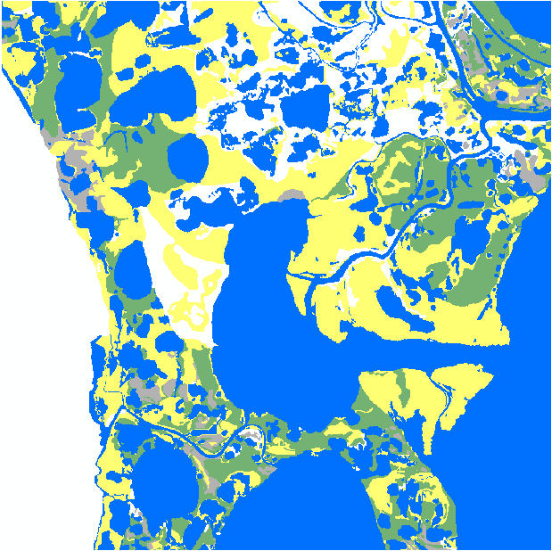
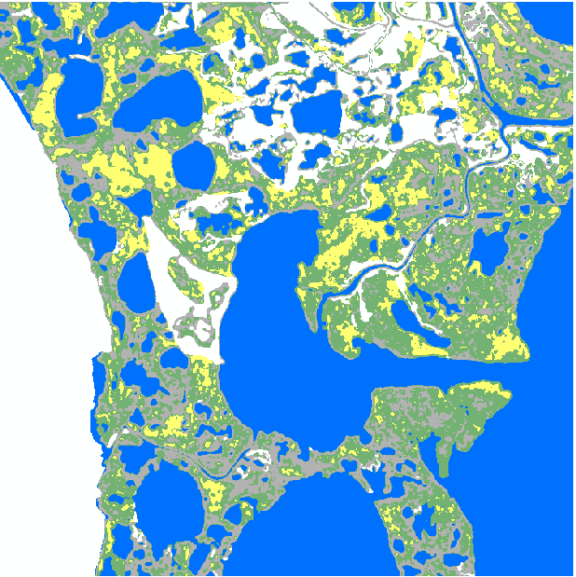
Selawik Summer 2017 Inundation Extent
Reclassified NWI
Sentinel-1 C-SAR
Permanent Open Water
Permanent Inundation
No Data
0 1.25 2.5 5 km
Not Inundated
Seasonal Inundation
Notes:
Speaker Notes:
Here is a visual comparison of the Selawik SAR classification and the NWI classification
We validated our classification with this map because this was the most recent NWI data available and received to us as a draft during the term.
We chose to focus on this smaller area of Selawik for because we saw that it experienced change throughout the growing season.
Significant differences between the two classifications can be seen around the center lake where NWI labels a lot of area as permanent inundated vegetation, and our classification labeled the area as seasonal inundation

Slide 18
Selawik Accuracy Assessment
NWI & C-SAR Summer 2017 Inundation Classification
Overall agreement: 59.10%
NWI Classification
Class | Permanent Open Water | Not Inundated | Permanent Inundated Vegetation | Seasonal Inundated Vegetation
Permanent Open Water | 80.01% | 0.03 | 0.13 | 0.07
Not Inundated | 9.24 | 46.98% | 17.55 | 36.83
Permanent Inundated Vegetation | 0.64 | 8.24 | 24.19% | 17.17
Seasonal Inundated Vegetation | 10.11 | 44.75 | 58.13 | 45.93%
C-SAR Classification
Total Area Classified (ha): 17676.63
Incorrectly Classified Area (ha):
Permanent Open Water: 1975.73
Not Inundated: 249.45
Permanent Inundation: 3645.88
Seasonal Inundation: 1358.39
Notes:
Speaker notes:
Our tool’s ability to pick up this seasonal change explains why there is disagreement between the NWI classification and ours.
The matrix shows that a majority of what NWI calls Permanent inundated vegetation was classified as Seasonal in ours, resulting in this low percentage of agreement in the permanent inundated vegetation column and seasonal inundated vegetation column.
This percentage of agreement in Not inundated is low as well, however this class was significant smaller in this area and actually had the least incorrectly classified area.
The disagreement between the two images could also be reflective of the temporal difference in data used during classification between NWI and us. Our tool is able to create a unique classification looking at many dates rather than one – which is what is typically used in creating the NWI maps.

Slide 19
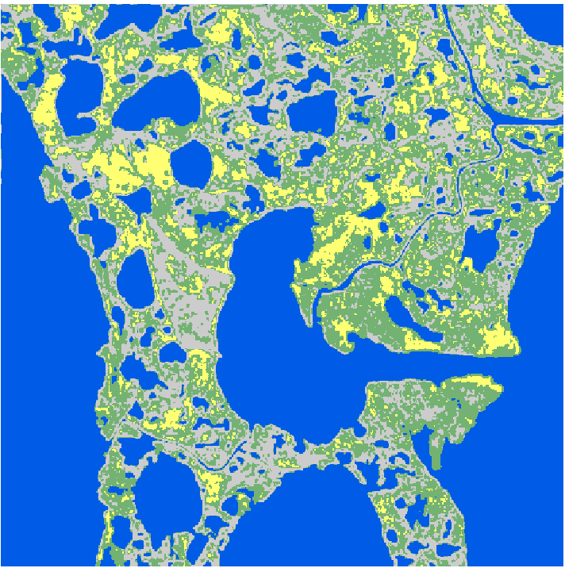
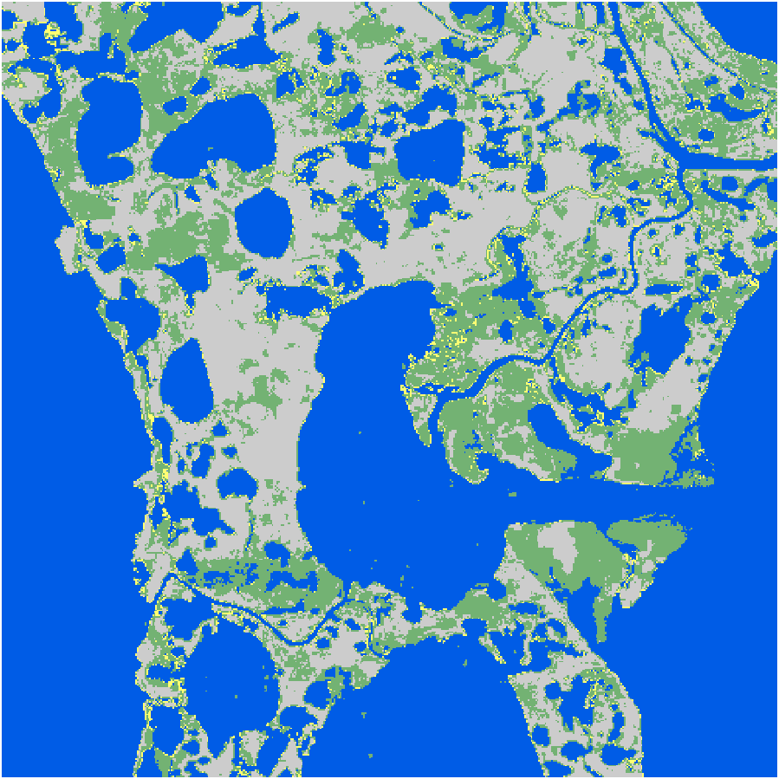
Selawik Summer 2017 Inundation Extent
NWI Reclassification
Sentinel-1 C-SAR
Landsat DSWE
Permanent Open Water
Permanent Inundation
No Data
0 1.25 2.5 5 km
Not Inundated
Seasonal Inundation
Notes:
Speaker Notes:

Slide 20
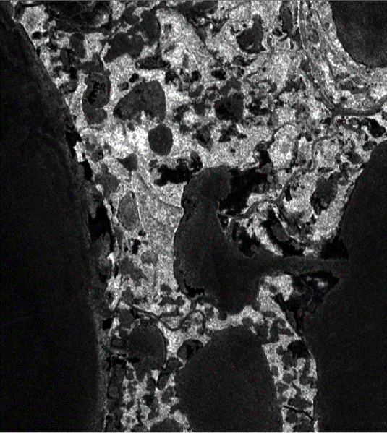
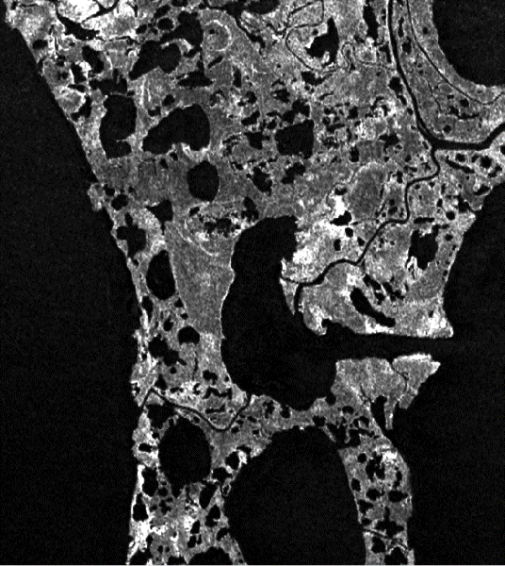
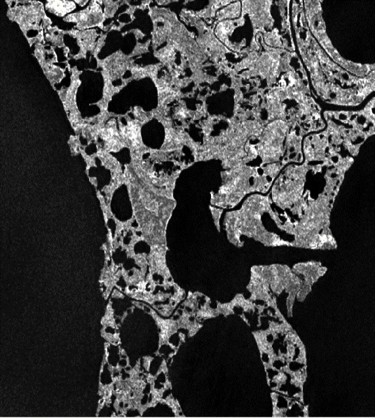
Selawik Summer 2017 Visually-Detectable Seasonal Inundation
Sentinel-1 C-SAR Imagery (VV Polarization)
Inundated Vegetation
Open
Water
May 17, 2017
July 16, 2017
September 14, 2017
0 2.5 5 km
Notes:
Speaker Notes:
We decided to check the SAR imagery for the 10 dates to see what the issue might be, here are three images spaced two months apart that highlight the change that occurs in this area
We noticed that this area was flooded during May as noted by the darker tone around this center lake.
In July this darker tone is replaced by a lighter tone, which is indicative of inundated vegetation growing in the previously flooded area.
As the year progresses, the brighter tones are less prevalent, indicating that this area has dried up a bit.
This change in inundation is the reason why our tool classified a majority of this area as seasonally inundated vegetation.

Slide 21
Selawik Summer 2017 Inundation Extent
Landsat DSWE
Sentinel-1 C-SAR
Permanent Open Water
Permanent Inundation
No Data
0 1.25 2.5 5 km
Not Inundated
Seasonal Inundation
Notes:
Speaker Notes:
We also compared our map to a DSWE classification that uses multispectral imagery over the growing season
At first glance there is a lot of permanent inundated vegetation in the DSWE classification as noted by the lack of yellow.
This can be explained by the inability of multispectral imagery to penetrate through vegetation to detect inundated surfaces underneathe.
There is also more areas classified as not inundated in DSWE, possible explanation is a bias in data included. Multispectral imagery is unable to penetrate cloud cover, portions of data covered by clouds must be excluded.
Dates with available data that were included in the in the algorithm, might have been during warmer and drier periods with no cloud cover, resulting in the large areas of land classified as not inundated.
Differences in DSWE and SAR classifications is that DSWE also considers vegetation as a factor for identifying wetlands to make up for its penetrating abilities, while SAR directly looks for the presence of water.

Slide 22
Selawik Accuracy Assessment
DSWE & SAR Summer 2017 Inundation Classification
Overall agreement: 65.5%
DSWE Classification Percentage
Class | Permanent Open Water | Not Inundated | Permanent Inundated Vegetation | Seasonal Inundated Vegetation
Permanent Open Water | 87.79% | 0.02 | 5.51 | 1.30
Not Inundated | 4.64 | 33.49% | 43.83 | 28.89
Permanent Inundated Vegetation | 1.08 | 14.79 | 10.92% | 18.96
Seasonal Inundated Vegetation | 6.49 | 51.70 | 39.74 | 50.85%
C-SAR Classification
Total Area Classified (ha):
22500.00
Incorrectly Classified Area (ha):
Permanent Open Water: 1465.02
Not Inundated: 3593.34
Permanent Inundation: 516.69
Seasonal Inundation: 2220.03
Notes:
Speaker notes:
The disagreement between areas that are not inundated, contain permanent inundated vegetation, and seasonal inundated vegetation can be explained by the data collection bias from dates on warmer and drier dates and multispectral imagery’s inability to penetrate vegetation canopy.
DSWE has the issue of only included dates with no cloud cover, and in an area like Selawik where cloud cover is persistent, our tool as an advantage in that it incorporates more dates into the classification regardless of atmospheric conditions.

Slide 23
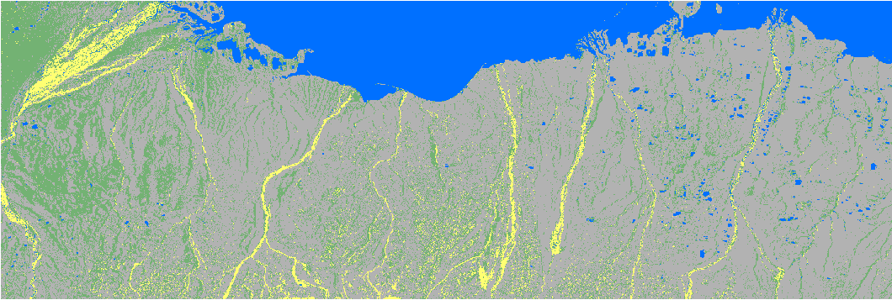
Area 1002 Summer 2017 Inundation Extent
Sentinel-1 C-SAR
Permanent Open Water
Permanent Inundation
No Data
0 2.5 5 10 km
Not Inundated
Seasonal Inundation
Notes:
Speaker Notes:
We classified Area 1002, we did not have any datasets that we could confidently validated to
NWI data was inconsistent in it’s labeling of codes and missing data.
This area is currently being mapped by the National Wetlands Inventory and their contractors – this map will be able to provide insight on seasonal inundation extent for them.

Slide 24
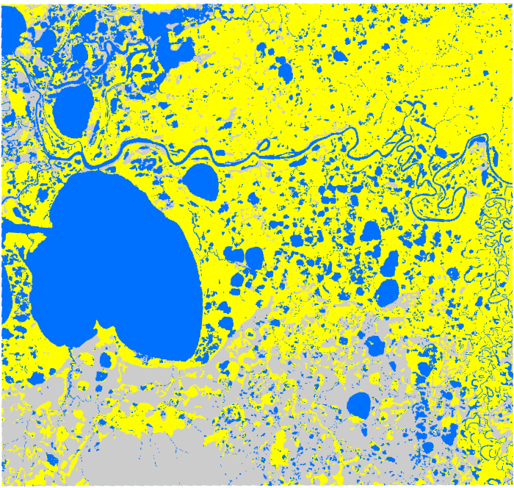
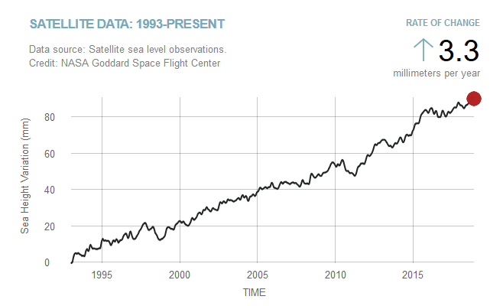
Modeling to 2020
Sea Level Affecting Marshes Model (SLAMM)
Reclassified NWI Wetland attributes to SLAMM codes
Used IfSAR Alaska 5 m DTM as input DEM and to make slope raster
Ran the model using current rate of sea level change (3.3 millimeters per year)
Not Inundated
Inundated
0 2.5 5 10 km
Image Credit: NASA Global Climate Change
Open Water
Notes:
Image Source(map): Sea Level Affecting Marshes Model Output
Image Source(Graph): NASA Global Climate Change https://climate.nasa.gov/vital-signs/sea-level/ (Public Domain)
Speaker Notes:
Looking into the future, the wetland maps that contribute to the NWI mapping completion can be used to forecast change in the future – having robust NWI data helps with forecasting
We used the Sea Level Affecting Marshes Model (SLAMM) to forecast wetland change in Selawik for 2020.
The model was found on NOAA’s DIGITALCOAST website and developed by Warren Pinnacle Consulting.
We ran the model on Selawik as this area would be affected by sea level rise due to its close proximity to the ocean.
This model used NWI data that was reclassified into codes that the model could read, similar to the reclassification methods used in our validation process.
The model also used digital elevation model and slope in order to predict wetland extent.
The Interferometric Synthetic Aperture Radar 5 meter DEM for Alaska was used as the model input as well as for creating the slope raster. The model was run using a sea level rise rate of 3.3 millimeters per year.

Slide 25
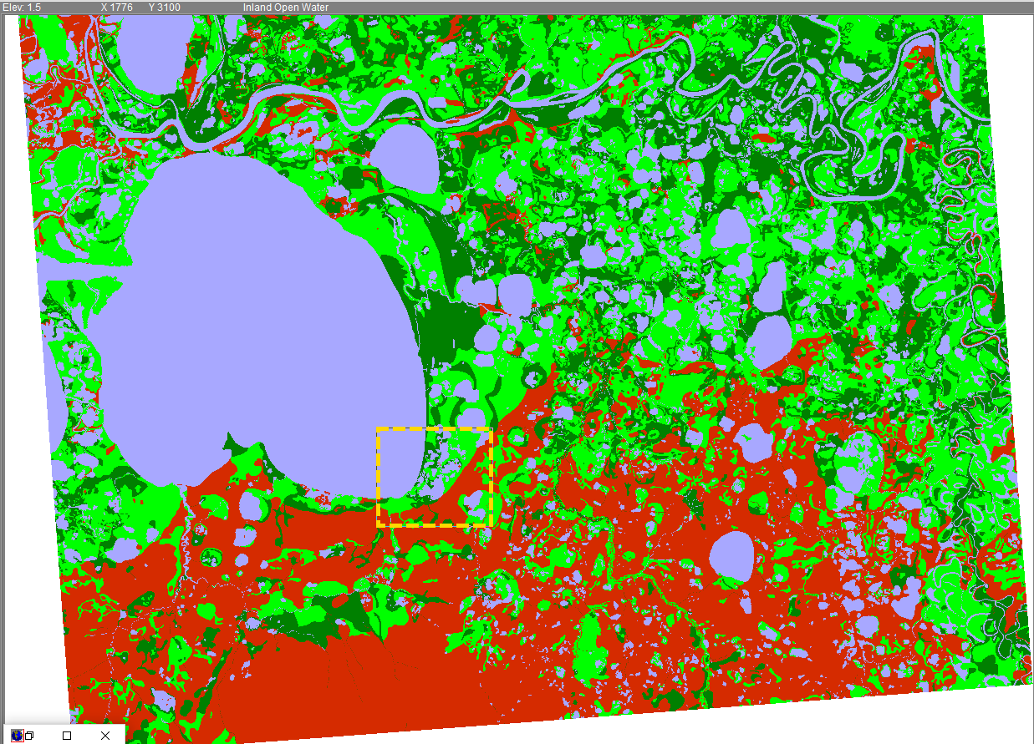
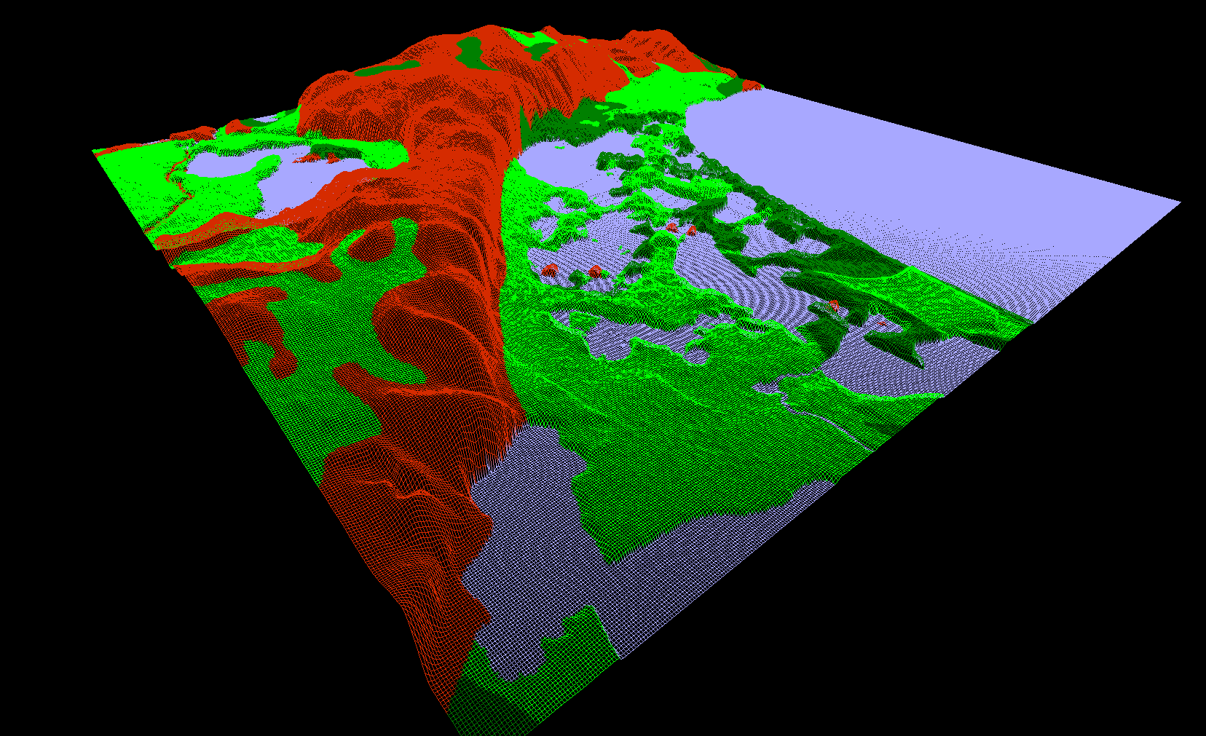
Modeling to 2020
Sea Level Affecting Marshes Model (SLAMM)
Not Inundated
0 2.5 5 10 km
Open Water
3-Dimensional Wetland Visualization of Selawik
Inundated Vegetation
Inundated Vegetation (Marsh)
Notes:
Image Source: Sea Level Affecting Marshes Model Output
Speaker Notes:
The model also provided a visualization of their wetland classification overlayed on the topography to create a 3 dimensional visualization.
This helped us visualize the relationship between elevation and inundation. In these images, red indicates non-inundated areas, blue indicates open water, and green indicates inundated vegetation.
We can see that in this area at the corner of this lake that lower elevations are inundated or open water as indicated by the color, and the upland areas are typically non-inundated areas. This was also a good way to double check to see if the missing data areas in the NWI were in fact upland like we assumed.

Slide 26
Errors and Uncertainties
?
Sentinel-1 calibration and image co-registration
Variability in climate throughout different years
Resampling uncertainty during validation
Impacts of Sentinel-1 incidence angle
There is a lack of ground truth data
x
Notes:
Image Source (icons): Made using PowerPoint shapes (created by team)
Speaker Notes:
Some uncertainties that can contribute to error include the uncertainty in SAR data calibration and image co-registration from Sentinel-1 and ASF.
Although the majority of these wetlands are relatively flat, terrain correction using a coarse resolution DEM could lead to inaccurate corrections that could result in inaccurate representation of brightness values.
Images from Sentinel-1 could be incorrectly co-registered, resulting in erroneous comparison of our datasets.
Image displacement from a decreased incidence angle would result in the data accurately representing what is on the ground.
Although NWI is created from some ground truth data and is a reliable source of information for wetlands, it lacks the same temporal timescale and it isn’t exactly ground truth
Datasets were resampled to different pixel sizes (NWI resized to Sentinel and Sentinel resized to DSWE), which could lead to inaccuracies generated from resampling.
-we ran into obstacles in setting automated reflectance value threshold in SWEET as vegetation and soil type different across the sites, resulting in non-uniform brightness values

Slide 27
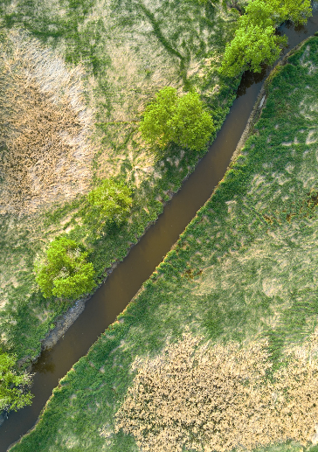
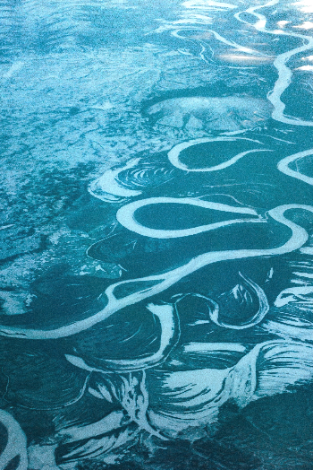
Conclusion
Our tool uses multi-temporal C-SAR datasets to detect wetland inundation
It is a unique method of wetland classification
The thresholding technique effectively detected inundation, and although VV, VH, VV/VH varied across sites, it showed potential for automation
Image Credits: John Westrock, Simon Sun, and Bryan Minear
Notes:
Image sources:
https://unsplash.com/photos/hWmhy3doTFE (Unsplash License --> free to use) John Westrock
https://unsplash.com/photos/gJDfaNKo9bY (Unsplash License --> free to use) Simon Sun
https://unsplash.com/photos/BQRXwq6oNjw (Unsplash License --> free to use) Bryan Minear
Speaker Notes:
In conclusion we’ve created a tool can be very beneficial to wetland mappers who are seeking to identify the seasonality of inundation for wetlands
Our user-friendly tool’s and ability incorporate data from multiple dates allows for an easy and robust wetland classification
There is more room for more validation of it’s products because of the lack of comparable datasets.
Datasets we have come across have used only one date, or are unable to detect inundation as well as SAR imagery.

Slide 28
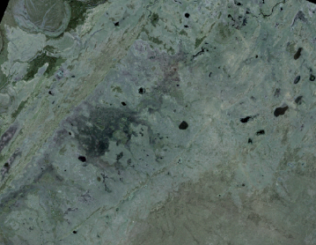
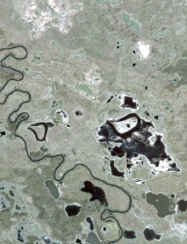
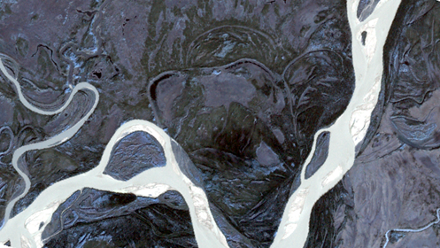
Future Work
☑
Automate threshold selection
Integrate into ASF’s SAR Processing Pipeline (HyP3)
Explore the capabilities of using L-Band SAR (e.g. NISAR) for wetland inundation mapping
Image Credit: Planet Labs Inc.
Notes:
Image Source (aerial images): https://api.planet.com/
Image Source (icons): Made using PowerPoint shapes (created by team)
Speaker notes:
-were not able to fully automate SWEET due to variances in threshold values and site-specific conditions
-integrate into ASF’s HyP3 platform for efficient data sharing and more collaboration
-utilize future SAR imagery through NISAR in 2021 - also benefits NASA EO

Slide 29
Bruce Chapman | Science Advisor at the DEVELOP California – JPL Node
Megan Lang | Chief Scientist at the US Fish and Wildlife Service
Jeremy Nicoll | Deputy Director at the Alaska Satellite Facility
Franz Meyer | Chief Scientist at the Alaska Satellite Facility
Alice Lin | Fall 2018 DEVELOP Alaska Eco I Team Member
Briant Fabela | Fall 2018 DEVELOP Alaska Eco I Team Member
Erika Higa | Center Lead at the DEVELOP California – JPL Node
This material contains modified Copernicus Sentinel data (2017), processed by ESA.

