Slide 1
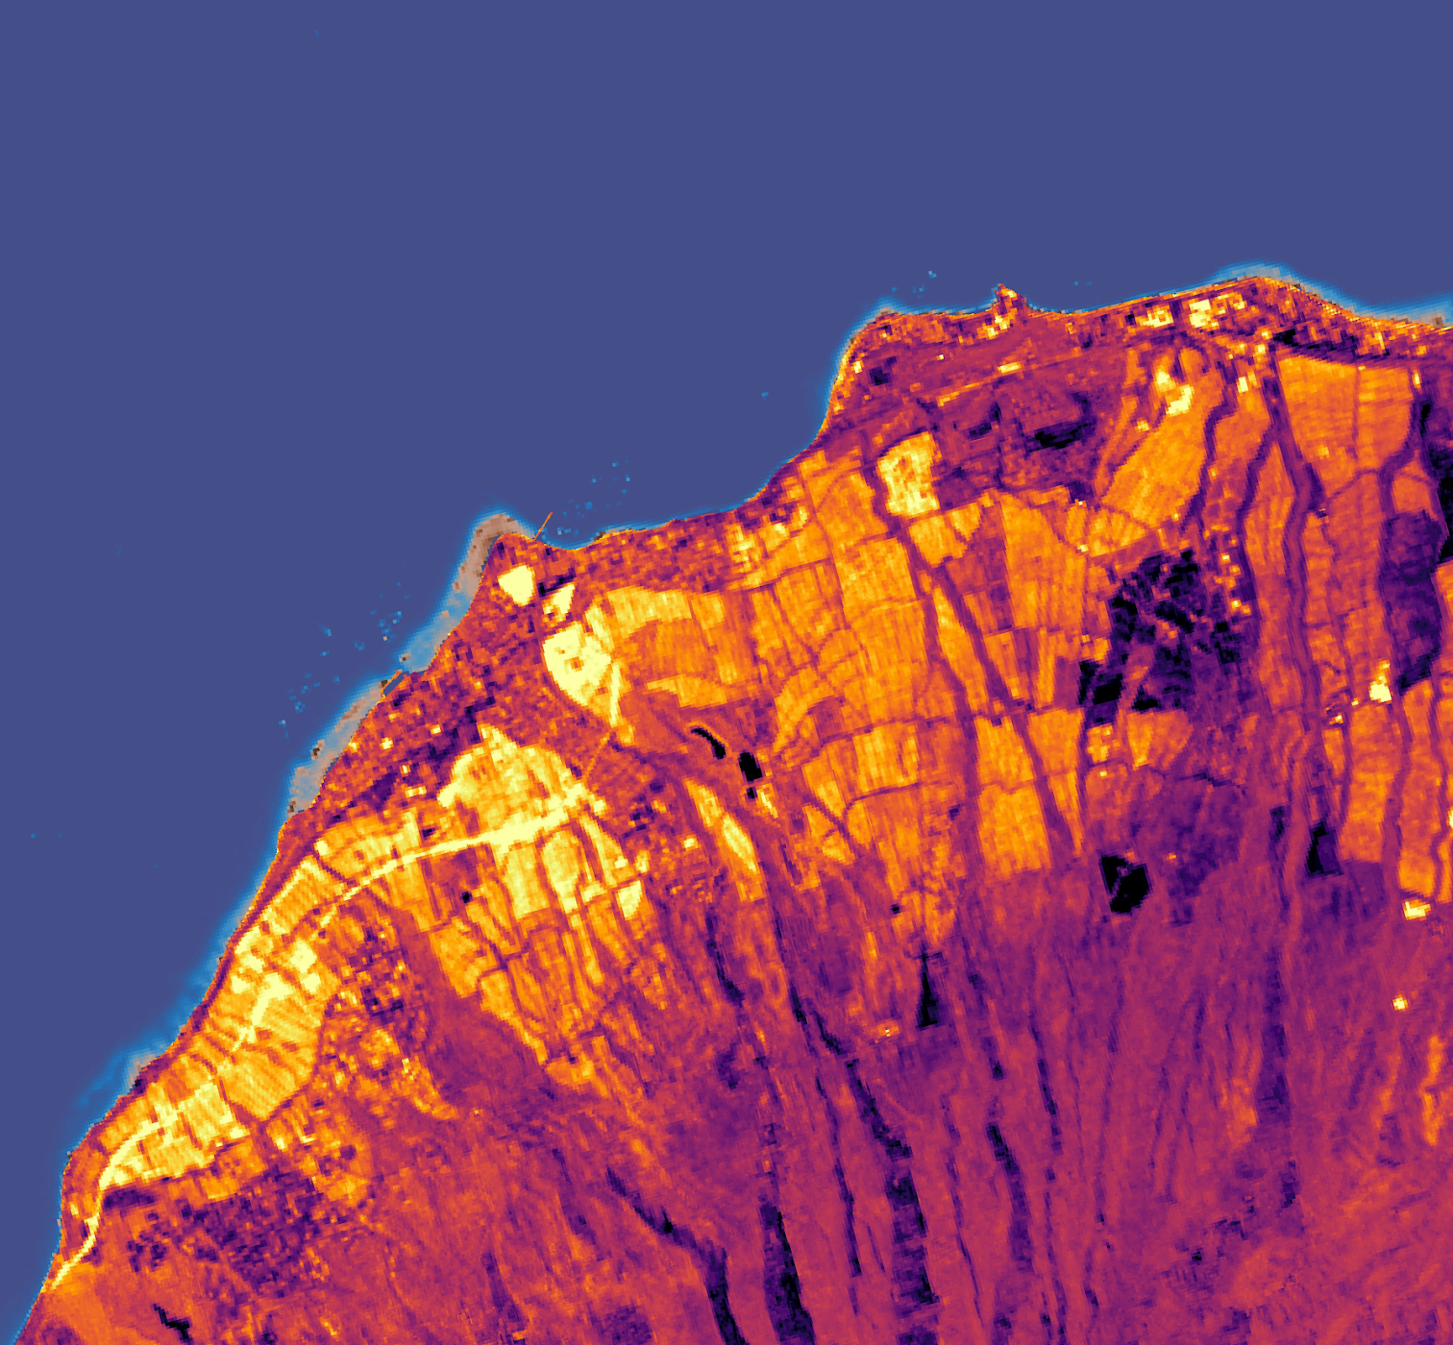
Hawai'i Water Resources
Monitoring the Impacts of Land-Based Sources of Pollution on Water Quality Along the Coast of West Maui, Hawai'i, to Assess Coral Reef Condition
Arev Markarian
Emily Deardorff
Arthur Platel
Sophia Skoglund
Ames | Fall 2019
Notes:
Hello! we are the Hawaii Water Resources team and we are excited to share from our ten week journey exploring the feasibility of using Earth Observations to monitor land use and water quality changes.
I am Arev Markarian, this is Emily Deardorff, Arthur Platel, and Sophia Skoglund.

Slide 2
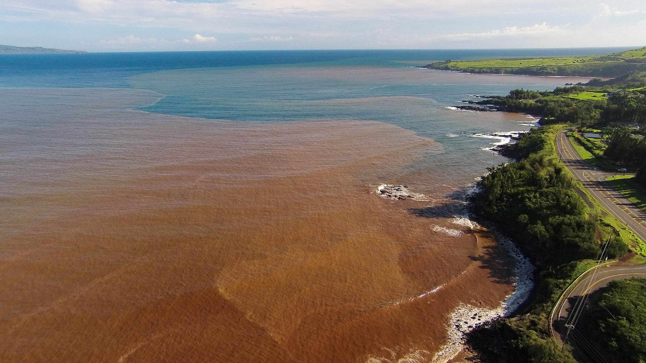
Road Map
West Maui
Partners
Study Design
Methods
    Land Cover Classification
    Water Quality
Validation
Results
Conclusion
Image Credit: R2R
Notes:
We will first introduce to you our study area, our wonderful partners and their concerns, the spatial methods we employed to address these concerns, followed by our findings!
Image Credit:
1. R2R: (written permission received to use image from Tova Callender)

Slide 3
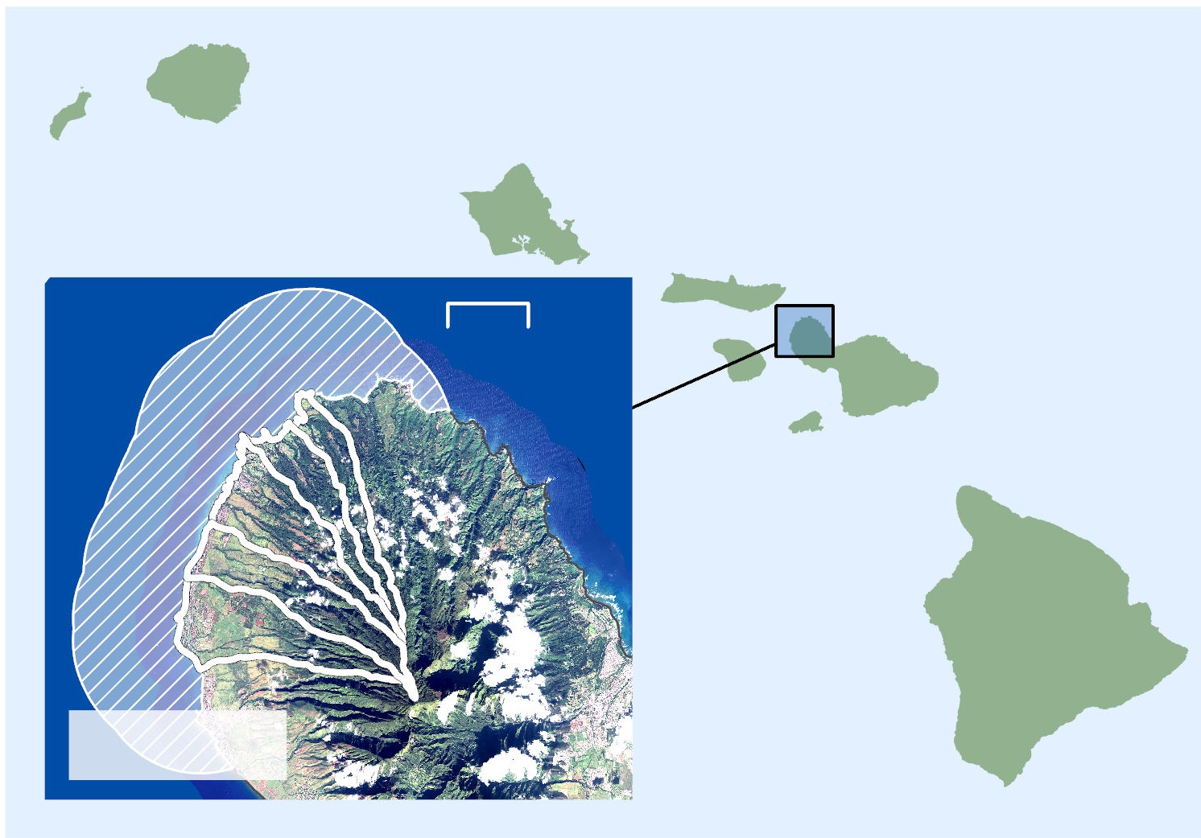


West Maui, Hawai'i
Majority of the coastline is surrounded by coral reefs
Population has increased 40% since 1990
Designated as priority watershed by the US Coral Reef Task Force
Marine Study Area
Watersheds
N
0
40 km
Pacific Ocean
West Maui
Image Credit: DEVELOP team - Data: NCRS Orthoimagery 2017, State of Hawaii Office of Planning GIS Data
Notes:
West Maui is the Western peninsula of the 2nd largest Hawaiian island of Maui. Majority of the coastline is surrounded by coral reef beds which provide habitat necessary to sustain the diversity of the marine ecosystem and health of fisheries, which promote the economy and protect the shoreline. These colorful reefs and clear waters attract many tourists in addition to great population and development increase. Coral reefs are already susceptible to decline in this climate and these changes in West Maui have prompted the USCRTF to designate these watersheds as priority in 2011, as delineated by the white border in the map. Reef mass has dropped between 30 and 75% in this region in the last two decades.
Map Data Credit: USGS High Resolution Ortho Imagery, 2017; State of Hawaii Office of Planning GIS Layers

Slide 4
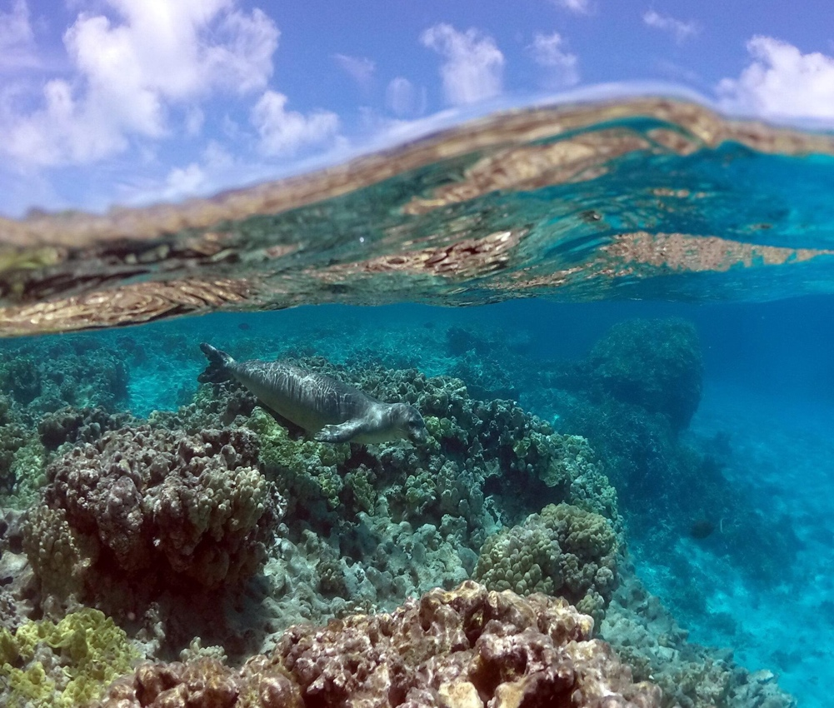
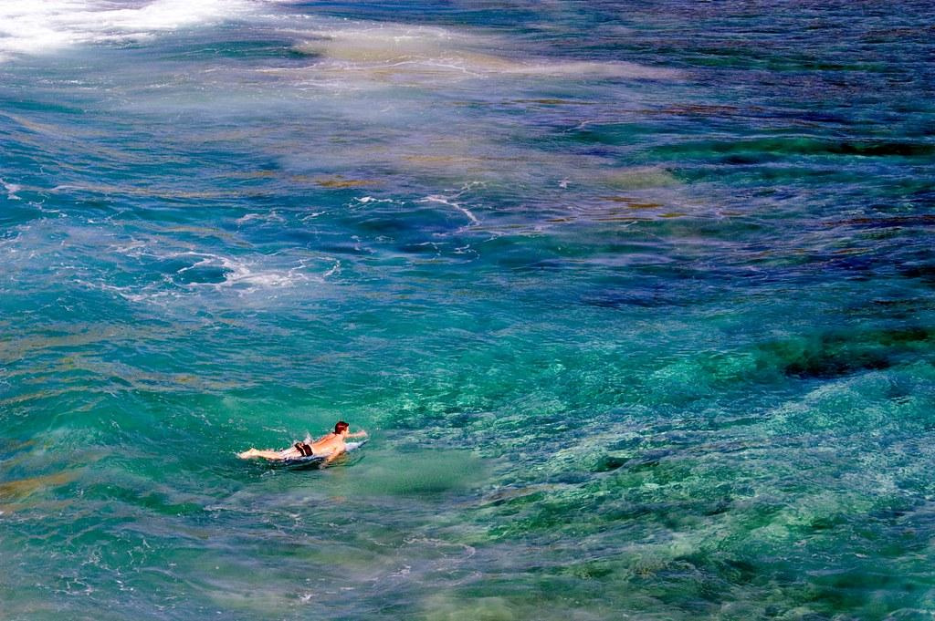

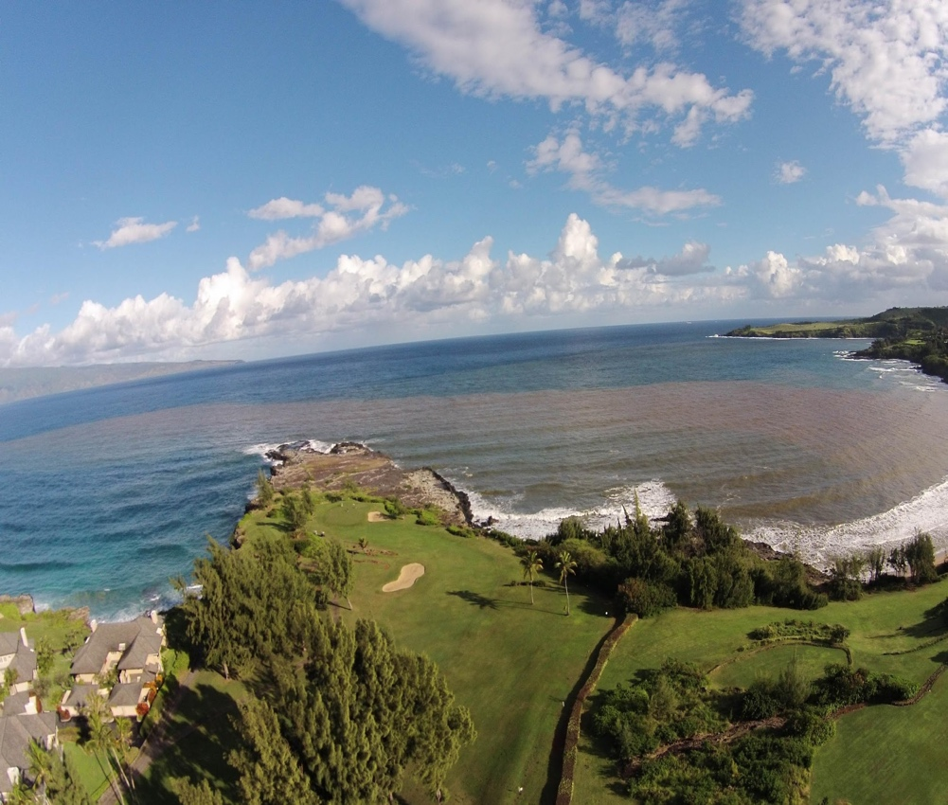
Community Concerns
Water Quality
Land- Based Sources of Pollution (LBSP)
Coral Health
&
Marine Biodiversity
Economy: Fishing, Recreation, Tourism, and Agriculture
Image Credits (Left to Right): NOAA, R2R, USGS, R2R
Notes:
The four main concerns of this community are therefore based on the value and sensitivity of this ecosystem. The activities on the island have an effect on the health of the coastline habitats as we can see with the large sediment plume in the second image. The community thrives off the balance between coral health and the ecosystem services provided, which is why it’s important to monitor land based sources of pollution.
Image Credits:
NOAA/PIFSC/HMSRP: https://www.flickr.com/photos/noaaphotolib/41240733471/
R2R: written permission received to use image from Tova Callender
Susan Hazlett, USGS: https://www.flickr.com/photos/usgeologicalsurvey/8539141325/in/photolist-oSun6H-e1zkdz-qHq8Kf-naUXfD-qGAMmx-pviGB3-wYcF4x-wSokCe-iyXXMh
R2R: written permission received to use image from Tova Callender

Slide 5
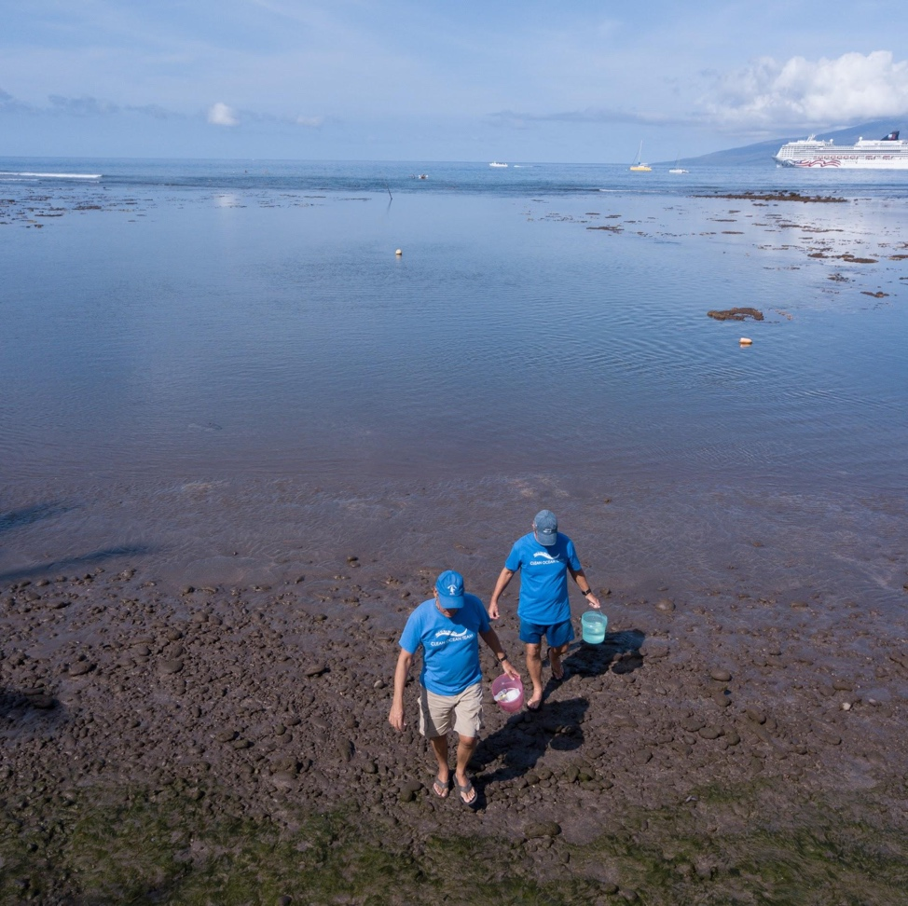
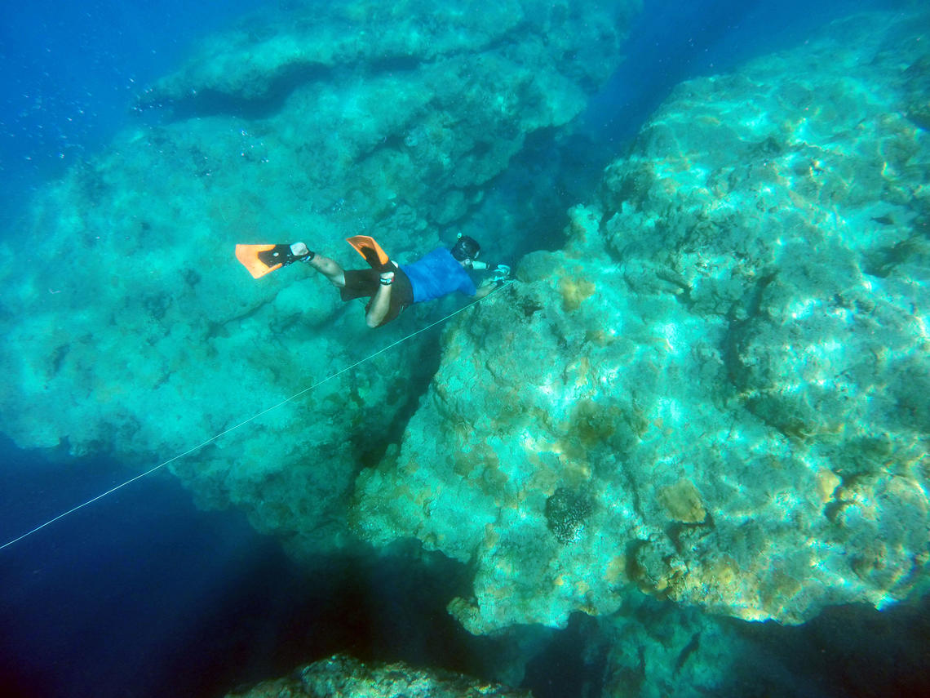
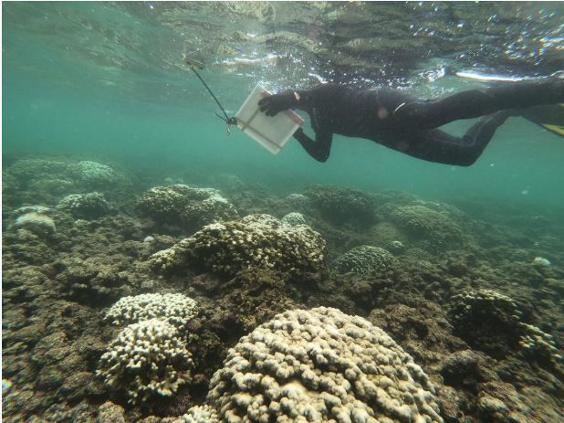
Partners
US Coral Reef Task Force, West Maui Ridge to Reef Initiative
USGS Pacific Coastal and Marine Science Center
Hawai'i Department of Land and Natural Resources, Division of Aquatic Resources
Image credit: (Left to Right) Hawai’i DLNR-DAR; USGS PCMSC; R2R
Notes:
In order to bolster the monitoring by this community we had the privilege of working with R2R, USGS, and DLNR-DAR to get an understanding of the problem and implications on the ground, as well as history of the ecosystem.
Image Credit:
1. Hawai’I DLNR-DAR: Written rights from the Hawai’I DLNR, and Dan W Dennison https://dlnr.hawaii.gov/blog/2019/11/05/nr19-186/
2. USGS PCMSC: https://www.usgs.gov/centers/pcmsc/multimedia
3. R2R: written permission received to use image from Tova Callender

Slide 6
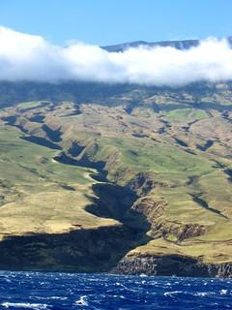
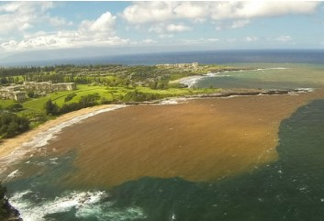
Study Objectives
Classify land cover over 30 years & detect change
Analyze trends in water quality parameters
Explore the relationship between LULCC, turbidity, and Chl-A
Produce a Google Earth Engine Application for continuous analysis
Image Credits (Left to Right): NOAA/NMFS/OPR, R2R
Notes:
With these community concerns in mind, our team set out to:
classify land cover from the last three decades and detect change in the priority watersheds
analyze trends in water clarity associated with storm events and locations of effluents
explore the potential correlation between inland cover changes and near-shore water quality degradation
create a geospatial tool to access this information into the past and future
Image Credit:
NOAA/NMFS/OPR https://www.flickr.com/photos/noaaphotolib/5014271523/in/photolist-9gEWVu-8D7ikF-9gEXh9-vbKWH3-HGjfid-TExji9-JbJM91-8D6sei-8TVpFw-fL2n8b-8D85SB-8DbciJ-9gEXes-fL2naJ-8JLyhC-fJrDt8-8LTSyi-8QvgZb
R2R: written permission received to use image from Tova Callender

Slide 7
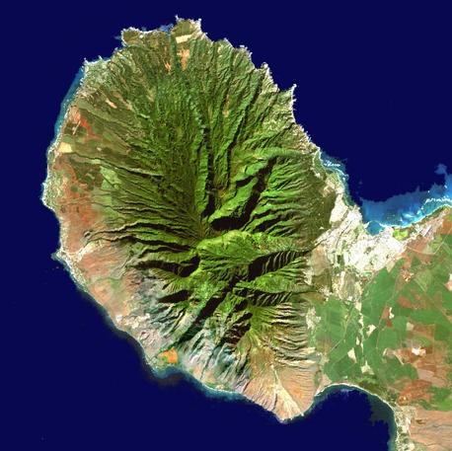
Study Period
January 1989-October 2019 (30 years)
Within time frame:
    Extreme rainfall events
    Coral bleaching events
    Agricultural shifts
          End of pineapple & sugar cane farming
    Economic shifts
1990
2000
2020
Image Credit: USGS
Notes:
The study period for this project was 1989 to 2019.
Having a three decade study period encapsulates the short term changes, caused by weather events for example, as well as long term changes in agriculture.
This region of the world is prone to having topical storms which exacerbates any changes happening inland and carries the nutrient and sediments near shore into the water. Some large-scale changes within our priority watersheds includes phasing out of sugarcane production in 1998, and then pineapple production in 2009 (this tidbit is foreshadowing some interesting analysis we will come across later)
Image Credit:
1. USGS: https://www.usgs.gov/media/images/maui

Slide 8
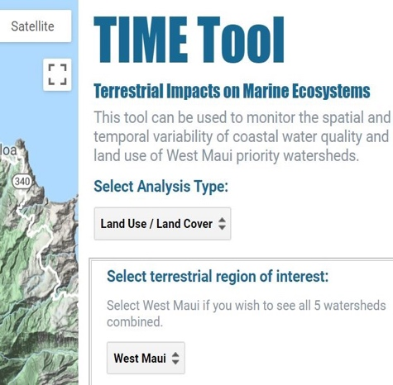


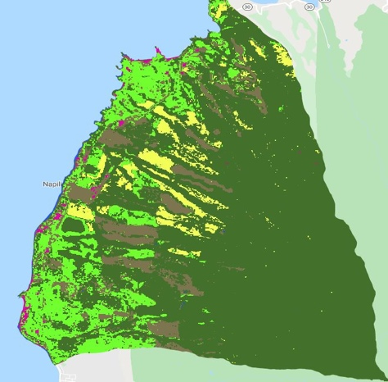
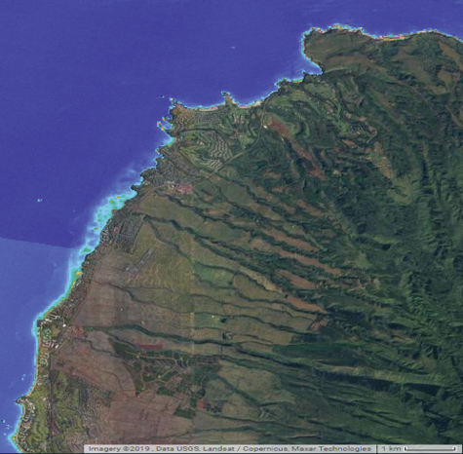
Methods
Outputs
Inputs
Processing
Analysis
Google Earth
Engine Tool
Data Acquisition
Validation
Ancillary Data
Google Earth Engine
Land Cover
Time-Series
NASA Earth Observations
Extract Water Quality Parameters
Classify Land Cover
Water Quality
Time-Series
Image Credit: USGS
Notes:
Our project workflow is broken into four stages.
For the first stage we determined our inputs: which satellites we could use and which years had viable imagery.
Next, using Google Earth Engine we created a tool to calculate Turbidity and Chl a and perform a supervised land classification.
Third, using our tool we were able to validate our outputs then analyze for patterns and relationships
Image Credit:
1. USGS: https://www.usgs.gov/media/images/maui

Slide 9

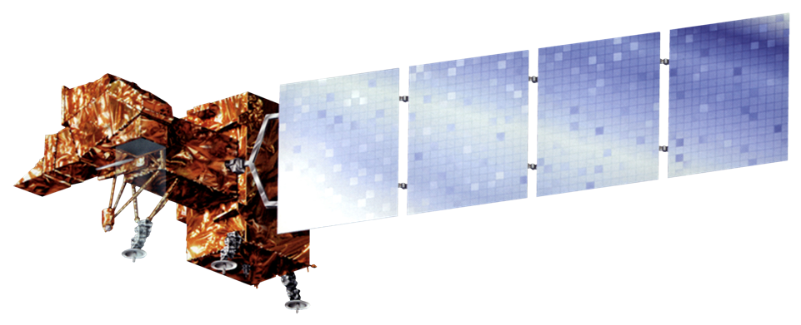

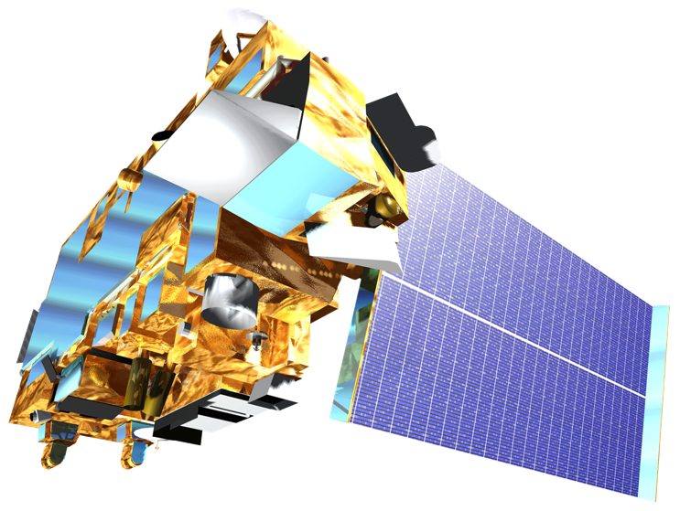
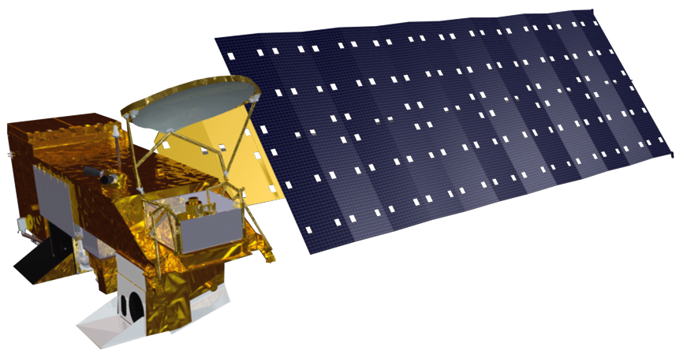
Satellites/Sensors Used
Land Cover and Water Quality
Landsat 4 / 5
Thematic Mapper
Landsat 7
Enhanced Thematic Mapper+
Landsat 8
Operational Land Imager
No available images of study area
No available images of study area
1989
1992
1999
2003
2012
2002
Aqua MODIS
Sea Surface Temperature
2000
Terra MODIS
Image Credit: NASA DEVELOP
Notes:
Here is the list of satellites that were necessary to use in order to cover our study period. We employed L4/5, 7, and 8 to monitor land cover and water quality at 30m resolution. There were gaps in the available years of imagery for our specific study area as we can see in the timeline. Aqua and Terra MODIS were employed to understand general sea surface temperature at 250m resolution.
Image credit:
1. NASA DEVELOP: http://www.devpedia.developexchange.com/dp/index.php?title=List_of_Satellite_Pictures

Slide 10
LAND COVER
Notes:
Now we will dive into methodology we used to classify land cover

Slide 11
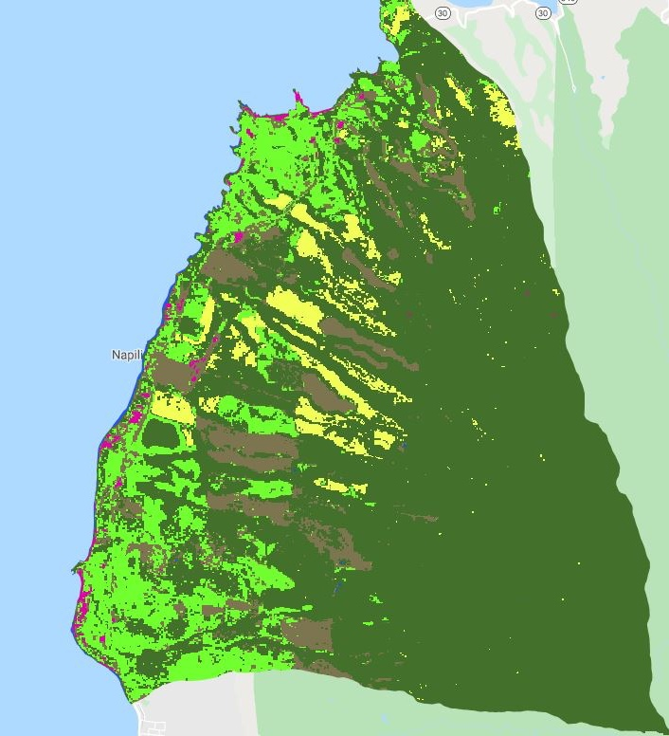
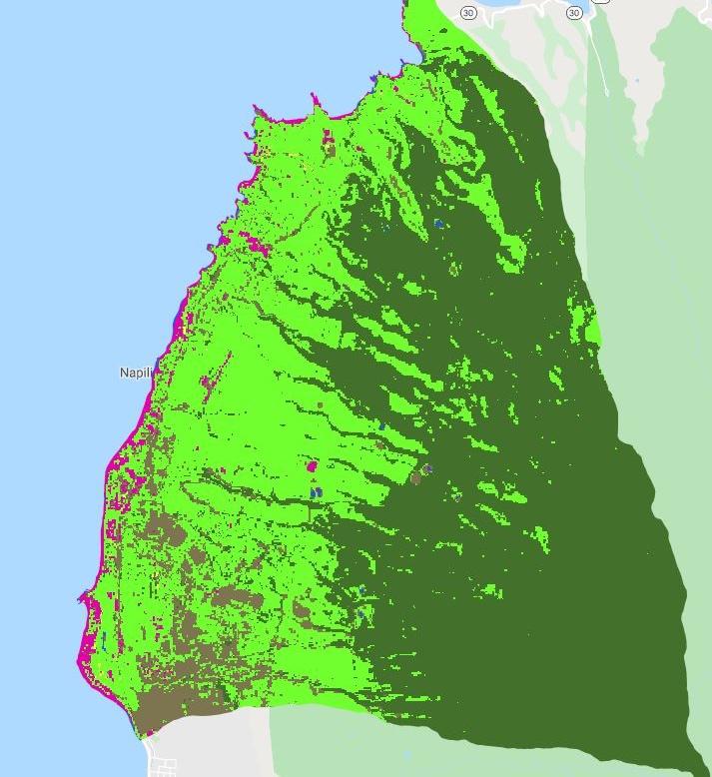





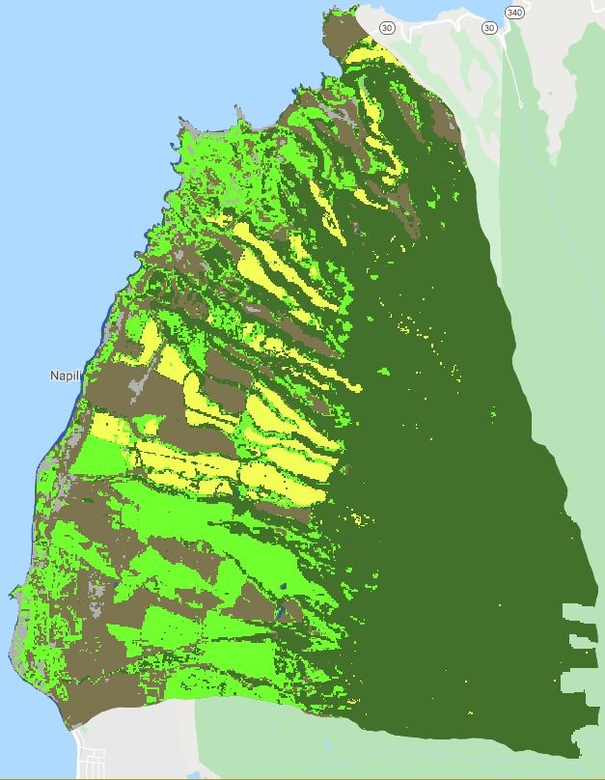
Methods
1989
2019
Classified using CART Classification Method
2 sets of training points for different sensors
Land Cover Classes:
    Pineapple
    Agricultural Veg
    Veg-Non Ag
    Barren
    Urban
Pineapple
Agricultural Veg
Vegetated Non-Ag
Barren
Urban
Image Created in Google Earth Engine by the DEVELOP Team using USGS Data (RD image)
Notes:
We ysed a couple of methods for our land change analyisi – the first of which is a land classification using the CART (classification and regression trees) supervised classification method in Google Earth Engine. Since we collected images from 3 different satellite sensors, we had to create two separate training sets for the classifications to work accurately, one training set for Landsat 4/5/and 7 sensors and a separate training set for Landsat 8 OLI sensors.
For our classification we were able to differentiate 5 land classes : Pineapple. Agricultural Vegetation, Vegetated-Non-Agriculture, Barren and Urban. Its important to note Agricultural vegetation encompassed all other agriculture aside from pineapple and in our study, area included land cover such as sugarcane, golf courses and fallow agricultural lands. Don’t mention but classified using blue, green, red , nir, swir1, swir2, temp, DBI ( dry built up index), DBSI (Dry barrens soil index), NDSoI ( Normalized Difference Soil Index), Salinity Index and NDVI.

Slide 12
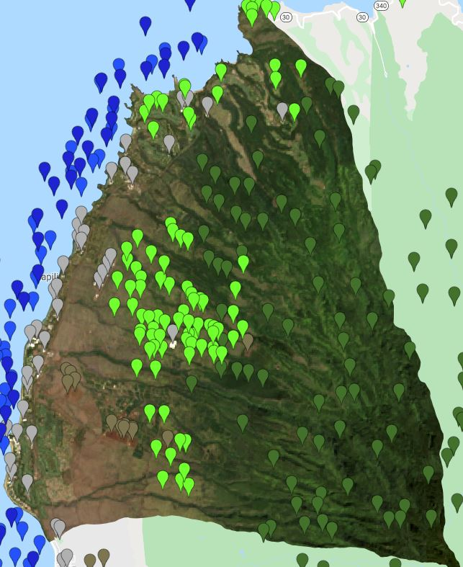
Validation
Validated using control points from each classification
Validated in Google Earth Engine:
  Overall Accuracy
  Validation Error Matrix
Notes:
Once we had our classifiers working, We used validation points to run an accuracy and a validation error matrix in GEE. The image on the left shows an example of some our our validation points.

Slide 13
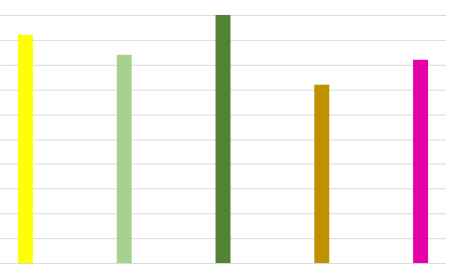
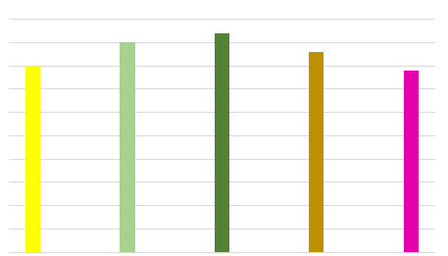
Validation
TM & ETM+ Classification Accuracy: 93.8%
OLI Classification Accuracy: 94.2%
Percent Accuracy TM/ETM+ Classifier
Percent Accurate OLI Classifier
100
95
90
85
80
75
70
65
60
55
50
100
95
90
85
80
75
70
65
60
55
50
Pineapple Agricultural Veg Veg-Non Ag Barren Urban
Pineapple Agricultural Veg Veg-Non Ag Barren Urban
Notes:
Taking a look at those validation results, we can see that overall, both classifiers were able to do a very good job. The Thematic Mapper and Enhanced Thematic Mapper Classification had an over all accuracy of 93.8% and the Landsat * Operational Land Imager classifier had an accuracy of 94.2%. The chart below shows the accuracy for each land class Showing that overall our data is accurate.

Slide 14
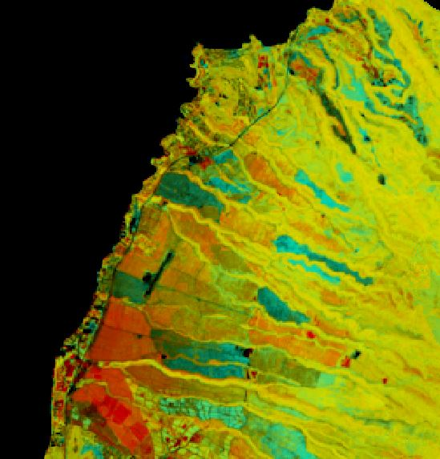
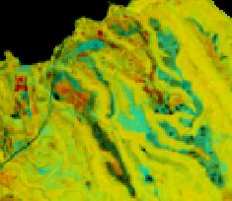



NDVI Change Map
NDVI Change Detection
Map 1989 to 2019
NIR - red
Normalized Difference Vegetation Index
NDVI =
NIR + red
NDVI Change = NDVI 2019 - NDVI 1989
NDVI Increase
NDVI Decrease
Vegetated, No-NDVI change
Non-Vegetated, No-NDVI change
Notes:
In addition to our land cover classification, we created an NDVI change map to better understand shifts in vegetation and development. The NDVI change map shows changes in The Normalized Difference Vegetation Index which represents changes in ‘greenness’ of the landscape and the map shown here shows changes between and 1989 and 2019. On the Map the green areas represent regions where greenness has increased, and red areas represent regions where greenness has decreased. Yellow represents vegetated regions with no change in greenness and black represents unvegetated regions with no change in greenness. The inset map shows the Kapalua Plantation Golf Course and surrounding area. The Golf Course was opened in 1991 and its development is indicated by an increase in greenness on the NDVI change map

Slide 15
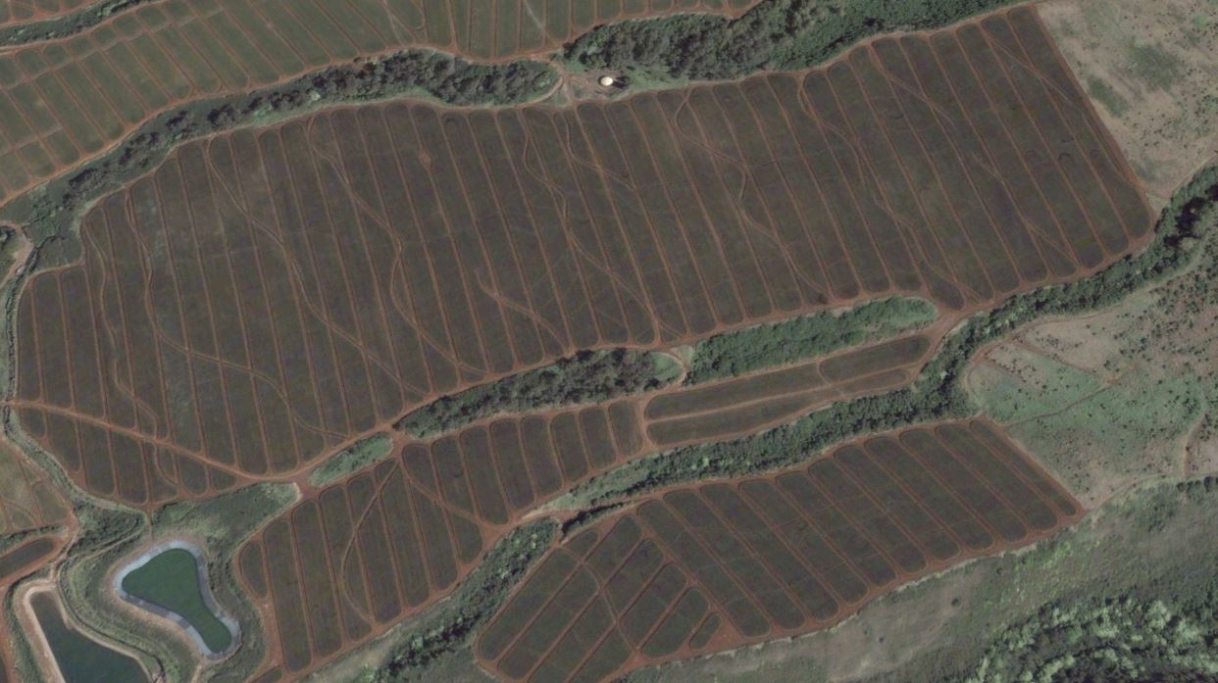
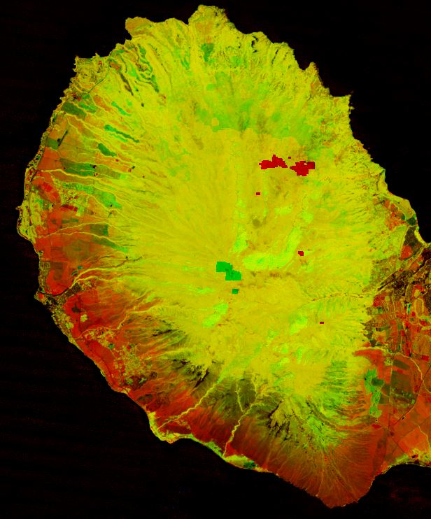
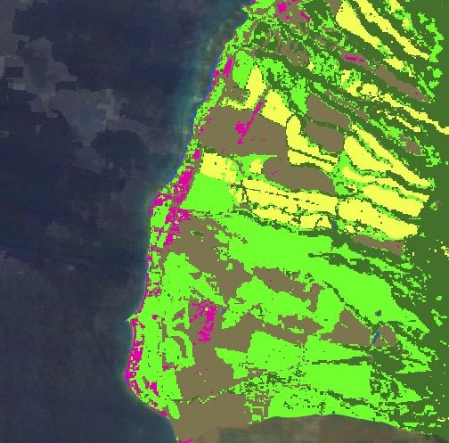
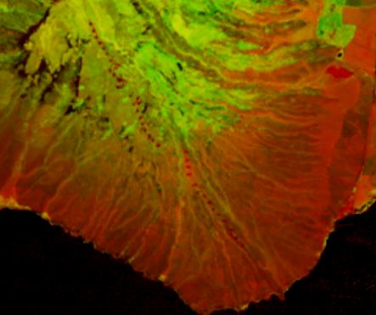
Small Scale Land Cover Changes
NDVI Change Detection Map 1989 to 2019
Land Classification 1990
NDVI Increase
Pineapple
NDVI Decrease
Agricultural Veg
Vegetated, No-NDVI change
Vegetated Non-Ag
Barren
Non-Vegetated, No-NDVI change
Urban
Notes:
In addition to the golf course, we were able to notice other small-scale changes using our NDVI change map and Land classification maps. The first image is again showing the NDVI Change during our study period. You can see in the inset map, there are many small red circles indicating regions with a decrease in NDVI. These regions correspond with the development of Wind Turbines in these areas during our study period which we were very excited to pick up in our change map. Looking over to the right our Land classification maps were also able to pick up small scale land cover. Shown in yellow are pineapple fields that our classification was able to detect. The image is showing what the pineapple fields look like from above

Slide 16
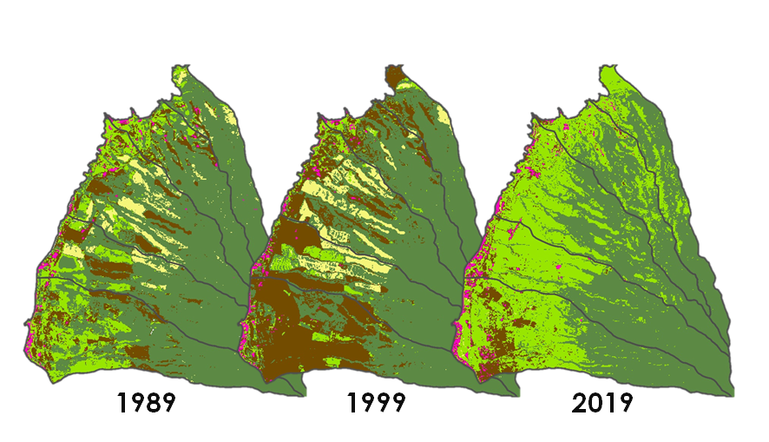
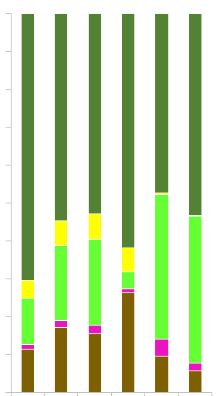

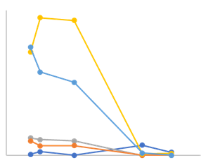
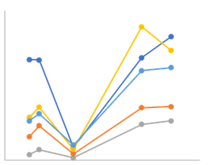
Results
Wahikuli
Honolua
Honokahua
Kahana
Honokowai
100
90
80
70
60
50
40
30
20
10
0
Pineapple
Pixel Count
Percent of Total Land Cover
1990
2000
2010
2020
Agricultural Vegetation
Pineapple
Pixel Count
Agricultural Veg
Vegetated Non-Ag
1989 1990 1992 1999 2013 2019
Barren
Urban
1990
2000
2010
2020
Images Created in ESRI ArcGIS Pro by the DEVELOP Team
Notes:
Now that we have looked at our analysis methods, lets look at the results.
We noticed two major landcover changes during our study period. The first major shift was between 1989 and 199 in which we saw a significant decrease in agricultural vegetation and an increase in barren land.
The second major shift we noticed was a complete disappearance of pineapple between 1999 and 2019 and an increase of agricultural vegetation during that time
Later Emily(Kowalski) will analyze why we think we see these shifts.
As Arrev mentioned earlier, there were several major agricultural shifts during our study period and we were able to detect them in our land classification. The first major agricultural change we noticed was between 1989 and 1999 in which we noticed a significant decrease in agricultural vegetation and an increase in barren land as you can see from the land class chart.. This change correlates with the known end of sugar cane production in West Maui in 1998 and the year after in 1999 we can see a lot of barren fields. You can also see this change represented in the land class maps which indicate that most of the sugarcane was in the southern portion of the study area in (Wahikuli) and was left barren after 1998. Additionally we see steep decrease in pineapple, especially in the two central watersheds of our study area Kahana and Honokowai, between 1999 and 2009 which represents the end of Pineapple production in West Maui. In 2019 we can also see the highest levels of Agricultural Vegetation of any of the preceding years, and this change represents the increase in fallow agriculture that took over once the pineapple and sugarcane were finished.

Slide 17
WATER QUALITY
Notes:
now that we’ve seen the general changes in land cover, let’s dive into water quality

Slide 18
Water Quality Parameters
Chlorophyll-a
Photosynthetic pigment
High [chl-a] suggests an overabundance of algae
Turbidity
A measure of water clarity
low
high
Sea Surface Temperature
Changes in temperature can alter ocean physics, chemistry, and biology.
Typically, optimal coral growth occurs in water temperatures of 25 - 29 °C.
Precipitation
Storm events carry nutrients from watersheds into the ocean.
Topography and imperviousness affect the amount of runoff and subsequent sediment plume formation.
Notes:
There are a number of parameters that we can look at with remote sensing to determine water quality.
The first one is chl-a, a photosynthetic pigment found in the chloroplasts of algae. If satellites sense a lot of green in an area, that suggests high [chl-a], and therefore an overabundance of algae. This overabundance can block sunlight from reaching coral and other organisms.
A second parameter is turbidity, which is a measure of water clarity in which high turbidity corresponds to a large presence of suspended organic & inorganic matter. Once again, this can block out sunlight, and harm the coral that prefer clear waters.
Sea surface temperature is a more global scale factor. Typically, optimal coral growth occurs in water temperatures of 25 - 29 °C¹, so anything out of that range could put coral health at risk.
Finally, rainfall plays a big role in water quality because storm events can quickly carry nutrients and sediments from land into the ocean, possibly resulting in pollution and sedimentation. Topography and imperviousness of the area also influences the effects of precipitation.
McField & Kramer, Indicators of reef health in Mesoamerican reef (2007)

Slide 19
Water Quality Algorithms
Turbidity (Nechad et al. 2009)
K_{d}(PAR) (Song et al. 2017)
NDCI (Mishra & Mishra, 2012)
blue light penetrates, may mirror attenuation of light through water column
red exhibits strong association with suspended matter
coefficients varied by sensor
red band
NIR band
red band
A_{T} P_{w}
NIR - red
T _{(NTU)} =
K_{d}(PAR) =
-199.75(blue - red)+11.702
NDCI =
1.267(1 - (P_{w} /C))
NIR + red
Nephelometric Turbidity Units
light attenuation in the Photosynthetically Active Radiation domain (m⁻¹)
Normalized Difference Chlorophyll Index
Notes:
A few different algorithms were chosen to explore water quality along the West Maui coastline. Looking at multiple parameters allows us to detect a variety of patterns and to output in units comparable to field measurements. Using an algorithm with outputs in Nephelometric Turbidity Units was a priority because it could be compared directly with in situ data collected by the citizen science group Hui O Ka Wai Ola. The red band is a good indicator of turbidity because it can’t penetrate ocean waters very well, therefore reducing interference by benthic, or ocean bottom, reflectance. Kd(PAR) is another measure of water clarity, or more specifically, of light attenuation through the water column. This uses the red band of Landsat, which exhibits strong association with suspended matter, and the blue band, which penetrates the water in a way that resembles how light travels through the water column. Finally, our best option for sensing chlorophyll-a came down to Mishra & Mishra’s Normalized Difference Chlorophyll Index algorithm, which is specialized for Sentinel-2. Unfortunately, Landsat lacks bands that match Sentinel’s, so translation of the algorithm to this different satellite resulted in an NDCI that is in fact the same as NDVI. Because there are not yet algorithms to confidently map chlorophyll with Landsat, we chose to stick with measuring greenness of the water with the Normalized Difference Vegetation Index.

Slide 20
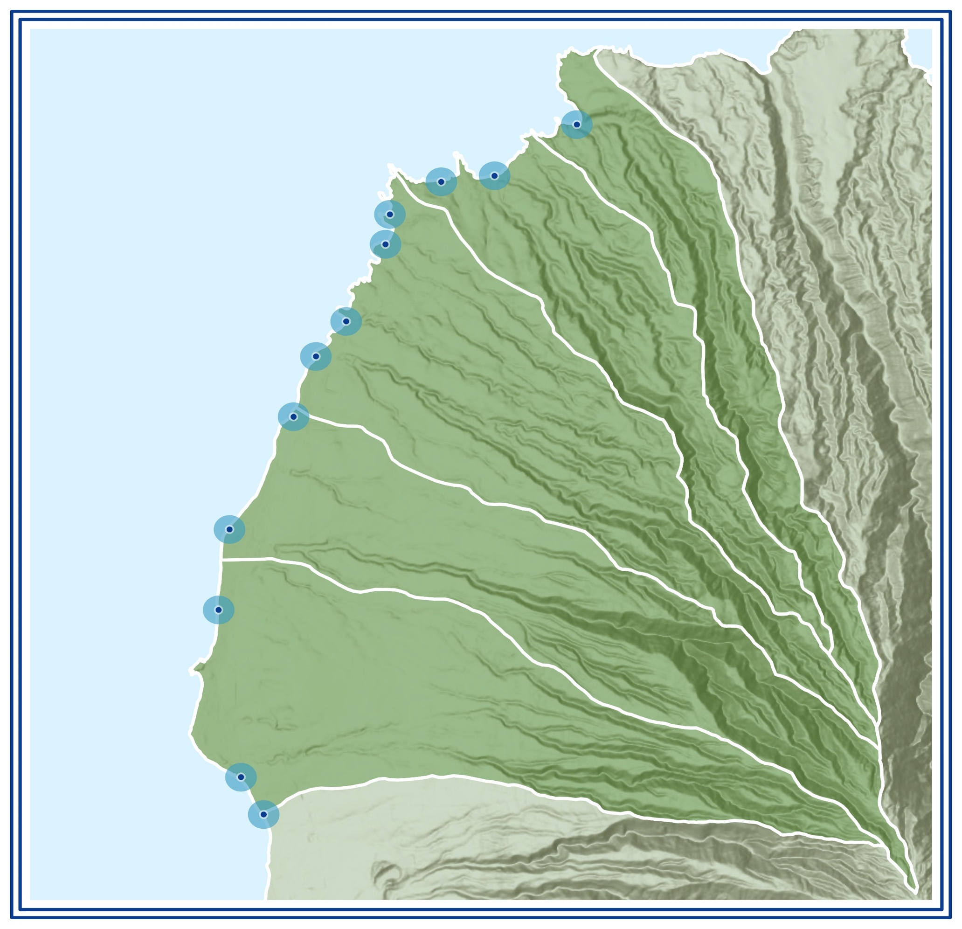
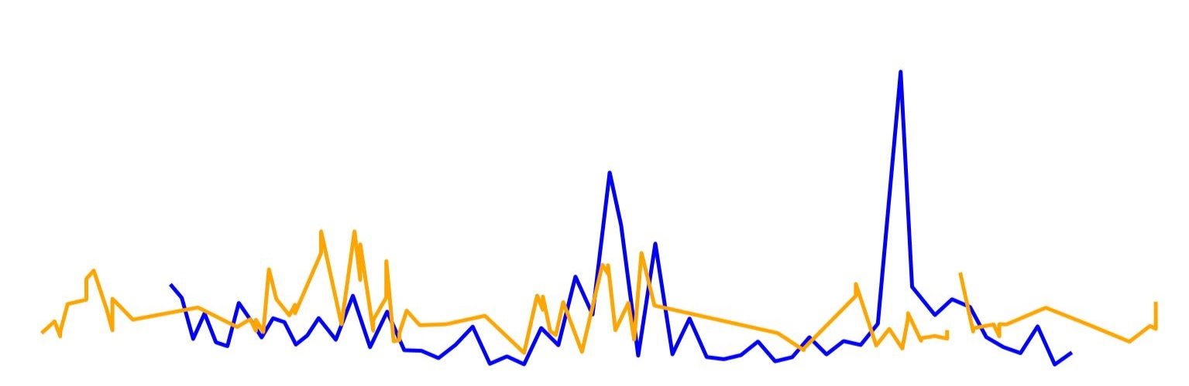
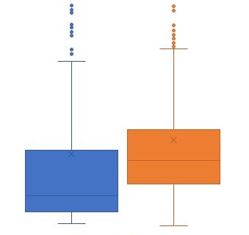
Water Quality Validation
Hui O Ka Wai Ola’s in situ Sampling Sites
Turbidity Value Comparison – Pohaku Site
60
40
20
0
In Situ
Honolua
DT Beach
Turbidity (NTU)
Oneloa
Honolua
Kapalua Bay
Model
Napili
Honokahua
Kaopala
Kahana Village
2016
2017
2018
2019
Kahana
Pohaku
20
16
12
8
4
0
Numerical Comparison
Turbidity algorithm outputs roughly match in situ data, but are generally higher.
Kaanapali
Honokowai
Airport Beach
Turbidity (NTU)
Wahikuli
Canoe Beach
Wahikuli
In Situ
Model
Notes:
To validate the Landsat-derived turbidity model, we compared the outputs to in situ data collected by Hui O Ka Wai Ola, a citizen science group working with the R2R Initiative. On the right is a map of their sampling sites. We extracted modeled turbidity from these specific locations and plotted the results against the in situ data from 2016 to now. As you can see in top left plot, the two sources appear to share similar patterns of change over time. Additionally, the box and whisker plot shows us that the turbidity algorithm is outputting data with a range in values slightly greater, but very similar to that of the in situ data.

Slide 21
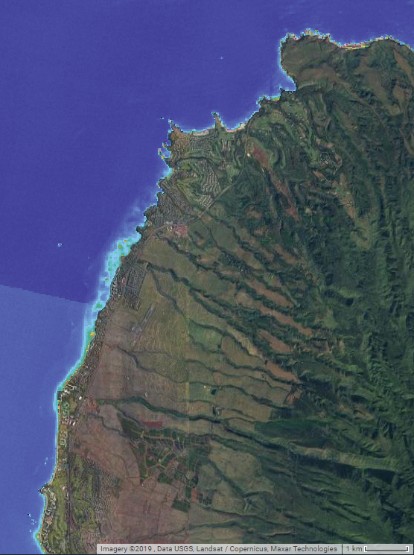
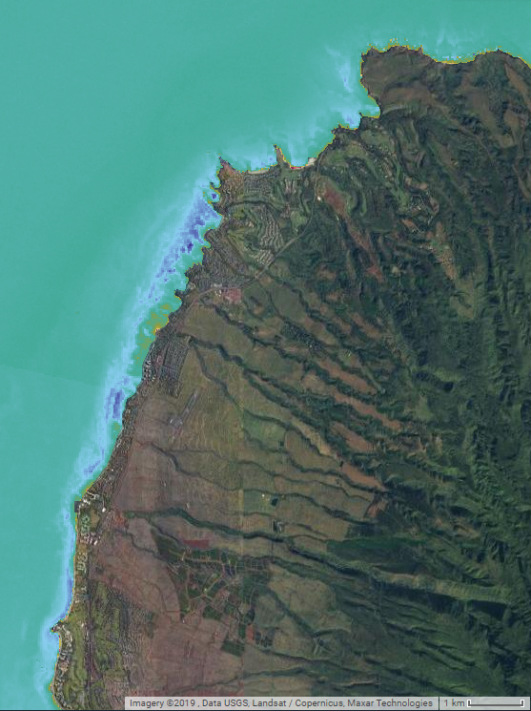
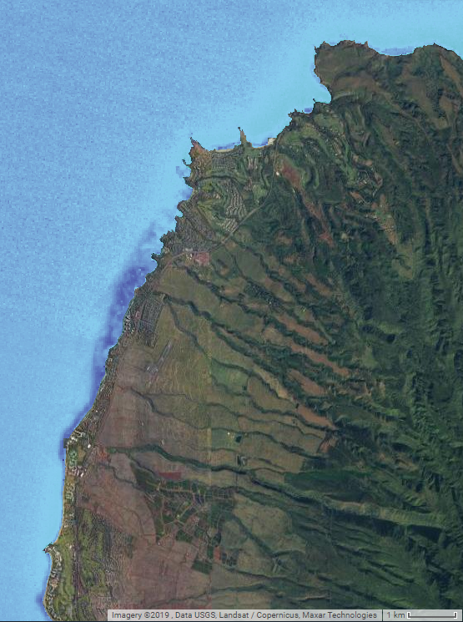
Results: Water Quality
N
note the effects of ocean currents & bathymetry
➣
Turbidity (NTU)
K_{d}(PAR) (m⁻¹)
NDCI
0
30
0
30
-1
1
Water quality algorithms run on the Landsat 8 OLI image taken February 10th, 2014.
Notes:
Shown here are outputs from the TIME tool for each water quality parameter. Spatial variation is only seen close to shore, no more than about 1 km out. NDVI, interestingly, appears to be an inverse of turbidity, which suggests that turbid waters are also less green, characterized by lower chlorophyll concentrations. The map of Kd(PAR) reveals a pattern not seen in the other maps, in which clarity is lower next to shore, very high out from that, and then lower again beyond 1 km out. This may be explained by the bathymetry of the area and the ocean current that flows between islands. That current would account for the increase in Kd(PAR) (decrease in clarity) far from shore.

Slide 22
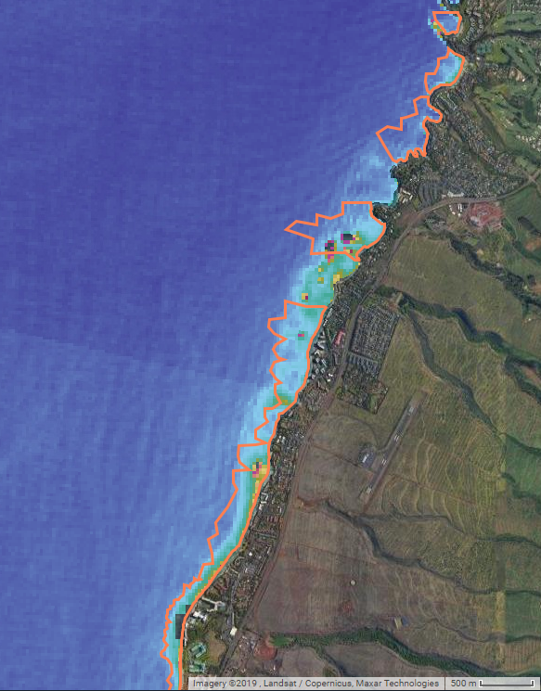
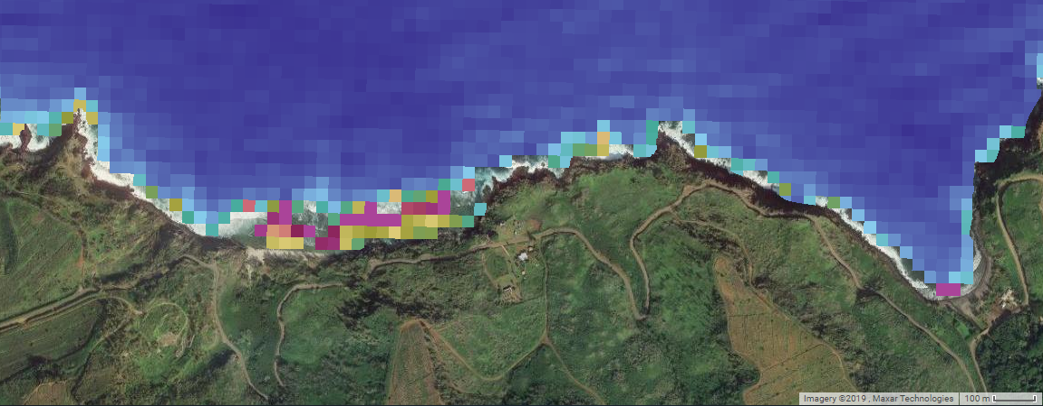
Results: Water Quality
Turbidity (NTU)
0
30
Turbidity (NTU) produced by the Nechad et al. (2009) algorithm on the Landsat 8 OLI image taken February 18th, 2017.
Water quality algorithms should be used with caution over coral reefs because benthic reflectance may interfere with the detection of each parameter.
N
outlines of the coral reefs
➣
Notes:
When we outlined the locations of coral reefs on our maps, we noticed that our tool may be detecting high turbidity when in fact the high values may be attributed to reflectance off the coral reefs themselves. Water quality algorithms should therefore be used with caution over the coral reefs. On the flip side, the algorithm does map high turbidity in some locations where there are not reefs that would cause interference.

Slide 23
ANALYSIS
Notes:
So, for our analysis, we took time to examine the water quality and land cover patterns individually, and then we looked at them together.

Slide 24
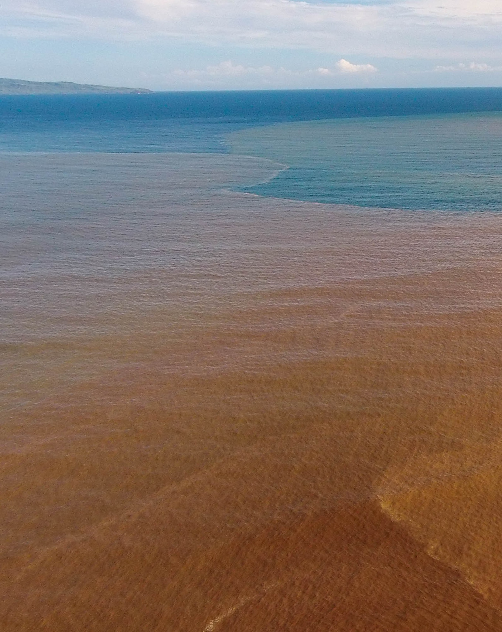

Water Quality Analysis
Summer
Fall
Winter
Spring
10
9
8
7
6
5
4
3
2
1
0
Precipitation (cm/month)
Precipitation Data: NOAA
Image Credit: Tova Callender, West Maui R2R
Notes:
Since our partners mentioned sediment plumes inundating reef beds after storms in the past, we decided to look closer at the relationship between the two.
First, we looked at the general seasonal patterns in turbidity and how it corresponded with precipitation. As you may remember, we would expect to see higher turbidity levels during times of high precipitation, since precipitation collects sediment when it runs off the landscape.
By analyzing the outputs of our turbidity models, we drew out some of these turbidity trends specific to West Maui. We found that fall is the season with the highest average turbidity values, followed by winter. The high fall turbidity values correspond with the increase in precipitation as the rainy season begins. What we are seeing here is that earlier precipitation events seem to cause higher amounts of turbidity than the later, albeit more frequent, precipitation events that occur in the winter.
Image: Written permission received to use image from Tova Callender)

Slide 25
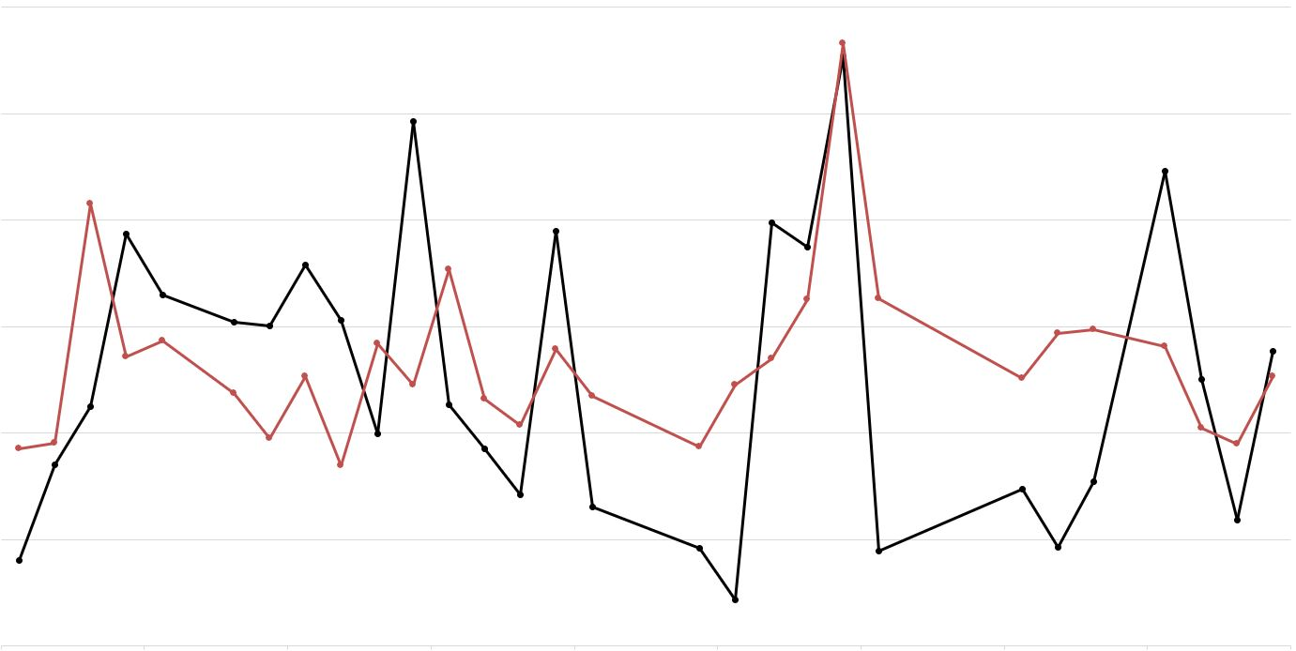
Correlation - Rain & Turbidity
Kapalua Bay Site
14
12
Lag Time
Precipitation
Turbidity
Precipitation (mm/month)
Turbidity (NTU)
7
6
Precipitation is a strong predictor of turbidity
(p < 0.05)
0
Jan 16
Jan 17
Jan 18
Notes:
We also took a look at the interplay between turbidity and precipitation at a slightly more close-up scale, as shown by this graph here that shows the interplay between turbidity and precipitation over a 3-year period..
We found that precipitation is a strong predictor of turbidity on a more month-to-month scale as well. This was a significant effect found in both remotely sensed data and in-situ data for the study area.

Slide 26
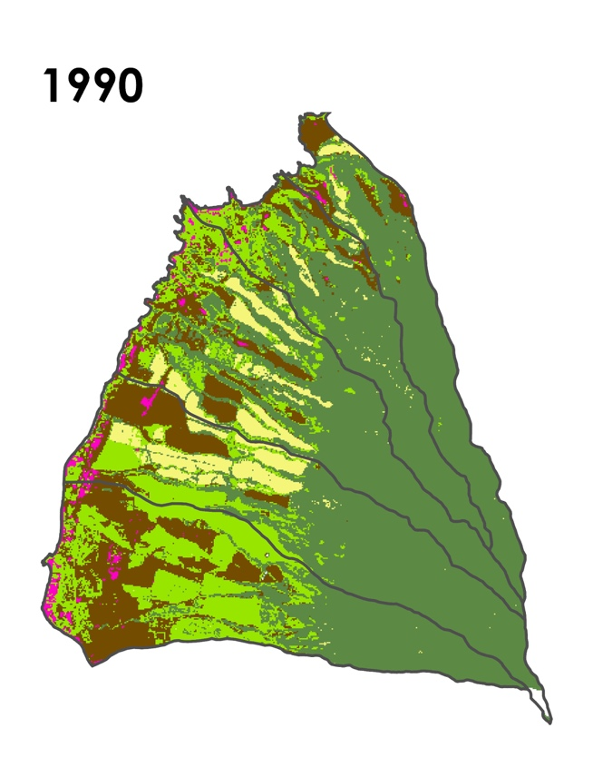
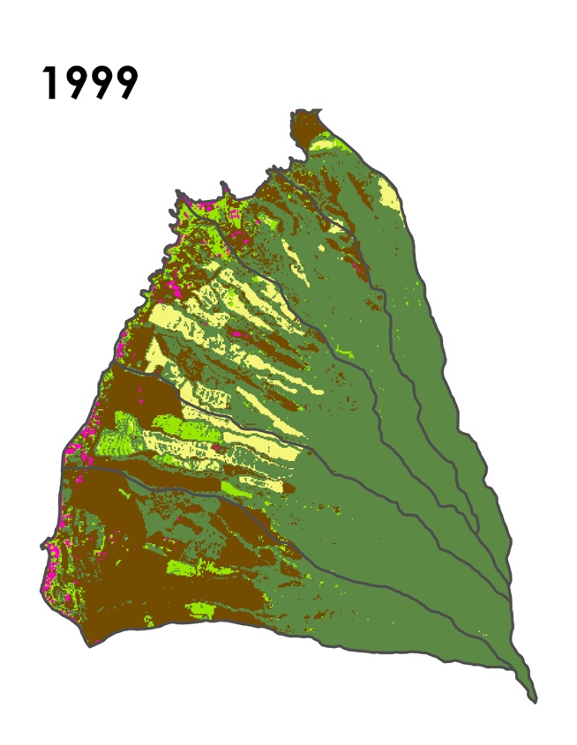
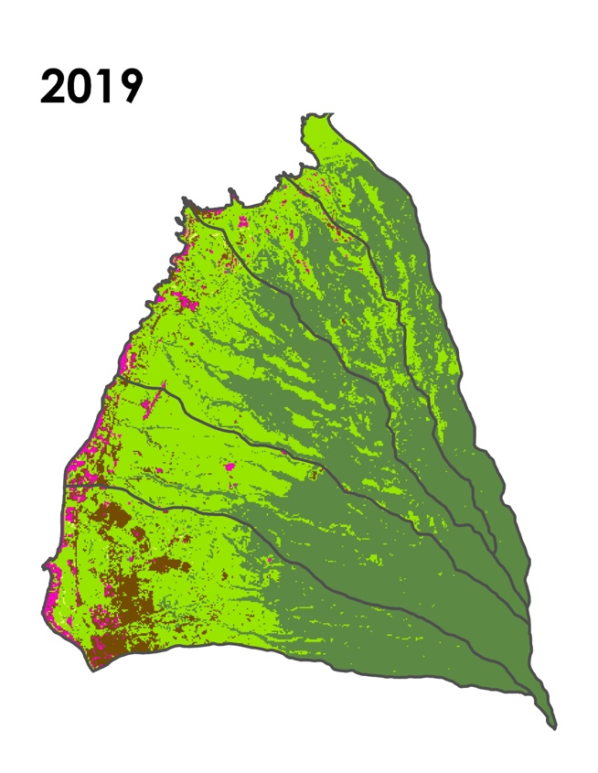
Land Cover Analysis - Temporal
Yearly fluctuations in crops, phasing out of sugar cane
Phasing out of pineapple, shift toward resort-focused economy
1998:
Sugar cane farming ends (in W. Maui)
2009: Pineapple farming ends
1990
2000
2020
Notes:
We also looked at the temporal dynamics in land cover classifications in the watersheds.
West Maui went through notable economic shifts over the study period, and we found that these shifts were clearly detectable in our land classifications.
As you may remember, we saw significant fluctuation in the barren and agricultural land classes, and a complete disappearance of the pineapple land classes over the 30-year study period. When you look at the 1990 image, you see a patchwork of land types including barren, agricultural, and pineapple. This is reflective of the high-impact agriculture that was occurring in the area during the late 80’s and early 90’s.
In the 1999 image, you see a high amount of barren land, which we originally thought was a malfunction of our classifier. After some further analysis and conversation with our partners, we realized that this actually captures West Maui in a transitional state, when the sugar cane farms in the area were being rapidly phased out.
In the 2019 image, we see modern Maui, with a more homogenous land cover of shrubby fallow fields in the lowlands and the more dense non-agricultural vegetation in the highlands.
Notably, Maui also experienced a boom in tourism in the late 2000’s, which we may expect would result in higher amounts of urban impervious surfaces. We did not find a significant difference in the urban impervious classes, however.

Slide 27
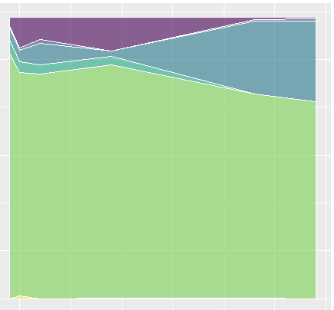
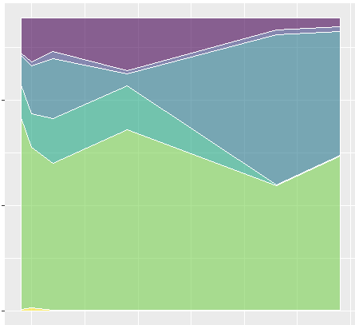
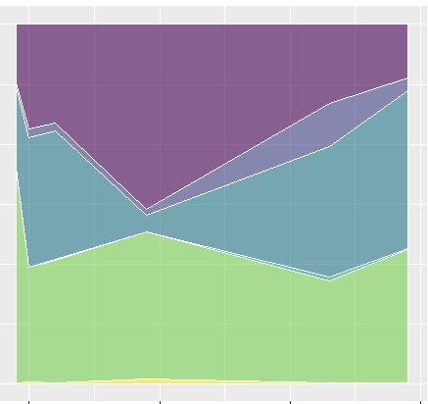



Land Cover Analysis - Spatial
North
Middle
South
Honolua
Kahana
Wahikuli
Barren
Barren
Barren
Ag. Veg.
Ag. Veg.
Pineapple
Ag. Veg.
Vegetated (not ag.)
Vegetated (not ag.)
Vegetated (not ag.)
1990
2000
2010
2020
1990
2000
2010
2020
1990
2000
2010
2020
Honokahua
Honokowai
Barren
North
Barren
Ag. Veg.
Ag. Veg.
Pineapple
Middle
Vegetated (not ag.)
Vegetated (not ag.)
South
Water
1990
2000
2010
2020
1990
2000
2010
2020
Notes:
We also looked for spatial trends in the land cover data. The 5 watersheds can be roughly grouped into three groups in accordance to their spatial trends.
The two northernmost watersheds, Honolua and Honokahua, were characterized by their high amount of non-agricultural vegetation as well as an increase in the “other agriculture” land class in the 2000’s and 2010’s.
The middle two watersheds, Kahana and Honokowai, were the ones that were home to pineapple farming, up until the mid-2000’s.
The southernmost watershed, Wahikuli, is characterized by having a substantially higher amount of “barren” pixels throughout the study period as well as a slightly higher amount of urban impervious surfaces than the rest of the watersheds. This watershed also has the lowest proportion of non-agricultural vegetation.
These groupings should be useful for determining how best to streamline mitigation studies for multiple watersheds in the region.

Slide 28




Seasonal Trends
2015
2019
Land Classifications (number of pixels)
Barren, Urban, Other ag Trends per Season over 30 years
350
0
-350
Daily Average Precipitation - Residuals (mm)
Precipitation Trends per Season over 30 years
40
30
20
10
0
Model-Derived Turbidity (NTU) - Kapalua
Pineapple
Agricultural Veg
Vegetated Non-Ag
1
0
-1
Sea Surface Temperature - Residuals (C)
Barren
Urban
Notes:
The purpose of our study circles back to studying how land based source pollution may be affecting water quality in our study area, but there are other important factors that also affect coral health in the region. As we have discussed, turbidity events are harmful for the health of corals, an effect that is pariculalrly noticeable in West Maui reefs. Anomalous sea surface temperatures can also stress coral reefs, particularly anomalously high. By looking a little deeper at the interplay of these effects, we are able to point out time periods of coral stress, during which we would be interested in going back and seeing what kinds of effects the coral reefs were experiencing.
The combined effects of these coral risk factors were reflected in at least two of the more recent prolific coral reef bleaching effects, with one of them actually occurring currently. The timeframe of these events are highlighted in red.

Slide 29

Terrestrial Impacts on Marine Ecosystems (TIME) Tool
Notes:
Now we’d like to give you a live demonstration of the TIME (Terrestrial Impacts on Marine Ecosystems) tool, which our partners will eventually be able to use.
----------------------
After a code release process, the TIME Tool will be made available to our partners at West Maui Ridge2Reef Initiative. This tool will allow Ridge2Reef and its affiliates to better incorporate long-term land use and water quality data into their watershed planning processes. It will also allow for improved retrospective analysis of completed mititgation projects, and it will give them the ability to perform a well-rounded analysis of the watershed health at their date of interest.

Slide 30
Conclusions
Land Cover Classification:
  Yearly satellite imagery composites can reliably detect changes in agricultural shifts
Water Quality:
  Bottom reflectance affects feasibility and efficacy of water clarity algorithm outputs
Benefits of Tool:
  Elicit retrospective analysis of Implementation Projects
  Guide future management
Benefits of Analysis:
  Understand long term trends
  Identify specific LBSP stressors
Notes:
Given this was a feasibility study, some things we noticed include bottom reflectance affecting water quality measures, after validation it was confirmed that yearly composite imagery can detect large and small scale ag shifts noted throughout our study period. The TIME Tool is sufficient in analyzing decadal trends, however more frequent satellite images with less clouds could offer more accuracy. Higher resolution imagery can more accurately classify between different types of agriculture, such as pineapple and sugarcane fields.

Slide 31
Limitations
  Due to limitations in satellite imagery availability, there are two 7-year gaps in our analysis
  There remains a lack in ocean water quality algorithms suited for clear and shallow coastal waters
  Detected changes in land cover and water quality may be strongly influenced by seasonality
Notes:
We found some limitations in the availability of satellite imagery and the applicability of ocean water quality algorithms. We also would advise those using the TIME tool to be cautious about the potential for seasonal changes to affect the results.

Slide 32
Future Work
  Recommend that in situ data collection be performed on days when Landsat passes over, when possible
  Incorporate even more ocean dynamic data (wind, current, tide, wave) as well as a more specific knowledge of the timing relationship between land use and water quality.
  Incorporate more accurate water quality algorithms that are yet to be created
Notes:
In the future, we would recommend that in situ data be collected on dates that correspond with the Landsat passes. Along with better matched in situ data, this analysis could be made more complete by incorporating even more ocean dynamic data such as winds, currents, tides, and waves. It would also be helpful to incorporate a more specific knowledge of the timing dynamics between land cover and water.
In future analyses, it would be useful to incorporate water quality algorithms that are better suited to this particular region.

Slide 33
  Tova Callender
  US Coral Reef Task Force, West Maui Ridge to Reef Initiative
Russell Sparks
  Hawai’i Department of Land and Natural Resources, Division of Aquatic Resources (DLNR-DAR)
  Curt Storlazzi
  US Geological Survey
  Dr. Juan Torres-Pérez
  Bay Area Environmental Research Institute, NASA Ames Research Center
  Dr. William J Hernández-López
  University of Puerto Rico
Gina Cova
  DEVELOP Fellow (NASA Ames Research Center)
Zachary Bengtsson
  DEVELOP Fellow (NASA Ames Research Center)
John Dilger
  Science Advisor (Spatial Informatics Group, LLC)
Lorenzo Terenzi
  NASA Ames Research Center
Notes:
The Hawai'i Water Resources Team would like to thank all of our mentors and partners who helped make this project possible. We would like to especially thank:
Tova Callender (West Maui Ridge to Reef Initiative)
Russel Sparks (Hawai'i Department of Land and Natural Resources)
Curt Storlazzi (U.S. Geologic Survey)
Dr. Juan Torres-Pérez (Bay Area Environmental Research Institute, NASA Ames Research Center)
Gina Cova, DEVELOP Fellow (NASA Ames Research Center)
Zachary Bengsston, , DEVELOP Fellow (NASA Ames Research Center)

