Slide 1
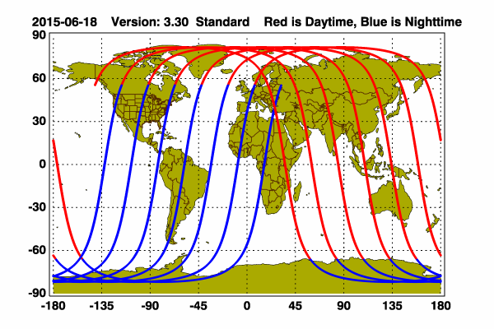
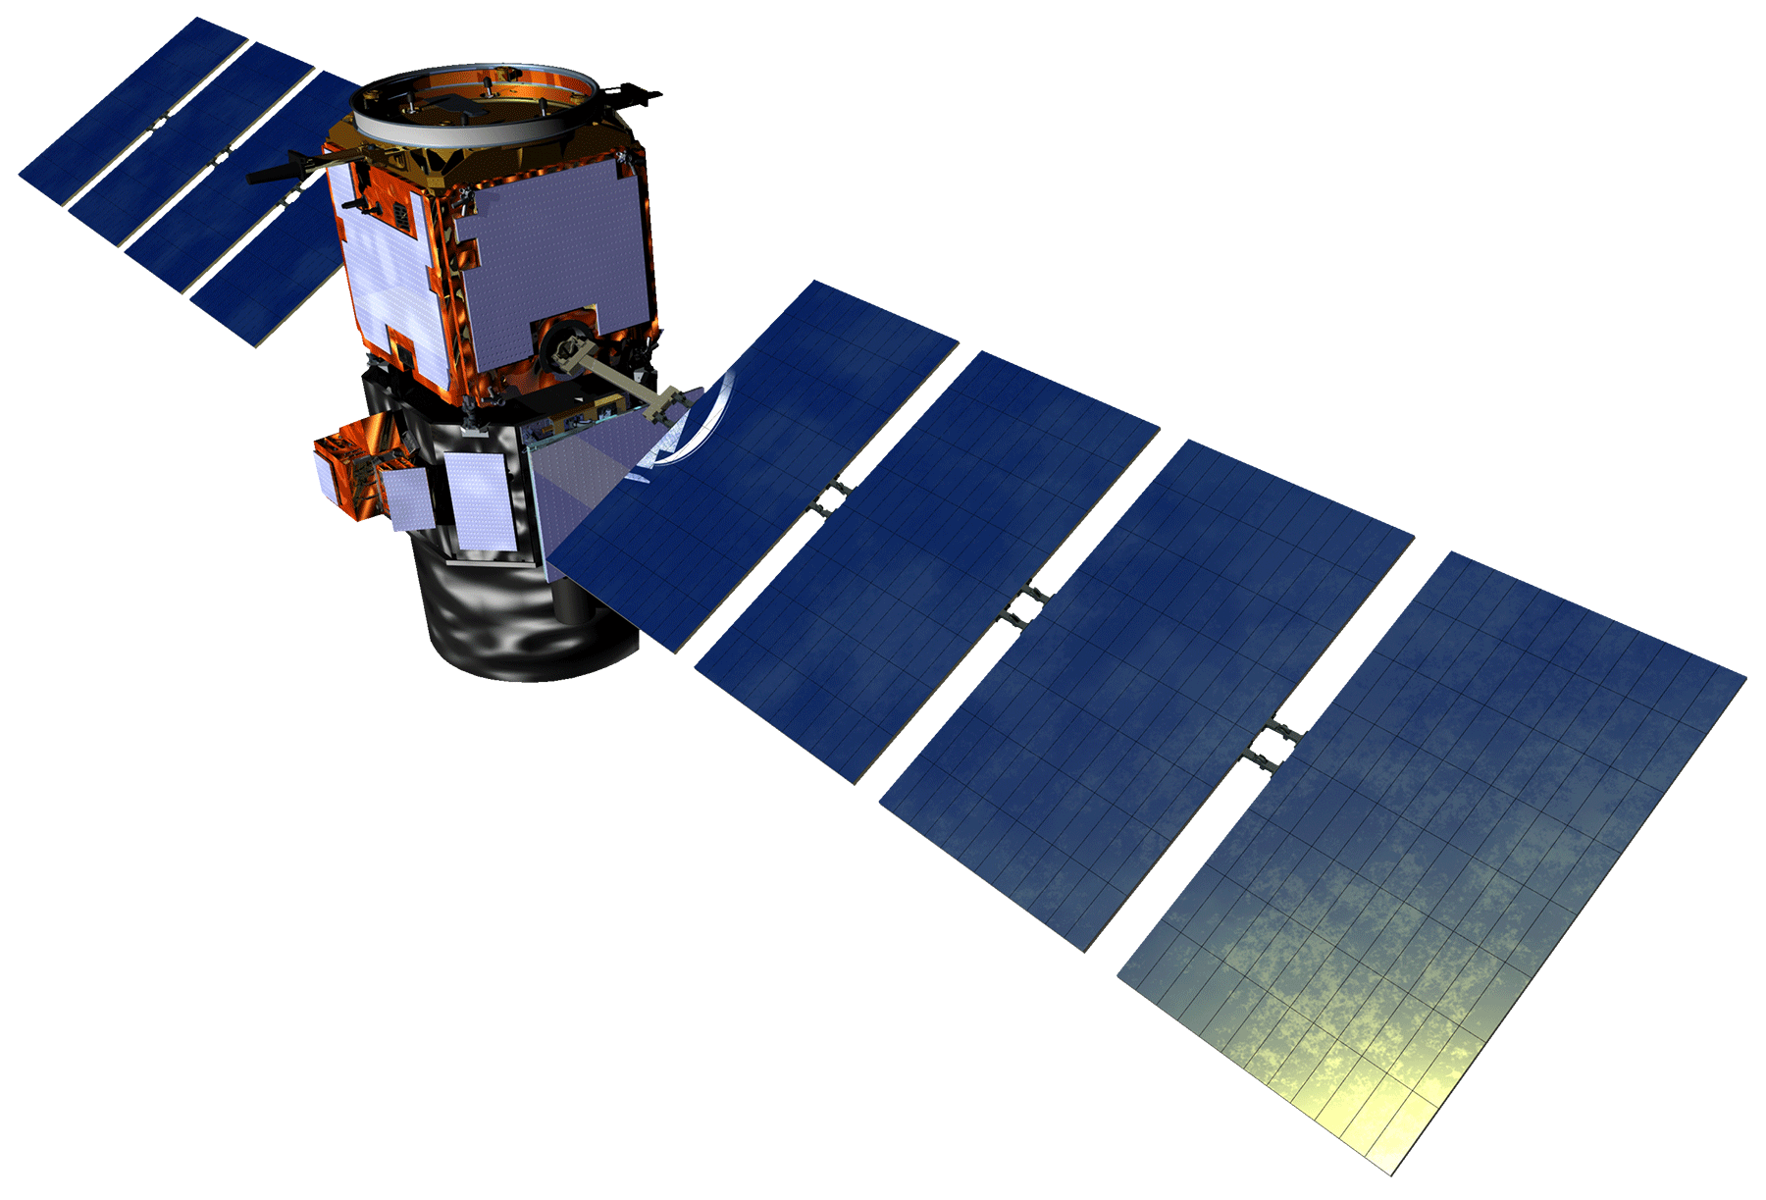
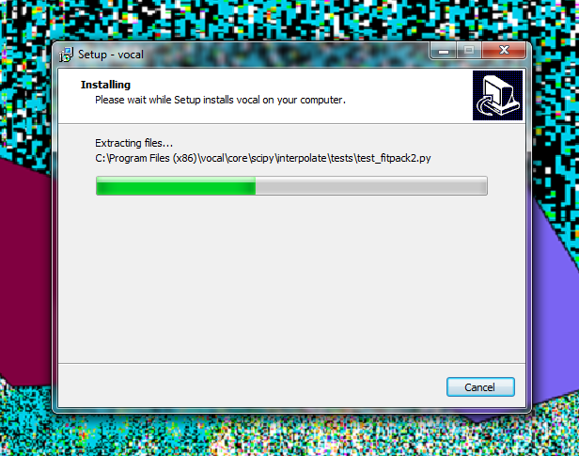
CALIPSO Cross-Cutting III
Interacting with CALIPSO Data Through a Graphical User Interface (GUI)
Kathleen Moore (Project Lead) & Jordan Vaa
DEVELOP National Program at NASA Langley Research Center
Abstract
Objectives
Atmospheric scientists analyze satellite data as part of their assessments of atmospheric health. One such satellite, the Cloud-Aerosol Lidar and Infrared Pathfinder Satellite Observation (CALIPSO), outputs images of longitudinal cross-sections of the Earth’s atmosphere. Depending on the wavelength of light used in the observation, it is possible to detect the presence of various aerosols. Some are natural sources, like dust storms, and sulfur dioxide from volcanos. Others are human-made, like sulfates from factories and smoke from burning biomass. It is important to track aerosols because an abundance of atmospheric aerosols contributes to accelerated cooling and warming of the Earth. The first instance of a visualizer for this data was written in an obscure, proprietary language, Interactive Data Language (IDL), making further modification of this tool virtually impossible. Since then, DEVELOP has produced new visualization software, Visualization of CALIPSO (VOCAL), written in Python.
As of the completion of the previous term, in addition to displaying CALIPSO images, the team added the ability for the user to “select” regions of interest by drawing shapes and assigning attributes to them. This information can subsequently be pushed to a backend database for the purposes of sharing and collaboration. However, the tool still needed to be enriched with other features such as better exception-handling and descriptors for annotations, and it needed to have cross-platform compatibility. Consequently, we have added these and other features to enrich the user experience, and we streamlined installation of the software on the Windows and Mac OS X operating systems. These updates have greatly improved VOCAL’s usability.
Ease installation of VOCAL installation packages for Windows 7 system
Enhance attributes of the polygons that are drawn and strengthen the tie between them and the associated *.hdf files with which they are associated
Improve sanity-checking/error-handling and communication between the system and the user
Study Area
Methodology
Finalize installation
Deploy to partner
Feedback collection
Functionality
creation
Orbit path of CALIPSO
Results
Earth Observations
Cloud-Aerosol Lidar and Infrared Satellite Observation (CALIPSO)
Screenshot showing installer built for Windows 7.
Acknowledgements
Conclusions
Team Members
CALIPSO Cross-Cutting II, LaRC Summer 2015
Grant Mercer
Nathan Qian
CALIPSO Health and Air Quality, LaRC Spring 2015
Ashna Aggrawal
Courtney Duquette
NASA DEVELOP National Program
Michael Bender
Dr. Kenton Ross
VOCAL can impact the efficiency of atmospheric science research collaboration and, more generally, visually-based research.
Proper error-handling and –logging establish a solid platform for VOCAL through which improvements can be incorporated in subsequent releases.
The future of VOCAL lies in increased flexibility. This could come in two forms: portability (building a stand-alone installer for all major operating systems or creating a web-based application) and efficiency (integrating the off-site OPeNDAP data service from NASA for real-time data access.)
Project Partners
Jordan Vaa and Kathleen Moore (Project Lead)
CALIPSO Science Team
Dr. Charles Trepte
Dr. Amber Soja
NASA Langley Research Center

