Slide 1
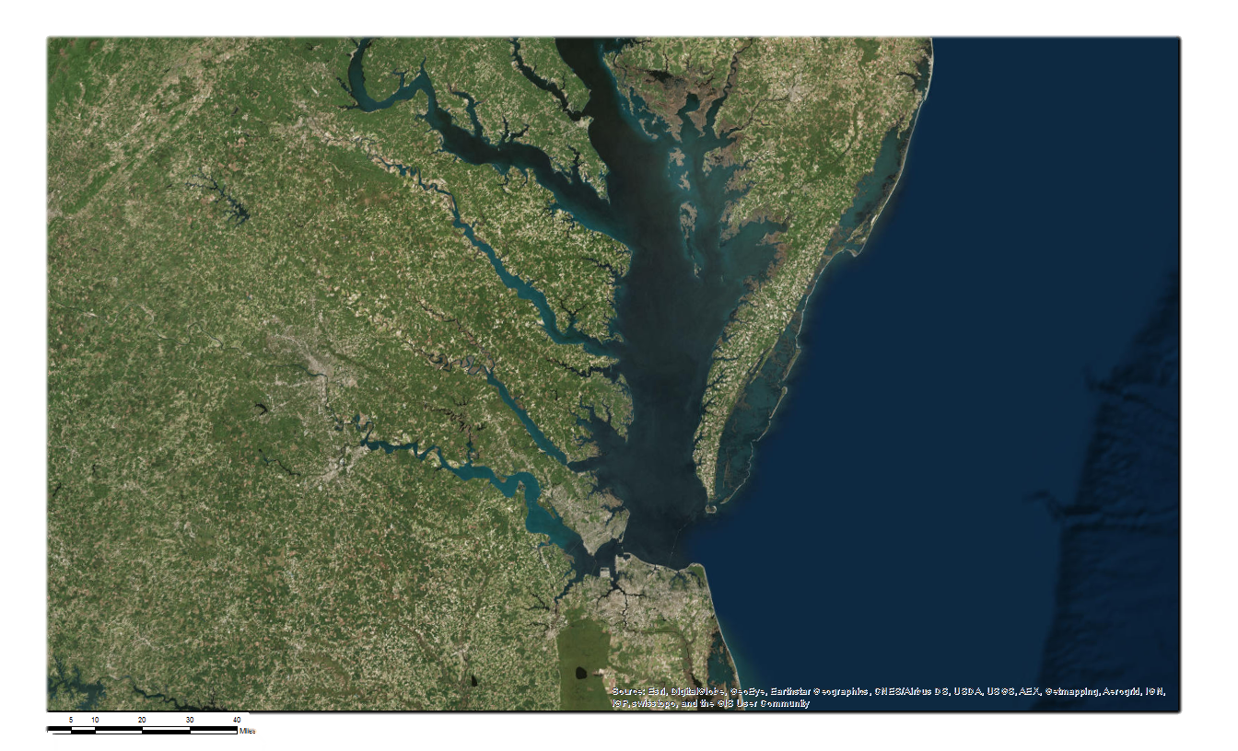
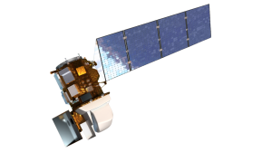
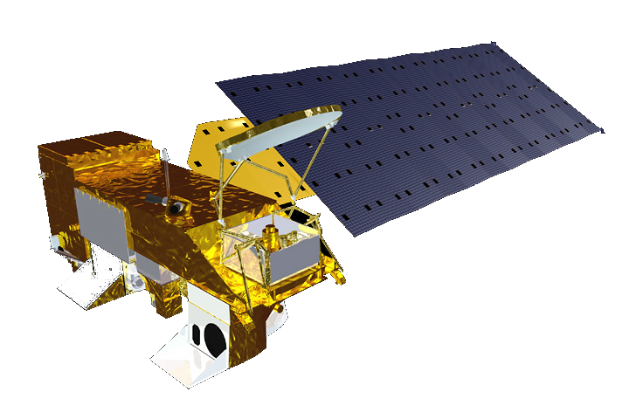
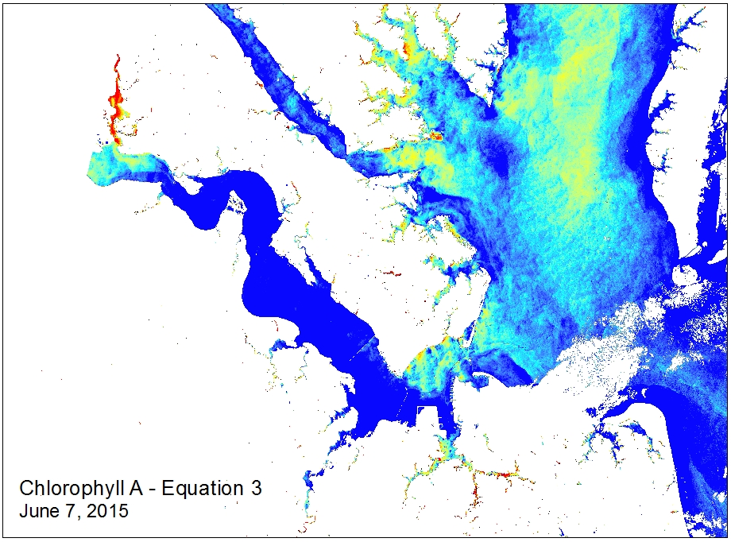
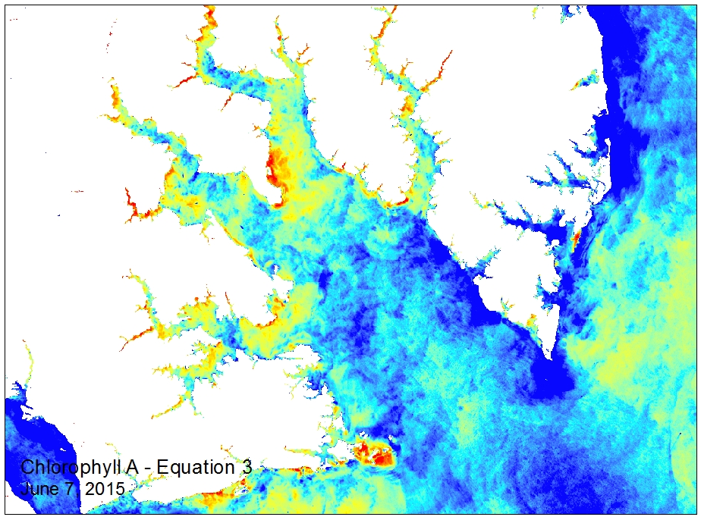
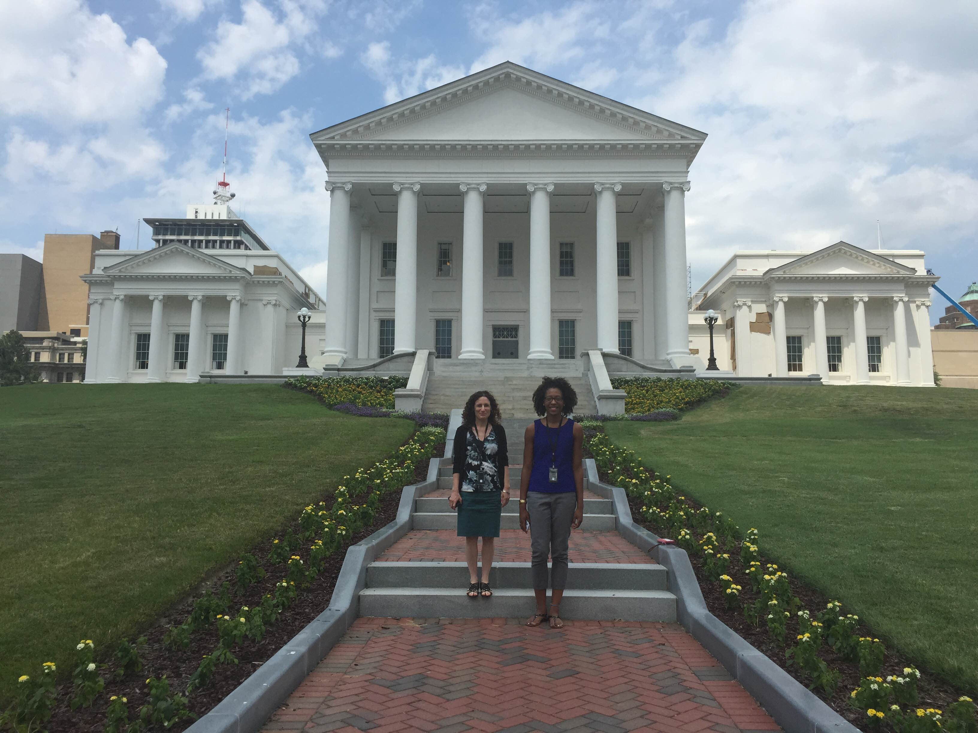
Virginia Water Resources
Utilizing NASA Earth Observations to Monitor the Extent of Harmful Algal Blooms in Chesapeake Bay Watershed
Cassandra Morgan | Sara Lubkin
Virginia Commonwealth University | University of Mary Washington
Abstract
Objectives
A Harmful Algal Bloom (HAB) is a high concentration of microscopic algae which has a negative impact on the environment. Harmful algal bloom species have had an increasing ecological impact on the Chesapeake Bay Watershed where they disrupt water chemistry, kill fish and cause human illness. In Virginia, scientists from Virginia Institute of Marine Science and Old Dominion University monitor HABs and their effect on water quality; however, these groups lack a method to monitor HABs in real time. This limits the ability to document associated water quality conditions and predict future blooms. Band reflectance values from Landsat 8 Surface Reflectance data (USGS Earth Explorer) and MODIS Chlorophyll imagery (NOAA CoastWatch) were cross calibrated to create a regression model that calculated concentrations of chlorophyll. Calculations were verified with in situ measurements from the Virginia Estuarine and Coastal Observing System. Imagery produced with the Chlorophyll-A calculation model will allow VIMS and ODU scientists to assess the timing, magnitude, duration and frequency of HABs in Virginia’s Chesapeake watershed and to predict the environmental and water quality conditions that favor bloom development.
Create tools that will allow partners to easily process Landsat 8 OLI/TIRS data to show chlorophyll estimates at 30 meter resolution
Identify potential sampling locations based on estimated chlorophyll concentrations
Provide a more comprehensive overview of Harmful Algal Bloom activity in the Chesapeake Bay Watershed
Study Area
Methodology
Data Acquisition
Image Processing
Image Processing
Landsat 8
USGS Earth Explorer
ArcGIS
Remove land and clouds from image
ArcGIS
Focal statistics: 1.4 km Smoothed Landsat image
MODIS, Chlorophyll
NOAA CoastWatch
ArcGIS
MODIS, Chlorophyll Pointfile
ArcGIS
VECOS Water Quality
Data
ArcGIS
Extract Lsndsat band
Values to MODIS points
James River, Chesapeake Bay Watershed
Analysis
Earth Observations
Product
Regression Equation
R software
Results
Landsat 8
Aqua MODIS
$$[Successful Regression will go here ∗fingers crossed∗]$$
Conclusions
Beautiful maps of successful regression will go here, below are placeholders – images from a model from a paper we utilized before beginning the process to create our own.
In the Chesapeake Bay watershed….
Based upon analysis of data, the highest chlorophyll concentrations are seen in the months of xyz
Future work utilizing remote sensing for identifying chlorophyll…
Possible graphs of chlorophyll/temperature/ sediment, etc in comparison to in situ data collected by the Hampton Roads Sanitation District.. Depends on success with regression
Team Members
Project Partners
Acknowledgements
Virginia Institute of Marine Science
Kim Reece
Jian Shian
Wolf Vogelbein
Virginia Department of Environmental Quality
John Kennedy
Tish Robertson
Anne Schlegal
Advisors
NASA DEVELOP National Science Advisor
Dr. Kenton Ross
Others
Virginia Deputy Secretary of Natural Resources for the Chesapeake Bay
Russ Baxter
Dept. of Biological Sciences, Old Dominion University
Todd Egerton
Hampton Roads Sanitation District
Will Hunley
This is a placeholder – it will be replaced.
Sara Lubkin, Cassandra Morgan

