Slide 1
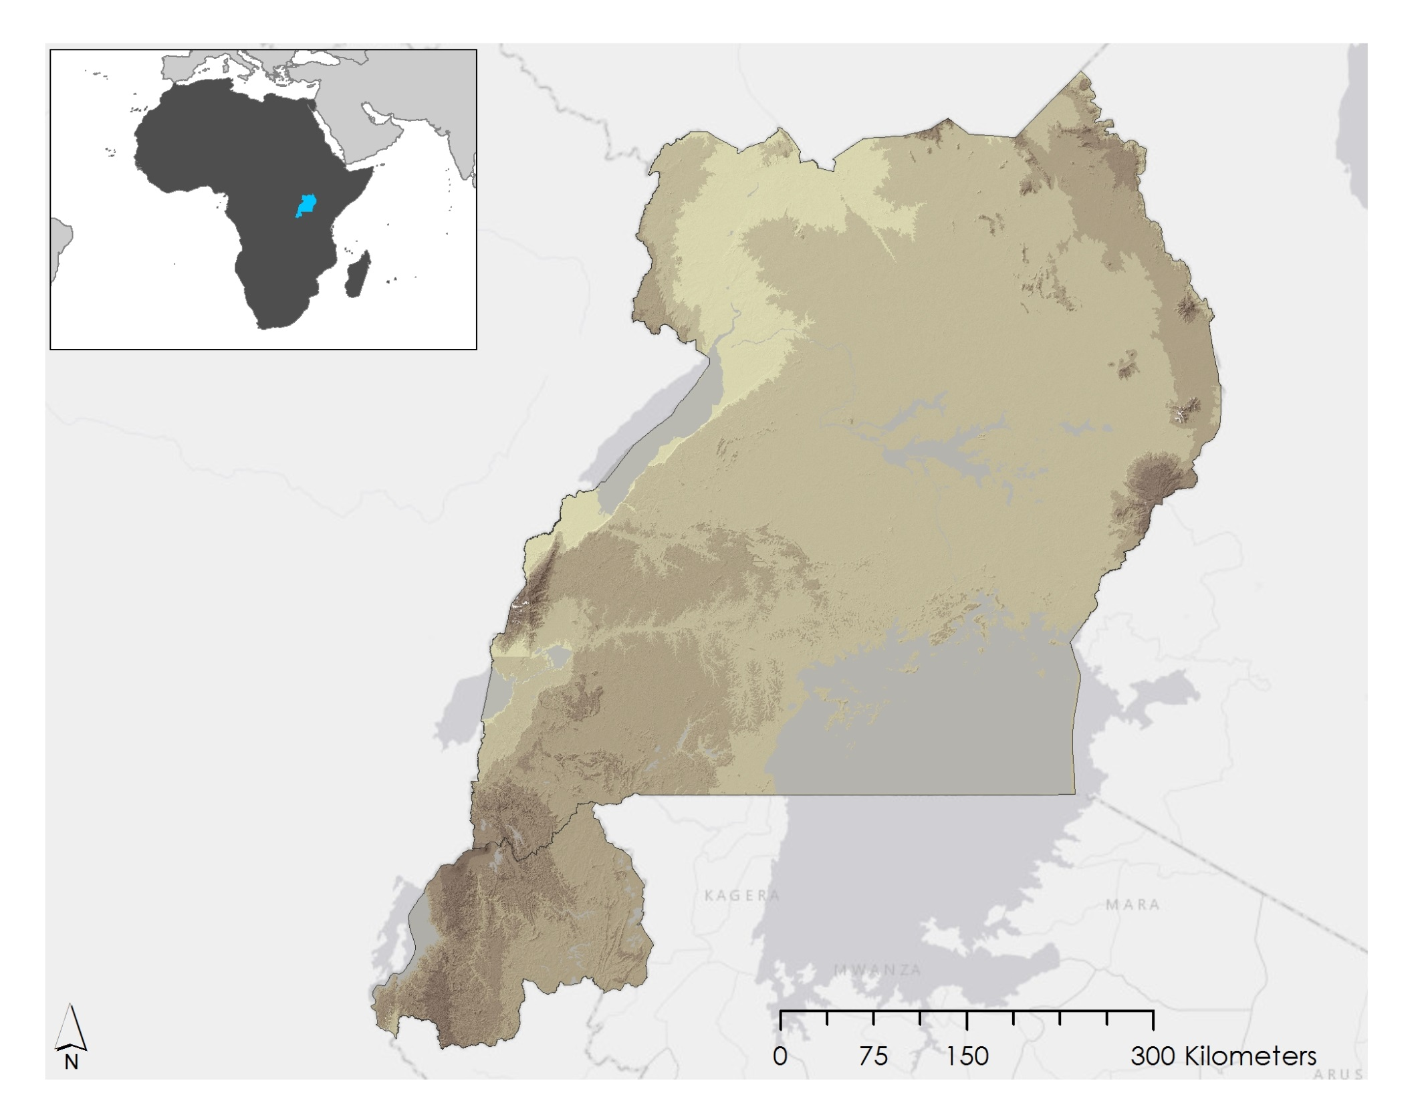
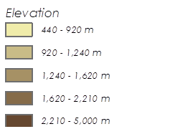
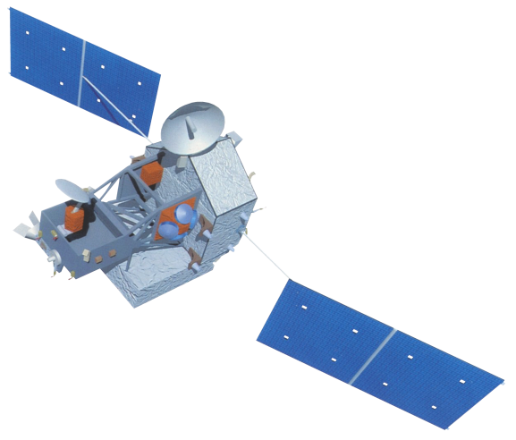
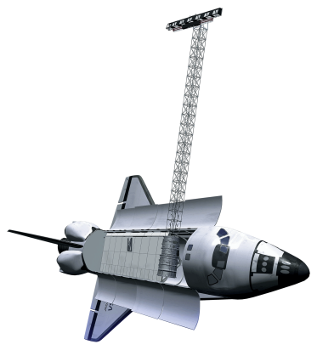
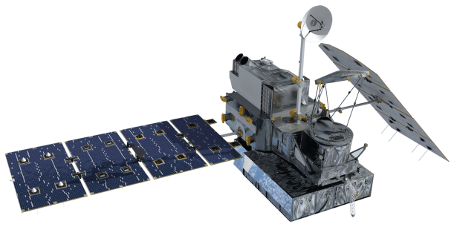
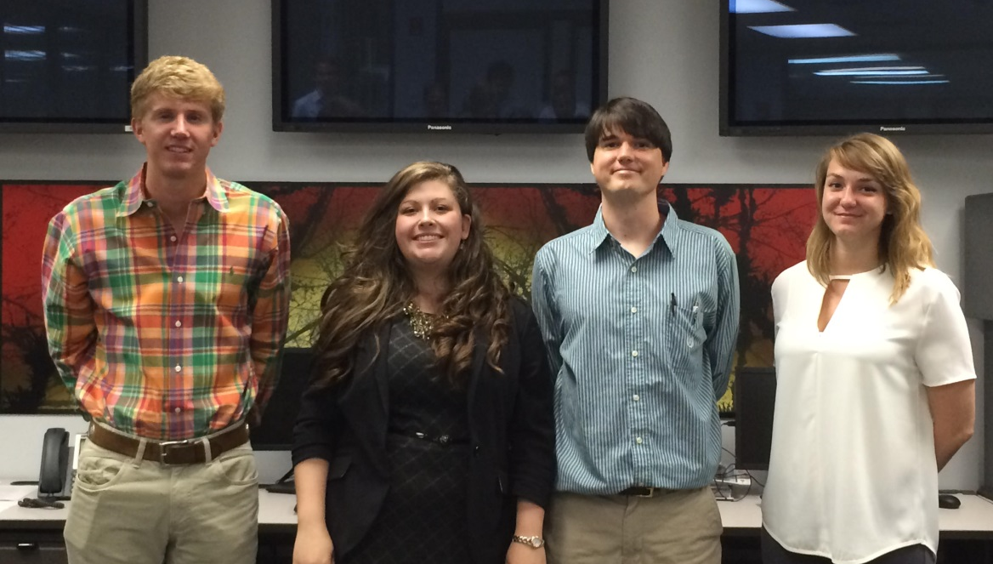
East Africa Disasters
Assessing Landslide Characteristics and Developing a Landslide Potential Hazard Map in Rwanda and Uganda Using NASA Earth Observations
Leigh Sinclair (Project Lead), Padraic Conner (Co-Project Lead), Tyler Finley, Jeanné le Roux
NASA DEVELOP National Program
Abstract
Objectives
Keep this blank for now.
Body text point size should be at least 24.
Caption text point size should be at least 16.
Feel free to rename, move, and resize sections as needed.
Supply updates to SERVIR’s Global Landslide Catalog (GLC), an online database documenting rainfall triggered landslides around the world
Create a Landslide Susceptibility Map for the study area using a sample of landslide data from the GLC and landslides found through Google Earth
Assess satellite rainfall performance, specifically GPM and TRMM, in identifying landslide conditions
Study Area
Methodology
1
Global Landslide Catalog
2
Google Earth [Landslide locations]  News Reports [Time of Landslide]  Landsat 8 [Time of Landslide]
Landslide Susceptibility Map
Landslide Thresholds [Precipitation, Slope, etc.]  Fuzzy Model
Variables
Reclassify
Landslide Susceptibility Map
Landslide Thresholds
Fuzzy Membership
Earth Observations
Fuzzy Landslide Thresholds
Fuzzy Overlay
TRMM TMPA
3
Preliminary Assessment of GPM and TRMM
Landsat 8 OLI
4
GPM Data [Precipitation]  TRMM [Precipitation]  CHIRPS [Precipitation]
GPM DPR
Potential Hazard Map
SRTM-V2 C-Band
Landslide Susceptibility Map  SEDAC [Population Density Data]
Results
Conclusions
TBD
TBD
Team Members
Project Partners
Acknowledgements
NASA SERVIR Coordination Office at NASA Marshall Space Flight Center
SERVIR Applied Sciences Team at NASA Goddard Space Flight Center
Regional Centre for Mapping of Resources for Development (RCMRD)
We would like to thank our Science Advisor, Dr. Jeffrey Luvall (NASA at NSSTC), Science Mentor Dr. Robert Griffin (University of Alabama in Huntsville), and Eric Anderson (SERVIR) for their guidance on this project.
Tyler Finley, Leigh Sinclair, Padraic Conner, and Jeanné le Roux
NASA Marshall Space Flight Center

