Slide 1
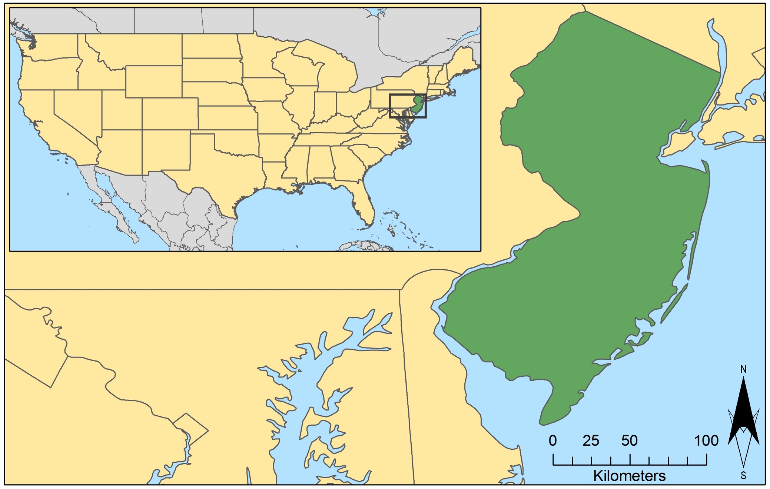
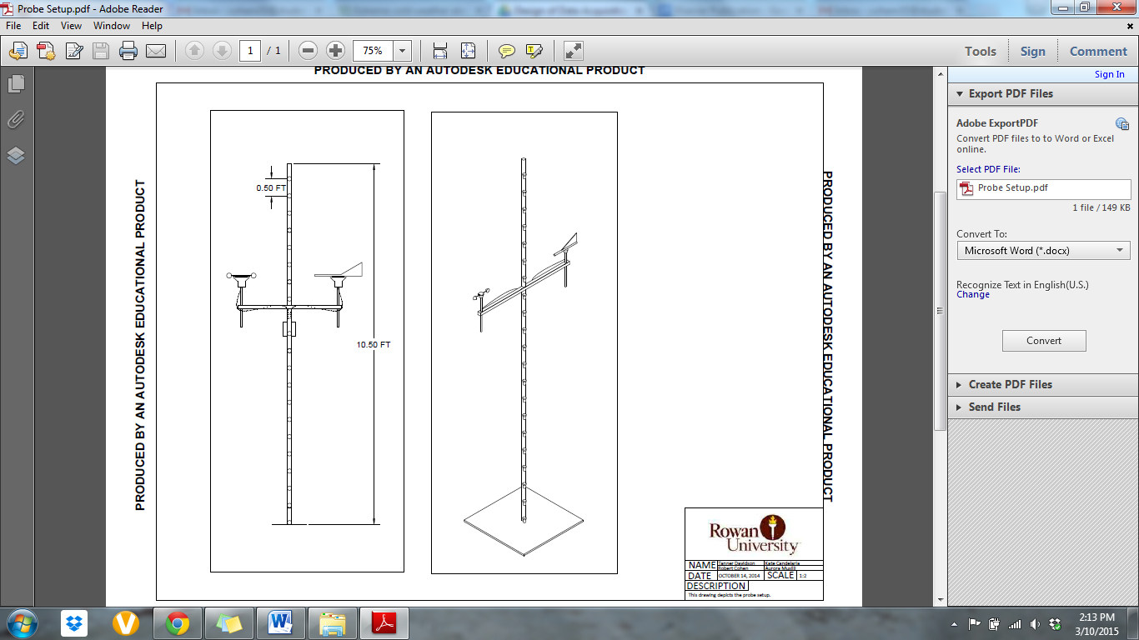
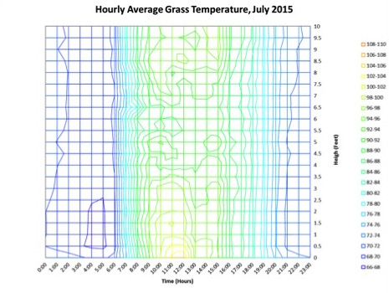
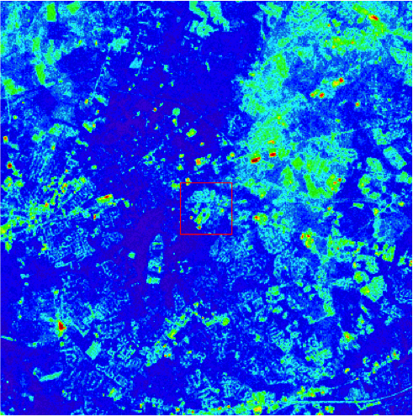

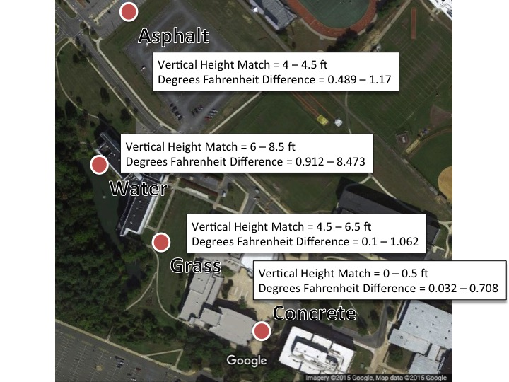
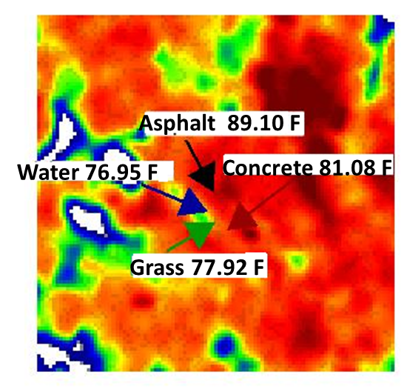
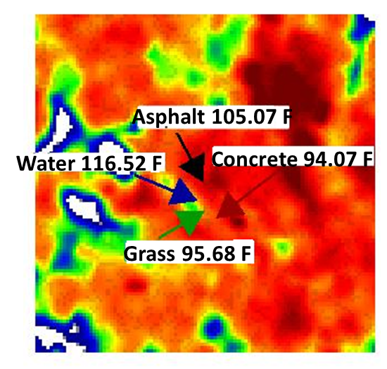
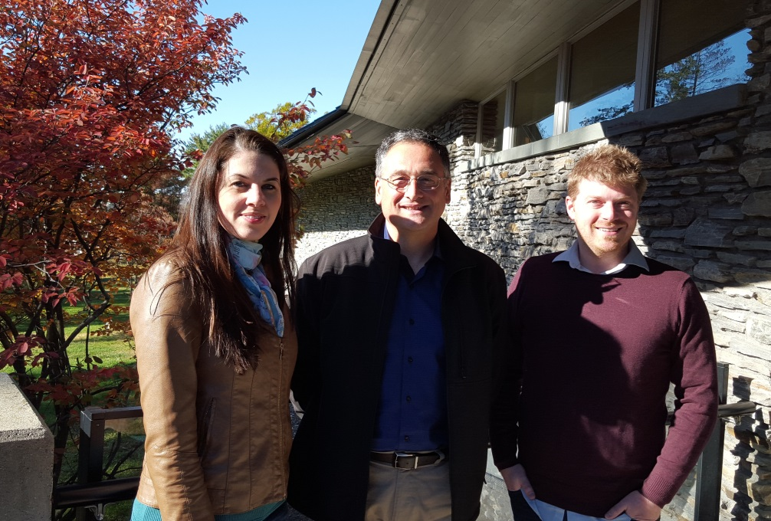
New Jersey Health & Air Quality
Modeling near surface air temperature profiles of complex urban systems based on land surface properties and correlating on-site and satellite data to better understand temperature profiles in urban microclimates
Maryam Karimi (Project Lead, NOAA Crest Institute of CUNY), Jerrod Lessel
DEVELOP National Program at the International Research for Climate and Society
Abstract
Objectives
Urbanization has created an increase in what is known as the urban heat island (UHI) effect. The excess heat in these urban environments has led to a rise in heat related illnesses and mortality. There is little understanding of urban microclimate. To better understand the impact of different land surfaces in an urban system a quantitative study was completed, analyzing on-site locations representing varied microclimates and analyzing satellite imagery of Glassboro Township of New Jersey. A correlation is being developed to measure surface and near surface air temperatures of microclimate in different environments. The on-site study revealed that varied environments (grass, water, and concrete) result in different temperature profiles within the range of 0 to 3 meters. Results indicate: grass was the coolest environment, water was the most temperate, and concrete had the highest peak temperatures. The satellite study revealed that increased levels of urbanization, with no methods of heat mitigation, resulted in higher average temperatures. Both the on-site and satellite data confirm that the increased urbanization leads to increased temperatures within microclimates.
Improve understanding of the effect of the Urban Heat Island (UHI) on the near surface air temperature where humans interact
Mitigating the UHI effects in urban microclimate’s
Develop a correlation identifying the role of surface features on near surface air temperature for new perspectives in urban design for developers and city management
Collect field measurements of temperature profiles
Analyze temperature profiles for specific microclimates
Compare field measurements against remotely sensed data
Study Area
Methodology
New Jersey
Glassboro
Height (feet)
Study Area: Glassboro, NJ (Rowan University Campus)
Study Period: May – July 2015
Earth Observation
Sensors were spaced at half foot increments on a 10 foot pvc pole within varying microclimates (asphalt, grass, mainly water, and concrete surfaces) located on the Rowan University campus.
Time (hours)
Example of a temperature profile from one of the probes.
Example of a Landsat temperature scene used to compare against the probe data.
Results
Landsat 8
5/22/2015
Probe Height 0 ft
7/25/2015
Probe Height 0 ft
Conclusions
Landsat temperature maps for May and July 2015.
In our analysis over the study period of May 2015 through July 2015, we found that Landsat image temperatures matched the different microclimates at varying vertical heights.
For asphalt, at the vertical height of 4 to 4.5 ft, the Landsat imagery most closely matched the probe data with only 0.489 to 1.17 °F difference.
For concrete, at the vertical height of 0 to 0.5 ft, the Landsat imagery most closely matched the probe data with only 0.032 to 0.708 °F difference.
For grass microclimates, at the vertical height of 4.5 to 6.5 ft, the Landsat imagery most closely matched the probe data with only 0.1 to 1.062 °F difference.
Finally for mainly water microclimates, at a vertical height of 6 to 8.5 ft the Landsat imagery most closely matched the probe data with only 0.912 to 8.473 °F difference.
Using results from this work and future work (at additional locations), different constants could be calculated in order to complete an empirical formula.
Even after such a formula is completed though, there may still be errors due to changes in conditions from those that were used to find the formula’s constants.
As such, an offset table should be included in order to correct for weather types and surface types in different environments.
Temp. (°F) | Probe Height (ft) |  |  |  |  |  |  |  |  |  | 5/22/2015
 | Landsat | 0 | 0.5 | 1 | 1.5 | 2 | 2.5 | 3 | 3.5 | 4 |  | 4.5 | 5 | 5.5 | 6 | 6.5 | 7 | 7.5 | 8 | 8.5 | 9 | 9.5 | 10
Asphalt | 80.6 | 89.1 | 84.0 | 83.8 | 83.1 | 83.0 | 82.4 | 82.3 | 81.4 | 79.3 |  | 80.1 | 81.7 | 82.1 | 81.8 | 81.7 | 81.6 | 81.8 | 81.7 | 81.7 | 83.0 | 81.4 | 82.0
Concrete | 78.5 | 81.1 | 78.5 | 78.1 | 78.2 | 78.0 | 78.4 | 78.0 | 78.2 | 78.2 |  | 78.0 | 77.8 | 77.7 | 78.3 | 78.1 | 77.8 | 77.6 | 78.3 | 77.9 | 78.6 | 78.0 | 77.8
Grass | 76.9 | 77.9 | 78.1 | 78.2 | 78.6 | 78.5 | 78.1 | 78.9 | 78.4 | 78.0 |  | 77.0 | 77.6 | 76.7 | 77.2 | 76.1 | 77.3 | 77.5 | 77.9 | 79.0 | 80.0 | 80.4 | 80.7
Water | 75.4 | 77.0 | 77.0 | 77.9 | 77.8 | 77.2 | 77.4 | 77.4 | 77.1 | 77.1 |  | 76.9 | 76.9 | 76.6 | 76.7 | 76.6 | 76.6 | 76.6 | 76.6 | 76.4 | 76.7 | 76.6 | 77.1
Temp. (°F) | Probe Height (ft) |  |  |  |  |  |  |  |  |  | 7/25/2015
 | Landsat | 0 | 0.5 | 1 | 1.5 | 2 | 2.5 | 3 | 3.5 | 4 |  | 4.5 | 5 | 5.5 | 6 | 6.5 | 7 | 7.5 | 8 | 8.5 | 9 | 9.5 | 10
Asphalt | 96.9 | 105.1 | 107.5 | 106.6 | 106.3 | 106.6 | 108.0 | 104.7 | 102.3 | 98.0 |  | 99.7 | 105.5 | 110.5 | 105.2 | 109.0 | 104.6 | 108.0 | 105.1 | 105.2 | 109.5 | 104.1 | 107.2
Concrete | 93.4 | 94.1 | 91.9 | 91.7 | 91.7 | 91.6 | 91.8 | 91.4 | 91.4 | 91.4 |  | 91.1 | 90.9 | 90.7 | 90.9 | 90.8 | 90.7 | 90.7 | 91.1 | 91.2 | 91.5 | 91.5 | 91.3
Grass | 90.3 | 95.7 | 91.9 | 92.5 | 92.7 | 94.0 | 94.0 | 94.7 | 92.3 | 93.1 |  | 92.0 | 93.8 | 91.9 | 92.7 | 91.4 | 92.0 | 92.1 | 94.0 | 96.6 | 97.8 | 97.7 | 97.4
Water | 88.7 | 116.5 | 110.0 | 107.1 | 108.4 | 105.3 | 104.9 | 104.6 | 105.0 | 107.0 |  | 103.6 | 98.9 | 97.5 | 97.2 | 98.0 | 100.9 | 100.7 | 97.5 | 97.9 | 99.3 | 99.5 | 99.2
Team Members
Project Partners
Maryam Karimi (Team Lead)
Pietro Ceccato (Science Advisor)
Jerrod Lessel (Center Lead)
Bureau of Environmental Surveillance and Policy, New York City Department of Health and Mental Hygiene
We Act for Environmental Justice
Columbia University, Mailman School of Public Health
Consortium for Climate Risk in the Urban Northeast (CCRUN)
Rowan University, College of Civil and Environmental Engineering
Acknowledgements
Thank you very much to Dr. Pietro Ceccato for being an outstanding advisor on this project. We also wish to thank the project partners and collaborators.
International Research Institute for Climate and Society

