Slide 1
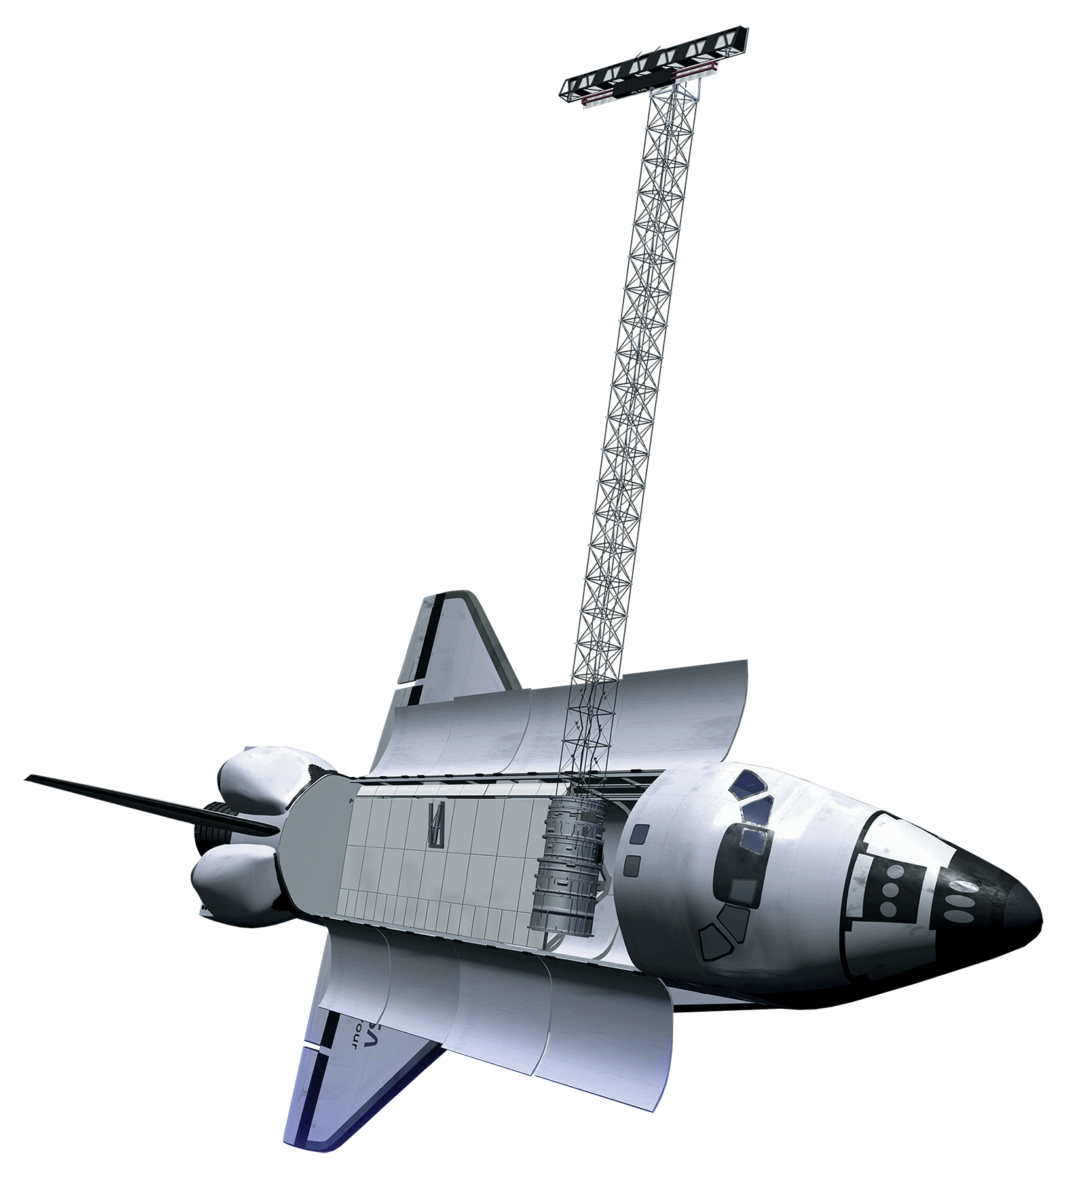

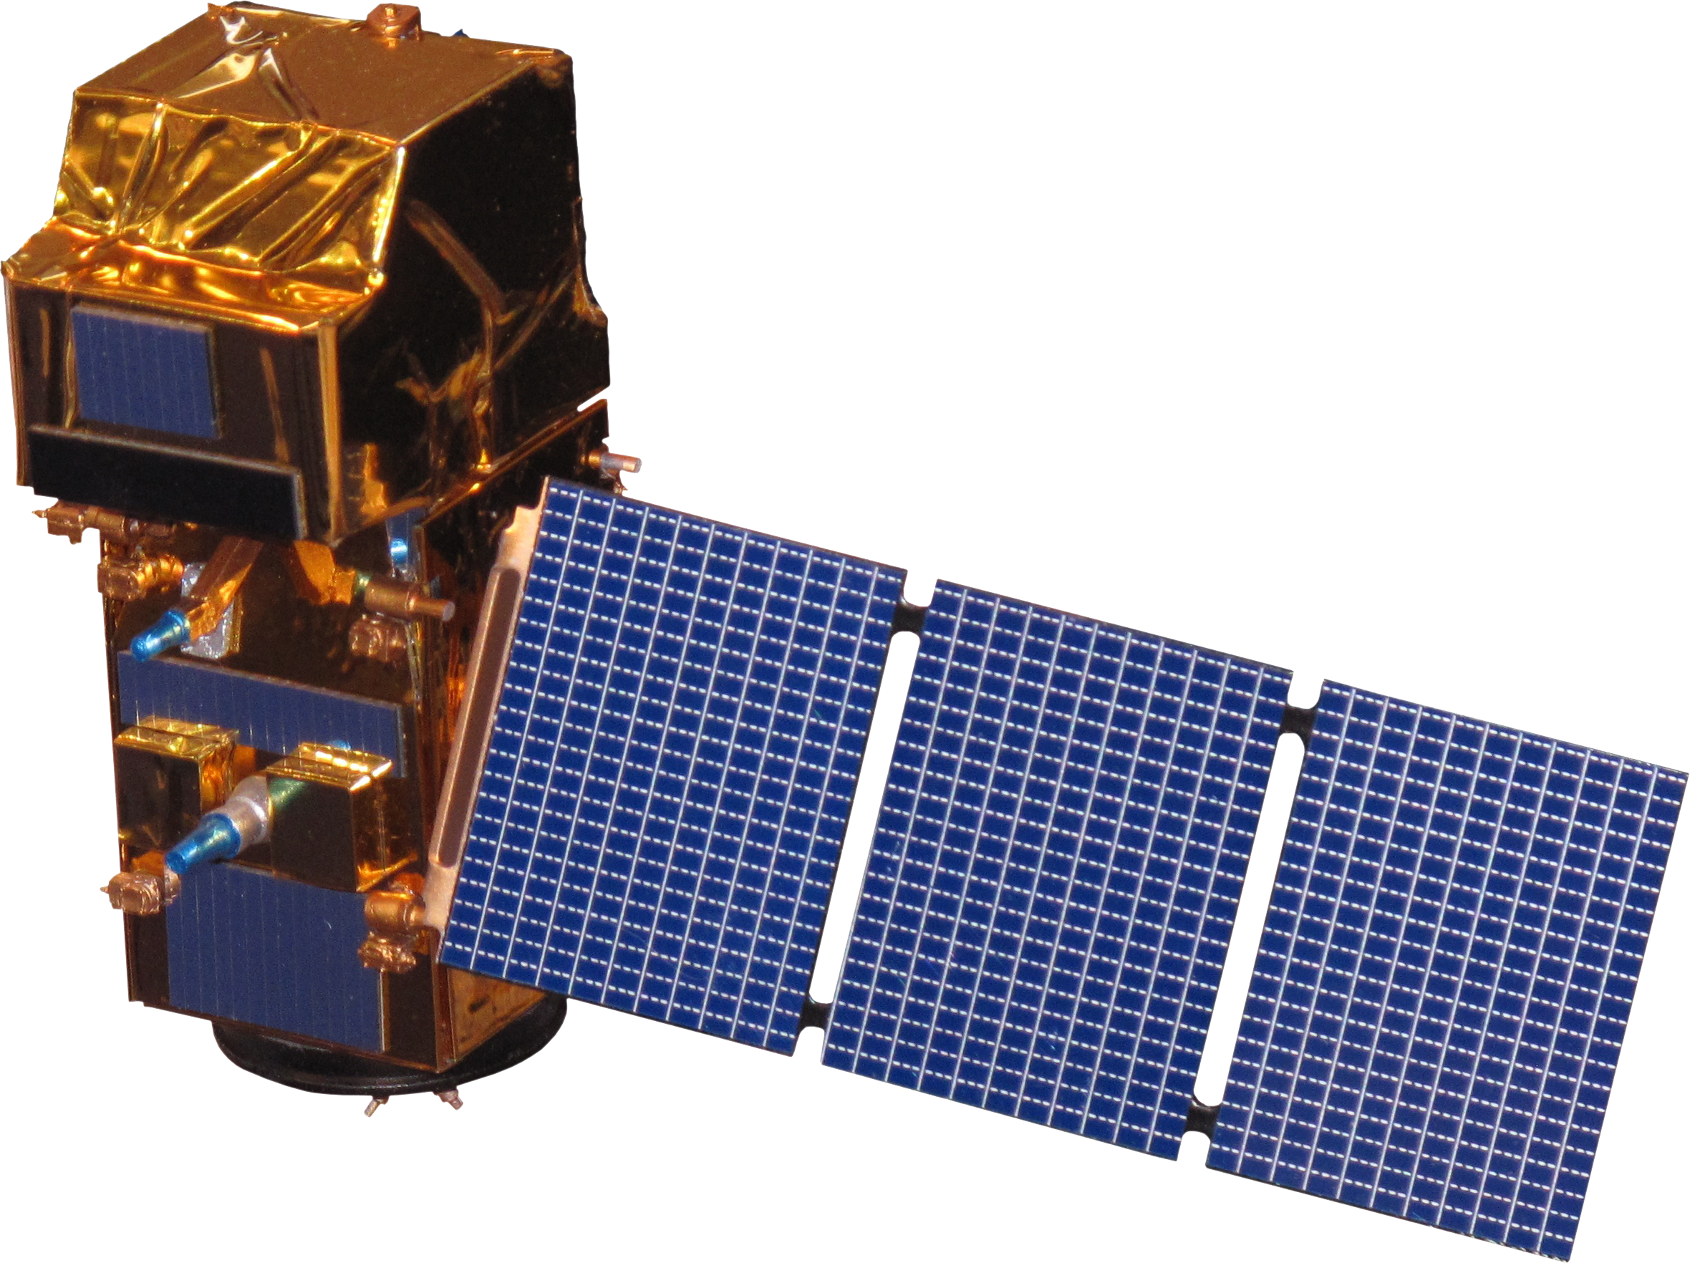
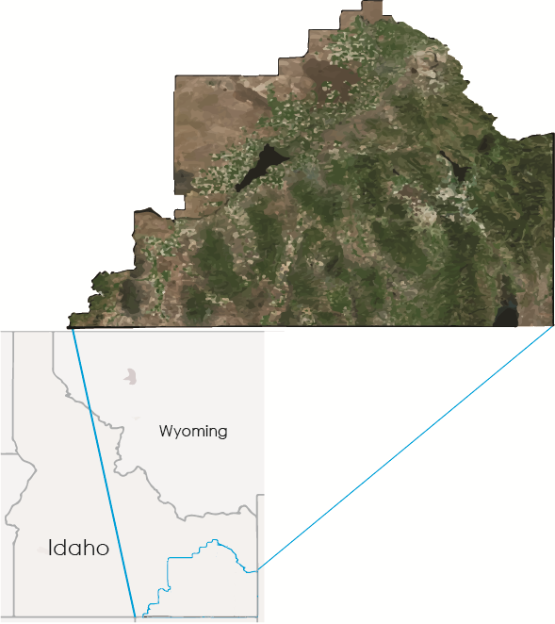
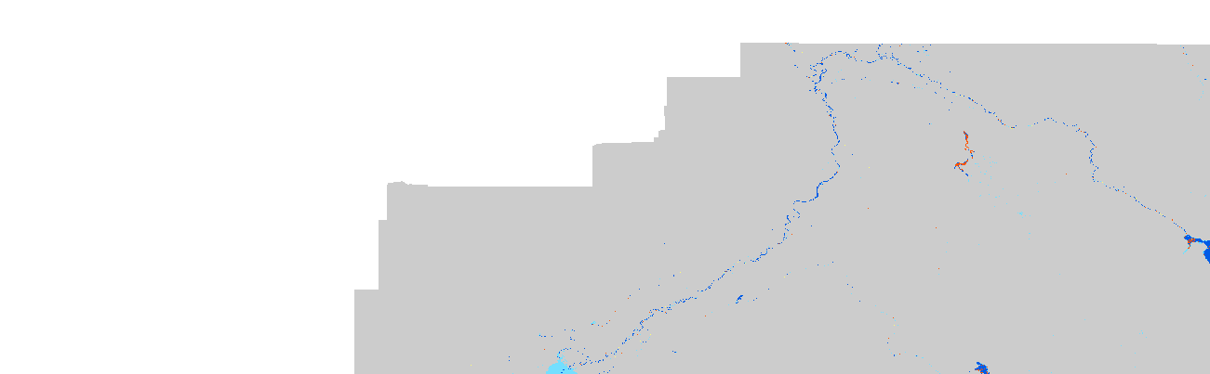
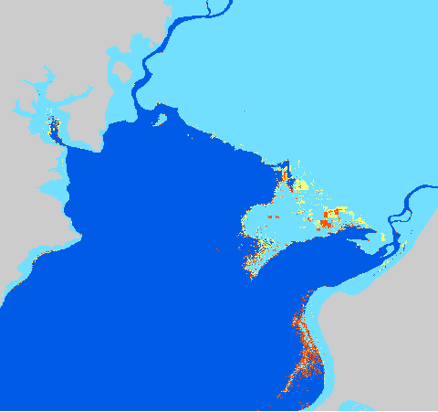
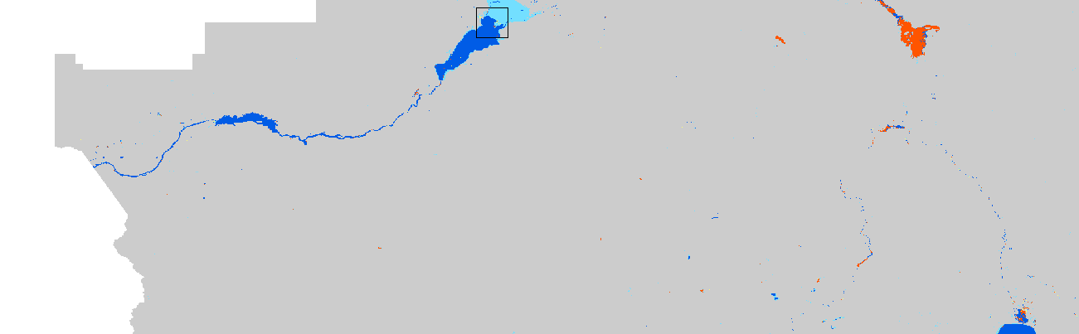
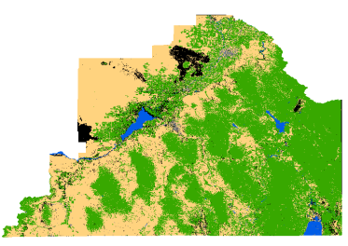
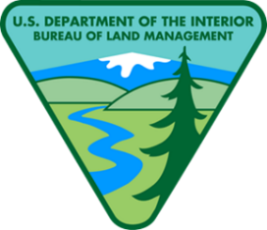







Utilizing NASA Earth Observations to Identify Existing Surface Water Features and Improve Water Management and Resource Allocation in Southeast Idaho
Abstract
Objectives
Understanding water dynamics in southeast Idaho is critical to planning and improving water management practices. Partner organizations that focus on water resource management, such as the Bureau of Land Management (BLM) and Idaho Department of Water Resources (IDWR), currently use the National Hydrography Dataset and legacy knowledge to identify water bodies. However, this approach has been insufficient to meet all their needs because these datasets may not always reflect the current ground conditions. This poses a risk for officials at the BLM and IDWR that could lead to ineffective use of their resources and inefficient management practices. Therefore, this study used NASA Earth observations and Google Earth Engine (GEE) to create a tool that would allow end-users to better identify and track water bodies within their management area. Known as the Surface Water Indicator Model (SWIM), this tool incorporated Landsat 8 imagery, Sentinel-2 imagery, multiple water indices, and topographic data into a Support Vector Machine (SVM) classifier. This study combined multiple water indices into a single tool to create a more accurate surface water indicator. The resulting SWIM tool was created in both GEE and ESRI ArcGIS to allow the end-users their choice of platform. The SWIM tool will help natural resource managers with current and seasonal surface water indication and provide more accurate data for land managers.
Improve the water resource data available for project partners
Identify surface water changes within study area
Create a tool that can be used by project partners to record and manage water bodies
Earth Observations
Shuttle Radar Topography Mission
Landsat 8 (OLI)
Sentinel-2
Study Area
Results
Southeast Idaho, as defined by the Eastern Idaho Bureau of Land Management (BLM), starts at the eastern side of Craters of the Moon National Monument to the southeast corner of Idaho.
Using Sentinel data increased the ability of the SWIM tool to detect water bodies and smaller rivers. Three seasonality maps created over one time step were combined to create a map showing the likelihood of the presence of intermittent water bodies. Since training and validation points are randomly divided during each run of the SVM classifier, the likelihood of detected intermittent water bodies were determined
43°0'0"N
114°0'0"W
113°0'0"W
112°0'0"W
42°0'0"N
Likelihood of Correct Classification
for Intermittent Water Bodies
ID
Image Source: ESRI, OpenStreetMap, GIS user community
Non-Water
Unlikely Intermittent
Likely Intermittent
Perennial
0
100
200
300
400
Miles
Possibly Intermittent
0
200
400
600
800
Kilometers
by running the SVM classifier three different times. These results were then characterized by agreement, where agreement across all three images was likely intermittent, two image agreements was possibly intermittent, and one image was unlikely intermittent.
Methodology
Southeastern Idaho Water Resources II
Water Indices
MNDWI
AWEsh
MBSRV
MBSRN
MBSRV>MBSRN
Final Results
ArcMap
The overall accuracy of each class was determined to be 68%, while water alone showed an 80% accuracy.
Classification of Surface Water
Accuracy Assessment
Map Elements
Topography
Support Vector Machine (SVM) Classifier
Exposed Substrate
Slope
Aspect
Elevation
Final Results
GEE
Water
Canopy Cover
Accuracy Assessmenty
Urban
Secondary Variables
Sagebrush Steppe
SAVI
Iron ratio
False Color Composite
Agriculture Composite
This SWIM tool was applied to multiple time-steps in the 2016 water year in order to differentiate intermittent water bodies, water that occurs during a wet season, from perennial water bodies, water that occurs all year. This comparison was completed with both Sentinel-2 and Landsat-8 imagery to compare model accuracy across multiple resolutions.
Conclusions
Water detection accuracy is satisfactory
Stream fragmentation could be further reduced
Sentinel 2 imagery allowed better classification of water bodies
Sentinel 2 was limited to a smaller time frame than Landsat 8
Project Partners
Acknowledgements
Idaho Department of Water Resources, State Office
Bureau of Land Management, Pocatello Field Office
A special thank you to our contributors for their time and assistance with this project,
Advisors: Keith Weber, Lead Science Advisor (GIS Training and Research Center at Idaho State University); Charles Peterson (Biology Department, Idaho State University); Mark Carroll (NASA GSFC)
Project Partners: Karen Kraus, Bureau of Land Management (BLM), Natural Resource Specialist; Linda Davis, Idaho Department of Water Resources (IDWR), Senior GIS Analyst; Danielle Bruno-Fayreau, Idaho Department of Water Resources (IDWR), GIS Analyst
Former Project DEVELOPers: Traci Olson, Dylan Thomas , and Caitlyn Toner
Others: Kelly Meehan, NOAA National Centers for Environmental Health, Geoinformatics Fellow; David Thau, Google, Senior Developer Google Earth Engine
Team Members
Cody O’Dale
Team Lead
Austin Counts
Brooke Colley
Claire Haupt
Paul Bushman
Courtney Ohr
BLM at ISU GIS TReC & Wise County Clerk of Circuit Court’s Office – Spring 2017

