Slide 1
Malawi Disaster
Comparing Techniques of Inundation Detection for the January 2015 Malawi Floods using NASA Earth Observations
Andrew Kruczkiewicz (Project Lead)
Helen Cen

Slide 2
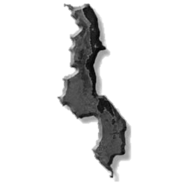
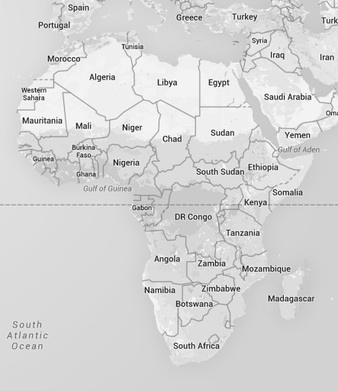
Background: Malawi
Source: Google Earth
Source: Ismall Mia, Flickr.com
Notes:
Demographics
3rd poorest country in the world (World Bank 2014)
GDP- $780
Life expectancy- 58
Water Availability
“Has significant volumes of water in lake and rivers…”
“….however, water resources are declining” (UNEP 2013)
Climate change
Land degradation (deforestation)
Pollution
Considered water-stressed
http://www.unpei.org/sites/default/files/e_library_documents/Malawi_Policy_Brief_Water_Resources_MSEOR.pdf
http://data.worldbank.org/indicator/NY.GDP.PCAP.PP.CD?order=wbapi_data_value_2013+wbapi_data_value+wbapi_data_value-last&sort=desc

Slide 3
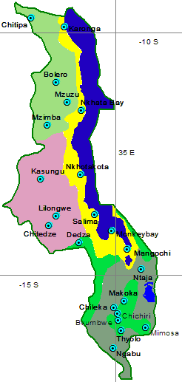
Background: Malawi
Weather stations
22 full stations
2 reporting 24 hours
Max reporting: 6X daily
Min reporting: 2X daily, only weekends
Gradient of climate zones
Annual rainfall varies from 725-2500 mm
Max temperature varies from 20-32 C
Prone to climate shocks
Floods
Flash Floods
Riverine Floods
Droughts
Source: http://www.metmalawi.com/weather/stations.php
Notes:
Colors on the map indicate the high gradient of climate zones in Malawi.
The main point of this slide is to highlight the various climate zones in Malawi and illustrate the lack of coverage by weather stations…. We need remote sensing to complete the picture.
These three facts lead to a high level of vulnerability, coupled with a low level of resilience, lead to Malawi being one of the most disaster prone countries.
There are currently 22 full weather stations in Malawi, with two reports each 24 hr period. Malawi receives approximately 725-2500mm of rainfall annually and maximum temp between 20-30c
Hence, the country is prone to flooding and droughts.

Slide 4
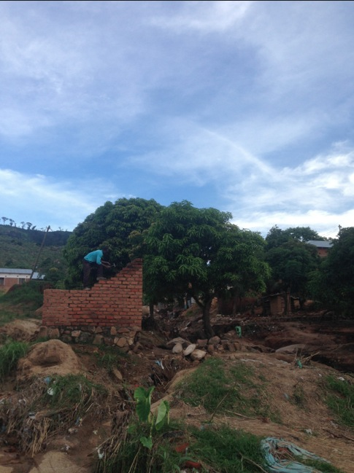
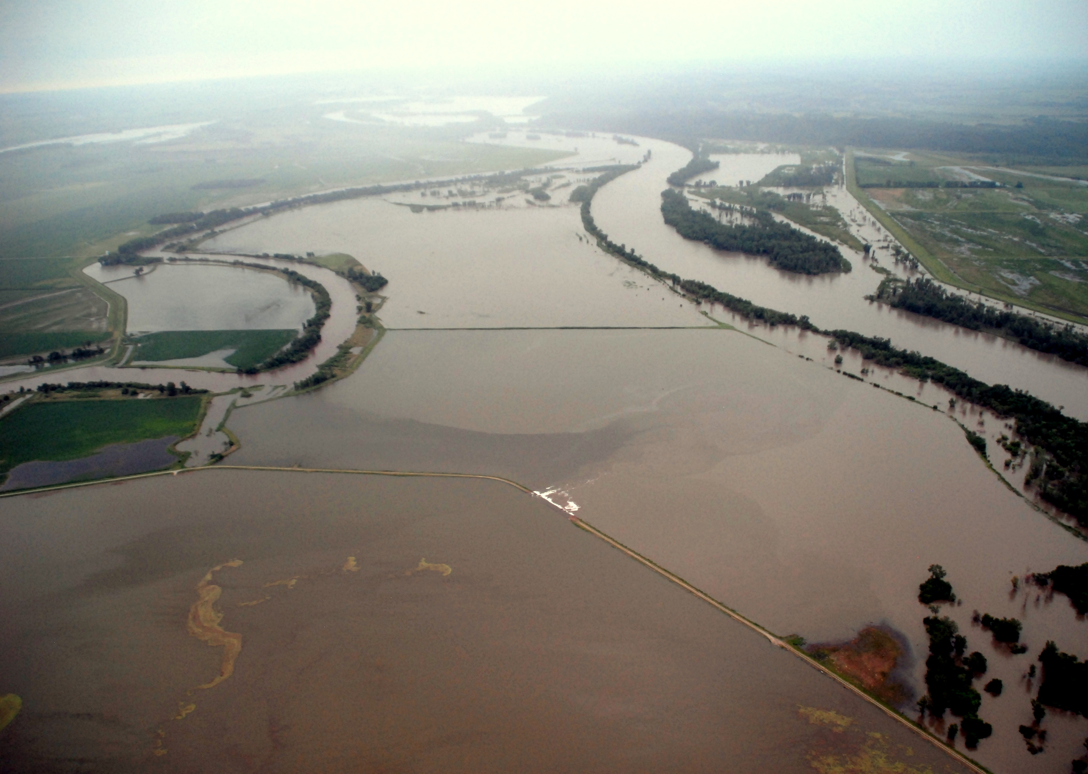
Background: Disasters
Disaster
Climate Shock
Vulnerability
Source: Andrew Kruczkiewicz
Notes:
It is important to note that a disaster will occur when a natural hazard is multiplied by vulnerability. In other words, countries or areas that are less vulnerable for many reasons (e.g. to socioeconomic factors or increased resilience or perceptions of climate risk).
Malawi has both a high vulnerability and high risk of natural hazards, leading to a high risk for disasters.
The pictures show left- a flood, middle- a hand drawn map showing a synoptic weather map with an ITCZ location which leads to heavy rain and right- poor construction of homes and poor location of homes increases vulnerability
A region with sparse climatic and environmental data
Prone to flooding (occasionally leading to a national disaster)
Needs reliable time series of climatic and environmental data to analyze flood impact
Temporally and spatially

Slide 5
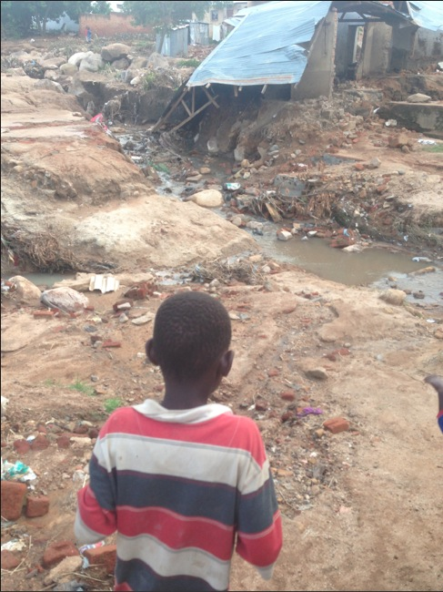
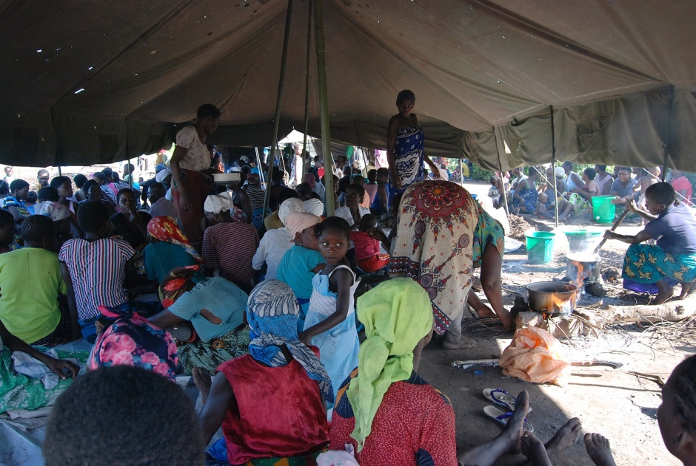
Community Concerns
Malawi January 2015 Floods
Affected 15 out of 28 districts
>276 deaths
174,000 displaced
1,000,000 affected
Urgent need of food, water, and shelter
Overcrowded displacement sites
Concern for rape, cholera, diarrhea and malaria
Source: Andrew Kruczkiewicz
Source: United Nations Development Programme, Flickr.com
Notes:
The project used the January 2015 floods in Malawi as a case study.
The flood affected 15 out of 28 districts, with more than 276 deaths, 174,000 displaced and 1,000,000 affected.
The affected regions were in urgent need of food, water and shelter. The displacement sites were overcrowded, raising concerns for rape, cholera, diarrhea and malaria.

Slide 6
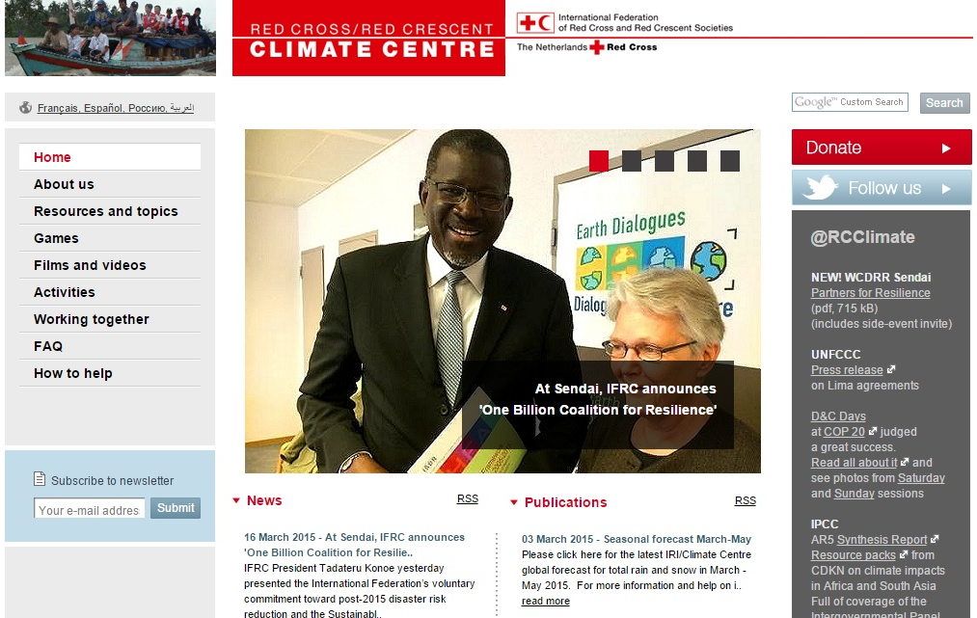
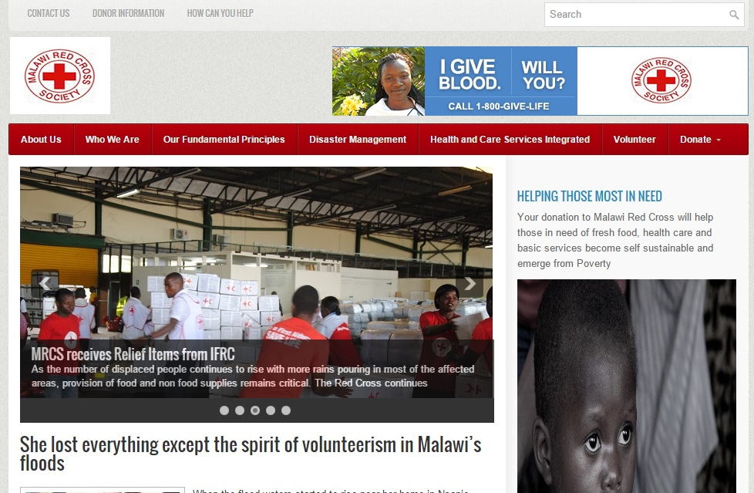
Community Concerns
Project Partners:
Red Cross Red Crescent Climate Centre (RCRCCC), Boundary Organization, POC: Erin Coughlan, Senior Climate Specialist
Malawi Red Cross, Collaborator and End-User, POC: Hastings Kandaya, Director- Programmes and Development
Notes:
The project partners for this project are Ms. Erin Coughlna, the senior climate specialist at Red Cross Red Crescent Climate Centre, and Mr. Hastings Kandaya, director of programmes and development at Malawi Red Cross.

Slide 7
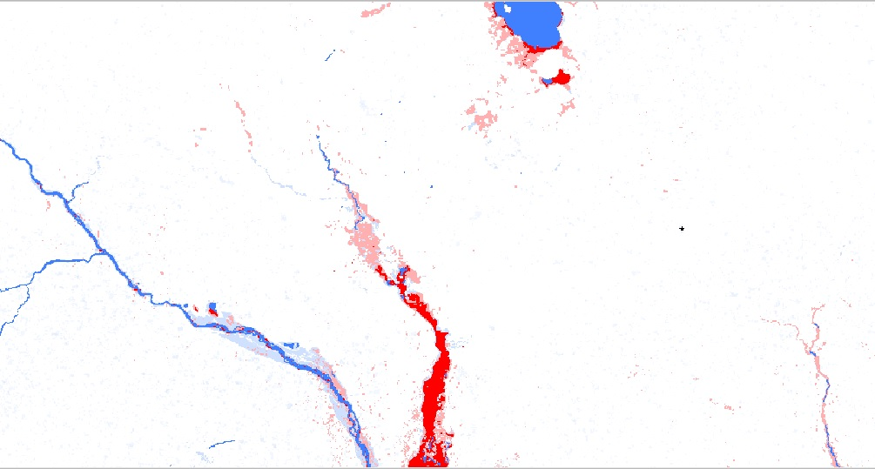
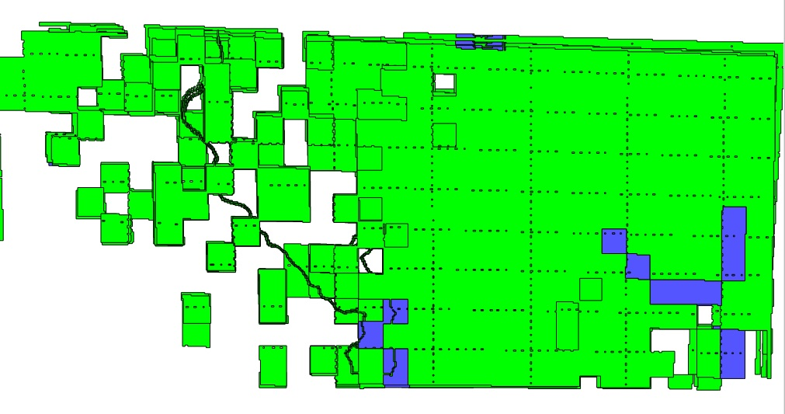
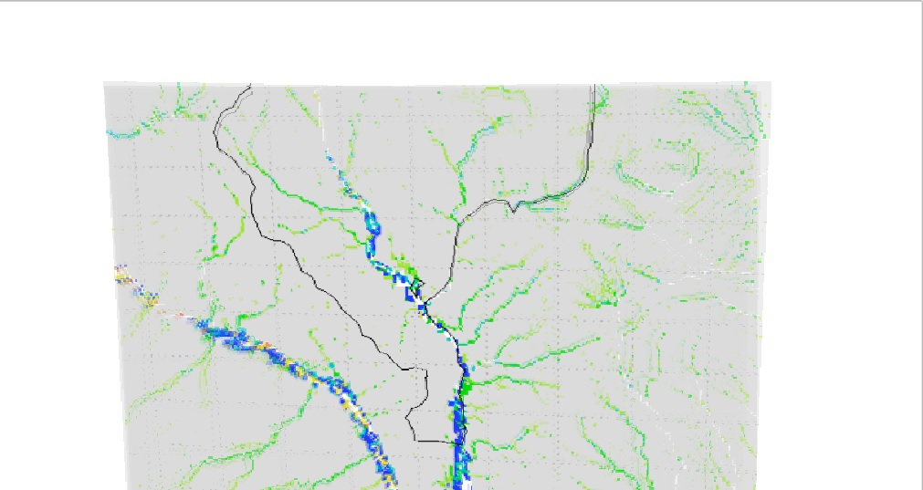
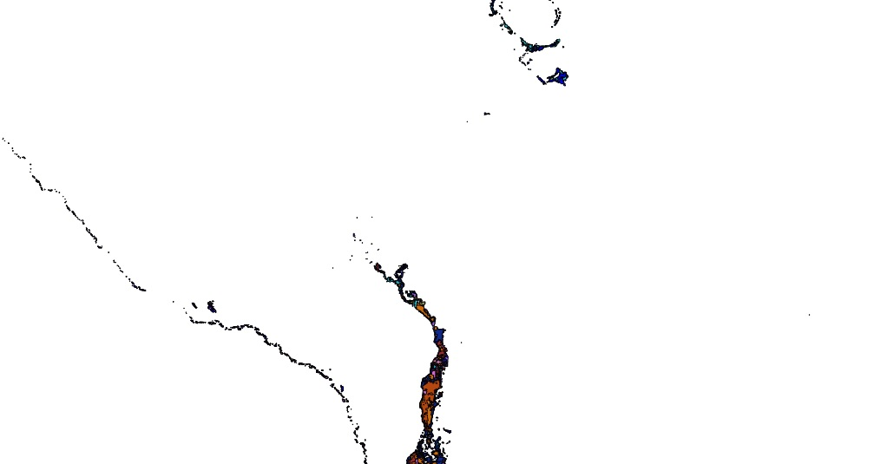
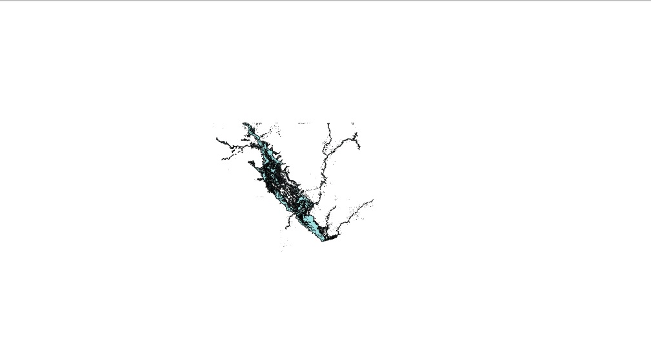
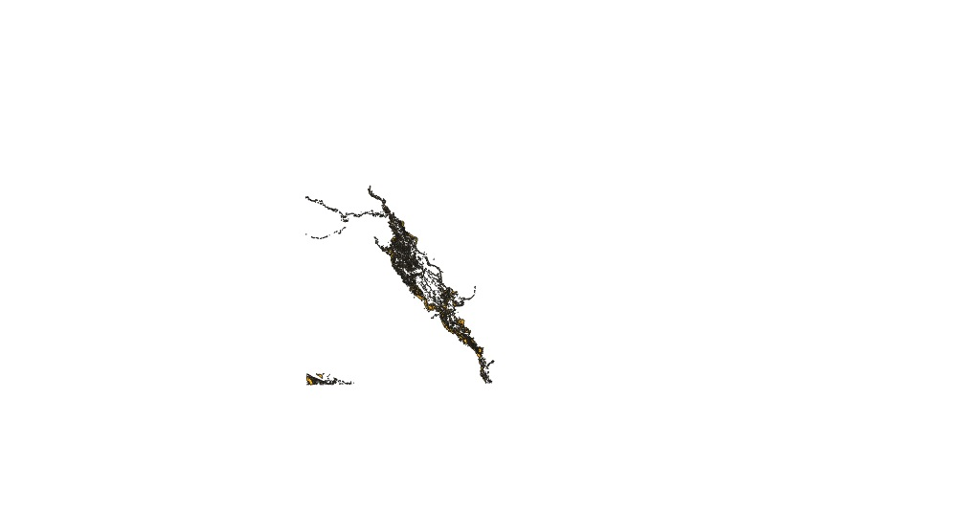
Project Objectives
Compare 7 inundation detection products
Validate inundation detection products with ground data provided by Uk Aid and Malawi Red Cross
DFO
GFMS-FD
GFMS-I
NRT-GFM
RADARSAT
RADARSAT-2
TerraSAR-X
Notes:
The objective of the project was to compare 7 inundation detection products which were used by disaster responders in Malawi
The Dartmouth Flood Observatory product
The Global Flood Monitoring System Flood Detection product
The Global Flood Monitoring System Inundation product
NASA Goddard Space Flight Center Moderate Resolution Imaging Spectroradiometer Near Real-Time Global Flood Mapping product
RADARSAT (Canadian)
RADARSAT-2 (Canadian)
and
TerraSAR-X (Germany)
The project also aimed to validate these inundation detection products with ground data provided by UK Aid and Malawi red Cross to explore the relationship of spatial coverage and accuracy of flood mapping products.

Slide 8
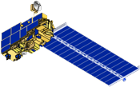
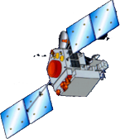
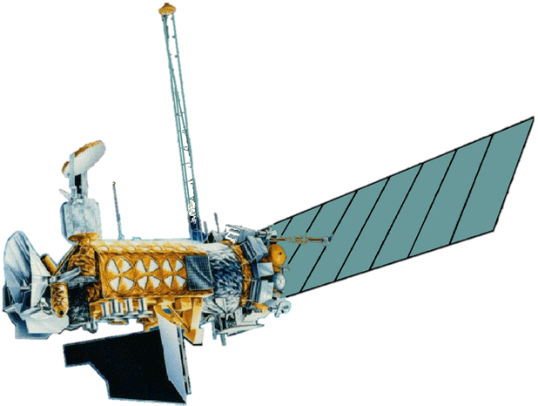
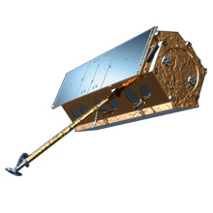
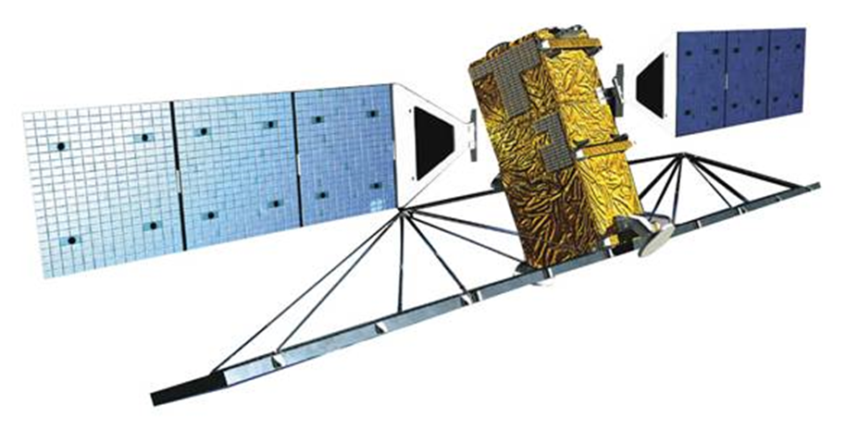
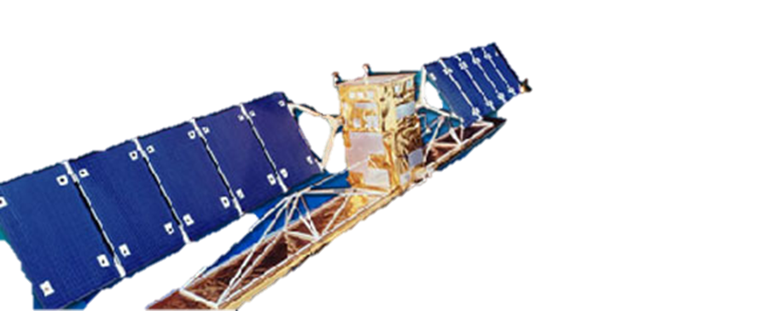
Project Methodology
NASA Earth observations
MODIS sensor aboard Terra and Aqua satellites
TRMM, Aqua (AMSR-E & AMSU-A), & Defense Meteorological Satellite Program satellites
Other Earth observations
Synthetic Aperture Radar (SAR)
Aqua
Terra
TRMM
DMSP
RADARSAT-2
TerraSAR-X
RADARSAT
Notes:
MODIS sensor aboard Terra and Aqua satellites
DFO (Dartmouth Flood Observatory Flood Detection Product) & NRT-GFM (NASA Goddard’s Office of Applied Science’s NRT Global Flood Mapping product)
TRMM, Aqua (AMSR-E & AMSU-A), & Defense Meteorological Satellite Program satellites
GFMS-FD & GFMS-I (Global Flood Monitoring System’s Flood Detection and Inundation product))
Synthetic Aperture Radar (SAR)
TerraSAR-X (Germany),
RADARSAT (Canada) &
RADARSAT-2 (Canada)

Slide 9
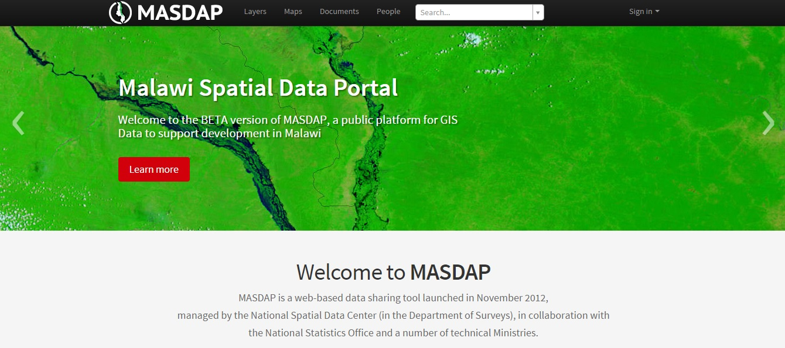
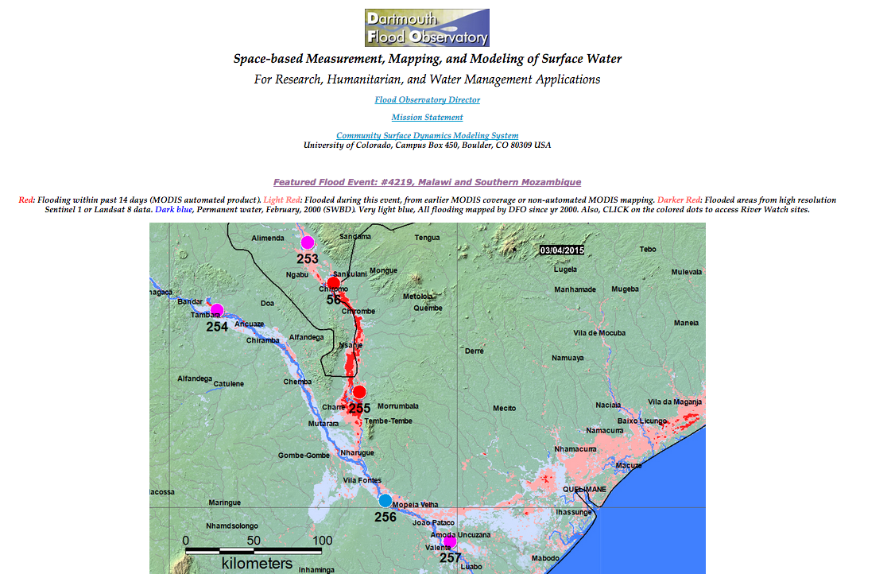
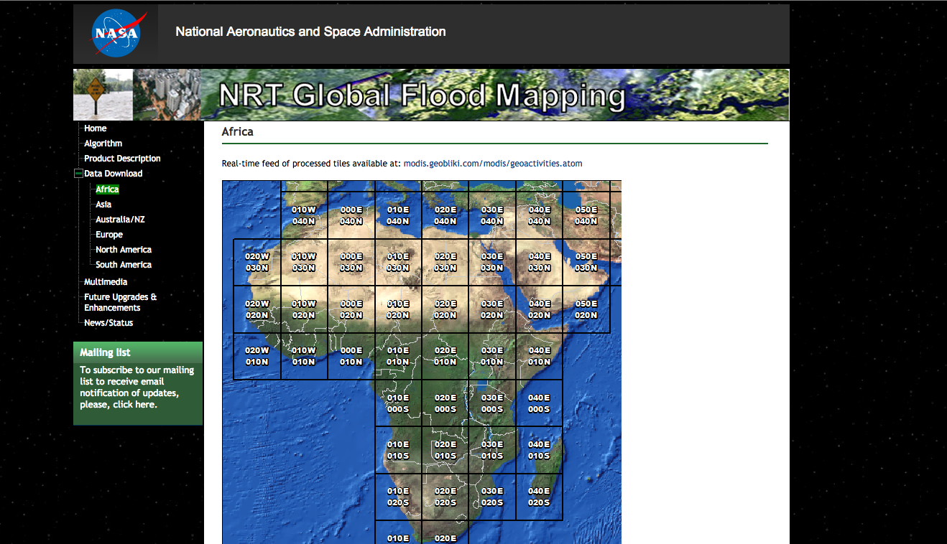
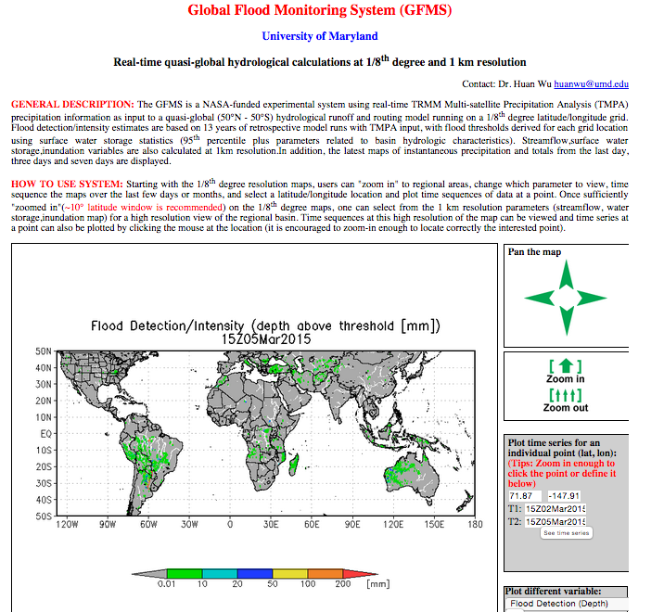
Project Methodology
Acquisition & Processing
First, flood map data was acquired from the following sources:
The Malawi Spatial Data Platform
The Dartmouth Flood Observatory website
NASA Goddard’s Office of Applied Science’s NRT Global Flood Mapping website
University of Maryland’s Global Flood Monitoring System website
Notes:
The Malawi Spatial Data Platform
TerraSAR-X, RADARSAT & RADARSAT-2
The Dartmouth Flood Observatory website
DFO
NASA Goddard’s Office of Applied Science’s NRT Global Flood Mapping website
NRT-GFM
University of Maryland’s Global Flood Monitoring System website
GFMS-FD & GFMS-I
All flood detection products were then added into QGIS for processing and visualization, with OpenStreetMap as base layer. The project then compared the maximum inundation extent of the seven satellite products

Slide 10
Project Methodology
Analysis: Step 1
Flood map products were grouped based on various similarities
Synthetic aperture radar products: Same type of sensor
Near real time products: Same temporal availability
University of Maryland Global Flood Monitoring System products
Group 1: SAR Products
Group 2: Near real time products
Group 3: University of Maryland Global Flood Monitoring System products
Notes:
For step 1 of the analysis,
The products were grouped into three categories based on predominant sensor used in their development.
Group 1 consists of products using the Synthetic Aperture Radar sensor: TerraSAR-X, RADARSAT and RADARSAT-2.
Group 2 consists of products with same temporal availability: DFO, NRT-GFM
And
Group 3 consists of products produced by University of Maryland’s Global Flood Monitoring System: GFMS-FD, GFMS-I

Slide 11
Project Methodology
Analysis: Step 2
Map of shelter sites acquired from UK Aid and Malawi Red Cross Society
Notes:
Step 2,
A map of shelter sites was acquired from UK Aid and Malawi Red Cross, and used for comparative analysis of each flood detection product

Slide 12
Project Methodology
Analysis: Step 3
QGIS and OpenStreet Map used for post-processing; Each product was layered and qualitatively analyzed. Spatial agreement was compared within the group
Notes:
Step 3,
Each inundation detection product were than layered above the shelter sites data and OpenStreet Map in QGIS for post-processing. Through so, each product was qualitatively analyzed and spatial agreement was compared within the group.
This image shows the process for Group 1 accuracy comparison, focusing on TerraSAR-X, RADARSAT, and RADARSAT-2

Slide 13
Project Methodology
Analysis: Step 3
Notes:
Group 2 includes products using MODIS sensor: DFO and NRT-GFM.

Slide 14
Project Methodology
Analysis: Step 3
Notes:
Group 3 comprises products produced with flood models: GFMS-FD and GFMS-I.

Slide 15
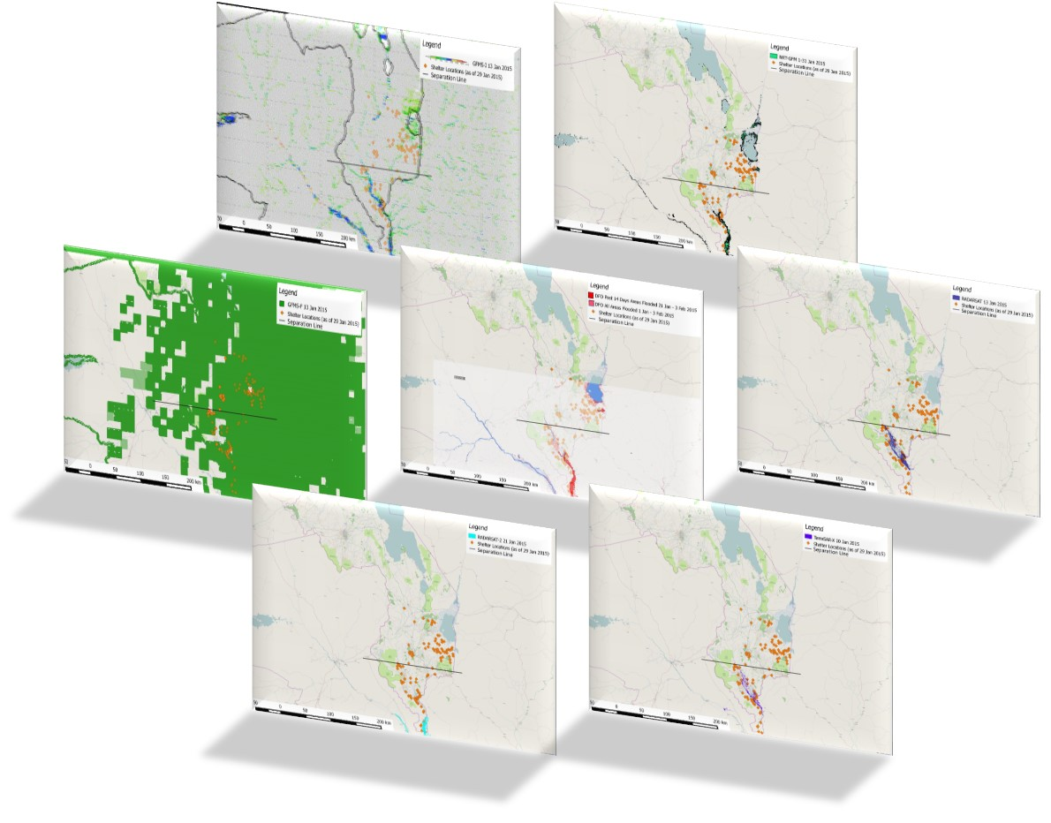
Results
Results
Analysis of product comparison
Qualitative spatial analysis of relationship between shelters and inundation products
Notes:
Analysis of product comparison
Qualitative spatial analysis of relationship between shelters and inundation products
Through visual comparison across all flood detection products, it was apparent that spatial coverage and accuracy differ approximately north of Chikwawa district and south of it. Hence, a black horizontal line was drawn to help analyze results. Above the line are areas prone to flash floods, and below the line areas are susceptible to riverine floods.
As shelters are usually located in close spatial proximity to inundated communities (usually within 10 km), we assume that inundation signals nearby shelters are valid. Further quantitative analysis which will be completed in the next term

Slide 16
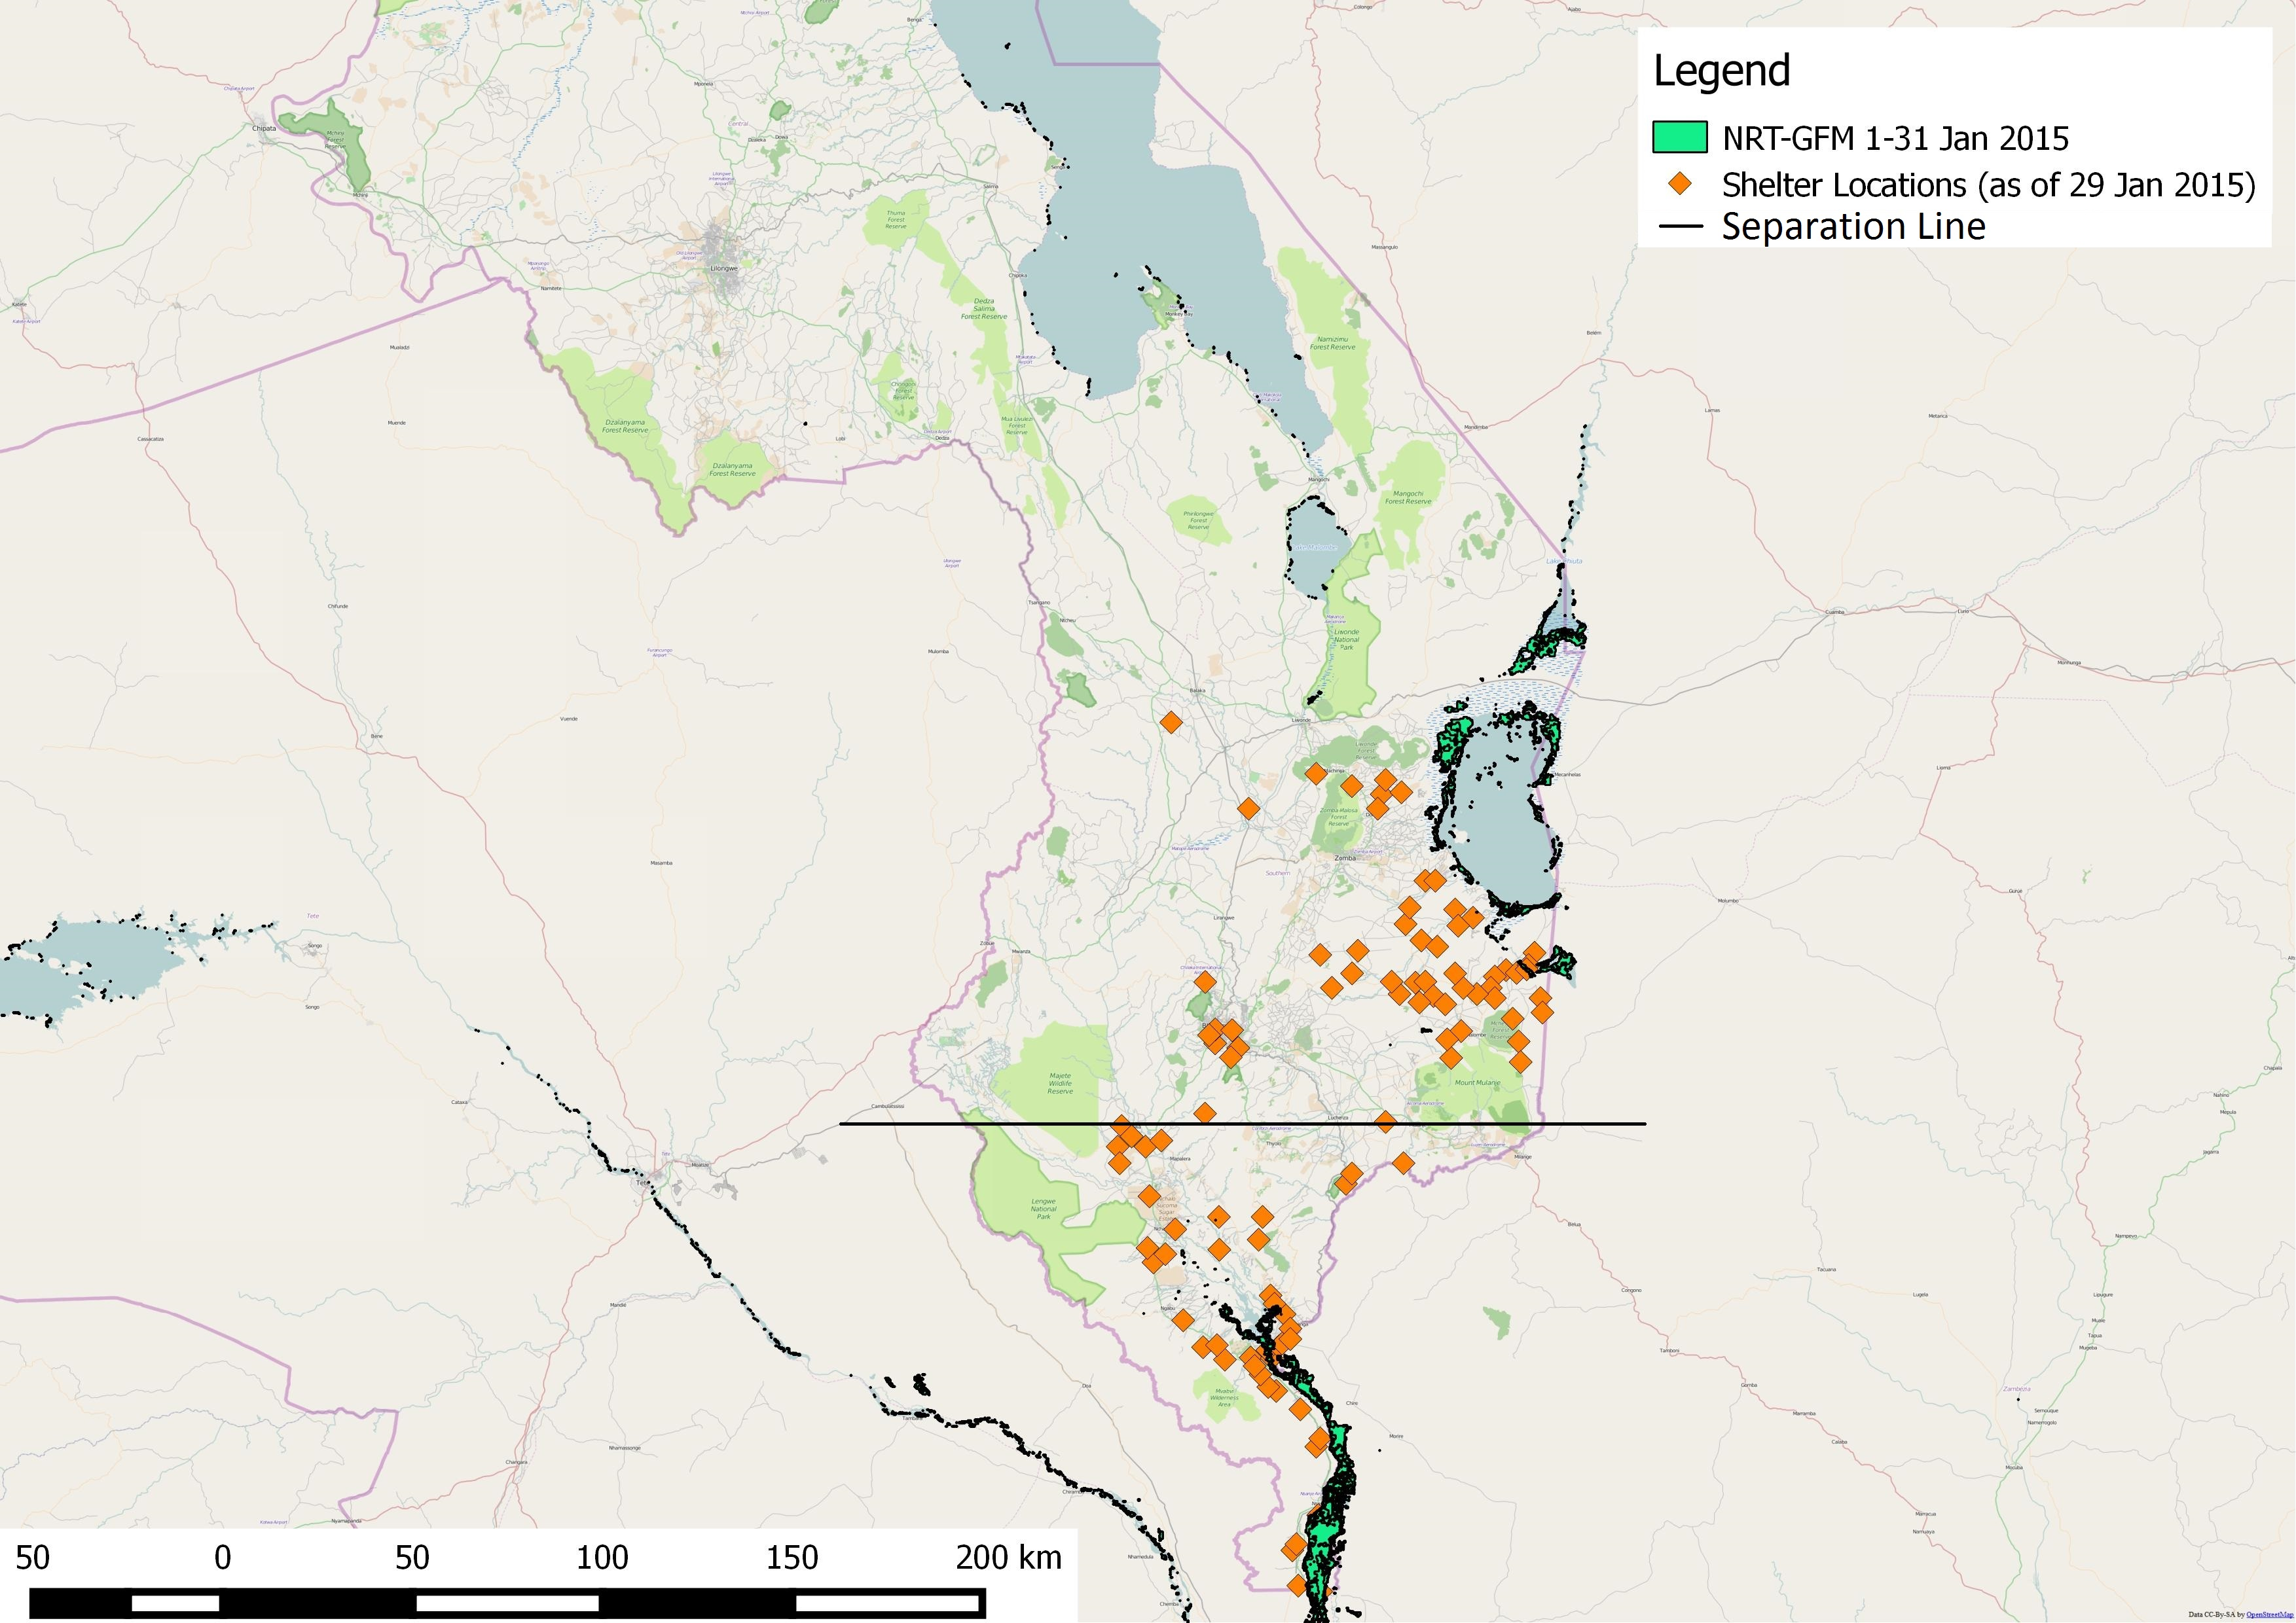
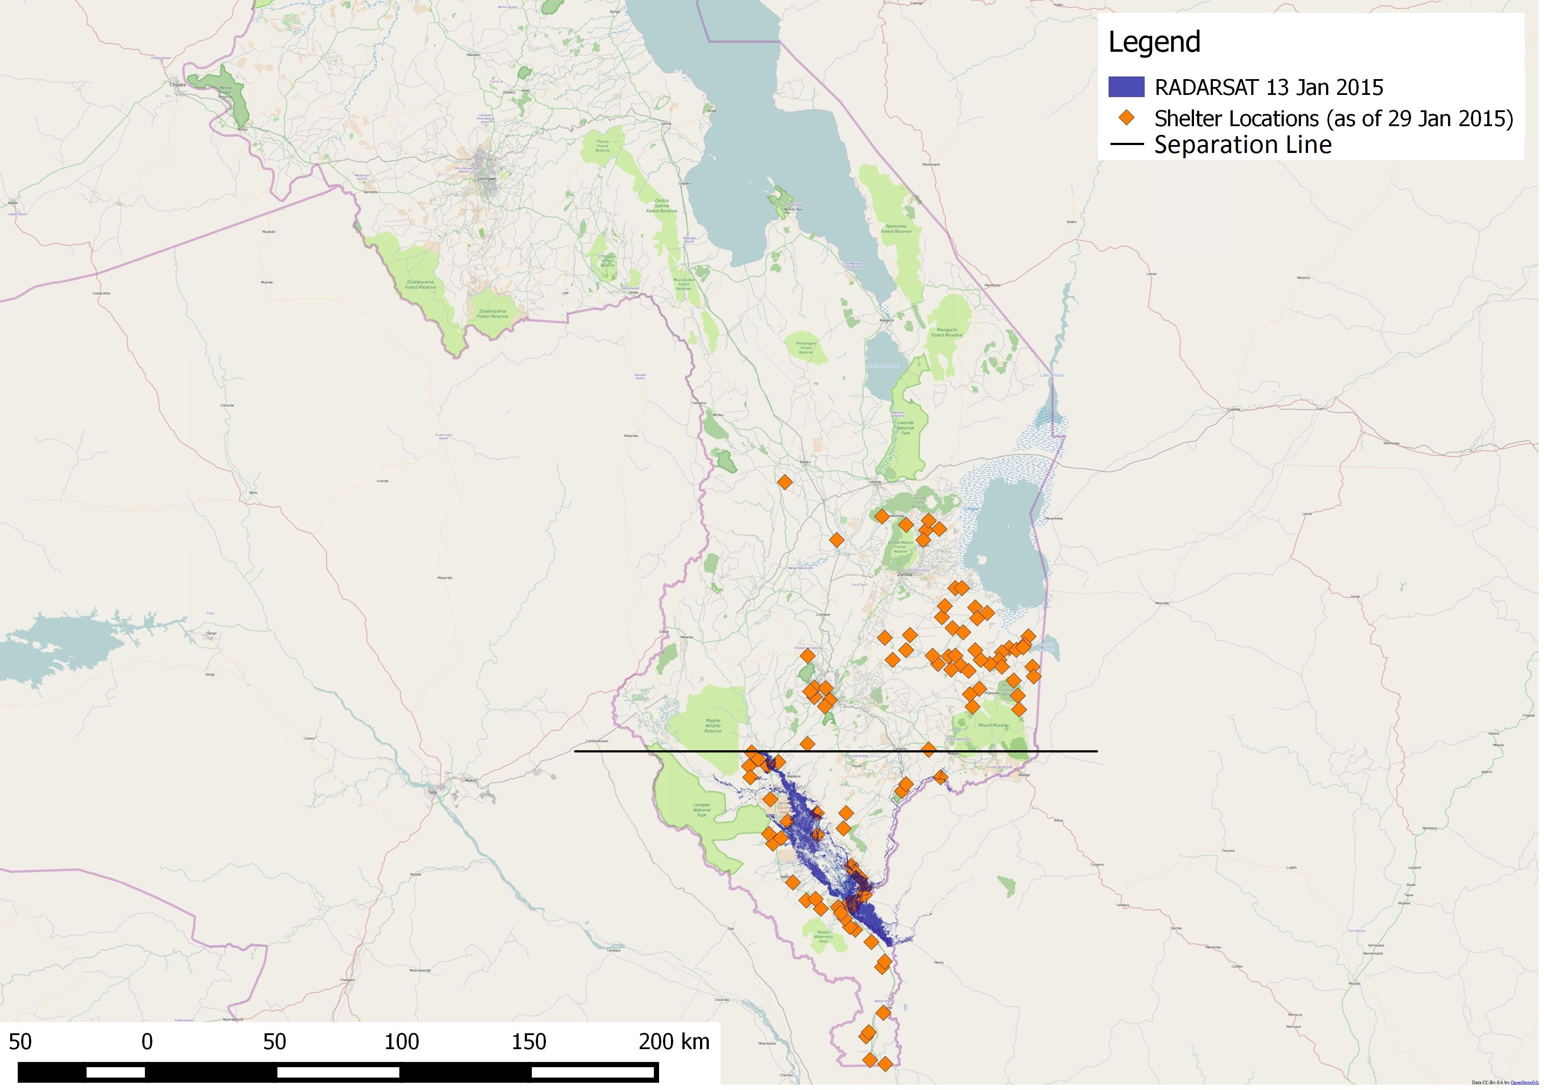
Results
Discussion
We have noticed that there are some groups of shelters that are spatially distant (more than 100 km) from inundation signals of some products.
The relationship between inundation signal and types of floods
There are barriers in inundation and flood detection, especially for flash floods.
NRT-GFM
RADARSAT
Notes:
We have noticed that there are some groups of shelters that are spatially distant (more than 100 km) from inundation signals of some products.
The relationship between inundation signal and types of floods
The shelters that are not near the inundation signals of some products were housing victims of flash floods- Mostly Phalombe and Blantyre districts
The shelters that were near the inundation signal of all products were housing victims of riverine floods- Mostly Chikwawa and Nsanje districts
There are barriers in inundation and flood detection, especially for flash floods.
This can have significant impact on disaster monitoring and preparedness and humanitarian response

Slide 17
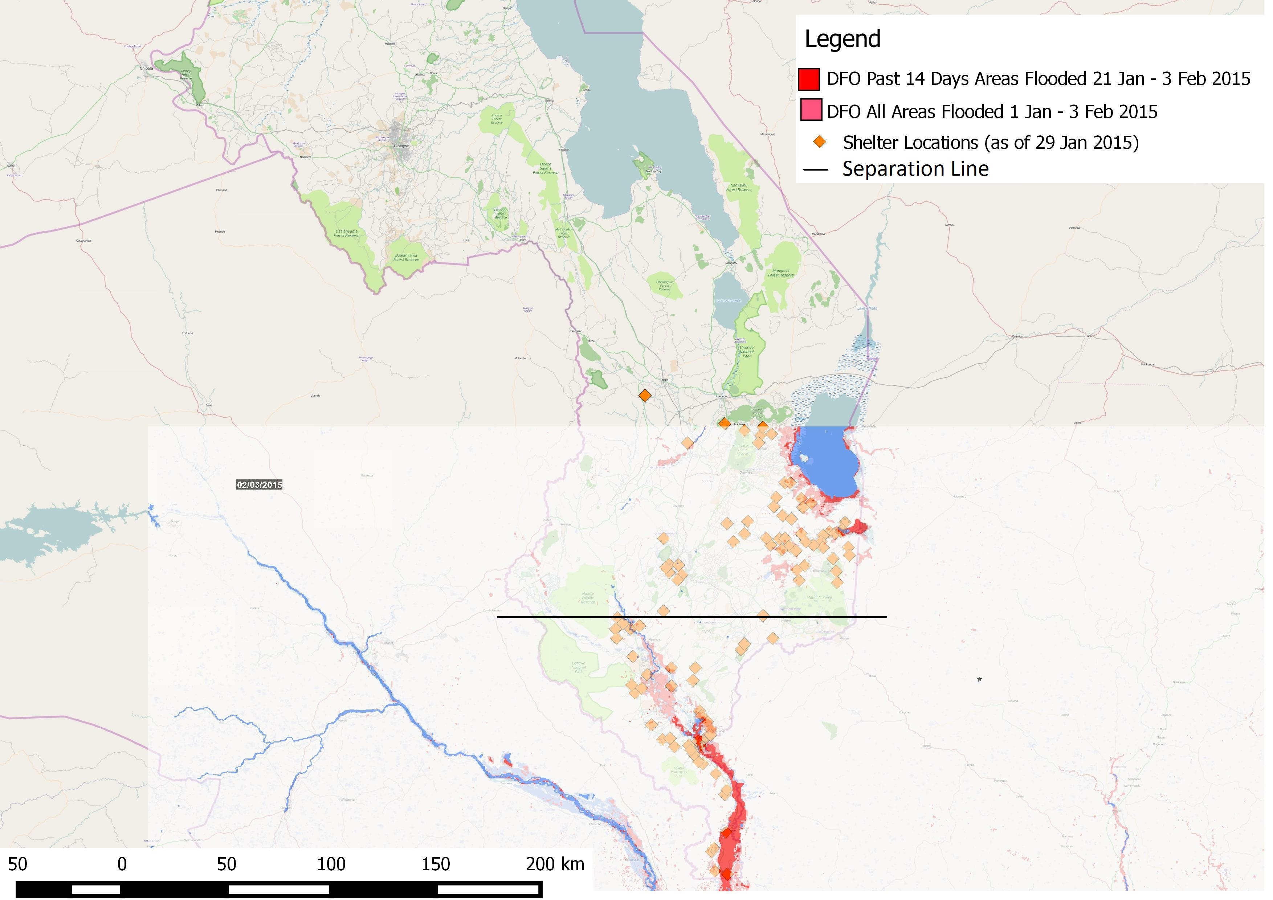
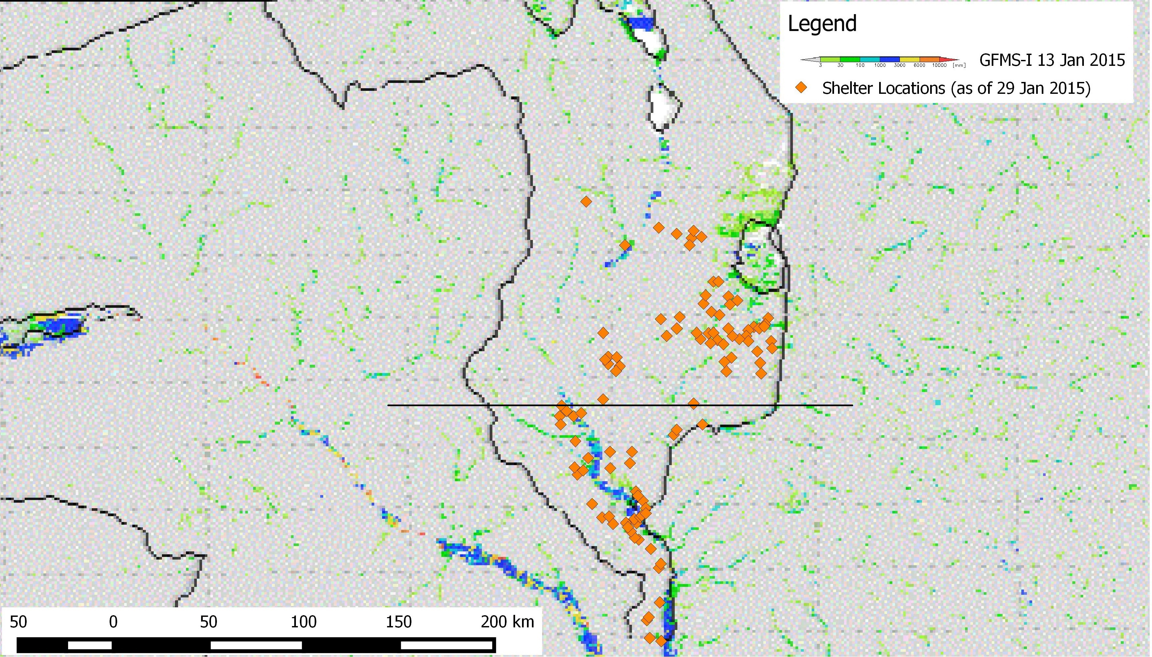
Conclusions
Products that showed the highest skill in identifying areas impacted by riverine floods
Group 1:
Group 2:
Group 3:
TerraSAR-X
RADARSAT
DFO
NRT-GFM
GFMS-I
Notes:
From the comparative analysis, TerraSAR-X and RADARSAT in Group 1, DFO and NRT-GFM in Group 2 along with GFMS-I in Group 3 can better detect riverine floods at high resolution, which can better assist disaster managers for decision making.

Slide 18
Conclusions
Products that showed the highest skill in identifying areas impacted by flash flood
GFMS-I
DFO
Notes:
DFO and GFMS-I showed flooding near shelters in flash flood prone regions, yet ground truth data was needed for further verification.

Slide 19
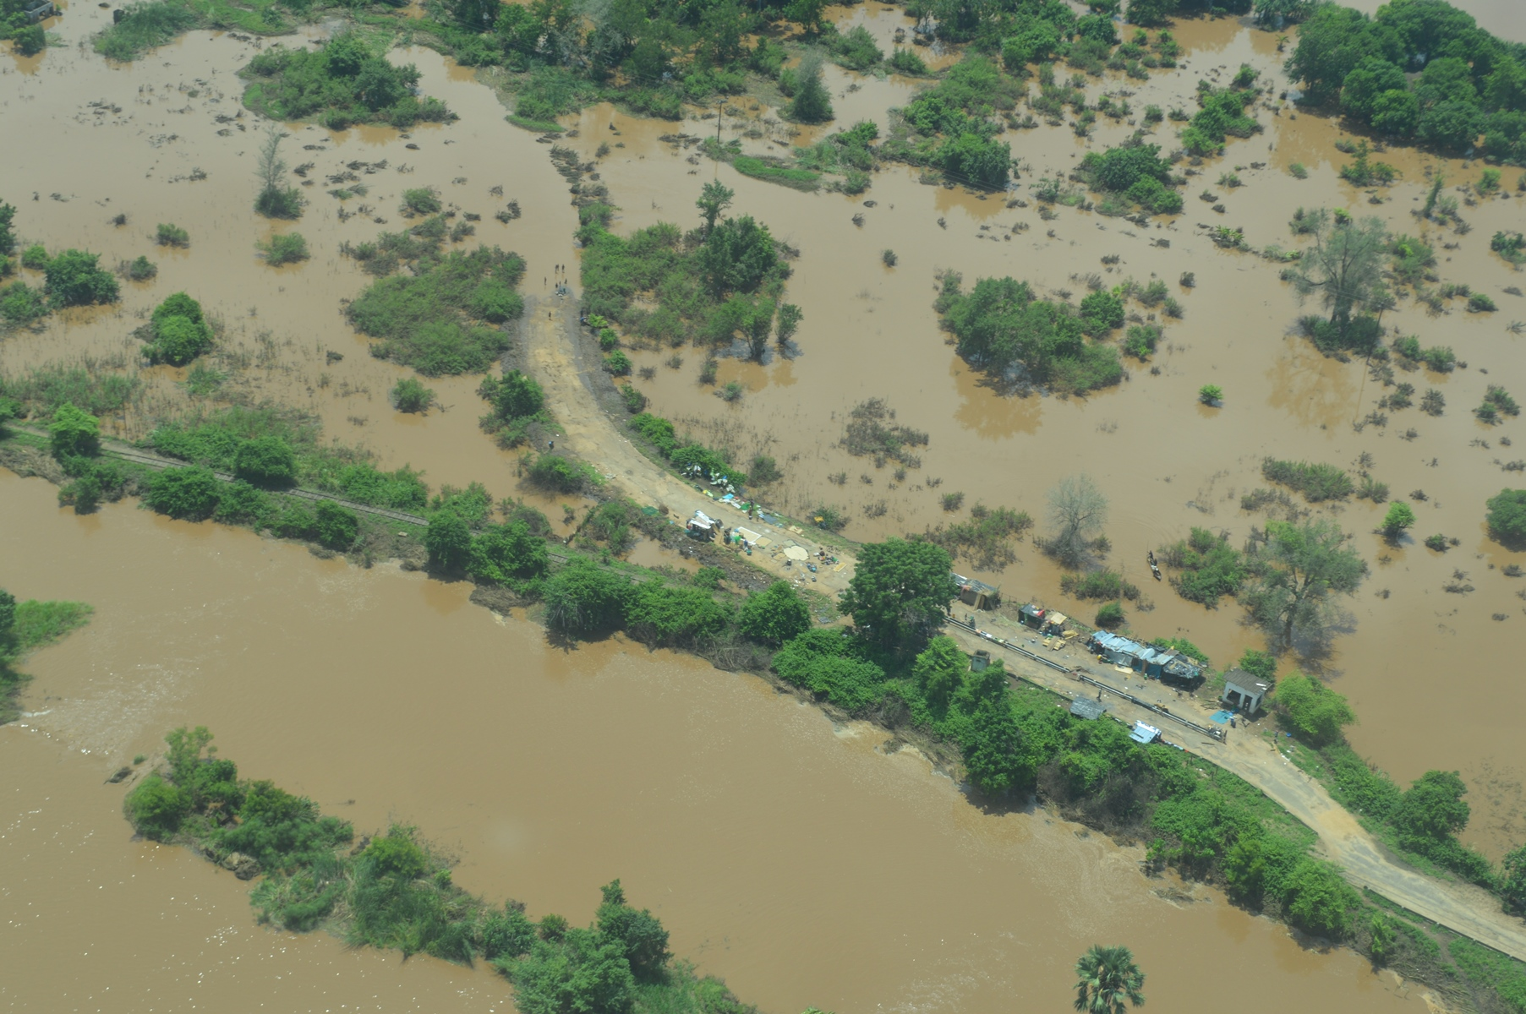
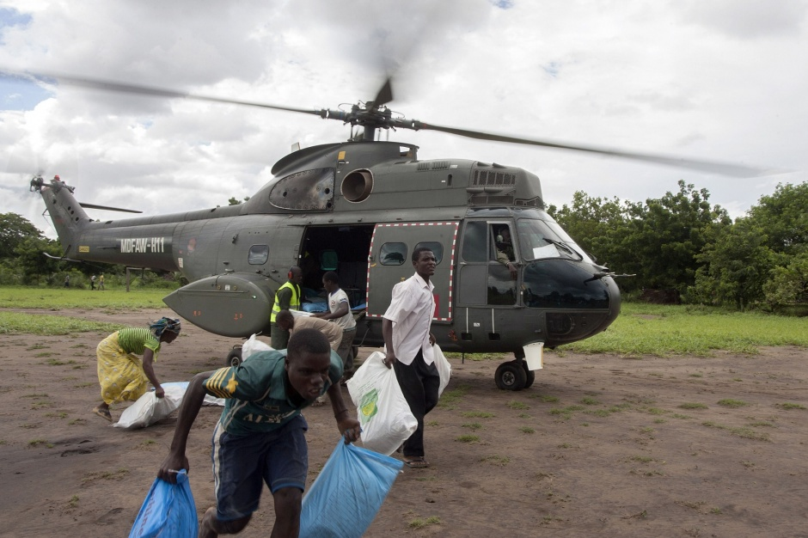
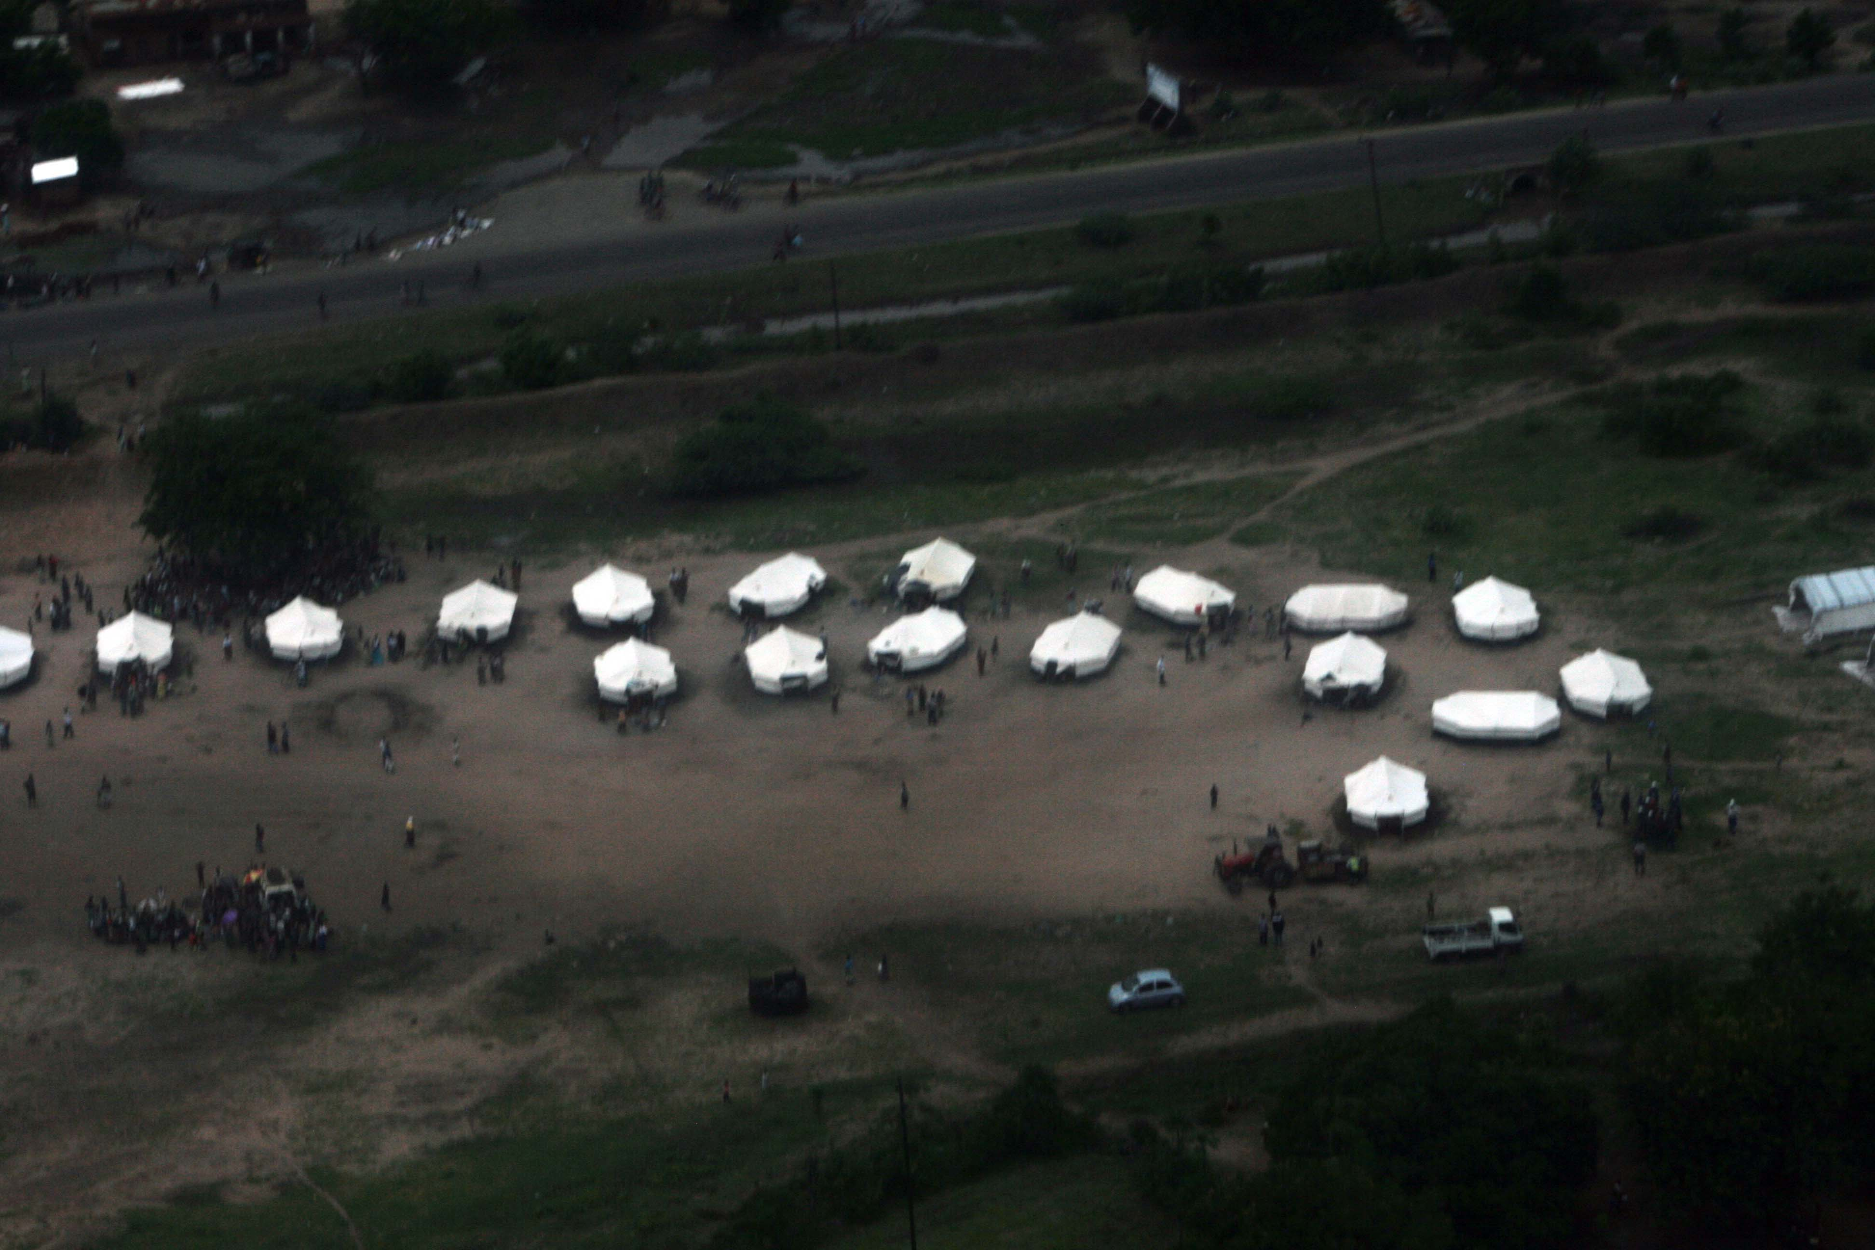
Conclusions
Benefits of Research
Identify a set of flood detection products that accurately depict flood events in Malawi
Enable Stakeholders to better monitor spatial extent of floods
Improve efficiency of disaster response programs
Raise awareness on potential affected locations being overlooked
Promote accurate documentation of flood disasters
Source: United Nations Development Programme, Flickr.com
Notes:
Through this research, a set of flood detection products that can accurately depict flood events in Malawi were identified. This would enable stakeholders to better monitor spatial extent of floods, improve efficiency of disaster programs, raise awareness on potential affected locations being overlooked, and promote accurate documentation of flood disasters.

Slide 20
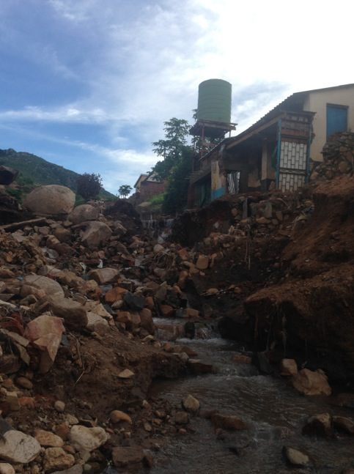
Conclusions
Future Work
When flooded village data becomes available, quantitative analysis of accuracy may be possible
New data from Soil Moisture Active Passive (SMAP) may allow for monitoring of antecedent and near real time soil moisture conditions
Comparison of forecast (seasonal and short-term) with validated inundation maps
Source: Andrew Kruczkiewicz
Source: Andrew Kruczkiewicz
Notes:
For future research, we hope when flooded village data becomes available, a quantitative analysis of accuracy may be possible
SMAP data may allow for monitoring of antecedent and near real time soil moisture conditions, an important driver of flash floods, for inclusion in a potential flash flood early warning system
Comparison of forecast (seasonal and short-term) with validated inundation maps

Slide 21
Acknowledgements
Advisor
Dr. Pietro Ceccato, Lead Environmental Monitoring Program, IRI (Science Advisor)
Partners
Red Cross/Red Crescent Climate Centre (RCRCCC), Boundary Organization, POC: Erin Coughlan, Senior Climate Specialist
Malawi Red Cross, Collaborator and End-User, POC: Hastings Kandaya, Director- Programmes and Development
Previous Project Contributors
Jerrod Lessel
Alex Sweeney
Special Thanks
Keiko Seito, World Bank
This material is based upon work supported by NASA through contract NNL11AA00B and cooperative agreement NNX14AB60A.

