Slide 1
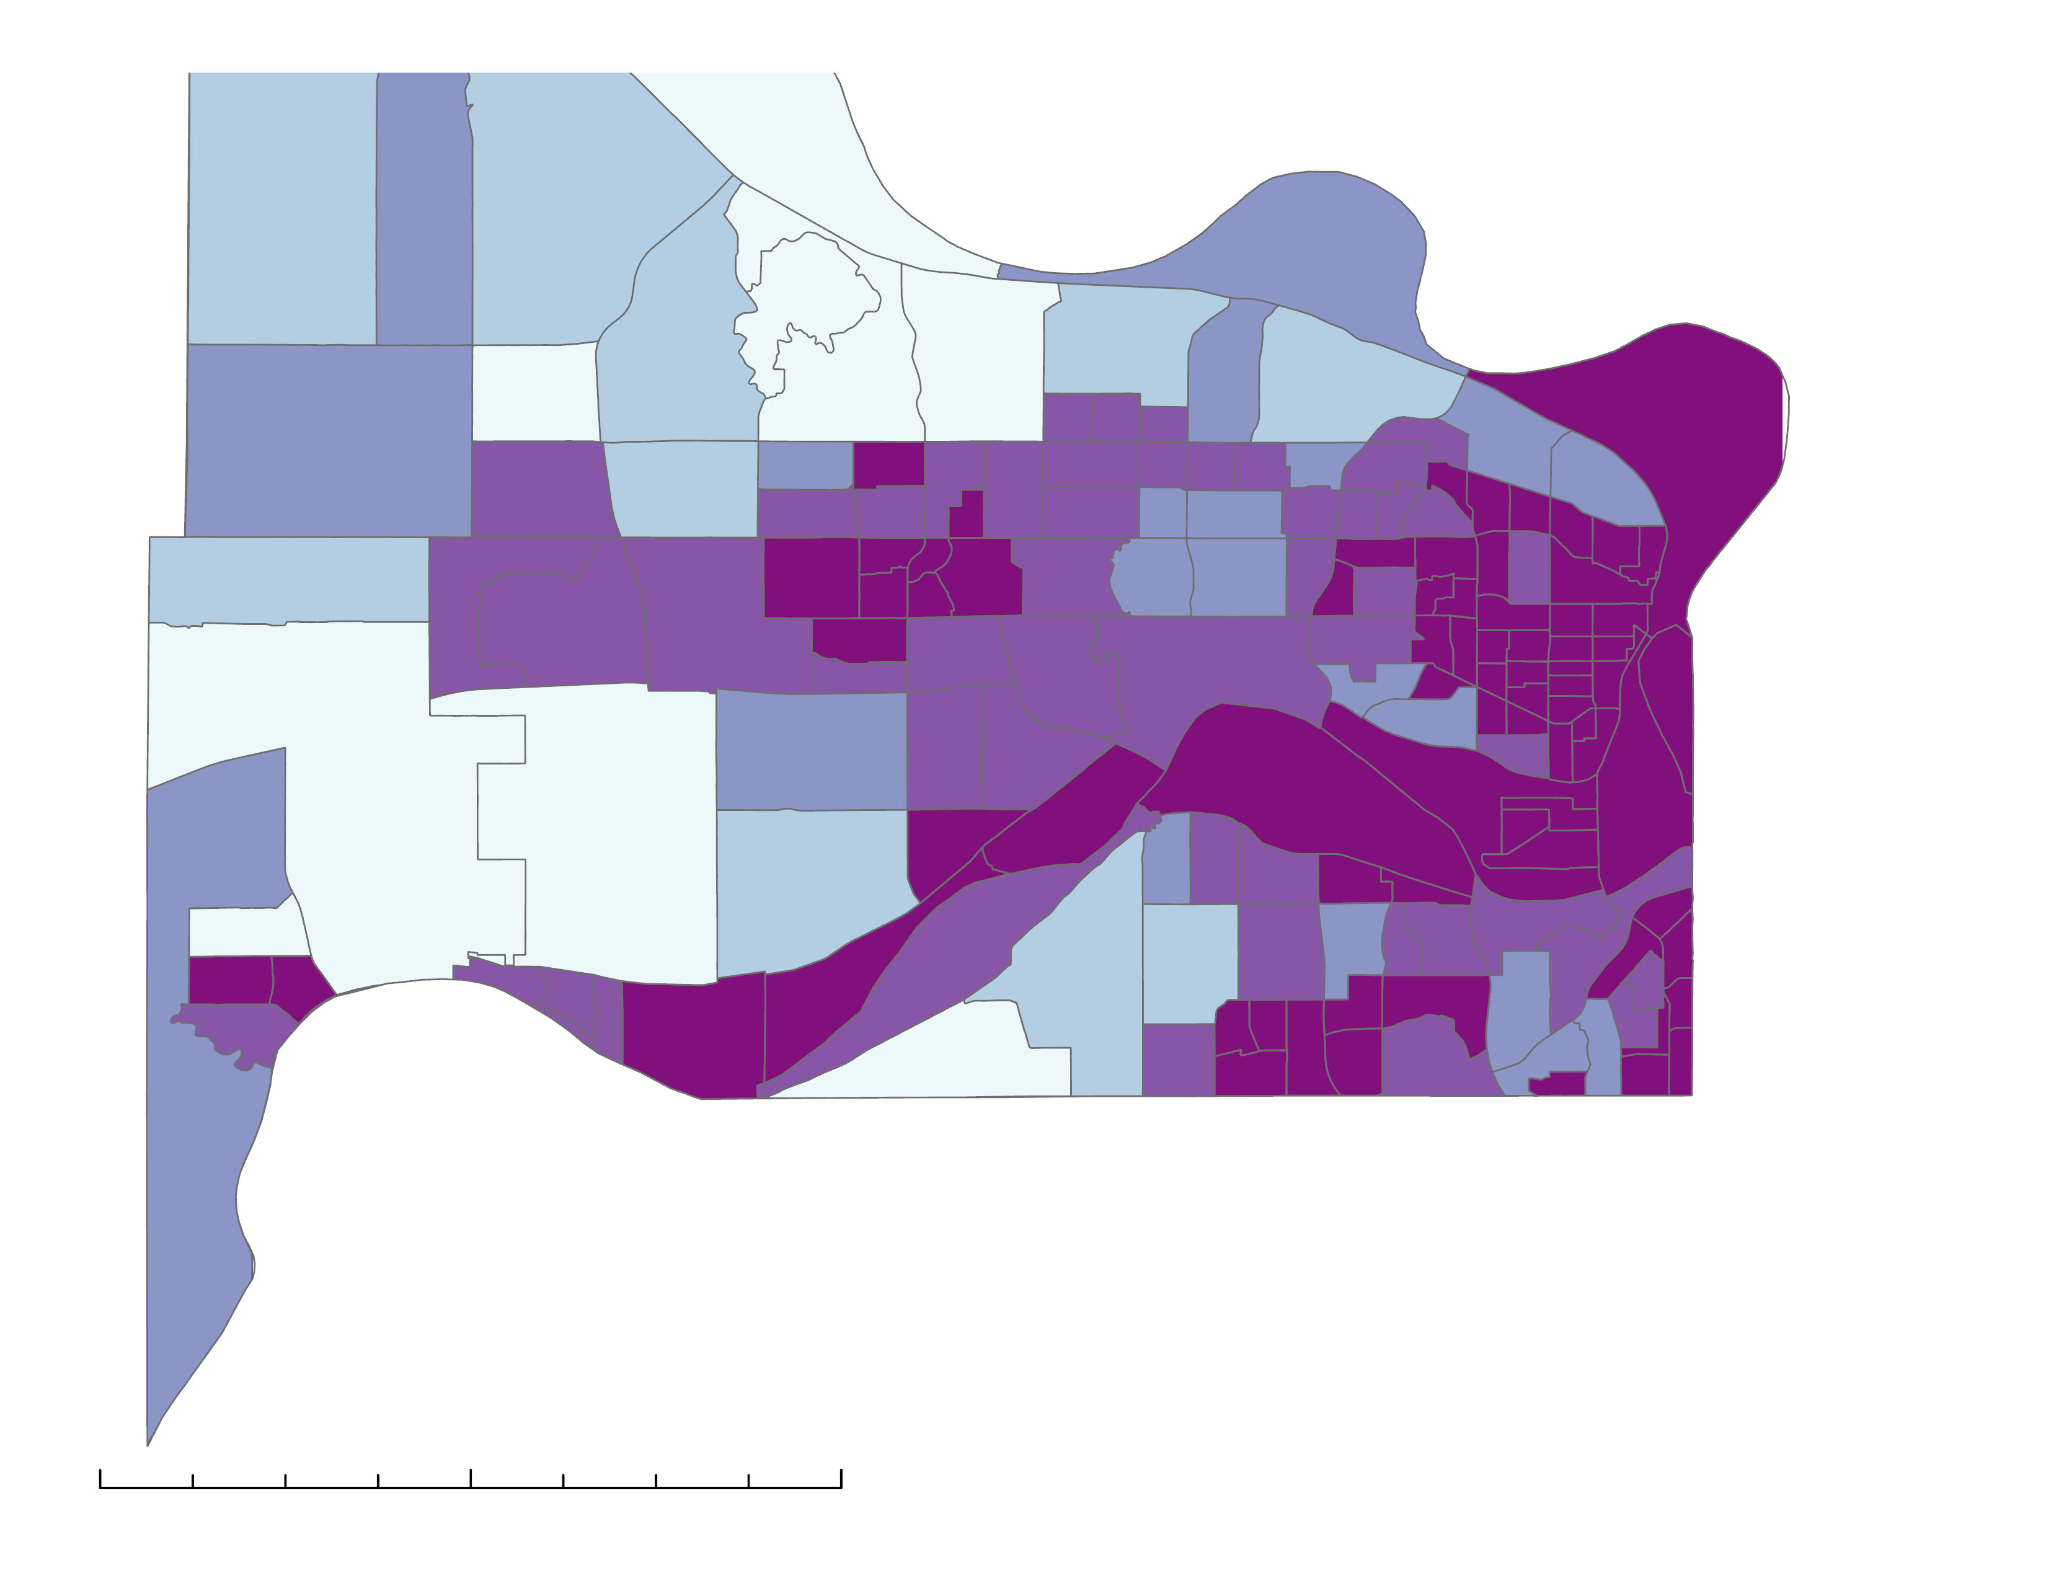
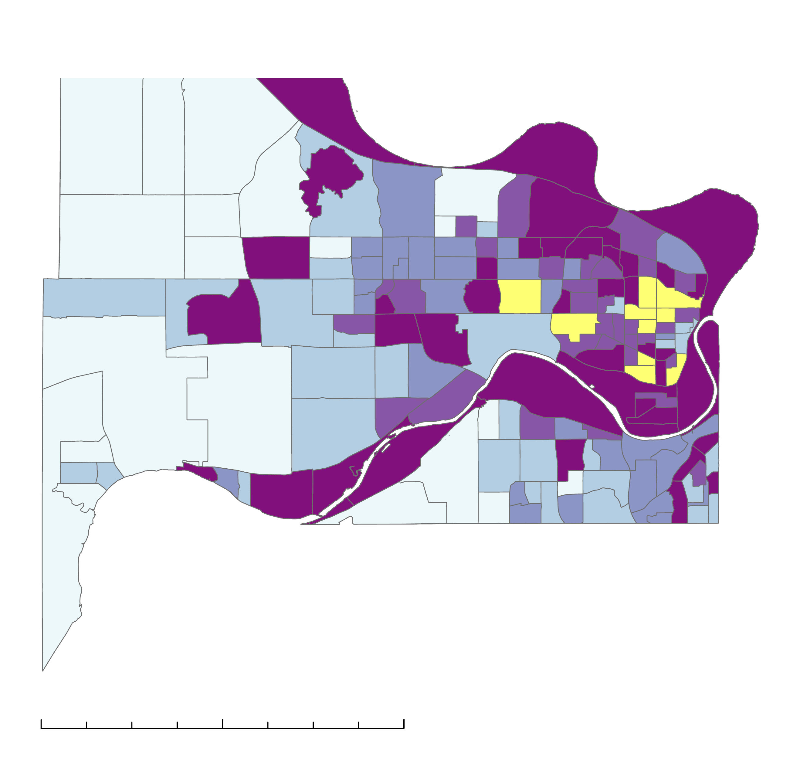
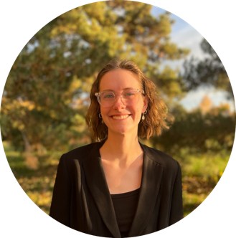
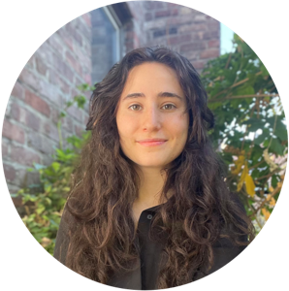
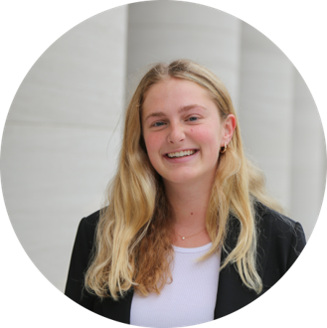
Analyzing Precipitation and Land Cover Data to Refine the Assessment of Urban Flood Vulnerability
COMMUNITY CONCERNS
PROJECT OBJECTIVES
Kansas City Disasters II
Impervious surfaces in disinvested neighborhoods
Which communities
in Kansas City, Kansas are most affected by
LOW
STORMWATER RETENTION?
Examine inequitable distribution of ecosystem services affecting water quality and quantity
Combined sewer overflows (CSOs)
Explore implications of land cover and precipitation variance
Polluted runoff
Stormwater retention by soils is an ecosystem service which mitigates flooding and waterway pollution caused by runoff. This is inhibited by an abundance of impervious surfaces which prevent stormwater infiltration into soils and creates excess runoff that flows across the ground’s surface, picking up pollutants and flooding urban environments.
Identify points of intervention for green infrastructure projects
RUNDOWN ON RETENTION
Northeast Wyandotte: Groundwork NRG's Focus Area
RETENTION RATIOS & CENSUS BLOCKS
N
Average Retention Ratio
0.001 - 0.211
Low retention disproportionately affects
low-income communities
0.212 - 0.284
0.285 - 0.365
0.366 - 0.404
0.405 - 0.470
0 2.5 5 10 miles
GREEN INFRASTRUCTURE ANALYSIS
N
Wyandotte County and Groundwork can better prioritize green infrastructure initiatives in areas where low retention ratios coincide with socioeconomic vulnerabilities
Green Infrastructure Analysis
Higher
socioeconomic vulnerability
Lower socioeconomic vulnerability
Block candidates for green infrastructure
Earth Observations
0 2.5 5 10 miles
GPM IMERG: Integrated Multi-satellite Retrievals for Global Precipitation Measurement
Team Members
EXAMPLE
Acknowledgements
Previous Contributors: M. René Castillo, Hadwynne Gross, Eric Sjöstedt, Raychell Velez
Advisor: Dr. Kent Ross
Fellow: Tyler Pantle
Partners: Groundwork USA (Jalisa Gilmore, Lawrence Hoffman),
Groundwork Northeast Revitalization Group (Rev. Adri Showalter-Matlock)
Image credits: Made x Made (TheNounProject), NASA, DEVELOPers
Nora Carmody
Project Lead
Dain Kim
Kameron Lloyd
Ruby Nagelberg
MA - Boston

