Slide 1
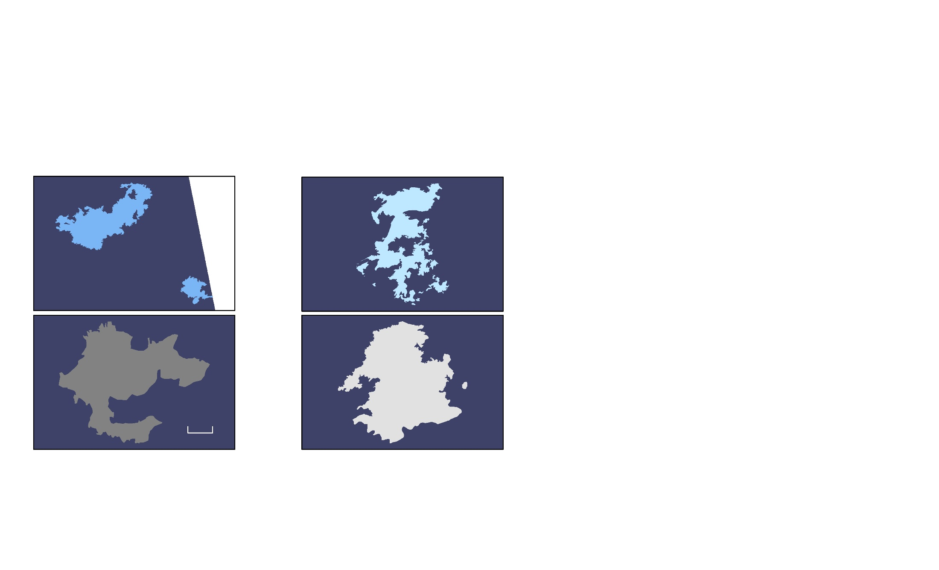
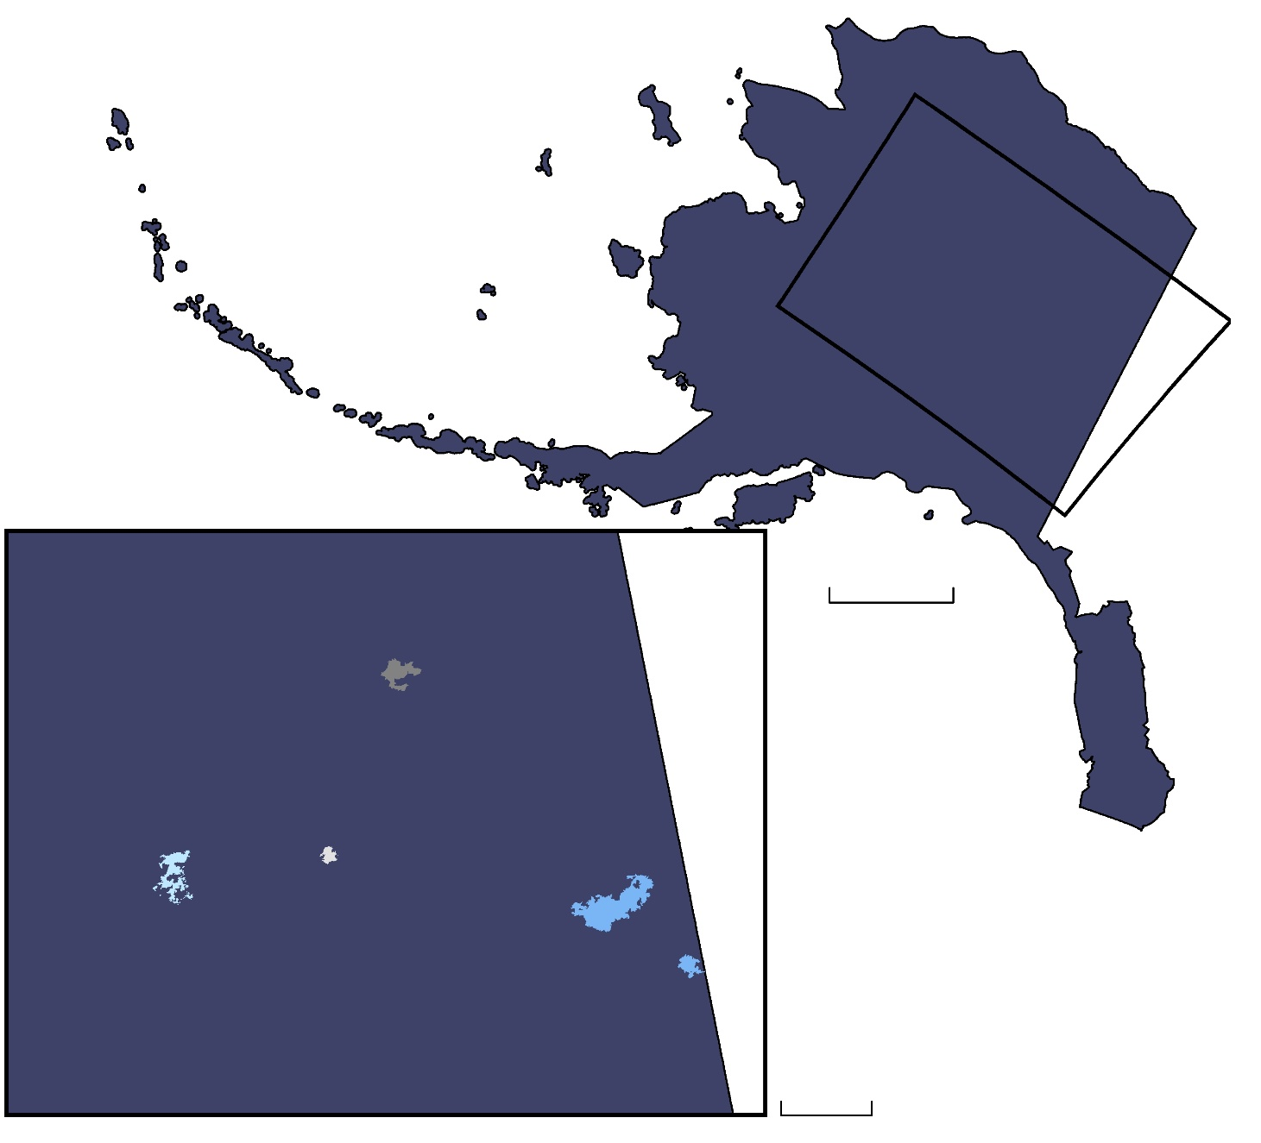
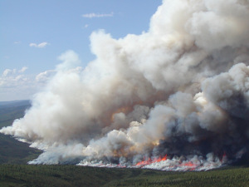
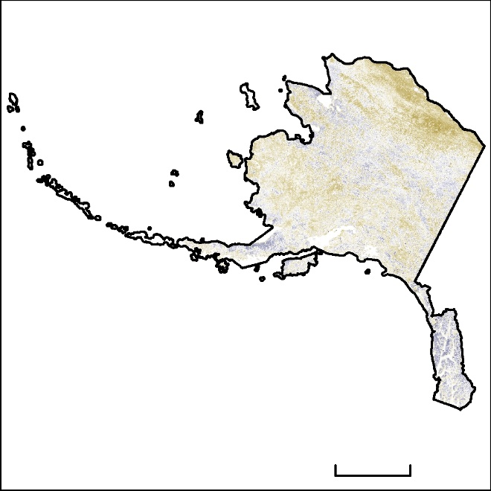
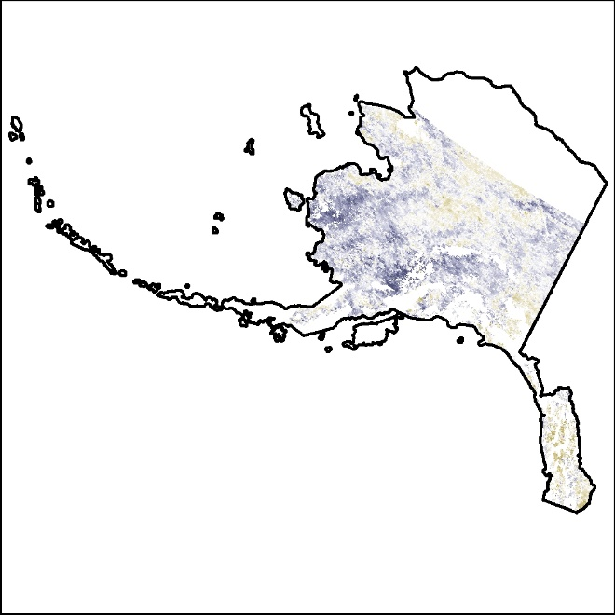
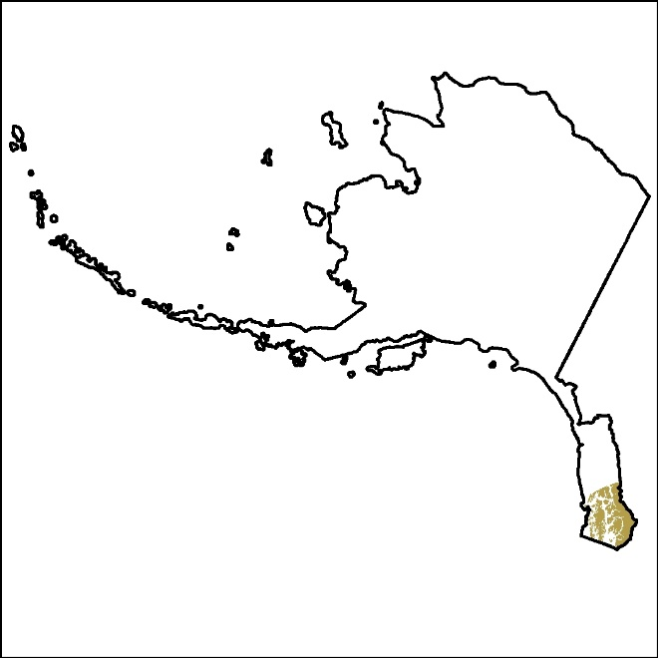
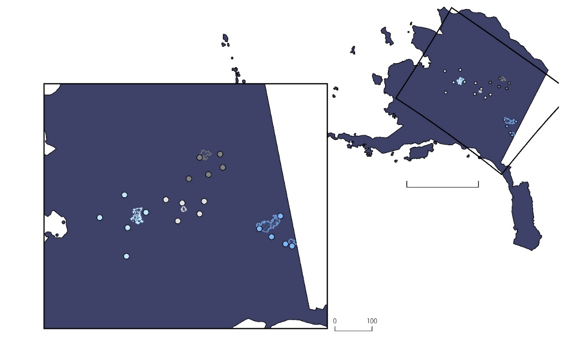
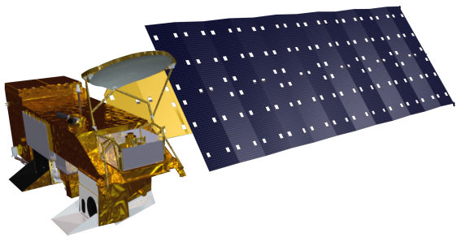

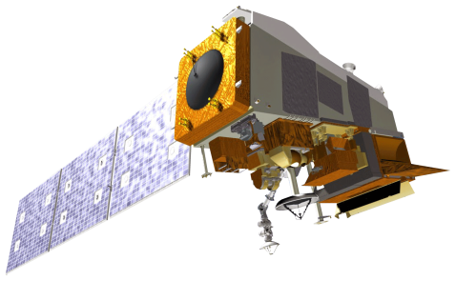
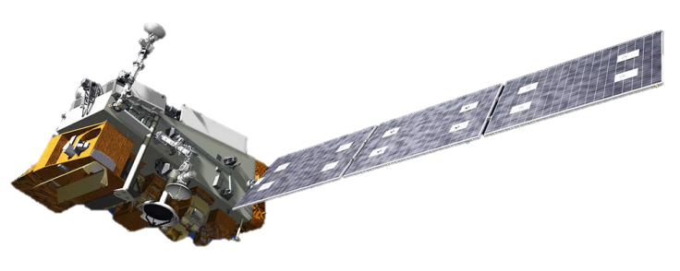

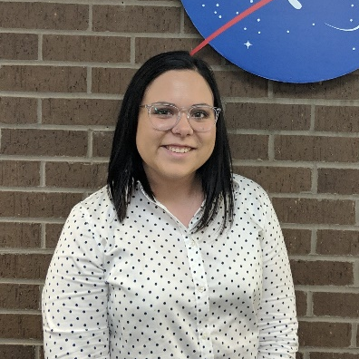

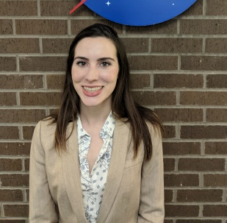
Evaluating the Atmosphere-Land Exchange Inverse Evaporative Stress Index for the Alaskan Environment to Determine Wildfire Likelihood
Abstract
Objectives
Alaska Disasters
Alaska’s wildfire season has progressively increased in duration and intensity over the last decade, leaving forested areas subject to devastating destruction. These increases in wildfire occurrence are due to gradual rises in land surface temperature, decreases in precipitation levels, and lack of soil moisture throughout the state. This causes concerns for air pollution as well as the destruction of homes and wildlife habitats within or around forests. The Alaska Disasters project team used remotely sensed data obtained from Aqua Moderate Resolution Imaging Spectroradiometer (MODIS), Terra MODIS, Suomi National Polar-orbiting Partnership (NPP) Visible Infrared Imaging Radiometer Suite (VIIRS), and National Oceanic and Atmospheric Administration-20 (NOAA-20) VIIRS from April through September of 2004, 2005, 2015, and 2018 to observe vegetation and moisture changes in affected areas before and after wildfires. Using the Atmosphere-Land Exchange Inverse (ALEXI) Evaporative Stress Index (ESI) generated by the NASA Short-term Prediction Research and Transition Center (SPoRT), the team determined if ALEXI ESI provided lead time on the evaluation of vegetation stress. Team members completed this analysis by using Pearson’s correlation coefficient to determine the correlation between the ALEXI ESI output and various vegetation monitoring indices. The team then compared the utility of the ALEXI ESI to the Canadian Fire Weather Index (FWI) to evaluate the benefit of using ALEXI ESI in conjunction with current decision-making processes in Alaska. With these results, the Alaska Interagency Coordination Center (AICC) and Alaska Fire Science Consortium (AFSC) are able to make better-informed decisions when determining fire management techniques and assessing the risk of future wildfire outbreaks.
Utilize MODIS and VIIRS sensors to introduce improved methods of evaluating vegetation stress and determining wildfire likelihood in Alaska
Evaluate and calibrate the ALEXI ESI product when applied to the Alaskan environment
Identify areas throughout Alaska that are prone to drought and wildfires
Communicate project results using an ArcGIS Online Story Map
Study Area: Alaska
Taylor Complex
Big Creek Two
Alaska
Nelson Mtn.
Zitziana River
0 100 mi
0 20 mi
Results
0 100 mi
Fire Case Studies
2018 ALEXI ESI Comparative Analysis
2004 – Taylor Complex
With the NDVI
June to July Pearson’s Correlation
R | R²
-0.153 | 0.023
2004: Taylor Complex (1,305,705 acres burned)
2005: Nelson Mountain (242,688 acres burned)
2015: Big Creek Two (315,918 acres burned)
2018: Zitziana River (71,942 acres burned)
Methodology
NDVI Anomaly
Image Credit: Alaska Fire Science Consortium
High : 4
0 300 Miles
Low : -4
Data Acquisition
Data Processing
Data Analysis
End Products
With the USDA Drought Monitor
Aqua/Terra MODIS-derived NDVI
ALEXI ESI
US Drought Monitor Data
Canadian Fire Weather Index (CFWI)
NDVI Calculation
  Mean
  Standard Deviation
  Anomaly
Drought Monitor
  Reclassify
CFWI
  Reclassify
Visual Comparisons
Pearson’s Correlation Coefficient – Spatial Correlation
Confusion Matrix – Accuracy Assessment
ALEXI ESI Comparative Analysis
Canadian Fire Weather Indices Comparative Analysis
ArcGIS Online Story Map
June to July Confusion Matrix | ALEXI ESI (not stressed) | ALEXI ESI (stressed)
2018 – Drought Monitor (not stressed) | 1,054 | 2
2018 – Drought Monitor (stressed) | 666 | 1
ESI
High : 4
Low : -4
US Drought Monitor
Classification
Drought
 | Overall Accuracy | Producer’s Accuracy | User’s Accuracy
2018 | 0.6123 | 0.6128 | 0.998
CFWI Comparative Analysis
With the ALEXI ESI
2018 Fire Stations
2015 Fire Stations
2005 Fire Stations
 | Overall Accuracy | Producer’s Accuracy | User’s Accuracy
2004 | 1 | 1 | 1
2005 | 0.7143 | 0.6667 | 1
2015 | 0.7143 | 0.6000 | 1
2018 | 1 | 1 | 1
2004 Fire Stations
Big Creek Two Fire
Zitziana River Fire
Earth Observations
Nelson Mountain Fire
0 300 mi
Taylor Complex Fire
Aqua MODIS
Suomi NPP VIIRS
Conclusions
Terra MODIS
NOAA-20 VIIRS
The ALEXI ESI had a low correlation to the MODIS-derived NDVI products, which demonstrates that the ALEXI ESI product may be detecting stress in green vegetation, providing increased lead time in wildfire detection.
The ALEXI ESI had an overall accuracy of 61% when compared to the USDA Drought Monitor drought classification areas during June and July of 2018.
The ALEXI ESI had an overall accuracy of 72% in 2015 when compared to the CFWI.
Project Partners
Alaska Interagency Coordination Center
Alaska Fire Science Consortium
NASA Short-term Prediction Research and Transition Center (SPoRT)
Acknowledgements
Team Members
Heidi Strader, Alaska Interagency Coordination Center
Alison York, Alaska Fire Science Consortium
Robert Ziel, Alaska Fire Science Consortium
Dr. Chris Schultz, NASA Short-term Prediction Research and Transition Center
Dr. Chris Hain, NASA Short-term Prediction Research and Transition Center
Dr. Jeffrey Luvall, NASA Marshall Space Flight Center
Dr. Robert Griffin, University of Alabama Huntsville
Maggi Klug, University of Alabama Huntsville
Leigh Sinclair, University of Alabama Huntsville, Information Technology and Systems Center
Helen Baldwin, University of Alabama in Huntsville
Madison Murphy, NASA DEVELOP Alabama – Marshall Node
Kathrene Garcia, NASA DEVELOP Alabama – Marshall Node
Christine Evans
Project Lead
Ryan Marshman
Brianna Santallana
Alabama – Marshall | Spring 2019

