Slide 1
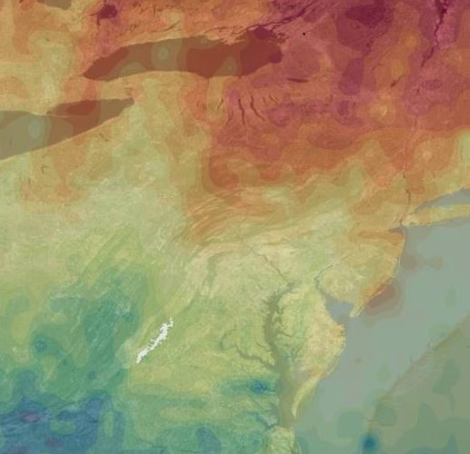
SHENANDOAH HEALTH & AIR QUALITY
Monitoring Air Quality in Shenandoah National Park to Address National Park Service Initiatives Using NASA Earth Observations
Ellen Bubak
Julie Terhune
Amanda Clayton
Nicholas Lenfant
Douglas Gardiner
NASA Langley Research Center
Summer 2017
Notes:
Ellen:
Good morning! We will be talking to you today about our research on air pollution in Shenandoah National Park. My name is Ellen Bubak and these are my teammates.
(Each team member says their name, degree, and school)

Slide 2
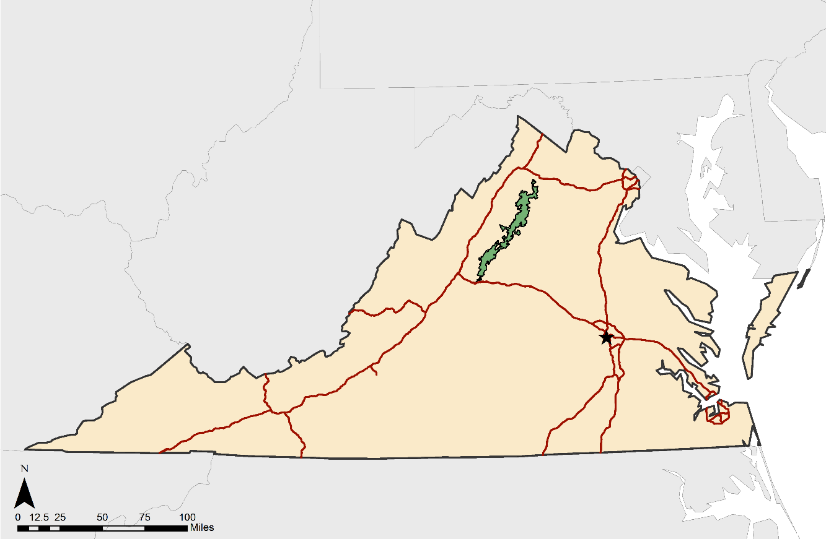
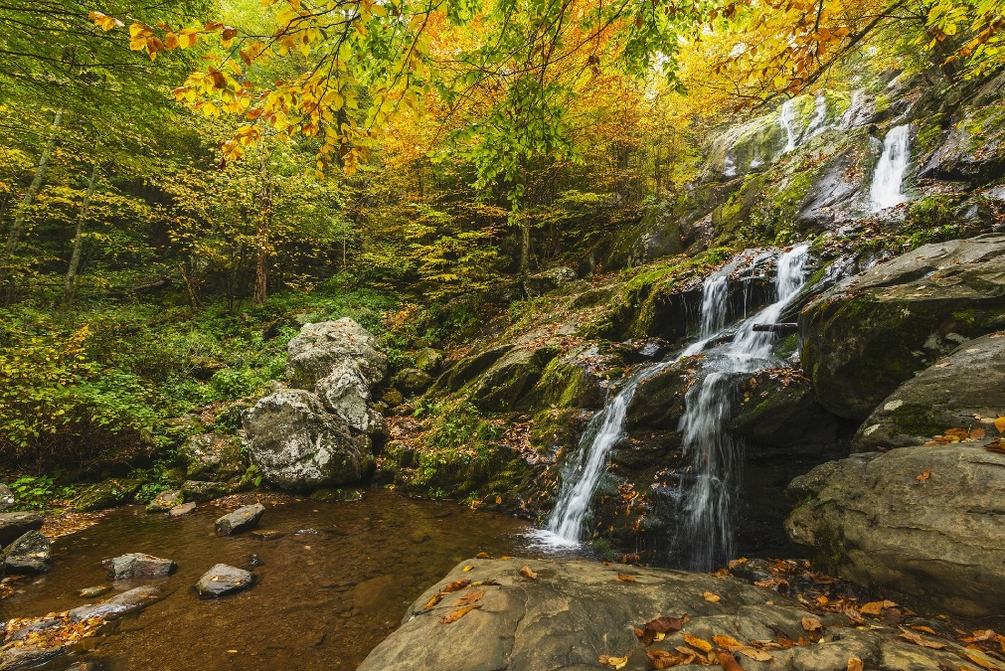
Shenandoah National Park
Credit: NPS
Notes:
Doug: Shenandoah National Park is located in the Blue Ridge Mountains in Virginia. Last year, the park had over 1.4 million visitors and is well-known for its scenic views and Skyline Drive.
---------------------------------------------------------
Picture: https://irma.nps.gov/Stats/SSRSReports/Park%20Specific%20Reports/Annual%20Park%20Recreation%20Visitation%20Graph%20(1904%20-%20Last%20Calendar%20Year)?Park=SHEN
Background source: https://www.nps.gov/shen/learn/management/statistics.htm
Visitor Information Source: https://irma.nps.gov/Stats/SSRSReports/Park%20Specific%20Reports/Annual%20Park%20Recreation%20Visitation%20(1904%20-%20Last%20Calendar%20Year)?Park=SHEN

Slide 3
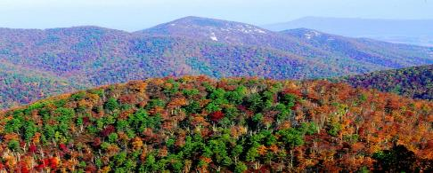
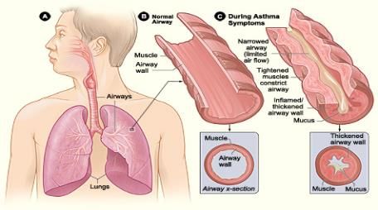
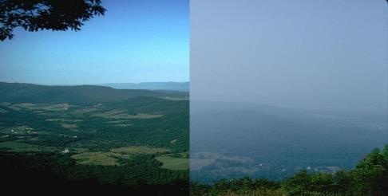
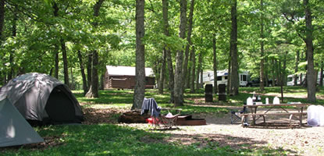
Partner Concerns
Air Quality
Health
Credit: NPS
Credit: Wikimedia Commons
Credit: NPS
Credit: NPS
Visibility of Scenic Views
Park Attendance
Notes:
Doug:
Our partners at the National Park Service told us they were concerned with air quality, park attendance, visibility, and air health. Having a better understanding of the air enables the park service to inform visitors of days that may have decreased visibility or potential health threats. It also helps with knowing when plants and animals may be at risk.
-----------------------------------------------------------------
[Images] – (from noon going clockwise) (1) Picture of park visitors, (2) Picture of respiratory system for humans, (3) Scenic background of skyline drive, (4) Atmosphere, clean or dirty.
Air quality pic: https://www.nps.gov/media/photo/view.htm?id=21C216AB-155D-451F-6704A6D62CF9D8CA
Scenic views pic: https://www.nps.gov/media/photo/view.htm?id=19ED5520-155D-451F-673BABF05B820A3D
Health: https://commons.wikimedia.org/wiki/File:Asthma_attack-illustration_NIH.jpg
Park attendance: https://www.nps.gov/shen/planyourvisit/camping.htm

Slide 4
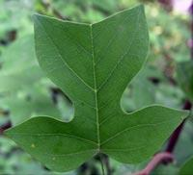
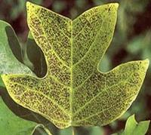
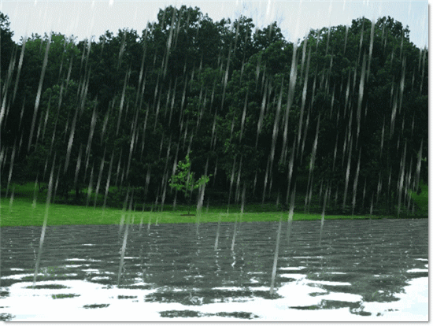
Atmospheric Pollutants
Ozone
Nitrogen
Dioxide (NO₂)
Sulfur Dioxide (SO₂)
Causes plants and animals to be more vulnerable to health defects
Can increase likelihood of respiratory problems and responsible for acid deposition
Primary cause of acid rain
Notes:
Doug: A method of measuring harmful pollutants is by using the National Ambient Air Quality Standards; which sets the bar for safe levels of various pollutants. Our project focused on 3 of these: Ozone, NO2, and SO2.
---------------------------------------------
Optional:
Ozone impacts the park because it causes plants and animals to be more vulnerable to health defects. Meanwhile, nitrogen dioxide can increase the likelihood of respiratory problems in people and is responsible for acid deposition. Sulfur dioxide can lead to acid rain which has detrimental effects on the park’s nature.
-------------------------------------------
[Images] – Project Image, can be found on project page from DEVELOPedia
A method of measuring these harmful pollutants is by using the National Ambient Air Quality Standards; which sets the bar for safe levels of various pollutants. Our project focused on 3 of these; Ozone, Nitrogen Dioxide, and Sulfur Dioxide.

Slide 5
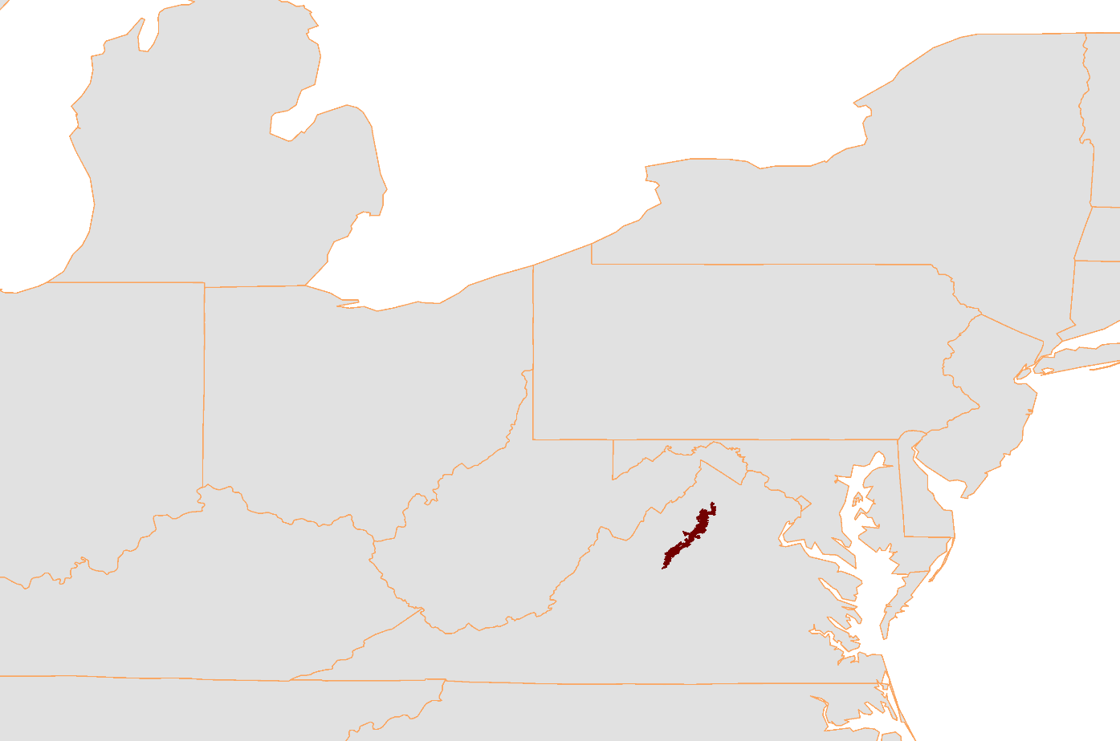
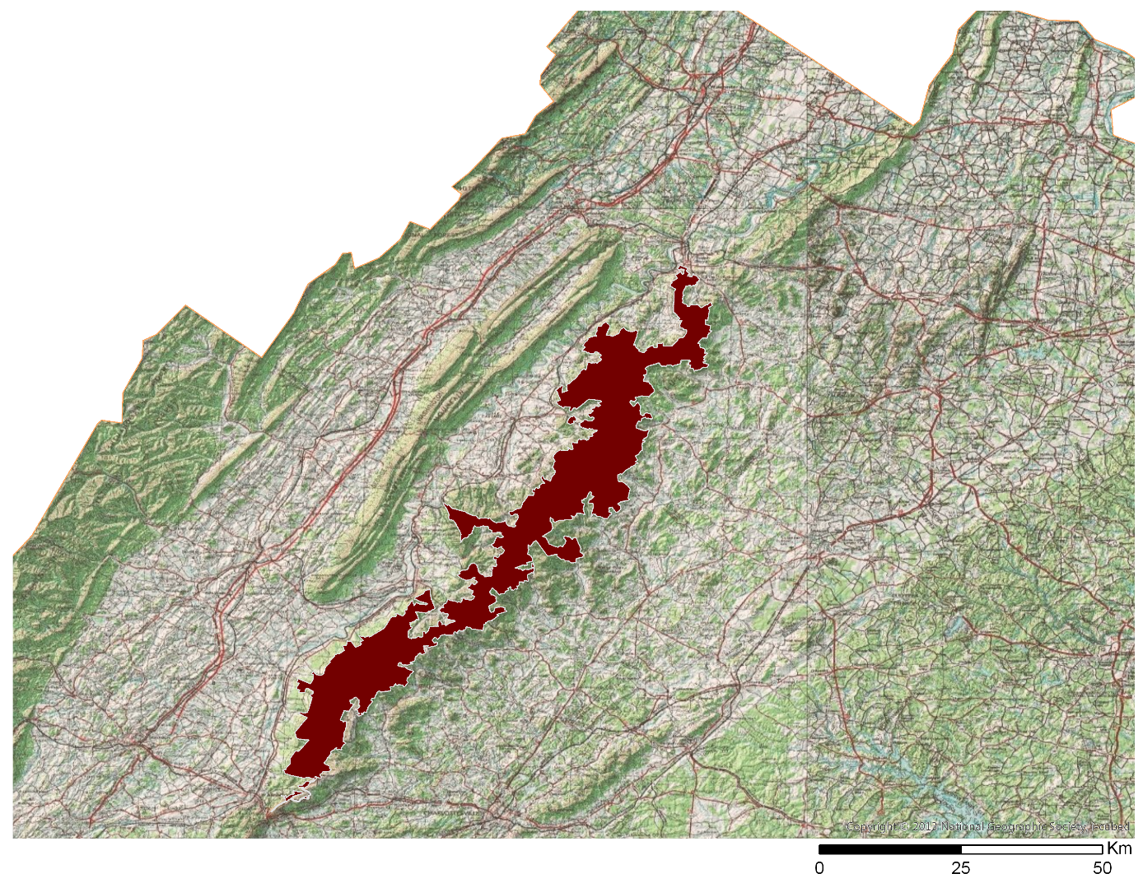
Study Area
Shenandoah National Park
Chesapeake Bay Airshed
Notes:
Doug:
The focus of this project is on Shenandoah National Park which is located in northwestern Virginia. We decided to expand our study area to a modified version of the Chesapeake Bay airshed, in order to account for air transport and mixing that would affect Shenandoah National Park.
**Do NOT mention pixel size, etc. in this slide—too much time and out of scope**
------------------------------------------------------------
[Images] Shenandoah National Park on the left, Map of portion of US that makes up the Chesapeake Airshed on the right

Slide 6
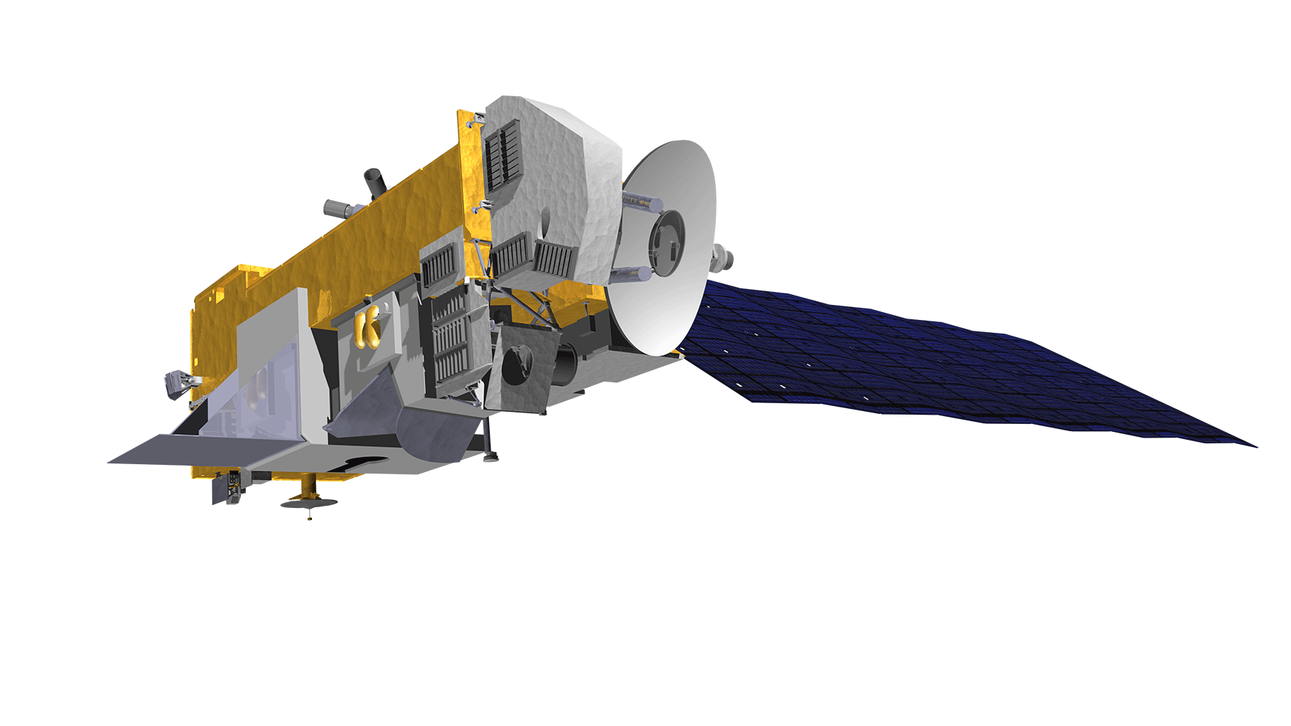
NASA’s Aura Satellite
Video
Launched July 15, 2004
Equatorial crossing at 1:30pm
Four Sensors onboard
High Resolution Dynamics Limb Sounder (HIRDLS)
Microwave Limb Sounder (MLS)
Tropospheric Emission Spectrometer (TES)
Ozone Monitoring Instrument (OMI)
Notes:
Julie:
Data used for this project came from both NASA Earth observations from the Aura satellite and the in situ data collected by the Park Service in Shenandoah.
Aura’s instruments measure trace gases in the atmosphere. There are four sensors on Aura, including the Ozone Monitoring Instrument, or OMI, which we used for our project. ------------------------
Optional
The sensor is pretty small– or about the size of microwave.
------------------------------------------
Video: https://aura.gsfc.nasa.gov/about.html
[Images] – (Upper Left) Image of Aura Satellite from DEVELOPedia, (Right side) OMI being used on the Earth from (https://svs.gsfc.nasa.gov/cgi-bin/details.cgi?aid=3736)
**add URL for images into speaker notes**

Slide 7
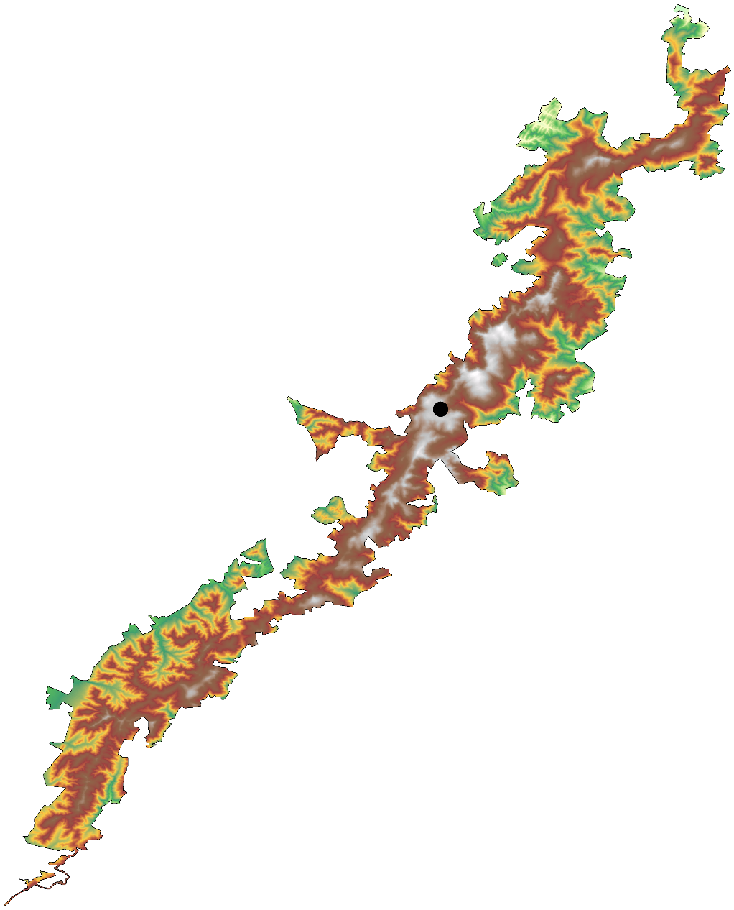
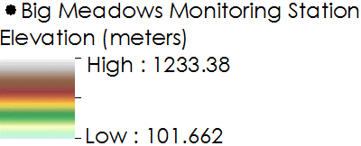
Big Meadows Monitoring Station
Video
Credit: Shenandoah National Park
Notes:
Julie:
The Park service currently relies on one air quality station near Big Meadows, in the central part of the park, to assess air quality for all of Shenandoah. This video shows some of the monitoring instruments that help the park track wet and dry deposition, ground-level ozone, and visibility. Most of the monitoring done at the Big Meadows station is in conjunction with national, interagency networks, including the Environmental Protection Agency’s CASNET program, where we accessed data for our project.

Slide 8
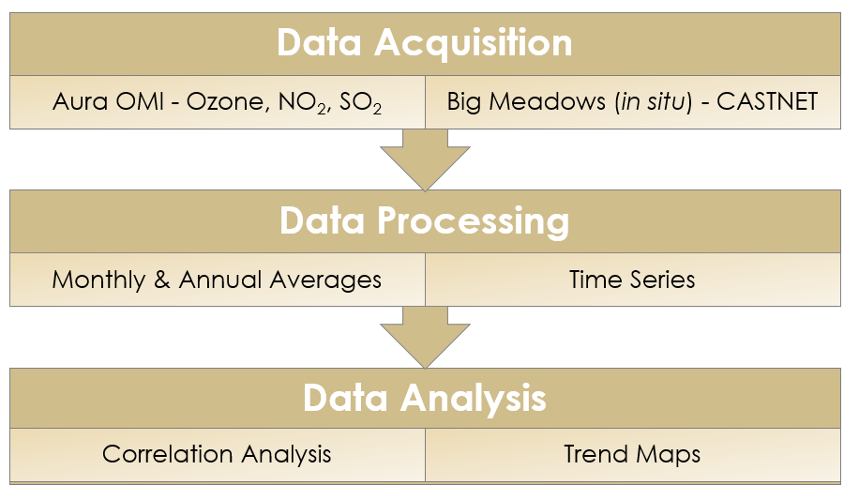
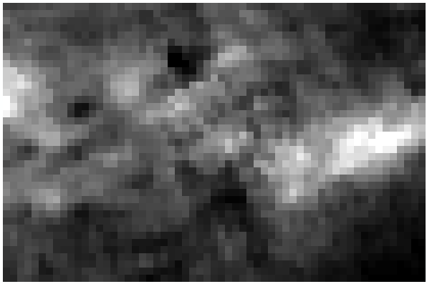
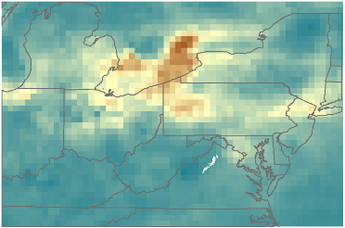
Objectives & Methodology
Identify trends in remotely sensed data of atmospheric measurements
Analyze data on a monthly and annual basis
Create a methodology to visualize data over time
Raw OMI Data
Processed Data
Notes:
Julie:
For our project this summer we compared the ground-level data of Big Meadows air quality station with the remote sensing data of Aura’s OMI sensor. We wanted to take this information and analyze the data both on a monthly and annual basis to help identify atmospheric trends. We also wanted to create a methodology for handling remote sensing data in the park. With the comparison analysis we conducted we were able to create correlation graphs as well as trend maps.

Slide 9
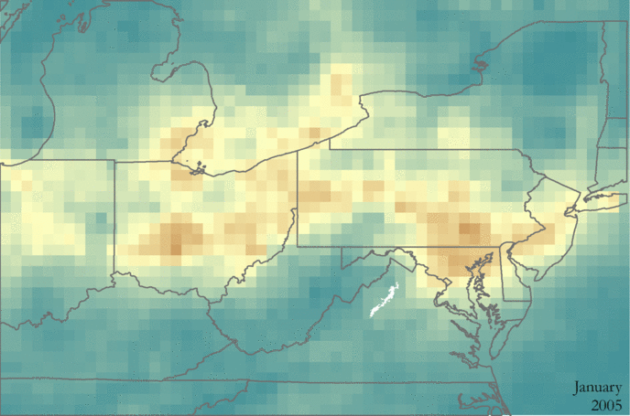
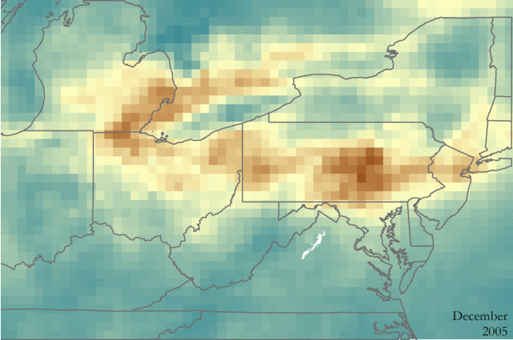
Tropospheric NO₂ 2005-2016
January
December
Molecules/cm²
High: 3.95e+016
Low: 0
Notes:
Julie:
Nitrogen Dioxide is not measured at Big Meadows Research Station. Since we did not have in situ to compare our findings to, we chose to process and analyze both total column and tropospheric NO2. We found that total column and tropospheric NO2 were extremely similar, so we are only showing you the tropospheric maps.
Overall, we found that there was more NO2 present in the winter months because of photochemical decomposition. By comparing these two months, we are able to visualize the decline in NO2 levels over the study period. You can see the source areas really well in these maps. We found that NO2 concentrations generally hover over large cities and in regions like the Ohio River Valley, which could drift and affect Shenandoah.
---------------------------------------------------------
**speak(point) to source regions (transport paths from source region) – rust belt (Detroit, Cleveland, pittsburg to philly/NYC

Slide 10
OMI Nitrogen Dioxide
Tropospheric | 2005 | 2006 | 2007 | 2008 | 2009 | 2010 | 2011 | 2012 | 2013 | 2014 | 2015 | 2016
AVG NO₂ (mole/cm²) * 10¹⁵ | 4.88 | 3.62 | 3.51 | 2.90 | 2.78 | 3.44 | 2.60 | 2.54 | 2.66 | 2.87 | 2.67 | 2.48
Notes:
Nick:
Here we have our OMI NO2 results. On the top we have a table of the average concentrations of tropospheric over Shenandoah National Park. Below that we have a graph of annual averages of both total column NO2 and tropospheric NO2. As you can see, these lines track each other very well. A likely explanation is that changes in total column NO2 are driven by tropospheric NO2. Displayed on the graph we see a general indication that NO2 values have been decreasing since 2005.
**changes driven by tropospheric NO2 abundance

Slide 11
Ozone
2005 2006 2007 2008 2009 2010 2011 2012 2013 2014 2015 2016
Notes:
Nick:
These two graphs show ozone around the park. In the top graph, you can see the cyclical trend of total column ozone, with high levels appearing every fall. In the bottom, we graphed data from the OMI sensor Shenandoah, with the ground-level ozone measurements taken at the Big Meadows station in the park. We were not able to see a significant correlation between the NASA Earth observations and the in situ data.

Slide 12
Sulfur Dioxide
2005 2006 2007 2008 2009 2010 2011 2012 2013 2014 2015 2016
2005 2006 2007 2008 2009 2010 2011 2012 2013 2014 2015 2016
Maximum SO₂
Average SO₂
Notes:
Nick:
Finally we have our OMI SO2 results. As you can see displayed there doesn’t seem to be any particular indication of decrease in SO2 concentrations. The top graph shows the satellite data in yellow and the measurements from Big Meadows in orange. The bottom graph compares the maximum and average values from satellite measurements over our study area. We likely do not see much for a trend in SO2 because the levels of sulfur dioxide around the park are at the detection limit for the OMI sensor.

Slide 13
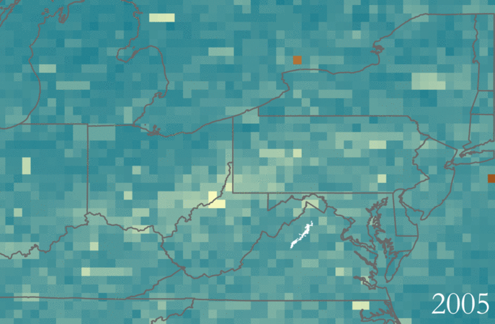
Conclusions
Tropospheric NO₂ Concentrations
Remotely sensed NO₂ exhibited a decrease over time
Ozone showed a cyclical pattern
SO₂ had no distinct pattern, likely due to OMI detection limits
2005 2006 2007 2008 2009 2010 2011 2012 2013 2014 2015 2016
SO₂ Annual Maximums
SO₂ data were not statistically correlated with in situ observations
Tropospheric NO₂ and total column NO₂ were highly correlated
Notes:
Ellen or Nick:
(Need to work on wording/content)
NO₂ contributes to acid deposition while SO₂ is the primary driver for acid rain. Both of these atmospheric parameters tie into the community concerns of our partners at Shenandoah National Park from visibility to park health. The graph shown at the top is the annual tropospheric NO₂ measurements for both the averages and maximums for Shenandoah National Park and its surrounding region. The measurements show a relative decline over the years. The map on the bottom shows the annual maximum values of SO2 over the study period. There appears to be a slight decline, but it is hard to tell because of the low detection limit.
To summarize some of our conclusions, we were able to pick out a decrease over the study period in NO2. Ozone and SO2 did not have this same pattern, but ozone was cyclical.
SO2 and Ozone data were not statistically correlated with the observations from the station at Big Meadows.

Slide 14
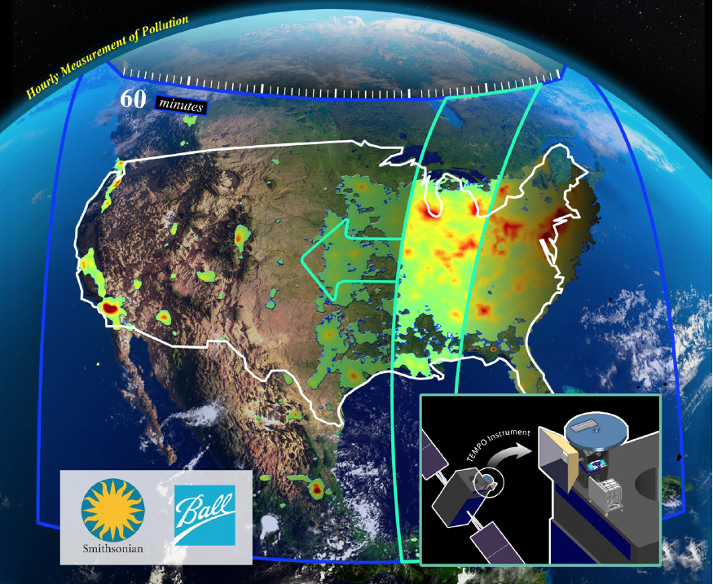
Future Research
Look into methane, formaldehyde, carbon monoxide, etc.
Introduce tropospheric O₃ into analysis
TEMPO
Improved spatial resolution
Measures air pollution
Credit: NASA
Notes:
Ellen:
Our term is the first of two NASA DEVELOP projects that partner with Shenandoah on Health and Air Quality. Our team created maps and analyzed OMI data while creating a methodology to use remote sensing data in the park. The second term will build off of this to study aerosols and visibility, sulfur dioxide and acid rain, and create a visual representation for the data.
Our team believes that there likely is a relationship between ground-level ozone and the ozone sensed from satellites, but the data available to us were not able to show this relationship. Instead, we hope the next term of the project will be able to incorporate tropospheric ozone residuals into their analysis, which theoretically is more likely to correlate with ground-level data.
Limitations of available data focused this project on ozone, nitrogen dioxide, and sulfur dioxide. In reality, there are many other atmospheric parameters that are related to the community concerns addressed here. We have attempted to leave a methodology in the event that other atmospheric parameters have similar quality and availability in the future as remote sensing technology improves. One example of this would be the instrument TEMPO, which will be launched in the future and features improved spatial resolution to study air pollution.
https://fpd.larc.nasa.gov/assets/larc_fpd_tempo_fact_sheet_12_2_16.pdf

Slide 15
Acknowledgements
Project Partners
Jalyn Cummings
Shenandoah National Park
Dr. Barkley Sive
National Park Service
Science Advisors
Dr. Bruce Doddridge
NASA Langley Research Center
Dr. Kenton Ross
NASA Langley Research Center
Notes:
Ellen:
We would like to acknowledge our project partners, Jalyn and Barkley, along with our science advisors, who provided wonderful guidance throughout the project, Dr. Bruce Doddridge and Dr. Kent Ross.

