Slide 1
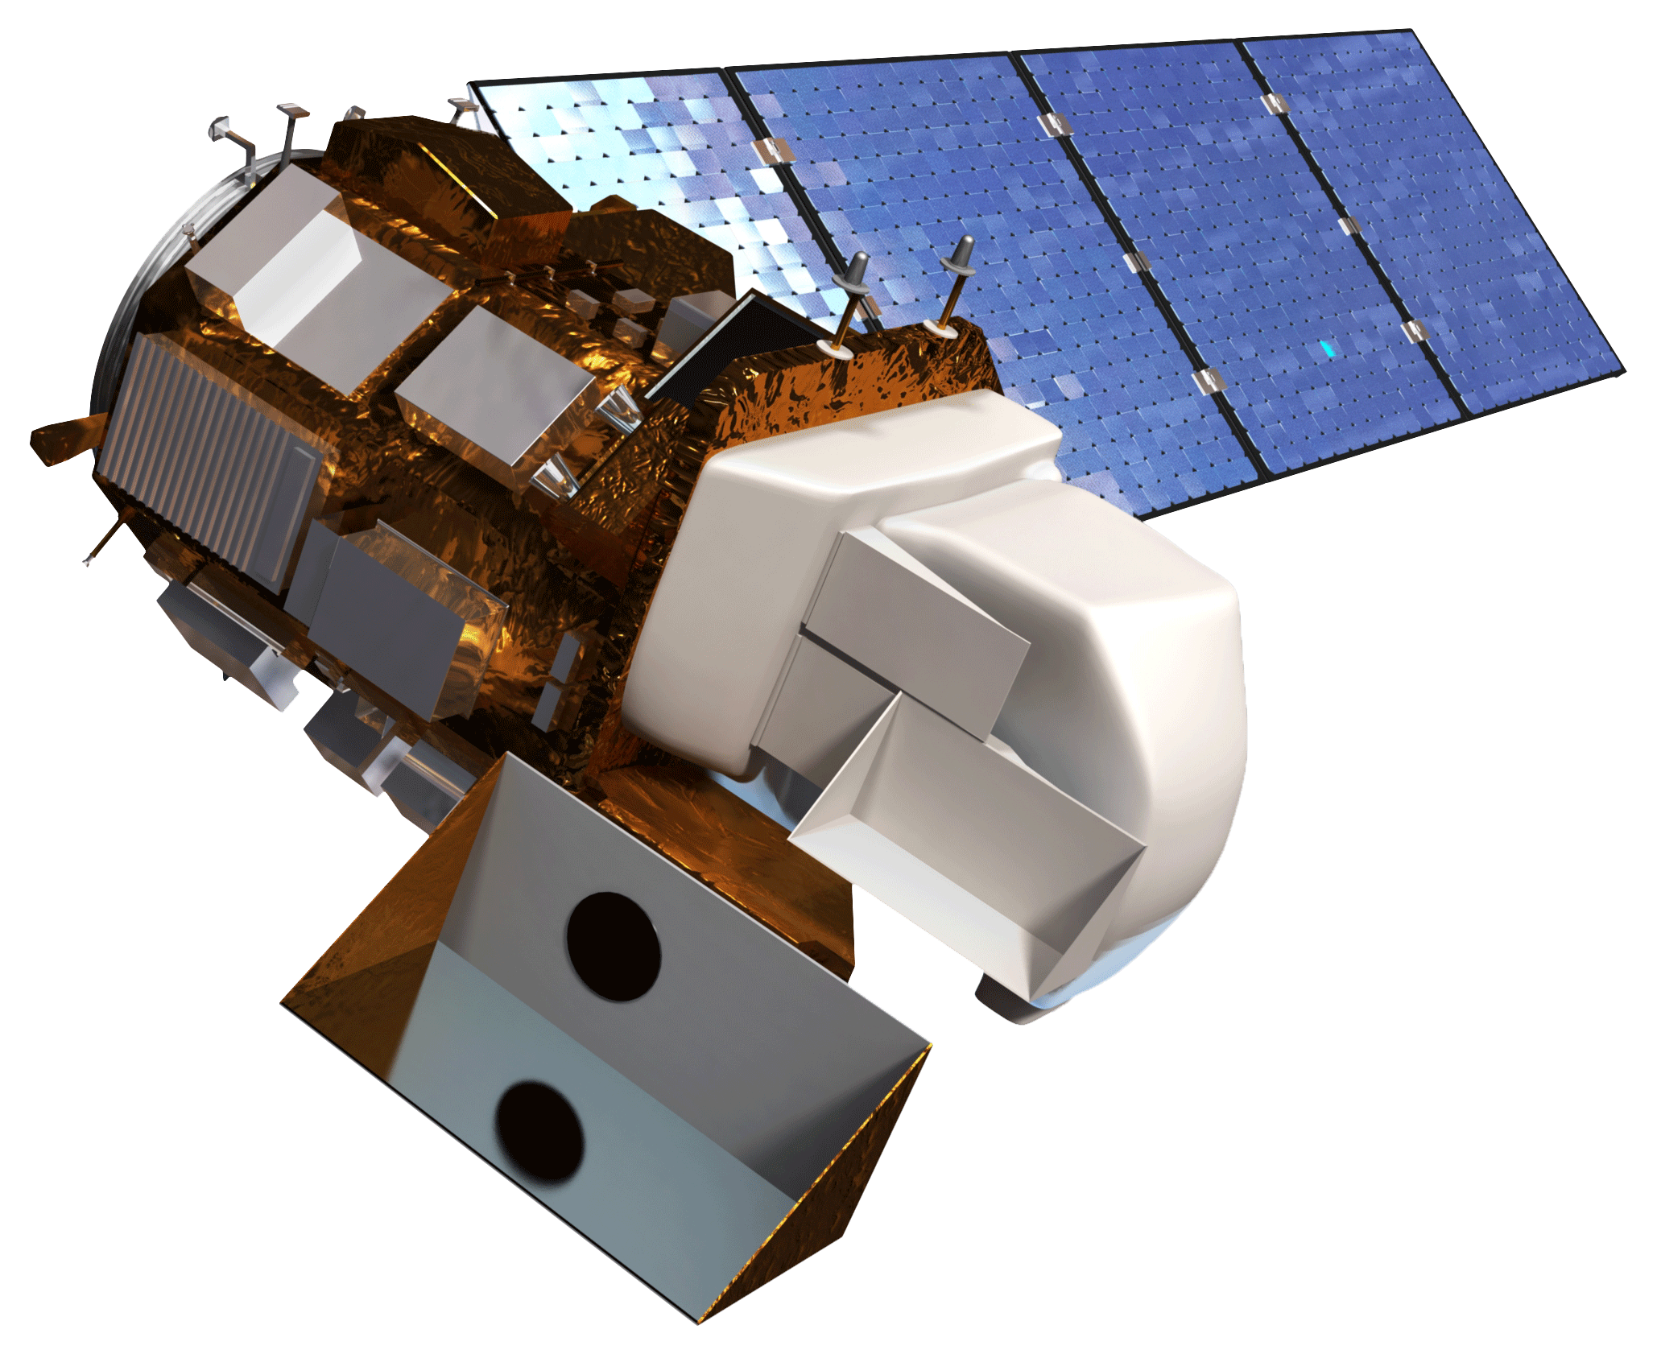
Jeff May (Project Lead)
Jenna Williams
Zachary Simpson
Keith Weber, ISU
John Schnase, GSFC
Mark Carroll, GSFC
Landsat 8 Operational Land Imager (OLI)

Slide 2
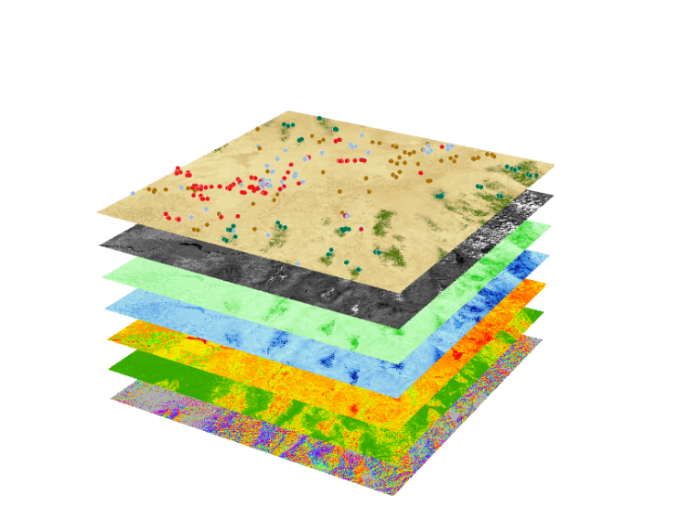
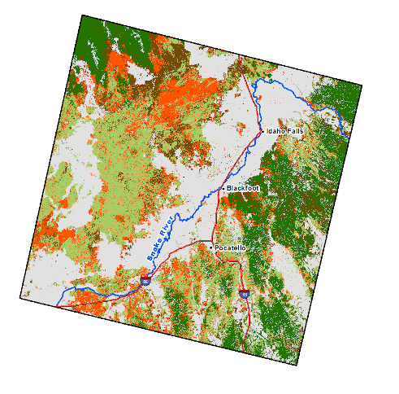
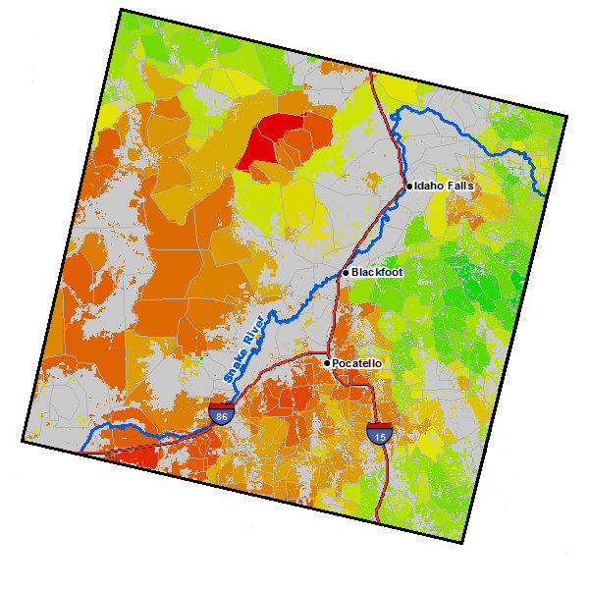
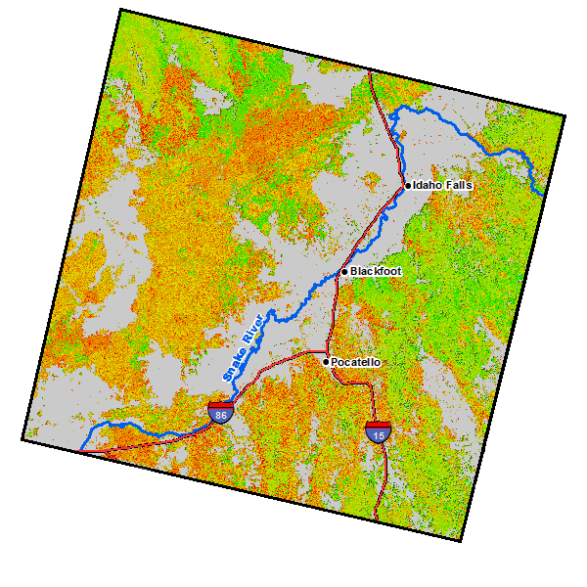
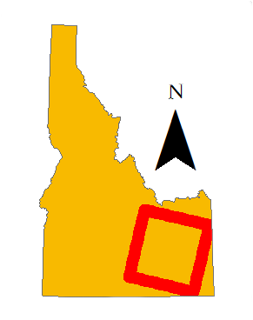
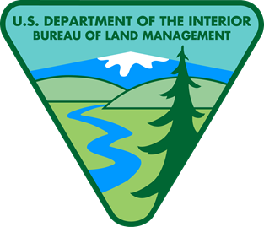
Idaho Disasters III
Using Landsat Earth Observations to identify increased fire hazard due to the invasion of cheatgrass (Bromus tectorum L.)
Methods stack
Point
Classification
NASA RECOVER
Mask
CTA results
Zonal mean FSM
HUC 6 Watershed
NDBSI
brightness
Bare ground
Tassel Cap
greenness
Sagebrush/
Herbaceous
High
Idaho Department
of Lands
mSAVI2
wetness
Cheatgrass
Slope
Montane Forest
FSM per-pixel
Low
Aspect
Study Area, Study Period
Wildfire, coupled with invasive plant species, are a primary drivers of change in semi-arid savanna ecosystems. Cheatgrass has extended fire regimes in southeast Idaho and created a positive feedback cycle with wildland fire, resulting in landscapes that burn more frequently and become increasingly dominated by this invasive plant. These wildfires disrupt ecosystems, human localities, critical habitats of threatened Greater Sage Grouse, and transform sagebrush dominated landscapes into cheatgrass dominated monocultures.
It is becoming more and more difficult for land managers to mitigate fire risk as the wildland urban interface (WUI) expands. The potential for fire risk increases as people build homes in less urbanized areas.
The classified fuel model maintained a 74% overall accuracy with a kappa coefficient of 0.67. A pixel-based fire susceptibility model (FSM) was validated against historic fires under the assumption that areas that have higher fire return rates are more susceptible to fire. The model produced a r² value of 0.61.
This study demonstrates that it is possible to identify specific species contributing to increasing wildfire occurrence when that species has phonological characteristic that are different than native vegetation.
These results support decision making processes by our partners with respect to resource allocation and supports post-fire rehabilitation planning and fuel reduction programs.
The study area consisted of the southeastern portion of the Snake River Plain, specifically Landsat WRS-2 path 39 row 30. This study used spring/summer 2013, 2014, and 2015 imagery from Landsat 8 Operation Land Imager (OLI) and decision – tree – based classification to create a vegetation distribution model that identified areas with a high presence of cheatgrass and subsequently created a classified fuel model. This model was combined with topographic variables to produce two fire susceptibility maps that identify which areas are most combustible. One shows fire susceptibility on a per pixel basis while the other indicates fire susceptibility of level 6 hydrological unit code boundaries.

