Slide 1
Natchez Trace
Ecological Forecasting
and Water Resources
Utilizing NASA Earth Observations to Assess Current and Historic Wetlands Extent along the Natchez Trace Parkway
Jennifer Rackley (Project Lead)
Ashley Gideon
Tyler Lynn

Slide 2
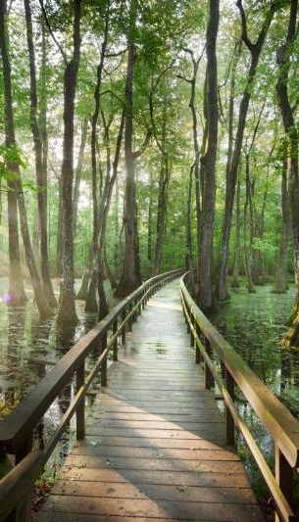
Background
Wetlands provide habitats for hundreds of species throughout the parkway
Beavers (Castor canadensis) are a keystone species for wetland habitats
Parkway quality is a focus for management strategies
Knowledge of historic wetland extents will inform future parkway management
Cypress Swamp
Image Credit: National Park Service
Image Credit: National Park Service
Notes:
The wetlands along the Natchez Trace Parkway are a valuable ecological resource for hundreds of species within the region. Their presence is necessary for healthy species diversity and habitats, as well as the parkway’s scenic and environmental quality. Beavers are a keystone species for wetland habitats - they are capable of drastically altering the landscape to flooded conditions to better suit their needs. While this provides the necessary habitat for wetlands species, this can have important impacts on the parkway quality and adjacent lands by affecting maintenance and damaging property. The National Park Service prioritizes parkway quality in its management strategies, and is currently working to balance beaver populations with maintenance issues. Having a better understanding of historic wetland extents along the parkway will help to inform future management strategies for the parkway.
Image URL: http://www.nps.gov/media/photo/gallery.htm?id=8A813BA3-1DD8-B71C-07EAEA16F240BC89

Slide 3
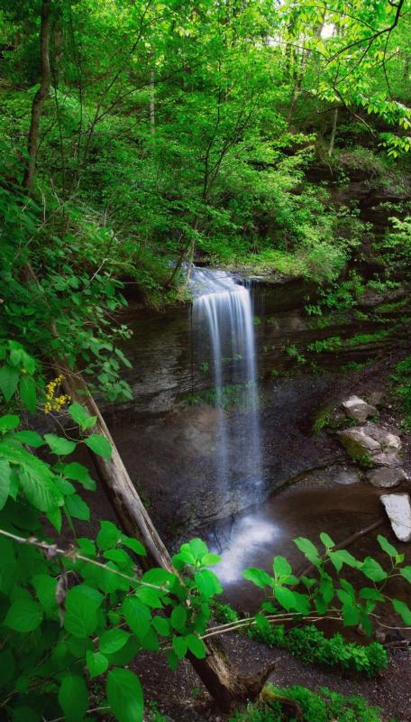
Community Concerns
Management strategy for beaver populations
Beaver damming activity, causing damage to roads, property, and private lands
Historic context for wetland extents along the parkway
Fall Hollow
Image Credit: National Park Service
Image Credit: National Park Service
Notes:
Community concerns included factors which involve the quality of the parkway. The National Park Service is in the process of developing a new management strategy for beaver populations along the parkway in order to better manage their damming activity. Beaver dams have impeded parkway maintenance and impacted the quality of private lands. A historic context for the parkway’s wetland extents is needed for better understanding current wetland and possible future wetland conditions.
Image URL: http://www.nps.gov/media/photo/gallery.htm?id=88B142F5-1DD8-B71C-075F53D23FFAE592

Slide 4
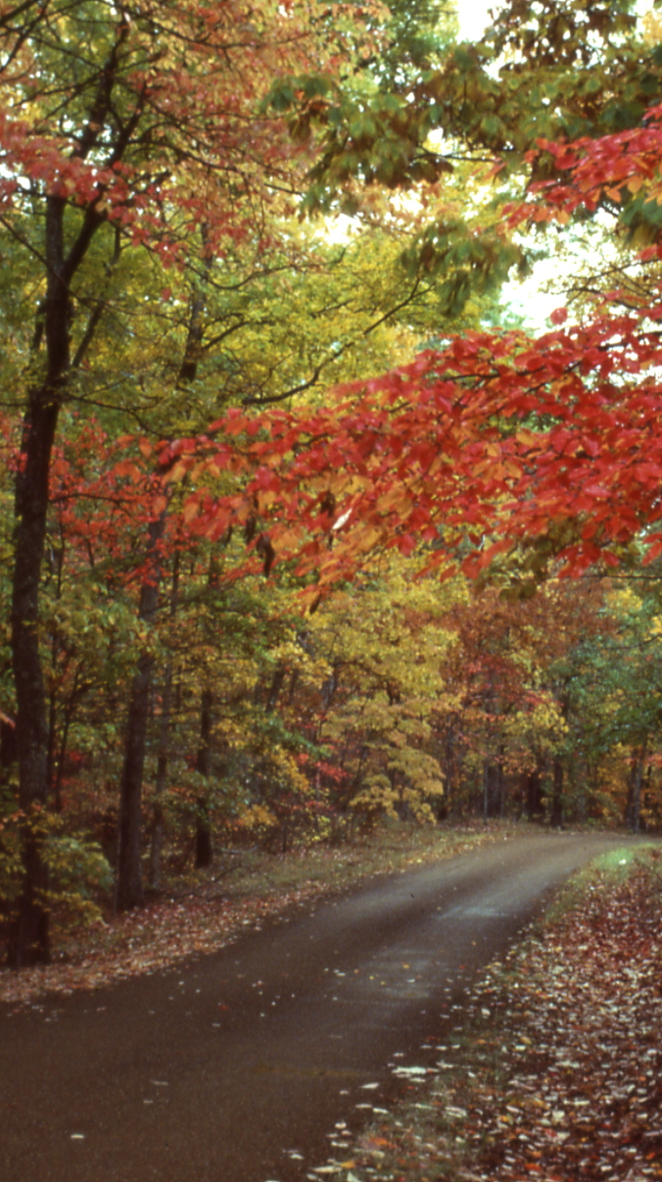
Objectives
Establish historic wetland extents for the Natchez Trace Parkway throughout the years 1992 to 2015
Provide information for past and future wetland extents to aid the National Park Service in conservation management and maintenance strategies
Address community concerns resulting from beaver damming activity, which has caused damage to roads, property, and private lands
Image Credit: National Park Service
Notes:
Our objectives for this project were to establish the historic wetland extent for the parkway over a 23-year period, from 1992 to 2015. We also wanted to examine both past and future contexts for wetland extents to provide a management resource for the NPS for both conservation and maintenance purposes. This project addressed community concerns about parkway and land quality due to beaver damming activity, which has affected wetland extents.
Image URL: http://www.nps.gov/media/photo/gallery.htm?maxrows=20&showrawlisting=false&tagid=0&id=88B142F5-1DD8-B71C-075F53D23FFAE592&startrow=21

Slide 5
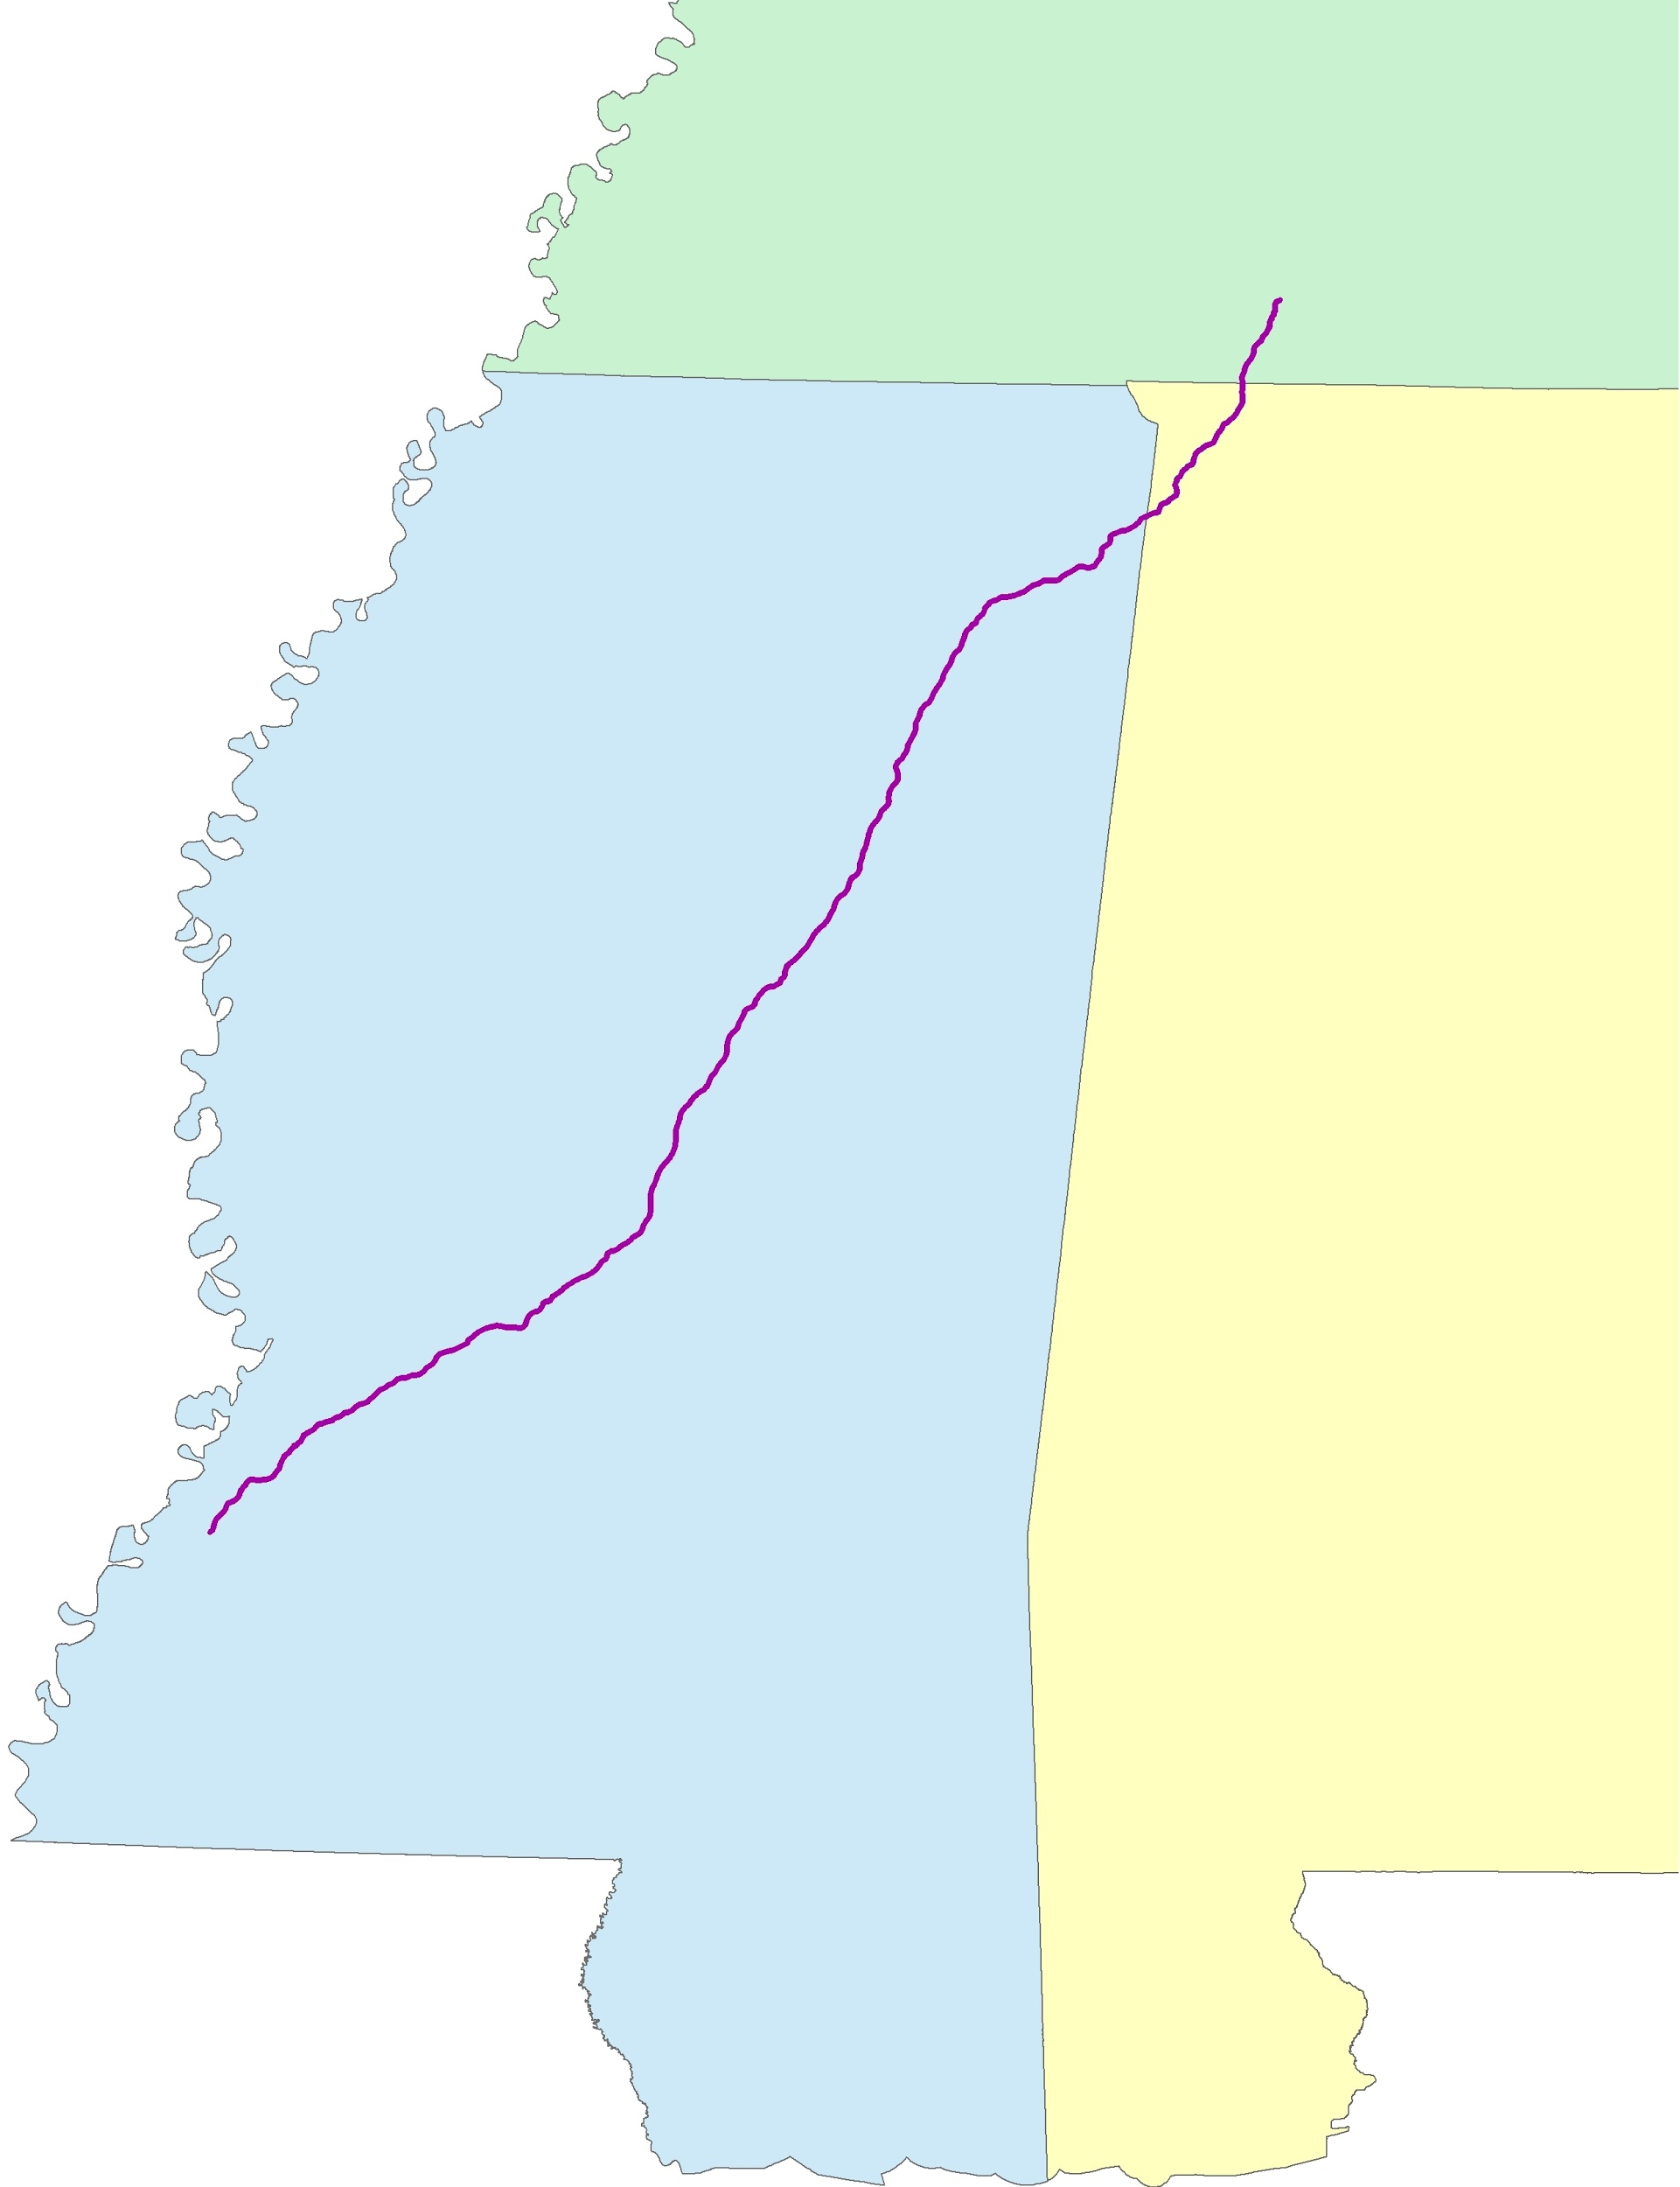
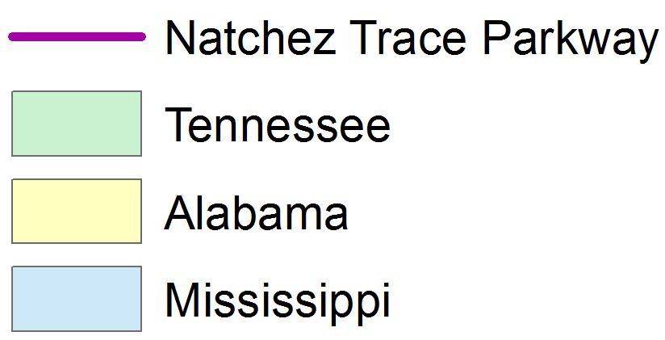
Study Area and Study Period
Parkway contained within Landsat path 22, using rows 36, 37, and 38
Time series years: 1992, 2001, 2006, 2011, and 2015
Modeled result: 2020
Notes:
Our study area was for the majority of the parkway, which was contained within Landsat path 22 and spanned across Mississippi and into portions of Alabama and Tennessee. For the time series, we processed the years 1992, 2001, 2006, 2011, and 2015. Our modeled projection year was for 2020.

Slide 6


NASA Satellites and Sensors
Landsat 5
Landsat 8
Thematic Mapper (TM)
Operational Land Imager (OLI)
Notes:
For this project, we used Landsat 5 Thematic Mapper and Landsat 8 Operational Land Imager data to perform our land cover time series classifications.

Slide 7
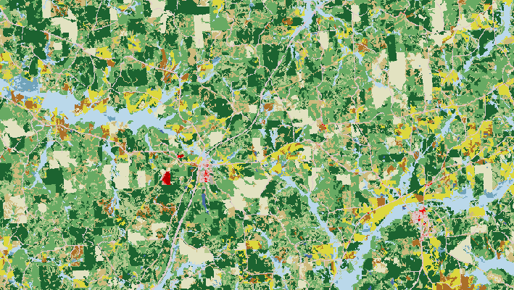
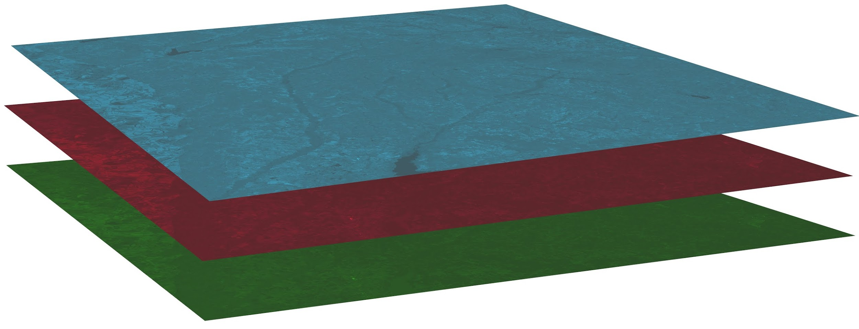
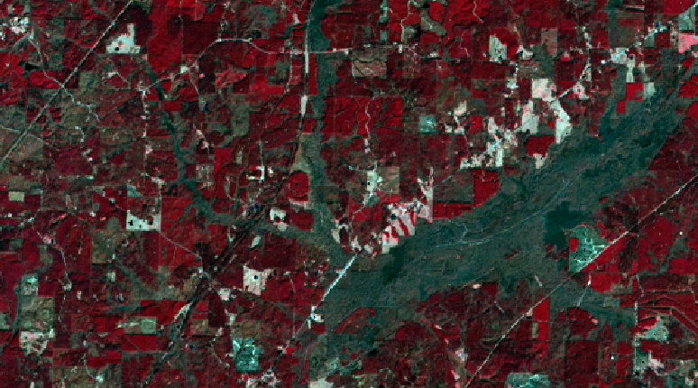
Land Cover Classification Methods
Near Infrared
Visible Red
Visible Green
Accuracy Assessment
Landsat Data
National Land Cover Database
Supervised Classified image
Unsupervised Classification
Supervised Classification
70 classes created
Maximum Likelihood algorithm
Notes:
The land cover classification was performed in ERDAS Imagine 2015 using Landsat 5 and 8 data collected for January or February. DEVELOP Python dnppy scripts were used to make atmospheric corrections. Each Landsat date was stacked using green, red, and near infrared bands. An unsupervised classification was run to automatically converge similar spectral signatures into 70 classes, followed by a supervised classification using the maximum likelihood algorithm. We then performed an accuracy assessment for this classification using land cover data from the USGS National Land Cover Database.

Slide 8
Land Cover Classification
Results
Final classified image
Legend of class categories
Water
Forest
Wetland
Etc...
Notes:
Our land cover classifications were grouped into (8?) categories, including (woody and non-woody wetlands, forest, and impervious). This image shows (name of selected area; discuss changes in this region over time).

Slide 9
LULC Accuracy Assessment
Error Matrix
Error Matrix table
Notes:
100 random points were generated to check the accuracy of the supervised classification. These points were checked against the NLCD data for the study area. An accuracy report produced an error matrix, which compared the amount of random points correctly classified versus incorrectly classified. An accuracy percentage for each class was also produced.

Slide 10
LULC Accuracy Assessment
Classification Accuracy Table
Accuracy Assessment Table
Notes:
From the error matrix, an accuracy table was then calculated to determine the total percent accuracy of the land cover classification for each year. The overall accuracy for (year) was (percent).

Slide 11
TerrSet Land Change Modeler Methods
TerrSet LCM Program
1992 Classified Image
2015 Classified Image
Projected Model for (Year)
Notes:
The projected conditions for 2020 were modeled using the TerrSet Land Change Modeler program using the classified images for our study period’s beginning and ending dates, which were 1992 and 2015. Based on the changes the LCM determined occurred during this time between these dates, the modeler calculated the likely changing conditions in the year 2020.

Slide 12
TerrSet LCM Results
Modeled image of focus area 1
Modeled image of focus area 2
Legend of class categories
Water
Forest
Wetland
Etc...
Modeled image of focus area 3
Notes:
These are selected areas of interest for the National Park Service along the parkway that have historically been difficult to manage or administer maintenance. This slide show the changing wetlands extent for these areas as modeled by the LCM for the year 2020.

Slide 13
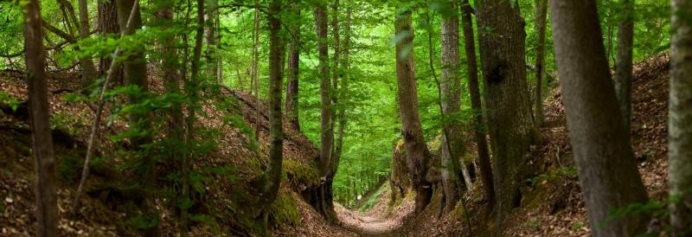
Conclusions
Work in progress
Sunken Trace
Image Credit: National Park Service
Image Credit: National Park Service
Notes:
Image URL: http://www.nps.gov/media/photo/gallery.htm?id=88B142F5-1DD8-B71C-075F53D23FFAE592

Slide 14
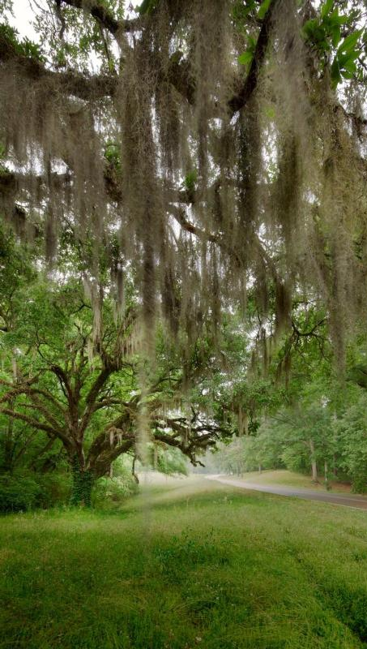
Product Uncertainties
Difficulties discerning similar spectral signatures for different classes
Resolution coarseness prevented aerial identification of beaver dams
Image Credit: National Park Service
Image Credit: National Park Service
Notes:
There were some uncertainties with this project. Some challenges arose when attempting to distinguish between classes with similar spectral signatures, such as with impervious surfaces and barren soil. Additionally, it was initially the goal to identify all beaver dams within our study area from aerial and Landsat imagery. However, this proved prohibitively difficult due to resolution coarseness and leaf cover with available imagery.
Image URL: http://www.nps.gov/media/photo/gallery.htm?id=88B142F5-1DD8-B71C-075F53D23FFAE592

Slide 15
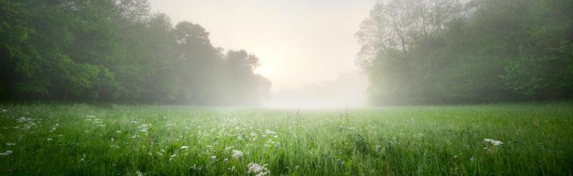
Image Credit: National Park Service
Future Work
Expanding study area buffer
Including all portions of parkway
Modeling for more future years
Including more use of known beaver presence
Notes:
Future work could include expanding the project study area. This could mean increasing the buffer size around the parkway, in the interest of identifying problems in outlying areas which could potentially create problems within the parkway. The project study area could also be expanded to include all portions of the parkway - this project focused on the portion contained within Landsat path 22. Future work may also include modeling for more years for farther in the future, past 2020. Finally, having more information on known beaver presence on a subsequent project could be useful to locate areas which have the potential to become more problematic for the National Park Service.
Image URL: http://www.nps.gov/media/photo/gallery.htm?id=88B142F5-1DD8-B71C-075F53D23FFAE592

Slide 16
Advisors
Joe Spruce (NASA Stennis Space Center)
James “Doc” Smoot (NASA Stennis Space Center)
Dr. Kenton Ross (NASA Langley Research Center)
Partner
National Park Service (Deanna Boensch)
Mentor
Dr. Bert Eichold, M.D., Dr. PH (Mobile County Health Department)
Notes:
We would like to thank all advisors and contributors for this term’s project! This includes our science advisors, Joe Spruce and James “Doc” Smoot from Stennis Space Center, and Dr. Kenton Ross from Langley Research Center. We’d also like to thank our mentor, Dr. Bert Eichold from the Mobile County Health Department.

Slide 17
Thank You!
Team picture?

