Slide 1
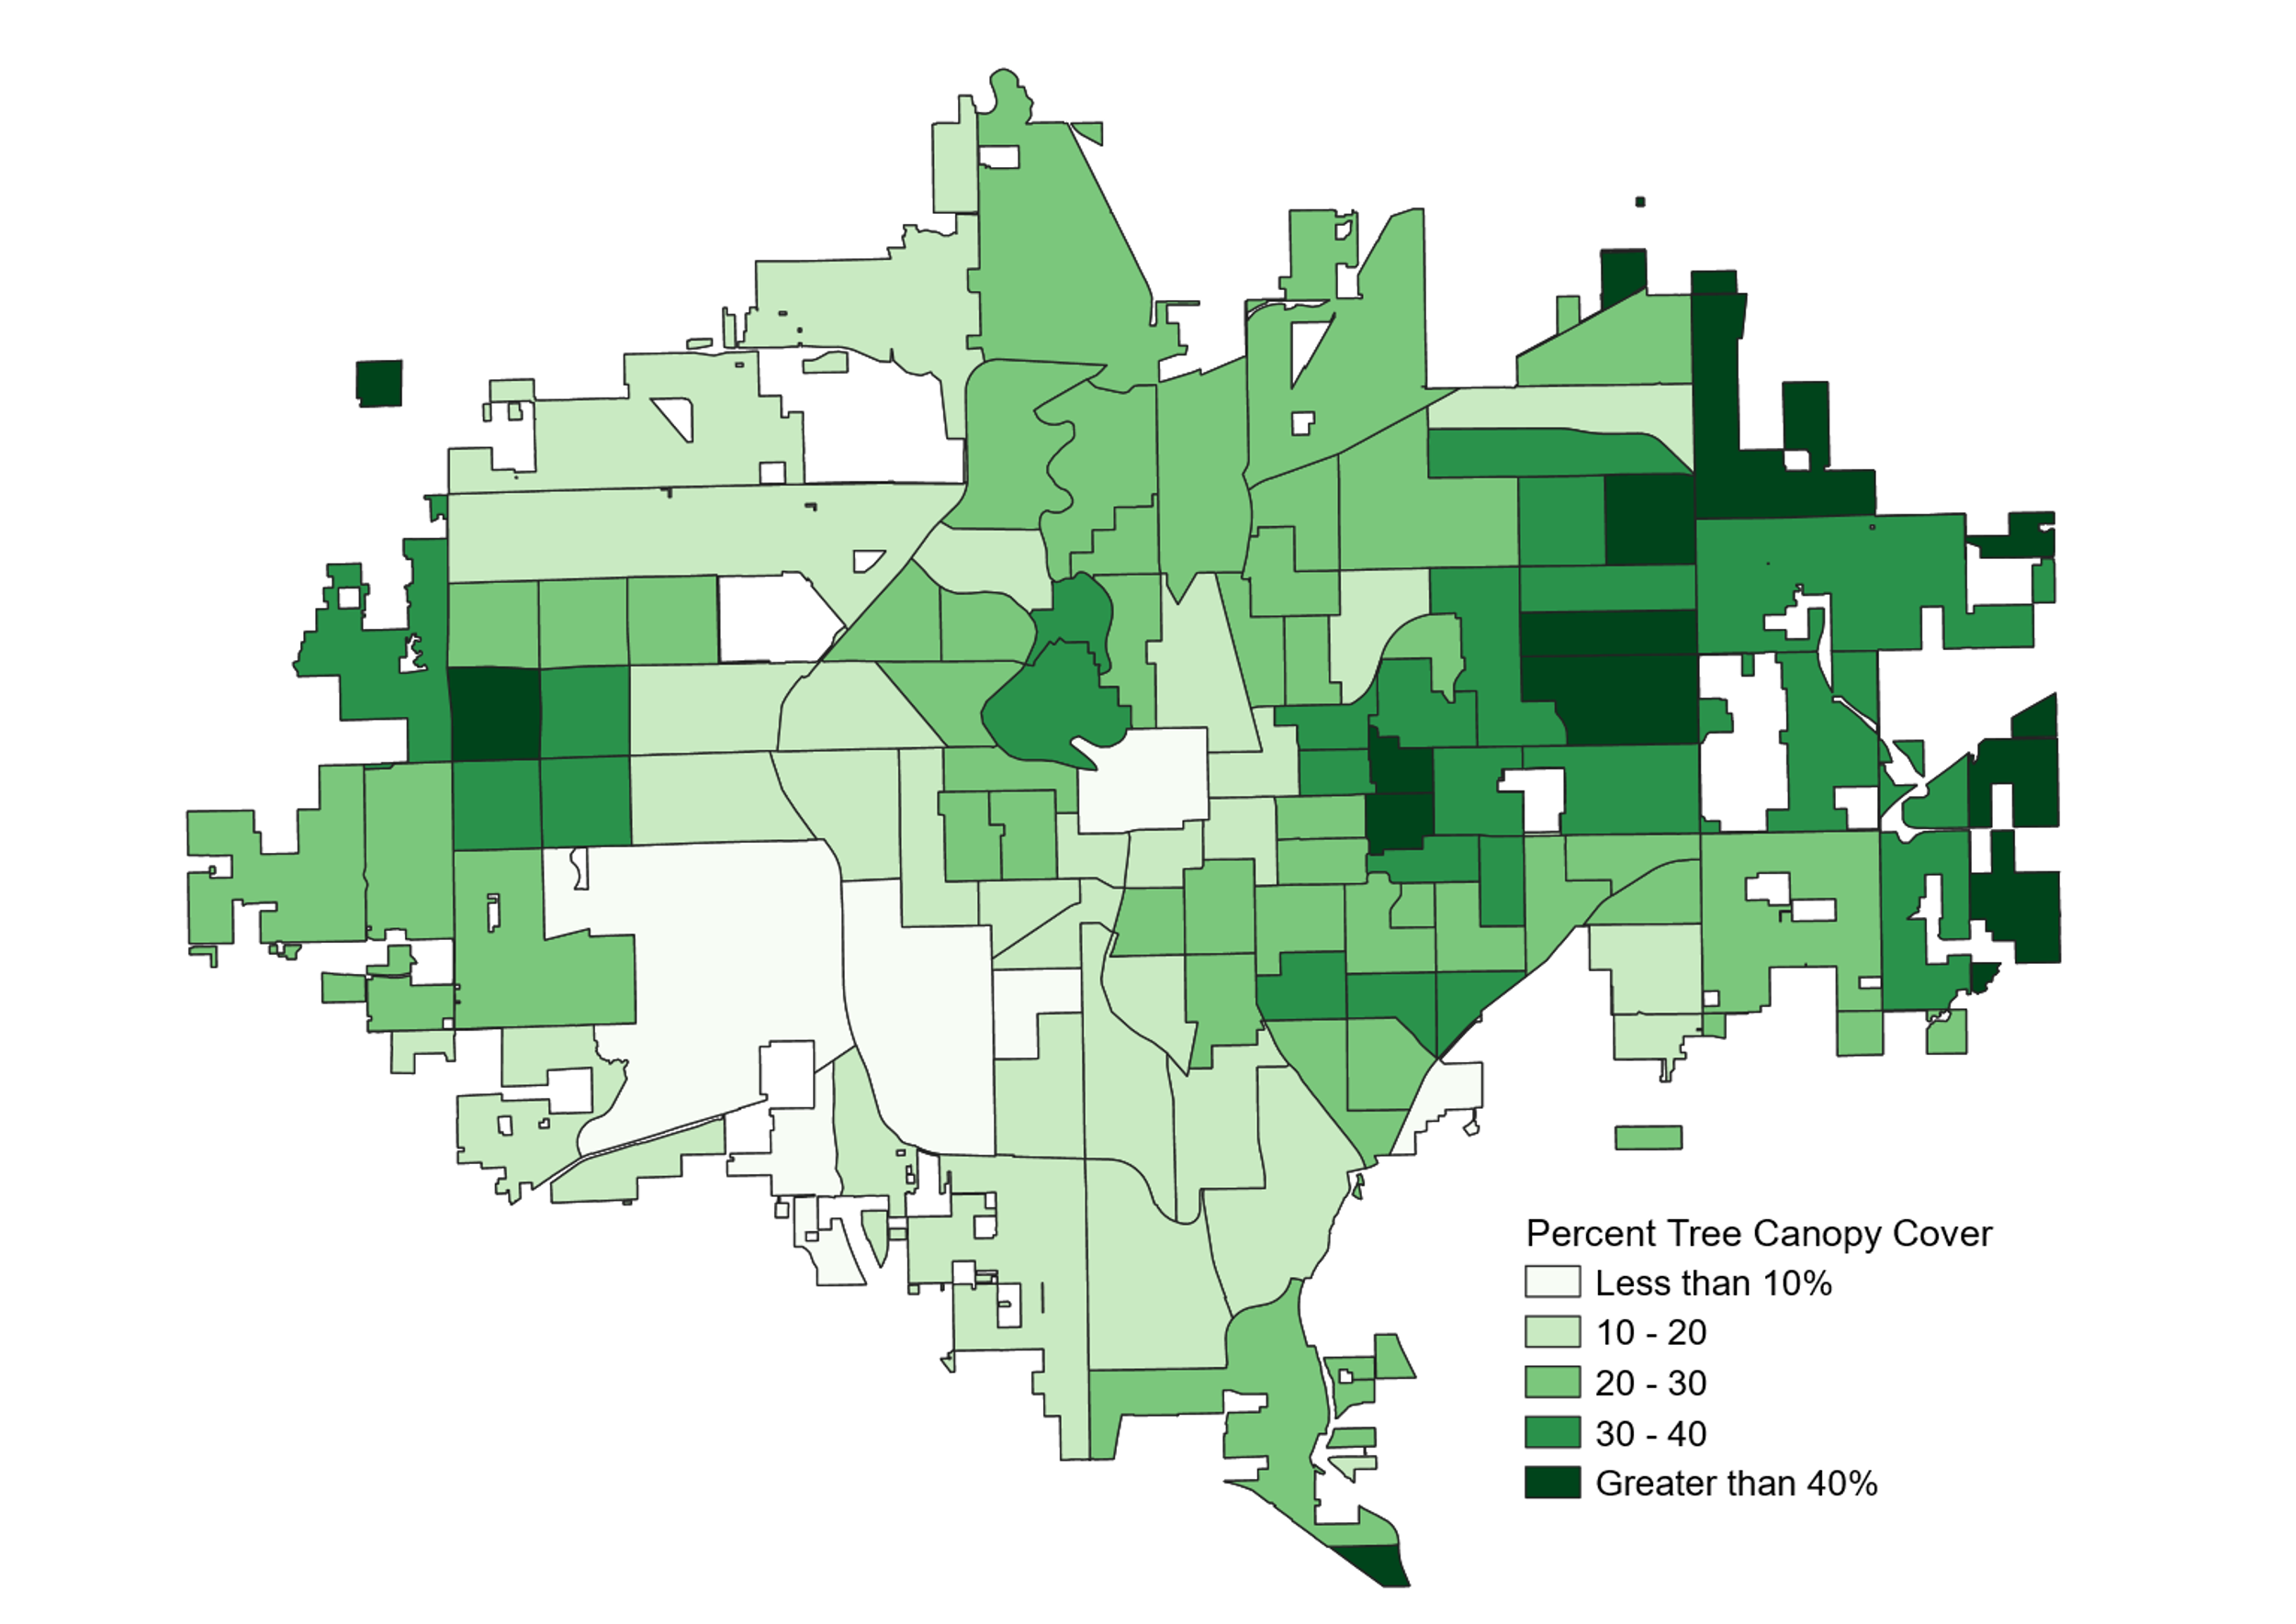
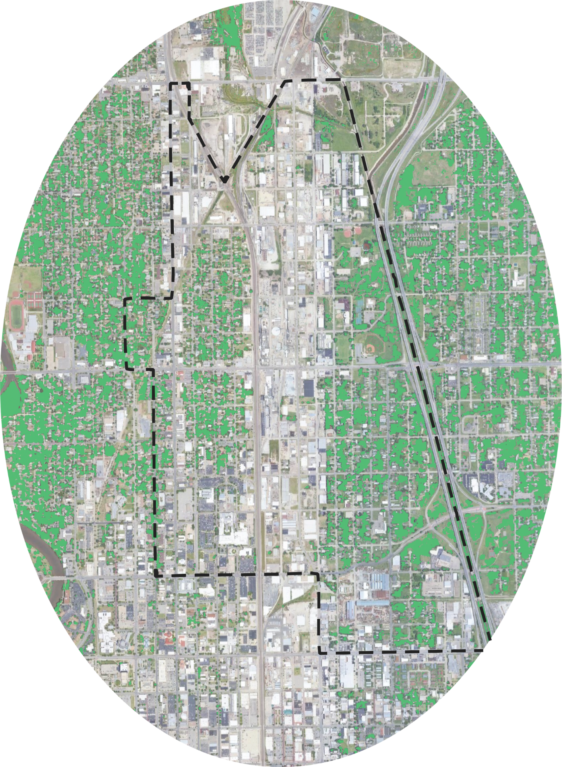
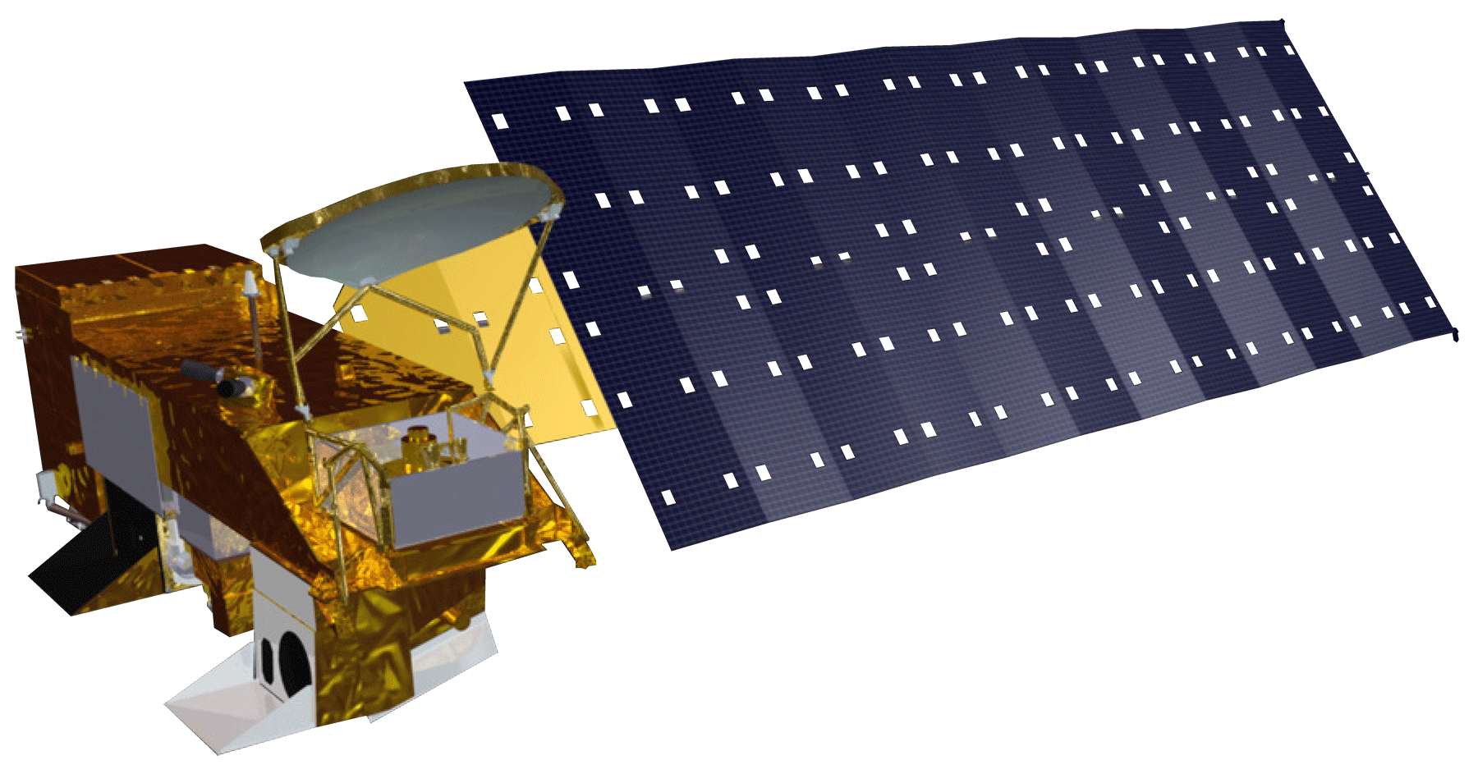
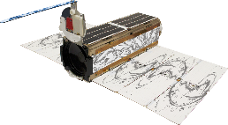
Using Satellite Data to Identify Neighborhoods Vulnerable to Extreme Heat for Equitable Climate Mitigation and Planning
COMMUNITY BACKGROUND
Which communities in Wichita are most vulnerable to EXTREME
HEAT?
ENVIRONMENTAL JUSTICE
Wichita Climate
Wichita’s Climate Adaptation and Mitigation Plan in development
Addressing systemic,
historical environmental inequities
Decreasing tree cover in the city
Community members as equal partners
More extreme and frequent heat events
Action-oriented;
calls for change
CITY LEVEL TREE CANOPY
Heat Risk disproportionately affects
minority and underserved communities
Vulnerabillity map for whole city
For instance, in this census tract:
Historically: redlined by HOLC
Today:
28% are below poverty line
78% are non-white
Environmental Risks:
Heavy metal contamination Superfund site
Limited tree canopy cover
Percent Tree Canopy Cover
Less than 10%
10 – 20
0 2.5 5mi
20 – 30
Source: Google Imagery base map
PlanetScope imagery for pixel
classification courtesy of Planet Labs, Inc.
30 – 40
Greater than 40%
CITY LEVEL HEAT RISK
The City of Wichita can
better allocate heat mitigation resources (tree planting) based on identified high-risk areas
High Vulnerability
Earth Observations
Team Members
Low Vulnerability
Low
Exposure
High
Exposure
Aqua MODIS
Landsat 8 OLI/TIRS
PlanetScope
Acknowledgements
Advisors: Dr. Kent Ross & Lauren Childs-Gleason (NASA Langley)
Partners: Nina Rasmussen (City of Wichita)
Fellow: Marco Vallejos
Assistant Fellow: Remi Work
Image Credits: evi1000(The Noun Project)
Brooke Laird
(Project Lead)
Melissa Ashbaugh
Muskaan Khemani
Sadie Murray
Virtual Environmental Justice
Notes:
Image: Sunrise by evi1000
Source: https://thenounproject.com/icon/sunrise-1806809/
Image: Aerial imagery
Source: Google Imagery base map + PlanetScope imagery for pixel classification courtesy of Planet Labs, Inc.

