Slide 1
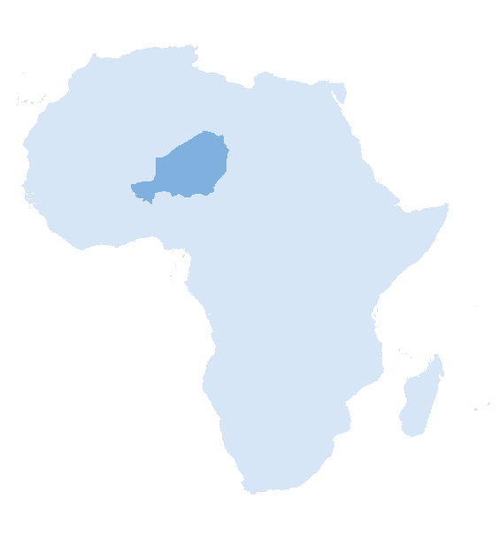
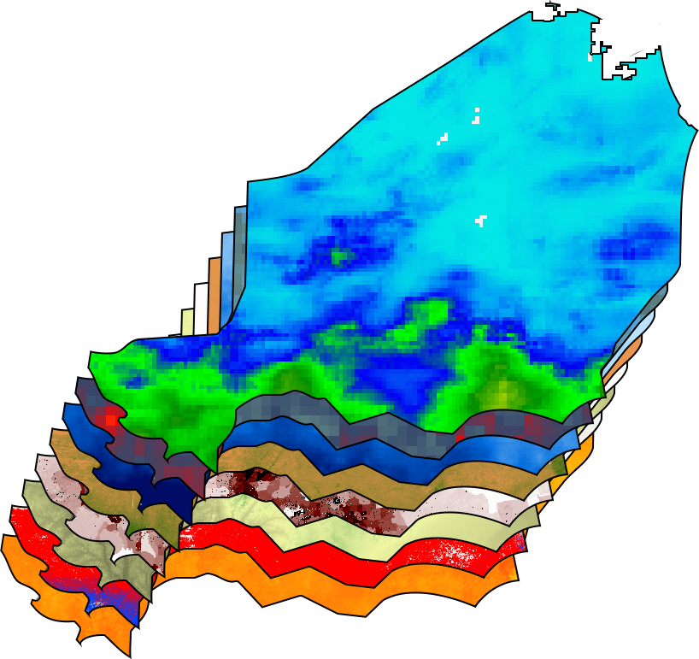
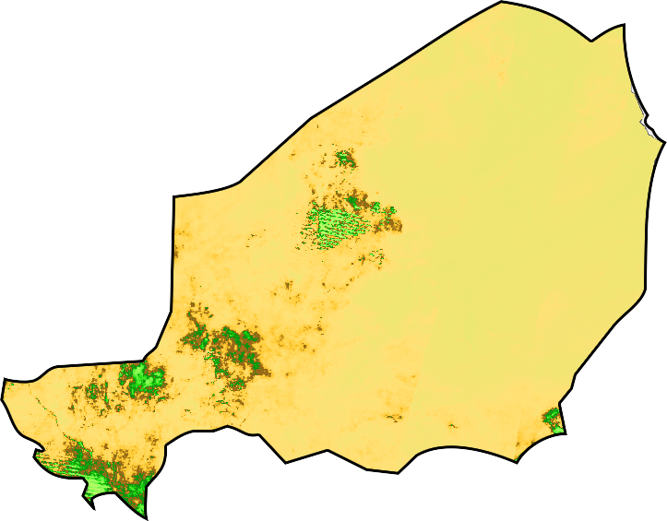
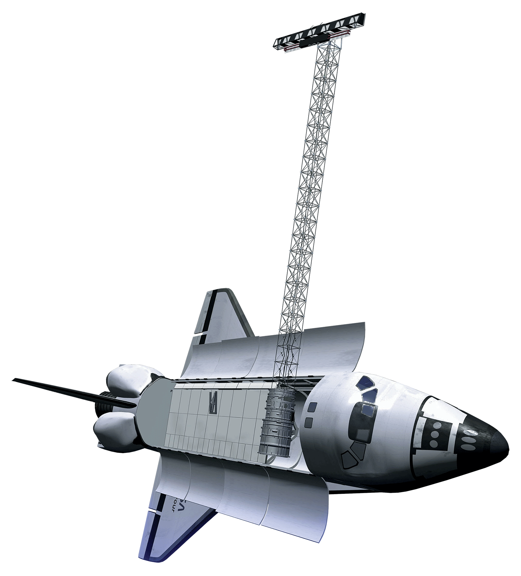
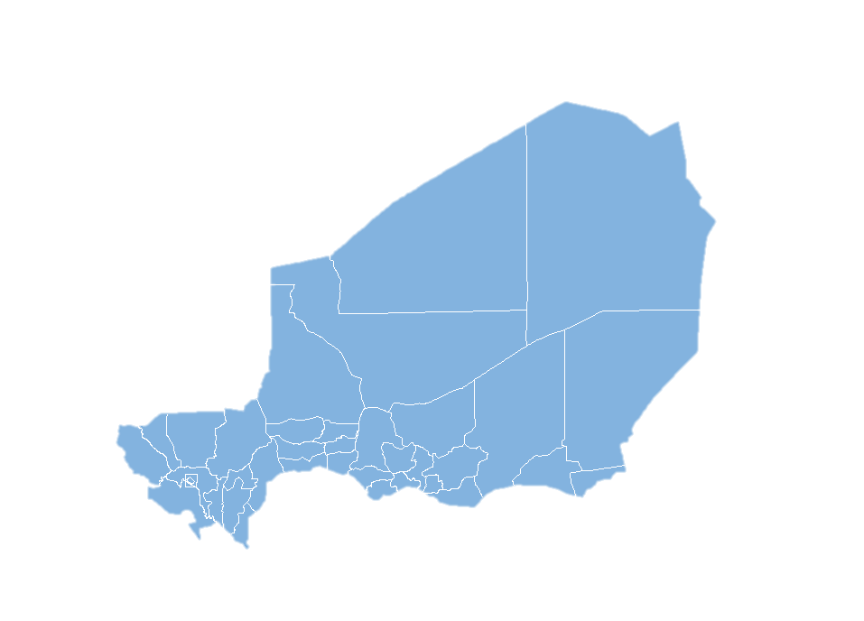
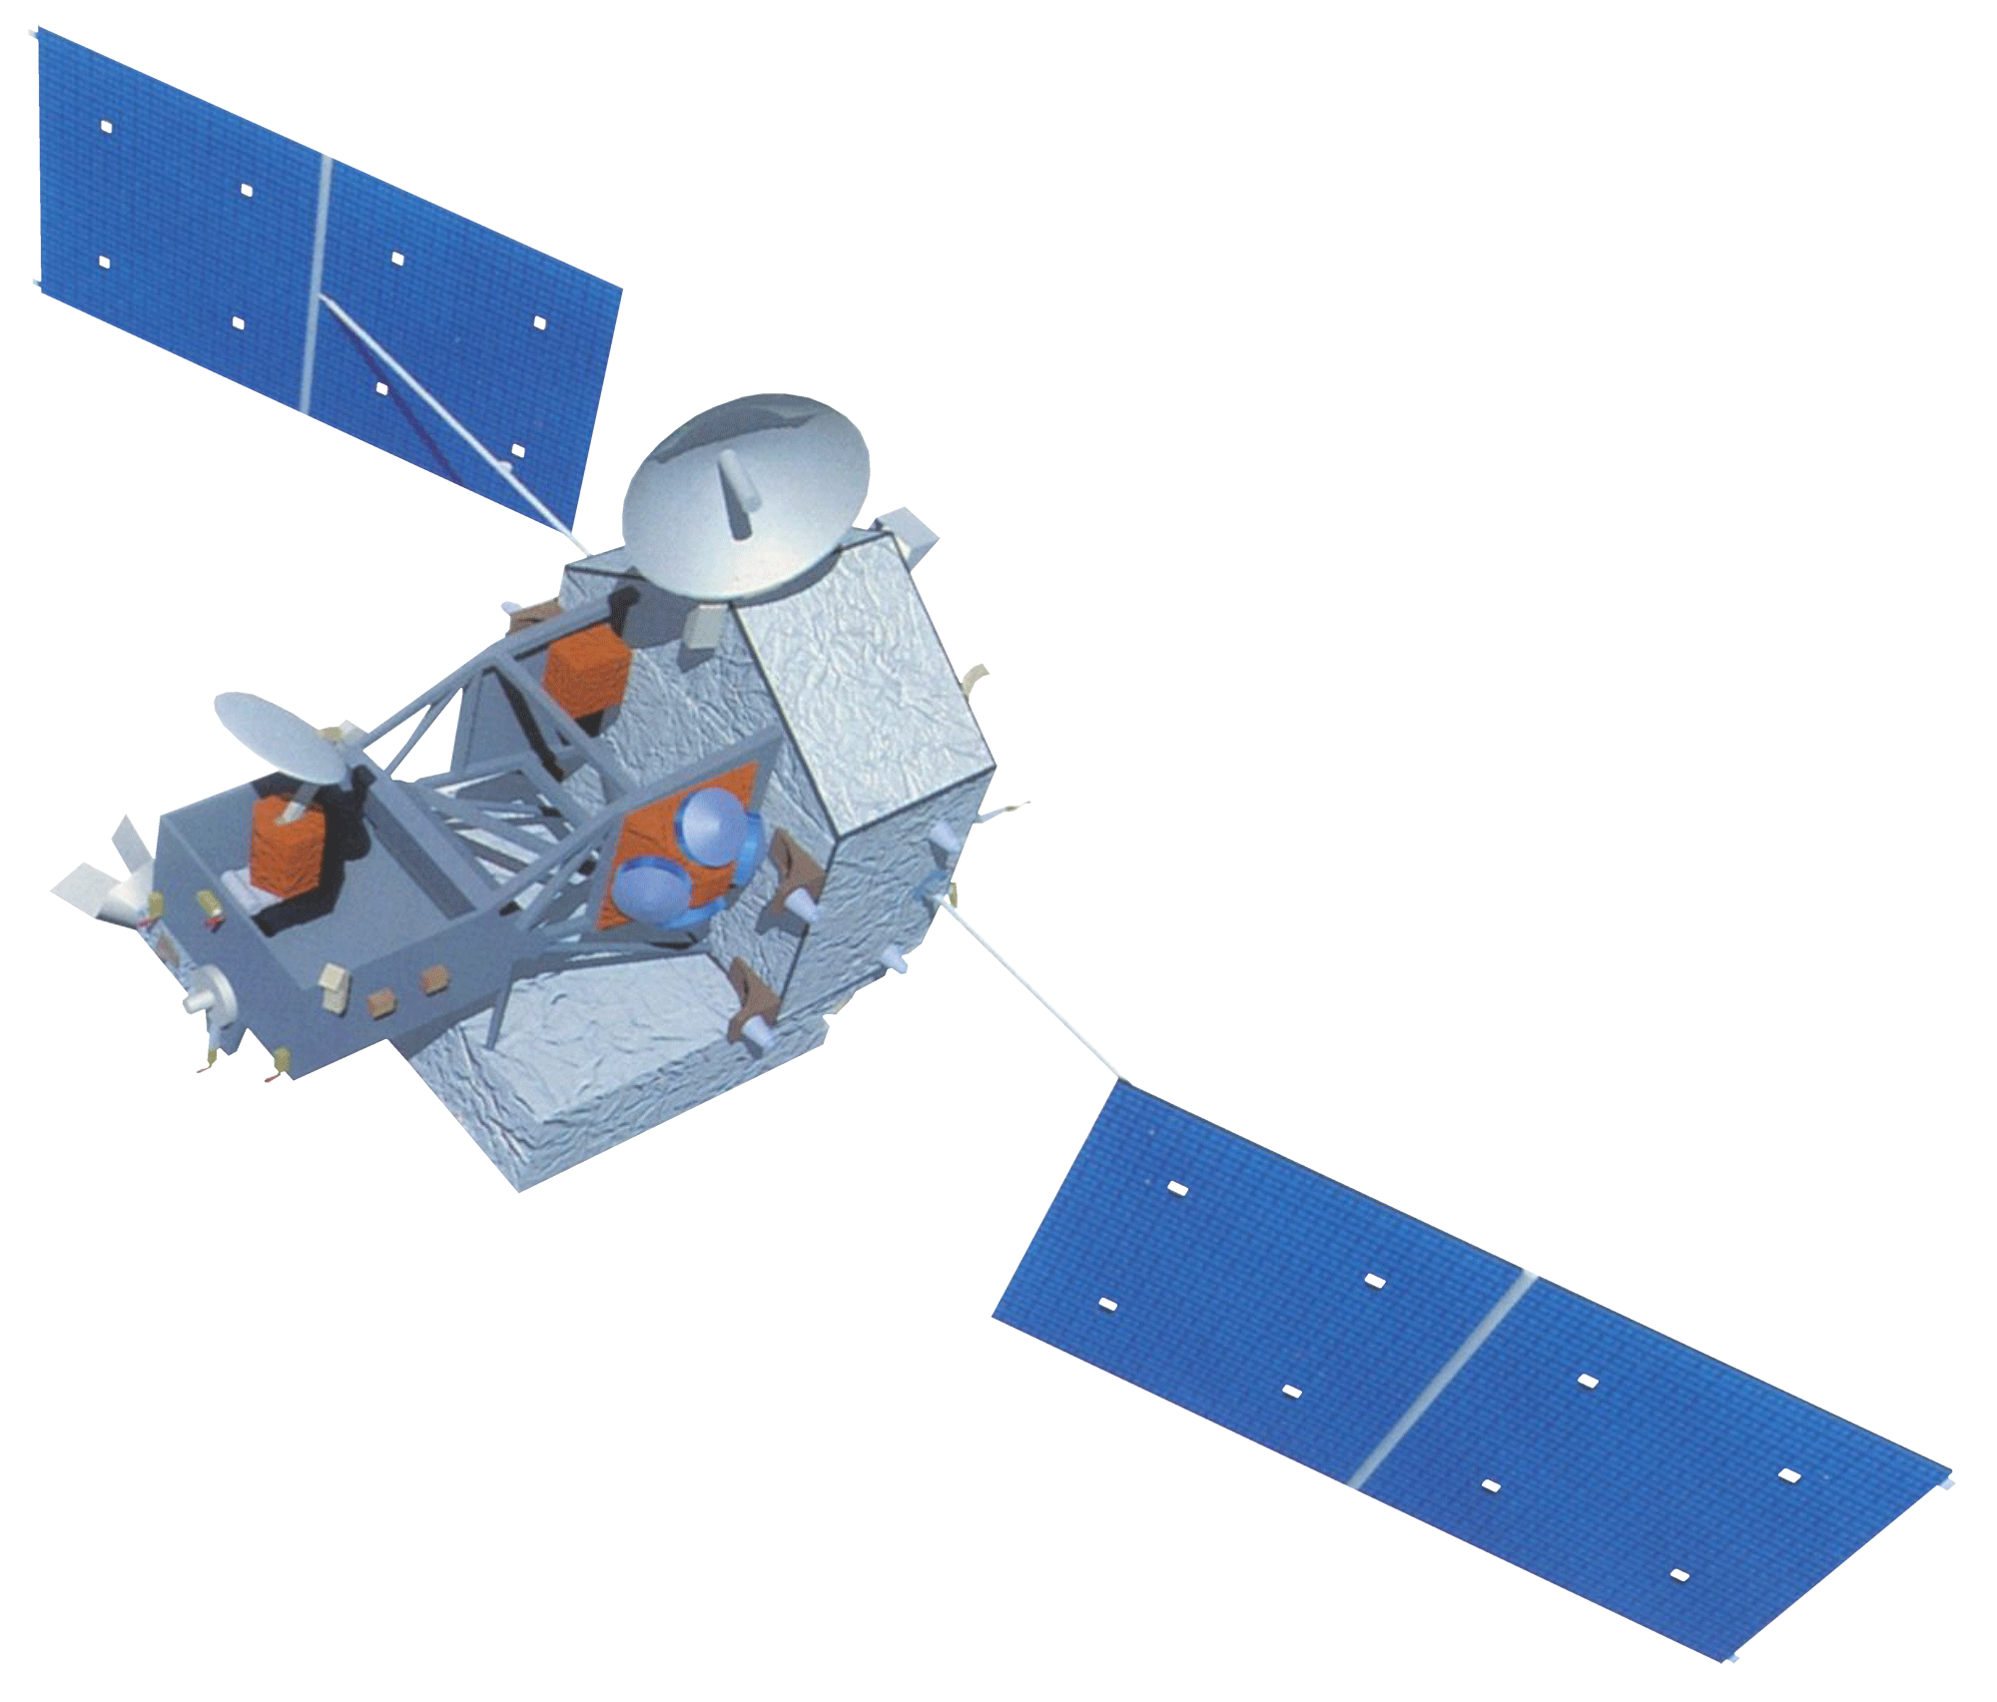
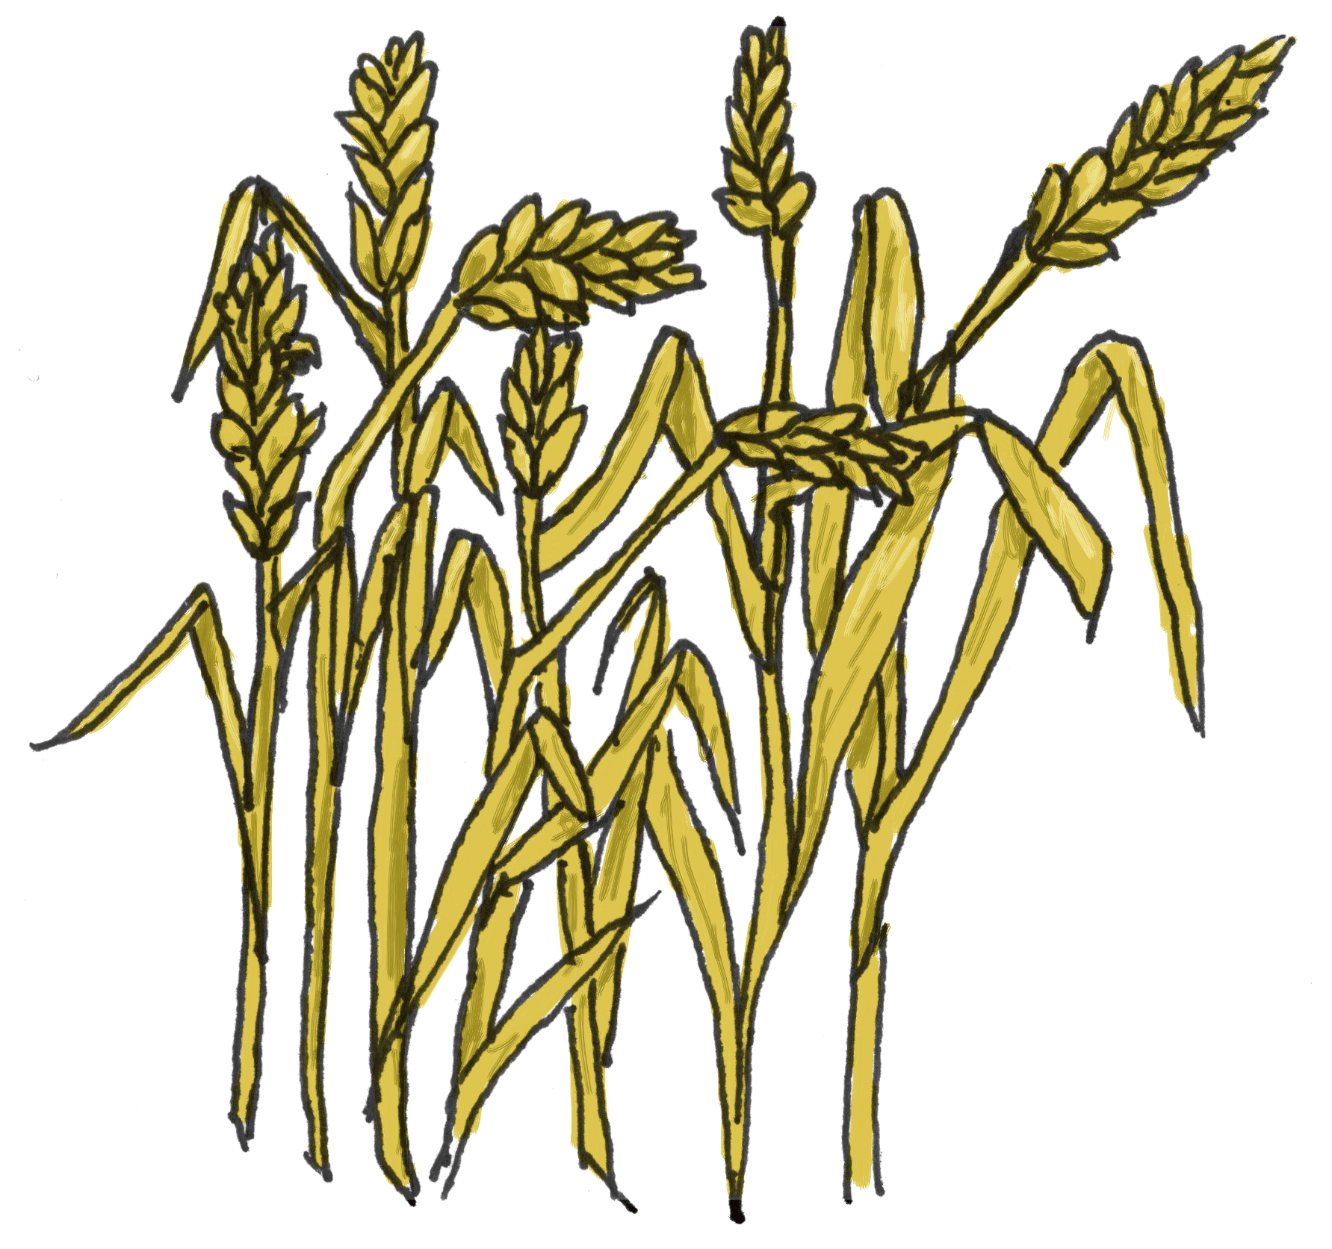
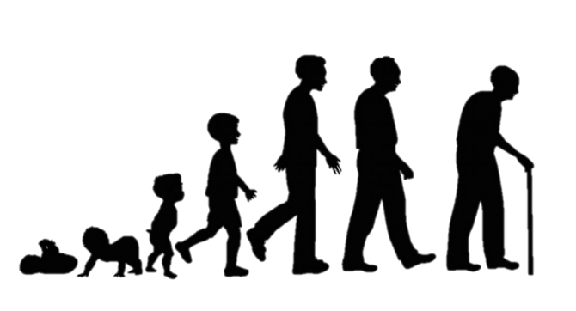
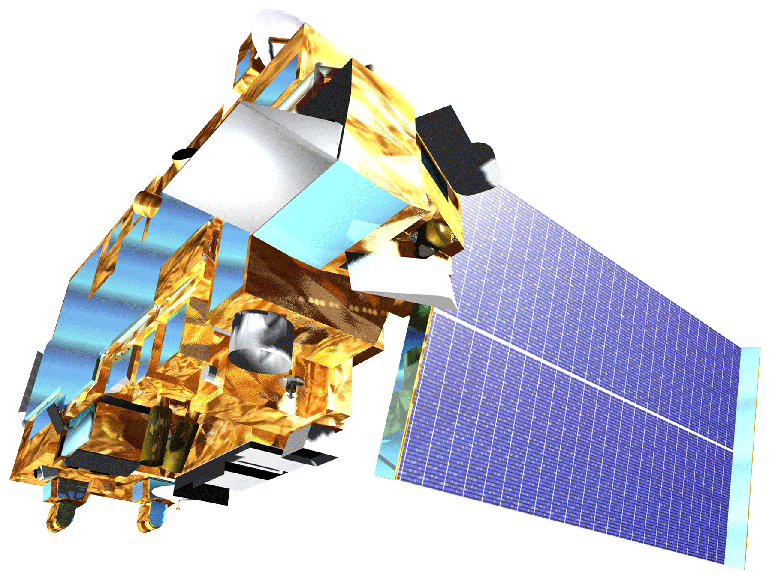
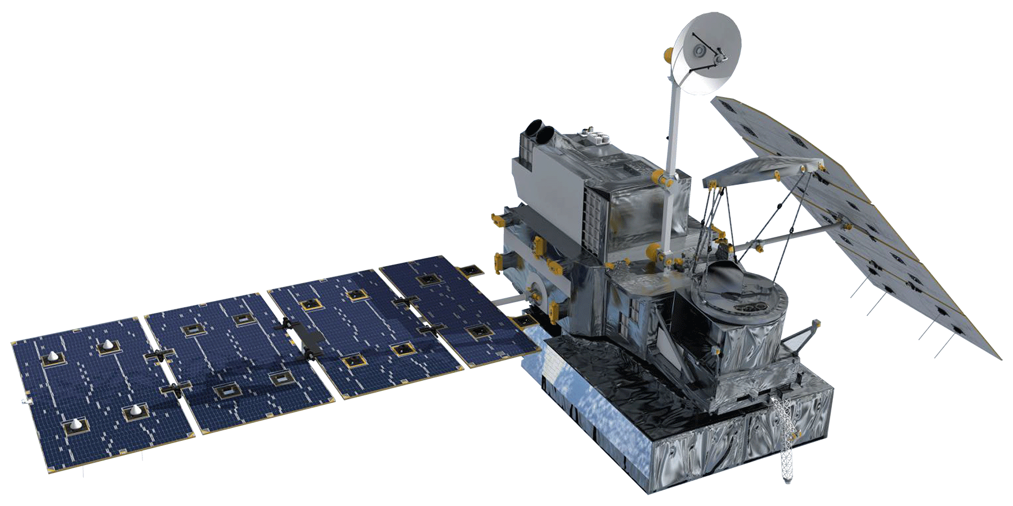
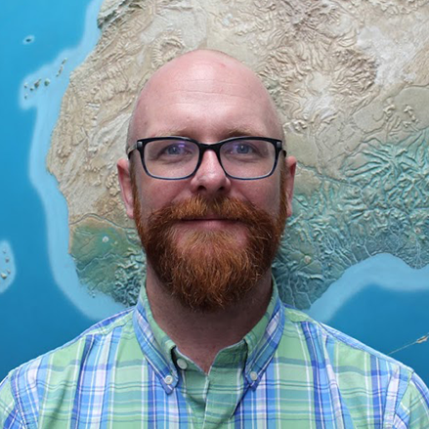
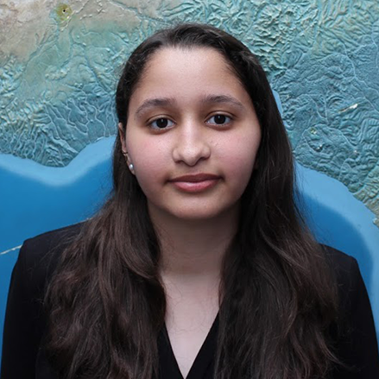
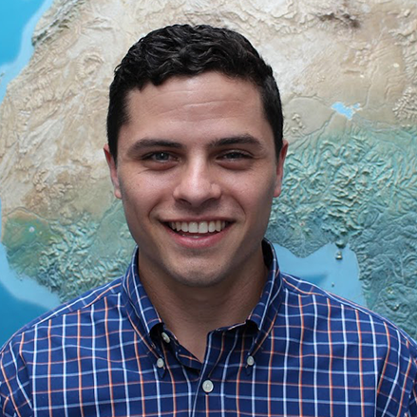
Implementing a Global Tool Based on Spatially Continuous Precipitation
Analysis for Resiliency Monitoring and Measuring at the Community Scale
Abstract
Project Partners
Global water resources are important for societies, economies, and the environment. In Niger, limited water resources restrict the expansion of communities and agriculture. Mercy Corps, a humanitarian aid agency, currently works in over forty countries around the world to address a variety of stresses. These include water resources and building long-term food resilience. A partnership between NASA DEVELOP and Mercy Corps was established as a means to facilitate the integration of NASA Earth observations into Mercy Corps’ resilience building process. Using the Tropical Rainfall Measuring Mission (TRMM), Global Precipitation Measurement (GPM), and Climate Hazards Group InfraRed Precipitation with Station data (CHIRPS), the team created a precipitation climatology that highlights low and high rainfall from 1981 to 2016. A Google Earth Engine tool, RAIn (Rainfall Analysis Integration), was built to help visualize and analyze both environmental and socioeconomic datasets. This tool allows for near real-time updates of trends in precipitation and improves Mercy Corps’ ability to spatially evaluate changes in resiliency by monitoring shocks and stressors.
Mercy Corps
Objectives
Enhance Mercy Corps’ ability to assess the role of precipitation as a shock or stressor in Niger
Address historical precipitation trends to identify the average start of the growing season and significant deviations
Provide an interface for developing a strategy to increase food security for all citizens
Methodology
Study Area & Earth Observations
Drought Index
Precipitation
Land Surface Temperature
NASA Earth
Observations
Africa
SRTM
Niger
Socioeconomic
Data
Niger Water Resources
TRMM
SHOCKS
STRESSES
Terra
GPM
Conflicts over natural resources
Grain and livestock price volatility
Erratic, dispersed rainfall
Loss of pasture and viable land
Results
NDVI harmonic output and Precipitation 2000 - 2003
Rainfall Analysis INtegration (RAIN) – Google Earth Engine
MODIS NDVI
CHIRPS Precipitation (mm)
Precipitation
Malaria
Vegetation
Children
Drought
2000
2001
2002
Conclusions
THEORY OF CHANGE
Harmonic analysis was used to determine the seasonal trends in each agricultural zone.
An interactive map of environmental and socio-economic layers was generated to dynamically query and visualize weekly data.
Team Members
Acknowledgements
Thanks to Théodore Kabore, Sandrine Chetail, Kate McMahon, and Eliot Levine at Mercy Corps for providing guidance in this effort. Additional thanks to James Favors, Dr. John Bolten, Dr. Kenton Ross, Dr. Frederick Policelli, Dr. Eric Brown de Colstoun, Dr. Bailing Li, and Dr. David Green at NASA for their scientific advising throughout the project.
Jared Tomlin
(Project Lead)
Raghda El-Behaedi
Ryan Lingo
Sean McCartney
Alison Thieme
NASA Goddard Space Flight Center – Summer 2017

