Slide 1
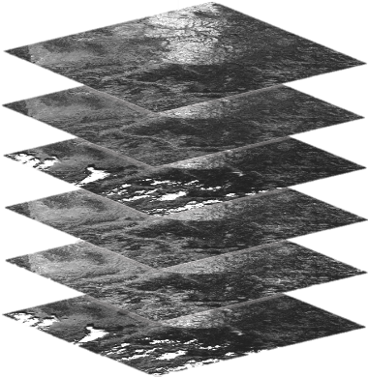
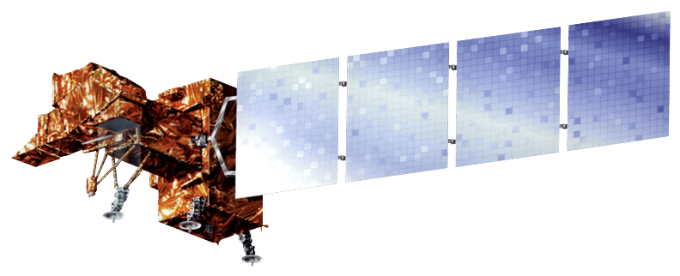
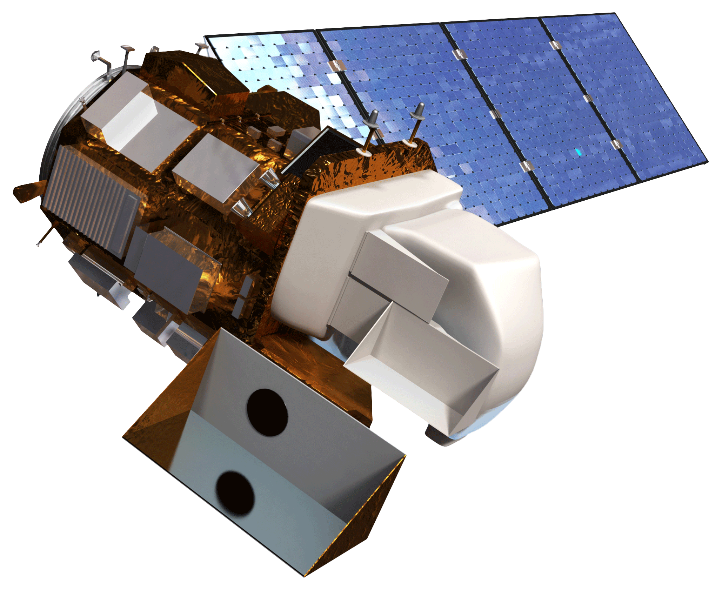
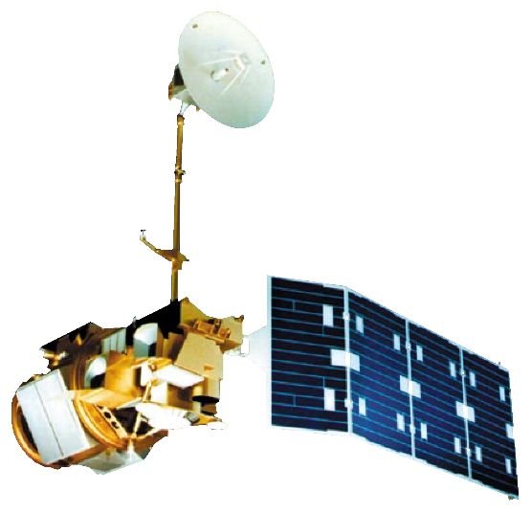
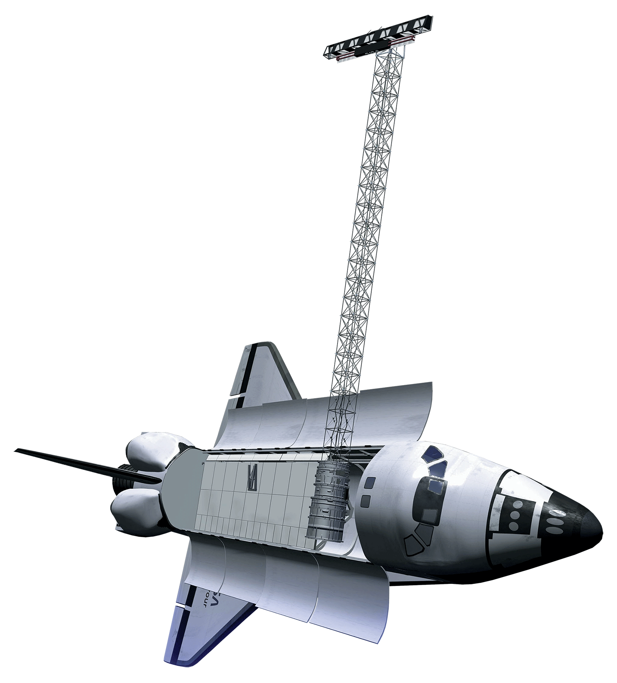
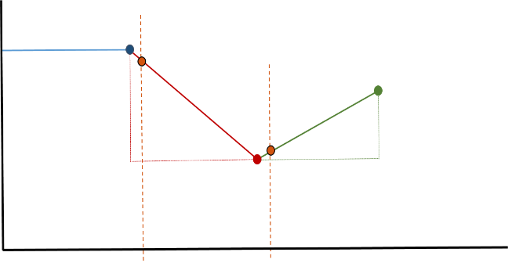
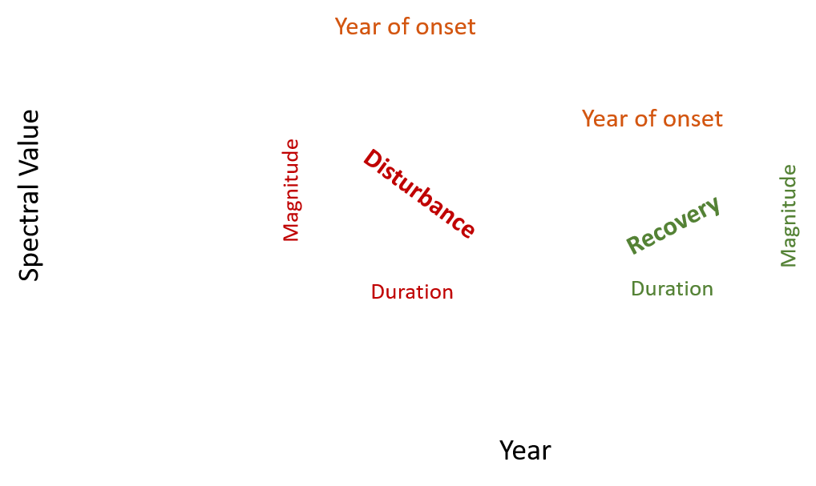
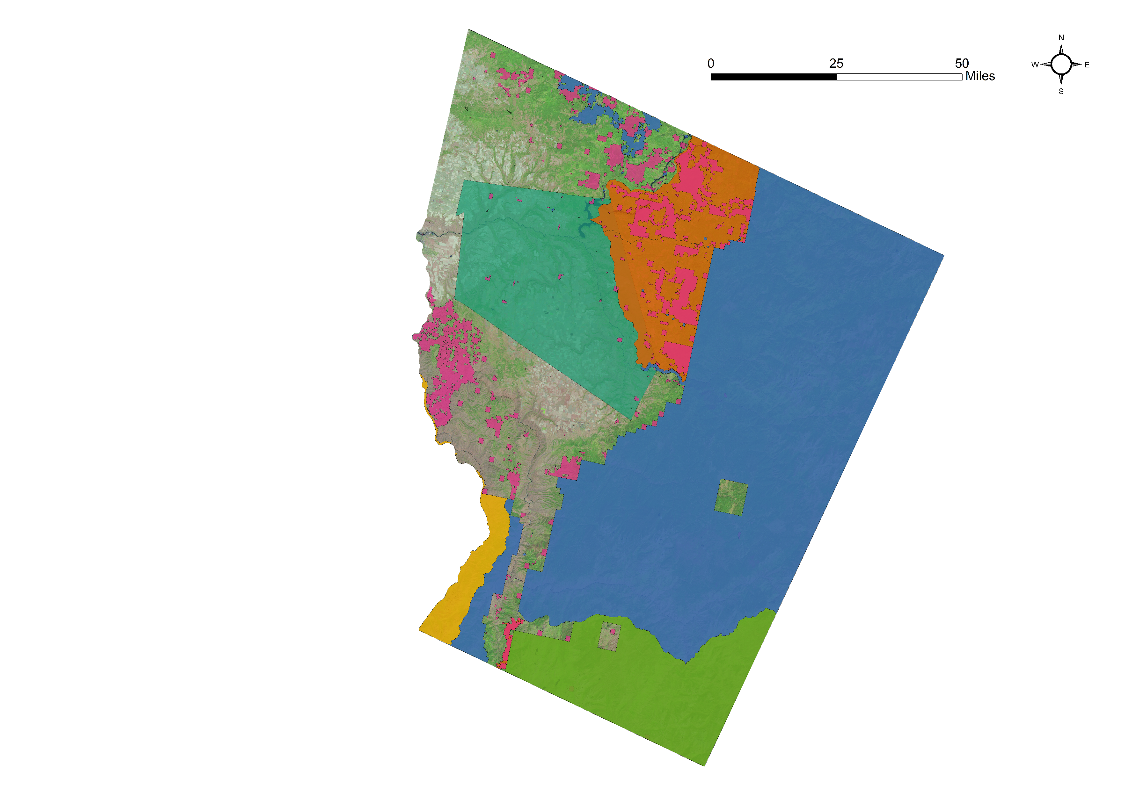
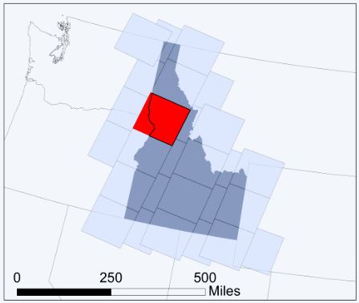
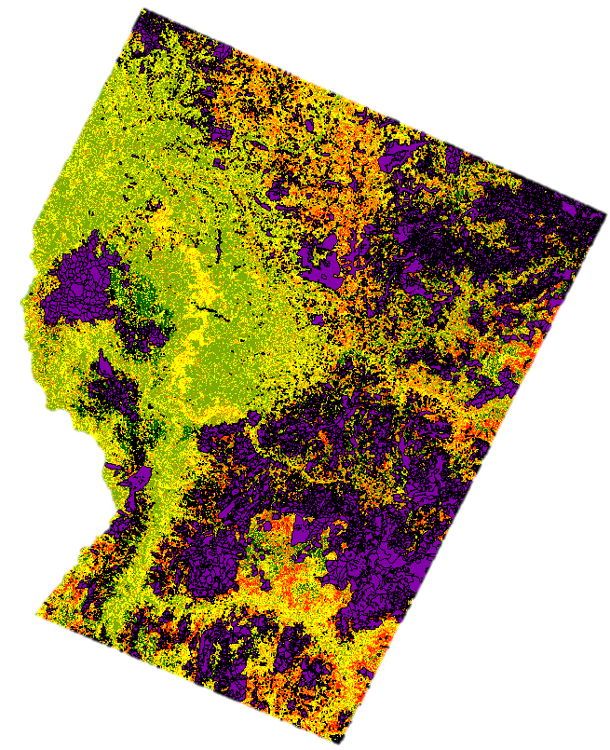
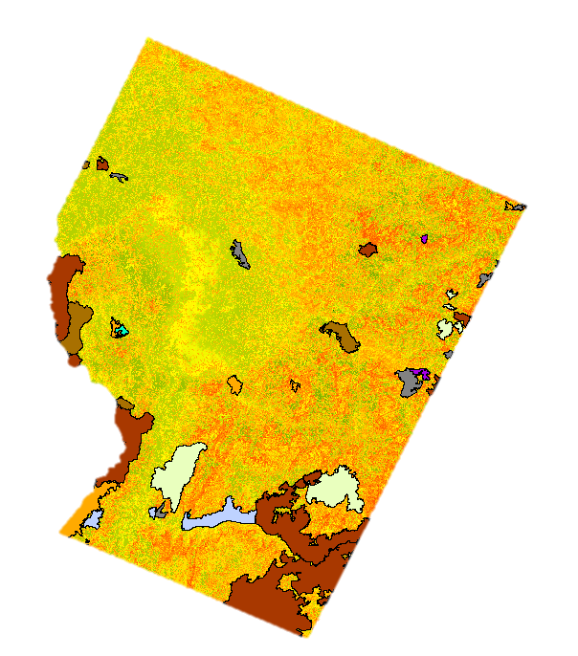
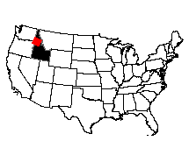
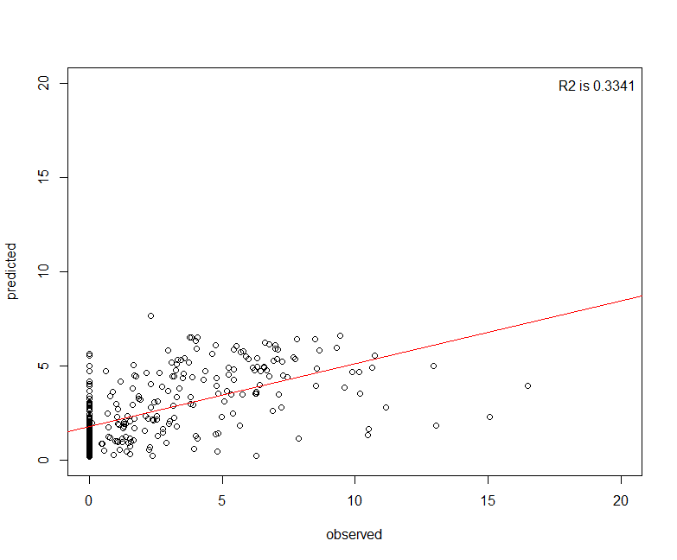
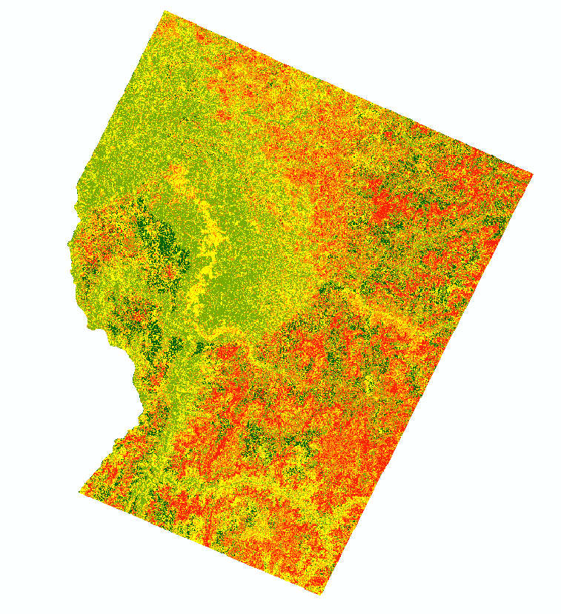
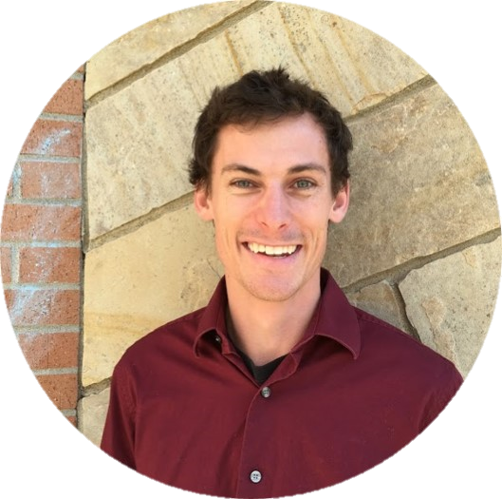
Utilizing NASA Earth Observations to Estimate Dead Aboveground Biomass Following Pest and Disease Outbreaks in Central Idaho Forests
Abstract
The magnitude and timing of forest disturbances have implications for global carbon cycles and forest ecosystem recovery. The carbon stored in central Idaho forests makes up a significant part of the overall carbon stocks in United States forests. Similar to the broader regional pattern of forest disturbance in the western United States, Nez Perce-Clearwater forests in central Idaho have been increasingly impacted by disturbances from insects, disease, fire, and clear-cutting activities in recent decades. This project estimated the distribution, timing, and drivers of dead biomass with an emphasis on tree mortality resulting from forest pests and disease. The team utilized NASA’s Landsat series alongside United States Forest Service Aerial Detection Survey data to determine forest disturbance and recovery trends. Forest disturbance data outputs from LandTrendr, LiDAR-derived aboveground total biomass maps, and forest inventory data were used in a Random Forest Classification model to estimate dead biomass. These results allowed the team to map dead biomass by year and cause, which will be used by partners at the Bioenergy Alliance Network of the Rockies as a primary input in future efforts to determine the economic and environmental feasibility of utilizing dead aboveground biomass for biofuel production.
Objectives
Determine the distribution, drivers, and timing of forest disturbance in two of central Idaho’s National Forests.
Model dead aboveground biomass in this area for partner organizations to determine the feasibility of using dead aboveground biomass for biofuel feedstock.
Methodology
Earth Observations
Landsat 7 ETM+
Generate time series composites
using LandsatLinkr
Landsat 8 OLI
Landsat 4-5 TM
SRTM v3
Classify disturbance using
LandTrendr
Study Area
Predict and model dead
aboveground biomass using a
random forests model
Tree 1
Tree 2
Tree 3
42028
Compile and compare aerial
detection survey (ADS) data and
Monitoring Trends in Burn
Severity (MTBS) data to dead
aboveground biomass
ADS
MTBS
Land Allocation in Study Area
Nez Perce-Clearwater Energy
State Lands
State Forest
Tribal Lands
Nez Perce-Clearwater National Forests
Results
Payette National Forest
RMSE of Predicted
vs. Observed Outcomes
Wallowa-Whitman National Forest
Dead Biomass Distribution ($\sqrt{Mg/hectare}$)
R²=0.3341
RMSE=2.597
Conclusions
Predicted
9 of the 84 predictor values were found to be the most important for standing dead biomass: elevation, total biomass, greatest disturbance magnitude, compound topographic index, longest disturbance magnitude, most recent disturbance pre-event vertex value, greatest recovery magnitude, longest disturbance recovery duration, and northness.
The visual alignment of modeled dead biomass distribution matches ADS and MTBS data distribution.
Unfiltered settings better capture disturbance dynamics at plot points than the tight and loose filter options in LandTrendr.
These preliminary results will be useful for the next phase in this project, comparing outputs using USFS forest inventory plot data as the training data in a random forest model using similar input predictor variables.
Observed
Predictor | Relative Importance
Elevation | 1.0000
Total Biomass | 0.3904
Greatest Disturbance Magnitude (Unfiltered) | 0.1432
Longest Disturbance Magnitude (Unfiltered) | 0.1309
Most Recent Disturbance Pre-Vertex Value (Unfiltered) | 0.0983
Northness | 0.0897
Compound Topographic Index | 0.0683
Longest Disturbance Recovery Segment Duration (Unfiltered) | 0.0589
Greatest Recovery Magnitude (Unfiltered) | 0.0388
Dead Biomass ($\sqrt{Mg/hectare}$)
Acknowledgements
1.389 – 3.324
Dr. Paul Evangelista, Natural Resource Ecology Laboratory, Colorado State University
Dr. Amanda West, Natural Resource Ecology Laboratory, Colorado State University
Tony Vorster, Natural Resource Ecology Laboratory, Colorado State University
Brian Woodward, NASA DEVELOP, Fort Collins Center Lead
Dr. Michael Falkowski, Natural Resource Ecology Laboratory, Colorado State University
Patrick Fekety, University of Minnesota
3.324 – 4.005
4.005 – 4.791
4.791 – 5.429
5.429 – 6.811
Team Members
Table 1: Top 9 variables determined by VSURF used in the random forest model.
Project Partners
Bioenergy Alliance Network of the Rockies – Tony Vorster
Natural Resource Ecology Laboratory, Colorado State University – Dr. Michael Falkowski
Emily Campbell
Team Co-Lead
Emma Hatcher
Team Co-Lead
Evan Gohring
USGS at Colorado State University – Spring 2017

