Slide 1
Lake Victoria Water Resources II
Developing an Automated, Near Real-Time System to Monitor Eichhornia Crassipes over the Winam Gulf in Lake Victoria
Jeanné le Roux (Project Lead)
Dwight Tigner
Daryl Ann Winstead
Christina Fischer
Sara Amirazodi

Slide 2
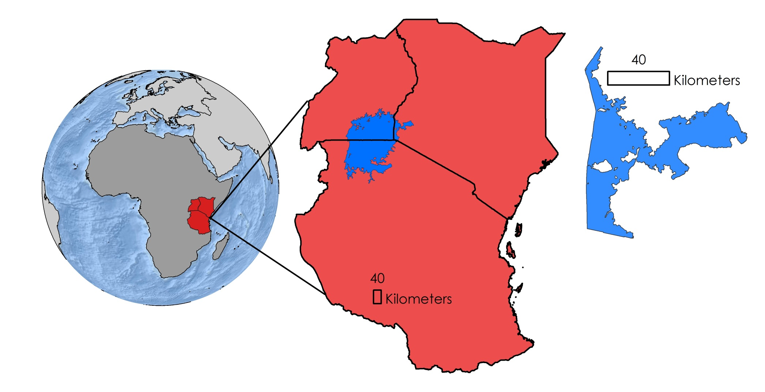
Study Area & Study Period
Uganda
Kenya
Lake
Victoria
Tanzania
Winam Gulf,
Kenya
Winam Gulf, Lake Victoria
January 2013 to February 2016
Notes:
This study focused on the Winam Gulf, which is located in the Kenyan portion of Lake Victoria in Africa.
Our project partners have identified this as a region of focus for the study of the invasive water hyacinth. The gulf’s isolated nature and close proximity to highly populated cities has degraded the water quality over time which has fueled outbreaks of algae and water hyacinth.

Slide 3
Objectives
Develop Surface Aquatic Vegetation Detection Tool (SAVDT)
Accuracy assessment on data from SAVDT outputs
Implement Sentinel-2 data
Image Credit: Jeanné le Roux
Notes:
This term’s objectives were to develop the Surface Aquatic Vegetation Detection Tool (SAVDT) using the methodologies created from the previous term and converting them to a python script that will automate the retrieval and processing of the data. Those methodologies include using Landsat imagery and running a Normalized Difference Water Index (NDWI) and Normalized Difference in Vegetation Index (NDVI), which will be talked about more in the upcoming methodology section. In addition to using Landsat, the team implemented Sentinel-2 data in order to have a larger range of images for accuracy assessment which will result in better accuracy assessment outputs.
Image Credit: Team lead Jeanne’ le Roux

Slide 4
Project Partners
NASA SERVIR Coordination Office at MSFC
NASA SERVIR-Eastern and Southern Africa Hub
Regional Centre for Mapping of Resources for Development (RCMRD)
Makerere University Department of Geomatics and Land Management
Image Credit: NASA
Notes:
We partnered with the SERVIR Coordination Office at MSFC, the NASA SERVIR-Eastern and Southern Africa Hub, the Regional Centre for Mapping of Resources for Development (RCMRD), and the Makerere University Department of Geomatics and Land Management for this project to assist with their current practices.
*Note: We plan on updating this image to better reflect our project partner locations, and are only using this image as a placeholder
Image source: http://www.nasa.gov/mission_pages/servir/overview.html

Slide 5
Community Concerns
Degradation of water quality
Restricted access to water extraction and boating
Decreased oxygen and nutrient levels
Vector for disease carrying snails
Image Credit: Ronald Woan
Notes:
Eutrophication due to runoff causes water hyacinth to spread rapidly and results in the degradation of water quality in Lake Victoria, which in turn directly affects everyday water usage.
Water hyacinth growth restricts access to boating docks used for transportation, water extractors for clean drinking water and irrigation use, and fishing, which the locals depend on daily.
Due to its nature of growth, water hyacinth blocks sunlight from the water column resulting in decreased oxygen and nutrient levels, which negatively affect biodiversity throughout the lake.
Schistosomiasis is a devastating tropical parasitic disease. The infectious form of the parasite is secreted by snails living in fresh water, resulting in contamination. Water hyacinth serves as a breeding ground for these snails as it provides physical attachment surfaces, shade, reduced temperature fluctuations, and food for snails carrying the parasite. Water hyacinth has a tendency to flourish in shallower waters near the lake shore, significantly increasing the human population exposure and infection risk of schistosomiasis due to activities such as boat launching and fishing. As a result, schistosomiasis poses a severe threat to populations living near water hyacinth infested waters.
Image Credit: https://www.flickr.com/photos/rwoan/8237176439/in/photolist-dxTFzr-oCdDW2-RxuFC-4uCqco-4MXBPm-dxTGfr-cXN3Wo-4tWwJf-dxYWDN-dxYX3A-867mJZ-86aw9u-4xZMYB-4tWvKA-fjEFq1-86avou-4tWyAA-4tSvuM-dxZccd-9UgPn3-fAdui8-4tSv2K-bAi9Gv-8jdY4Z-2iaYc-oCbXMC-dxZbxd-4tStJt-dxYYQo-dxTJKD-dxTKci-6zbJr2-4xecB-P4TdH-99Wqqa-cAkreq-dNH1Ar-dxTGGe-dxZd7L-4tSvVP-8jdYUD-4tSygn-9fXKcU-oUFtZ3-dxZ7Uf-oCdYP3-4tWpns-4zAQ4h-4tSmKH-4tSo7Z

Slide 6
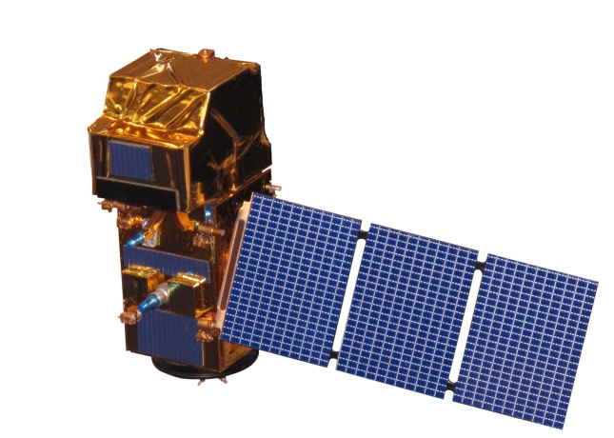
NASA Satellites & Sensors
Landsat 8 Operational Land Imager (OLI)
Landsat 8 OLI
Auxiliary Data
European Space Agency’s Sentinel-2
Sentinel-2
Notes:
NASA’s Landsat 8 data, as well as the ESA’s Sentinel-2 data, were used for this project.

Slide 7
Methodology
Automation of data download process
Automation of hyacinth detection process
Accuracy assessment of algorithm
Development
Testing
Analysis
text
text
text
Notes:
- This term the project was focused on developing Python scripts to automate processes for downloading data, detecting water hyacinth, and assessing the accuracy of the model outputs.

Slide 8
Methodology
Landsat 8 data downloaded from Amazon Web Services using DEVELOP’s dnppy
Sentinel-2 data downloaded from ESA using GitHub
Automatic download scheduled using Python
Notes:
Once Landsat 8 and Sentinel-2 data were downloaded using scripts
The images were atmospherically corrected and converted to surface reflectance

Slide 9
Methodology
MNDWI extracted from data using arcpy and formula:
$\text{MNDWI}\text{=}\frac{\text{(}\text{green}\text{−}\text{SWIR}\text{)}}{\text{(}\text{green}\text{+}\text{SWIR}\text{)}}$
Reclassified with ArcMap 10.3
Notes:
MNDWI, which is the Modified Normalized Difference Water Index,
was calculated on automatically downloaded Landsat and Sentinel imagery
to distinguish between water and non water features and extract aquatic vegetation over the gulf,
Scripts for Reclassification and Select by Attributes tools were then applied
to extract everything in the -1 to 0 range
And the raster to polygon tool was used
to convert selections into shapefiles

Slide 10
Methodology
Accuracy assessment for Landsat 8 improved
Accuracy assessment for Sentinel-2 developed
All scripts tested
“Surface Aquatic Vegetation Detection Tool” developed
Notes:
An accuracy assessment was performed on Landsat 8 and Sentinel-2 data
And all scripts were tested
- The Surface Aquatic Vegetation Detection tool was developed

Slide 11
Results
TBD
Notes:
This is where our results will go.

Slide 12
Results
TBD
Notes:
This is where our results will go.

Slide 13
Conclusions
TBD
Image Credit: Mike Spasoff
Notes:
This is where our conclusions will go.
Image source: https://www.flickr.com/photos/clownfish/201316695/in/photolist-iMNrv-dVXsAd-FqPHh-iMNhx-c9cdhG-r8dDUB-c9c6Ys-EPyQ5-6rXhjS-c9c7Ko-BQSU6-5yNzB-4zfYJt-vA1QgC-4zR8rL-4zSDqk-pUeoqF-gDXUf-mBcowr-4zqSe6-mBe4GY-iW3FWz-mBcNRM-pUpAUT-d3upKm-5X6rGP-rxUnSJ-CmA96g-7MWGty-vRhsGU-6AisFt-ejDDES-6AnAF7-8auhg7-SGV2R-4ZQ5tR-iMNJU-4jLnM-6tTpwY-5oNTov-8xeLVx-8xeLVz-gmZ1UX-4wNA6M-4ygsLi-7mRbRM-duxkci-duxkdH-jSy77-jSy9f

Slide 14
Errors and Uncertainties
Cloud cover in satellite imagery
Difficult to automate Sentinel-2 data download due to large file size
Inaccuracies along the coastline in study area shapefile
Amount of in situ data for validation
Image Credit: Jeanne le Roux
Notes:
Our errors and uncertainties consisted of cloud cover in our Landsat images, inaccuracies of coastline shapefiles, amount of in situ data validation, and difficulty downloading Sentinel-2 data due to its large file size. We also had issues with converting our data into python codes and scripts.

Slide 15
Source: Google Images
Image Credit: Michael Shade
Future Work
Revise the script to be completely open source
TBD
Notes:
For future references, we have set goals to revise our python script to become completely open source.
Image Source: https://commons.wikimedia.org/wiki/File:Africa_Lake_Victoria_10_006.jpg

Slide 16
Advisors
Dr. Jeffrey Luvall, NASA at NSSTC
Dr. Robert Griffin, University of Alabama in Huntsville
Africa Flores, NASA SERVIR Coordination Office at MSFC
Dr. Joe Ortiz, Kent State University
Dulci Avouris, Kent State University
Partners
James Wanjohi Nyaga, RCMRD
Dr. Robinson Mugo, NASA SERVIR-Eastern and Southern Africa Hub
Dr. Anthony Gidudu, Makerere University Department of Geomatics and Land Management
Others
Leigh Sinclair, NASA DEVELOP
Timothy Klug, University of Alabama in Huntsville
Austin Vacek, University of Alabama in Huntsville

