Slide 1
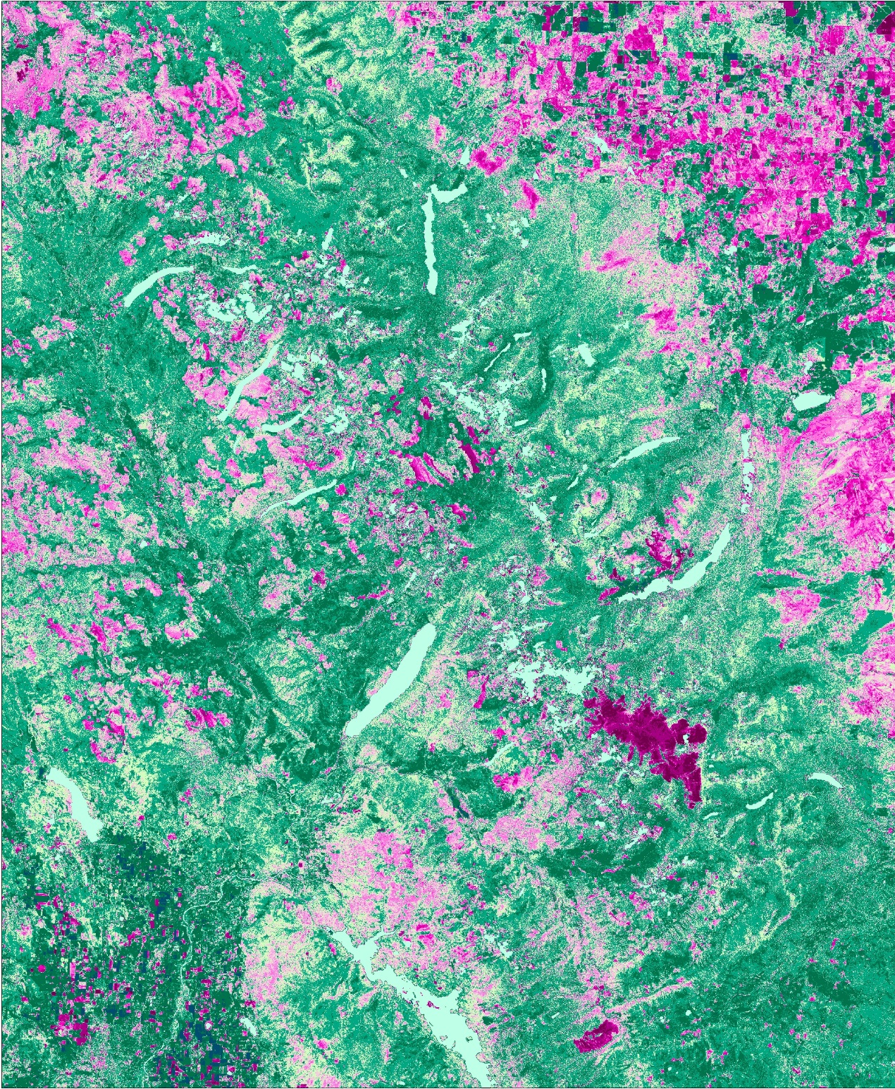
Jordan Lubbers (Project Lead)
GLACIER NATIONAL PARK CLIMATE
Utilizing NASA Earth Observations to Quantify Landscape Disturbances Related to a Changing Climate in Glacier National Park
Dr. Sunita Yadav
Ryan Avery
Joe Harris
Suzannah Richards
Zachary Wardle
Notes:
Sunita: We are the Glacier National Park Climate Team *Introduce yourself (name, degree/field, school)*
Ryan introduces himself
Jordan: My name is Jordan Lubbers and I’m the project lead for Glacier National Park Climate. The rest of the team wasn’t available to make it today.

Slide 2
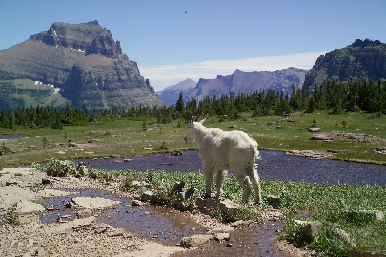
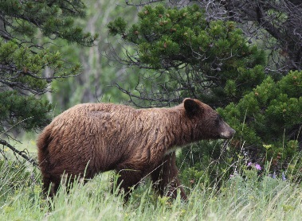
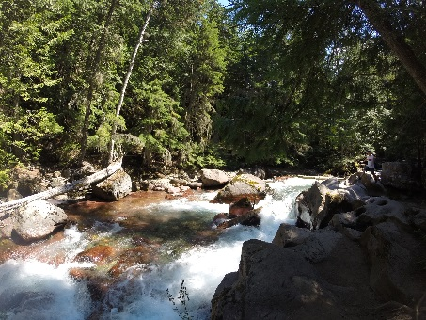
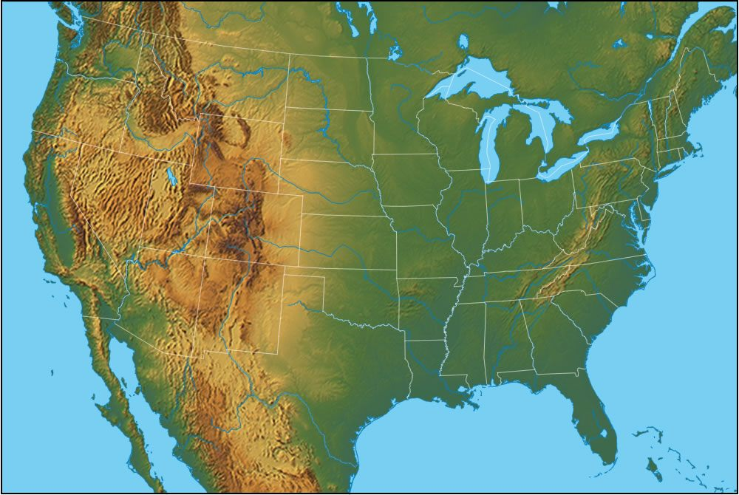
Glacier National Park (GNP)
Part of the Crown of the Continent ecosystem
1583 square miles
International biosphere reserve
Intact wilderness ecosystem
Two continental biomes
Image Credits: (Top) Glacier National Park, (Left) Michael Lusk, (Bottom) Courtney Ohr
Notes:
-At just over 1500 square miles, Glacier National Park is part of the larger Crown of the Continent ecosystem and one of the last undisturbed wilderness ecosystems in the contiguous US. It is also home to many species of flora and fauna endemic to the region.
-Bisected longitudinally by the continental divide, the west side of the park is influenced by Pacific Maritime conditions whereas the east side of the park is more similar to the northern great plains. As such the park is split between two continental biomes
Image Credits: (Top) Glacier National Park, (Left) Michael Lusk, (Bottom) Courtney Ohr

Slide 3
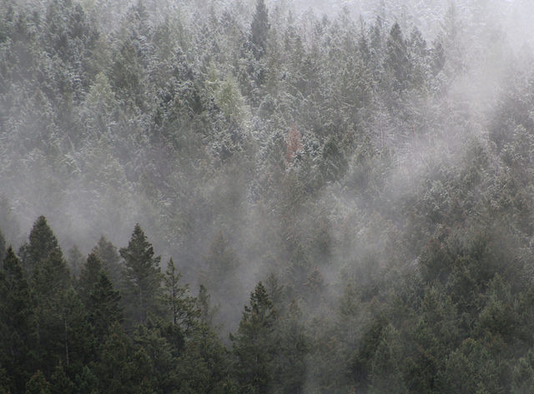
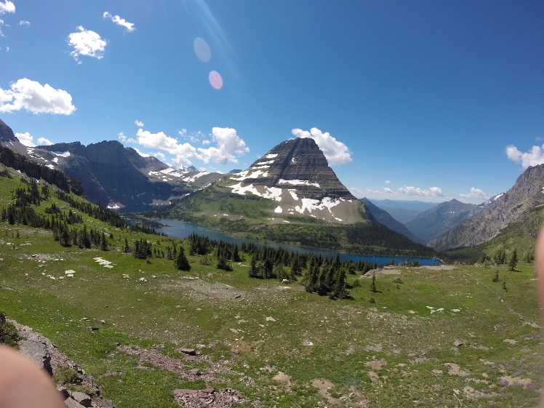
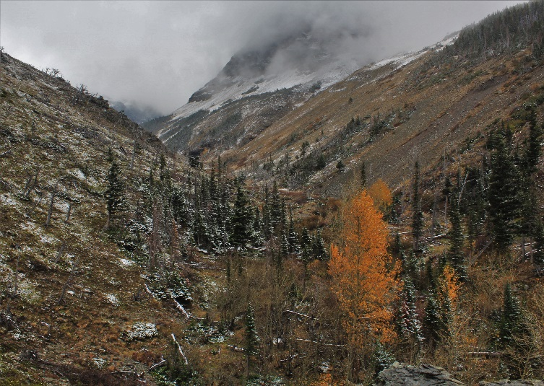
Community Concerns
Climatic extremes since 1999
Numerous landscape disturbances in recent history
Enhance park management efforts
Image Credits: (Left) Eric Sawtelle, (Right) Courtney Ohr
Notes:
-Park managers note existing climate extremes since June of 1999, but the resulting ramifications of these extremes are not fully understood.
-The park has also been affected by numerous landscape disturbances in recent history.
-Examining abrupt and subtle landscape disturbances within the park will better enable the park staff to focus management resources and respond accordingly to disturbances within the park.
Image Credits: (Left) Eric Sawtelle, (Right) Courtney Ohr

Slide 4
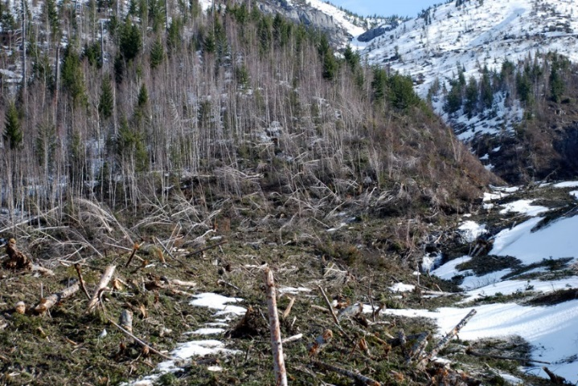
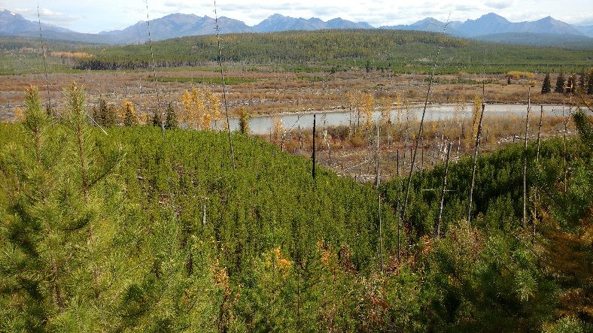
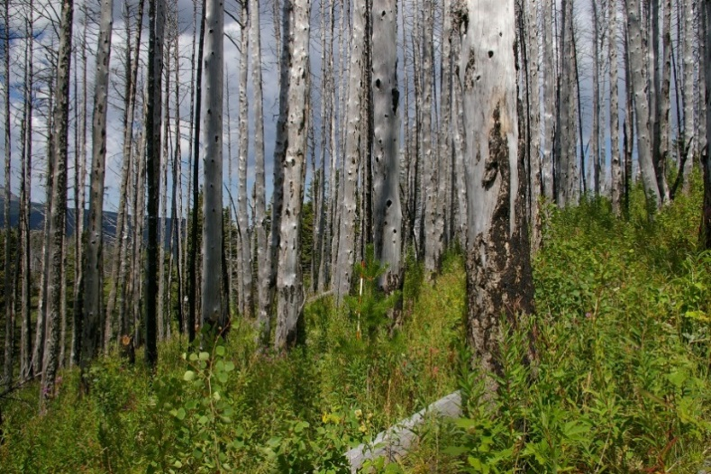
Project Objectives
Detect, quantify, and map disturbances
Understand disturbances spatially and temporally
Assess accuracy of methods
Image Credits: Richard Menicke
Notes:
-We aimed to detect and quantify landscape disturbances related to a changing climate within Glacier National Park. The main types of disturbance that park staff are concerned with are: fire, pathogens such as mountain pine beetle, fungal pathogens such as white pine blister rust, avalanches, landslides, and floods;
-Disturbed areas tend to have complex dynamics: for example, areas attacked by pine beetle may subsequently be more prone to forest fires because of an increased fire load. This makes detecting the original source of disturbance equally complex.
-By creating disturbance maps of the park, we can begin to understand how disturbances behave on both a spatial and temporal scale.
-Combining these maps with other disturbance datasets provided by project partners will allow us to assess the accuracy of our methods.
Image Credits: Richard Menicke

Slide 5
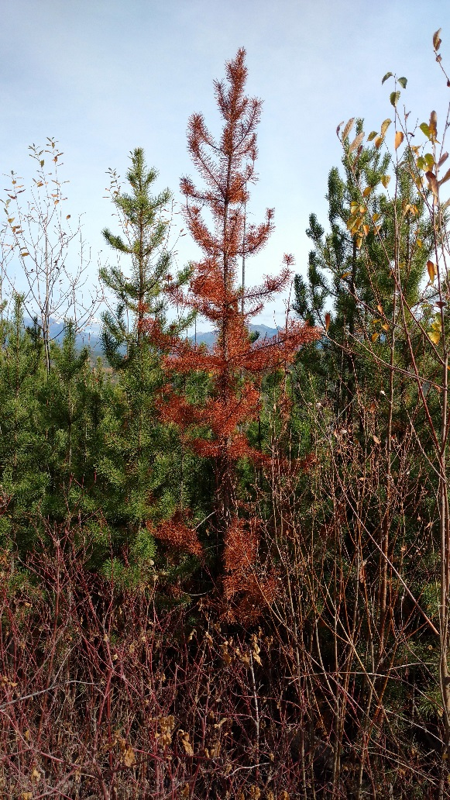
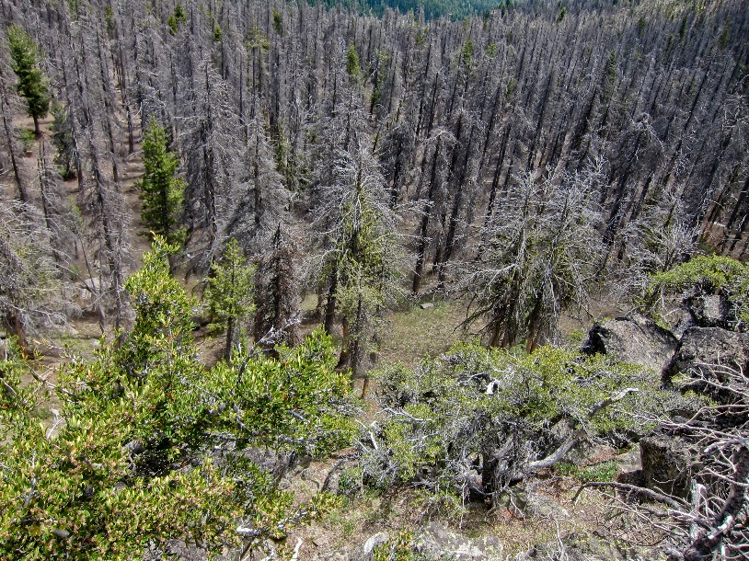
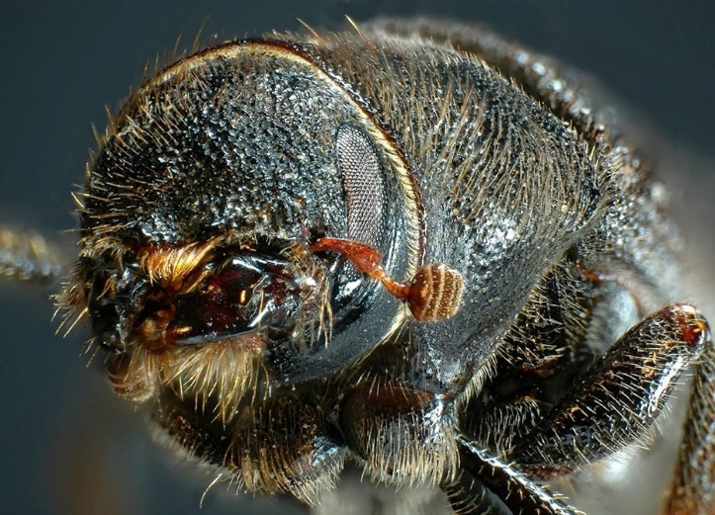
Detecting Pathogens
1st Year: Trees attacked late summer
2nd Year: ‘Red attack’
5th Year: ‘Gray attack’
∆NDMI reflects pathogen presence
Sensitive to minute changes
Image Credit: (Left) Richard Menicke, (Top) Michael McCullough, (Bottom) Simon Fraser University
Notes:
One of our main goals in this project was to detect areas within the park attacked by mountain pine beetles and blister rust fungi
-These pathogens can destroy whole stands of coniferous timber which can create additional fuel for fires and subsequently leads to more intense and widespread fires.
-The brief life cycle of the pine beetle attack on forest stands is that during the first year, trees remain green, in the second year the needles begin to die and they turn red, and then finally in the fifth year they fall off.
-These changes are not only noticed in true color but also representative of sensitive changes in Normalized Difference Moisture Index (NDMI), so this is what we used to identify and map areas of pathogen presence
Image Credit: (Left) Richard Menicke, (Top) Michael McCullough, (Bottom) Simon Fraser University

Slide 6
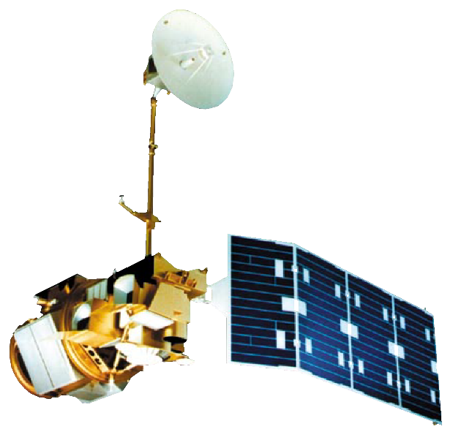
NASA Earth Observations
Landsat 7 ETM+
Landsat 8 OLI
Landsat 5 TM
Image Credit: NASA
Notes:
For this project we utilized Landsat 5, 7, and 8’s surface reflectance sensors. We chose Landsat because of its high spatial and temporal resolution.
Image Credit: NASA

Slide 7
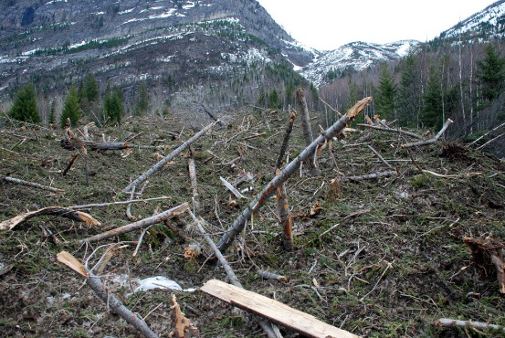
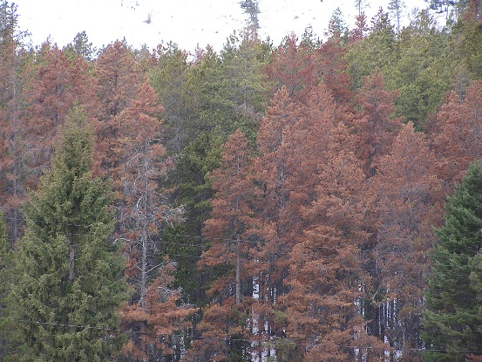
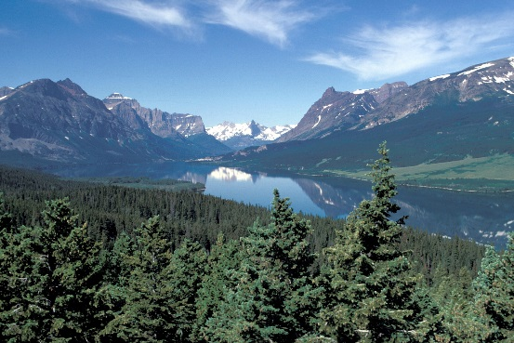
Workflow/Methods
∆NDMI ≥ Abrupt Threshold
Establish ∆NDMI Thresholds
Fire Removal
Cloud Removal
Abrupt Threshold ≥
∆NDMI ≥ Moderate Threshold
∆NDMI ≤ Moderate Threshold
Image Credits: (Top Right) Richard Menicke, (Middle Right) US Forest Service, (Bottom Right) National Park Service, (Middle Left) USDA
Notes:
Surface reflectance datasets for the months from June to September 1999-2016 were obtained and all images corrected for clouds. As our objective was to detect possible pathogen disturbance, Fire polygons mapped by park staff were removed as well. Then in conjunction with Insect Aerial Detection Surveys or ADS, this data set was utilized to establish a threshold based decision tree classification scheme in order to detect various types of disturbance within the Park, a methodology outlined previously by Goodwin and co-authors. Thus, an abrupt threshold represents sudden changes in NDMI, such as due to avalanches, the moderate threshold most likely corresponds to pathogen pressure from mountain pine beetle and associated fungi, and lastly, the lower thresholds correspond to low-level disturbance such as the green attack phase of pine beetle attacks.
By cross referencing Aerial Detection Survey polygons with our threshold classification, we could assess the accuracy of our methods.
Image Credit: (Left) Richard Menicke, (Top) Michael McCullough, (Bottom) Simon Fraser University

Slide 8
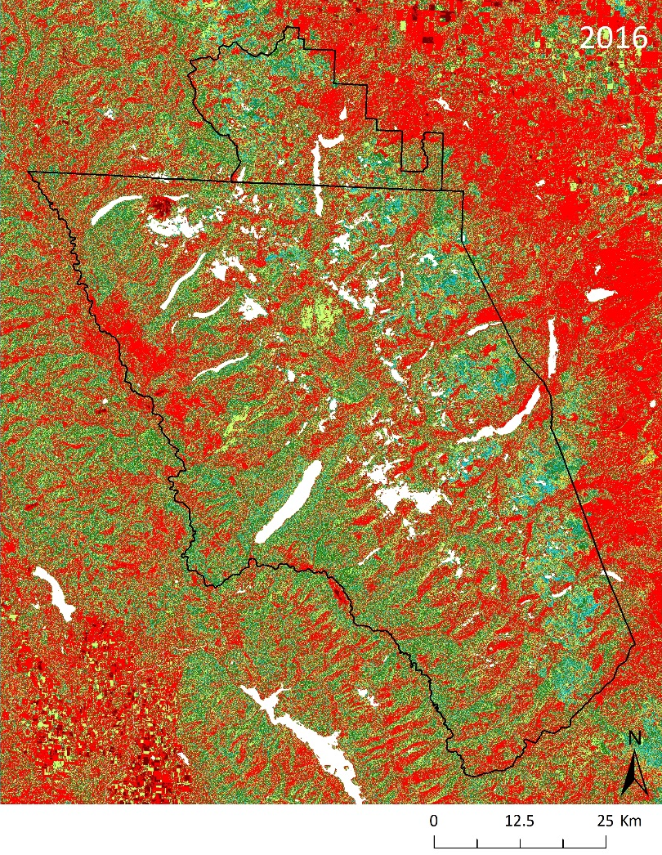
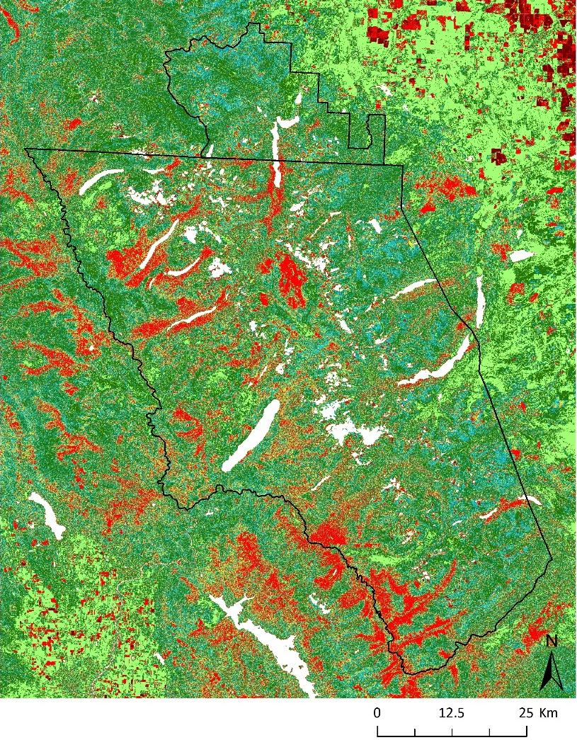
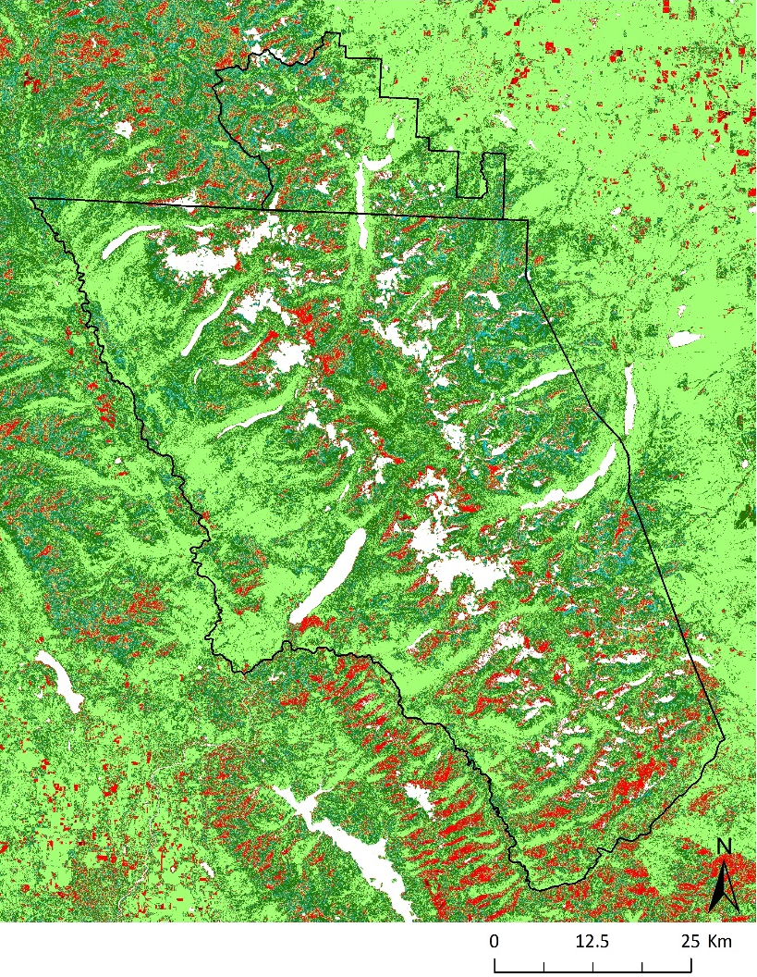
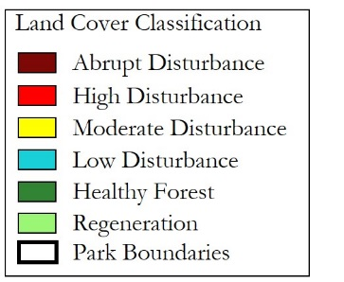
Results
Vegetation Disturbance in Glacier National Park
2001
2010
2013
Notes:
-Because NDMI is affected by seasonal changes in precipitation, we used a reference date of July 21 as it offered a good look at “prime vegetation growth” with minimal cloud cover
-Yearly disturbance maps were analyzed using SNOTEL data
-After comparing delta NDMI images from year to year, we found that years with below average precipitation would result in corresponding years having an unusually high amount of disturbance, and therefore, not accurately reflect the presence of landscape disturbances, because of a high percentage of false positives
-On the other hand, the threshold scheme employed paralleled the USDA ADS maps more closely for years with average precipitation, whereas for years with above average precipitation, there was a tendency for over-predicting forest categories

Slide 9
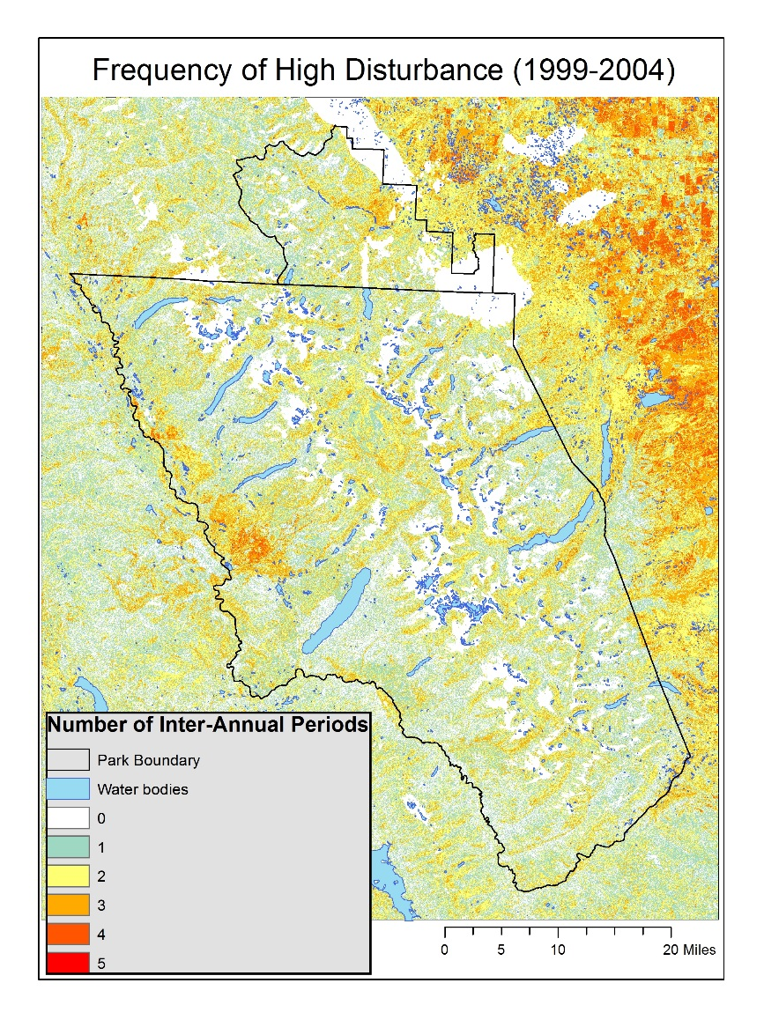
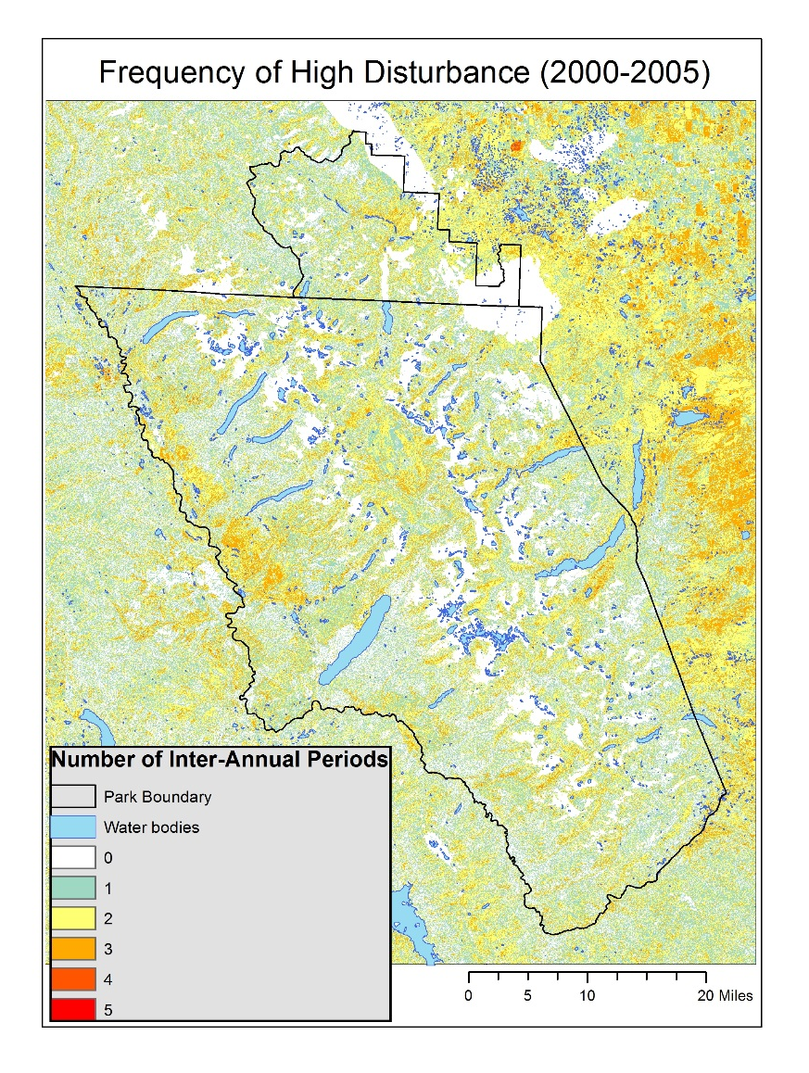
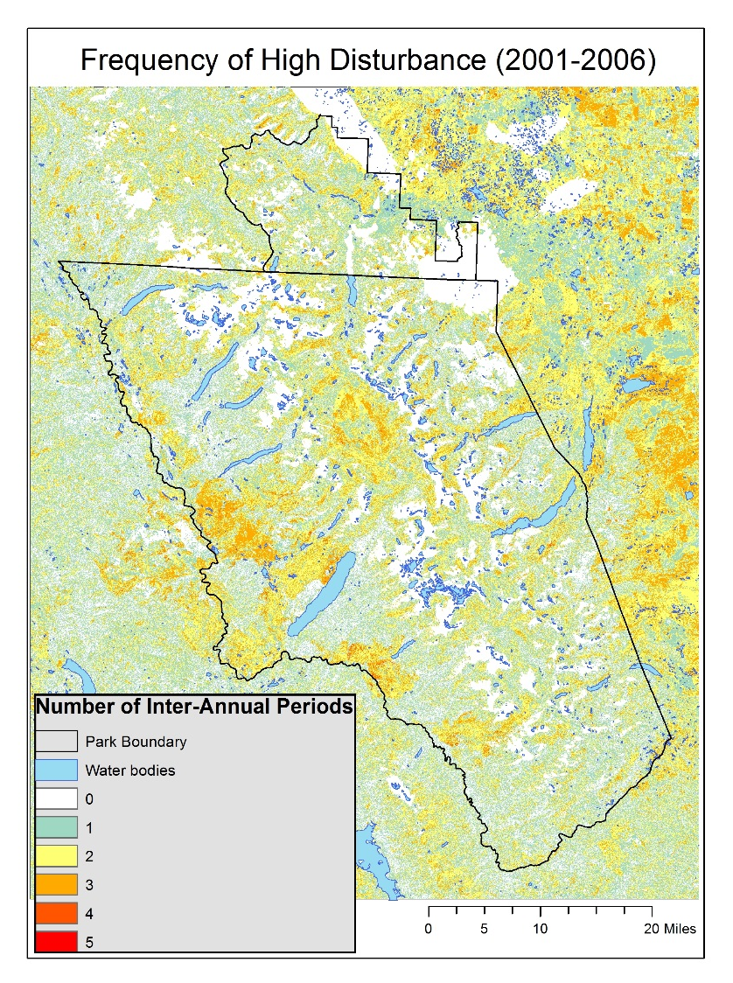
Results
Notes:
Additionally, areas of the park that displayed persistent disturbance over a 5-year time span were identified.
These rolling frequency maps are useful to identify hotspots or new areas displaying disturbance. [The large region in the NE is a grassland/sagebrush and thus outside our study area]
Given the life cycle of the mountain pine beetle, these could be areas of potential attack.

Slide 10
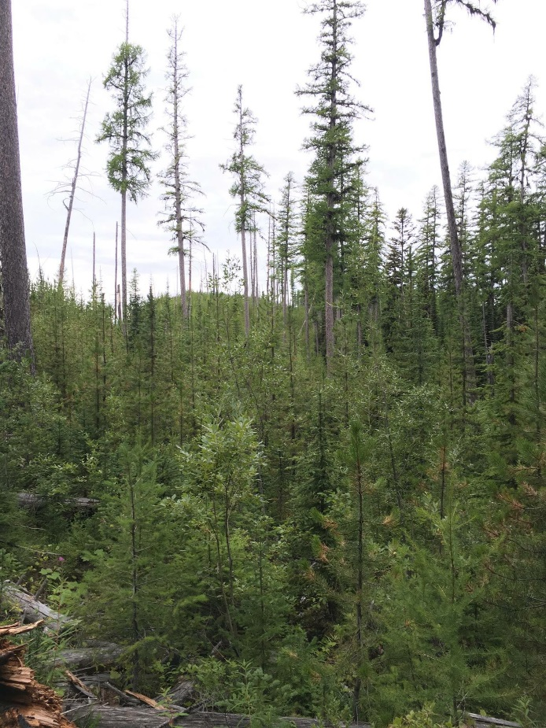
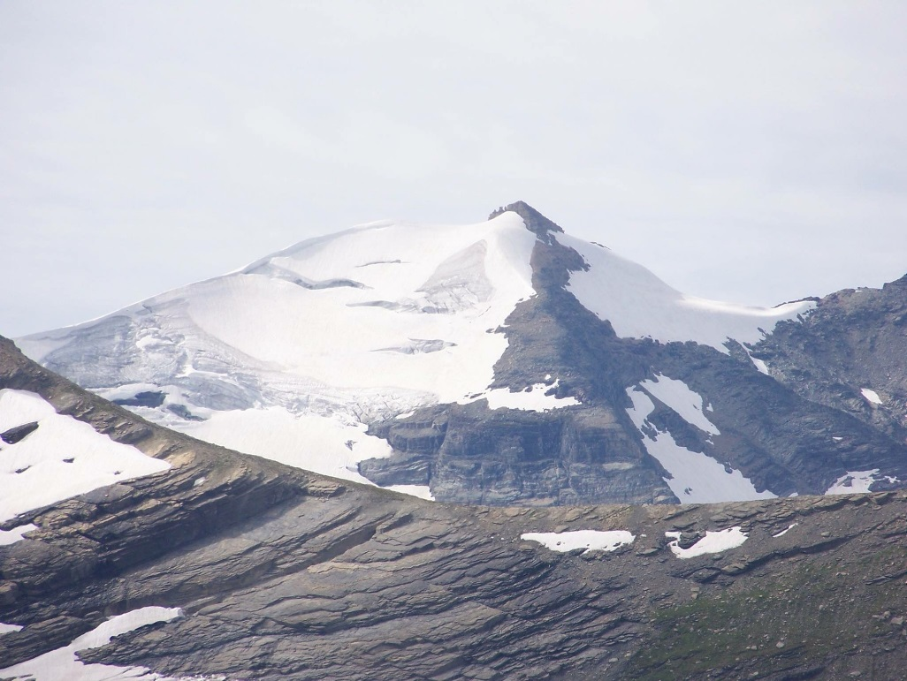
Conclusions
Threshold based classification schemes can provide a quick, accurate way of identifying and mapping landscape disturbances.
Cautious interpretation for drought years - ∆NDMI
Glacier National Park shows increasing disturbance from 1999-2015.
Image Credit: Jordan Lubbers
Notes:
-By using a threshold based classification scheme that utilizes changes in NDMI, we found a way to provide a quick and accurate way of identifying and mapping landscape disturbances within Glacier National Park.
-During drought years or wetter than normal years, the results from this threshold classification should be interpreted with caution, so as to avoid falsely identifying healthy forest as disturbed forest.
-We noted that, Glacier National Park is becoming increasingly disturbed with respect to pathogens from 1999 through 2015.
Image Credit: Jordan Lubbers

Slide 11
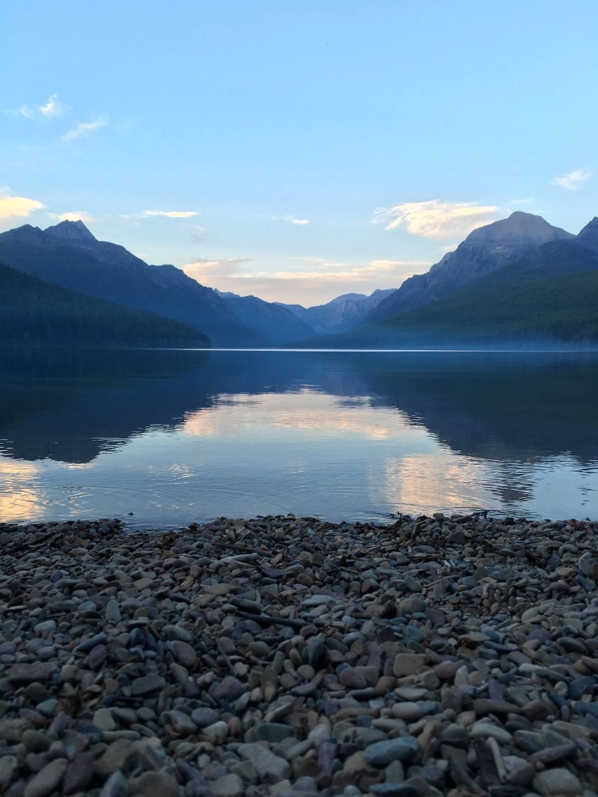
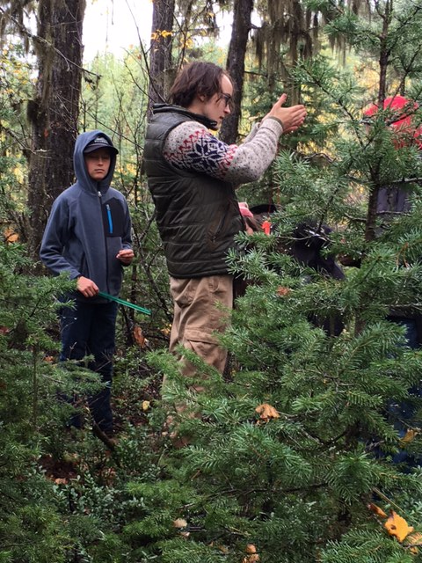
Future Work
Use ∆NBR to map fire areas and apply methodology to Waterton Lakes National Park in Canada
Look into why certain areas are disturbed more than others (e.g. forest type, soil type, elevation, etc.)
Develop disturbance prediction models for GNP
Engage high school groups in the area
Image Credits: (Left) Jordan Lubbers, (Right) Eric Sawtelle
Notes:
Future work during the second term of the project will expand our methods to Waterton Lakes National Park in Canada, looking into why certain areas are more consistently disturbed than others, and possibly developing disturbance prediction models for Glacier National Park. We also plan to develop a ‘high school level’ tutorial on our methods, with the goal of continuing citizen science collaboration with area High Schools on disturbance detection within the park.
Image Credits: (Left) Jordan Lubbers, (Right) Eric Sawtelle

Slide 12
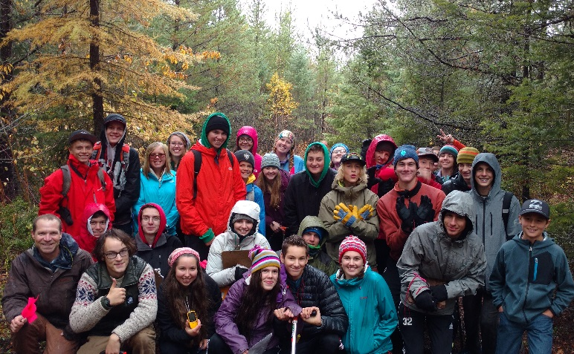
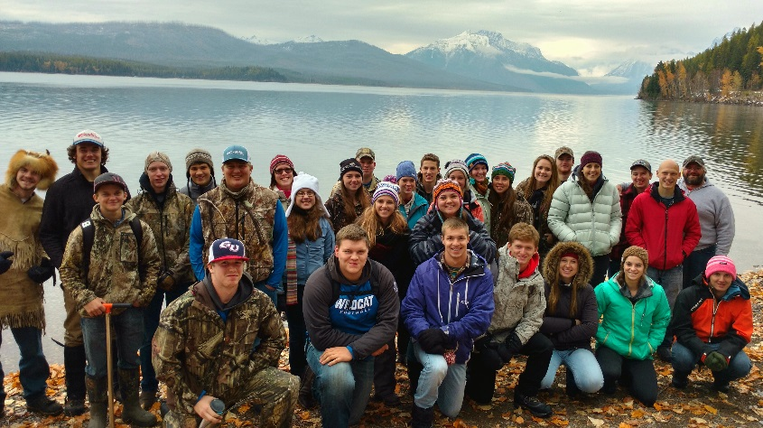
Advisor
NASA Langley Research Center
Dr. Kenton Ross
Partners
Glacier National Park
Richard Menicke
NASA Ames
Dr. Chris Potter
DEVELOP Staff
NASA DEVELOP National Program
Emily Gotschalk, Tyler Rhodes
Special Thanks
Whitefish High School, MT
Columbia Falls High School, MT
Image Credit: Richard Menicke
Notes:
We would like to thank the following individuals for their assistance on this project. Without them, this work would not have been possible.

