Slide 1
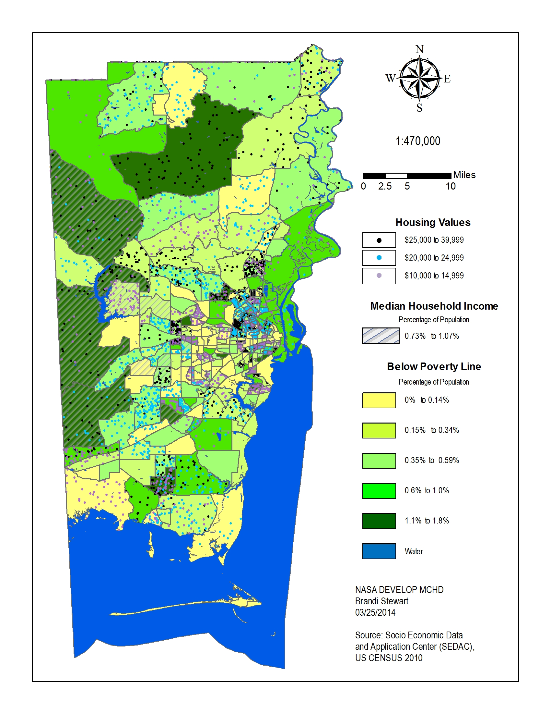
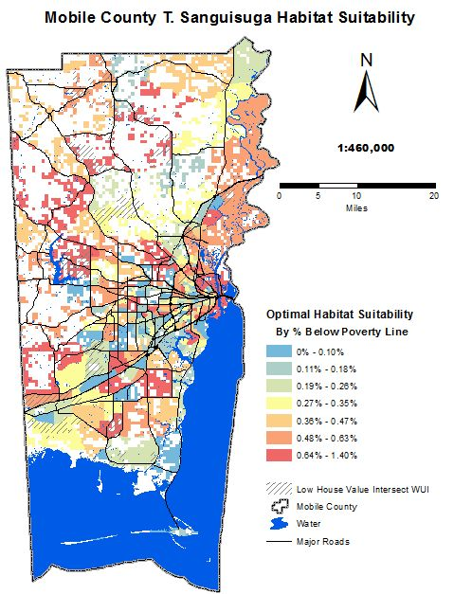
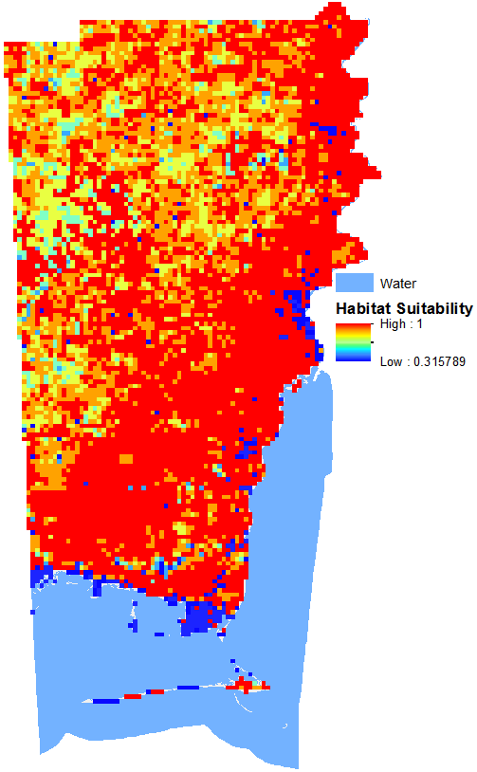
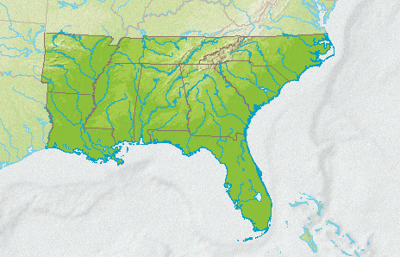
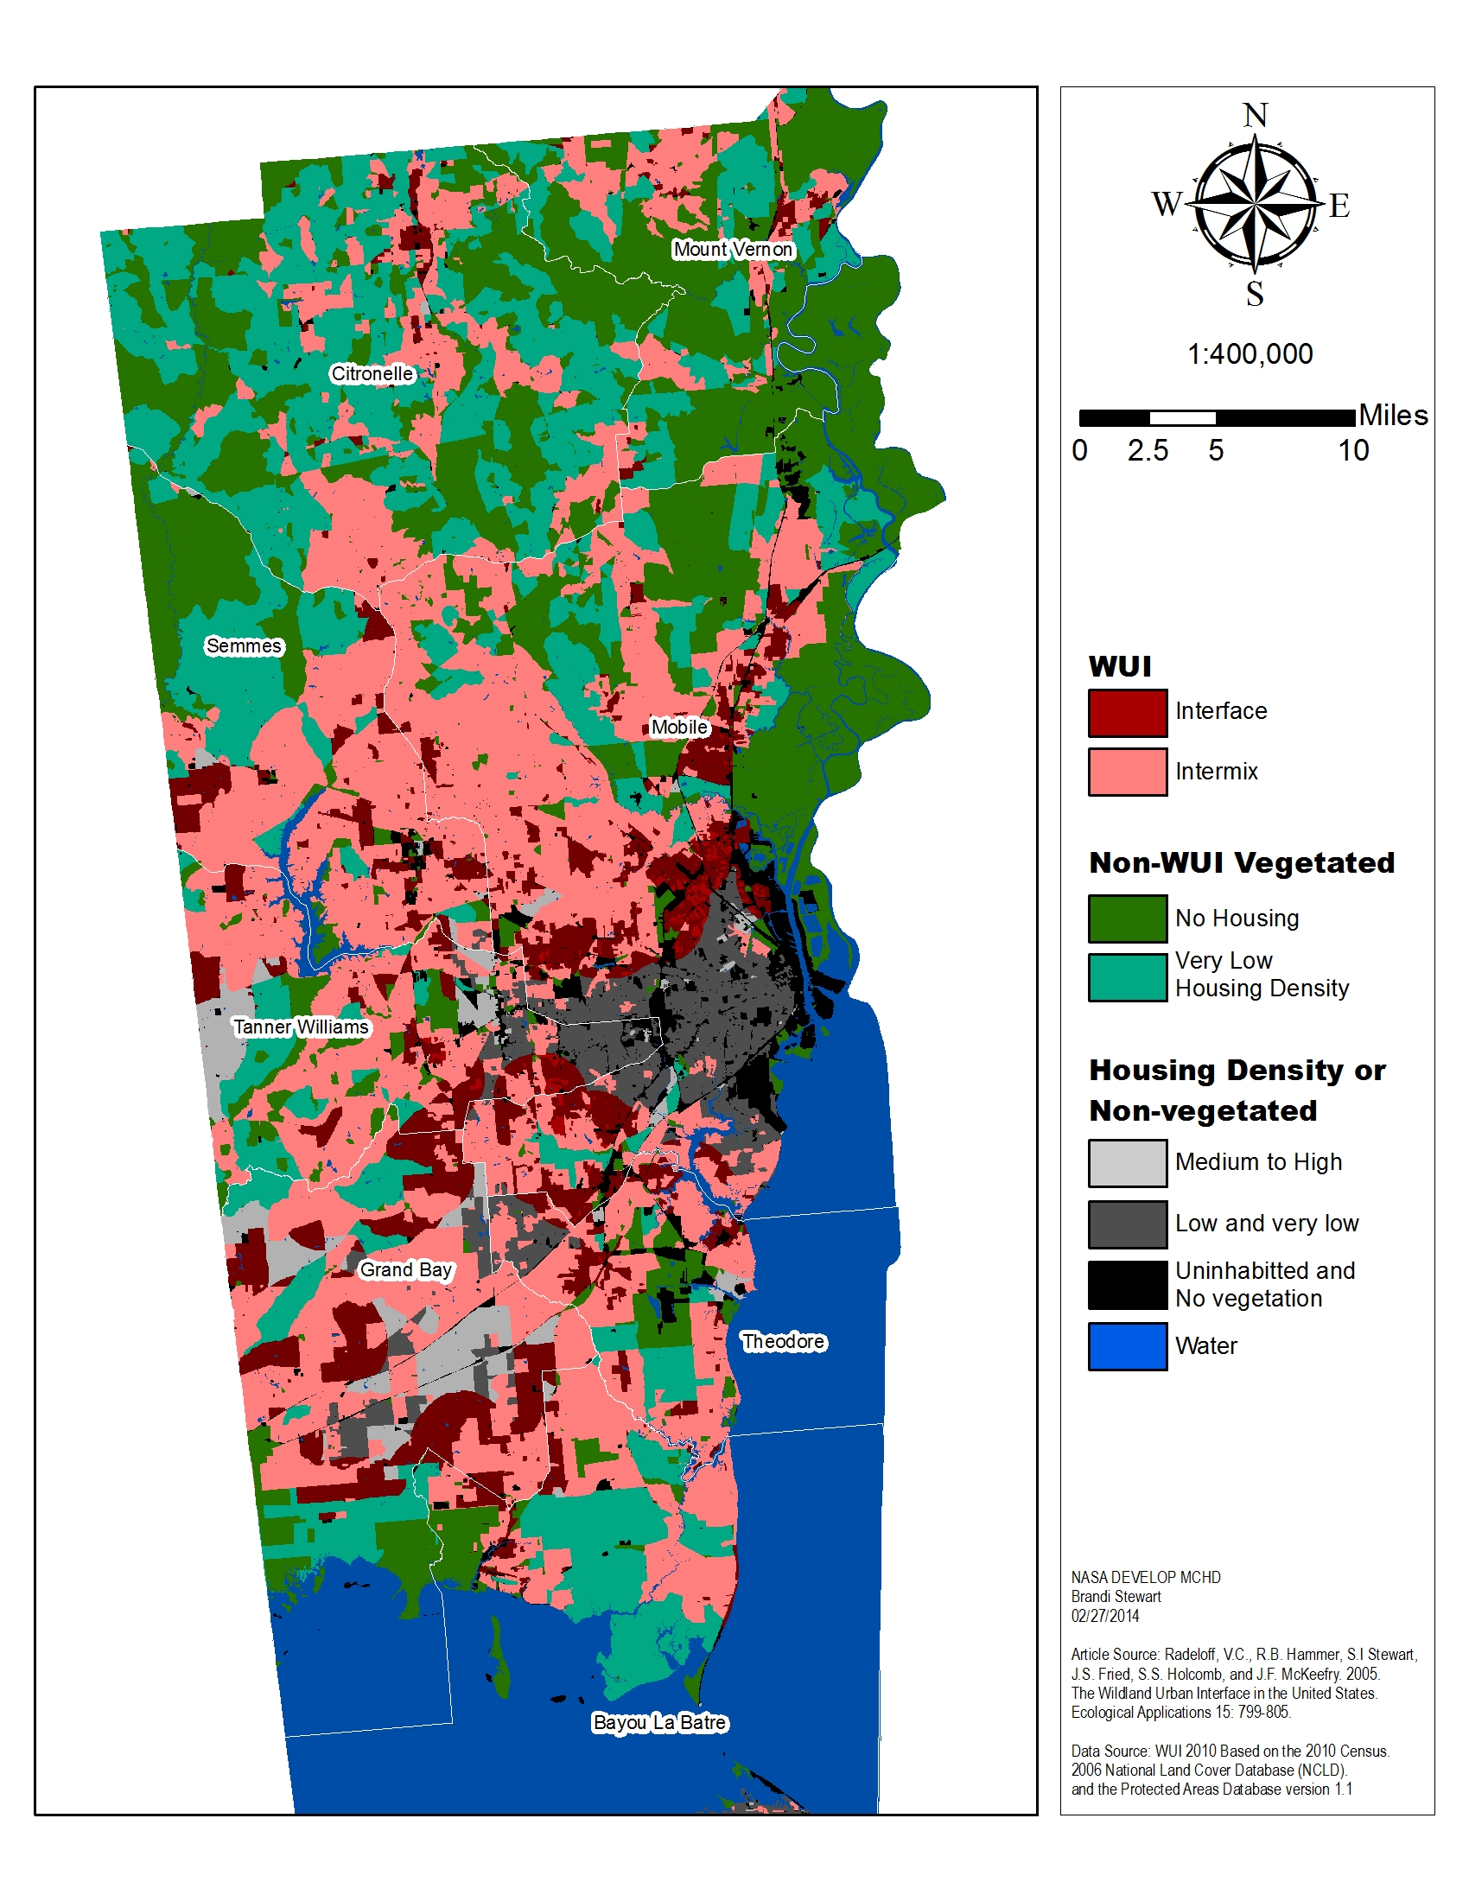
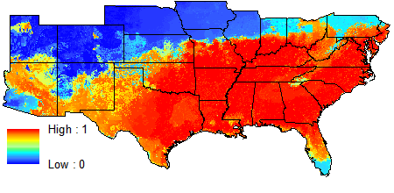
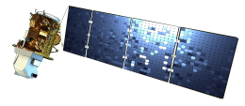
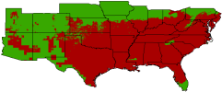
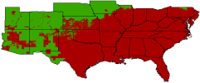
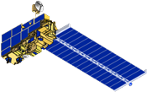
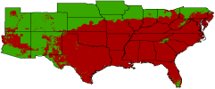
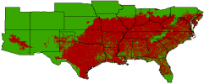
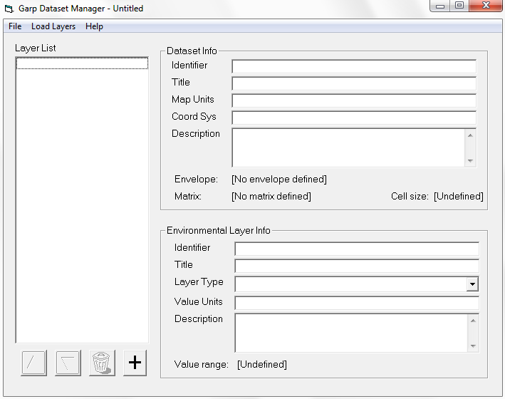
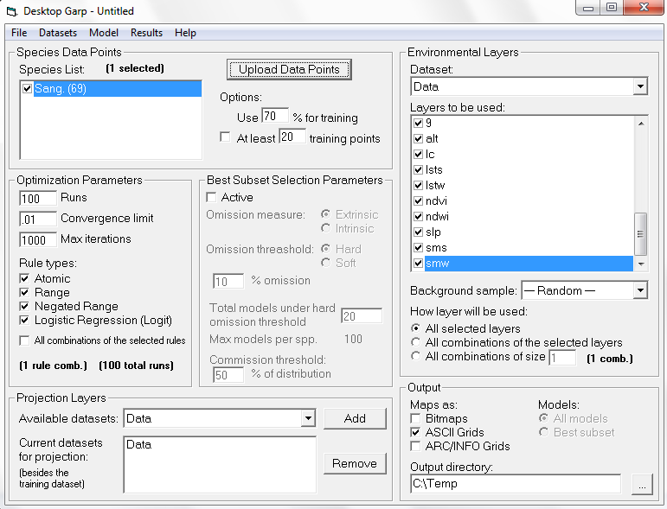
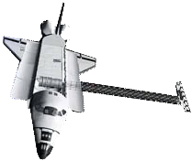
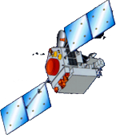
Southeast U.S. Health & Air Quality Chagas Transmission Risk in Alabama:
Habitat Suitability Modeling of Triatoma sanguisuga, the Expected Local Vector for Chagas Disease in the South Eastern United States
James Pickett,(University of South Alabama), Shikher Mishra (University of South Alabama), Brandi Stewart (University of South Alabama)
Mobile County Health Department
Since the 1960s, Chagas disease insect vectors, and infected reservoirs have been documented in the Southern United States. Despite this, little attention is given to Chagas disease in the U.S., and until recently, both vector and parasite associated with Chagas were considered endemic only to Latin America. Evidently, the most adaptable vector species inhabiting the U.S., Triatoma sanguisuga has become increasingly widespread throughout Louisiana. Due to the confirmed presence of vectors in Louisiana and a suspected case in Dothan, Alabama, the Mobile County Public Health Officer and University of Alabama scientists showed interest in pursuing deeper investigation. To facilitate collection and testing of the expected local vector, T. sanguisuga, ecological niche modeling was conducted with the Genetic Algorithm for Rule-set Production (GARP) software and data provided from NASA supported remote sensing satellites (e.g., Landsat 8 and MODIS Aqua/Terra). This study produced several maps that aided partners in collecting triatomines for testing and identifying locations with the greatest predicted transmission risks.
Demonstrate the benefits of using NASA Earth observing data for predicting habitat suitability of disease vectors and for assessing transmission risks
Aid in the collection and testing of T. sanguisuga specimens by determining which locations in Alabama provide optimal ecological niches for the vector
Compute factor maps (e.g., increased wild-urban interface and population density) that increase transmission risk
Socio-Economic Data
Habitat Suitability Map (Mobile County)
Wild-Urban Interface (WUI) Data
Priority Trap Placement Map
South Eastern
United States
Landsat 8
Environmental Layers
Habitat Suitability Map
MODIS
T. Sanguisuga Collection Sites
GARP Outputs
Aqua
SRTM
GARP Dataset Manager
Desktop GARP
Terra
Landsat 8
TRMM
The majority of the Southeastern U.S. shows high habitat suitability for the T. sanguisuga vector
Stacking all GARP outputs reveals areas of Mobile County where higher probability of encountering the vector exists. For example, the southern portion of the county which is largely wetland.
After screening the habitat suitability map with socioeconomic data and wild-urban interface, priority trap sites were mapped to aid partners in resource allocation for T. sanguisuga collection
Habitat Suitability Map
Wild-Urban Interface
Socio-Economic Map
Priority Trap Placement Map
The NASA mission scientists and principal investigators who provided data for this research
Stockwell and Peters, Genetic Algorithm for Rule set Production
Dr. Bernard Eichold, Mobile County Health Department
Mr. Joe Spruce, NASA Stennis Space Center
Dr. Kenton Ross, NASA Langley Research Center
Mike Ruiz, DEVELOP Program Manager
Lauren Childs, DEVELOP National Science Lead
Jamie Favors, DEVELOP Deputy National Science Lead
Mobile County Health Department
Mr. Jerry Folse, Vector Control
Dr. Monica Night, Epidemiology
University of South Alabama
Dr. Frances Mujica, Department of Earth Sciences
Dr. John McCreadie, Department of Biology
James Pickett, Brandi Stewart , Shikher Mishra
Notes:
----- Meeting Notes (5/31/12 13:25) -----

