Slide 1
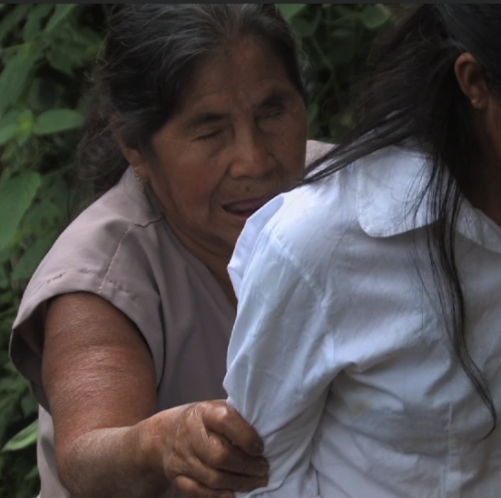
Alto Orinoco Health and Air Quality
Background Information
Utilizing NASA Earth Observations to Locate Remote Yanomami Villages in the Alto Orinoco Municipality for Targeted Eradication of River Blindness Disease
What is Onchocerciasis or River Blindness Disease?
Neglected tropical disease
Caused by a parasitic worm known as Onchocerca volvulus
Onchocerca volvulus is transmitted through the bite of a black fly
Source: Flickr User Gleilson Miranda
Source: The Carter Center
Sara Armirazodi
Rajkishan Rajappan
Zachary Tate
Symptoms of river blindness disease include itching, rash, skin discoloration, visual impairment, and blindness
Timothy Larson
Amanda Rumsey
Annabel White
Kyle Sowder
Notes:
AR: Hello we are here to talk about the Alto Orinoco Health and Air Quality which utilized satellite imagery to locate remote Yanomami Villages in the Alto Orinoco Municipality of Venezuela for the Eradication of Onchocerciasis
AR: Onchocerciasis or otherwise known as river blindness disease is a neglected tropical disease that is caused by a parasitic worm and is transmitted through the bite of a black fly. Some symptoms of river blindness disease include itching, skin discoloration, and blindness.
https://commons.wikimedia.org/wiki/File:%C3%8Dndios_isolados_no_Acre_5.jpg

Slide 2
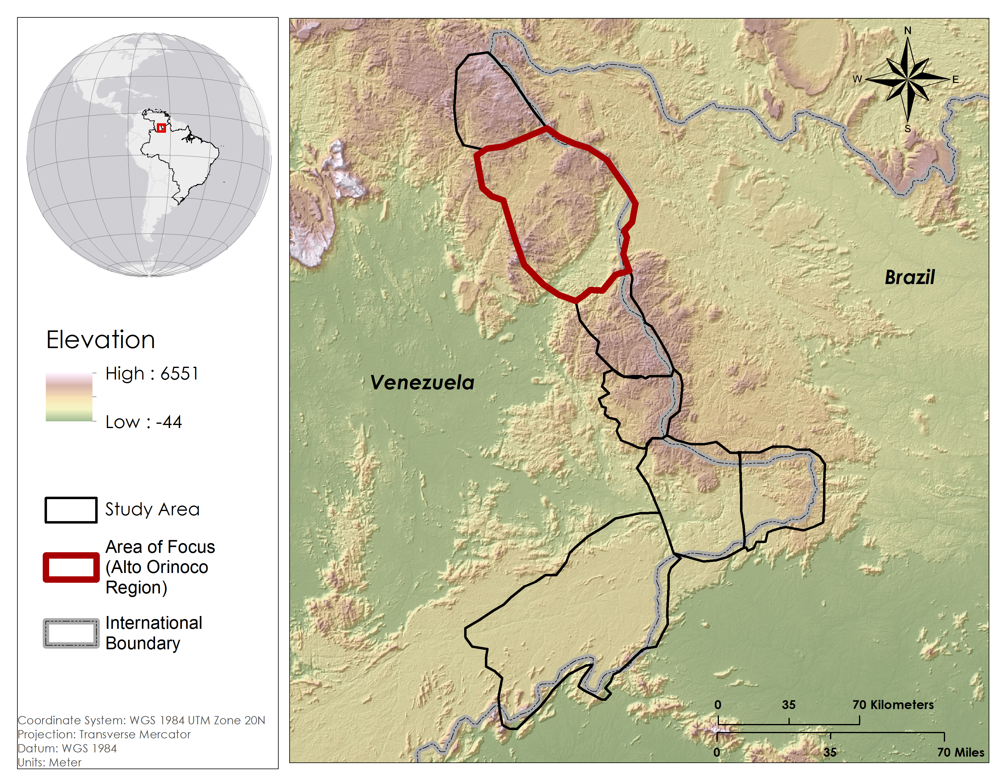
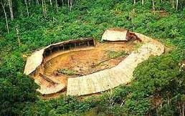
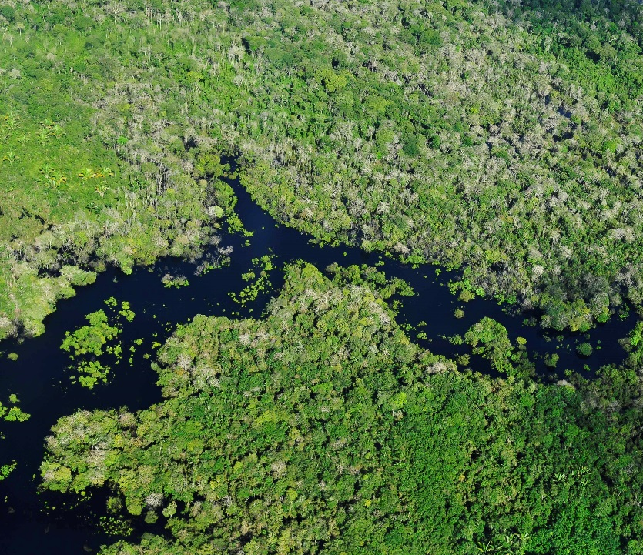
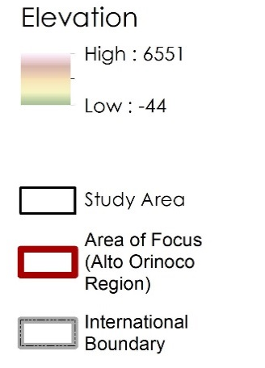
Background Information
Who is at Risk?
What are the Current Limitations to Providing Treatment?
13 sub regions of Brazil, Ecuador, Guatemala, Mexico, Venezuela, and Colombia
The Alto Orinoco Municipality is one of the last active transmission zones
122,282 people within the Alto Orinoco region are at risk
20,500 people within the Alto Orinoco region need treatment
Densely forested terrain
Political boundaries
Government Policies
Remote locations of Yanomami villages
Migratory nature of Yanomami people
Source: Wikipedia User Zeljko
Elevation
High: 6551
Low: -44
Alto Orinoco
Municipality
Area of Focus
Coordinate System: WGS 1984 UTM Zone 20N
Projection: Transverse Mercator
Datum: WGS 1984
International
Boundary
Source: Flickr User CIAT
Notes:
Today, river blindness is endemic to 13 sub-regions of Latin America. The Alto Orinoco municipality in Venezuela is one of the last remaining active transmission zone for river blindness. Within this region, over 122,000 people are at risk for the disease and 20,500 people are currently seeking treatment for the disease.
The Carter Center has been working to provide treatment to the Yanomami tribes that inhabit the Alto Orinoco municipality, but entry into the region is hindered by densely forested terrain, political boundaries and policies, remote village locations, and migratory patterns of the Yanomami tribe. These factors make it difficult for The Carter Center to appropriately identify active village.

Slide 3
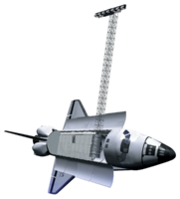
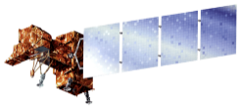
Objectives
Utilize NASA Earth observations and DigitalGlobe data to locate remote Yanomami villages
Convey the locations and physical characteristics of the villages to The Carter Center so that they can provide medical treatment
Develop a suitability model to assist The Carter Center in future village identification efforts
Source: NASA
Notes:
In order to support the Carter Center in their efforts to eliminate river blindness disease within the Americas, the goals of this study was to utilize NASA earth observations and high resolution digital globe information to locate remote Yanomami villages, convey the locations and physical characteristics of these villages to The Cater Center for the effective distribution of treatment, and to develop a suitability model to assist The Carter Center in future village identification efforts.

Slide 4
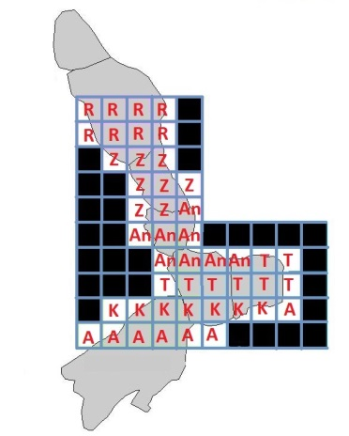
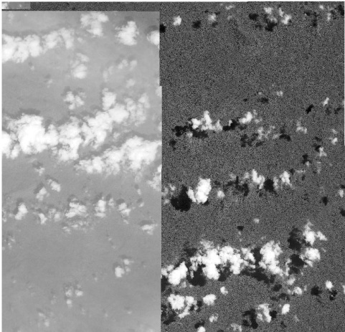
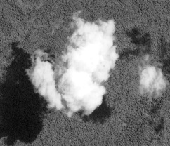
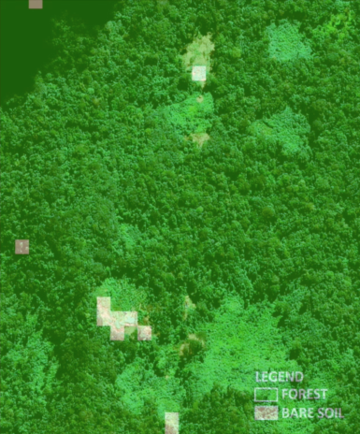
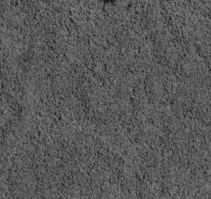
Project Methodology
Data Sources
1. DigitalGlobe
WorldView -1,2,3
GeoEye -1
Quickbird -2
NASA Earth Observations
Landsat 8 OLI and TIRS
Village Identification Methodology
The study area was dissected into 46 grids
Each team member was assigned 7-8 grids to visually inspect
Each grid was inspected on a pixel-by-pixel basis using a high resolution cloud-free DigitalGlobe mosaic
If a cloud was present in the cloud-free mosaic, raw imagery from another date was substituted in
A “soil - vegetation” k-means unsupervised classification was used to cross-check grids
Steps 1 and 2
Step 3
Step 4
Step 5
Notes:
The locations and physical characteristics of the Yanomami villages were determined using Digital Globe Imagery. The study area was dissected into 46 sub grids and each team member was assigned 7 to 8 grids to visually inspect on a pixel by pixel basis using a digital globe cloud free mosaic. If a cloud was present in the “cloud-free mosaic”, raw digital globe data was substituted in. Soil vegetation classification data derived from a k-means unsupervised classification performed on a cloud free Landsat 8 composite of the study area was then used as a cross-checking tool. Areas classified as soil were double checked.

Slide 5
Project Methodology
Double Checking Methodology
Raw panchromatic and RGB DigitalGlobe data were combined into yearly mosaics
Everyone was assigned a new set of 8 grids
Everyone visually inspected their grids with yearly mosaics
Village Identification
Village ID
Diameter of village
Number of huts
Temporal Information
Sensor Information
Population Estimate
Notes:
After completely the initial inspections for our assigned grids, everyone was assigned a new set of grids and panchromatic and RGB yearlydigitalglobe mosaics were used to search for villages. When a village was identified, the village was marked with a point vector, and the village diameter, number of huts, temporal history, sensor history, and current population estimates were recorded.

Slide 6
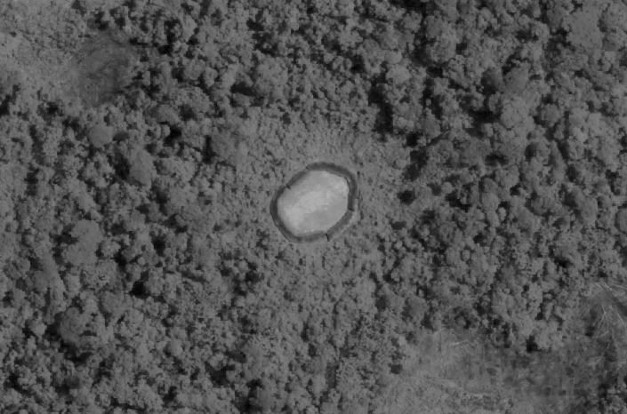
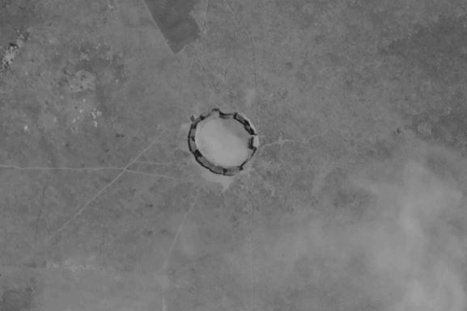
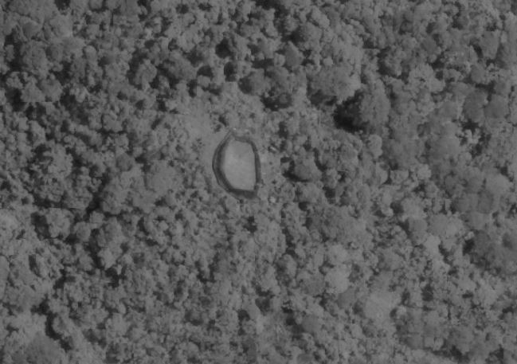
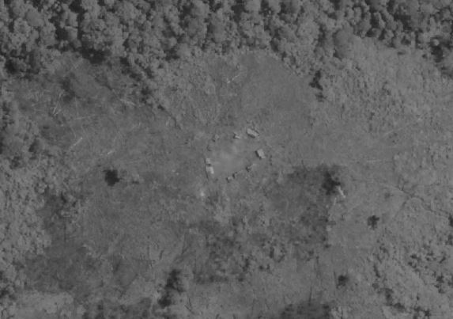
Village Identification Results
Active Villages
89 active villages
Abandoned Villages
17 abandoned villages
Population Estimate
1745 Yanomami people in the 89 active villages
Carter Center Deliverables
Village shapefile with an attribute table
KML file
Notes:
Through visual inspection of the high resolution data, 89 active villages and 17 abandoned villages were identified. Based on the , a total population for these villages is estimated to be 1745. The geospatial and attribute data

Slide 7
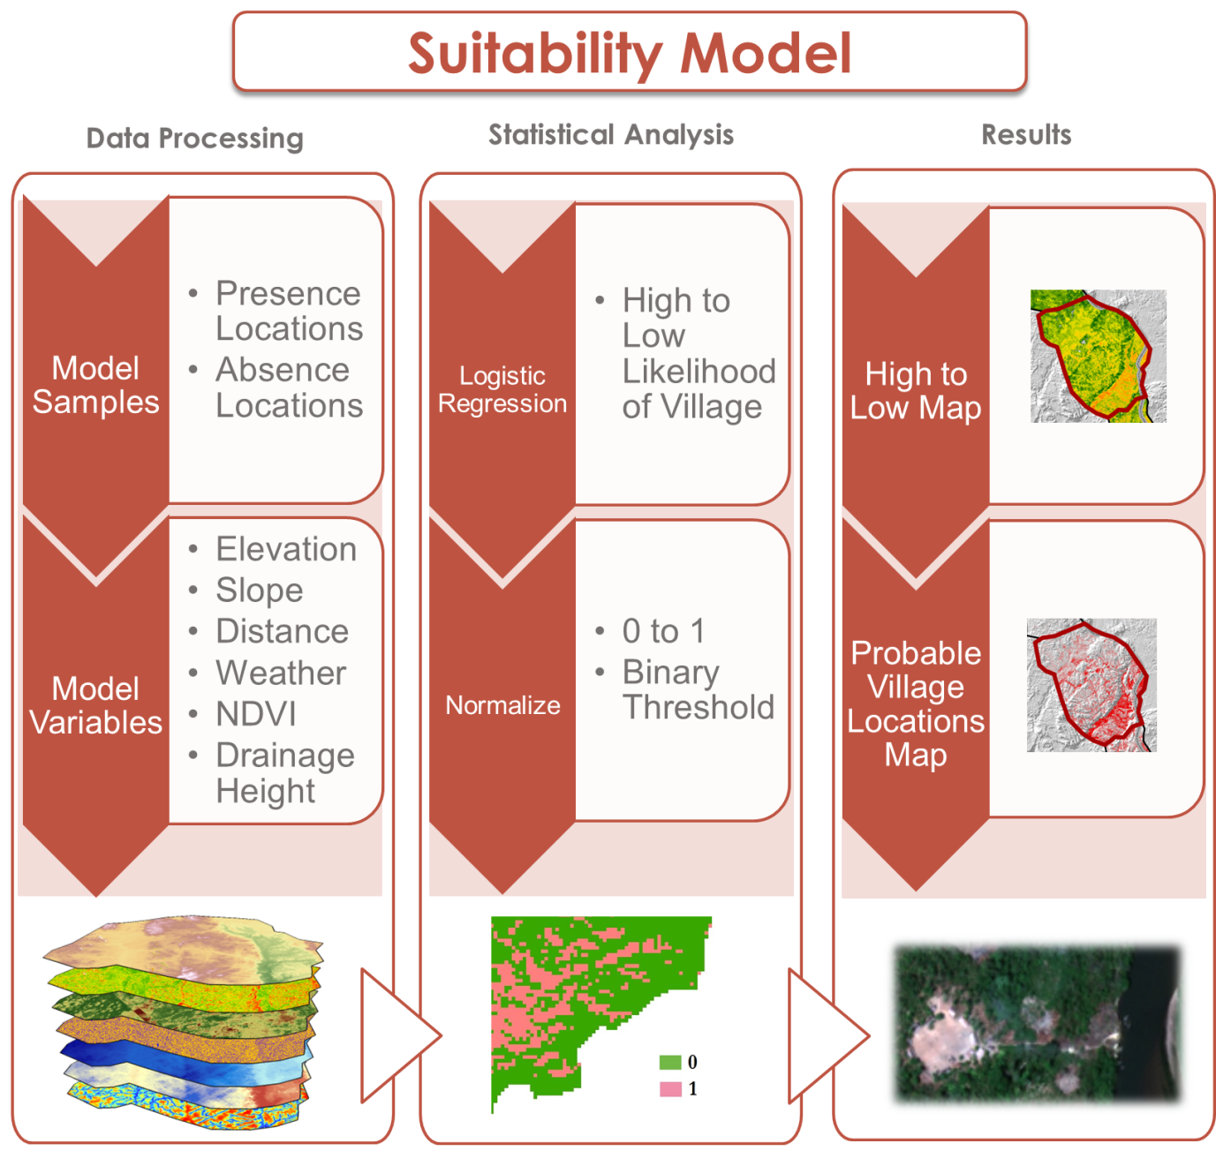
Project Methodology
Data Sources: Landsat 8 OLI/TIRS, SRTM
Notes:
First located villages in study area
Then noted characteristics for habitat parameters
Then tested coordinates and predicted new locations with suitability model

Slide 8
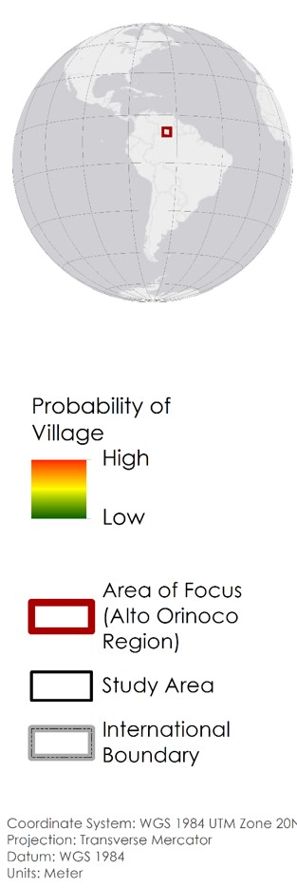
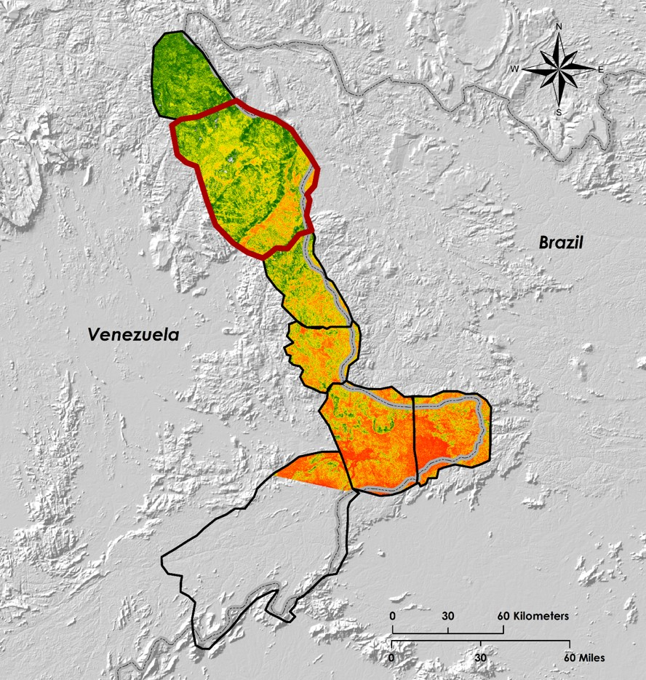
Suitability Model Results
Notes:
Used village coordinates and habitat parameters as input to perform logistic regression technique in ArcMap that predicted presence of locations vs. absence of locations
Scaled outputs from zero to one probability
Created threshold to identify and extract new probable village locations (mapped on next slide)

Slide 9
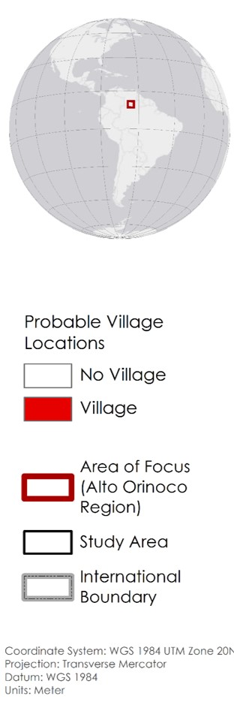
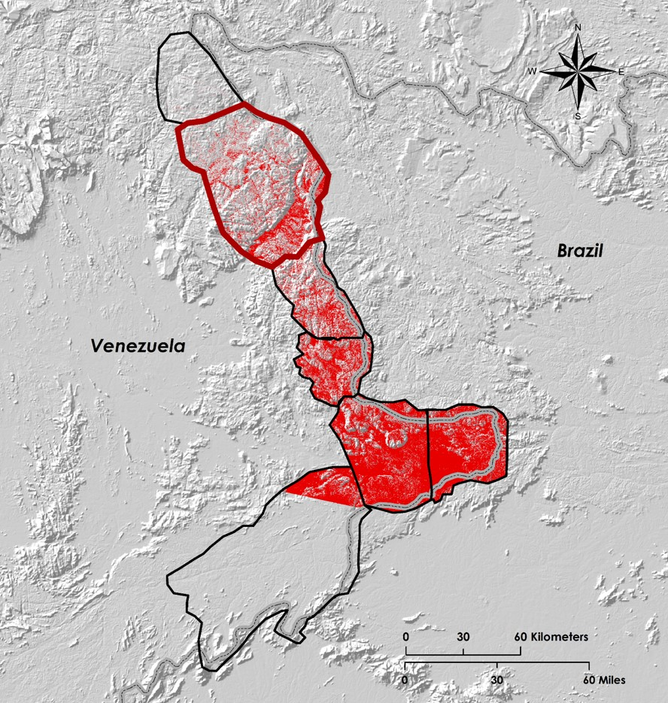
Suitability Model Results
Notes:
True positive 77% (predicted village that resulted in suitable village location)
True negative 51% (predicted not a village that resulted in unsuitable for village location)
False positive 49%
False negative 23%
Cross-validation accuracy 76% (accuracy of our predictions vs. outcomes)
Cross-validation correlation 0.6 (alignment of values so if one dataset changes, so will the others)
Significance of values less than 0.01 (significant)

Slide 10
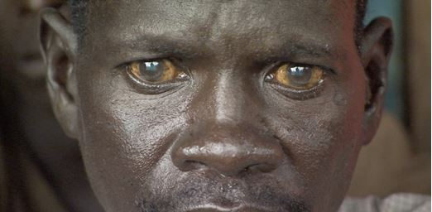
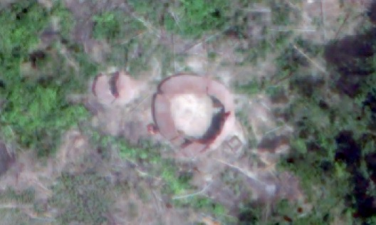
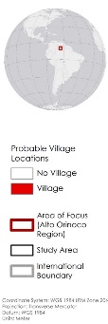
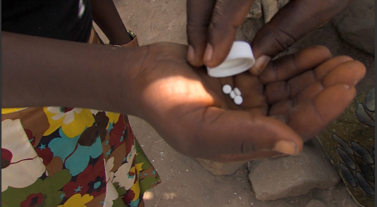
Acknowledgments
Conclusion
Advisors
Dr. Jim Tucker (NASA Goddard Space Flight Center)
Kel Markert (University of Alabama in Huntsville)
Dr. Kenton Ross (NASA DEVELOP)
Dan Irwin (SERVIR Program Director)
Dr. Jeff Luvall (NASA at National Space Science and Technology Center)
Dr. Robert Griffin (University of Alabama in Huntsville)
Katie Melocik (NASA Goddard Space Flight Center)
Dr. Thomas Unnasch (University of South Florida)
Melanie Salyer, Mentor (Wise County)
River Blindness Disease effects:
Reinforces poverty cycle
Impacts ones quality of life
Influences ones ability to work and learn survival skills
About 90 remote Yanomami villages were identified in the Alto Orinoco Region
The suitability and probable village location maps have an 76% accuracy rating
Partners
The Carter Center
Dr. Frank Richards, The Carter Center
Lindsay Rakers, The Carter Center
The Carter Center will apply this intelligence to provide treatment and continue their eradication efforts
This material is based upon work supported by NASA through contract NNL11AA00B and cooperative agreement NNX14AB60A
Source: The Carter Center
Notes:
In conclusion, the village locations and probability maps will be used by the carter center to aid in their deliverance of treatment and eradication efforts of onchocerciasis.
These efforts are crucial because, because river blindness ,reinforces the poverty cycle by reducing an individuals ability to work and learn and impacts their quality of life.
And lastly, we would like to thank our science advisors and partners. For without which, this project would not have been possible.

