Slide 1
DEVELOP National Program
Virtual Information Session
May 31, 2017
Notes:
*type in WebEx chat and say message*
“Welcome, everyone!
We will wait a few more minutes for people to join and then we will get started. Reminder: There is both an audio and visual component to this webinar, so make sure you are signed in on WebEx to view the PowerPoint in addition to joining by phone!”

Slide 2
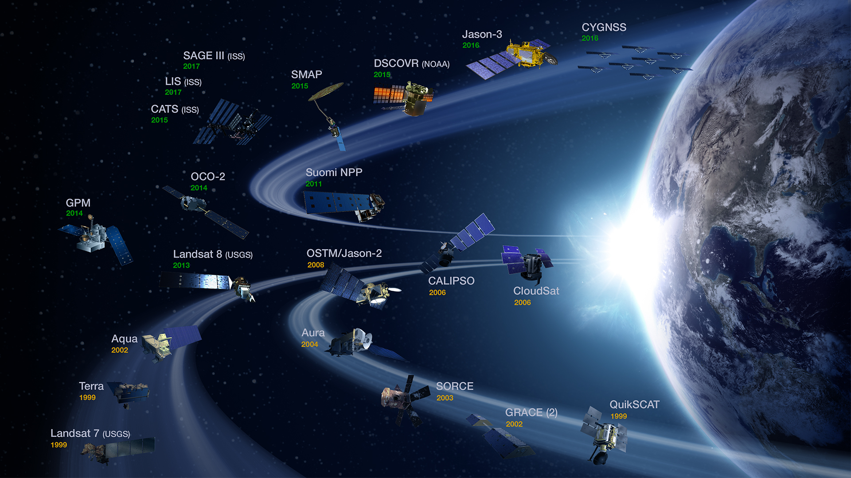
NASA Earth Observations
NASA Earth observations include a coordinated series of 18 polar-orbiting and low inclination satellites and 3 instruments on the ISS for long-term global observations.

Slide 3
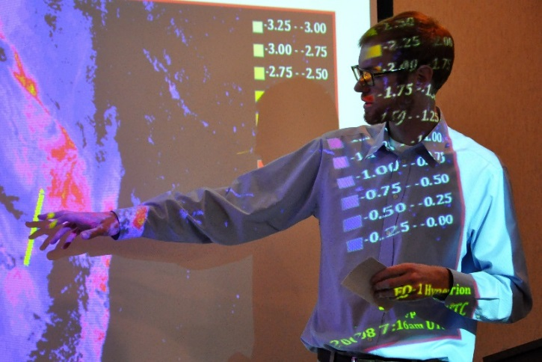
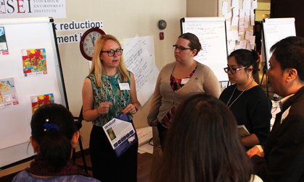

What is DEVELOP?
Measurements & Predictions
Communities
DEVELOP bridges the gap between NASA Earth Science and society, building capacity in both its participants and end-user organizations to better prepare them to handle the environmental challenges that face society.
DEVELOP is a dual-capacity building program:
Partners & Participants

Slide 4
Where DEVELOP Fits at NASA
NASA Administrator
Associate Administrator
Mission Directorates
Human Exploration & Operations
Space Technology
Science
Mission Support
Aeronautics Research
Joint Agency Satellite Division
Heliophysics
Division
Earth Science Division
Planetary Science Division
Astrophysics Division
Applied Sciences Program
Capacity Building Program
DEVELOP National Program

Slide 5









NASA Applied Sciences Program
“Discovering Innovative & Practical Applications
of NASA Earth Science”
The Applied Sciences Program (ASP) serves as a bridge between the data and knowledge generated by NASA Earth Science and the information and decision-making needs of public and private organizations. The goal of the program is to discover and demonstrate innovative uses and practical benefits of NASA Earth science data, scientific knowledge, and technology.
Ecological Forecasting
Health & Air Quality
Water Resources
Agriculture
Climate
Disasters
Energy
Oceans
Weather

Slide 6
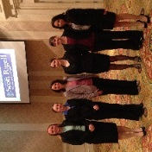

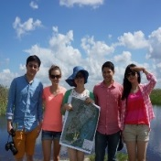
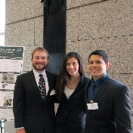
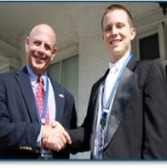
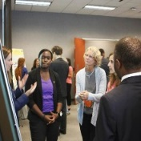
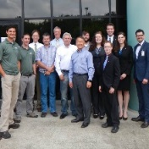
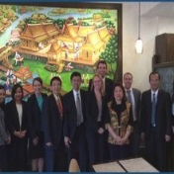
Who Participates in DEVELOP?
Participants
Benefits:
Enhanced decision support through use of
NASA Earth observations
Increased exposure to NASA Earth Science
technologies and capabilities
Recent Graduates
Military Personnel
Transitioning Professionals
Decision-Makers
Students
Benefits:
Scientific & Technical Skills
Personal Development
Professional Development & Networking
State and Local Govt.
Federal Agencies
International
NGOs

Slide 7
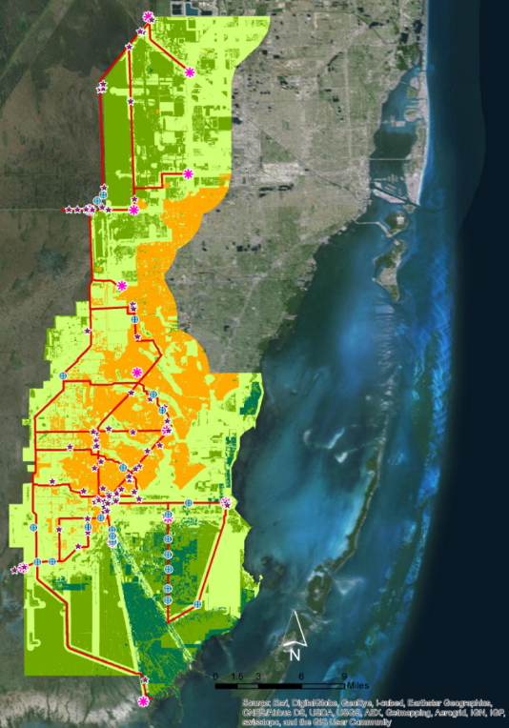
Project Characteristics
>
350+ Participants Conducting 80+ Projects Per Year
Highlight the applications and capabilities of NASA Earth observations
Address community concerns relating to decision-making for real-world environmental issues
Partner with organizations who can benefit from using NASA Earth observations to enhance decision making by providing decision support tools
Align with at least one of the nine NASA Applied Sciences Program’s National Application Areas
Incorporate teams with diverse academic backgrounds
Rapid Feasibility & Implementation: 10 weeks

Slide 8
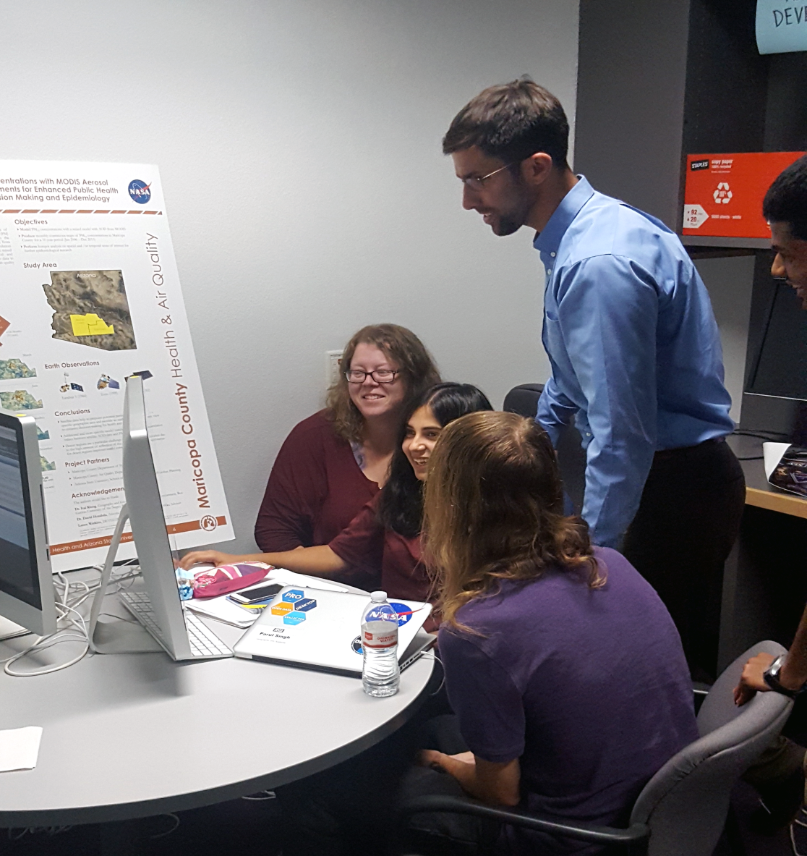
Science Advisors & Project Collaborators
Science Advisors play a vital role in the DEVELOP program. Not only do they oversee the scientific integrity of the projects, but they work with teams on a regular basis to build their scientific skills for the future.
Have a project idea? Tell us about it!
DEVELOP relies on the science community to create and advise new and current projects.
Have an expertise in Earth science? Volunteer to advise a project team!
DEVELOP is always accepting volunteer science advisors that would love to engage with you.

Slide 9
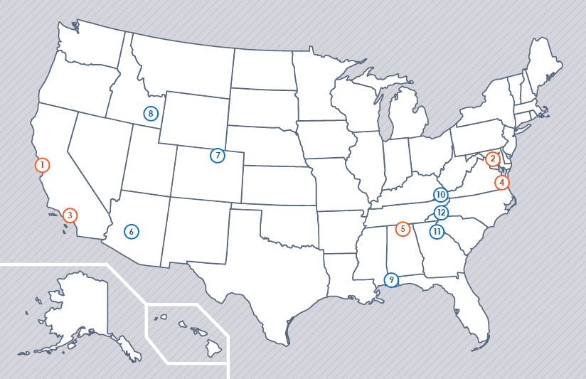
Where is DEVELOP?
NASA Centers
Ames Research Center – Moffett Field, CA
Goddard Space Flight Center – Greenbelt, MD
Jet Propulsion Laboratory – Pasadena, CA
Langley Research Center – Hampton, VA
Marshall Space Flight Center – Huntsville, AL
Regional Locations
BLM at Idaho State University – Pocatello, ID
Mobile County Health Department – Mobile, AL
NOAA National Centers for Environmental
Information – Asheville, NC
University of Georgia – Athens, GA
USGS at Colorado State University – Fort Collins, CO
Wise County Clerk of Court’s Office – Wise, VA
Maricopa County Department of Public Health
and Arizona State University – Tempe, AZ
1
2
3
4
5
8
1
7
2
10
4
6
v
12
7
3
v
6
5
11
v
8
v
9
9
v
10
v
11
v
12
v

Slide 10
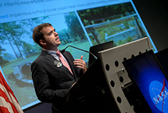




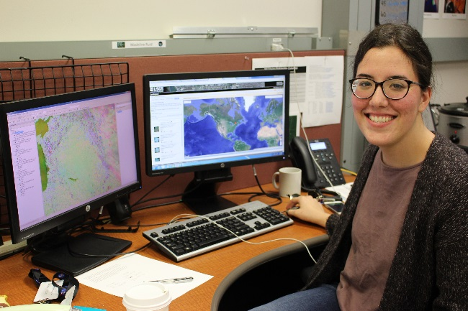


What Makes a Successful DEVELOPer?
CORE VALUES
COLLABORATION
INNOVATION
PASSION
DISCOVERY
DEVELOPers are passionate about the environment!
Notes:
1. Works well on a team
Collaboration is key
2. Willing to learn
Skills go beyond GIS and Remote Sensing
Participants learn to improve technical writing, presentation, professional skills
3. Flexible
Flexibility with project changes and learning to overcome challenges
4. Hard working and positive
There is a lot to accomplish in 10 weeks
5. Motivated and seeks to motivate others
Projects are unique and led entirely by DEVELOP teams
Eager to problem solve
DEVELOPers are passionate about the earth and excited to grow!

Slide 11
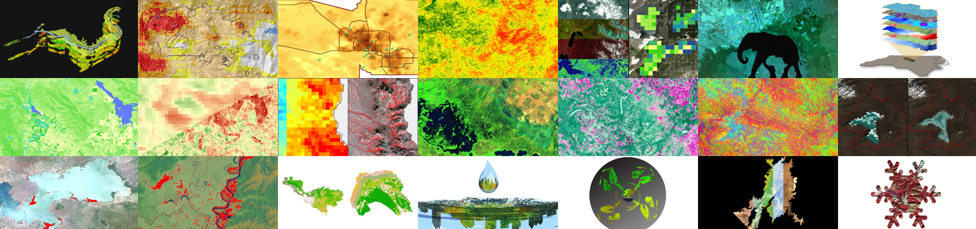
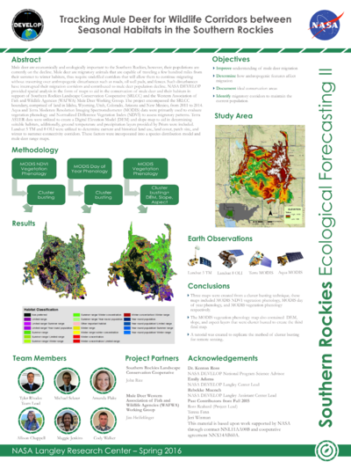
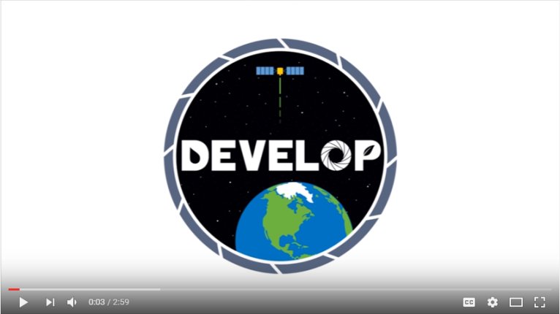
Deliverables
Throughout the 10 weeks, teams complete a variety of deliverables to communicate their research! These include:
Project Summary
Technical Report
Poster
Presentation
Video
Project Imagery
Project Page on DEVELOP’s internal Wiki

Slide 12
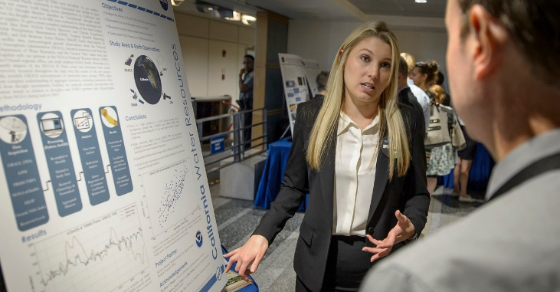
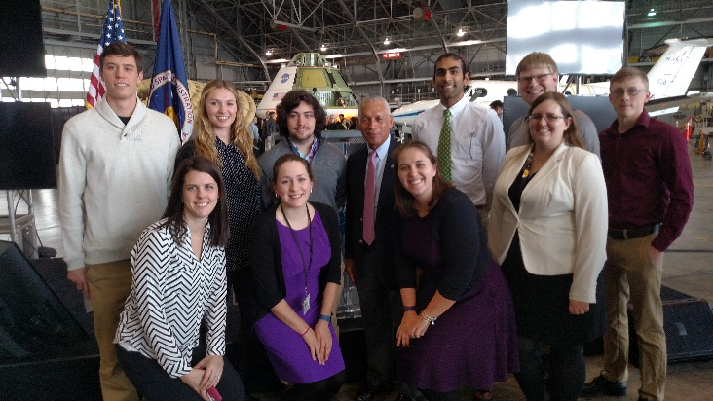

Participant Eligibility
Age 18+ with a minimum 3.0 GPA
Current students, recent graduates, early career professionals, transitioning career professionals, US Military service members & veterans
Interdisciplinary backgrounds (majority from STEM fields), no experience is required but a strong interest in GIS, remote sensing, and science is important
US Citizens & Foreign Nationals*
* US citizenship required to apply to DEVELOP locations at NASA Centers. Foreign nationals must be currently enrolled or recently graduated an accredited U.S. school. Acceptances are conditional upon proof of a visa or approved CPT/OPT that will allow them to legally work within the U.S.
Three 10-week terms per year
Spring, Summer, and Fall
Participants must reapply each term

Slide 13
Participant Opportunities
Common Majors
Common Software and Programming Languages
Geography
Environmental Science
Computer Science
Remote Sensing
GIS
Biology
Engineering
Chemistry
Meteorology
Physics
Accounting
Economics
Mathematics
Public Policy
Communications
ESRI ArcGIS
ERDAS IMAGINE
ENVI/ IDL
Python
MATLAB
R
Microsoft Office Suite
Google Earth Engine
Fall Term 2017
September 11th – November 17th
Apply Online:
May 22nd – June 30th
Paid and volunteer positions offered! Pay level is determined by education level and DEVELOP location

Slide 14
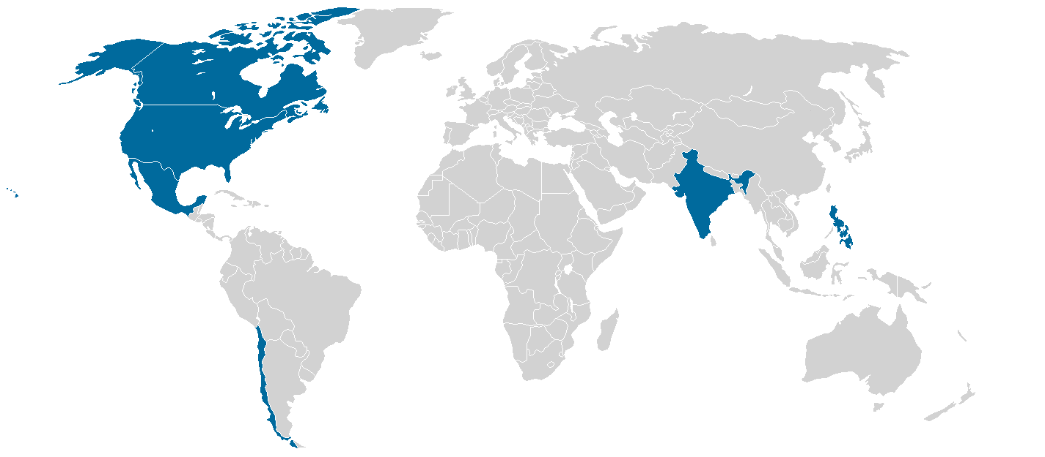
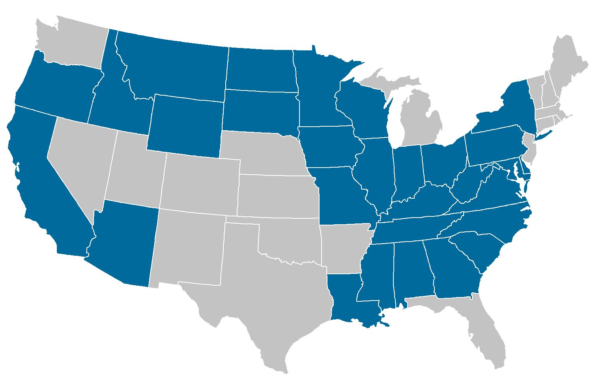
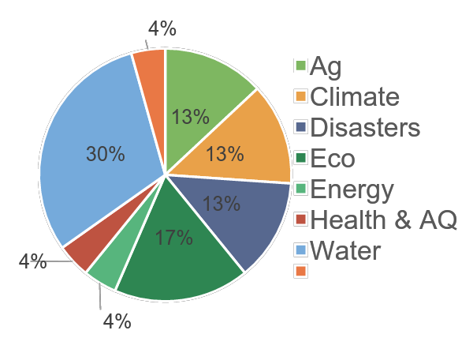
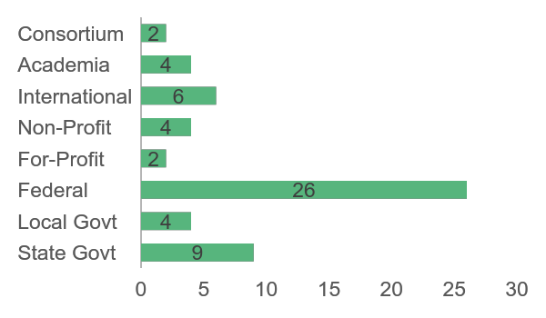
Spring 2017 Stats
22
Projects
30 States & 6 Countries Impacted
87% Domestic
13% International
1st TERM (17)
Application Areas Addressed
Partner Total by Type
57
Partners
2nd TERM (6)

Slide 15




Find DEVELOP on Social Media!
DEVELOP National Program: features projects, node highlights & accomplishments, VPS announcements www.facebook.com/developnationalprogram
Once a DEVELOPer, Always a DEVELOPer: job posts
https://www.facebook.com/groups/387243741376125/
Articles & Important Events: Tweet @NASA_DEVELOP or #NASADEVELOP
http://twitter.com/#!/nasa_develop
NASA DEVELOP National Program:
VPS and promotional videos www.youtube.com/user/NASADEVELOP
NASA DEVELOP National Program: features projects, node highlights & accomplishments, and VPS announcements
https://plus.google.com/+NASADEVELOP

Slide 16
THANK YOU!
QUESTIONS?
NASA-DL-DEVELOP@MAIL.NASA.GOV
Notes:
Thank you all so much for attending our Virtual Information Session. Now we will switch over to the Question & Answer portion. Please type your questions in the chat box and we will try to answer as many as we can in the remaining time.
*announce how much time we have left*
If we don’t get to your question, I encourage you to please reach out to our DEVELOP email which is displayed on this slide. Amanda, I’ll turn it over to you to read our first questions…

