Slide 1
ENVIRONMENTAL JUSTICE NEEDS ASSESSMENT
Health & Air Quality
Assessing the Needs and Capacity of Organizations Working Towards Health and Environmental Justice Related to Health and Air Quality
Elizabeth Duran
Paige Aldenberg
Sadie Murray
Thomas Schindelman
Virtual Environmental Justice
Notes:
[Liz] Hello! Thank you all for coming to our presentation. We are the Environmental Justice Health and Air Quality team, and we will be speaking with you today about our project titled "Assessing the Needs and Capacity of Organizations Working Towards Health and Environmental Justice Related to Health and Air Quality".
TIME: 17s (total: 17s)

Slide 2
Who we are
Liz Duran – Team Lead
Paige Aldenberg
Sadie Murray
Thomas Schindelman
Notes:
[Liz] To begin, I wanted to introduce our team. I am Liz, the team lead for the Health and Air quality team, and my incredible team members are Paige Aldenberg, Sadie Murray, and Thomas Schindelman.
TIME (assumed): 1m0s (total: 1m50s)

Slide 3
Outline
OVERVIEW
Project basics and our project objectives
METHODS
Deep dive into our outreach, dialogues and analysis methods
RESULTS
Conclusions from our data, as well as errors and uncertainties
CONCLUSION
Suggestions, future work and acknowledgements
Notes:
[Liz] First, we will take you through our project basics and our objectives. Next, we’ll take you through our process of collecting information and analysis methodology. Then we will discuss our results, including walking you through our StoryMap, Assessing Justice and Environmental Needs Assessment for Health and Air Quality or AJENDA . Finally, we will address our conclusions, errors and uncertainties and future work.
TIME: 33s, (total: 50s)
------------------------------Image Information Below ------------------------------
Image Credit to Microsoft PowerPoint icons

Slide 4
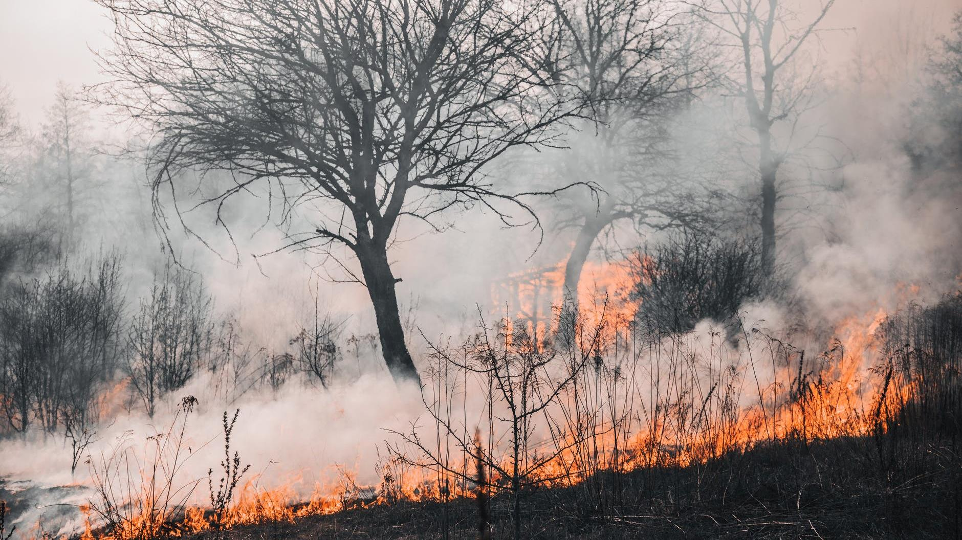
OVERVIEW
Image Credit: Vladyslav Dukhin
Notes:
[Liz] We will begin with an overview of our project.
------------------------------Image Information Below ------------------------------
Dukhin, V. (2020). Forest fire. [Image]. Pexels. Public Domain. Retrieved from https://www.pexels.com/photo/forest-fire-4070727/

Slide 5
Environmental Justice
"The fair treatment and meaningful involvement of all people regardless of race, color, national origin, or income, with respect to the development, implementation, and enforcement of environmental laws, regulations, and policies"
- EPA
"Today, zip code is still the most potent predictor of an individual's health and well-being"
- Dr. Robert Bullard
EXAMPLES OF ENVIRONMENTAL INJUSTICES
THREE TYPES OF JUSTICES
Distributive Justice
Procedural Justice
Lack of Green Space
Food Desert & Food Swamp
Intergenerational Justice
Contaminated Drinking Water
Notes:
[Liz] Environmental Justice: Environmental justice is defined by the U.S Environmental Protection Agency (EPA) as “the fair treatment and meaningful involvement of all people regardless of race, color, national origin, or income, with respect to the development, implementation, and enforcement of environmental laws, regulations, and policies.” It is a movement that began with activists, not with academics or researchers, and often explores the human relationship with their surrounding environment.
There are three main types of justices that contribute to EJ: distributive justice, procedural justice, and intergenerational justice. Distributive justice describes the equal distribution of benefits and burdens in an environment; procedural justice occurs with equitable institutional decision-making with respect to the values and interests of stakeholders; intergenerational justice focuses on preventing contemporary injustices from replicating themselves in the future. All three components influence and play a role in achieving environmental justice.
Dr. Robert Bullard, who is seen as the father of environmental justice, recently said," Today, zip code is still the most potent predictor of an individual's health and well-being." Where we live and what we live next to plays a large role in our health. Having a lack of green spaces (such as parks), living in a food desert or food swamp and not having access to drinking water are examples of environmental injustices that have detrimental health affects on populations.
------------------------------Image Information Below ------------------------------
Image Credit to Microsoft PowerPoint icons
TIME:

Slide 6
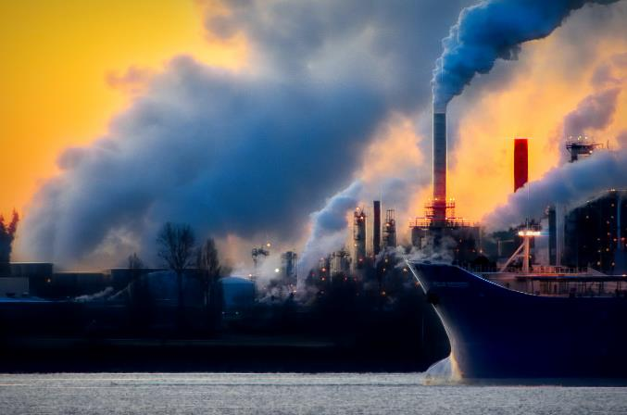
Health and Air Quality
"9 out of 10 people worldwide live in places where air quality exceeds WHO guideline limits"
-World Health Organization (WHO)
Image Credit: Chris LeBoutillier
Health Impacts of Air Pollution:
Cancer
Respiratory Disease
Asthma
Cardiovascular Disease
Morbidity and Mortality
Source Mullen et al. 2020; Rubio et al. 2021, WHO 2021
Notes:
[Liz] Health and Air Quality:
Air quality is recognized as the leading environmental risk factor and plays an important role in the health of individuals. According the World Health Organization, 9 out of 10 people worldwide live in places where air quality exceeds WHO global guideline limits. Throughout epidemiological literature, air pollution has been linked to many negative health impacts including cardiovascular disease, respiratory disease, asthma, cancer, mortality and more.
------------------------------Image Information Below ------------------------------
LeBoutillier, C. (2018). Black ship on body of water screenshot. [Image]. Pexels. Public domain. Retrieved from https://www.pexels.com/photo/black-ship-on-body-of-water-screenshot-929382/.

Slide 7
EJ, Health and Air Quality
Due to current and historical inequities, certain communities are exposed to unequal levels of air pollution, leading to health disparities.
Low Socioeconomic Status (SES)
Racial/Ethnic Minorities
Linguistic Isolation
Pre-existing Health Conditions
Communities most impacted by poor air quality conditions include:
These same communities often lack access to necessary resources such as:
Health Care
Legal Resources
Scientific Expertise
Notes:
For this project, we wanted to look at organizations in the entire United States working in the overlap of Environmental Justice and Health and Air Quality. Environmental justice in relation to air quality investigates the disproportionate distribution of air pollution and its health inequities and disparities. Communities are exposed to varying levels of air pollution but feel the negative impacts differently due to current and historical inequities, such as infrastructure and housing policies. This leads to health inequities and disparities. Communities who are most impacted are often from backgrounds of low ses, racial/ethnic minorities, linguistic isolation and more. These same communities often lack access to necessary resources such as healthcare, legal resources, scientific expertise and more.
TIME: 9s (total: 3m39s)

Slide 8
Project Objectives
Perform Needs Assessment
Create a Resource Directory
Connect Organizations to NASA
Determine Potential DEVELOP Projects
Notes:
The DEVELOP National Program set a goal to diversify their project reach and accessibility. The Health and Air Quality Needs Assessment team was created to address the regional gaps in projects related to air quality and environmental justice. We had four objectives for our work. First, we performed a needs assessment listening tour and engaged in discussions with organizations. Through these discussions, we determined opportunities for NASA Earth observations use in addressing their air quality and pollution concerns. Second, we created a living directory providing geospatial resources for organizations to use in addressing air quality concerns. Third, we connected organizations facing environmental injustice with NASA Applied Sciences personnel for future partnerships. Finally, we determined potential DEVELOP feasibility projects from our conversations with organizations.
TIME: 54s (total: 4m33s)
------------------------------Image Information Below ------------------------------
Image Credit to Microsoft PowerPoint icons

Slide 9
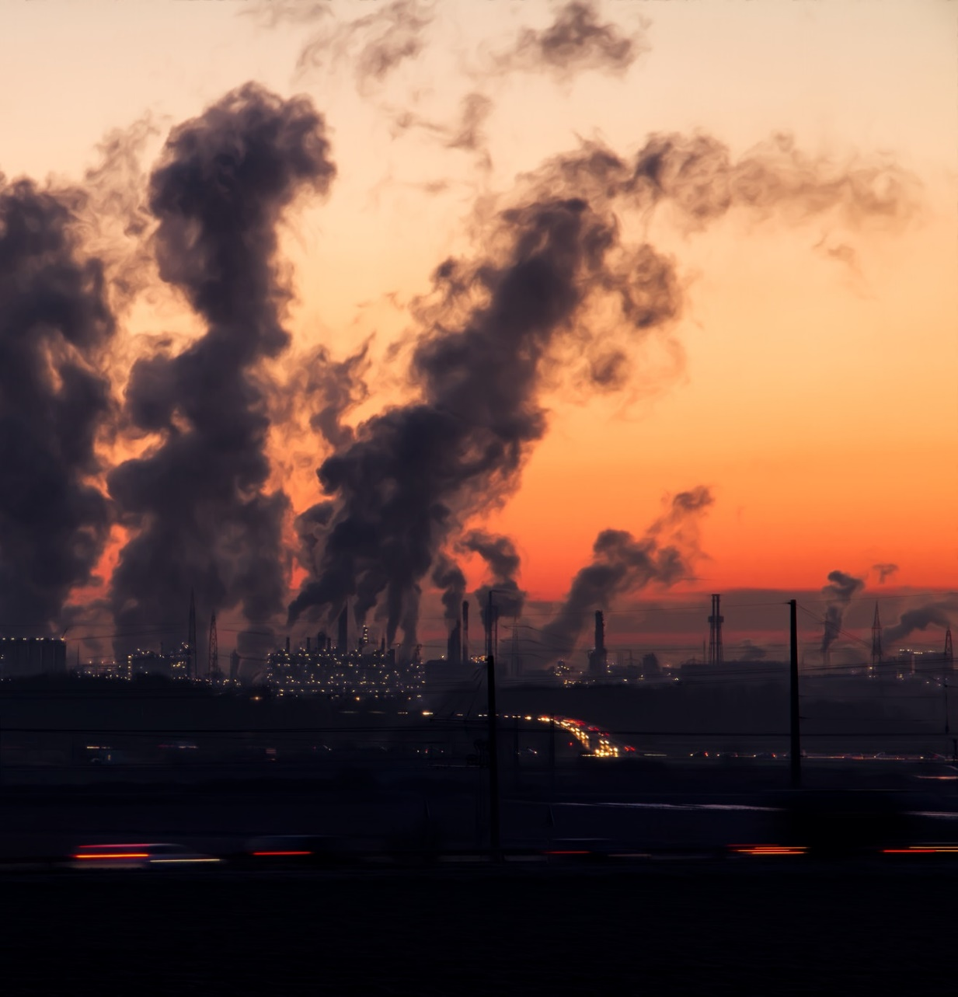
Heat
Industry
& Transportation
Core Target Areas
Wildfires
Misc.
Agriculture
Image Credit: Pixabay
Notes:
Since Health and Air quality is such a broad category, our team decided to narrow our scope by focusing on main sources of polluters. These core sources are : Wildfires, Industry and transportation, heat, agriculture, and other emissions, like volcanic emissions and Anthropogenic ones such as COVID and noise pollution. These five categories were chosen based on reoccurring themes throughout the literature and conversations with experts in the field.
------------------------------Image Information Below ------------------------------
Image Credit to Microsoft PowerPoint icons
Pixabay. (2016). Factory chimney smoke. [Image]. Pexels. CC0. Retrieved from https://www.pexels.com/photo/air-air-pollution-chimney-city-221000/.

Slide 10
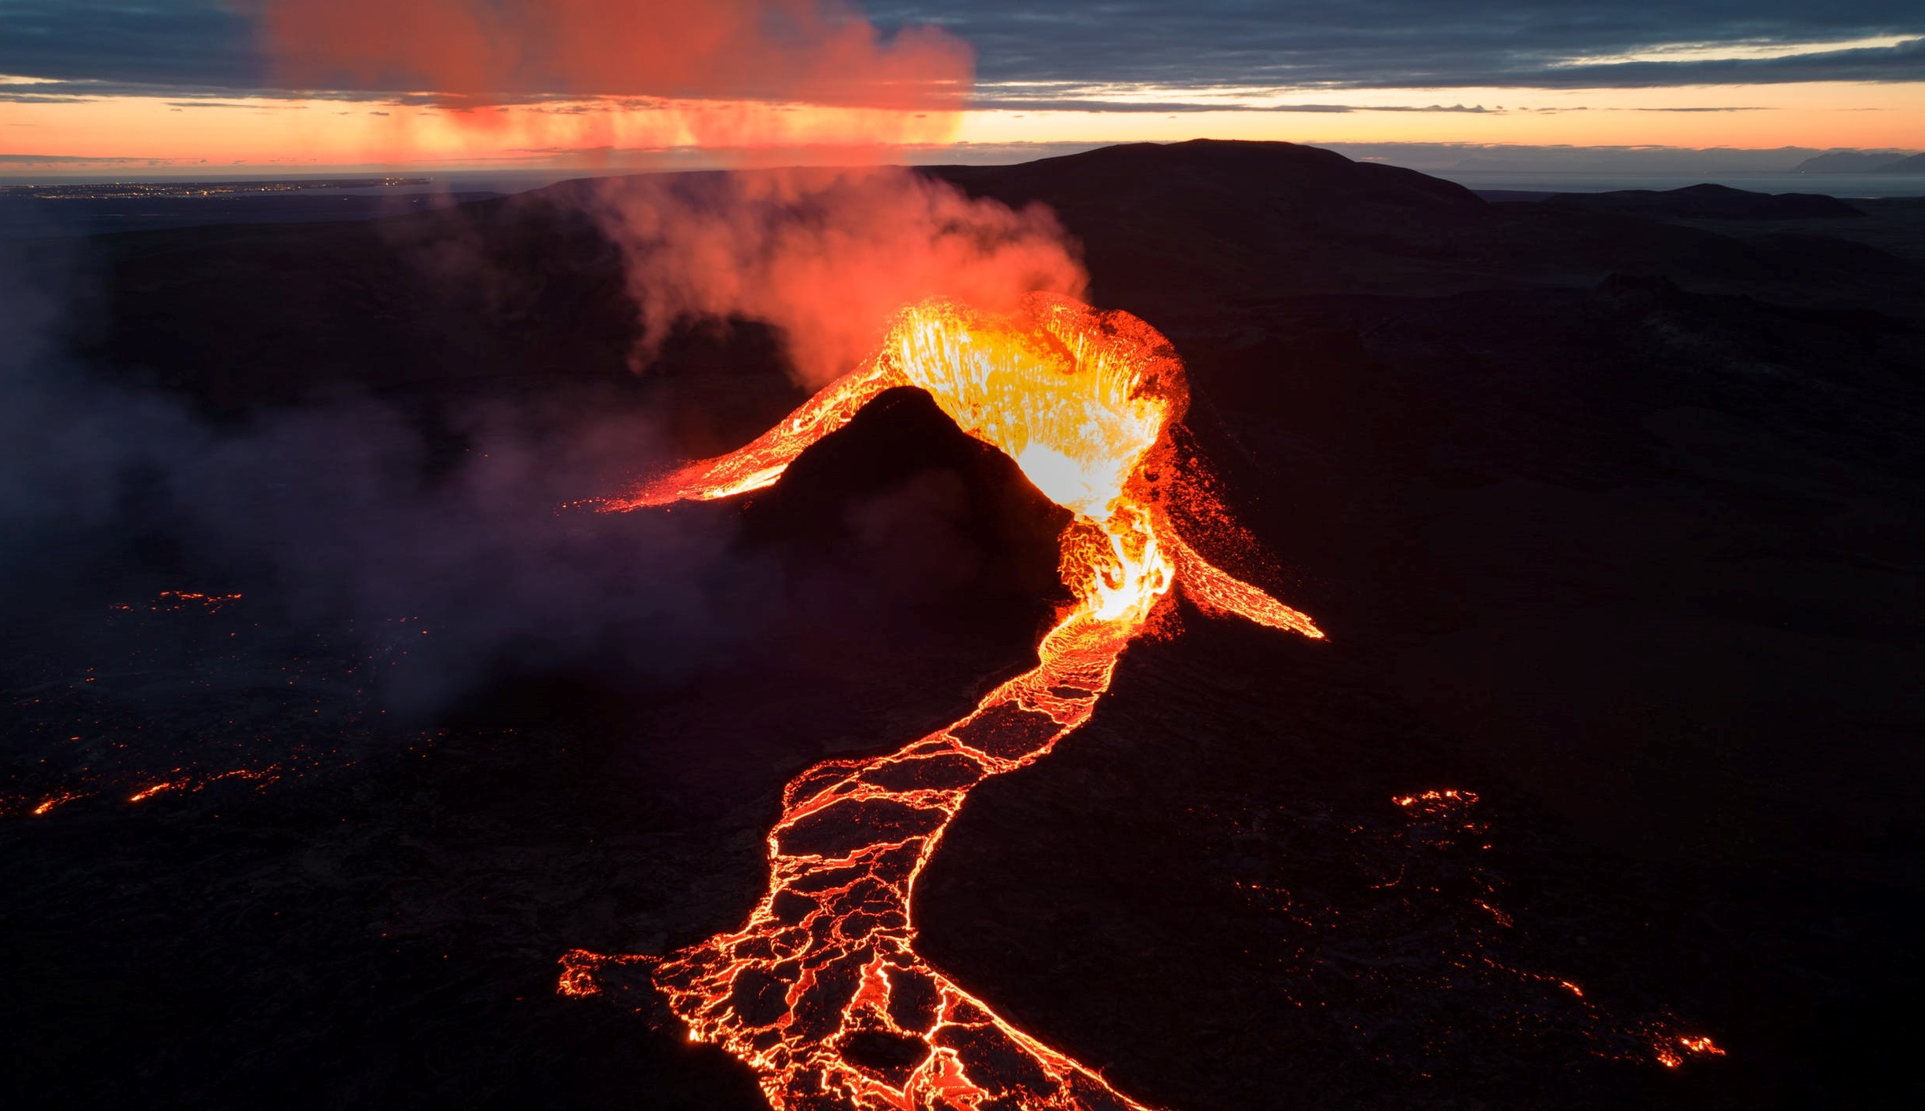
METHODOLOGY
Image Credit: Björn Austmar Þórsson
Notes:
I will now pass it on to [NAME] to discuss more about our methodologies for this project.
------------------------------Image Information Below ------------------------------
Austmar Þórsson, B. (2021). Orange and white lightning on black sand. [Image]. Pexels. Public domain. Retrieved from https://www.pexels.com/photo/orange-and-white-lightning-on-black-sand-8479590/.

Slide 11
Organizations & Outreach
Image Credit: fauxels
Researched US-based organizations focused on EJ, health and air quality
Contacted 90+ organizations
Spoke with organizations to gather insights into needs
Notes:
[Name] To begin our listening tour, our team researched community organizations throughout the United states that focused on environmental justice, health and air quality and/or both. We found organizations through a combination of papers we read, Google searching, conversations with experts in the field and our own experience. To ensure large coverage, our team reached out to at least one organization per state. In total, we emailed 91 EJ organizations in the United States.
We created an email template with the EJ Disasters team that stated who DEVELOP was, what our goals were, and introduced the options for exchanging information.
------------------------------Image Information Below ------------------------------
Fauxels. (2019). Top view photo of people near wooden table. [Image]. Pexels. Public Domain. Retrieved from https://www.pexels.com/photo/top-view-photo-of-people-near-wooden-table-3183150/.
Image Credit to Microsoft PowerPoint icons

Slide 12
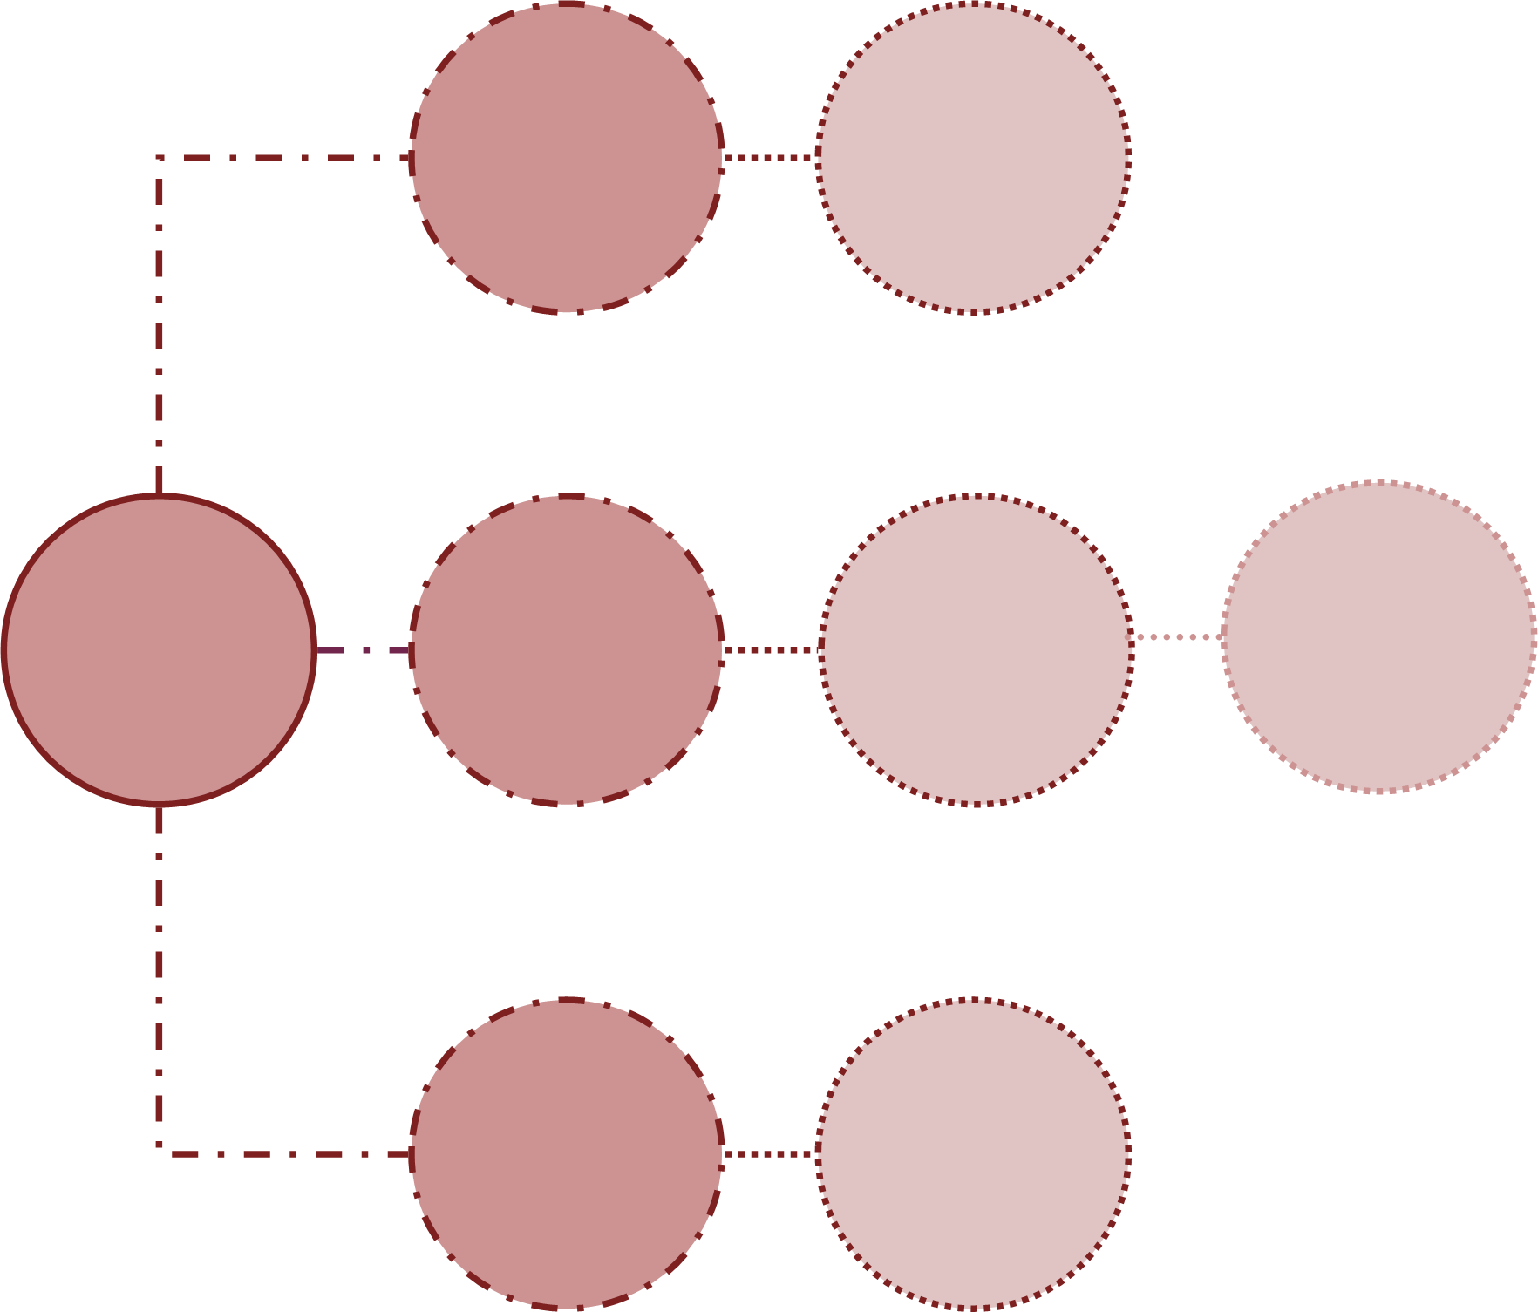
Send
Pre-Meeting
Questions
Interested, but Not Available
OUTLINE OF OUTREACH PROCESS
Send
Pre-Meeting
Questions
Reach out to
Organizations
via Email
Informational Exchange
Interested and Available
Not Interested/
No Response
Send Short
Assessment
Notes:
[Name] Prior to starting our conversations with the organizations that agreed to speak with us, the team gathered information about the organization. Organizations uninterested in speaking with us were sent a short, 5 minute assessment. Organizations interested in speaking with us were sent pre-meeting questions similar to those contained in the short assessment to better understand organizational needs and GIS capacity. Depending on organization responses to the initial email and the level of indicated interest, we sent either the pre-meeting questions or short assessment. Organizations that agreed to speak with us were scheduled in Calendly at times where at least two team members were available.

Slide 13
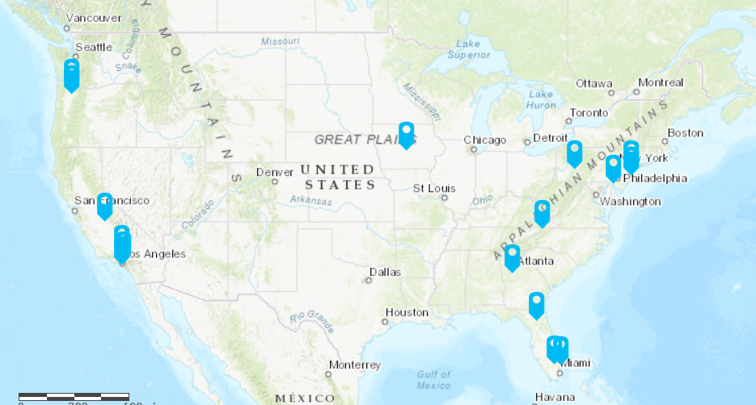
Discussions & Follow Up
30-minute conversations
Transcripts and notes taken with consent
Transcripts sent back to participants
NASA and geospatial technology resources provided
Follow up with organizations about possible further collaboration
N
0 mi
600 mi
Esri World_Topo_Map
Organizations engaged in conversations
Notes:
[Name] We conducted 30 minute long conversations that included 6 questions. A transcript was automatically taken via Teams, though at least one member of our team took notes on the meeting and proof-read the Teams transcript. After the transcript had been proofed and corrected, a copy was sent to the organizations to verify accuracy, along with links to resources they might find helpful in their work. Resources included educational resources, grant resources, mapping resources, and additional organizations they might be able to connect to. During and after each meeting, our team discussed potential future projects that DEVELOP could engage in with this organization. Project ideas were evaluated to determine the ones that would be most beneficial to both the organizations themselves and DEVELOP’s capacity building goals. We will continue this co-development of projects"
Basemap: World_Topo_Map from ESRI
Sources: Esri, DeLorme, HERE, TomTom, Intermap, increment P Corp., GEBCO, USGS, FAO, NPS, NRCAN, GeoBase, IGN, Kadaster NL, Ordnance Survey, Esri Japan, METI, Esri China (Hong Kong), swisstopo, MapmyIndia, and the GIS User Community

Slide 14
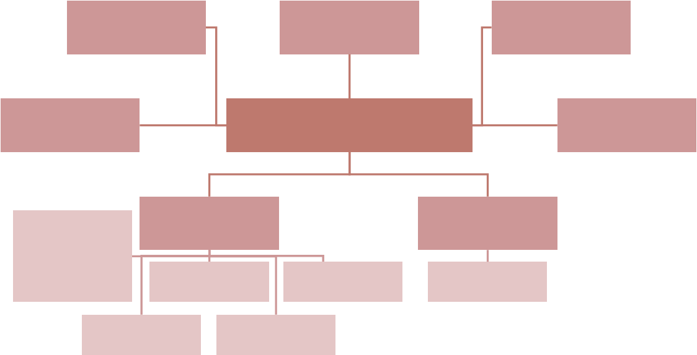
Analysis Methodology
Quantitative data analysis of information
NVivo and Word Cloud for themes from meeting transcripts
Challenges
NIMBY
Quotes
Demographics
NVivo Buckets
Region
Industry + Transportation
Sources
Technology
Heat
Wildfires
PurpleAir
Agriculture
Miscellaneous
Notes:
[Name]
For our analysis, we utilized a program called NVivo to review and assess our transcribed conversations for common themes and words spoken across all of our informational discussions. We created multiple NVivo buckets that helped characterize important words and phrases such as words related to sources, demographics, climate justice and more. NVivo also helped up create word maps that captured the main word/themes that a particular organization used.

Slide 15
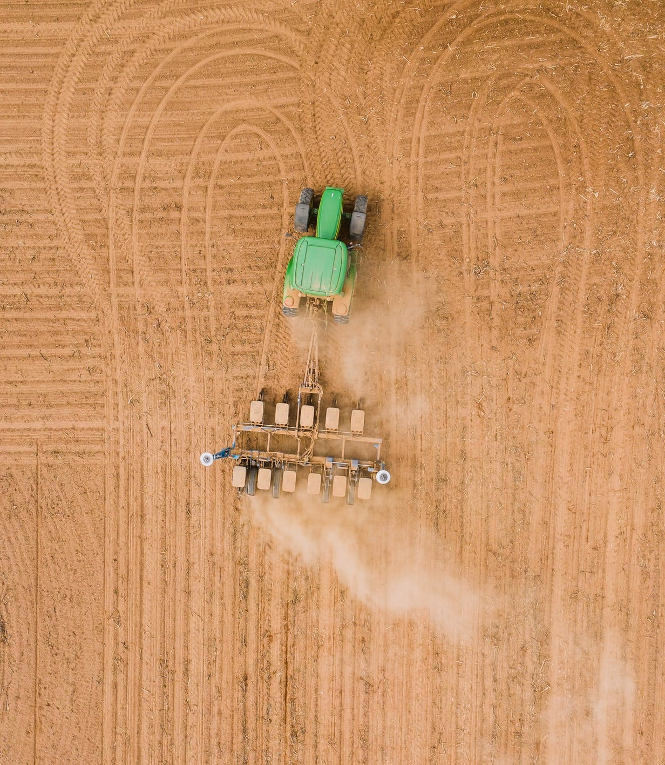
RESULTS
Image Credit: Kelly L
Notes:
[Name] I will now hand it over to [name] to discuss our results.
------------------------------Image Information Below ------------------------------
L., K. (2020). Field engine ploughing plantation in daylight. [Image]. Pexels. Public domain. Retrieved from https://www.pexels.com/photo/field-engine-ploughing-plantation-in-daylight-4394323/.

Slide 16
Health and Air Quality Concerns Addressed
Results
7%
8%
8%
Resource Mining
38.5% Response Rate
17.6% Acceptance Rate for Additional Communication
Disease
7%
19%
Transportation & Infrastructure
Industry
Agriculture
7%
Heat
22%
Wildfires
22%
Other
Sector of Work
40% of organizations mentioned the use of PurpleAir monitors
General concerns shown with current length of DEVELOP Projects
2%
4%
Healthcare
11%
17%
Aid
2%
Education
Air Quality Monitoring
Community Building
13%
18%
Research
Policy
Community Organizing
15%
Other
18%
Notes:
[Name] From our initial outreach to the 91 organizations, we received more than a 38.5% response rate with 17.6% accepting the request for a conversation. In these discussions, 40% of the organizations mentioned that they used PurpleAir monitors in their communities. For the organizations that did not respond to our initial email, we sent a follow-up for a short correspondence. To the right you can see more data from all our correspondences combined for the concerns each organization addressed and the sector of their work. The top three concerns were Transportation and Infrastructure, Industry, and Heat. The top three sectors of work were Research, Policy, and Community Organizing. Through our discussions, a common concern EJ organizations expressed was the current length of DEVELOP projects.
------------------------------Image Information Below ------------------------------
All graphs created by the VEJ HAQ team via Microsoft Excel and PowerPoint

Slide 17
Results
6%
Worked with GIS before
60% small-scale organizations
40% large-scale organizations
Common desired research themes:
Demographic and health data
Real time monitoring data
Smaller than or equal to census tract data
Yes
No
33%
Not Sure
61%
3%
24%
Resources Desired*
Educational Materials
DEVELOP Collaboration
38%
Grant Resources
Other
None (0%)
35%
*Follow-up correspondence not included
Notes:
Additionally, 61% of the organizations worked with GIS before in some capacity and the most common resources desired to continue their work was grant resources and a collaboration on a DEVELOP project. Mapping out our organizations, we found that 60% of the organizations were small-scale, meaning they only had one office, and 40% were large-scale, meaning they had multiple offices across their state or across multiple states. Common themes we saw were that many organizations wanted to look at demographic and health data, like from local hospitals, and also for this data to be in real time and focused on a specific area rather than state or region-wide.
------------------------------Image Information Below ------------------------------
All graphs created by the VEJ HAQ team via Microsoft Excel and PowerPoint

Slide 18
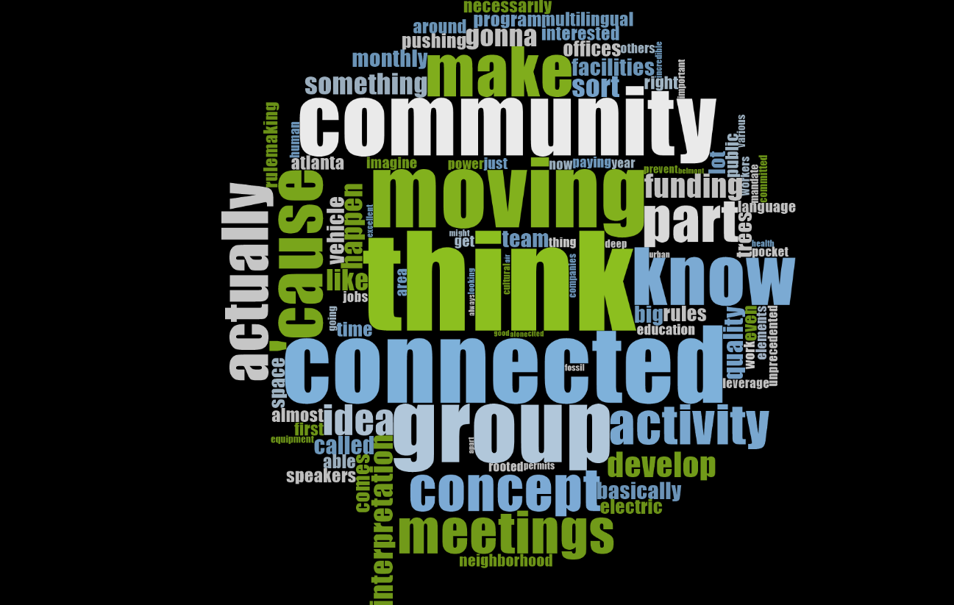
Results
Gained insight on the focus of the organizations' activities, priorities, challenges, demographics, capacity and solutions
Capacity issues consistent across organizations
Diesel was the most common miscellaneous pollution source mentioned
Racial justice was the biggest focus
Word cloud of Organizations' Priorities
Notes:
Of the conversations we completed, we were able to include 70% of them in our preliminary analysis seen here. Our preliminary analysis of the information revealed a few patterns: first, organizations activities focused on advocacy, whether educational or legal; second, organizations shared concerns over the inadequacy of data to address community issues especially at very fine scales; third, organizations shared a distrust of potential bad faith actors in the environmental justice world, including governmental bodies. The word cloud on your left is made up of the most common word said by each organization in regards to "Priorities" (Please note this is based on our preliminary data). Common themes and insights that we found throughout our analysis was that capacity was a common issue across all organizations, regardless of an organizations' scale/size. Diesel was the most common miscellaneous pollution source, and organizations seem to largely be talking about racial justice rather than socioeconomic or other justices.
------------------------------Image Information Below ------------------------------
All graphs created by the VEJ HAQ team via Microsoft Excel and PowerPoint
Word Cloud was created by the VEJ HAQ team via NVivo

Slide 19
A.J.E.N.D.A.
Assessing Justice and Environmental Needs Directory for Air Quality
Home to DEVELOP public resources relating to EJ work and goals
Further updated by the EJ fellow as DEVELOP's EJ work grows
Screen recording of AJENDA
Notes:
One of our goals for this project was to create a directory for the partners we engaged and for potential future partnerships. This directory will be a continuously updated ArcGIS StoryMap that is home to DEVELOP's goals for environmental justice work, how the initiative began, resources, and DEVELOP contacts. We named our StoryMap AJENDA, which stands for Assessing Justice and Environmental Needs Directory for Air Quality.
------------------------------Image Information Below ------------------------------
Screen recording provided by the EJ HAQ team.

Slide 20
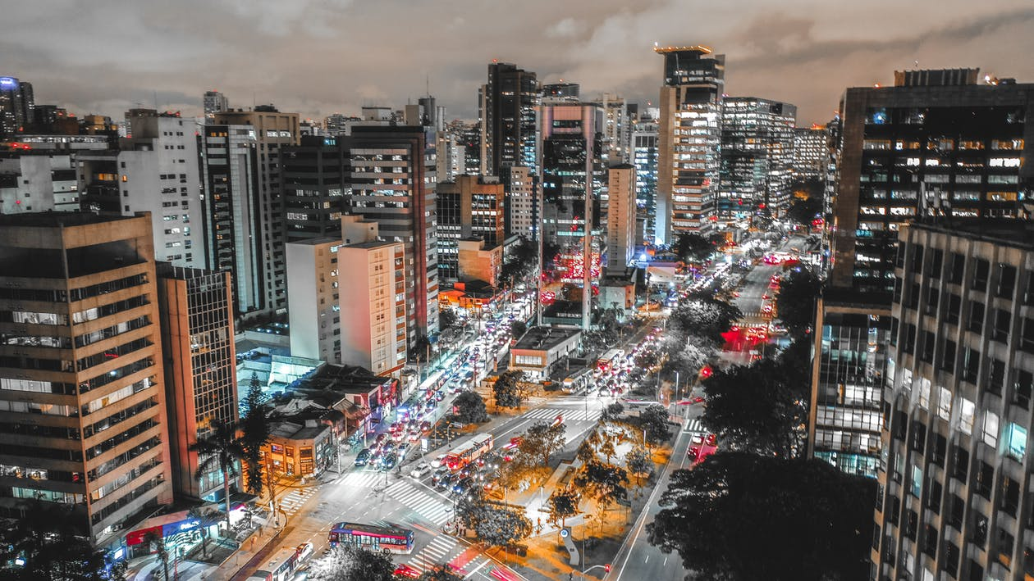
CONCLUSIONS
Image Credit: Sergio Souza
Notes:
I will now pass it on to Paige to discuss more about our conclusions for this project.
------------------------------Image Information Below ------------------------------
Souza, S. (2019). Ariel photo of city buildings during nighttime. [Image]. Pexels. Public domain. Retrieved from https://www.pexels.com/photo/aerial-photo-of-city-buildings-during-nighttime-2299571/.

Slide 21
Conclusions
Top Concern of Organizations: Transportation and Industry
Many organizations willing to talk with us acted as proxy for frontline communities
EJ work requires commitment!
Need to marry demographic/vector data with remotely sensed/raster data
Notes:
[Paige] From our research, we found the top concern regarding Health and Air Quality was transportation and industry.
We also found that most organizations willing to talk with us acted as a bridge between frontline community stakeholders and the governments and other parties they were communicating with instead of being the frontline communities themselves. It is also important to note that our findings are not all encompassing of all environmental injustices felt within communities throughout the US. We did not get to speak to organizations that represented specific identities or communities. For example, none of our organizations interviewed explicitly identified as LGBTQIA or were indigenous peoples.
Overall, building trust with these organizations created a large degree of uncertainty, given the very short time we had to communicate with them. Similar organizations doing environmental work spoke about spending months building trust with organizations prior to partnering, which is currently / inherently a challenge due to length of DEVELOP terms and projects.
Furthermore, __% of those spoken to expressed the desire to use vector data with raster data, implying a need to incorporate or account for this data in EJ DEVELOP projects in the future.
------------------------------Image Information Below ------------------------------
Image Credit to Microsoft PowerPoint icons

Slide 22
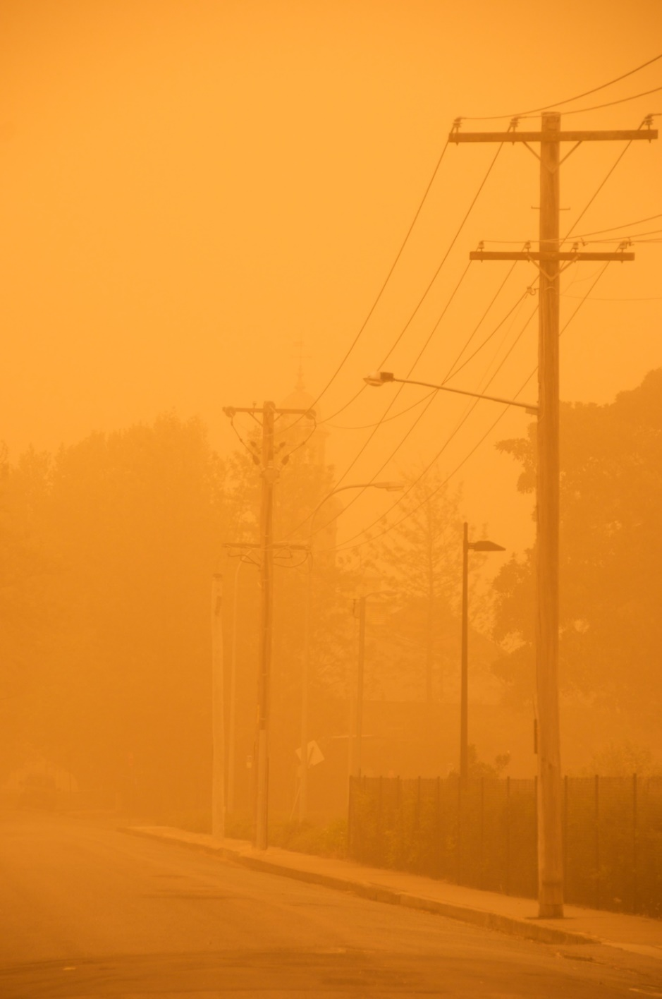
Errors & Uncertainties
Refine outreach methodology
Limited by time frame
Scope could be widened
Underestimation of interview length
Image Credit: Nomad Tales
Notes:
[Paige] Out of the 91 organizations we contacted, only a little more than 25% got back to us, making the low response rate a major source of error in our work. Another issue we ran into was that many of our initial emails were flagged as spam or were distrusted due to issues with our SSAI email not looking like a NASA email. Overall, building trust with these organizations created a large degree of uncertainty, given the very short time we had to communicate with them. Similar organizations doing environmental work spoke about spending months building trust with organizations prior to partnering, which we are unable to do due to the inherent limitations of DEVELOP terms and projects. [Frame this as an important step by DEVELOP] Finally, our initial search for organizations was not exhaustive and there are undoubtedly countless organizations we missed. Furthermore, our meetings easily surpassed the 30 minute initial time, with most discussions averaging 45-50 minutes long. Organizations had a lot to say even with just the 6 questions presented. As a result, we recommend for future projects to plan and schedule larger blocks of time for conversations.
------------------------------Image Information Below ------------------------------
Nomad Tales. (2009). Dust storm. [Image]. Flickr. CC BY-SA 2.0. Retrieved from https://www.flickr.com/photos/pnglife/3946489571/in/photolist-71JMRD-2kM53hJ-hDQPzu-FoGVPQ-2jLRKdW-a13BLS-duJtE-9ZZLHe-dowF5v-oG6gvj-6FZ8nY-73DzNF-a4Zdkc-FGXn8F-FEDgWh-FoGYLG-9v4WQw-71Cnpa-71Go3o-71GowC-71VWVa-71Gotj-2kALSnC-71NM4s-71GoyQ-71GTgm-71GomL-cfvU9q-71God7-71Go1m-7Th7ew-71LcMo-FoGXYQ-71Gch6-2jhMvze-6RTLL6-71GbeZ-71JYUc-64fVrV-71GbxH-71Gcf2-2jLudEY-71LbQy-71LbJ7-71Gc5F-71GbJp-5j8gX4-opbnaR-71GbLk-71LccY.

Slide 23
Next Steps and Future Considerations
Short Term
Contribute best practices guide to future EJ projects
Develop a directory of resources and share it with the organizations we have engaged in a dialogue
Offer several potential project ideas that DEVELOP can pursue with these organizations
Notes:
[Paige] In the short term, we will be codifying best practices for future environmental justice terms, developing a working directory of resources to share with the organizations we engaged in a dialogue with, and provide DEVELOP with several potential project ideas we have pursued further with these organizations that future DEVELOP EJ teams can pursue.
------------------------------Image Information Below ------------------------------
Image Credit to Microsoft PowerPoint icons

Slide 24
Long Term
Next Steps and Future Considerations
Long Term
Clarification of SSAI’s role in support of the NASA DEVELOP Program and projects
Follow up with organizations for future DEVELOP projects
Alternative timeline for DEVELOP environmental justice projects
Notes:
[Paige] In the long term, we hope to clarify SSAI’s role in support of the NASA DEVELOP Program and projects. Our emails were sent from SSAI addresses and by providing additional clarification of our role as science support interns, we hope to build trust more quickly with the organizations. We will continue to follow up with organizations and develop future projects, as well as explore an alternative timeline or set of deliverables for environmental justice projects.
------------------------------Image Information Below ------------------------------
Image Credit to Microsoft PowerPoint icons

Slide 25
Fellow
Marco Vallejos
Science Advisor
Lauren Childs-Gleason, NASA Langley Research Center
Other NASA Personnel
Dr. Kenton Ross, NASA Langley Research Center
Ryan Hammock, Creative Communications
Tamara Barbakova, Project Coordination
Additional Support
Dr. Jennifer Pipitone, Mount Saint Vincent College
Sara Grineski, University of Utah Professor
Timothy Collins, University of Utah Professor
Dr. Tarik Benmarhnia, UC San Diego Professor Environmental Epidemiologist
DEVELOP Virtual Environmental Justice Disasters Team
Notes:
[Paige] Once again, thank you so much for attending our presentation. Before we close, our team would like to give a huge thanks to our Fellow, Marco Vallejos, as well as our science advisor Lauren Childs-Gleason, who really encouraged us to take this project in whatever direction we found most helpful. We also want to thank others who significantly impacted our work, including Dr. Jennifer Pipitone, Sara Grineski, Timothy Collins, Dr. Tarik Benmarhnia, along with others within the DEVELOP Program, such as the entirety of the Environmental Justice Disasters Team, Dr. Kenton Ross, Tamara Barbakova, and Ryan Hammock.

Slide 26
Organizations Engaged
Robin Kemp, The Clayton Crescent
Mary Peveto, Neighbors for Clean Air
Steve Guyer, Iowa Environmental Council
Matt Hepler, Appalachian Voices
Amy Goldsmith, Clean Water Fund
Patrick Ferguson, Stop the Burn
Kieshaun White, Healthy Fresno Air
Dr. Erica Key, Future Earth
Bahram Fazeli, Communities for a Better Environment
Dr. Jason Douglas, Communities for a Better Environment
Matt Walker, Clean Air
Victoria Sanders, NYC– EJA
Eddie Bautista, NYC– EJA
Sara Wright, Oregon Environmental Council
Jamie Pang South, Oregon Environmental Council
Jana Gestellum, Oregon Environmental Council
Meisha Rainman, CicLAvia
Rachel Burke, CicLAvia
Alex Merlino, CicLAvia
Abigail Franks, Southeast Climate and Energy Network
Alexander Easdale, Southeast Climate and Energy Network
Sophia Pessagno, Southeast Climate and Energy Network
Shannon Smith, FracTracker Alliance
Matt Kesler, FracTracker Alliance
Notes:
[Paige] This project would not be possible without the organizations we learned so much from regarding environmental justice. Thank you all for your contributions, and with that, we will open the floor for any questions.

Slide 27
Optional Slides

Slide 28
A.J.E.N.D.A.
Assessing Justice and Environmental Needs Directory for Air Quality
Home to DEVELOP public resources relating to EJ work and goals
Further updated by the EJ fellow as DEVELOP's EJ work grows
Screen recording of AJENDA
Video Credit: Sakura Studio Videoproduktion
Notes:
One of our goals for this project was to create a directory for the partners we engaged with and for potential future partnerships. This directory will be a continuously updated ArcGIS StoryMap that is home to DEVELOP's goals for environmental justice work, how the initiative began, resources, and DEVELOP contacts. We named our StoryMap AJENDA, which stands for Assessing Justice and Environmental Needs Directory for Air Quality.
------------------------------Image Information Below ------------------------------
Sakura Studio Videoproduktion (2020). Drone footage of a volcanic crater [Video]. Pexels. Public domain. Retrieved from https://www.pexels.com/video/drone-footage-of-a-volcanic-crater-4237849/ .

