Slide 1
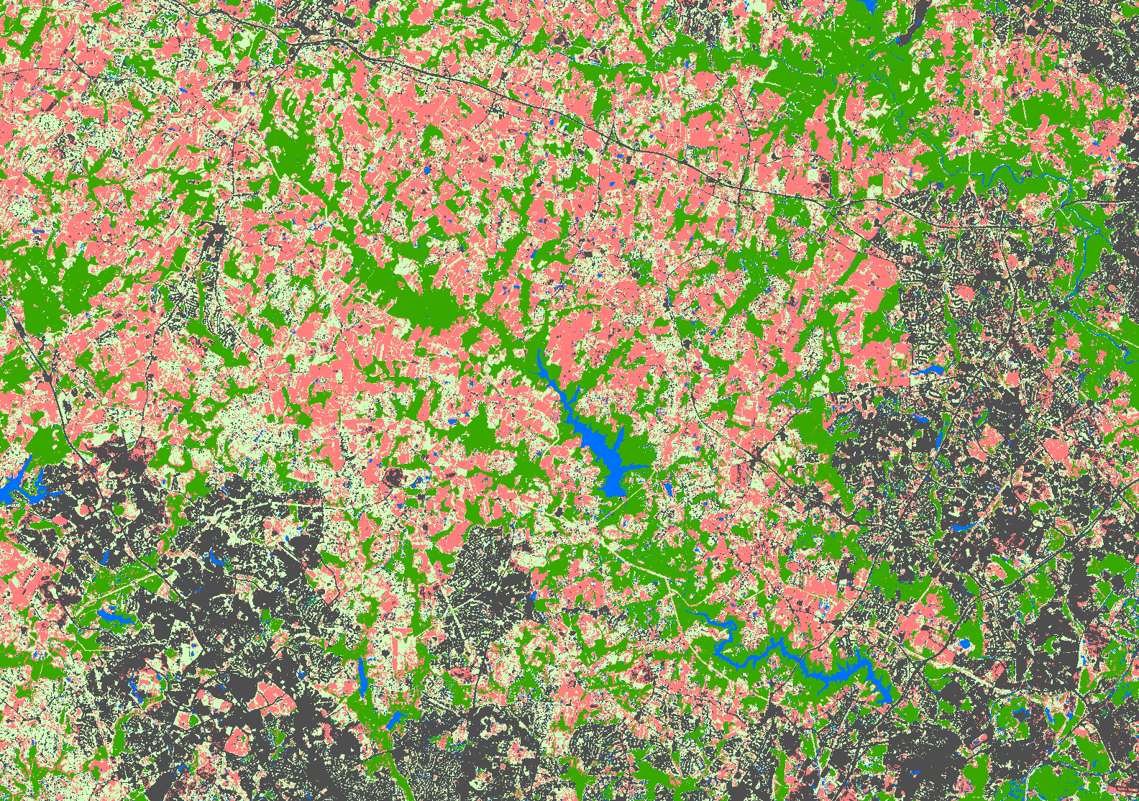
N
Crops
NonCrop
Water
Forest
0
5
10
Miles
Urban
Patuxent Water Resources
Caption: A supervised classification method is applied to a Landsat 5 Thematic Mapper image from July 1996, showing the Upper Patuxent Watershed. The image is incorporated into a synthetic raster dataset to track LULC changes associated with water quality.
Metadata Tags: water quality, watershed, land cover change, land use change, change analysis, agricultural runoff

