Slide 1
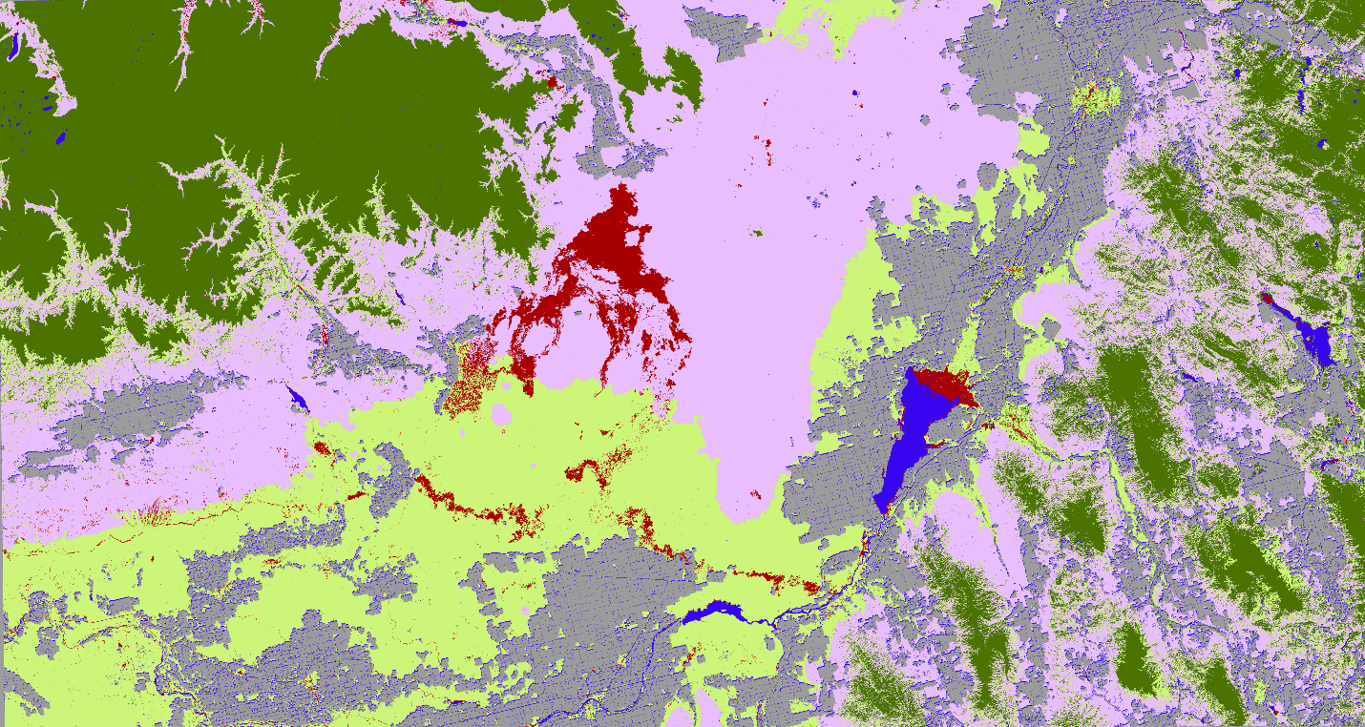

Courtney Ohr
(Project Lead)
EASTERN IDAHO DISASTERS
Utilizing NASA Earth Observations to Identifying Critical Wildlife Habitat Areas Threatened by Heightened Wildfire Susceptibility for Improved Conservation and Management Practices
Priscilla Addison
Jenna Williams
Notes:
In the summer of 2016, the Eastern Idaho Disasters team in Pocatello took on a project that looked into developing fire susceptibility models using remote sensing to identify mule deer and Greater Sage grouse habitats in the Sagebrush-Steppe ecosystem that may be threatened by wildfires.

Slide 2
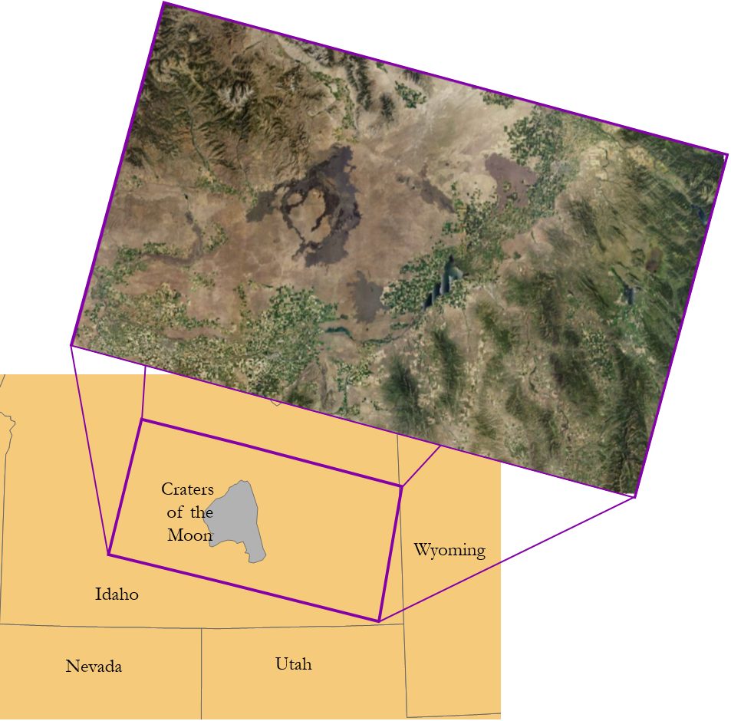
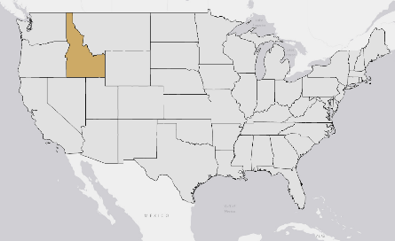
Area of Interest
Study Area
East Idaho
  Landsat-8 WRS-2 Path: 39 and 40 Row: 30
  Sentinel-2 R127
Case Study
  Craters of the Moon National Monument and Preserve
Study Period
Landsat-8
  June 2015
Sentinel-2
  June 2016
NAIP 2015
Notes:
The sagebrush-steppe ecosystem is home to many different types of flora and fauna. It is a resilient ecosystem that is able to handle many different environmental extremes but wildfires can be disastrous to the vegetation and as a result the wildlife habitats within it because landscape take a while to bounce back, if at all. Both mule deer and sage-grouse are dependent upon this ecosystem for habitat, forage, and breeding grounds.
This ecosystem is adapted to fires; historically, wildfires in this region would occur at long intervals allowing for native vegetation to re-establish. However, recent invasion of cheatgrass and other changes to the sagebrush-steppe ecosystem has altered this regime resulting in larger and more frequent wildfires, increasing the threat to the habitats. The goal of the project was to produce models that capture the fire susceptibility of the different habitats so park and land managers can proactively target threatened areas for fuel load reduction and intervention to help these species thrive.

Slide 3
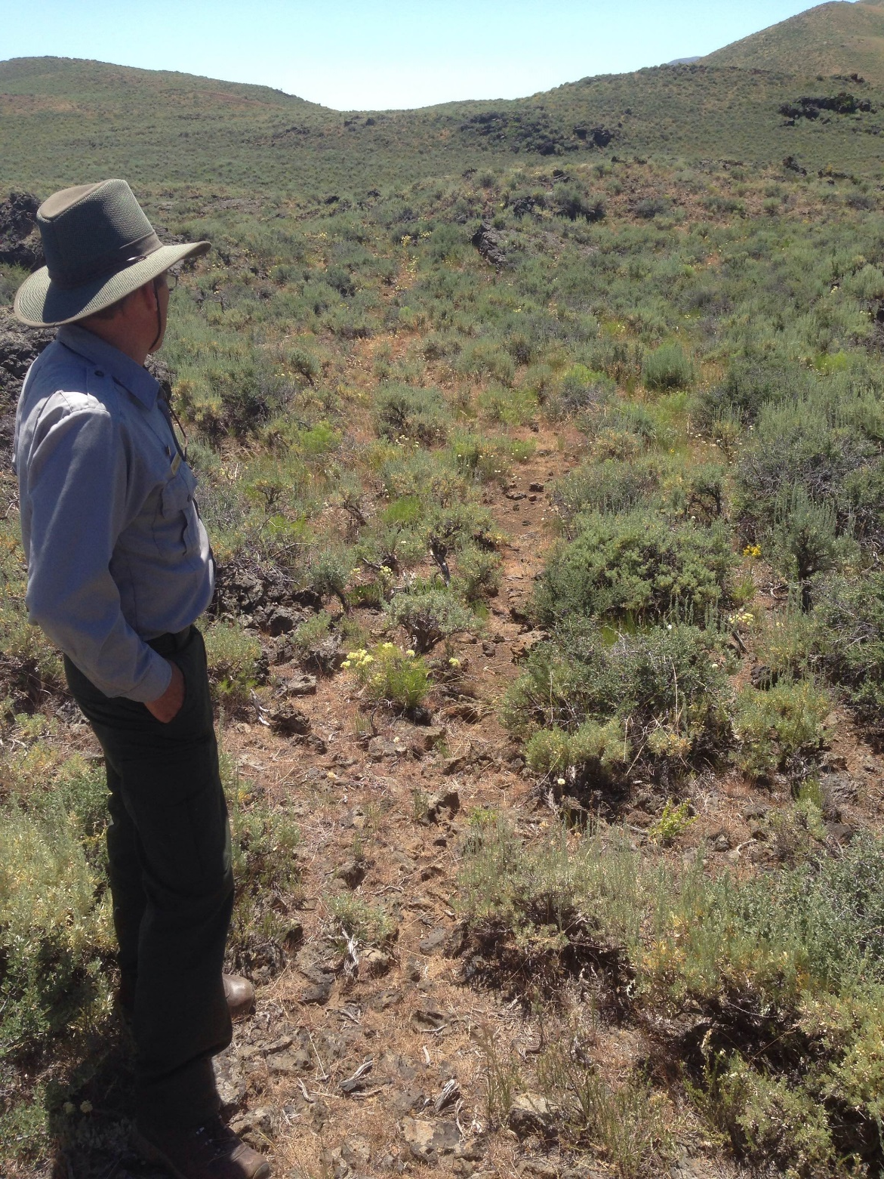
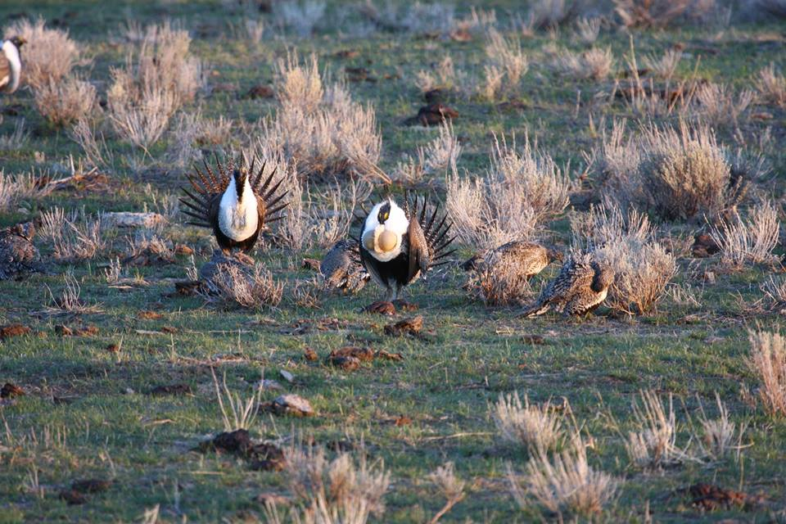
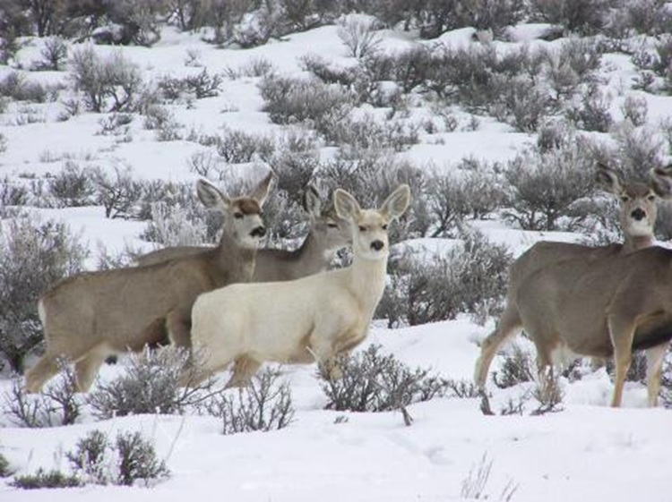
Objectives
Identify critical mule deer and the greater sage-grouse habitats that have an increased susceptibility to wildfires.
Compare performance of wildfire susceptibility models using 10 meter Sentinel-2 imagery versus 30 meter Landsat-8 imagery.
Image Credit: CRMO
To the left is a well documented mule deer migration path at Craters of the Moon
Image Credit: Jenna Williams
Image Credit: IDFG
Notes:
The objectives of the project were first, to build models to identify critical mule deer and the greater sage-grouse habitats that have increased wildfire susceptibilities based on the intrinsic factors of the landscape and secondly, to build the said models in different spatial resolutions to investigate their influence on output performance of the models.

Slide 4
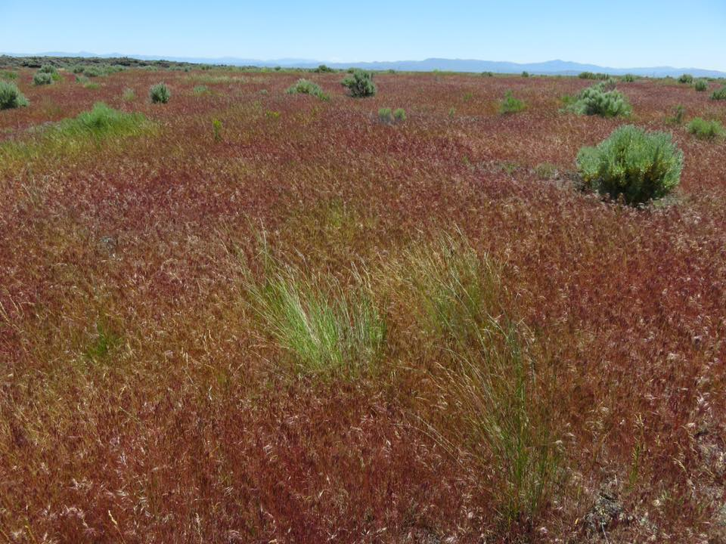
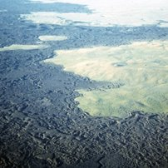
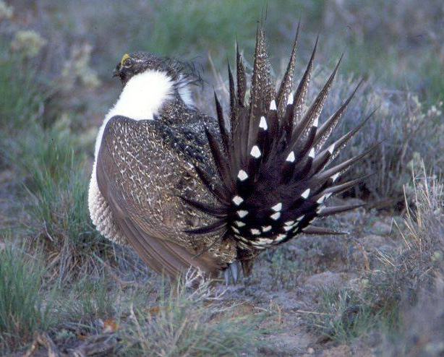
Image Credit: CRMO
Image Credit: CRMO
Image Credit: CRMO
Community Concerns
  Too many wildfire occurrences can induce biodiversity loss, disrupt ecosystems, and deplete resources
  Mule deer are an indicator species and common in big-game hunting
    150,000 hunters of mule deer in Idaho
  Sage-grouse are an umbrella species exclusive to sagebrush-steppe ecosystems
  Kipukas, islands of wildlife habitats throughout lava flows, are often not incorporated into broader habitat and vegetation analysis
Notes:
The motivation for this project was to address the concerns of our project partners, park and land managers at the Craters of the Moon National Monument and Preserve (CRMO) and Eastern Idaho Bureau of Land Management (BLM) .
There is a concern that too many wildfire occurrences in recent years are possibly inducing biodiversity loss, depleting resources and disrupting the Sagebrush-Steppe ecosystem . This increase in wildfires especially affects the mule deer population, which is an indicator of the health of the Sagebrush-Steppe ecosystem. Also, Idaho hunters rely on the survival of these species to sustain their hunting culture since mule deer form an important part of big game hunting.
The Greater Sage-grouse, is another species whose habitat is threatened by the recent spike in wildfires. These birds exhibit a strong sense of habitat fidelity and stay exclusively in the Sagebrush-Steppe ecosystem.
Finally, park managers at the CRMO especially need these models to assess the susceptibility of the habitats found within the park since current susceptibility models end at the outskirts of the park under the assumption that the rocky basalt formation “will not burn”. However, contrary to this assumption, found within this national park are kipukas, which are islands of vegetation and wildlife habitats. The CRMO may experience on average 4 fires annually so park managers are in dire need of a fire susceptibility model that will better inform them on where to focus their resources.

Slide 5
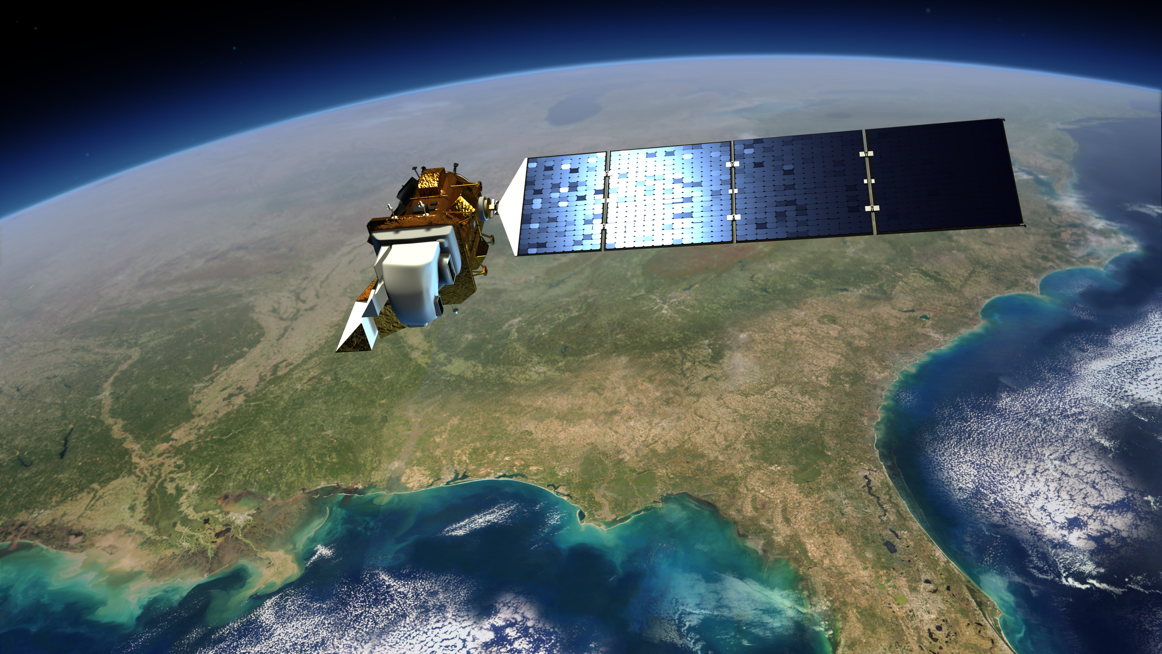
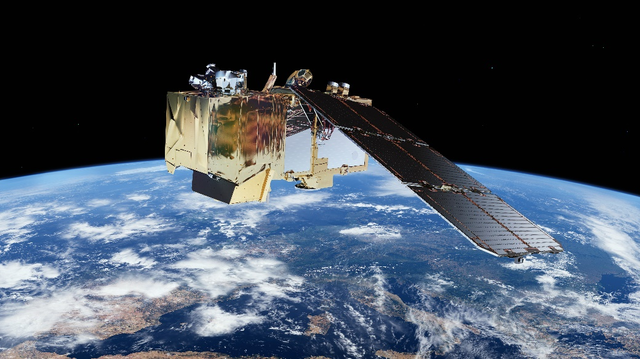
Earth Observations
Landsat 8 OLI
Joint NASA/USGS mission
Launched
  February 11, 2013
Temporal Resolution
  Every 16 days
Spatial Resolution
  30 meter
Continually archived
Sentinel - 2
European Space Agency
Launched
  2013
Temporal Resolution
  5 days with 2 satellites
Spatial Resolution
  10 meters
6-month rolling archive
Image Credit: NASA
Image Credit: esa.int
Notes:
For the analyses, we leveraged 30 meter Landsat-8 Operational Land Imager imagery and 10 meter Sentinel-2 imagery to investigate the influence of spatial resolution on output performance.

Slide 6
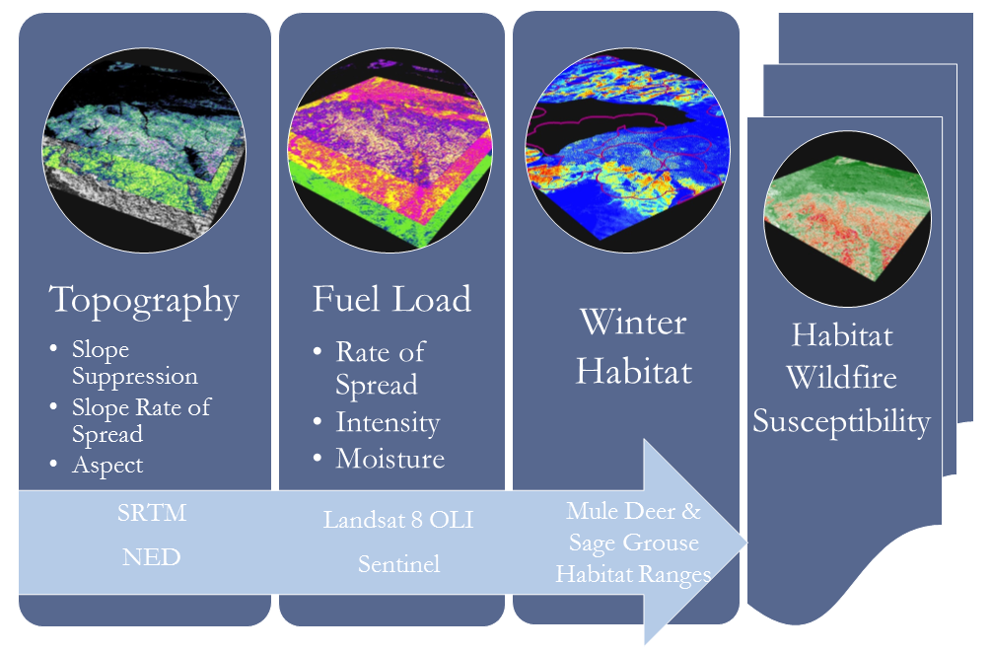
Methods Overview
Notes:
The analyses were done using only intrinsic parameters of the landscape with no consideration to external factors such as ignition sources or weather since these inherent are the most important to susceptibility models. The factors were topography, fuel loads, and habitat suitability.

Slide 7
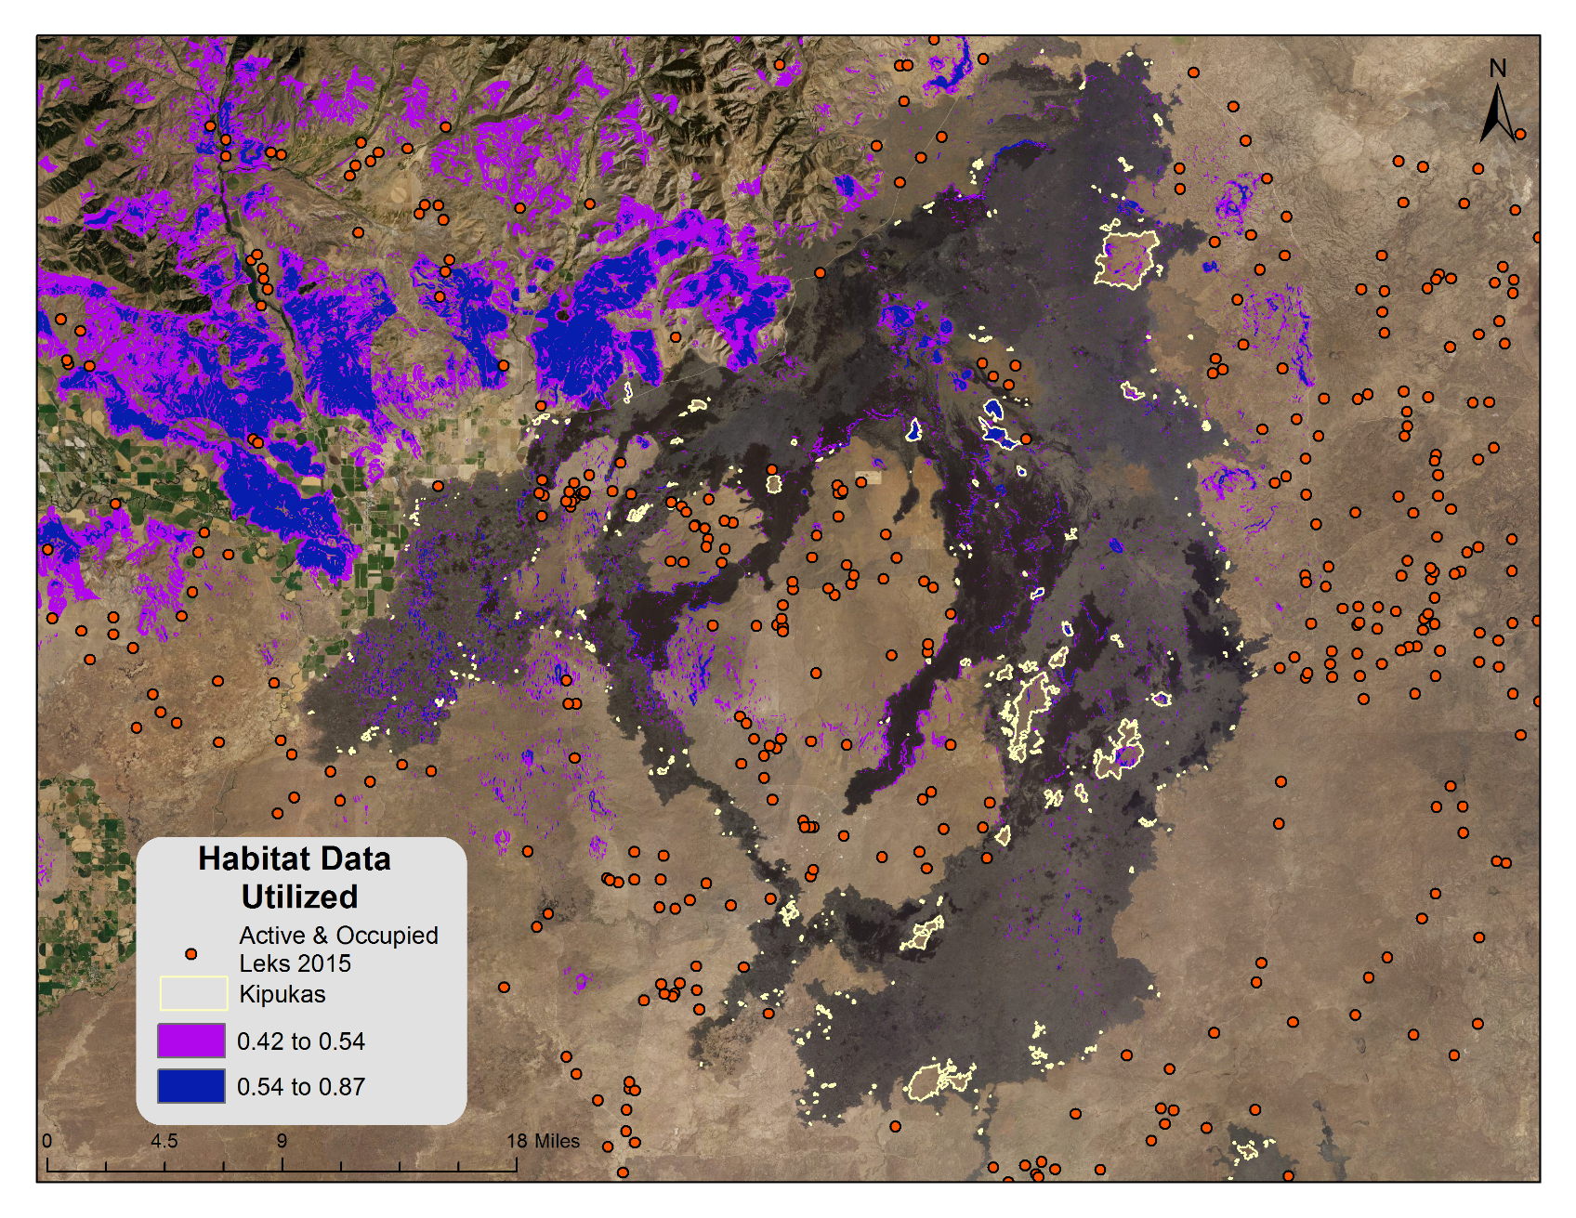
Data Sets Utilized
Habitat Data
Mule Deer Habitat – IDFG
Sage-Grouse Habitat – BLM
Fuel Type Data
2014 vegetation field data
BLM vegetation data
Ancillary Datasets
NAIP 2015
Idaho Cropland data
RECOVER Historic Fire Dataset
Digital Elevation Models (DEMs)
Notes:
Ancillary dataset utilized were 2015 NAIP data to preform supervised classification of basalt flows in Craters. Idaho cropland data to remove agricultural areas.
Historic fire data to remove update available datasets since their time of collection. Digital Elevation to derive topographical layers that are incorporated into the analysis.

Slide 8
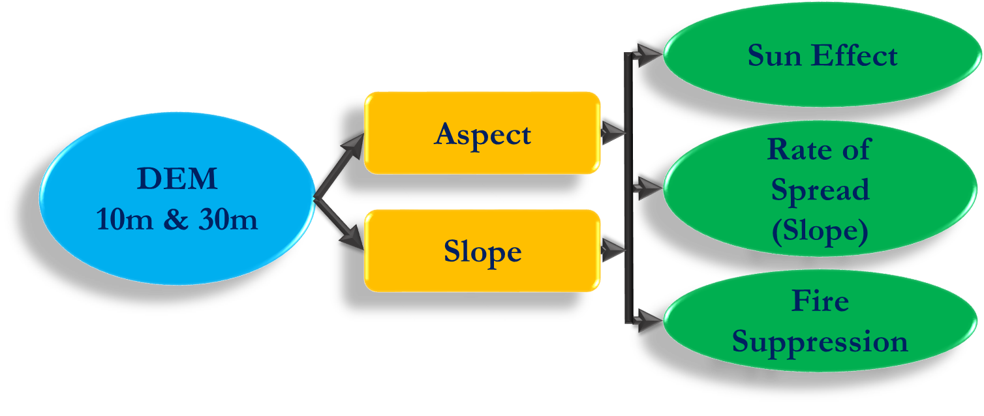
Topography
Topography
Notes:
For the topography component, we considered the aspect of a surface to investigate the effect of the sun’s position on its degree of desiccation. We also considered changes in slope and how it affects the rate of fire spread as well as suppression efforts. The rate of fire spread has been known to be influenced by slope, being easily transferrable with increase in steepness. Fire suppression efforts become difficult with increase in slope. Firefighters have identified a threshold of 30º beyond which their suppression equipment cannot easily traverse the steep slopes.

Slide 9
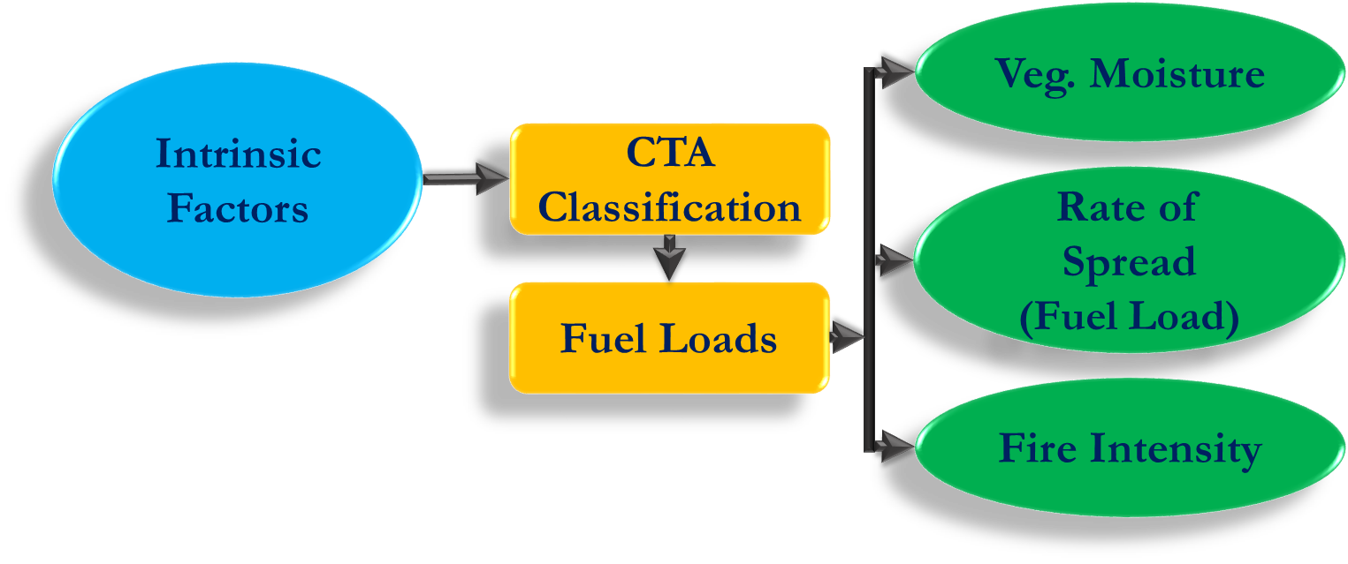
Fuel Load
Fuel Load
Vegetation moisture cut off was optimized for Landsat-8 and used for all models
Notes:
For the fuel load component, we developed a sub-model using Classification Tree Analysis to classify vegetation found in the study area. To do this, we used randomly sampled in-situ data of the study area collected by Idaho State University and the BLM to train the model. This model was later used to develop a map that classified all unknown vegetated areas in the entire study site. Vegetation moisture, fire rate of spread and fire intensity were then derived from the classified vegetation map in response to how they relate to fuel loads.
The vegetation moisture content variable accounts for how moisture in vegetation affects its flammability. High vegetation moisture can decrease the fire susceptibility of a location with high fuel loads by virtue of making the vegetation less flammable.
The rate of spread variable takes into account how easily a fire spreads depending on different fuel load classes. Lower fuel classes like grass have been known to be the main carriers of fire and were thus assigned higher weightings in comparison to denser vegetation like the slash.
The fire intensity variable takes into account how different fuel loads affect how much energy is released in the event of ignition. This variable was found to be directly proportional to fuel loading— higher fuel load equaled higher fire intensity.

Slide 10
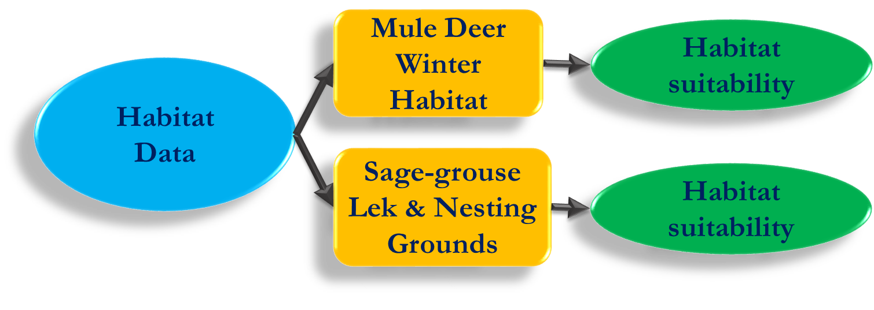
Habitat Data
Mule deer winter habitat for 2015 from IDFG
Greater Sage-grouse lek & nesting grounds from IDFG and BLM 2015
Notes:
The habitat data was a very critical input since it forms the main basis of our study. Mule deer habitat data was obtained as raster layer that showed gradation of habitat suitability, from high to low, as indicated by a model developed by the IDFG in 2015.
Greater Sage grouse habitat data was obtained as point locations of active and occupied lekking grounds for 2015. A lekking ground is a location where one or more male birds display to attract female partners during mating season. Per the recommendation of the Eastern Idaho BLM, a 6.2 mi buffer was put around these points to obtain entire habitat coverage of the Greater Sage grouse since typical habitats forms outward around these lekking grounds.

Slide 11
Habitat Fire Susceptibility
Mule Deer Habitat Fire Susceptibility 30 m
Habitat Fire Susceptibility
Expert Weightings
Topography
Sage-grouse Habitat Fire Susceptibility 30 m
Required Input | Contribution (%)
Aspect: sun’s position | 5
Slope: rate of spread | 18
Slope: suppression difficulty | 11
Fuel load: vegetation moisture | 11
Fuel load: rate of spread | 20
Fuel load: fire intensity | 18
Suitable habitats | 22
Fuel Load
Expert Weightings
Sage-grouse Habitat Fire Susceptibility 10 m
Habitat Data
Mule Deer Habitat Fire Susceptibility 10 m
Notes:
Combining all three components: topography, fuel load, and habitat data; we applied expert weightings to produce individual fire susceptibility models for both mule deer and sage grouse at 10m and 30m spatial resolutions.

Slide 12

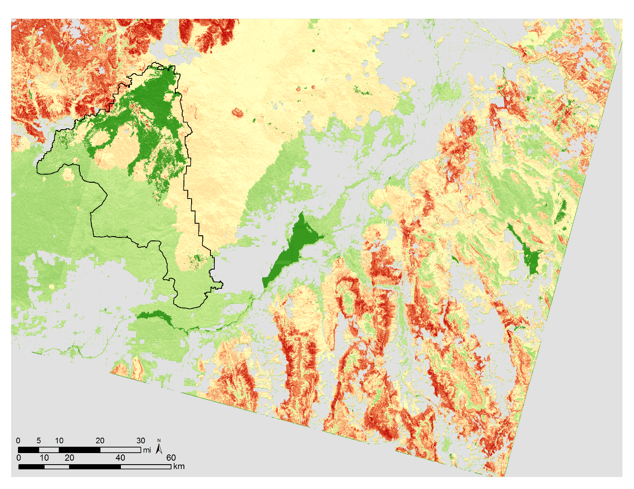
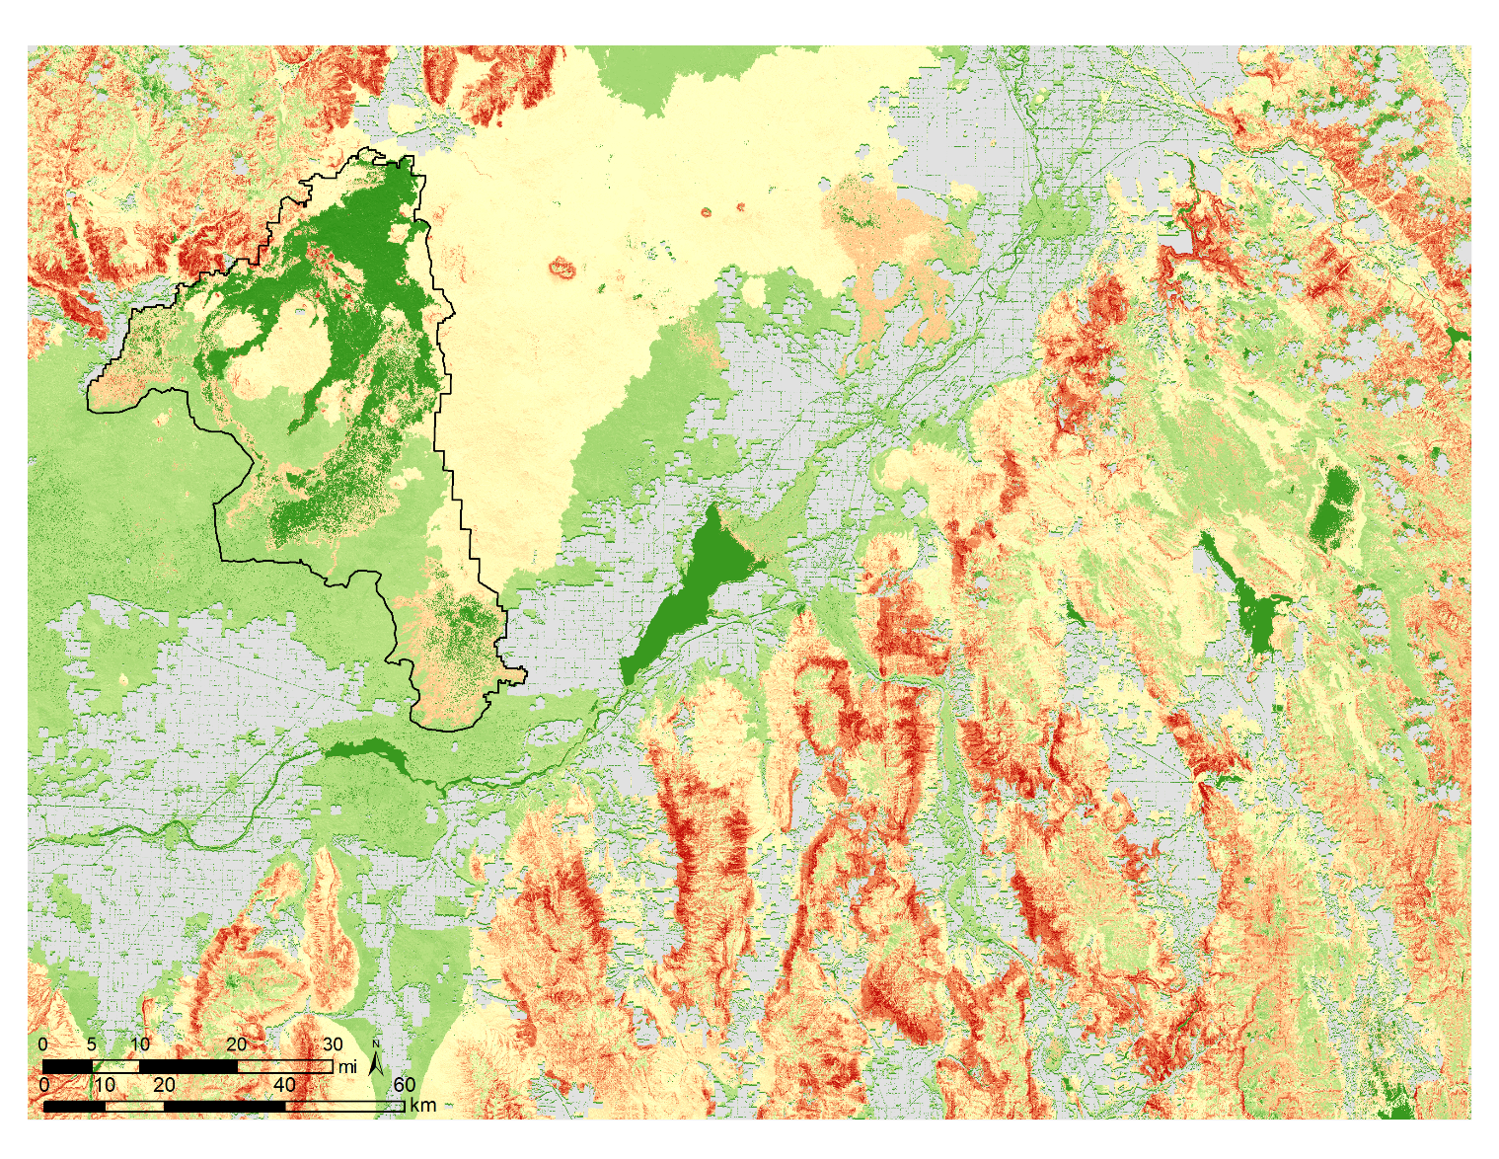
Mule Deer Classification
Landsat-8
30m
High: 932
Sentinel-2
10m
Low: 0
Notes:
Both the 30m and 10m wildfire susceptibility models were able to detect susceptible habitat across the study area and inside the kipukas so unlike the common misconception of this land being void of vegetation these satellites are picking up varying degrees of fuel loading that may threaten habitats if ignition were to occur. Random visual validation with Google Earth correlated high fire susceptibilities areas to highly vegetated areas and low fire susceptibilities to rocky areas in the basalt formation which gives credibility to the models performing satisfactorily.

Slide 13


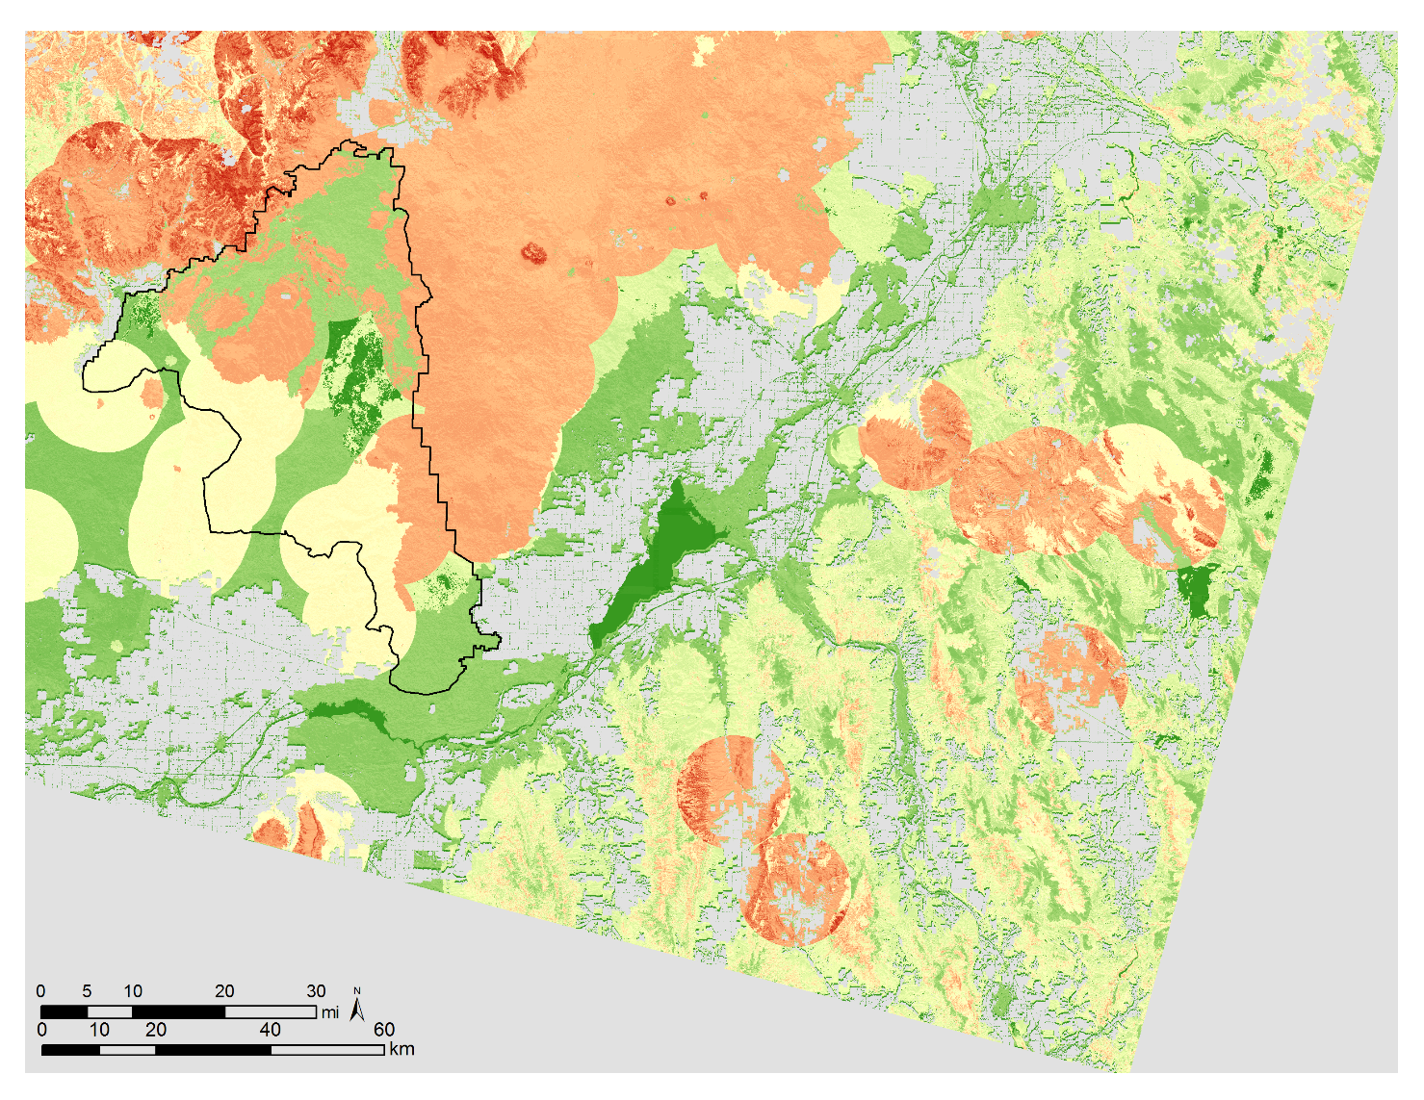
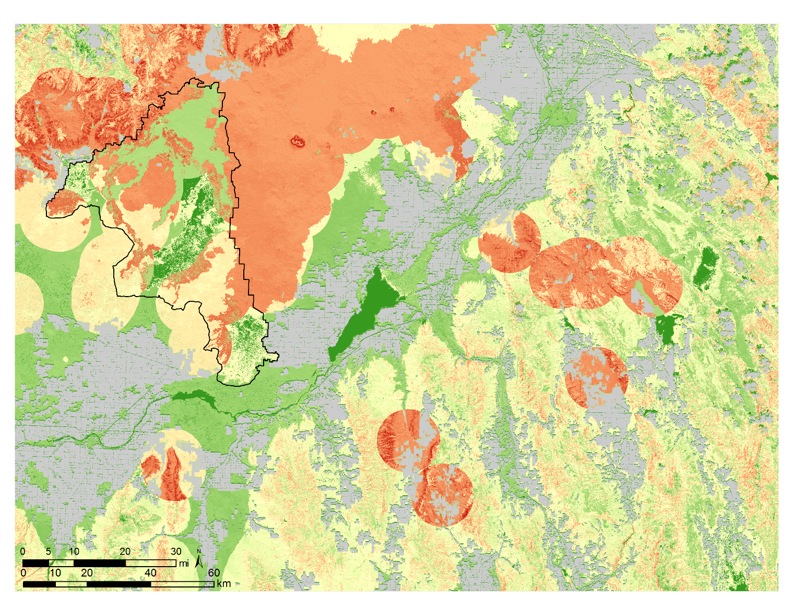
Greater Sage-grouse Classification
High: 932
Low: 0
Notes:
Overall classification of Greater Sage-grouse habitats found more high susceptibility across the study region. This is because there are more documented points and because the buffer applied was not in a graduated so the assumption was to apply high suitability to all areas within a 6.2 mile buffer of a lek site. As was done for the mule deer model, random visual validation with Google Earth correlated high fire susceptibilities areas to highly vegetated areas and low fire susceptibilities to rocky areas in the basalt formation which gives credibility to the models performing satisfactorily.

Slide 14
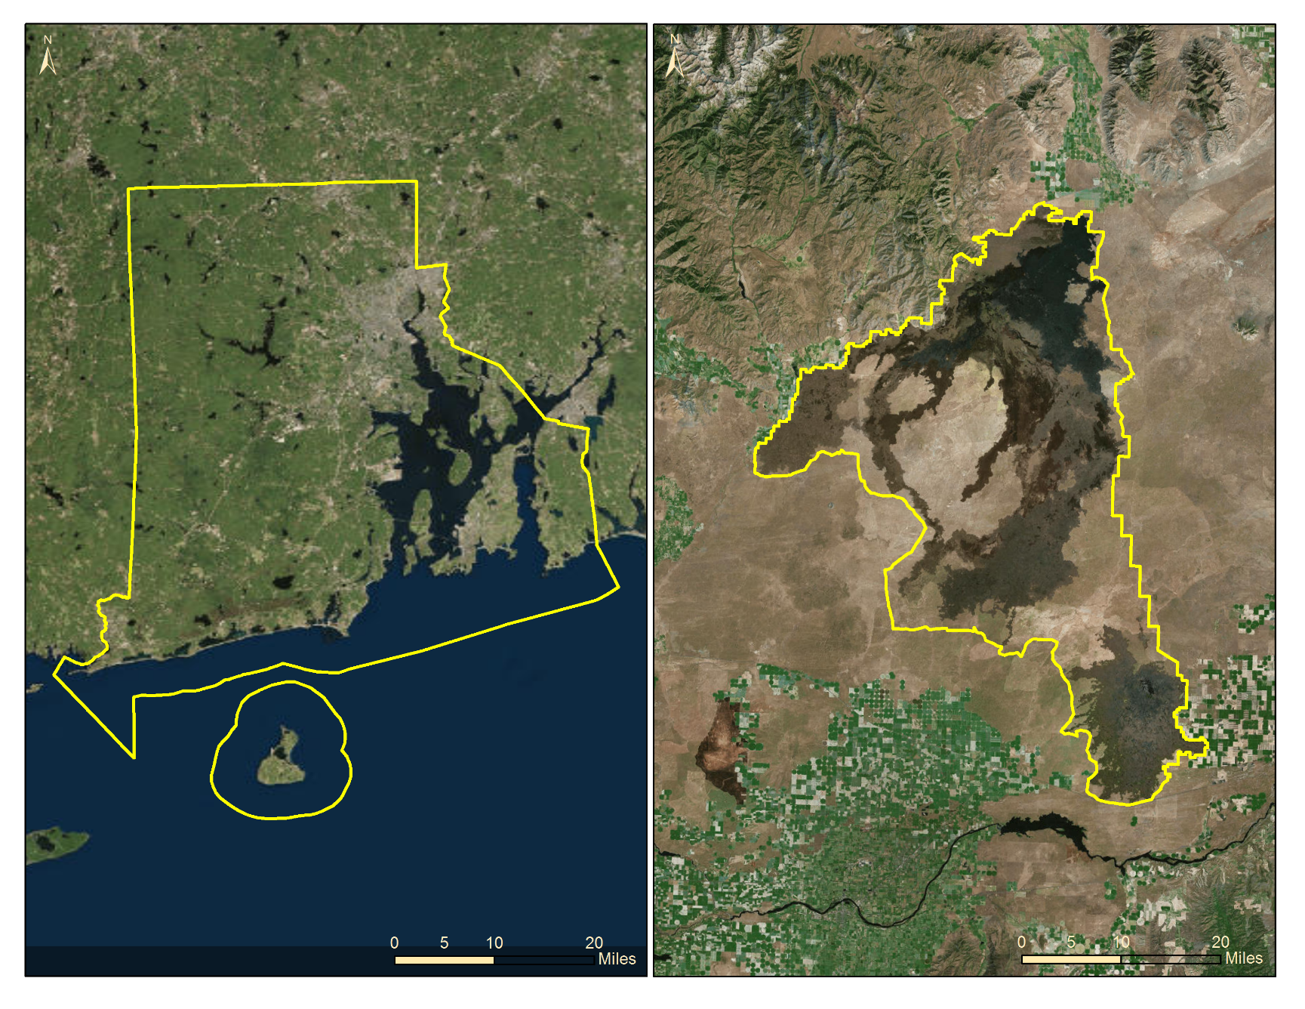
Craters of the Moon a case study
Rhode Island
Craters of the Moon
Founded
May 2nd, 1924
Managed by NPS and BLM
Habitat at Craters
93 Vegetation Community Types simplified into 8 vegetation types*
  166,400 acres of Sagebrush steppe
    A quarter of the sagebrush has burned since 1992
  400 acres of Mountain Shrub
  795 acres of Aspen/Cottenwood
  45,395 acres Conifer
  670 acres of Riparian
  41,792 acres of exotic grasslands
Animal Species
More than 3,000 species
  4 amphibians
  10 reptiles
  61 mammals
  223ish birds
  2,700 invertebrates
~776k acres
~753k acres
Notes:
Vegetation Inventory Project, Craters of the Moon National Monument & Preserve, Natural Resource Technical Report NPS/UCBN/NRTR-2009/277
We zoomed in to a subset of our study area, the CRMO, to perform more in-depth analyses that were not done for the entire study site due to time constraints. The CRMO is roughly the size of Rhode Island and most believe it be barren and devoid of suitable wildlife habitat. However, this area is host to more than 93 vegetation communities and more than 3,000 wildlife species.

Slide 15
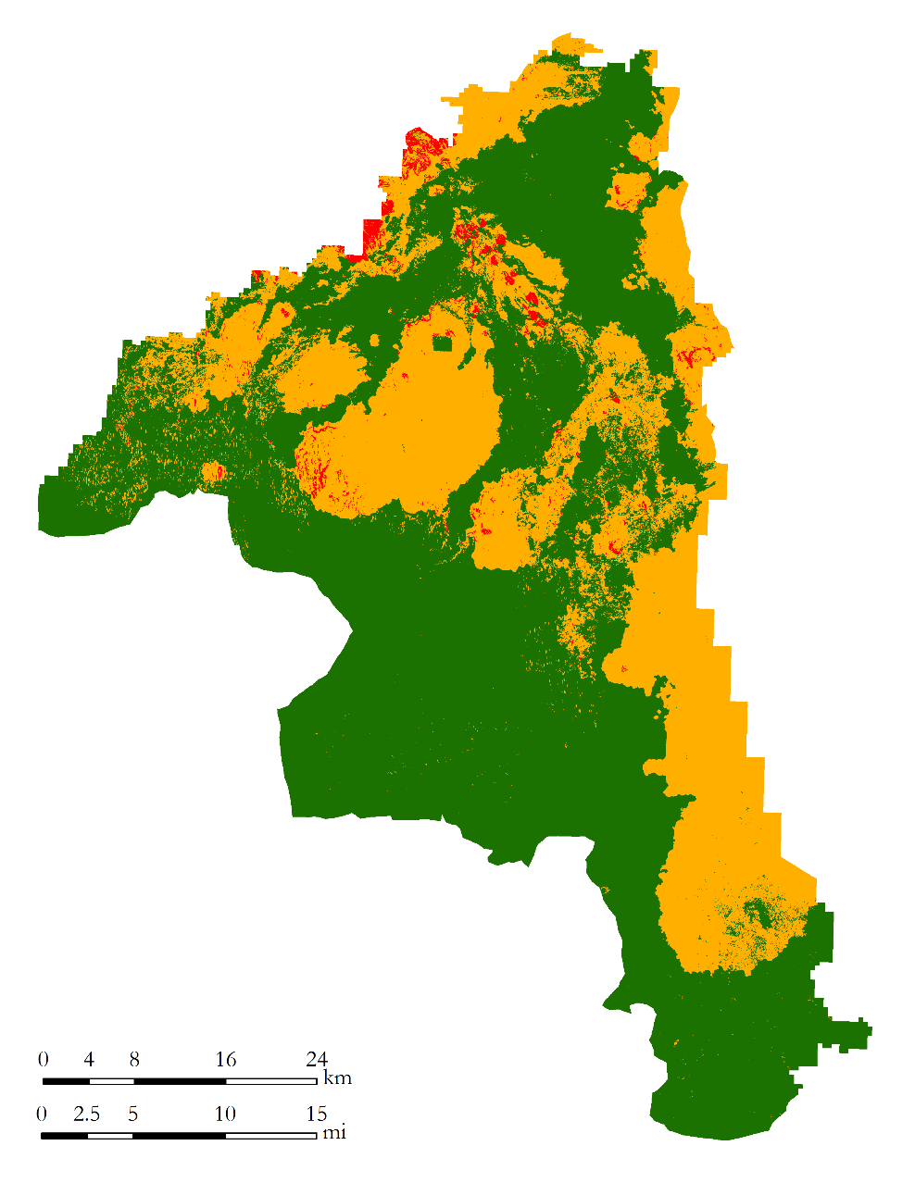
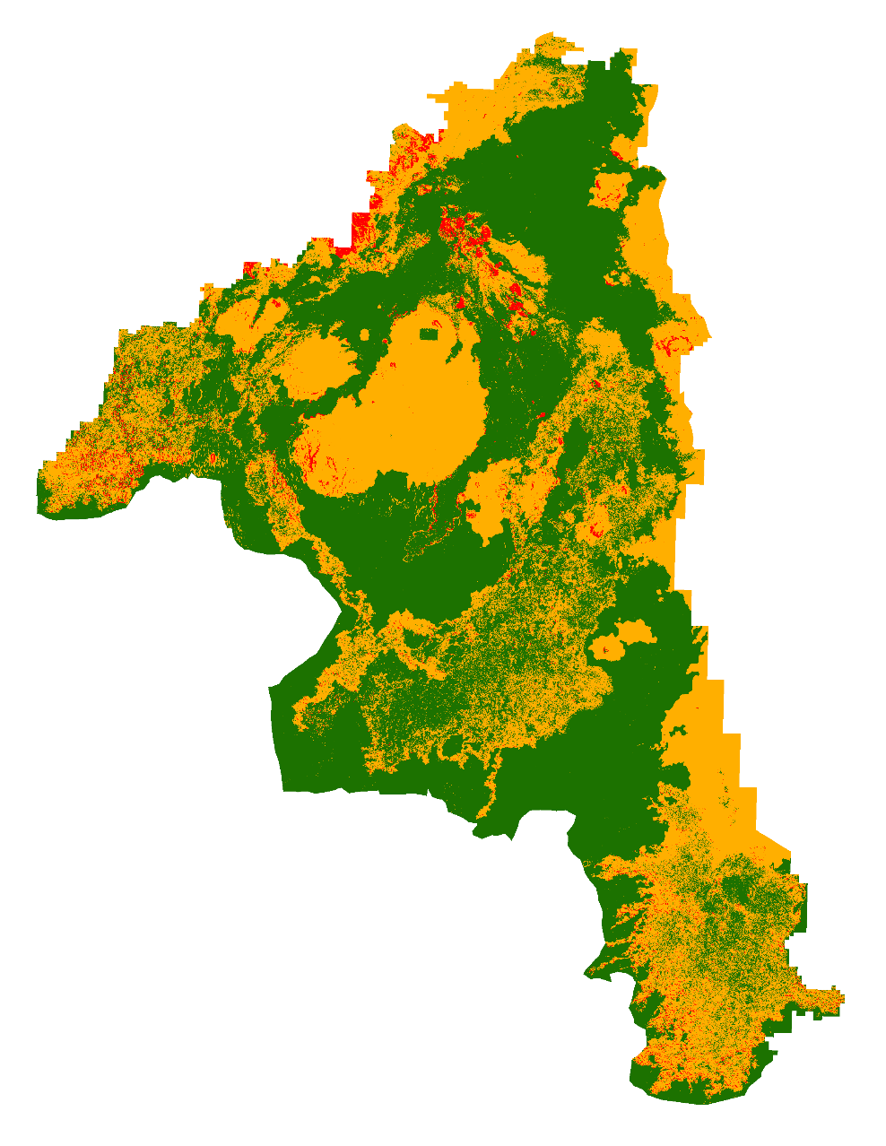
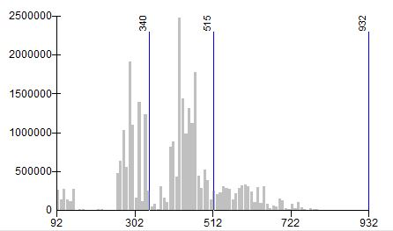
Mule Deer Classification
Landsat-8
Sentinel-2
60,000
48,000
36,000
24,000
12,000
0
Mule Deer
Area, acre
High Fire Susceptibility
Low
Moderate
High
Fire Susceptibility
Notes:
The fire susceptibility models were divided into low, moderate, and high classes using the natural breaks in the data distribution which showed great agreement between both sensors.

Slide 16
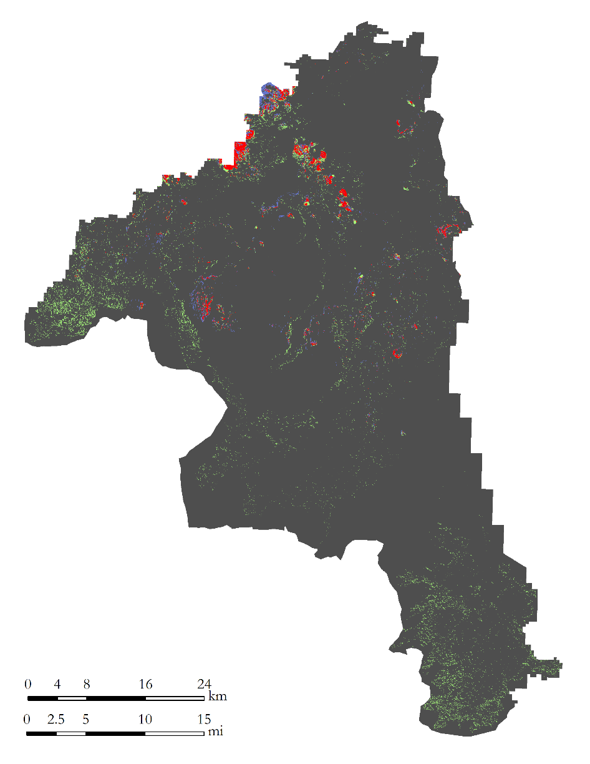
High Susceptibility: Mule Deer
Agreement and disagreement
High Susceptibility: Mule Deer
Mule Deer High Fire Susceptibility
Sensors | Acres Classified | Percent Classified
None | 726,839 | 96.6%
Landsat-8 | 4,750 | 0.63%
Sentinel-2 | 15,069 | 2%
Landsat | 5,591 | 0.74%
High Fire Susceptibility
None
Landsat-8
Sentinel-2
Both
Total Acres = 752,249
Notes:
The mule deer fire susceptibility models developed with Landsat-8 OLI and Sentinel-2 sensors, respectively show that the Sentinel-2 model identified twice as many highly susceptible acres in comparison to that of Landsat-8 OLI . Together both models classified a total of approximately 25,400 acres (3.4%) of the CRMO as highly susceptible to wildfires.

Slide 17
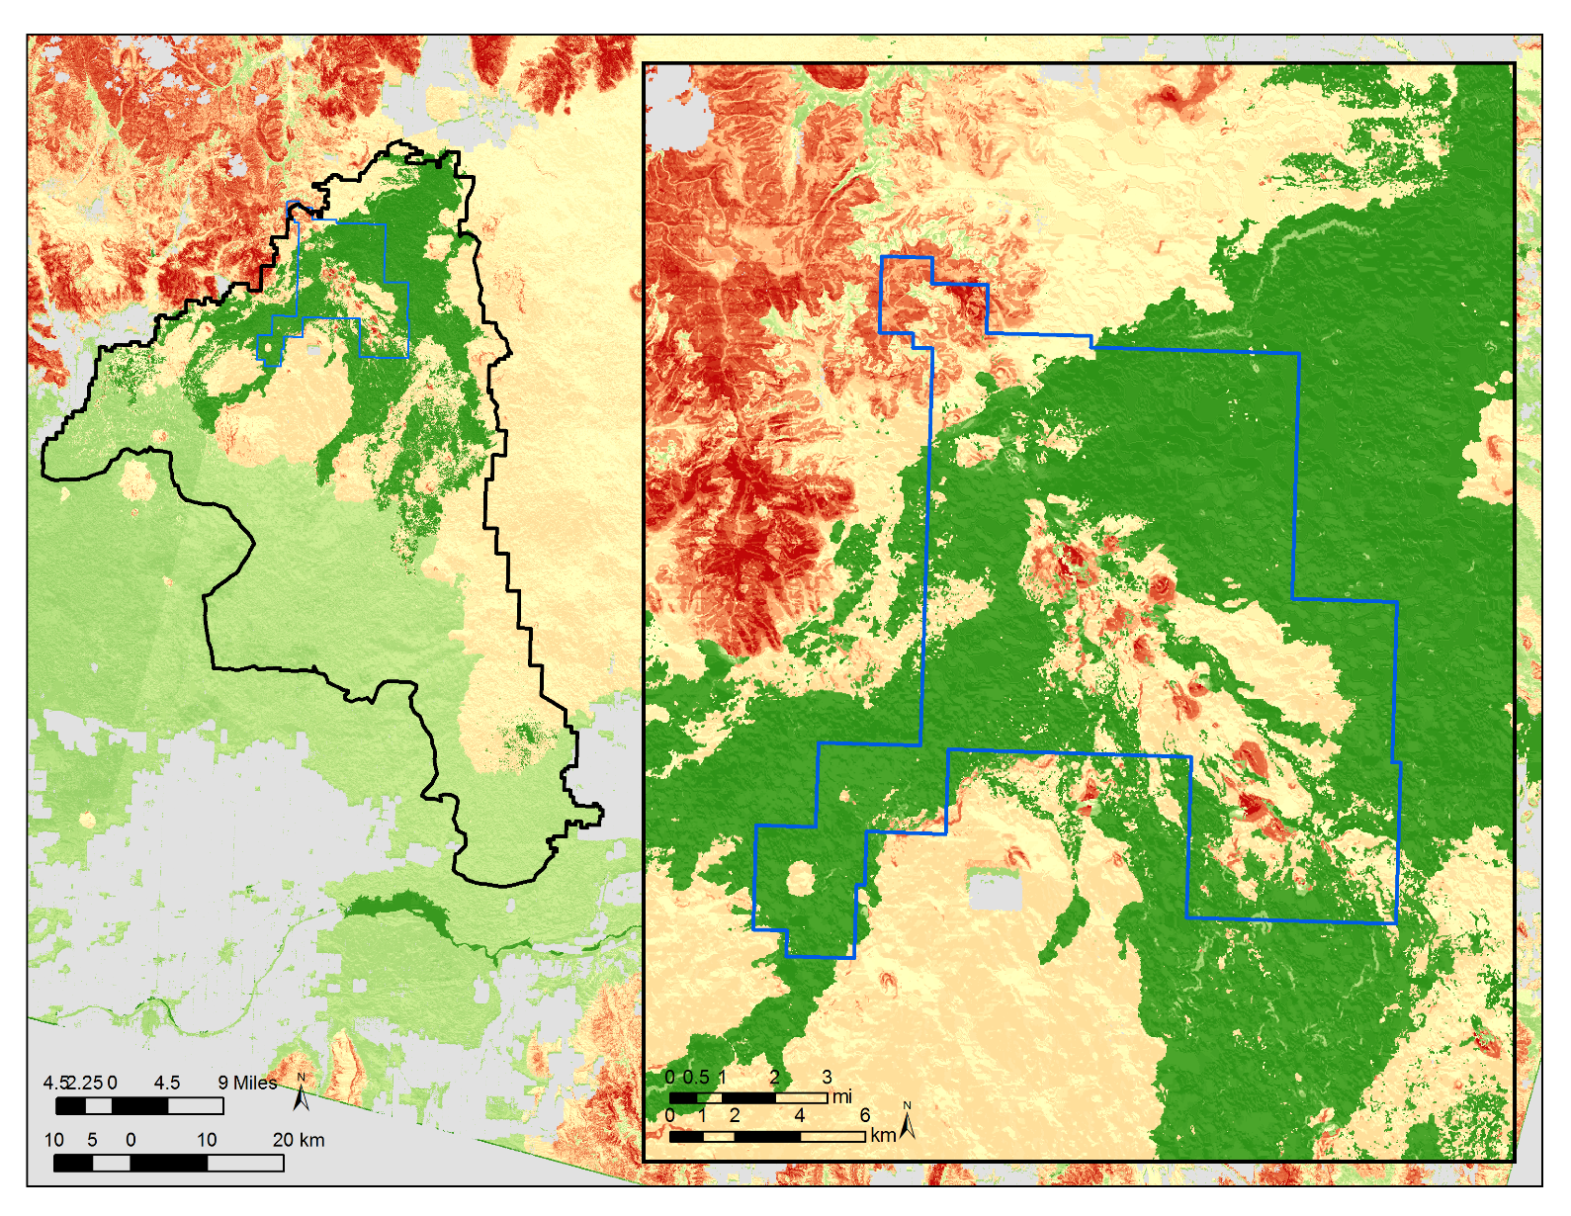
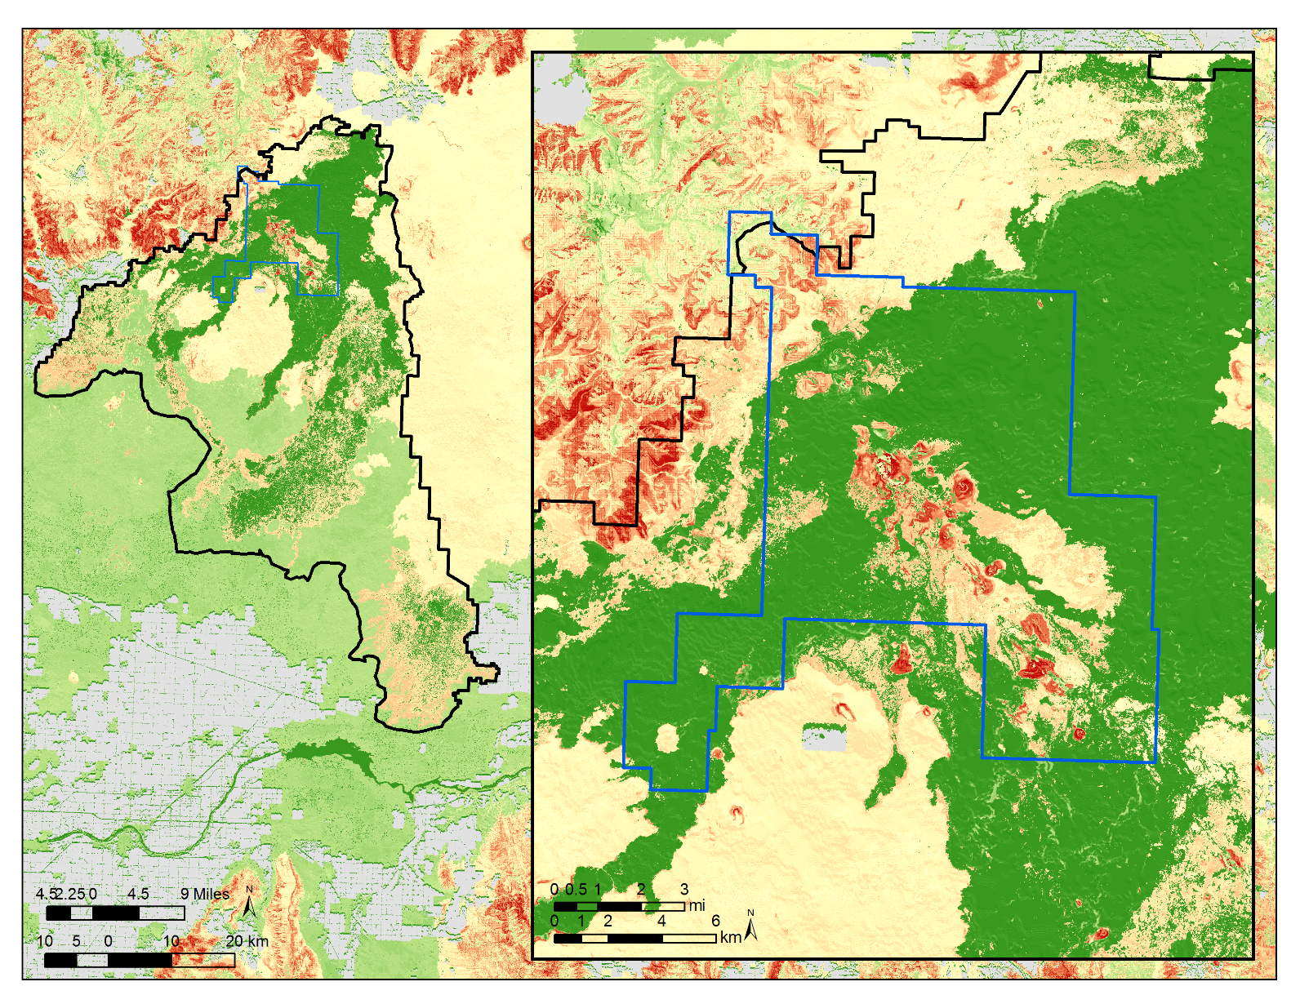
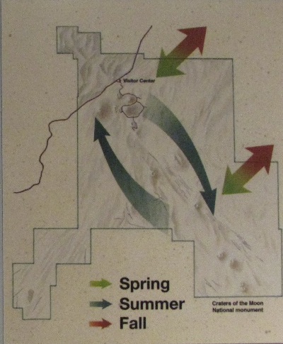
Known Mule Deer Path
High: 932
Landsat-8
Sentinel-2
Low: 0
Notes:
A mule deer summer migration path that is a narrow trail surrounded by basalt flow has been identified as being highly susceptible to wildfires. This migration path is an important identification; if the winter migration path was to burn, we would expect to see a direct correlation with mortality since there would be lack of vegetation providing forage and shelter on their journey.

Slide 18
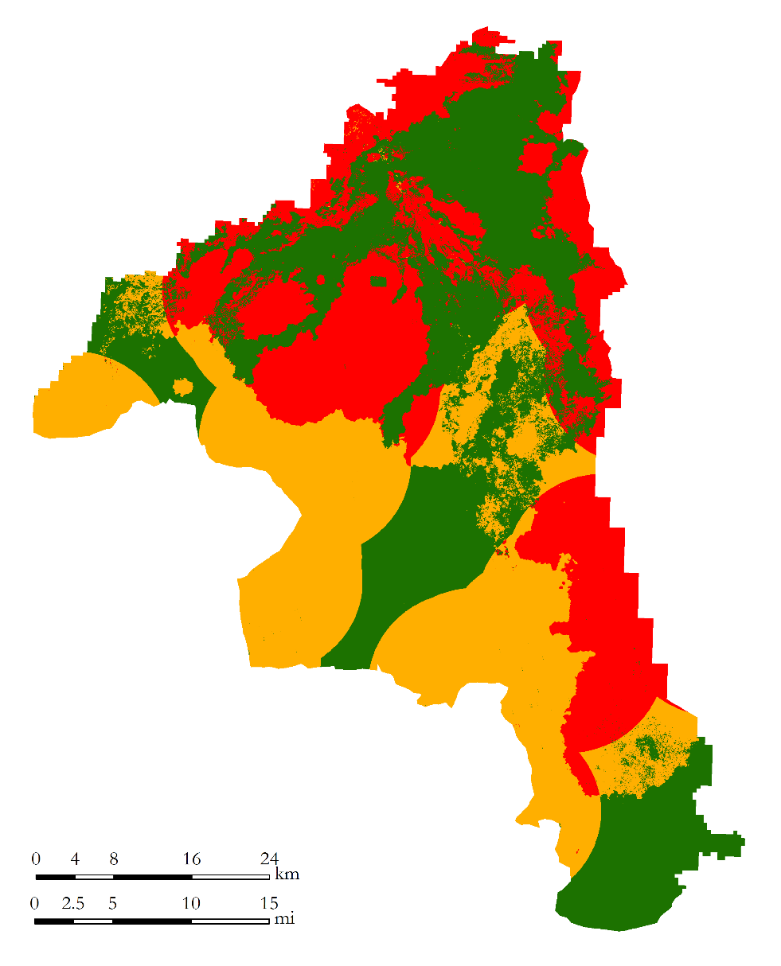
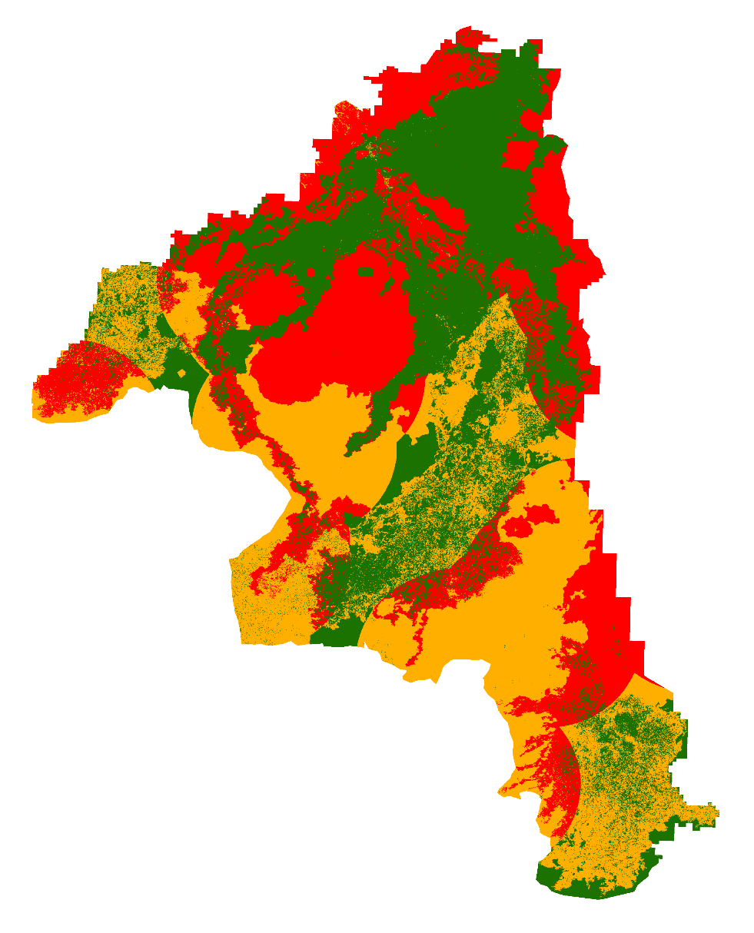
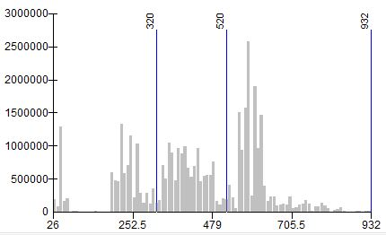
Greater Sage-grouse Classification
Landsat-8
Sentinel-2
Number of Pixels
GRSG
High Fire Susceptibility
Low
Fire Susceptibility
Moderate
High
Notes:
Both Greater Sage-grouse models showed comparable areas of high susceptibility with Sentinel-2 registering only 2% more area of high susceptibility than Landsat-8 OLI. Because of the large buffer there is an increased level of high fire susceptibility in the Greater Sage-grouse analysis.

Slide 19
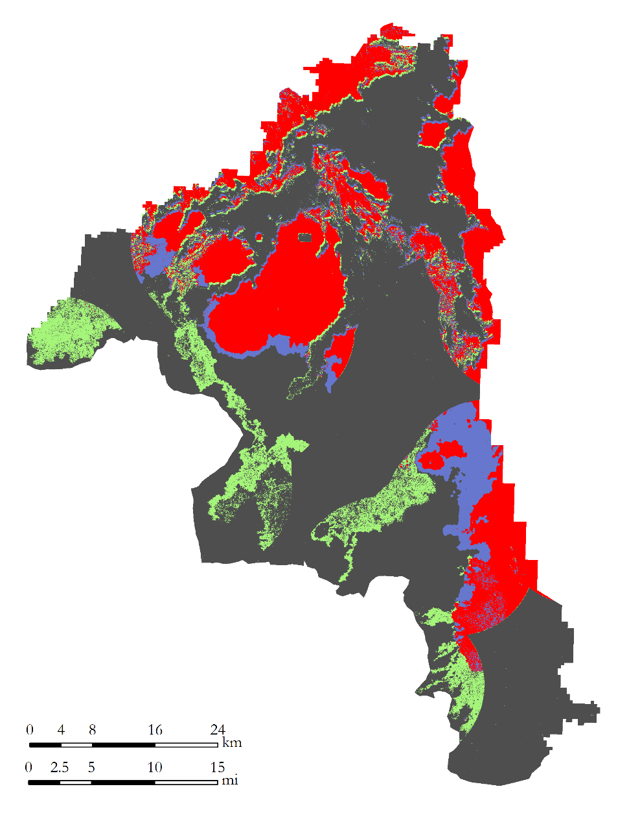
High Susceptibility: Sage-grouse
Agreement and disagreement
Greater Sage-grouse High Fire Susceptibility
Sensors | Acres Classified | Percent Classified
None | 459,584 | 61%
Landsat-8 | 55,685 | 7.4%
Sentinel-2 | 72,250 | 9.6%
Both | 164,719 | 21.8%
High Fire Susceptibility
None
Landsat-8
Sentinel-2
Total Acres = 752,249
Both
Notes:
Together both models registered approximately 292,700 acres (38.9%) of the areas as highly susceptible to wildfires. This is likely an overestimation of high susceptibility areas due to the fact that the suitability of the different areas of the Greater Sage-grouse habitats were not clearly identified or graded into classes as was done for the mule deer data. Spatial analyses of the highly susceptible areas showed 21.9% to be in agreement between both models.

Slide 20
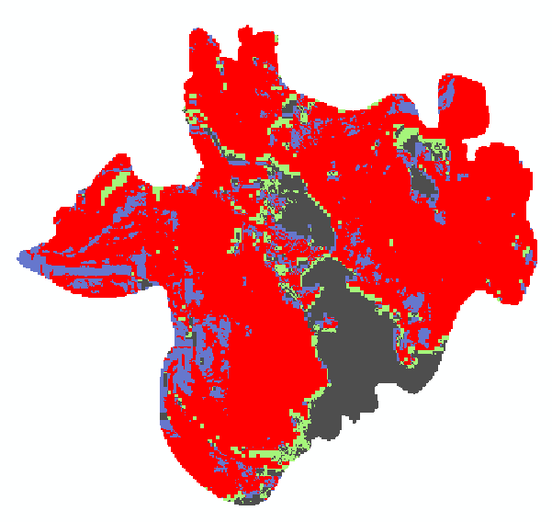
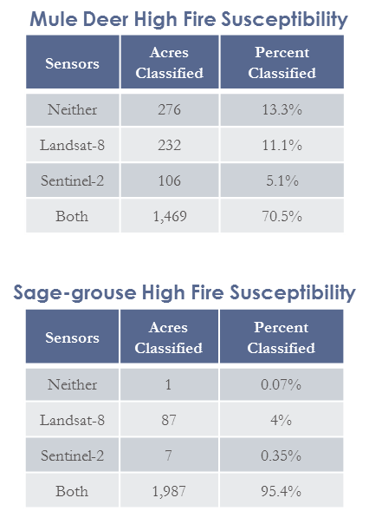
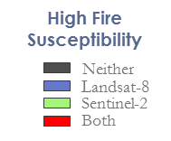
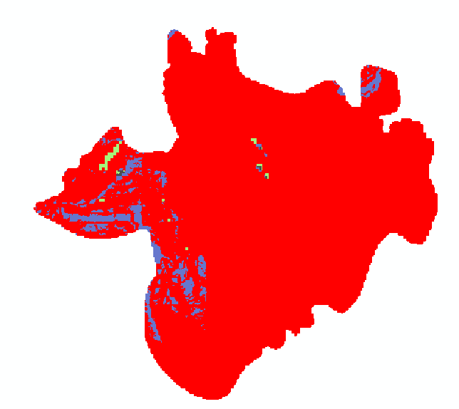
Timbered Dome Fire
Arco, ID
3 miles north of CRMO
Occurred July 04, 2016
Approx. 2,100 acres burned
70% of mule deer habitat predicted as highly susceptible by both models
95% of Greater Sage-grouse habitat predicted as highly susceptible by both models
Mule Deer
Greater
Sage-grouse
Notes:
On July 4, 2016, only days after the above models being generated, the Timbered Dome wildfire occurred just 3 miles north of Craters. This location lost both mule deer and sage-grouse habitats in the roughly 2,084 acre fire. Such a large loss of vegetation will take years to regenerate, if at all, creating a hardship for both mule deer and sage-grouse in the area.
Analyzing the burned areas based on the models developed in this project, highly susceptible habitats for each species were identified prior to the burn. This analysis serves as validation for the effectiveness of the models and reinforces the need for continued monitoring of habitats that are highly susceptible to wildfires. The results indicated that at least 76% of the mule deer habitat were highly susceptible to wildfire whereas 96% of the sage grouse habitat were highly susceptible

Slide 21
Conclusion
Initial validation with Google Earth shows highly vegetative areas correlate to those identified as highly susceptible to wildfires.
Resulting habitat models for mule deer identified high susceptibility in a well documented migration path through Craters.
Generally, Sentinel-2 was able to detect more vegetation in the basalt flows; likely a result of increased spatial resolution.
Landsat-8 performed satisfactorily and is a recommended choice for a compromise between speed and accuracy.
Suggest land/park managers focus resources toward areas where both satellites agree there is high fire susceptibility.
Notes:
For this study, we built fire susceptibility models for both mule deer winter habitats and Greater Sage-grouse lekking and nesting grounds found in CRMO. These models were generated at both a 30 m and 10 m spatial resolutions to investigate their effect on the accuracy of the output. Generally, the 10 m model was seen to pick up vegetation within the basalt formation better than that of the 30 m, a likely benefit of the increase in spatial resolutions. However, the 30 m model performed satisfactorily and is therefore a recommended choice for compromise between analyses speed and accuracy. Random visual validation using Google Earth correlated high fire susceptible areas to highly vegetated areas and low susceptibility to rocky areas with little to no discernible vegetation which gives credibility to the models performing satisfactorily.
Independent validation with a recently occurred Timbered Dome fire showed all four models to predict at least 76% of this burn as highly susceptible to fire and would have helped in mitigating the loss of this habitat had the model been developed earlier. We believe these models are great tools that will better inform park and land managers in their quest to prevent the loss of these species.

Slide 22
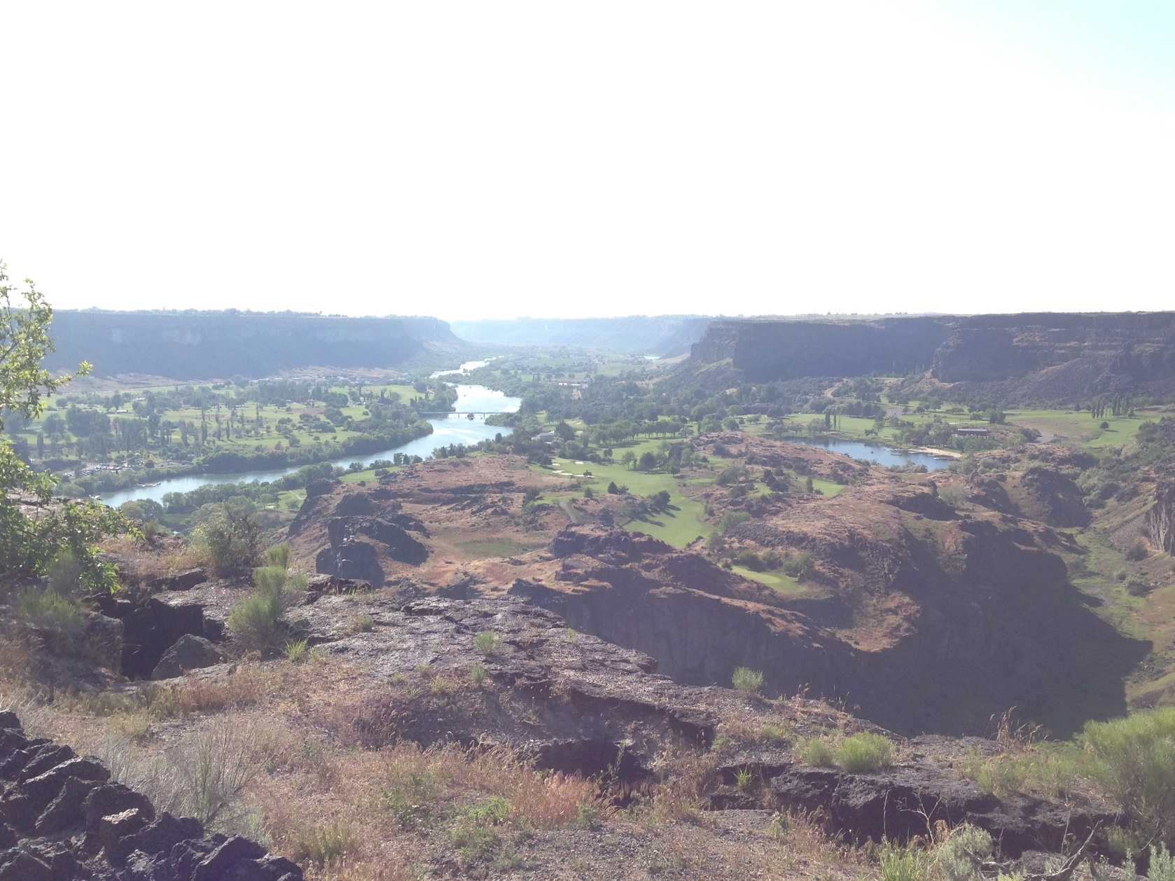
Future Work
Optimize vegetation moisture cutoff for Sentinel-2
Field validation of models
In situ field data points to increase accuracy between different ecosystems
Clear definition of habitat suitability for Greater Sage-grouse
Notes:
It would be ideal for future works to:
clearly define the breaks between the low moderate and high susceptibility classes
optimize the signature cutoff for Sentinel-2 vegetation detection
Perform field validations of the model and collect more fuel load points in the field
And lastly, to have a more clear definition of suitable habitat for the Greater Sage-grouse.

Slide 23
Partners
Todd Stefanic, National Park Service – Craters of the Moon National Park and Monument
Mike Kuyper, Bureau of Land Management- Pocatello Field Office
Georgina Pearson, National Park Service – Craters of the Moon National Park and Monument
Scott Bergen, Idaho Department of Fish and Wildlife- Pocatello Field Office
Advisors
Keith Weber, ISU GIS TReC
Others
Christ Colt, USDA Forest Service- Pocatello Field Office
Cody O’Dale, ISU GIS TReC
Kindra Ser, ISU GIS TReC
Notes:
We would like to thank all those who helped up on this project.

Slide 24
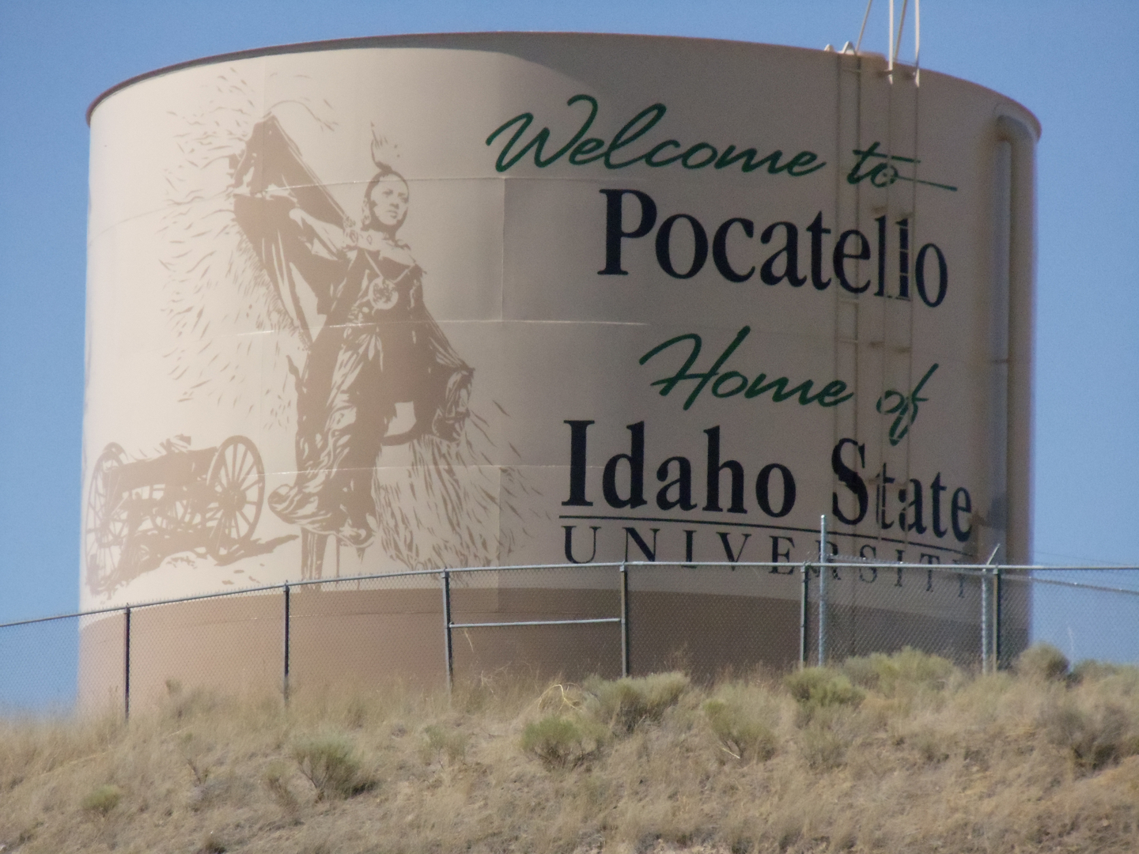
Next Term Slide
The Project:
Work to identify surface water sources in east Idaho using Earth observations to aid land and water managers with resource allocation
Partners:
Bureau of Land Management
Idaho Department of Water Resources
New Leadership:
Center Lead – Courtney Ohr
Communications Fellow – Caitlin Toner

