Slide 1
DEVELOP National Program
Antarctica Climate
The University of Georgia
Fall 2015
Imagery Gallery

Slide 2
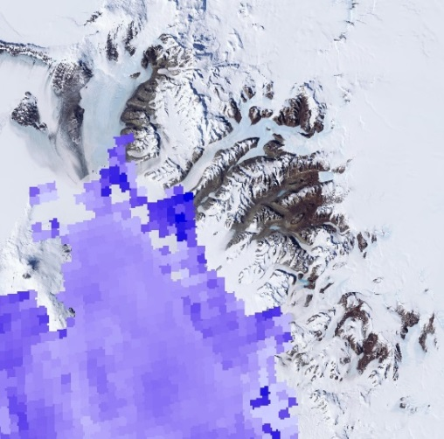
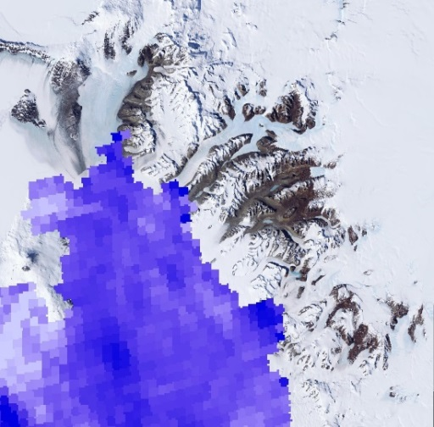
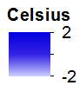
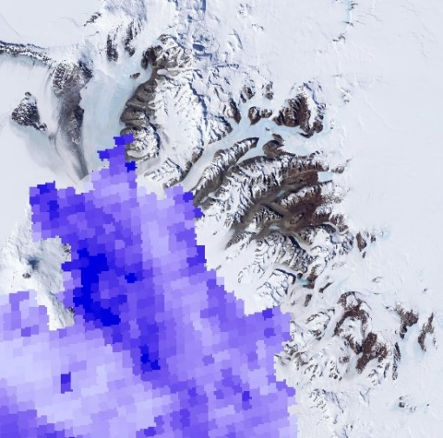
University of Georgia
Antarctica Climate
December 2003
December 2004
Multi-annual Sea Surface Temperature–
Sea surface temperature derived from MODIS on-board NASA’s Terra satellite representing multi-annual variation with the month of December from 2003 to 2008.
December 2005
December 2006
December 2007
December 2008

Slide 3
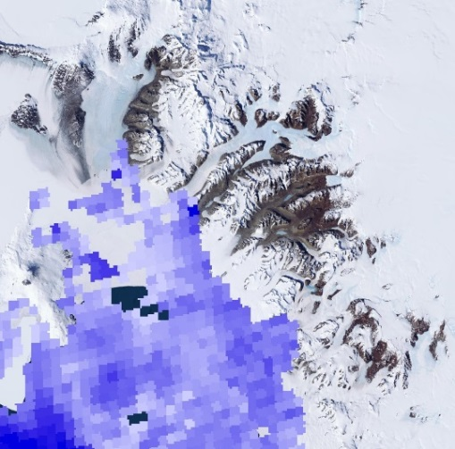
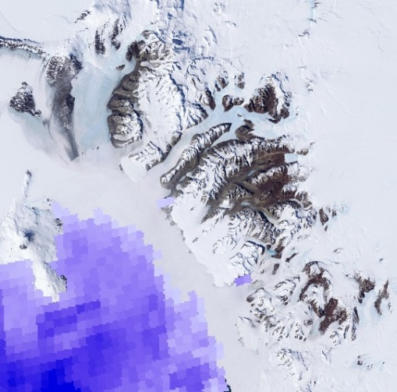
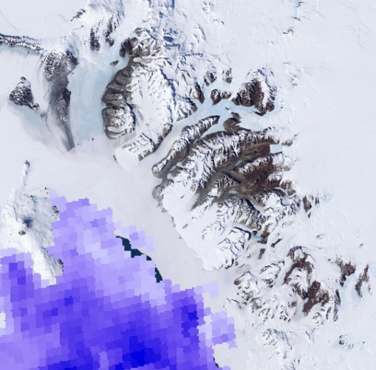
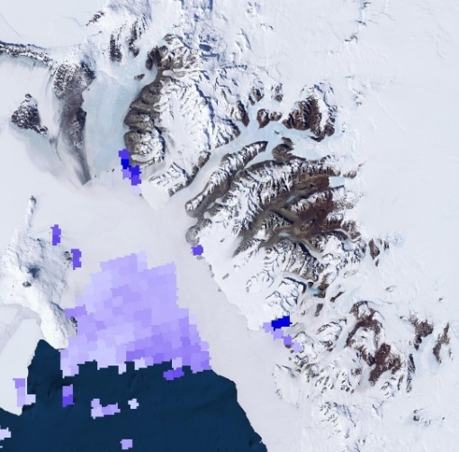
University of Georgia
Antarctica Climate
January 2006
February 2006
Seasonal Sea Surface Temperature-
Sea surface temperature derived from MODIS on-board NASA’s Terra satellite representing spring and summer variation in the year of 2006.
March 2006
November 2006
December 2006

Slide 4
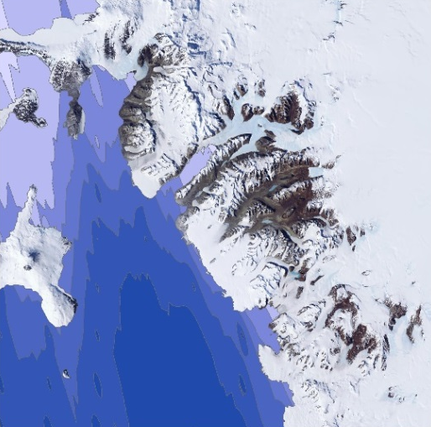
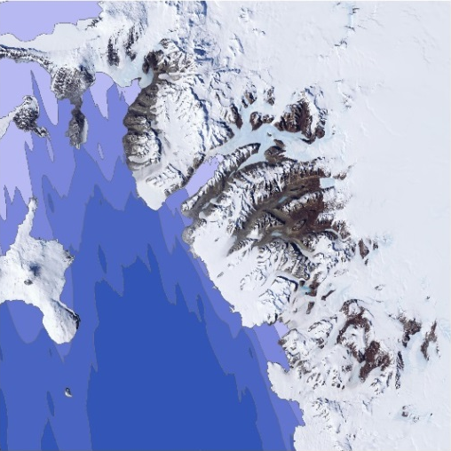
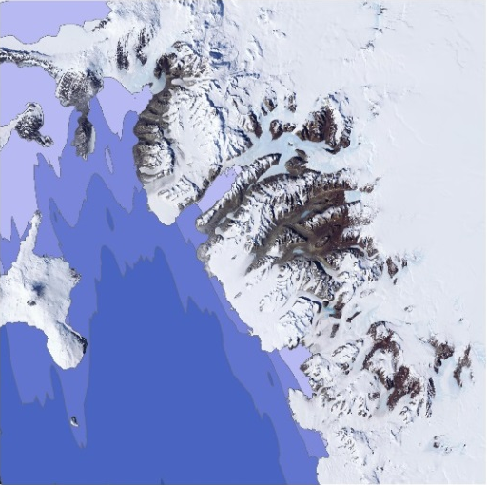
University of Georgia
Antarctica Climate
Spring Sea Ice Thickness-
Spring sea ice thickness derived from the Geoscience Laser Altimeter System (GLAS) onboard NASA’s ICESat from 2003 to 2007.
Spring 2003
Spring 2004
Spring 2005
Spring 2006
Spring 2007

Slide 5
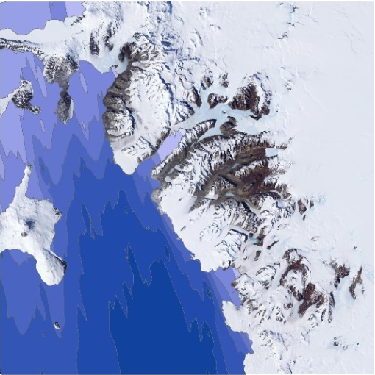
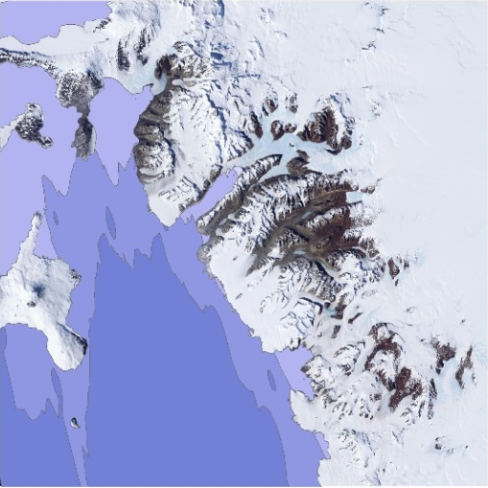
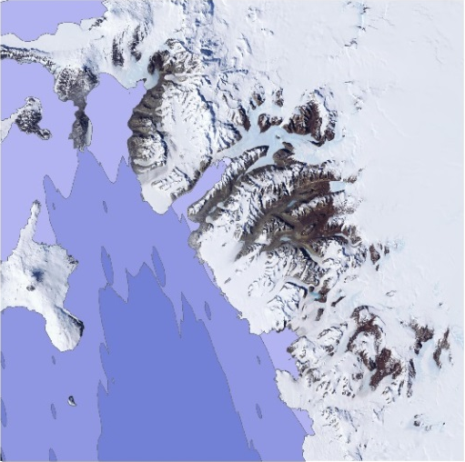
University of Georgia
Antarctica Climate
Summer Sea Ice Thickness-
Summer sea ice thickness derived from GLAS onboard NASA’s ICESat from 2004 to 2008.
Summer 2004
Summer 2005
Summer 2006
Summer 2007
Summer 2008

Slide 6
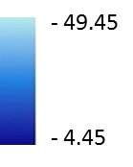
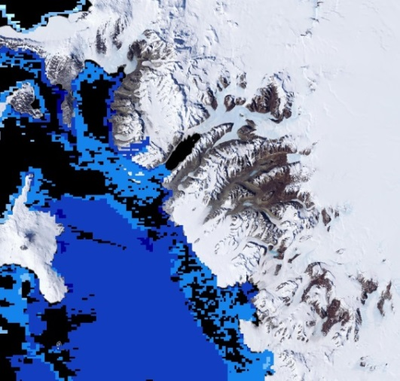
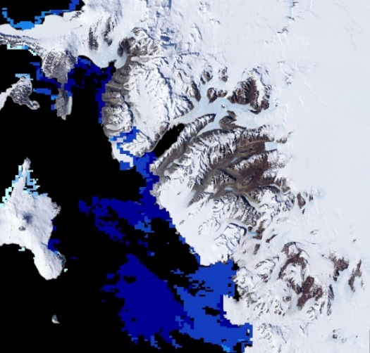
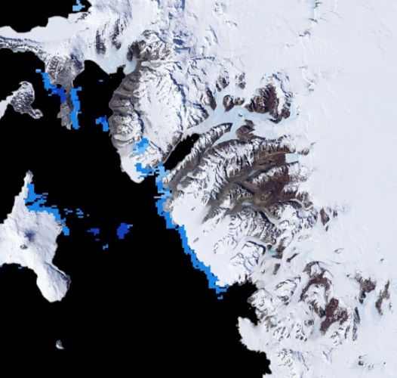
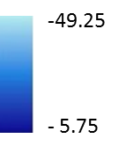
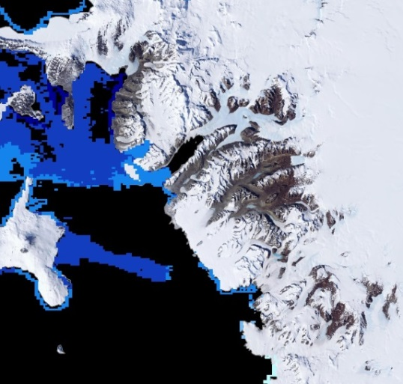
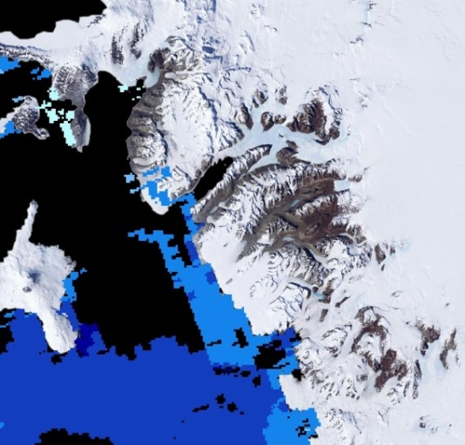
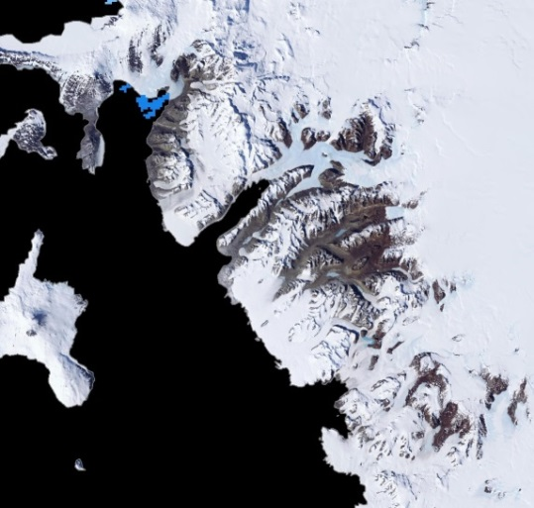
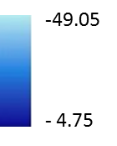
University of Georgia
Antarctica Climate
Celsius
October 2003
October 2004
Multi-annual Ice Surface Temperature–
Ice surface temperature derived from MODIS on-board NASA’s Terra satellite representing multi-annual variation with the month of October from 2003 to 2008.
October 2006
October 2005
October 2007
October 2008

Slide 7
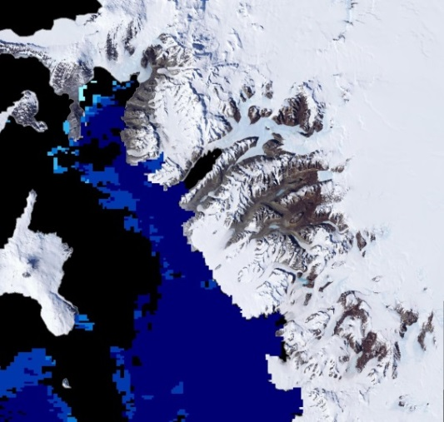
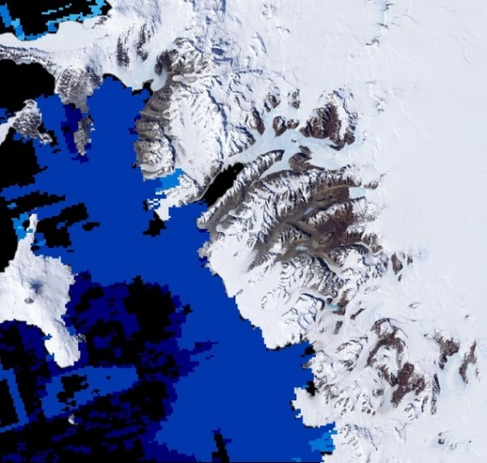
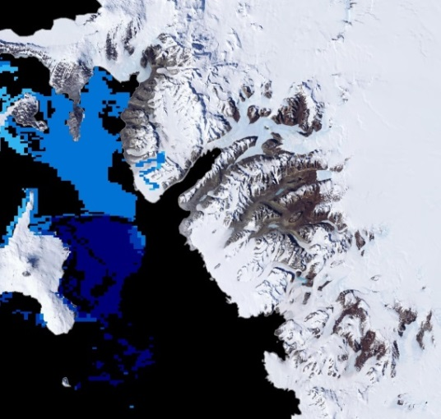
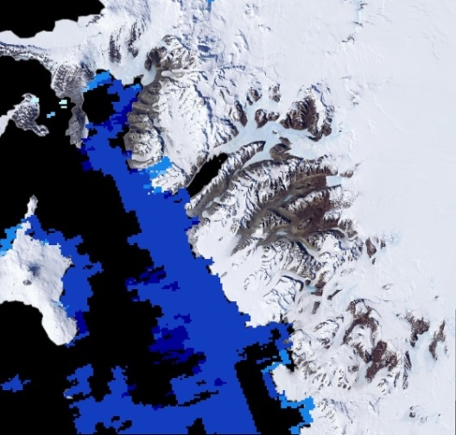
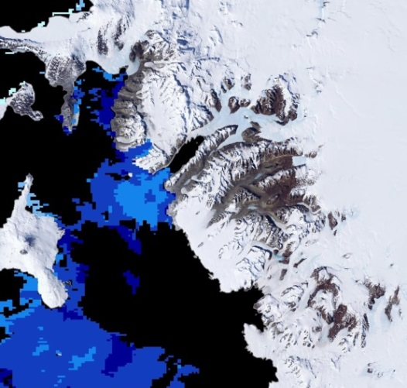
University of Georgia
Antarctica Climate
Celsius
January 2006
February 2006
Seasonal Ice Surface Temperature-
Ice surface temperature derived from MODIS on-board NASA’s Terra satellite representing spring and summer variation in the year of 2006.
March 2006
November 2006
December 2006

