Slide 1
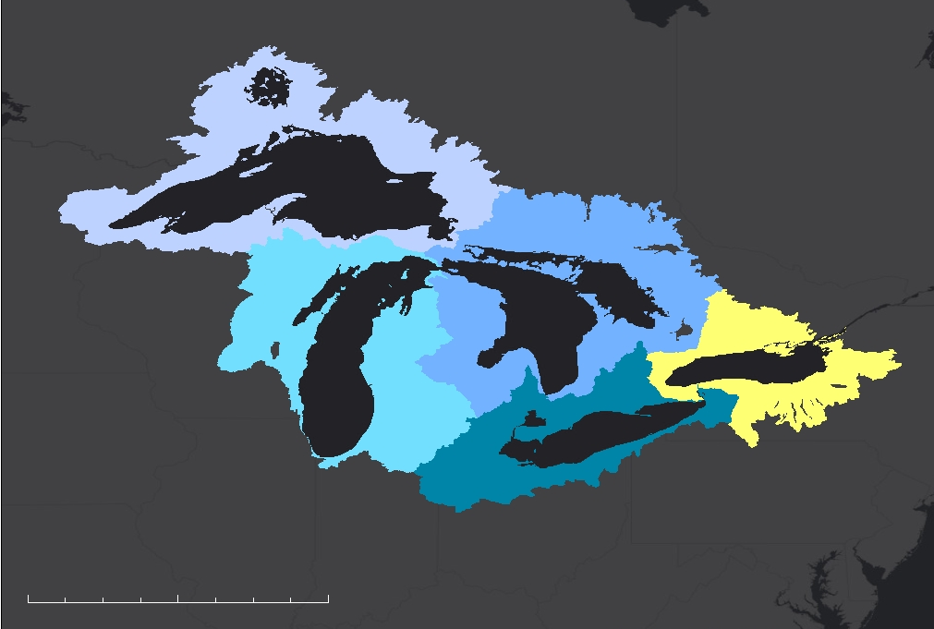
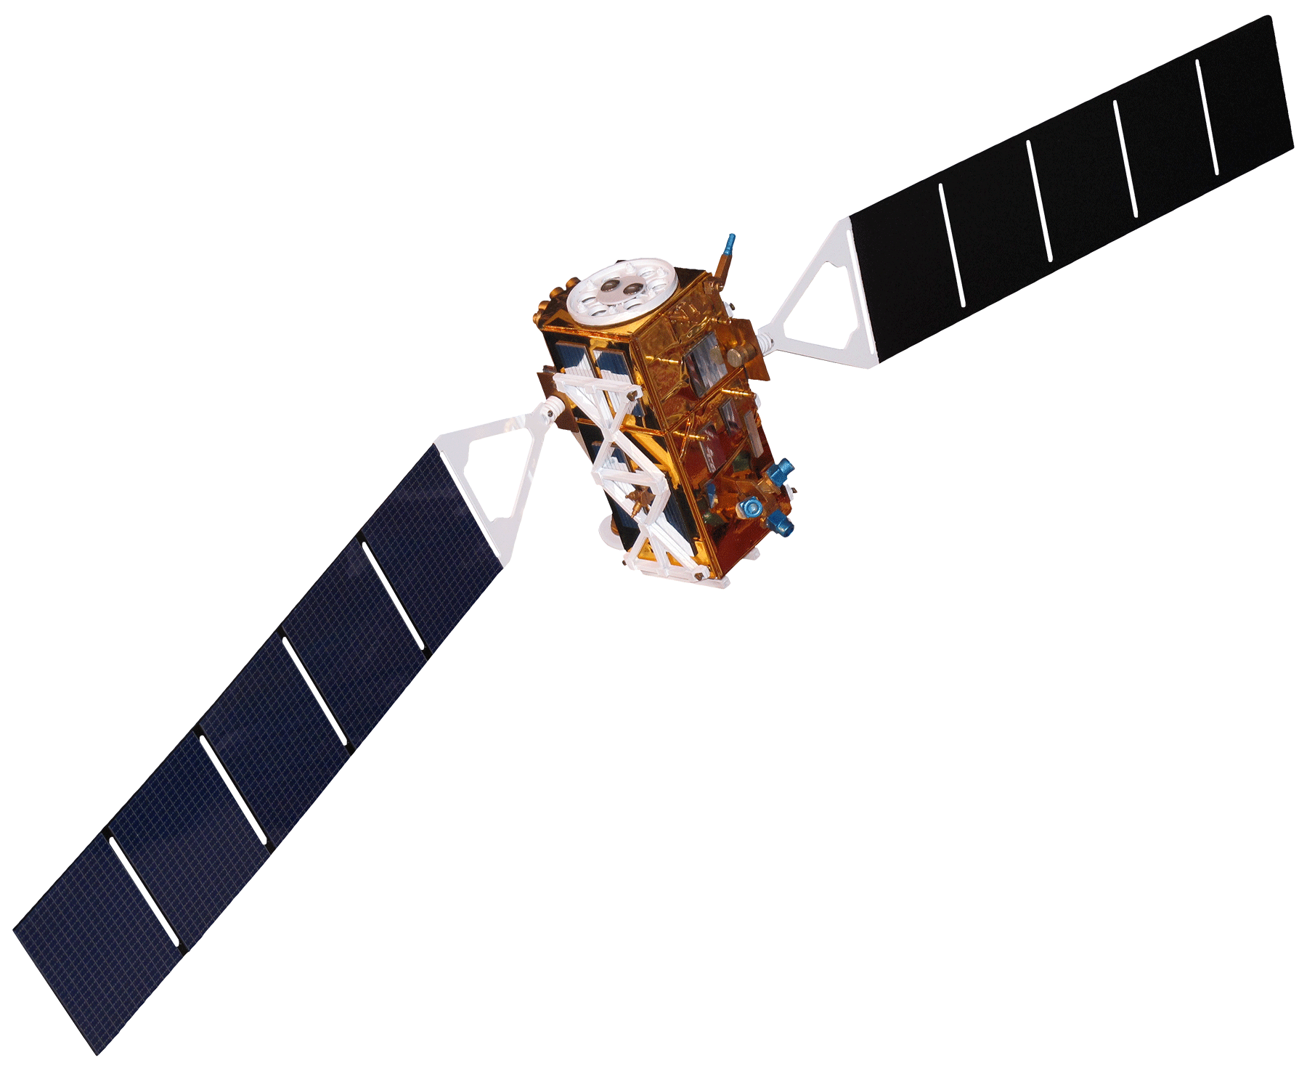
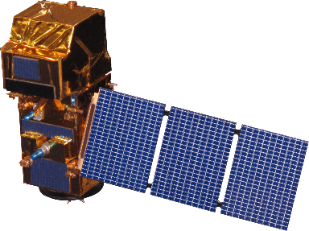
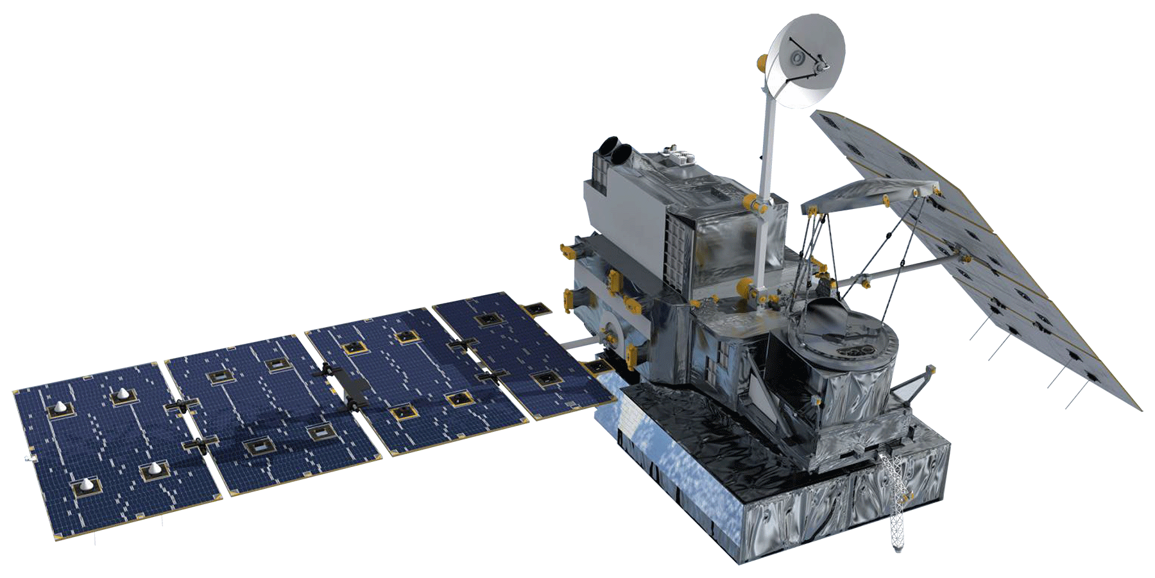
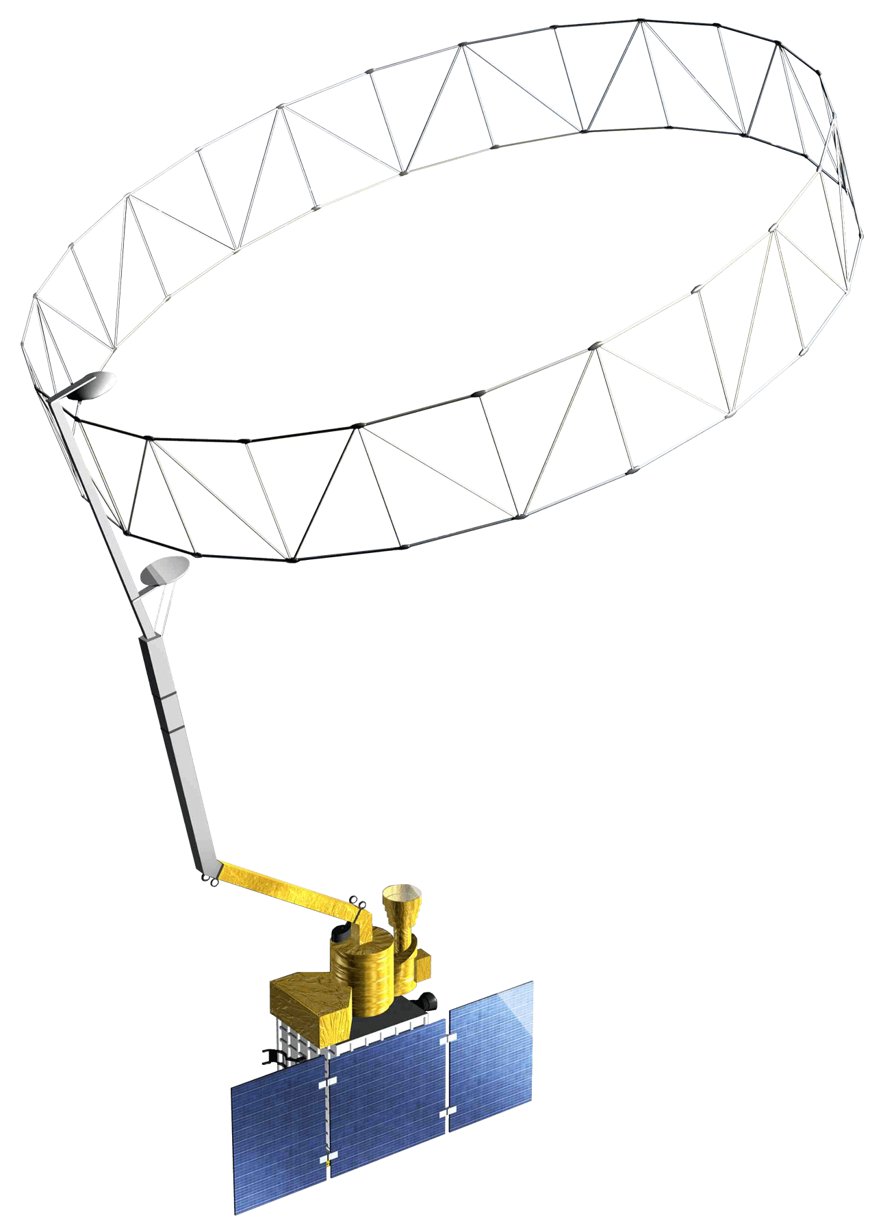
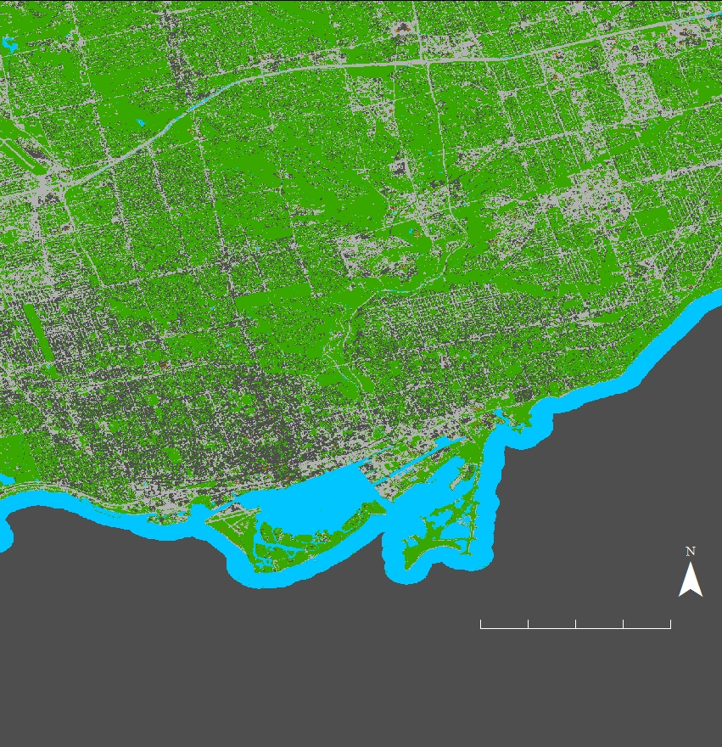
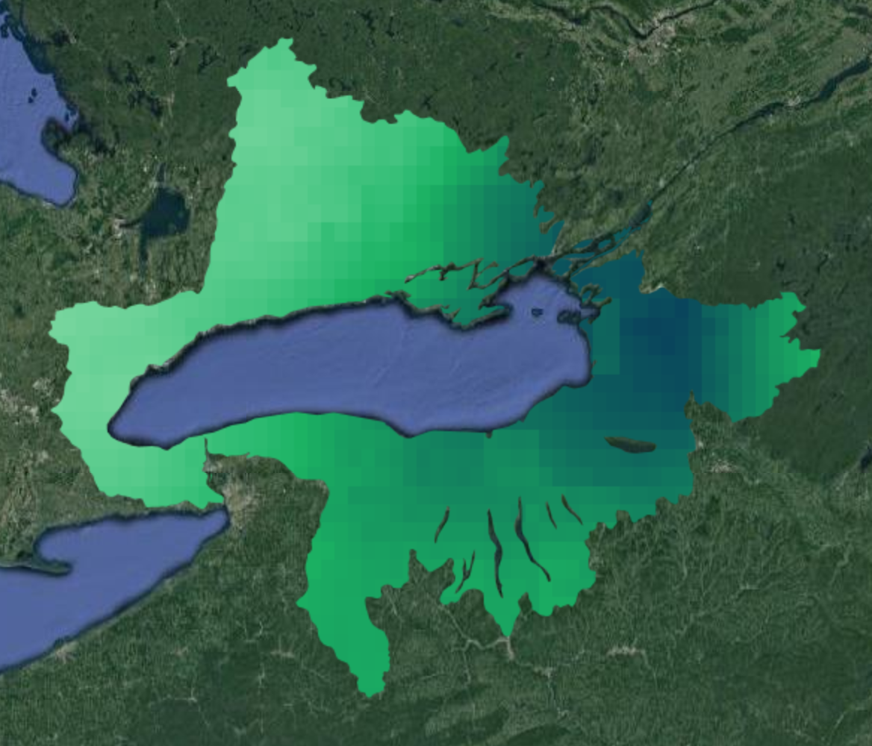
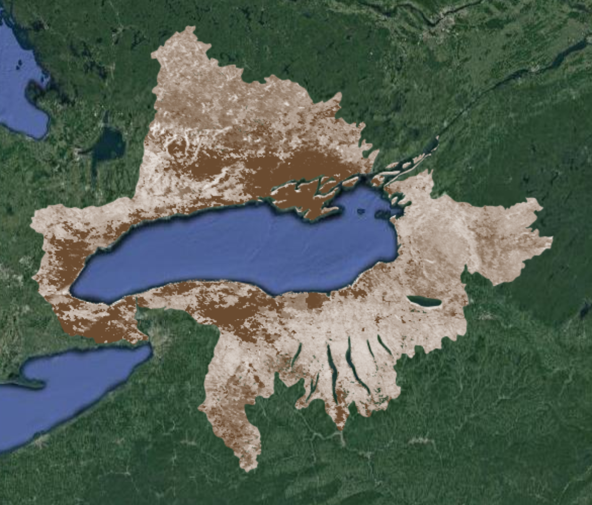
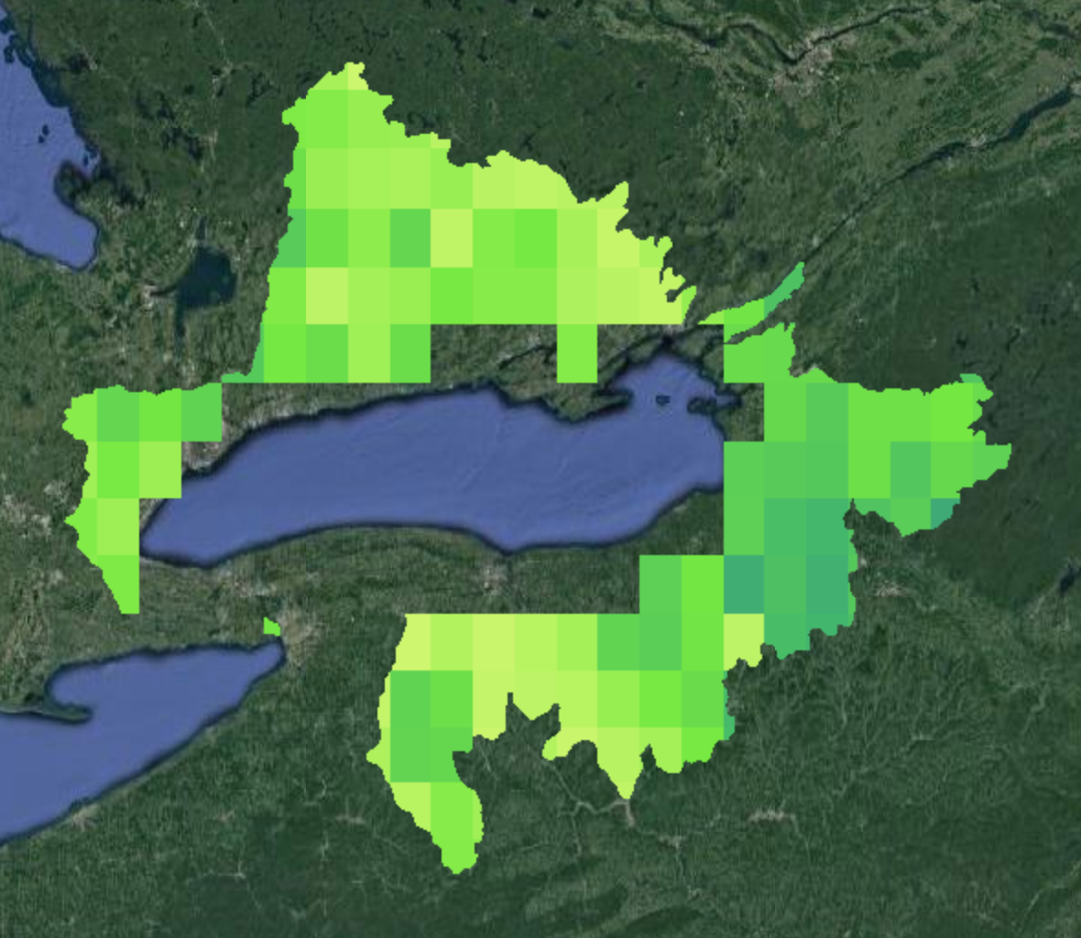
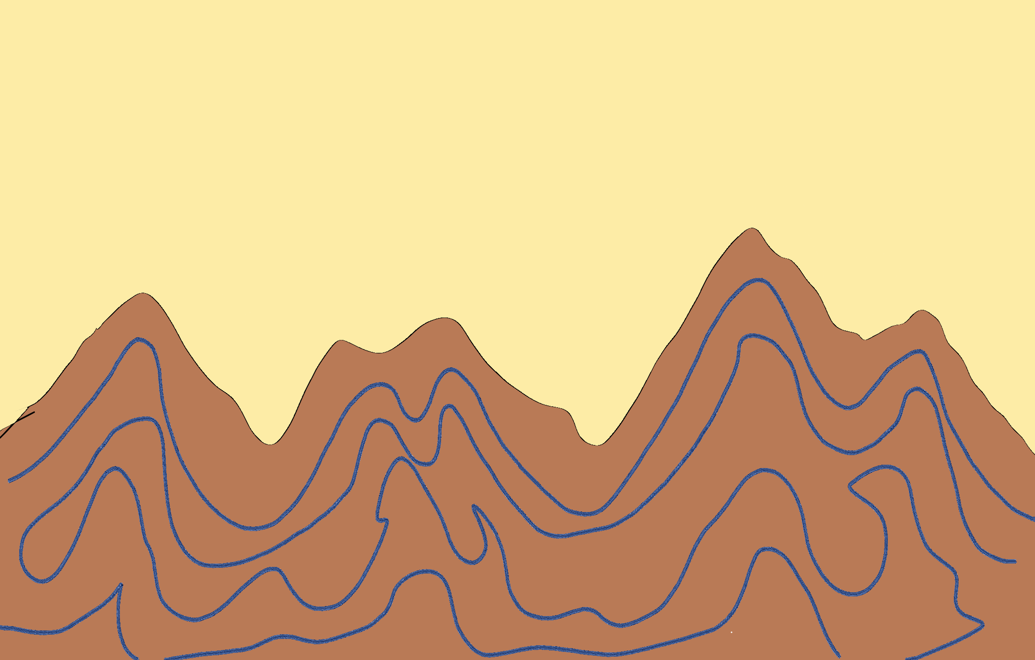
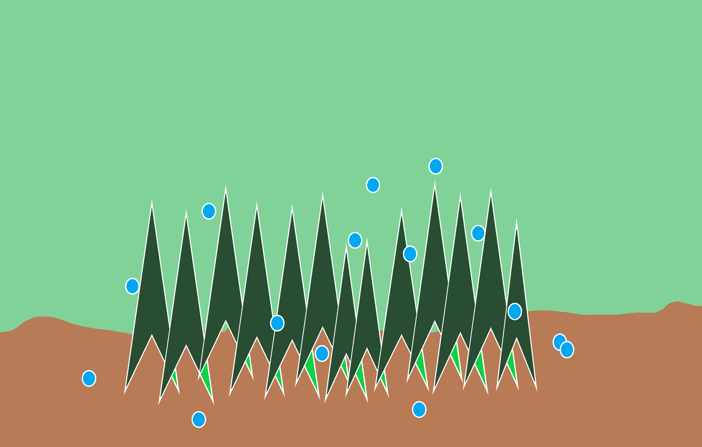
Employing NASA Earth Observations in the Greater Toronto Area to Improve Flood Preparedness for Coastal Communities
Abstract
Objectives
Study Area
From late January through the beginning of May 2017, an extraordinary amount of precipitation fell in the Lake Ontario watershed. By late April, large swaths of the Greater Toronto Area (GTA), including numerous lakefront properties, beaches, and public recreation facilities, had become inundated with water. Partnering with the City of Toronto, the City of Mississauga, the Great Lakes and St. Lawrence Cities Initiative (GLSLCI), the Credit Valley Conservation (CVC), and the Toronto and Region Conservation Authority (TRCA), this project provided tools for local and regional organizations to improve their response to flood events. These tools used Earth observations from six satellites to produce two end products. Sentinel-1 C-Band Synthetic-Aperture Radar (C-SAR) and Sentinel-2 Multispectral Instrument (MSI) provided data for flood extent maps using a classification algorithm. Global Precipitation Measurement (GPM) Integrated Multi-Satellite Retrievals for GPM (IMERG), Soil Moisture Active Passive (SMAP) L-band Radiometer, Terra Moderate Resolution Imaging Spectrometer (MODIS), and Shuttle Radar Topography Mission (SRTM) contributed precipitation, soil moisture, snow cover, and elevation data used in a Google Earth Engine (GEE) data visualization tool. The results of this project demonstrated the feasibility of GEE as a platform for providing municipalities in the Toronto metropolitan area with tools to understand and visualize flood behavior and associated patterns in hydroclimatic variables. Thus, these municipalities are better prepared to protect the most vulnerable flood-prone areas in the GTA.
Create a flood extent map for the Toronto area
Analyze trends in precipitation, snow cover, and soil moisture
Provide our partners with data to understand historic flooding events
Canada
United States
Greater Toronto Area
Lake Ontario Watershed
Lake Superior Watershed
N
Lake Michigan Watershed
Lake Michigan Watershed
0
230
460
Lake Huron Watershed
0
Miles
Lake Erie Watershed
Earth Observations
Sentinel-1 C-SAR
Sentinel-2 MSI
GPM IMERG
SMAP
Terra MODIS
SRTM
Methodology
Results
Sentinel-1 C-SAR and Sentinel-2 MSI
GPM IMERG, Terra MODIS, SMAP, and SRTM
FLOODING IN THE LAKE ONTARIO WATERSHED (FLOW) TOOL
LAND CLASSIFICATION MAPS
DATA
The FLOW data visualization tool provided a user-interface to interact with the four variables in the study area. Users can display maps for the specified variables.
Non-Flooded 5-Month Period May to September 2017
1. Select Year
Precipitation (GPM IMERG)
Snow Cover (Terra MODIS)
Year…
Lake Ontario Disasters
Calculated departure from normal by pixel for precipitation, snow cover, and soil moisture
2. Select Month
Merged and cleaned datasets
Applied random forest classification
Month…
N
PROCESSING
3. Select Variable
0
2
4
Variable…
0
500 mm
0
100 %
Miles
Soil Moisture (SMAP)
Elevation (SRTM)
Flooded 1-Month Period May 2017
PRODUCT
Land classification map showing water, vegetation, buildings, and paved surfaces
Reconstruction of historic hydroclimatic events
User interface to explore these events
0
N
0
28 mm
0
800 m
2
4
Project Partners
Acknowledgements
DIFFERENCE CHARTS
Vegetation
Soil
Miles
The Flooding in the Lake Ontario Watershed (FLOW) tool also produced charts which depict the departure from normal values across both the Lake Ontario Watershed and the Great Lakes Basin.
Water
Paved Surfaces
City of Toronto, Office of Emergency Management
City of Mississauga, Community Services Department, Environment Division
Great Lakes and St. Lawrence Cities Initiative
Credit Valley Conservation
Toronto and Region Conservation Authority
We would like to thank the following people:
NASA DEVELOP Arizona – Tempe Node Leadership: Erika Higa (Center Lead) and Megan Seeley (Assistant Center Lead and Geoinformatics Fellow)
Science Advisors: Dr. David Hondula (Arizona State University) & Dr. Cedric Fichot (Boston University)
Niagara Fall Disasters Team: Oyut Amarjargal, Eric Deutsch, Christie Fleming, & Celeste Gambino
City of Toronto, OEM: Garrett Christie, Tyler Griffin, & Maria Yung
City of Mississauga: Teresa Chan, Sameer Inchasi, Teresa Burgess-Ogilvie, Muneef Ahmad, & James Silburn
GLSLCI: Melissa Soline
This material contains modified Copernicus Sentinel data (2015-2019), processed by ESA.
*Buildings are masked out, with visible satellite showing underneath
Team Members
Conclusions
This project demonstrated the feasibility of Google Earth Engine for land classification by applying a random forest classification to an image containing both optical and radar data.
The FLOW tool illustrated that both soil moisture and precipitation were greater than normal during flooding in 2017. As compared to normal, soil moisture recorded 5.9mm more in July 2017 and precipitation recorded 209mm more in May 2017.
Tyler Hennessee
Project Lead
Isaac Gamoran
Meryl Kruskopf
Elizabeth Swanson
Arizona – Tempe | Spring 2019

