Slide 1
Mojave Desert Water Resources
Assessing Vegetation and Precipitation Indices to Aid Bighorn Sheep Habitat Monitoring and Management
Jacob Ramthun, Project Lead
Devon Burks
Mariah Heck
Notes:
Good afternoon. My name is Jake Ramthun. I graduated from Macalester College in Saint Paul, MN with a degree in geography and I am the Project Lead for the Mojave Desert Water Resources team at NASA DEVELOP’s Wise Office.
Hi, I’m Devon Burks. I graduated from Virginia Commonwealth University in Richmond, VA with a degree in Environmental Studies.
And my name is Mariah Heck, and I graduated from the University of Tulsa with degrees in Geology and Geophysics.

Slide 2
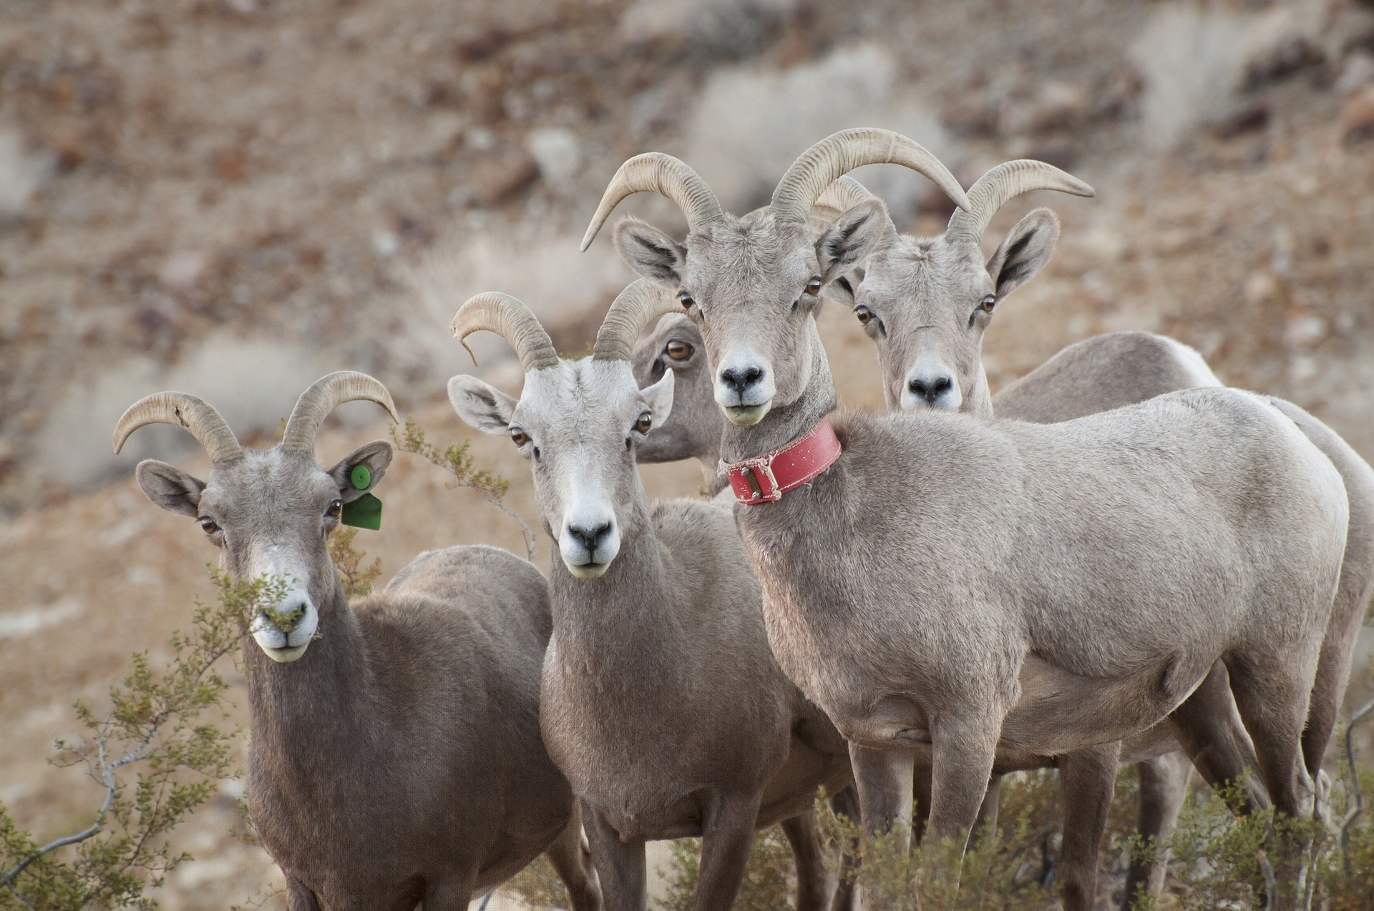
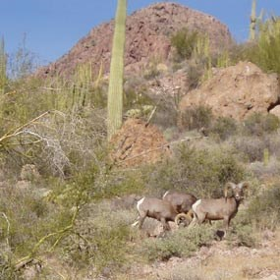
Community Concerns
Bighorn sheep (Ovis canadensis) primarily get water from foraging
Increasing risk of drought threatens available habitat
Small, isolated herds rely on wildlife management efforts (Creech et al. 2017)
Photo: Pixabay
Photo: National Park Service
Notes:
Bighorn sheep are important to the desert ecosystems in the Mojave National Preserve. They rely on foragable vegetation cover for hydration since water can be scarce. They are threatened by foraging competition of grazing livestock, the spread of respiratory disease, and especially the increasing risk of drought. By quantifying plant distribution indices, NASA Earth observation systems are currently being used by the National Park Service and the California Department of Fish and Wildlife to assess relationships between Bighorn sheep populations and habitat selection based off of vegetation availability. Unfortunately, recent extirpations of Bighorn sheep populations have negatively correlated with precipitation and elevation, signaling that drought and other climatic shifts may bring drastic challenges to local management efforts.
Photos:
https://www.nps.gov/orpi/learn/nature/bighorn-sheep.htm
https://pixabay.com/en/desert-bighorn-sheep-ovis-canadensis-956699/

Slide 3
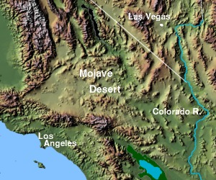
Study Area, 2013-2017
Image: Natural Resource Conservation Service
NV
UT
CO
Photo: USGS/ ESA, changes made to original content
CA
Old Dad Peak
AZ
NM
275 km
Image: Matthew Trump
Marble Mountains
10 km
150 km
Notes:
The Mojave Desert covers nearly fifty-thousand square miles of the American Southwest, but we’re particularly interested in two study sites in California, Old Dad Mountain (point to OD on map) and the Marble Mountains (point to MM on map). These sites were chosen because their rugged topography allows sheep to escape up the mountains to watch for predators. They also serve as representatives for many sheep habitats in the Mojave when it comes to vegetation greenness. We wanted to provide information that could help our partners identify how sheep gravitate towards available vegetation and defensible territory.
Image/Photo credit:
https://commons.wikimedia.org/wiki/File:Uspaintedrelief.png https://commons.wikimedia.org/wiki/File:Mojave_desert_map.jpg#filelinks Retrieved from http://www.esa.int/spaceinimages/Images/2014/09/Mojave_Desert

Slide 4
Project Partners
Mojave National Preserve
National Park Service, Wildlife Health Branch
California Department of Fish and Wildlife
Sierra Nevada Bighorn Sheep Foundation
Oregon State University
Image: National Park Service
Notes:
These are our project partners. They provided us with utilization distribution data from collared sheep and ideas on how to build on their previous research of NDVI by not only exploring NDVI but also alternative methods to measure vegetation indices, such as MSAVI-2, which my partner will explain more about shortly. One of our intentions was to develop a software tool to help them continue research after our work is done.
Image: https://commons.wikimedia.org/wiki/File:US-NationalParkService-Logo.svg

Slide 5
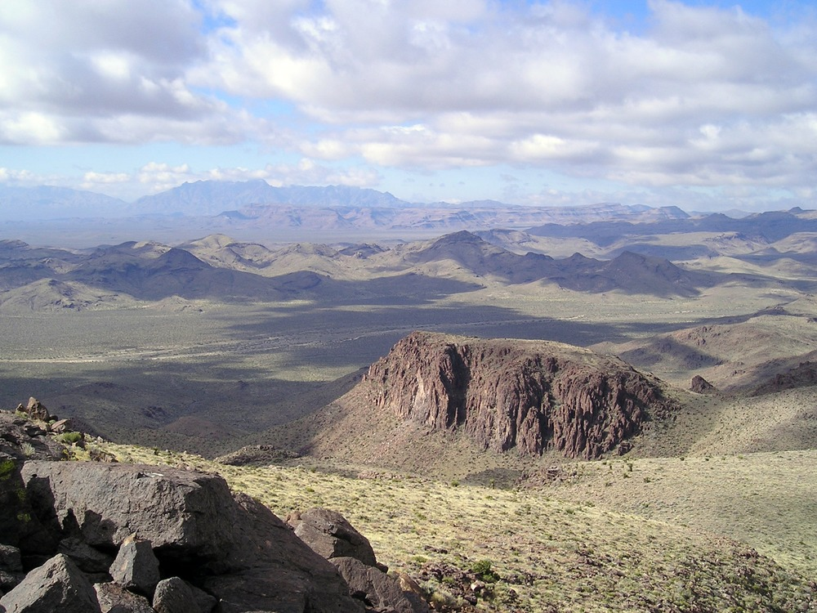
Objectives
Evaluate habitat selection determinants:
Precipitation
Vegetation Indices
Provide data to inform decision-making for conservation
Identify priority management areas
Image: National Park Service
Notes:
Our objective was to model Bighorn sheep habitat availability and selection using NASA Earth observations and in-situ data. We assessed the relationship between precipitation, measured vegetation indices, and habitat selection to aid in conservation and management efforts by identifying possible areas to implement artificial water sources.
Image Source: https://www.nps.gov/media/photo/view.htm?id=CAC503C2-155D-4519-3E3F8003140CF489

Slide 6
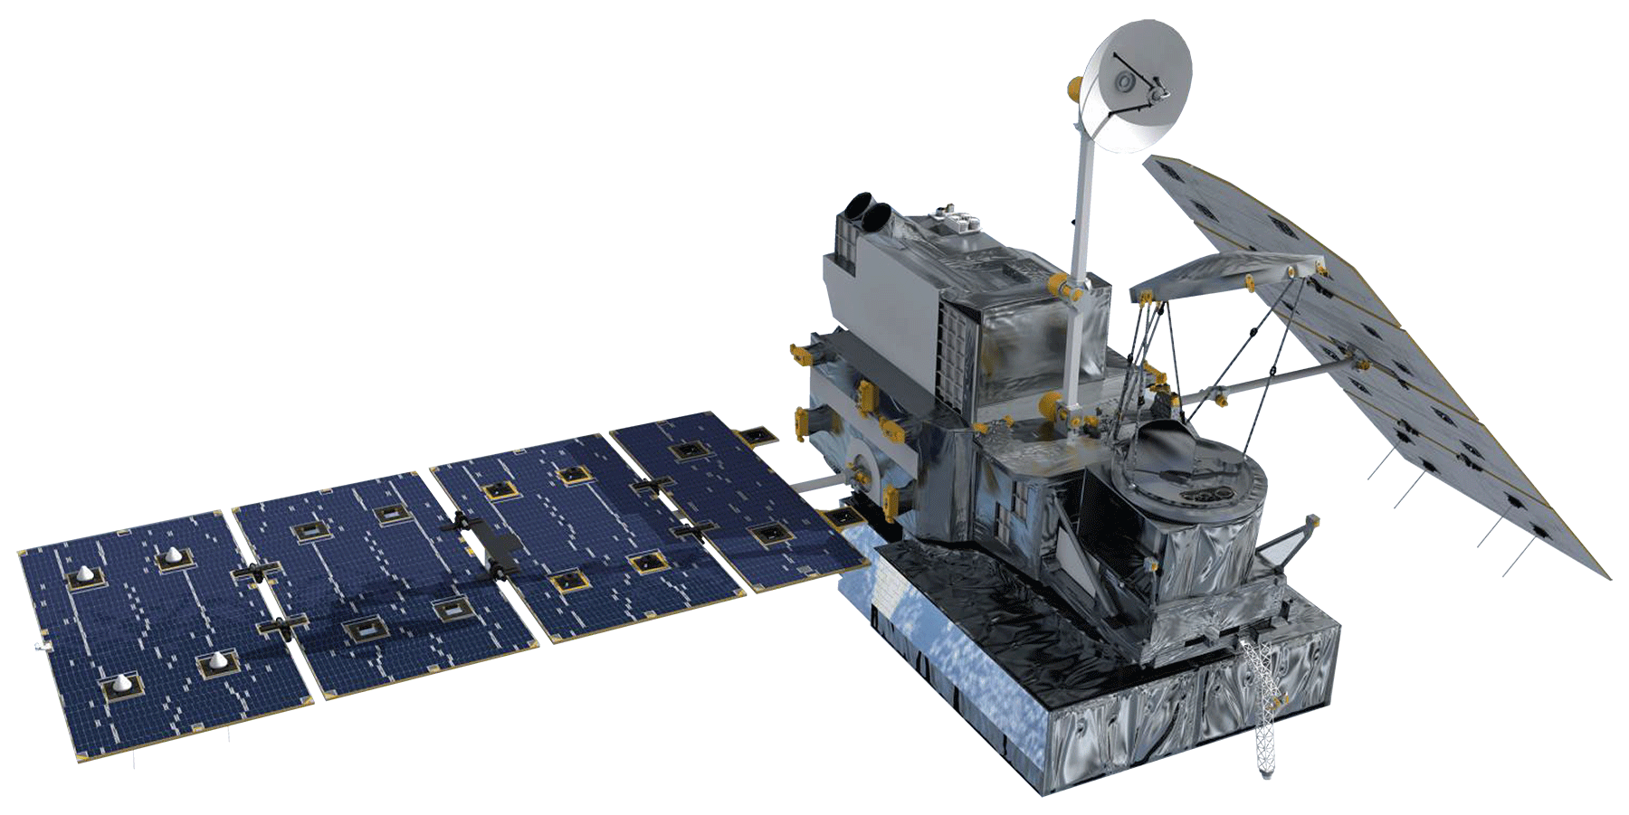
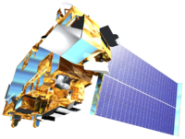
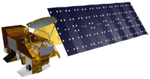
Data Sources
Landsat 8 OLI
GPM IMERG
Aqua MODIS
Terra MODIS
Notes:
We focused on data from these sources: Vegetation from MODIS and Landsat 8; and precipitation data from GPM and the ancillary data sets PRISM and CHIRPS. We were also provided with data from GPS collars, showing us where the sheep roam at different usage distribution levels. These were generalized regions, based on a limited number of herd members. For our study, we looked at the areas where they spent 50, 75, and 95% of their time.

Slide 7
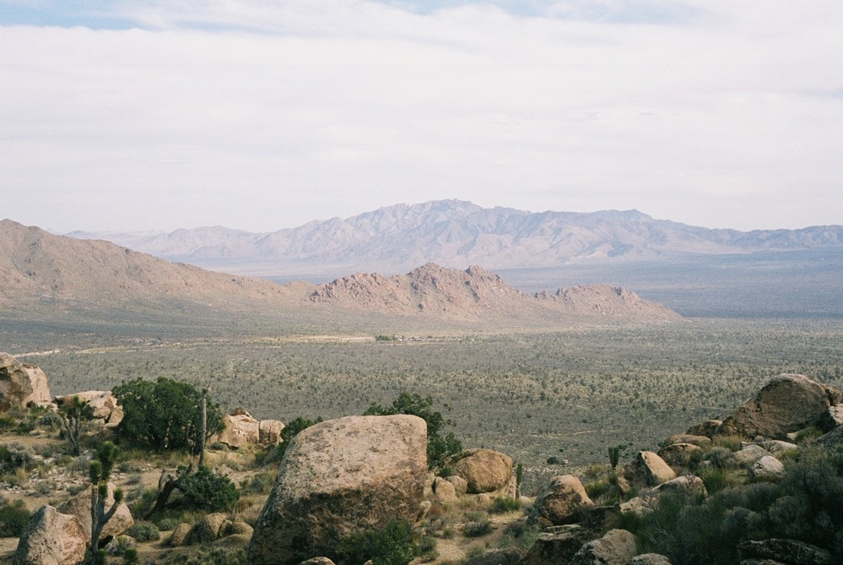
Workflow
Data Processing
Statistical Analysis
GPS Distribution
Distribution Vegetation Regression
Data Acquisition
Landsat,
MODIS
Zonal Statistics
NDVI, MSAVI2
Precipitation Impact on Vegetation
Processed Data
GPM
Precipitation
Image: National Park Service
Notes:
https://www.nps.gov/media/photo/gallery.htm?id=CAD231D3-155D-4519-3E14C69230B6A371
The raster datasets first underwent pre-processing. This involved calculating vegetation indices from the satellite data, and aggregating precipitation data into 16-day totals to match the Landsat data periods. Using the sheep distribution data provided by the GPS collars, we ran zonal statistics on the rasters and created tables of the data. These included the average amount of precipitation and the mean vegetation index levels within the each of the usage distribution levels.

Slide 8
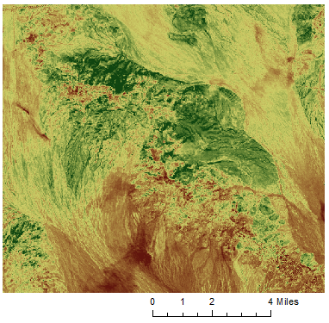
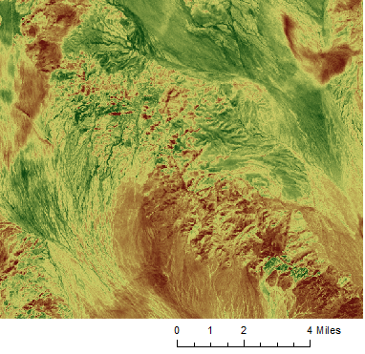
Vegetation Indices
NDVI
MSAVI2
Notes:
We specifically looked at NDVI and MSAVI2 as potential indices for this study. While NDVI is a familiar industry standard in remote sensing, MSAVI2, the Modified Soil-Adjusted Vegetation Index, is specifically designed for study areas with lots of bright, bare soil that can drown out the spectral signatures of vegetation. Finding them to be highly correlated, we decided that NDVI is more appropriate for the study area in spite of the fact that it does not account for soil. This is due to the abundance of rugged topography, and thus shadows, which can interfere with the MSAVI formula. Existing literature has suggested that in less shadowed desert scenes, MSAVI does provide a more accurate assessment, but only marginally.

Slide 9
Notes:
Using the sheep range data from the California Department of Fish and Wildlife, we compared mean NDVI values measured within more and more conservative aggregates of sheep habitat selection. In grey, our 95% usage interval represents almost the entire area visited by collared sheep within the given period, while our 50% interval, in blue, represents a much more centralized and selective depiction of the herd’s movements. We have to mindful of the fact that these areas are generalized from the movements of a fraction of the herd, but we would nonetheless expect to see that more visitation is reflective of better quality foraging.
In the Marble Mountains study area, splitting up our data into usage intervals suggests that for much of our study period, our most selective interval has higher mean NDVI intervals. In our final year, the last fourth of this chart, this trend is interrupted, but for the majority of our other three seasons, the blue 50% interval is highest. That being said, our more inclusive intervals do not fit this expectation, as the 95% interval is often higher in average than the 75% interval.

Slide 10
Notes:
When we shift focus to the Old Dad study area and break things down to a season-by-season basis, we stop seeing trends that fit our hypothesis. From October of 2014 to May of 2015, Old Dad Peak did appear to meet this expectation. An increase in precipitation mid-season precedes an increase in NDVI overall, and the more selective usage intervals appear to exhibit marginally higher mean NDVI values. This is about what we’d expect. However…

Slide 11
Notes:
The following season shows a reversal. Here, precipitation and its relationship to overall NDVI appears more sporadic, while our more selective intervals exhibit lower mean NDVI values throughout much of the year.

Slide 12
Notes:
Finally, the most recent season, 2016-2017, exhibits the most variability in the relationship between habitat selection and NDVI. We do see a much more clear relationship between precipitation and NDVI than the previous season, but the relative standings of more and less selective intervals varies throughout the year. There does not appear to be a consistent trend between usage intervals and mean NDVI.

Slide 13
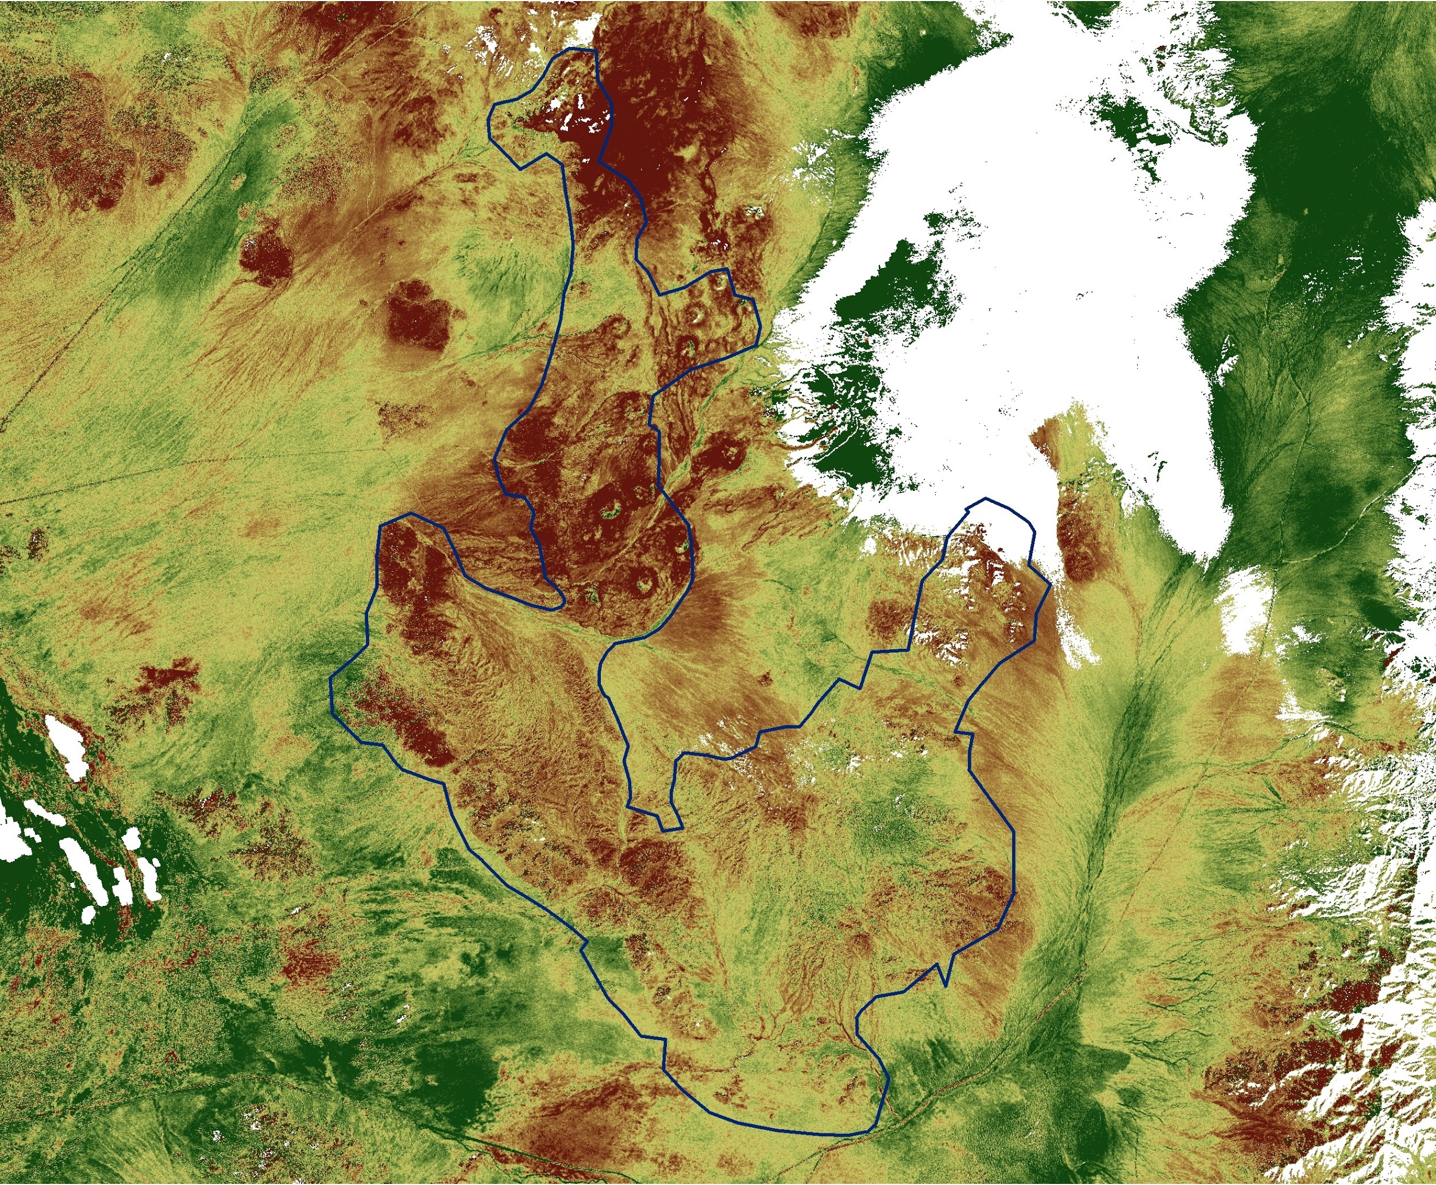
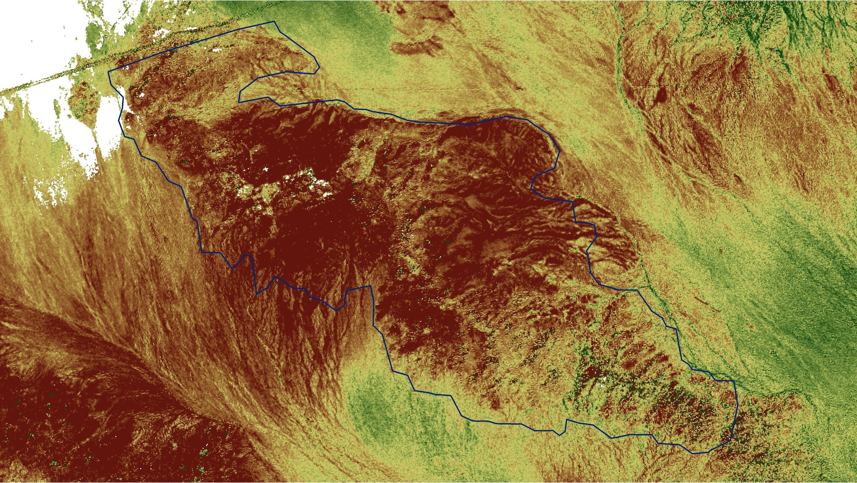
Change Analysis
Old Dad Peak
Marble Mountains
25
-25
NDVI % change =
Notes:
Lastly, we took a look at any changes in NDVI over the course of our study period at both of our study areas. Landsat scenes at similar points in the phenological cycle four years apart were selected. Then, the more recent measures were calculated as a percentage of the historical measures, and the resulting values were displayed as raster values, with decreases being shown here in red and increases in green. Though apparent decreases were observed just between these two dates, NDVI change across all of our dates was largely constituted by relatively small and sporadic shifts from a low baseline.

Slide 14
Limitations
Trade-offs in available precipitation data sources
Sporadic weather
Vegetation Indices vs Topography
Narrow ranges in NDVI means
Resolution
Accuracy
Notes:
The isolation of our study area lends itself to a low number of nearby precipitation stations, which is challenging when precipitation measured by satellites may evaporate before hitting the ground. The coarse resolution of satellite precipitation data and the scarcity of in-situ data limit confidence in analysis in sporadic weather environments like the Mojave Desert. When relying on interpolated or aggregated satellite measurements, a trade-off arises between resolution and confidence level of the precipitation estimates. We also see narrow ranges in NDVI resulting from fairly dry baseline conditions existing throughout most of the year. Remote sensing of arid environments necessitates the detection of very subtle shifts in vegetation.
Clipart: https://openclipart.org/detail/286612/scale

Slide 15
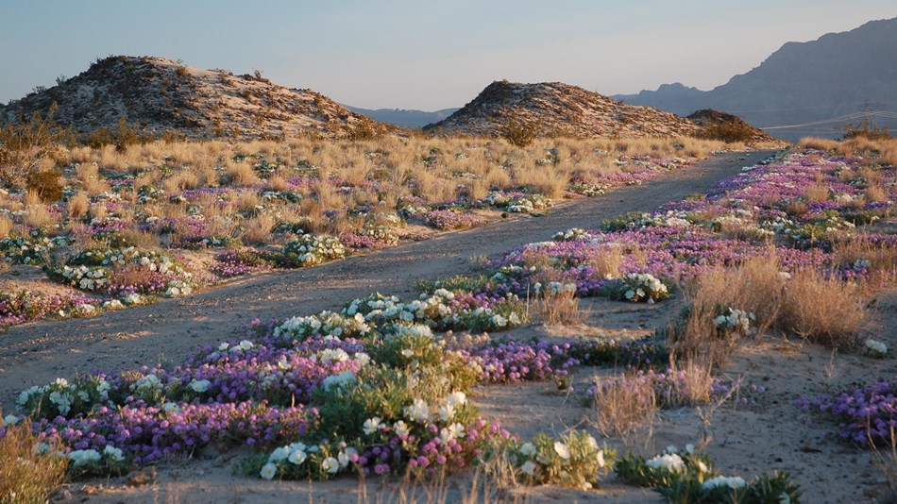
Conclusions and Future Work
Precipitation trends often preceded corresponding spikes or drops in NDVI
Utilization intervals did not show a clear relationship with NDVI
Surface hydrology may remove some barriers to this issue in future research
Image: National Park Service
Notes:
In conclusion, NDVI and MSAVI2 were highly correlated for our study area. However, due to the area’s high level of relief, NDVI is likely more appropriate for high shadow areas. We saw a clear correlation between utilization intervals and mean NDVI for Marble, while Old Dad Peak showed a weaker correlation. (and) With arid environments being characterized by sporadic and spatially limited precipitation events, surface hydrology and the pursuit of enhanced resolution rainfall data would greatly benefit future continuations of our research. The proposed second term of this project will expand in this direction, taking elevation and surface cover type into account to provide more detailed suggestions for habitat management partners.
Image: https://www.nps.gov/moja/index.html

Slide 16
Acknowledgements - Partners
National Park Service, Mojave National Preserve
Debra Hughson, Neal Darby
National Park Service, Biological Resources Division, Wildlife Health Branch
Nathan Galloway, Jenny Powers
California Department of Fish and Wildlife
Regina Abella, Paige Prentice, Dave German, Jeff Villepique
Oregon State University
Clint Epps, Daniella Dekelaita
Sierra Nevada Bighorn Sheep Foundation
John Wehausen

Slide 17
Acknowledgements
Science Systems and Applications, Inc.
Joe Spruce
NOAA National Centers for Environmental Information
DeWayne Cecil, Annette Hollingshead
The University of Virginia’s College at Wise
Bob VanGundy
Eric White
Emily Gotschalk
Notes:
Eric White was the Wise County Center Lead for the Mojave Water Resources Project. The original project proposal was written by Emily Gotschalk

Slide 18
Notes:
L to R: Mariah Heck, Geology/Geophysics, University of Tulsa; Jacob Ramthun (Lead), Geography, Macalester College; Devon Burks, Environmental Studies, Virginia Commonwealth University

Slide 19
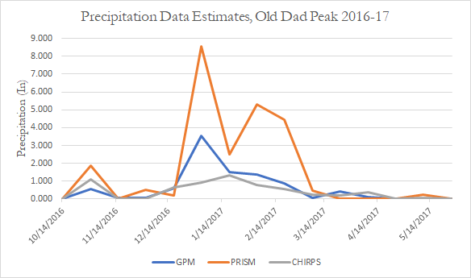
Appendix I
Notes:
Calculated by Zonal Statistics on that Season’s seasonal UD shapefile. Neither of these is necessarily “more correct”; rather one is more interpolated to a finer resolution and the other is coarser with greater confidence.

Slide 20
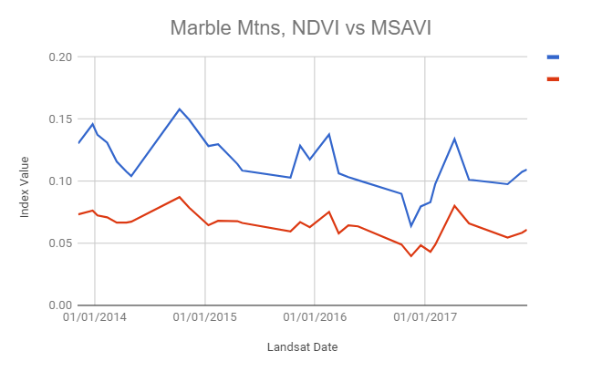
Appendix II
MSAVI2
NDVI
Notes:
-High level of correlation between MSAVI2 and NDVI
-While MSAVI2 does take bare soil into account, it doesn’t handle shadows/rough topography as well.

Slide 21
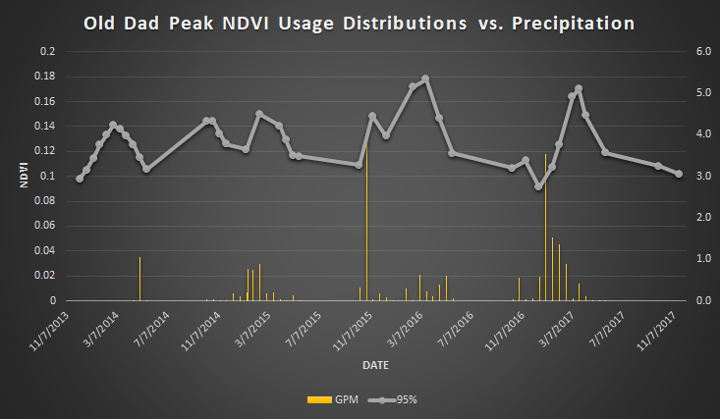
Appendix III
Notes:
Here we see the results of our comparison of Landsat NDVI with precipitation totals from GPM. Every data point here consists of the mean NDVI for a given Landsat image, paired with the total measured rainfall in the 16 day window since the previous Landsat image. We’ve blocked out the summers in pink here due to a lack of data
-GPM is more coarse, but as a result is less reliant on interpolation
-Though we do have a lot of missing data points due to summers/cloud interference, we do generally see relative maxima in the NDVI data in the spans following precipitation events. Summers here are blocked out in pink. In future drafts
-These are very small fluctuations in NDVI from a low baseline, but we do see this trend nonetheless

Slide 22
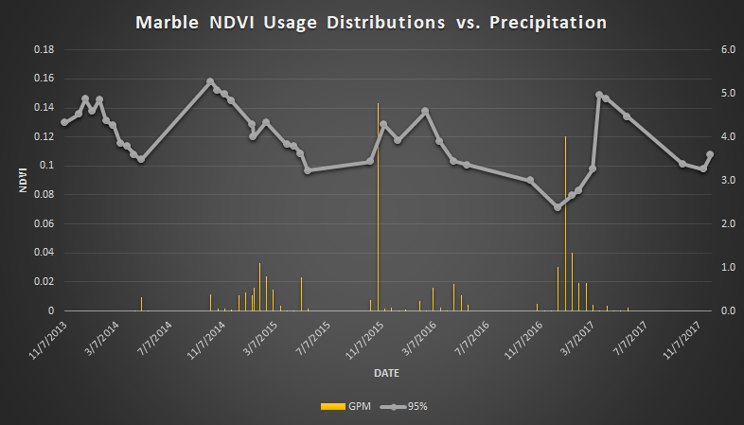
Notes:
Here we see the results of our comparison of Landsat NDVI with precipitation totals from GPM. In spite of its relatively coarse spatial resolution, we used GPM precipitation data for our final analyses because it is less contingent on interpolation and less subject to outliers than PRISM or CHIRPS. Every data point here consists of the mean NDVI for a given Landsat image, paired with the total measured rainfall in the 16 day window since the previous Landsat image. We’ve blocked out the summers in pink here due to a lack of data. It is worth noting that GPM data was unavailable for much of the first season; however, high winter rainfall for that year is reflected in that season’s relative maxima.
This graph is for Old Dad Peak. Here, we can see that spikes and dips in NDVI are often, but not always, preceded by correlating bursts or pauses in rainfall. This is not always the case, however [refer to end of the 15-16 season]. Exceptions, like the drop we see at the end of the 2015-16 season, may be explained by spatially limited precipitation that is common of arid ecosystems. It is also worth emphasizing that what is the trends above are actually constituted by small fluctuations from a relatively low baseline. We’re working with vegetation that is dry and patchy throughout most of the year, so any shifts we see are going to be subtle.
-This is GPM Data (for comparisons of GPM and PRISM, see Appendix I)
-GPM is more coarse, but as a result is less reliant on interpolation
-Though we do have a lot of missing data points due to summers/cloud interference, we do generally see relative maxima in the NDVI data in the spans following precipitation events
-These are very small fluctuations in NDVI from a low baseline, but we do see this trend nonetheless

Slide 23
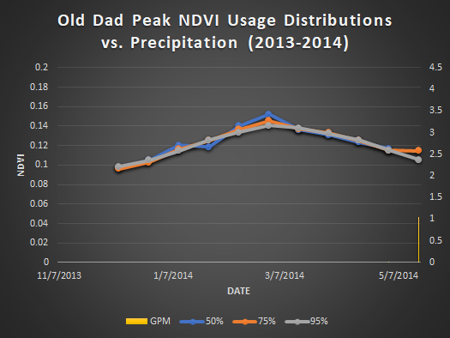
Appendix IV

