Slide 1
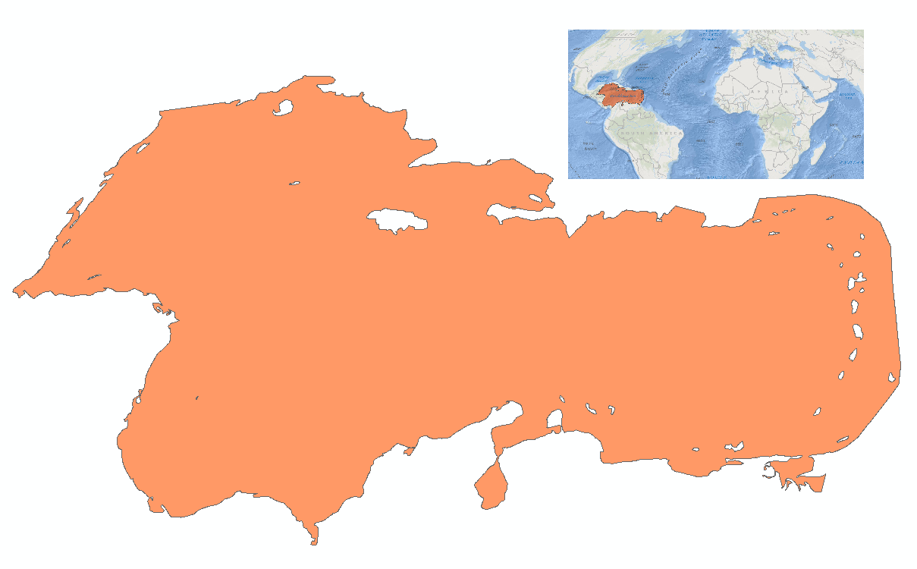
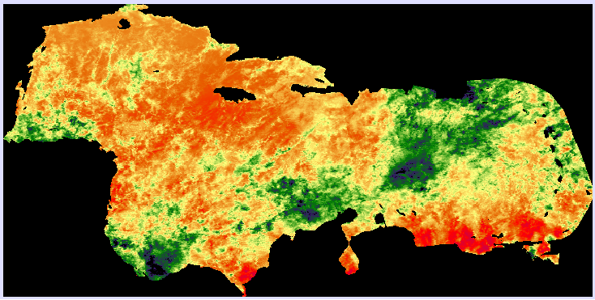
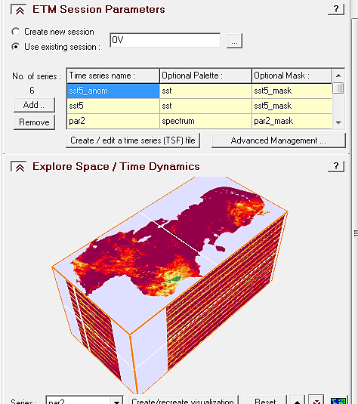
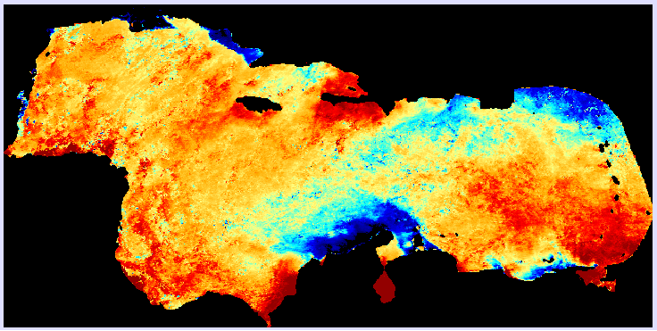
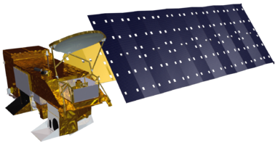
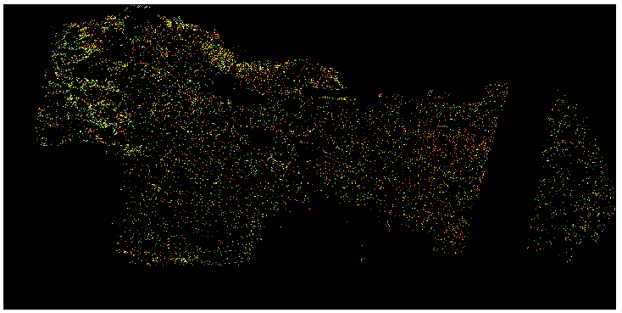
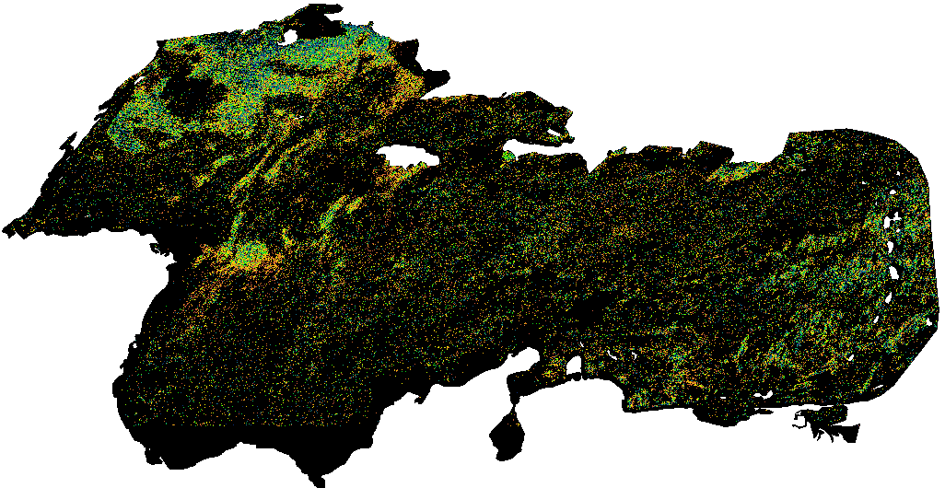
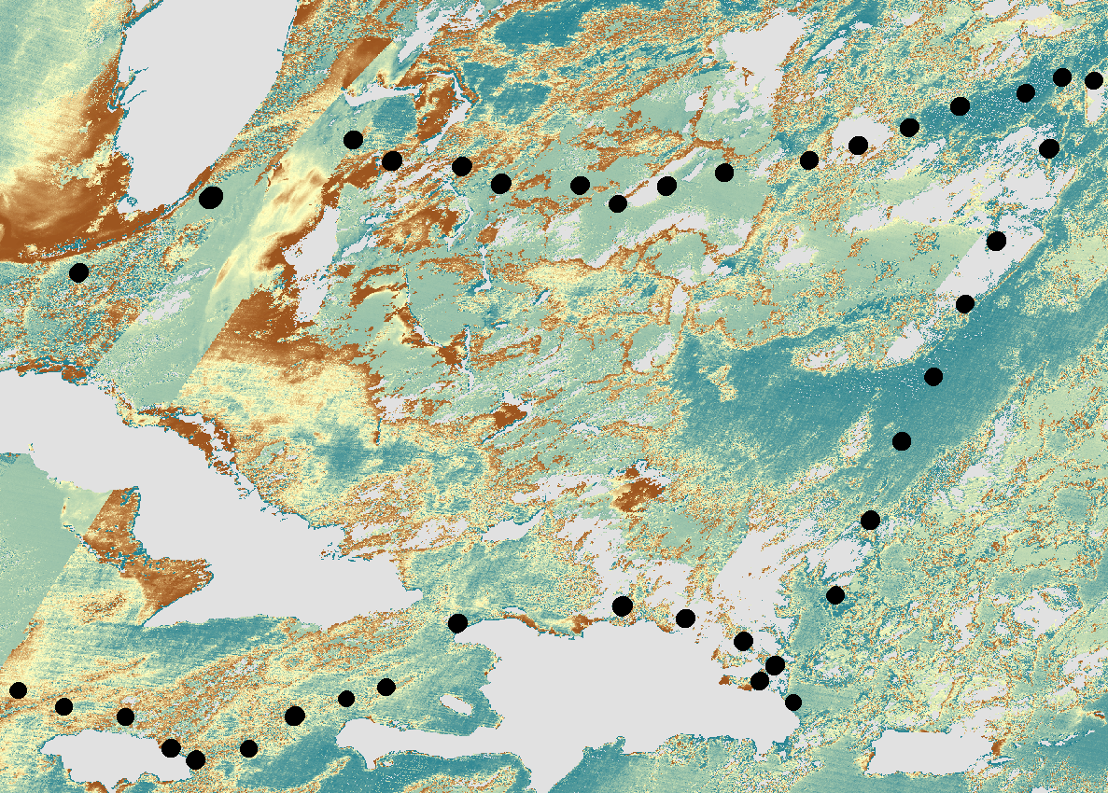
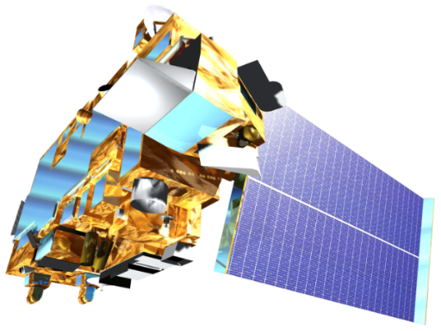
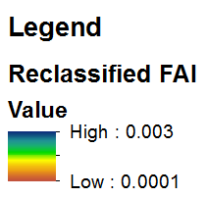
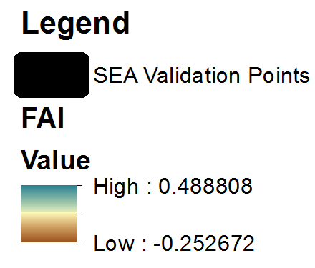
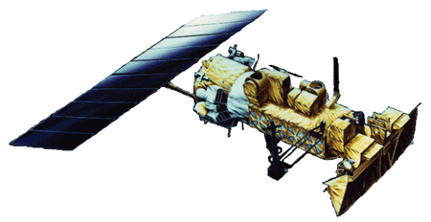
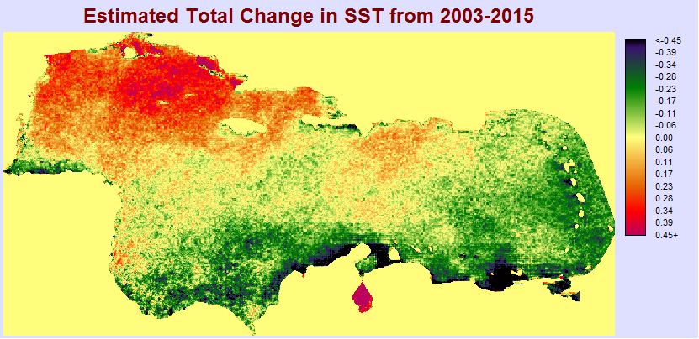
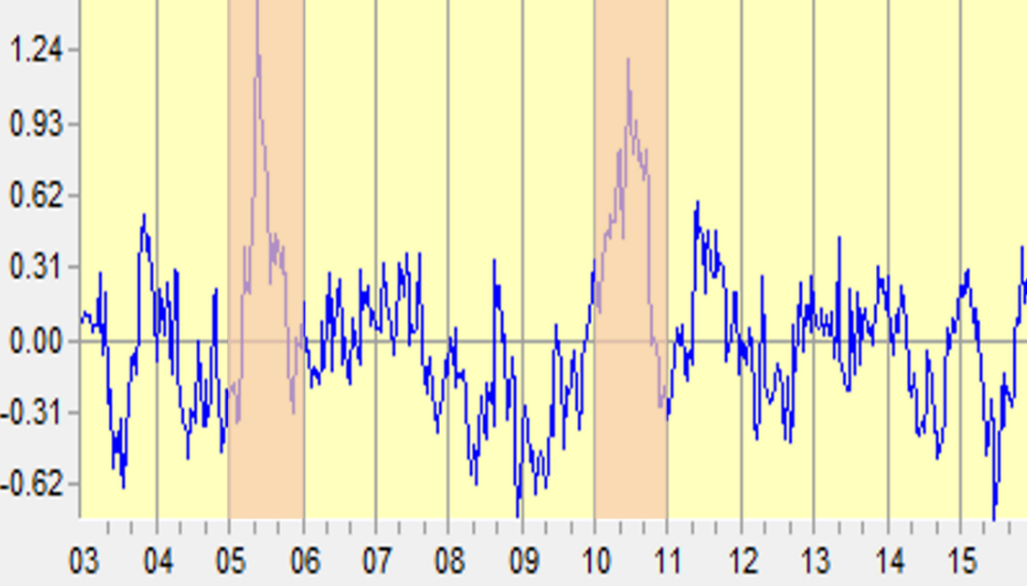
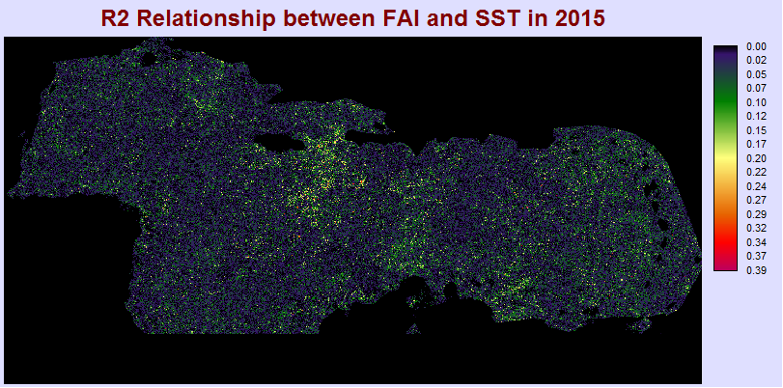
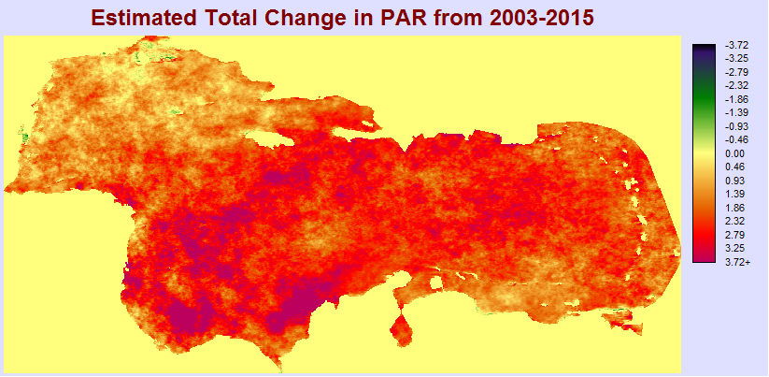
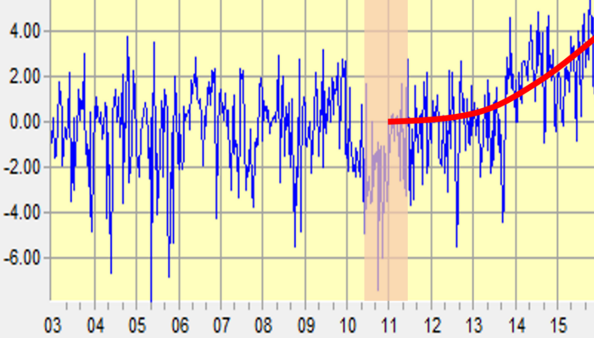
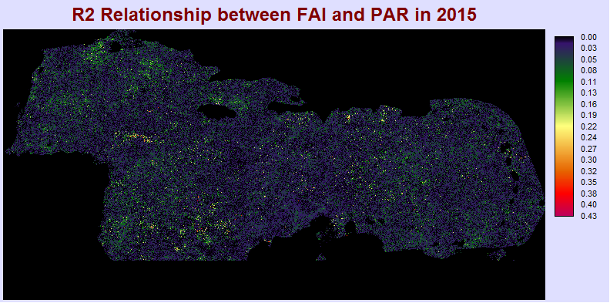
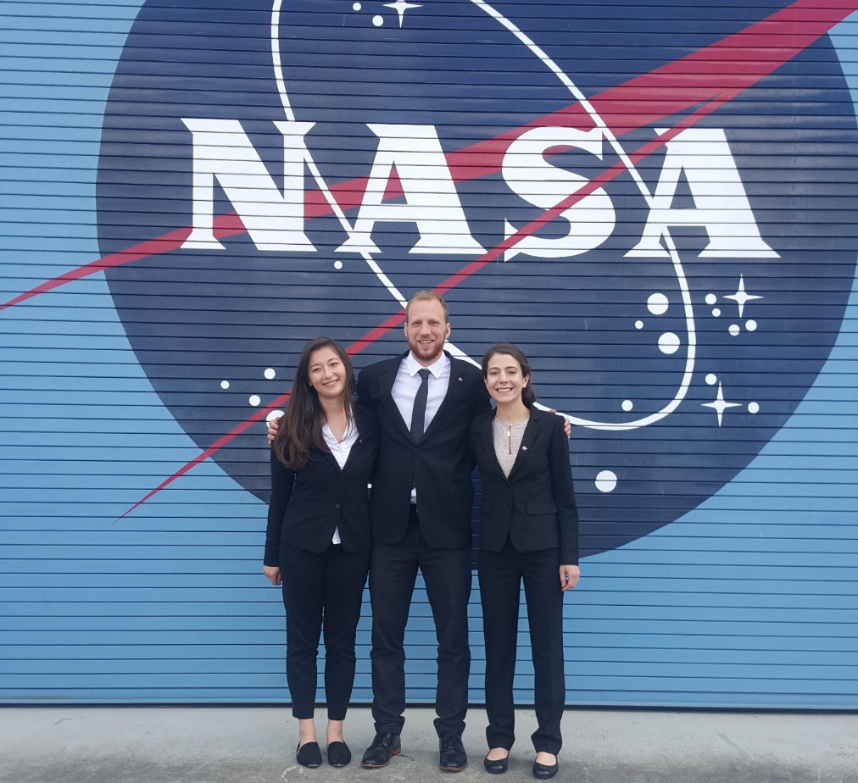
Caribbean Oceans
Utilizing NASA Earth Observations to Detect, Monitor, and Respond to Unprecedented Levels of Sargassum in the Caribbean Sea
Jordan Ped (Project Lead), Erica Scaduto, Emma Accorsi
DEVELOP National Program at NASA Ames Research Center
Abstract
Objectives
In 2011 and 2015, the nations of the Caribbean Sea were overwhelmed by the unprecedented quantity of Sargassum that washed ashore. This issue prompted international discussion to better understand the origins, distribution, and movement of Sargassum, a free-floating brown macro alga with ecological, environmental, and commercial importance. Despite its ecological importance in oceanic waters, the accumulation of large quantities of Sargassum on onshore sites threatens local tourist industries and shallow-water ecosystems like coral reefs and seagrass beds. As part of the international response, this project investigated the proliferation of this macro alga within the Caribbean Sea from 2003-2015, and used NASA Earth observations to detect and model Sargassum growth across the region. The Caribbean Oceans team derived the Floating Algal Index (FAI) using Terra MODIS data, and compared the FAI to various oceanic variables to investigate the ideal pelagic environment for Sargassum growth (Hu, 2015). The project also examined the annual spread of Sargassum throughout the region by using TerrSet Earth Trends Modeler. As part of the international effort to better understand the life cycle of Sargassum in the Caribbean, the results of this project will help local economies to promote sustainable management practices.
Trace historical patterns of Sargassum movement and growth in the Caribbean by utilizing NASA Earth observations from January 2003 through December 2015.
Assess if 2015 Sargassum levels are anomalous to trends since 2003 via quantitative analyses.
Identify key oceanic environmental variables correlated with Sargassum presence using NOAA Ocean Watch data.
Methodology
Study Area
TerrSet Earth Trends Modeler Inputs
TerrSet Earth Trends Modeler
TerrSet Earth Trends Modeler (ETM) Outputs
Photosynthetically Available Radiation
Caribbean Sea
Interannual Trends Analysis
Seasonal Trends Analysis
Anomaly Series
Linear Models
Retrieved from: http://www.theyucatantimes.com/2015/07/90-tons-of-sargassum-algae-washed-up-on-cancuns-beaches/
Sea Surface Temperature
The study examined oceanic conditions in the Caribbean Sea from January 2003 through December 2015.
Earth Observations
Aqua MODIS
Floating Algal Index
Terra MODIS
FAI Reclassification
FAI Validation
NOAA-17 and NOAA-18 –AVHRR
The trends in PAR and SST were analyzed throughout the study period. Then the Floating Algal Index (FAI) was used to detect Sargassum. Pixels identified as Sargassum via threshold values were correlated with oceanic variables using TerrSet ETM.
Results
Project Partners
Interannual trends and seasonal extremes in oceanic variables are observable with OLS regression and the anomaly series. These variables are the basis for the linear model of SST and PAR with one 8 day lag to FAI.
Dr. Porfirio Alvarez Torres, CiiMarGoMC
Dr. Francisco Arreguin, CICIMAR-IPN
Dr. Sergio Cerdeira, CONABIO
Dr. Laura Carillo, ECOSUR
Dr. Eduardo Santamaria del Angel, UABC
Dr. Roy A. Armstrong, UPR
OLS Regression SST Trend 2003-2015
Mean SST Anomalies
2015 FAI and SST₋₁ R² Relationship
Acknowledgements
OLS Regression PAR Trend 2003-2015
Mean PAR Anomalies
2015 FAI and PAR₋₁ R² Relationship
We would like to thank our Center Lead, Chippie Kislik, our Assistant Center Lead, Victoria Ly, and our science advisor, Dr. Juan Torres-Pérez, for their support and mentorship throughout this project.
We would also like to acknowledge: Chase Mueller, Dr. Porfirio Alvarez, Dr. Sergio Cerdeira, Dr. Roy Johnson, Frédérique Fardin, Amy Siuda, Deb Goodwin, and Jeffrey Schell.
Conclusions
Future Work
Team Members
Sea surface temperature remained roughly the same over the study period, with slight regional and seasonal shifts. It increased preceding the Sargassum inundation events of 2011, but this trend is not present in other inundation years.
Photosynthetically available radiation showed a clear increase over the study period. After a low in 2010, it rose steadily to maximums in 2014 and 2015, which may be related to Sargassum influx events.
TerrSet single variate linear models failed to show strong correlations between FAI and oceanic variables; this may be due to noise or the generality of the model.
Model the relationship between Sargassum and additional oceanic variables.
Reduce noise in FAI by using higher resolution imagery and improved cloud masking techniques.
Use FAI to investigate relative Sargassum quantities in 2005 (the warmest year in the study period for sea surface temperature).
Determine the geographic origin of Caribbean Sargassum.
Left to right: Erica Scaduto, Jordan Ped (Project Lead), Emma Accorsi
NASA Ames Research Center

