Slide 1
Georgia Water Resources
Assessing Groundwater Storage Change and Contamination Risk in Southwest Georgia
Wenjing Xu (Project Lead)
Doori Oh
Jason Reynolds(Co-lead)
Mingshu Wang
Linli Zhu

Slide 2
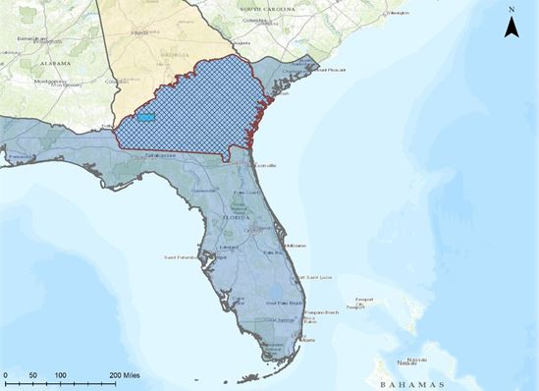
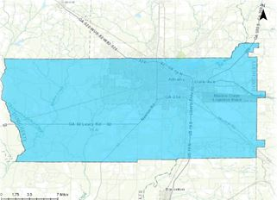
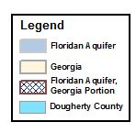
Study Area
Image Credit: Georgia Water Resources Team
Notes:
Dougherty County is located within the Dougherty Plain of southwest Georgia and is at the northern edge of Georgia’s portion of the Upper Floridan Aquifer (UFA). The county has a growing population that relies on groundwater resources from the UFA, the Flint River, and Lake Chehaw. Albany is Dougherty County’s largest metropolitan area with a population of approximately 76,000 residents. The local topography is generally flat and underlain by the Ocala Limestone, making this area an importance source of groundwater quantity change and prone to contamination. To address the increased demand for sustainable groundwater supply in Dougherty County, an effective groundwater monitoring and evaluation tool is critical for local water resources management.
Base Layer Source: ESRI, HERE, DeLorme, TomTom, Intermap, increment P Corp., GEBCO, USGS, FAO, NPS, NCRCAN, GeoBase, IGN, Kadaster NL, Ordnance Survey, ESRI Japan, METI, ESRI China (Hong Kong), swisstopo, MapmyIndia, Copyright OpenStreetMap contributors, and the GIS User Community.

Slide 3
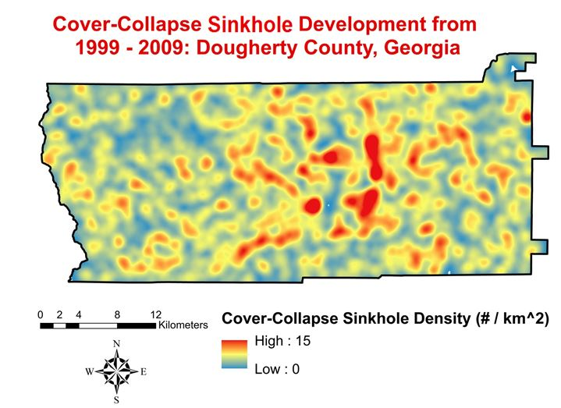
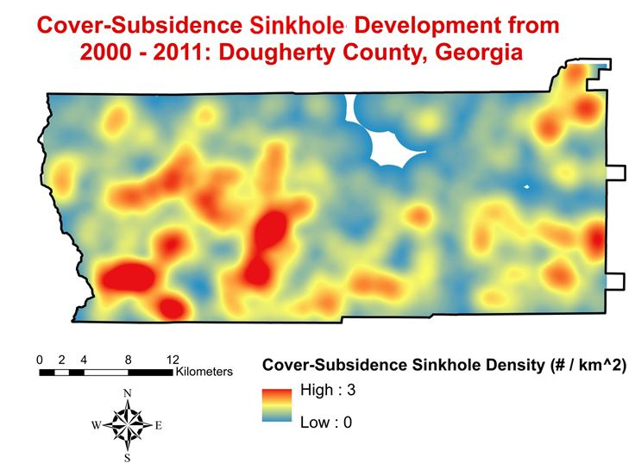
Sinkhole formation 1999 - 2011
Cover-collapse sinkhole
Cover-subsidence sinkhole
Notes:
This project follows the one done by Georgia disaster team in summer 2015. Their major focus is on sinkhole formation in the southwest Georgia during 1999 to 2011, and they found sinkhole density gradually increased in the study period. The team mapped sinkhole susceptibility derived from sinkhole density and susceptibility over the year. As we may know, the formation of sinkholes is directly related to groundwater. Is that possible that sinkhole density increase has something to do with groundwater change? How we can make use of sinkhole inventory to inform water management, especial groundwater management in practice? These questions lead to our project this term, which focuses on groundwater storage and contamination risk.

Slide 4
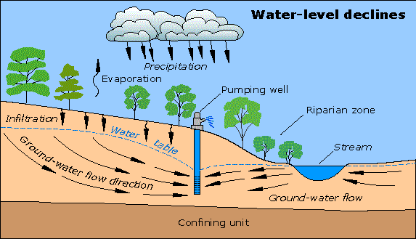
Image Credit: USGS
Notes:
Pumping groundwater at a faster rate than it can be recharged can have some negative effectives of the environment and the people who make use of the water:
Lowering the water table
Increase costs for the user
Land subsidence – the basic cause is a loss of below ground. This loss is most often caused by human activities, mainly from withdraw of groundwater.
Image credit URL: http://water.usgs.gov/edu/earthgwdecline.html

Slide 5
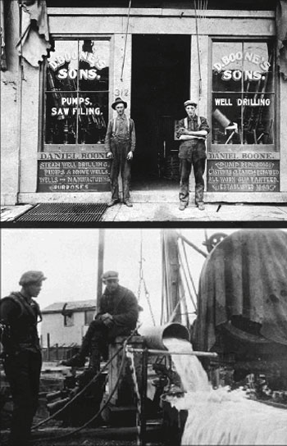
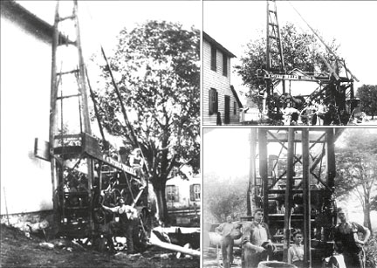
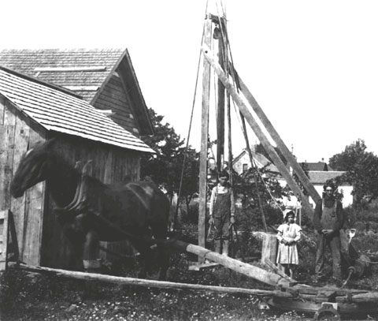
Churn Drill 1920
130 Years of Drilling with D.Boone's Sons
Horsepower Drives Drilling Machine
Image Credit: US Groundwater Association
Notes:
Groundwater is located subsurface. So there is a myth that it is only remotely related to our daily life. The use of groundwater can be dated back to 5000 BC. The use of groundwater in the U.S. were already popular 100 years ago.
The US uses nearly 80 billion gallons per day of groundwater for public use.
We are still using the same wells today. There way no other way to monitor groundwater before the GRACE mission launched in 2002.
Image Credit URL: http://info.ngwa.org/servicecenter/museum/museum.cfm

Slide 6
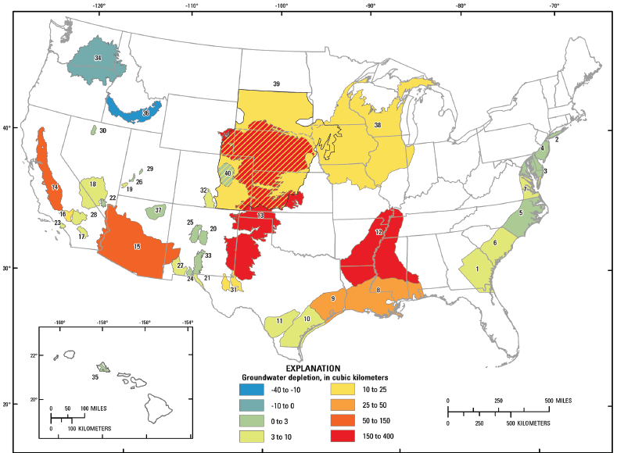
Community Concerns
Groundwater decrease may cause water supply shortage
Extensive development of sinkholes may increase groundwater contamination risk
A monitoring approach is needed to capture real-time changes and improve management strategies
Map of the U.S. showing cumulative groundwater depletion from 1900 to 2008
Image Credit: USGS
Notes:
In southwest Georgia, population grows significantly in an agricultural region with restrictions on surface water extraction due in part to recent drought conditions. Subsequently, demand for groundwater resources has increased. To sustainably manage water resources, it is important to quantify trends in groundwater storage change.
This area is also exposed to sinkholes which pose a threat to groundwater pollution, as they can quickly introduce contaminants to karst aquifer systems (i.e., the Upper Floridan Aquifer) which supply a large percentage of drinking and agricultural water in the study area. This knowledge will be useful for farmers who rely on groundwater resources, land use and city planners responsible for infrastructure development, and municipalities responsible for delivering safe drinking water to consumers.
Image credit URL: http://water.usgs.gov/ogw/gwrp/stratdir/activities.html

Slide 7
Objectives
QUANTITY
Groundwater Storage Change
Time Series
2002
2009
QUALITY
Compare
Groundwater
Contamination Risk 1
Groundwater
Contamination Risk 2
Notes:
The objectives of this project were to:
1.) Assess groundwater storage changes from 2002 and 2009 in the UFA (Upper Floridan Aquifer) portion of southwestern Georgia using NASA Earth Observations.
2.) Develop contamination vulnerability maps using Dougherty County as the focal area. Building upon the traditional DRASTIC model, sinkhole susceptibility was incorporated to assess groundwater contamination vulnerability. The sinkhole susceptibility results from the Summer 2015 Georgia Disasters project were utilized in the team’s modified DRASTIC model.

Slide 8
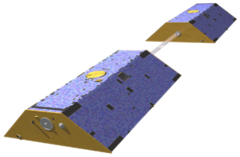
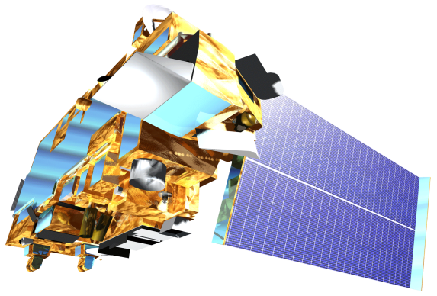
NASA Earth Observations
Gravity Recovery and Climate Experiment (GRACE)
Terra Moderate Resolution Imaging Spectroradiometer
(MODIS)
Notes:
Three NASA Earth Observations were used in this project.
GRACE and Aqua AMSR-E were used to quantify groundwater changes and develop the groundwater storage change map in this project. The GRACE satellite provided total water storage data while the Aqua AMSR-E sensor provided data for the snow water equivalent and soil moisture indices.
The Terra MODIS Earth Observation was used to assess the recharge parameter of the DRASTIC model. We obtained yearly evapotranspiration data from MODIS to accurately rate the recharge parameter of our model.
Image credit URL: http://www.devpedia.developexchange.com/dv/index.php?title=List_of_Satellite_Pictures

Slide 9
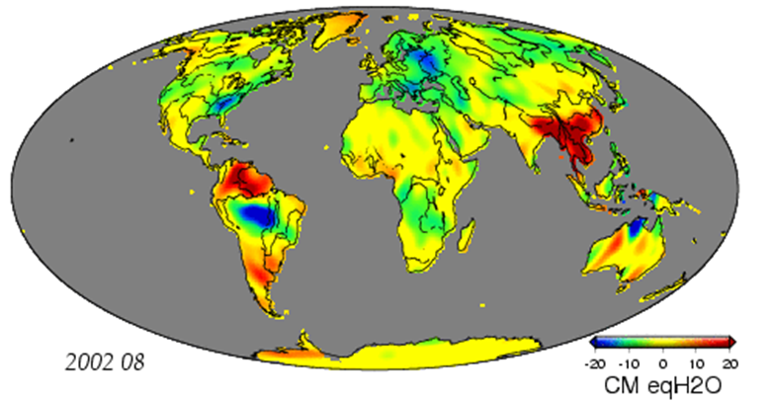
Quantity Analysis:
Gravity Recovery and Climate Experiment (GRACE)
Measures gravitational anomalies and its changes over time
Positive anomaly –
“mass surplus”
Negative anomaly –
“mass deficit”
Measurements recorded in cm of equal water thickness
Image Credit: NASA
Notes:
The GRACE satellites were launched in March 2002. GRACE’s primary objective is to measure gravitational anomalies over time and space. One of GRACE’s capabilities is to interpret water storage changes derived from its detection of changes in gravitational anomalies. Because water is so heavy, it can cause changes in Earth’s gravity field. Scientists to isolate the anomalies caused by water mass and measure hydrological elements such as groundwater.
A positive anomaly represents a “mass surplus” in Earth’s gravitational field while a negative anomaly represents a “mass deficit”. We can interpret a negative value as a decrease in water storage and vice versa.
Image credit URL: ftp://podaac.jpl.nasa.gov/pub/tellus/monthly_mass_grids/chambers-destripe/dpc200711/browse/anim/csr300lnd_RL04_500x260.gif

Slide 10
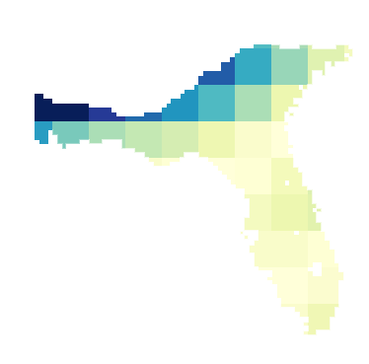
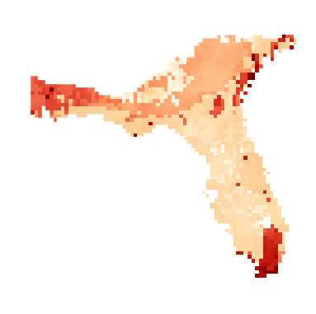
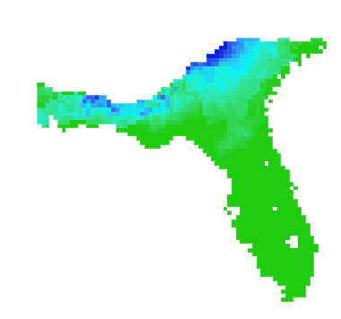
Methodology (Quantity)
Water Storage data (GRACE)
Soil Moisture and Snow data (NLDAS)
Groundwater Storage (GW)
Total Water Storage (TWS)
Soil Moisture (SM)
Snow Water Equivalent (SWE)
Groundwater Storage Variability
Notes:
To calculate the total groundwater storage in our study area region, we downloaded datasets from the GRACE mission and the NLDAS (North American Land Data Assimilation System) data platforms. We acquired monthly averages from the years 2002 and 2009.
Re-projecting, re-sampling, and masking the data to our study area were the basis of our data processing scheme. A major discrepancy we had to fix was that the NLDAS-2 parameters had a different unit measurement (kg/m²) than the GRACE data (cm). To convert the NLDAS-2 parameters from (kg/m²) to (cm), the data was multiplied by a 0.1 factor using Raster Calculator. To calculate the changes in groundwater depth, we performed the following equation in Raster Calculator:
∆GW=∆TWS-(∆SM+∆SWE)

Slide 11
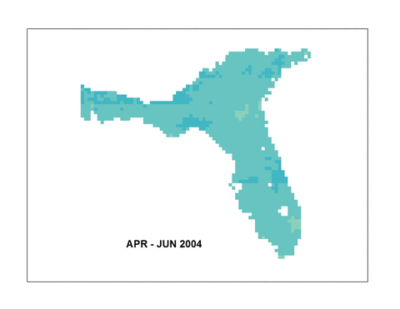
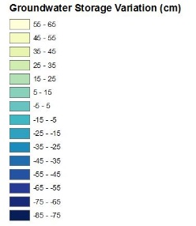
Results:
Groundwater Storage Variation Map
Groundwater storage change declined throughout the time period
Groundwater storage anomalies on average -13.25 (+/- 3.26) cm per year from 2002 – 2008
Notes:
Our results produced a groundwater storage variation map of the Floridan Aquifer. Analysis of our calculations revealed that groundwater storage changes declined from 2002 – 2009. Anomalies averaged -13.25 cm per year from 2002 – 2008. A careful look at Total Water Storage changes during this time period can explain this negative trend.

Slide 12
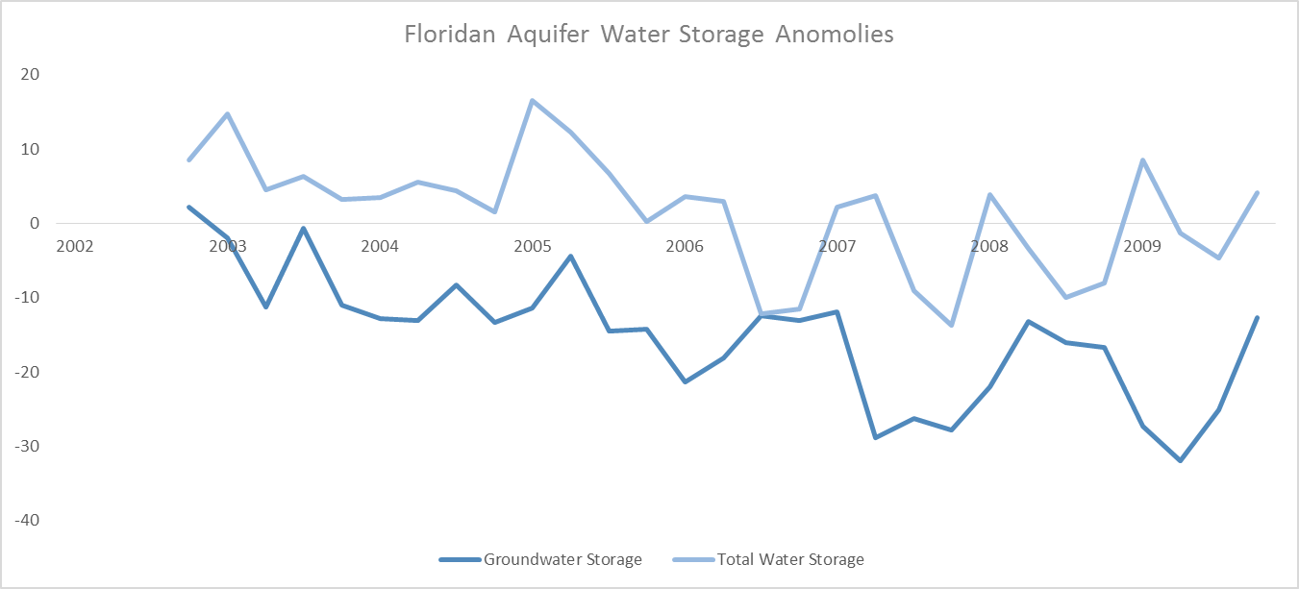
Result: Water Storage Trends
From Jan 2005 – Dec 2007, total water storage severely declined
ΔTWS was -4.28 cm per 3 months from 2005 – 2007
Water shortages in Georgia and other states located within the Floridan Aquifer resulted from the decline in water storage (Manuel, 2008; Florida Department of Environmental Protection, 2008)
Notes:
Total water storage from 2005 – 2007 severely declined in the Floridan Aquifer. Changes in total water storage averaged bout -4.3 cm every 3 months during this period. A severe drought persisted throughout the Southeastern United States from 2005 – 2007, resulting in the water storage decline. Groundwater storage suffered significantly with the decline in total water storage. The states of Georgia and Florida issued strict restrictions on groundwater withdrawal in 2007 as a result of the drought.
In 2009, extremely low anomalies were present. Such a large mass deficit of groundwater can to an increase in sinkhole development. We will now look at the risks involved with groundwater contamination and sinkhole susceptibility.

Slide 13
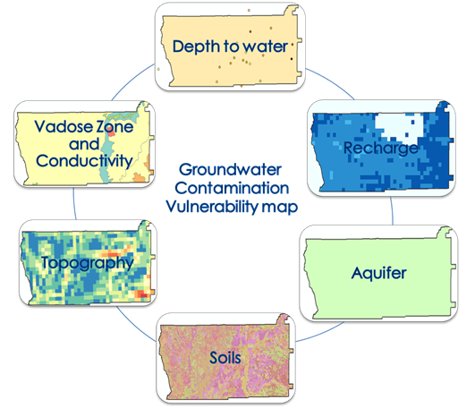
Quality Analysis:
The DRASTIC Model
Developed by the United States Environmental Protection Agency (EPA)
Employs overlay and indexing methodologies
Widely-recognized and used to assess groundwater vulnerability
Image credit: Georgia Water Resources Team
Notes:
Overview of DRASTIC: The DRASTIC model, which employs overlay and indexing methodologies, is widely-recognized and is mainly used to assess groundwater vulnerability. DRASTIC was first developed by the United States Environmental Protection Agency (EPA) and later modified by researchers to account for a range of different environmental settings. DRASTIC has been developed into various GIS-based modifications for many groundwater studies.

Slide 14
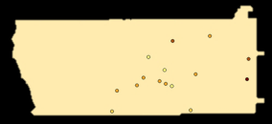
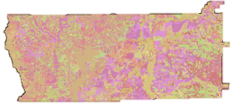
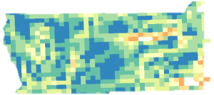
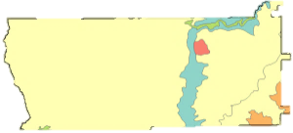
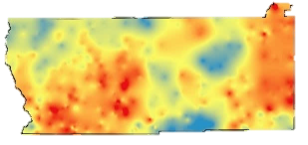
Methodology (Quality)
Well log data (USGS)
Precipitation data (PRISM)
Evapotranspiration (MODIS 16)
Geological data(USGS)
DEM data (NED)
Soil Data (USDA)
Depth to Water
Recharge
Aquifer Media
Soil Media
Topography
Impact of Vadose Zone and Conductivity
Groundwater Contamination
Risk Maps
Sinkhole Density
Notes:
Groundwater Vulnerability map:
Implementation of the DRASTIC model required obtaining multiple datasets from different sources. Six of the seven parameters in this model were obtained from government research databases. The final parameter was retrieved from the results of the 2015 Summer Georgia Disasters project.
Processing the data for the DRASTIC model included: Resampling all of the data sources to 1 km, creating a 10 km buffer around the study area, masking the datasets to this area, and using the Raster Calculator tool in ArcGIS.
A DRASTIC model value, including the rate (r) and weight (w), was assigned to each parameter for each pixel (1 km). Once the DRASTIC ratings were assigned, the pollution vulnerability for each pixel was estimated by calculating the DRASTIC Index value, from which the groundwater susceptibility map was generated for the years 2002 and 2009. Building upon the traditional DRASTIC model, sinkhole susceptibility was incorporated as a multiplier term to calculate a final, modified DRASTIC index (DRASTICS).
DRASTIC data analysis: Using sinkhole susceptibility maps from the Georgia Disasters team, groundwater contamination vulnerability can be associated with sinkhole formation, offering comprehensive details for groundwater quality.

Slide 15
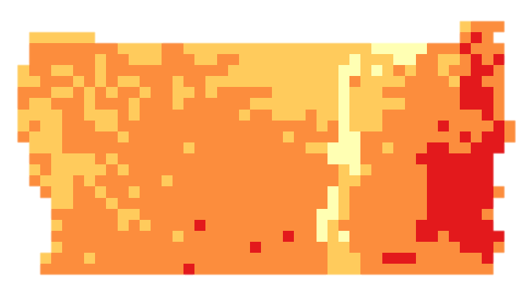
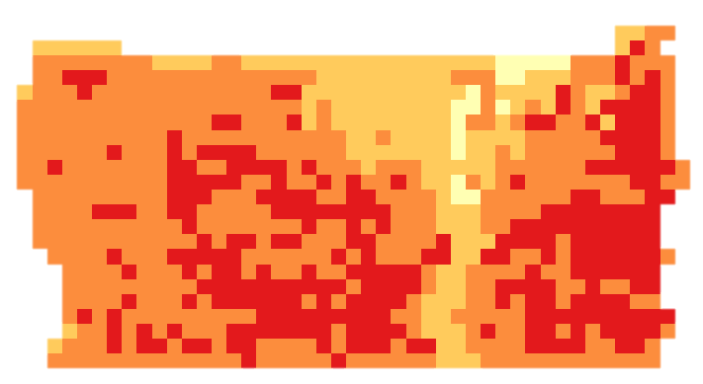
DRASTICS water contamination risk map
 | 2002 | 2009
DRASTCS MAP
Mean DRASTICS VALUE | 190.56 | 206.61
<
Overall water contamination risk has increased
Spatial variation of water contamination risk has increased
Notes:
Using DRASTICS model, we have produced ground water contamination maps of two snap years, i.e. 2002 and 2009, respectively. Consistent with the original DRASTIC model, our modification of DRASTICS model is an additive risk assessment model, where the higher the final score is, the more risky the area will be. We can see the final DRASTICS score varies largely, with a range from 99.8 to 257.1. Although there is not a universal cut-off value of the DRASTICS score to segment areas into different risk categories, the differences in these value effectively unveil the contamination risk of groundwater in this area. With a global average score of 190.6 in 2002 and 206.6 in 2009, there is an increasing trend of groundwater contamination risk in the Dougherty County, Georgia. Moreover, the spatial variation of groundwater contamination risk has also increased from 2002 to 2009, as more local extreme risk value emerges in the 2009 map.

Slide 16
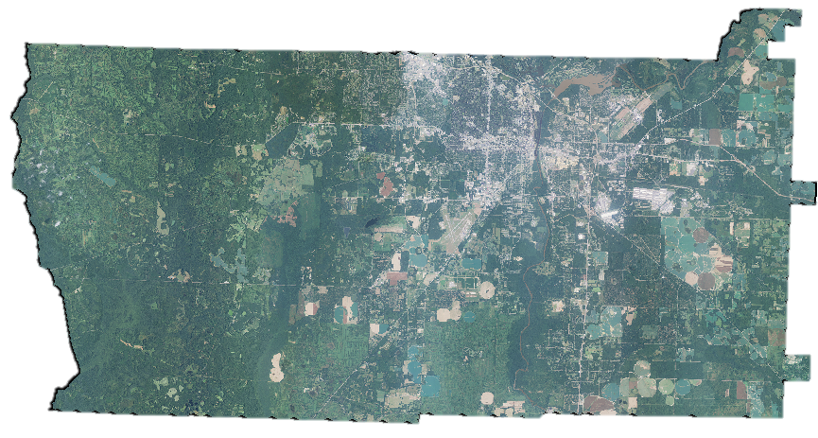
DRASTICS water contamination risk map
2002
2009
West Dougherty County: detailed monitoring
East Dougherty County: High risk area was dominated by agricultural land close to urban areas
Notes:
Importantly, while areas in the eastern Dougherty County are high risk region for both years, a growing high risk areas in western Dougherty County is observed from 2002 to 2009. Although all high groundwater contamination risk areas are dominated by agricultural land that is close to impervious surfaces, the underlying spatial process of the eastern and western part of the study area may not be the same. The spatial growth high risk area in the eastern part of the county is from city perimeter towards urban core, allowing high water contamination to diffuse from agricultural land towards urban areas. This phenomenon may be explained by the expansion of agriculture poses potential risks to groundwater. However, the directionality of the spatial growth of risk area in the western part of the county is reversed. It expands from the urban core towards the city perimeter, which may result from the urban development of the city of Albany, GA (the center city of Dougherty County, Georgia). According to the U.S. Decennial Census, there is approximately 1% population growth in Albany, GA from 2000 to 2010. The urbanization process, which is coupled with population growth and urban land expansion may impose the increasing level and areas with high groundwater contamination risk in this area.

Slide 17
Conclusions
Groundwater storage change declined throughout the time period.
A significant decline in groundwater storage occurred in the Floridan Aquifer from 2002 – 2009.
Depletion of groundwater storage increases the risk of water shortages and sinkhole development.
Due to the dramatic increases of groundwater contamination risk in the western part of Dougherty County, we recommend a detailed monitoring in this area.
High-risk areas were dominated by agricultural land close to urban areas.
Notes:
To conclude, the results of GRACE based groundwater storage analysis indicated that a significant decline in groundwater storage occurred in Floridan Aquifer from 2002 to 2009. Our analysis supports the importance of water management in times of drought, as significant decreases in total water storage further depleted groundwater reserves in the Floridan Aquifer. Depletion of groundwater encourages sinkhole development and can increase risk of water quality contamination (Sinclair, 1982). Additionally, groundwater fluctuated significantly over 2002-2009 which subjects limestone in karst landscapes such as Dougherty County to water dissolution as well as a decrease in structural support (Waltham, 2008). Our analysis of GRACE data also offers the end-user an alternative low-cost and long term water storage monitoring of large areas, such as the Floridan Aquifer.
Admittedly, DRASTICS model developed in this project has its limitation by simplifying the groundwater contamination process in real world. However, it still has the ability revealing some potential factors that influence the mechanism and process of contamination, in terms of depth to groundwater (D), net recharge (R), aquifer media (A), soil media (S), topography (T), impact of vadose zone (I), hydraulic conductivity (C) and sinkhole density (S). The comparison of two years’ DRASTICS maps implied that some environmental protection action is worthwhile to be taken by the end-user. Due to the dramatic increases of groundwater contamination risk in the western part of Dougherty County, we recommend a detailed monitoring in this area to the end-user. On the one hand, policy maker can devote the efforts in eliminating the source that generates contamination. On the other hand, they can interrupt or block the transmission channels of the pollutants. For eastern Dougherty County, areas with high groundwater contamination susceptibility appeared in both 2002 and 2009. And it is alarming that these high risk areas were dominated by agricultural land close to urban areas. Therefore, further examination, long-term monitoring, and rigid control are suggested for the use of pesticides and wastewater discharge in this area particularly.

Slide 18
Future Work
Research GRACE-derived groundwater forecasting models
Develop a finer scale groundwater storage level monitoring model using GRACE
Design a software package for DRASTICS model for public access
Notes:
Future work regarding GRACE and groundwater research can include: groundwater forecasting models using trends established in GRACE analysis. Further research on this topic will help water resource managers make intelligent decisions regarding water conservation.
To make GRACE data convenient for smaller areas such as Dougherty County, further research is needed to provide accurate GRACE measurements for regions smaller than 250,000 km2. This will help water resource managers make informative decisions on a local – level rather than a regional one.
To make our DRASTICS model easier to access and use, designing a software package should be looked into for future studies. Making the data accessible and user-friendly is a

Slide 19
Advisors
Dr. Adam Milewski, Water Resources and Remote Sensing Laboratory, Department of Geology, The University of Georgia
Matthew Cahalan, The University of Georgia
Partners
Randy Weathersby, City of Albany and Dougherty County Planning and Development Services, Southwest Georgia Water Resources Task Force
Past Contributors
Kimberly Berry, Mohamed Amin, and Tunan Hu, Georgia Disasters and Water Resources Team, DEVELOP Summer 2015
Other Contributor
Christopher Cameron, Assistant Center Lead, NASA DEVELOP

