Slide 1
DEVELOPedia
Improving the Functionality and Features of DEVELOPedia to Replace the DEVELOP Exchange
Logan Kendle
Gennifer Anderson; USAF
Rick Farmer
Carolyn Lynch
Luke Thompson; USAF
Timothy Stelter
Adam White

Slide 2
Progress of DEVELOPedia
Spring and Summer 2014
Still had organizational and presentation problems
Only included basics like adding participants, node and projects
Needed more features to replace DEVELOP Exchange

Slide 3
Fall Goals of DEVELOPedia
Fall 2014
All pages rewritten to include similar format
Many new “Add a…” pages added
Naming systems, tables, links, files, and forms all implemented to increase functionality
User friendliness and editing abilities added.
Increased file upload size

Slide 4
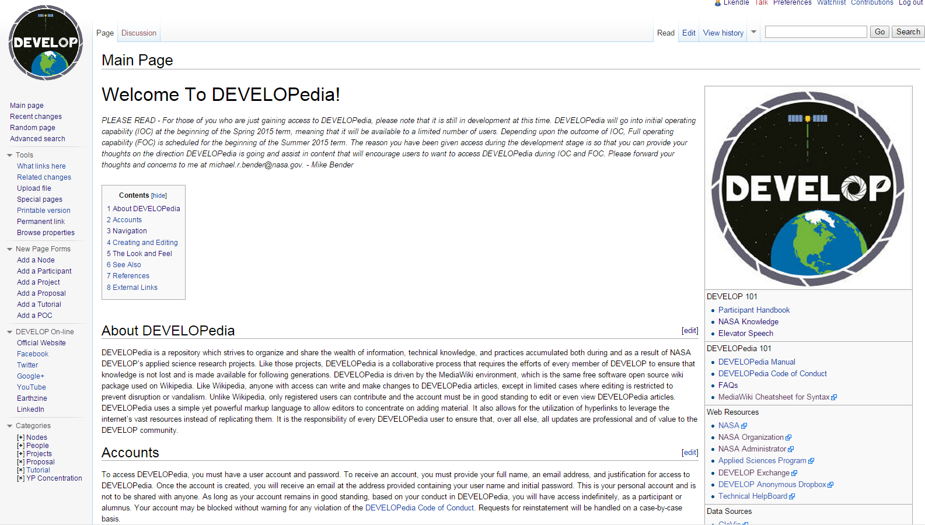
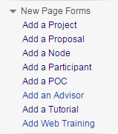
DEVELOPedia Main Page - Admin
The main page includes all of the main user functions to navigate the website and a list of useful resources for every DEVELOPer.
Admin view VS. User view

Slide 5
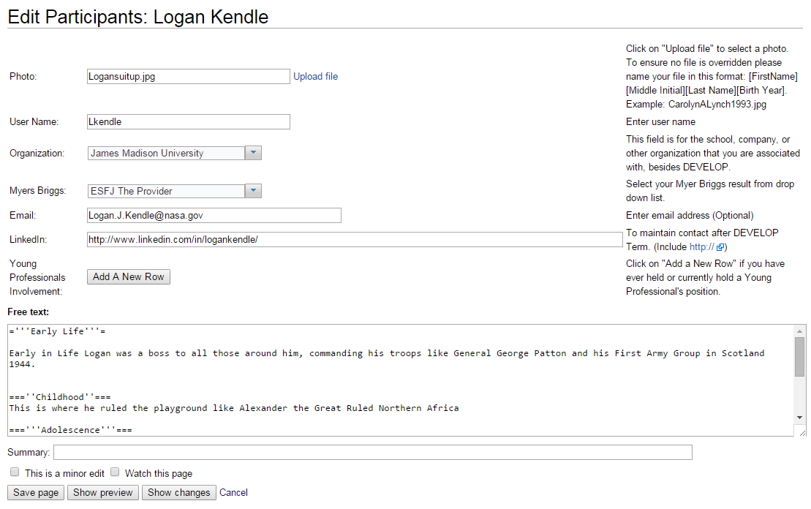
Add a Participant
The new participant page includes:
Myers Briggs personality test result
LinkedIn profile link to increase DEVELOP alumni database
Free text area to add information as you please.

Slide 6
Participant Example Page

Slide 7
Naming Projects

Slide 8
Naming Projects

Slide 9
Naming Projects

Slide 10
Naming Projects

Slide 11
Add a Project
Deliverables can now to labeled and stored on the DEVELOPedia site replacing the DEVELOP Exchange
Many of the sections from the tech paper can be easily added to the project page using tables and free text sections
New sections like ‘See Also’, ‘Reference,’ and ‘Abstracts’ can be added, moved, and removed easily

Slide 12
Project Example Page

Slide 13
Project Example Page Part 2

Slide 14
Add a Young Professional
Young Professional Status, skills, year, and specific tasks can now be added to each individual participant page. This will also help to provide information of how the YP’s can help the participants to complete their projects.

Slide 15
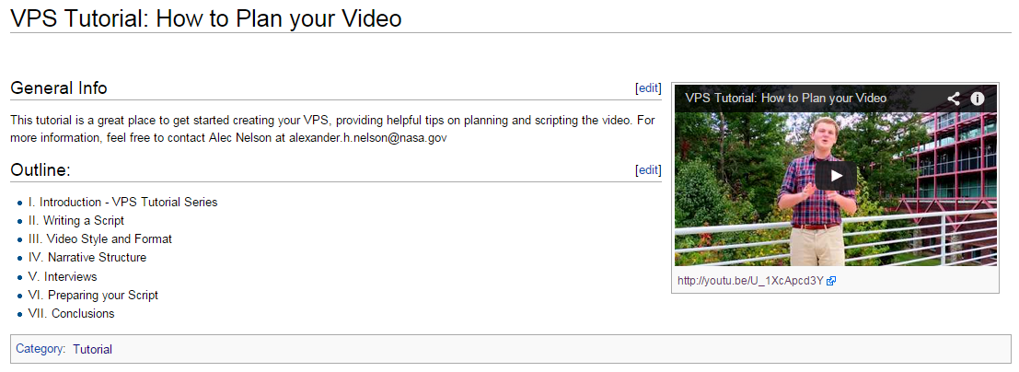
Add a Tutorial Page
Tutorials will continue to become a larger role in the DEVELOP term as projects become more intricate in ArcGIS and coding

Slide 16
Add a Point of Contact (POC)
This will create a new internal database for end-users, collaborators, and other individuals that contributed to completing Term projects. This page has the ability to show what projects those points of contacts could further help in future terms.

Slide 17
Add a Proposal
Previously proposals were saved as word documents and pdf’s.
DEVELOPedia will allow for proposals to be saved online and accessed anywhere.
This will also allow edits at anytime to update the proposals for future terms and show their current status as a project.

Slide 18
Proposal Example

Slide 19
Uploading New Files
Naming uploaded files must be completed with diligence so that they don’t overwrite previously uploaded files. Otherwise they can remove the association between previous files and projects. Following the naming nomenclature provided will help to avoid that.
The file max upload size was finally increased from 7MB to 60MB.

Slide 20
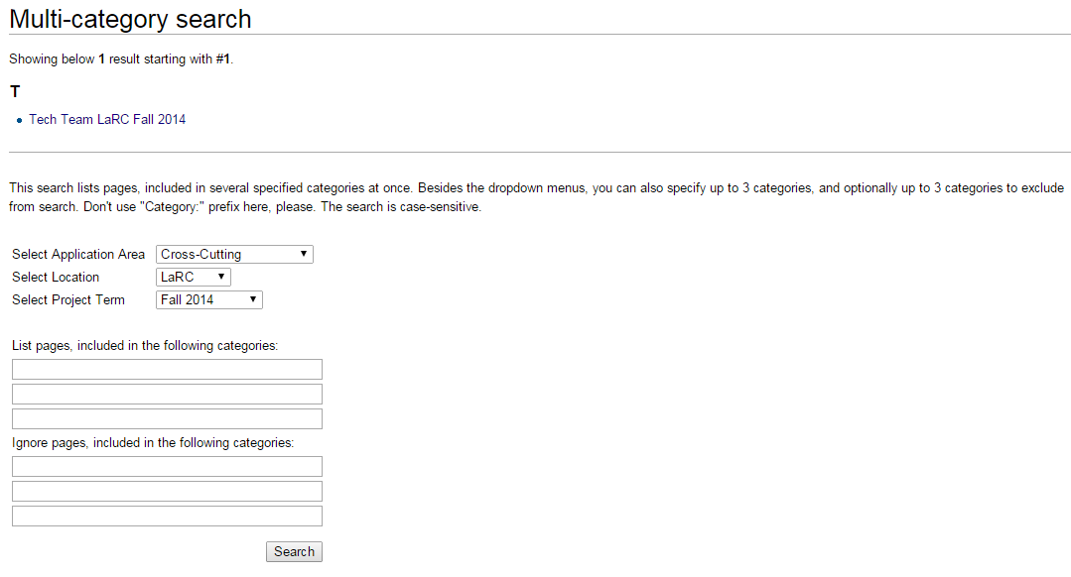
DEVELOPedia Abilities
Categories
Searching
This is the method to broadly search all projects at one time.
This is the method to specifically search inside terms, location, or application area.

Slide 21
DEVELOPedia Timeline
Fall 2013 - DEVELOPedia created by Jonathan Hicks and Ajoke Williams
Summer 2014 –
DP takes on it current user friendly look and have some of its features created using the Semantic MediaWiki write-up
Fall 2014 – DEVELOPedia takes on it’s current look and has the rest of it pages and forms added by Tech Team
Spring 2015 – Langley Node semi launch to gauge and problem solve DP’s remaining bugs
Summer 2015 – National Full Live launch to all DEVEVLOP Nodes
Team photo and DEVELOPedia logo go here

Slide 22
DEVELOPedia Manuals
User Guide for Dummies
Admin Manual
For everyday users of the DEVELOP Program
How-to pages on:
Add a Proposal
Add a Participant
Add Project Members
Add a POC
Adding Tutorials
Adding Files & Videos
Adding Users
Compressing Files

