Slide 1
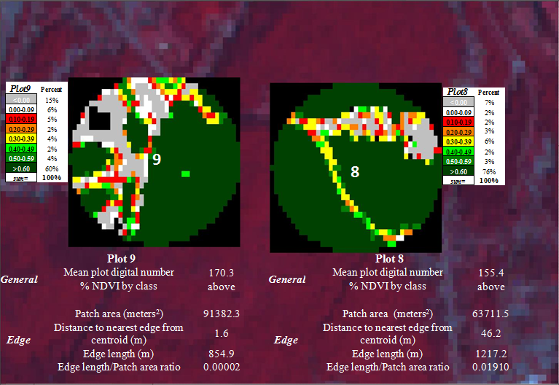
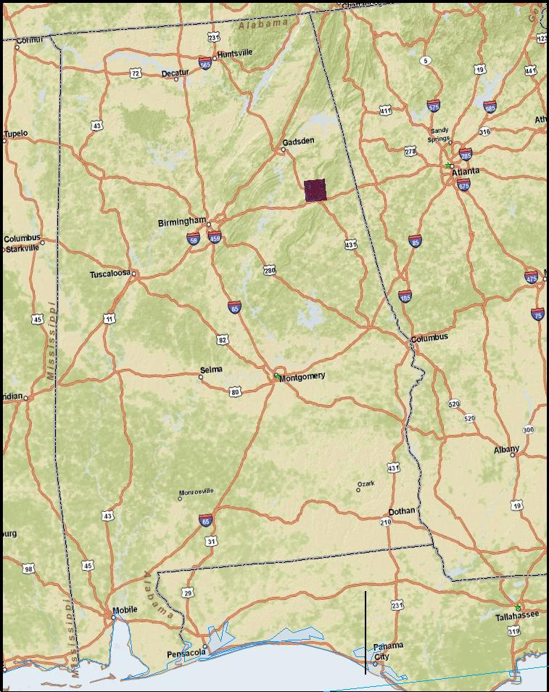
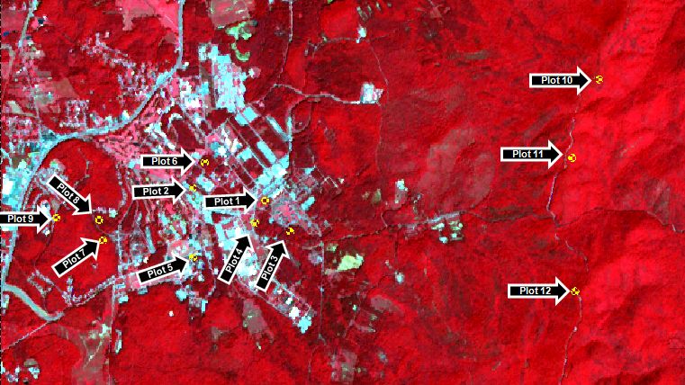
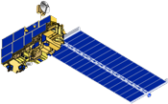
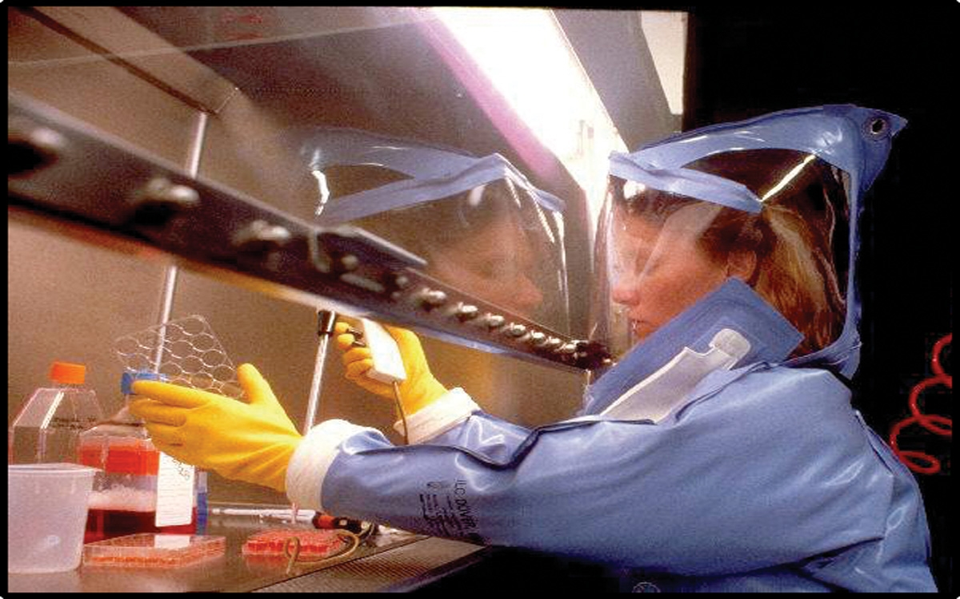
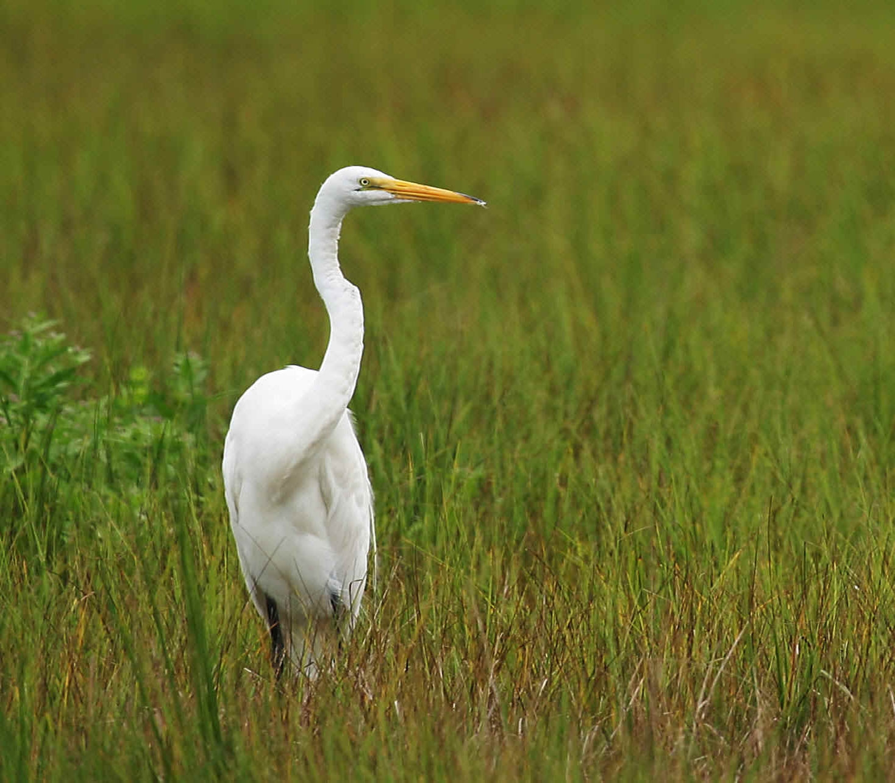
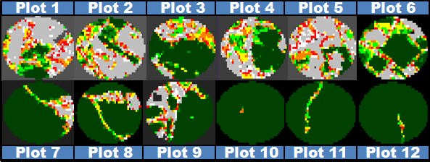
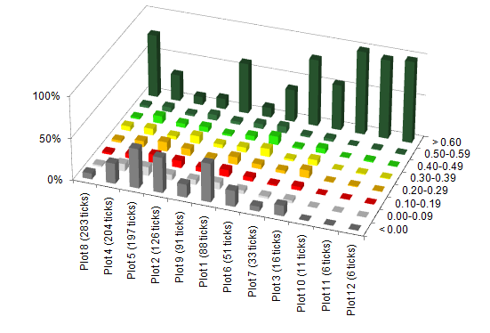
UAB/Marshall – Alabama Public Health
Characterization of Tick-borne Disease Risk
Using NASA Earth Observation Systems
Michael Behring, Steve Padgett-Vasquez, Taylor Poston, Connor Whitley, Jonathan Adams, Rusty Nall, Damien Willis, Dr. Donna Burnett (Science Advisor), Dr. Jeffrey C. Luvall (Science Advisor)
NASA DEVELOP Program, UAB-NASA Marshall Space Flight Center
OBJECTIVES
ABSTRACT
CONCLUSIONS
  Assess the beliefs/behavior of high risk population
  Develop best outreach practices for high risk group
  Test the hypothesis that edge effect is associated with tick population dynamics using the following satellite remote sensing variables
The vectors for tick-borne illnesses (TBI) like Lyme Disease (LD) and Southern Tick-Associated Rash Illness (STARI) are found in Alabama, however the extent of disease risk in the state remains largely uncharacterized. The Marshall Space Flight Center-UAB DEVELOP study identified the presence of the chain of infection for LD and STARI, yet popular knowledge of the risks of TBI and approaches to primary prevention strategies are limited. To address these issues, remote sensing analysis incorporated in situ tick population and soil moisture data into satellite imagery-based habitat maps to produce an initial model of spatial risk. Further analysis of ASTER satellite imagery provided remotely sensed measurements for vegetation vigor (NDVI), which were combined with tick population data for predictive model development based on edge effect quantification. In addition, implementation of a risk perception survey and weekly presentations to local high-risk groups provided outreach and prevention efforts. Future study will attempt to characterize entomologic risk through STARI PCR analysis of collected tick specimens.
Risk Perception survey created and awaiting IRB approval
Satellite remote sensing can identify environmental factors associated with likely tick habitats
Tick density inversely associated with plots where > 90% of area contains NDVI values over 0.60
Potential trends exist between variables related to edge length, patch area, distance to edge, and ratio of area to edge length with tick density
Statistical analysis will help to identify degree of correlation between tick abundance and predictor variables
Effects of forest fragmentation and terrestrial island biogeography to be explored in relation to tick habitat suitability
Response variable = Tick Density
METHODOLOGY
Tick Collection
Ticks were collected using a modified drag cloth method. The drag cloths used in the study were 1 meter x 1 meter squares of white flannel material attached to a 5/8” x 40” wooden dowel, forming a “flag” structure. The cloth was dragged through vegetation and across the forest floor at each site for 30 minutes, once a week for 5 weeks. The cloths were inspected approximately each 5-10 meters during the sampling. Any ticks found on the cloths were immediately removed using steel forceps and preserved for future laboratory processing in 1.5-milliliter centrifuge tubes containing 70% ethanol or isopropanol. Tubes were labeled with the site number and date of collection.
Patch area (m²) and Edge Length (m)
For each plot (n=12), satellite imagery was cropped using a 250m radius from the centroid. An NDVI algorithm was used to measure the vegetation within each plot. The perimeter and area of the edge around the cells falling into the category containing the centroid (NDVI > 0.60) was measured.
.
Distance to nearest edge (m)
Using the polyline trace feature, the measurement between the centroid and the closest point from a different NDVI classification was recorded.
.
TEAM MEMBERS
STUDY AREA
-Marshall Space Flight Center-
Jeff Luvall
-University of Alabama at Birmingham-
Michael Behring
Donna Burnett
Steve Padgett-Vasquez
Taylor Poston
- Jacksonville State University -
Jonathan Adams
Rusty Nall
Damien Willis
Alabama School of Fine Arts-
Connor Whitley
Tick drag plots were chosen from Fort McClellan in Anniston, AL due to varying degrees of habitat fragmentation.
ACKNOWLEDGMENTS
Sarah Parcak, PhD., Director
University of Alabama at Birmingham
Laboratory of Global Health Observation
Laura Elliot, Director
Camp Coleman/ Girl Scouts of America
EARTH OBSERVATION SOURCES
NATIONAL APPLICATION AREAS
ASTER
Terra
Public Health
Ecological Forecasting
RESULTS
Tick density by Environmental Variables
% NDVI by Class - plots classified according to an NDVI range comprising eight classification categories
Distribution NDVI by class and plot sorted by tick count
Notes:
Jonathan Adams
Rusty Nall
Damien Willis
Alabama School of Fine Arts-
Connor Whitley
I wanted to give you some feedback for the poster and since you can’t track edits in PPT, thought I’d just write bullet points here and let you make the changes.
Title: where it says UAB/Marshall you should write the short title which in your case would be ‘Alabama Public Health’
Objectives: take out the goals heading since that’s repetitive after objectives, I’d watch the use of the smaller font, if possible make it all the same size
Study area: perhaps a map showing where in Alabama this is would be more helpful for those not from the area?
Partners: Take out the section if you want to
Methodology: scoot the title bar up since the abstract isn’t filling the whole area above and you can use more space for methods
Natl App: new images were sent out, if you can’t find the email they are on the Exchange in the templates folder in the very top folder
Please ensure that the guidelines are turned on so you can see how everything is set up. Feel free to adjust sections as necessary to fit your project, but please do check that everything continues to line up with the vertical guidelines. Also, try to keep vertical spacing consistent on the left and right sides of the poster. I have set up text boxes with text sizes and formatting, if you need to change the size of the text, try to keep all text the same size. Please call or email me if you have any questions, or would like some assistance.
Tracey
757.864.9336
Tracey.L.Silcox@nasa.gov

