Slide 1
Arizona Health & Air Quality II
Enhancing Extreme Heat Intervention and Prevention Activities in Maricopa County Arizona with NASA Earth Observations
Daniel Finnell (Project Lead)
Teresa Fenn
Richard Muench
Ashley Brodie
Notes:
Notes: A continuation of a project performed during the summer of 2015

Slide 2
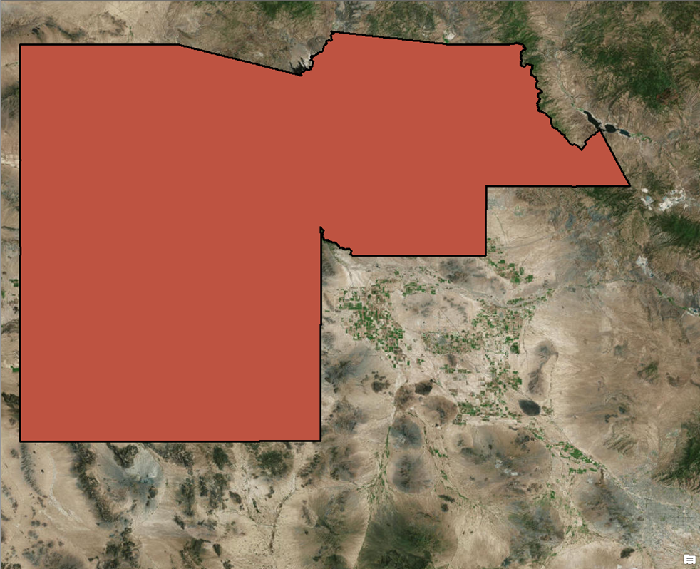
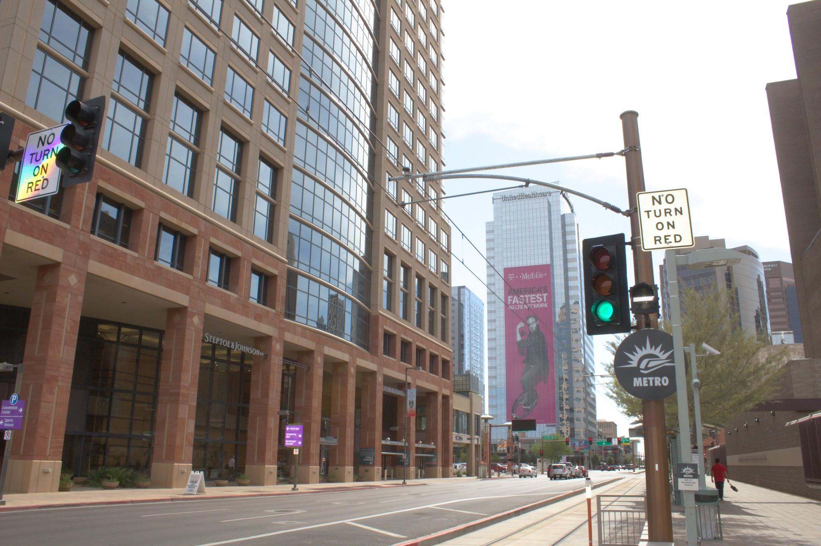
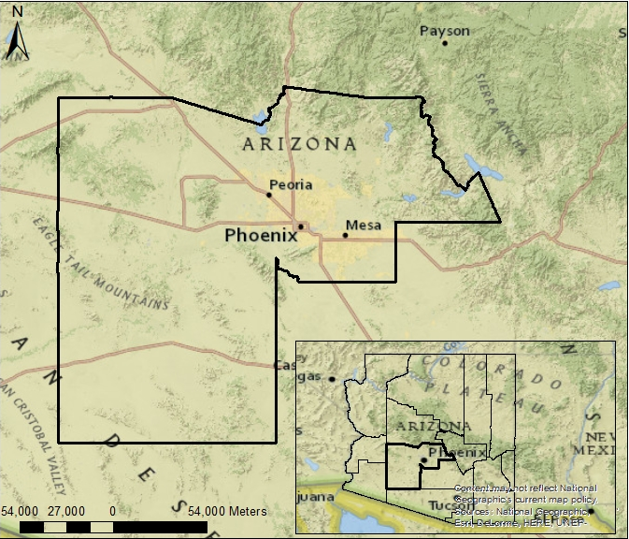
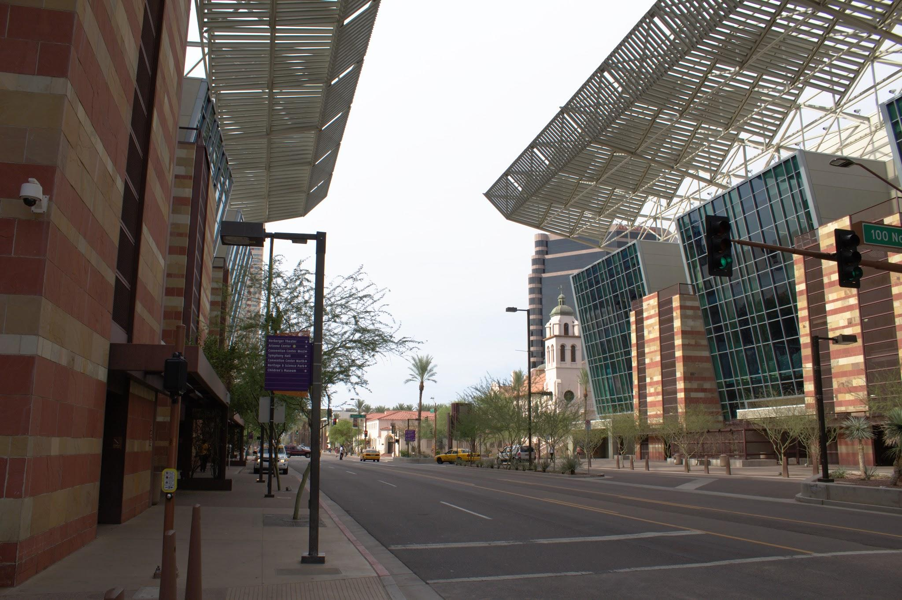
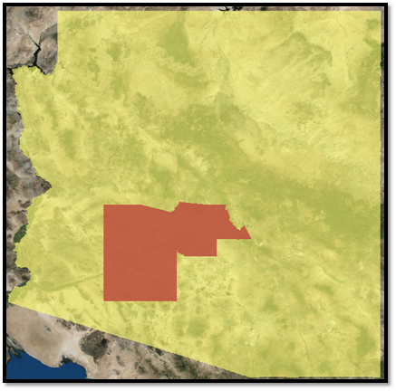

Study Area
Maricopa Co, AZ
Phoenix
Maricopa County
Image Credit: Geordi Alm
Notes:
Notes: Study area covers Maricopa County, Arizona which contains a variety of different landscapes and surfaces, from the densely populated city of Phoenix in the center to the barren desert in the south. Area also contains significant amounts of agriculture and mountainous regions.
Urban Heat Island effect

Slide 3
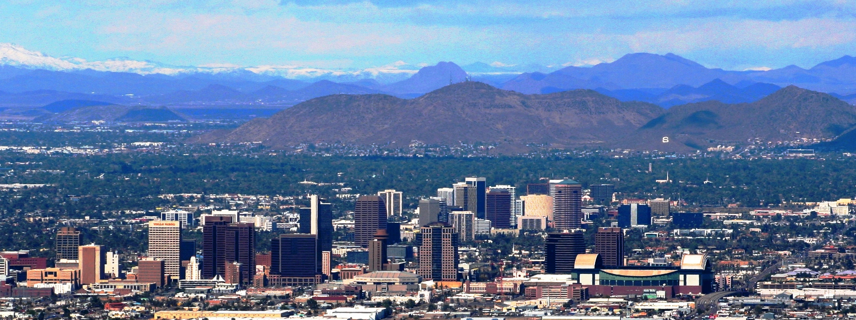
Image Credit: Dgustafson
Background
                Urban Heat Island (UHI)
More vulnerable populations include elderly, poor, homeless, and socially isolated
1,050 deaths due to extreme heat over a 7 year period
Suburban and Urban growth
                Temperatures exceed the NWS “Danger Zone” of 104°F
Image Credit: Monet
Notes:
Image Credit: https://en.wikipedia.org/wiki/Sunnyslope_Mountain#/media/File:PhoenixDowntown.jpg
DEVELOP was specifically contacted by Maricopa county GOV to determine the most effective way to monitor the problem.
Varying demographics factors play into how susceptible an individual is to extreme heat events (defined by days over 104°F).
Notes: Maricopa County experiences (ambient) temperatures at or above 104°F approximately 73 days per year, which occasionally lead to heat related illnesses and death. Rapid urban growth amplifies the Urban Heat Island (UHI) effect in which various factors cause the temperatures of urban areas to be significantly higher than the surrounding rural areas. Maricopa county has an estimated population of 4.1 million people, estimate as of july 1, 2015. Which is roughly 4 times larger than the pima county az, the second largest county in the state.
-> caused by a combination of higher carbon emissions and, at night, by the existence of impermeable surfaces which retain heat better than natural landscapes.

Slide 4
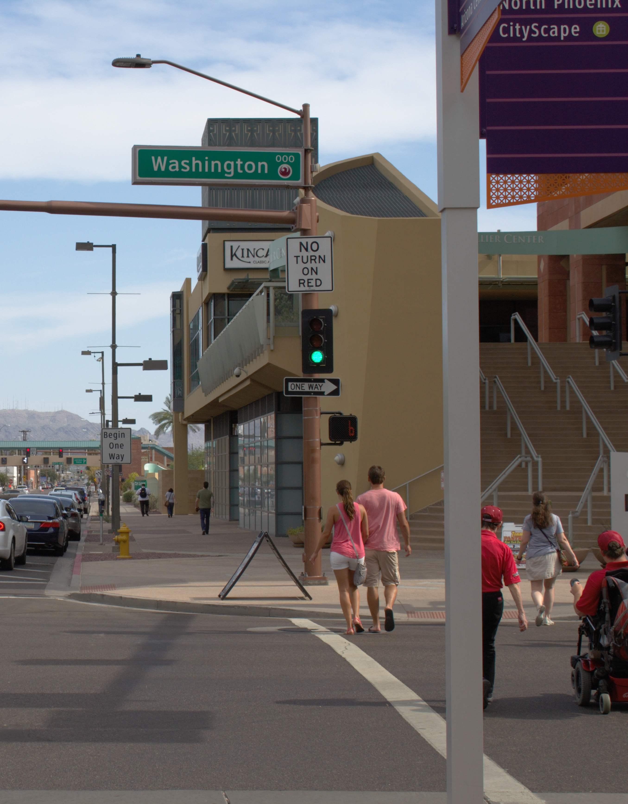
Objectives
Create a tool to monitor heat severity
Automate the creation of heat severity maps in Maricopa County, Arizona.
Obtain access to near real-time data via OPeNDAP
Image Credit: Geordi Alm
Notes:
Notes:
Primary objective is to CREATE a Python tool named “Land Surface Temperature MODIS Visualization” that will AUTOMATE the creation of heat severity maps in Maricopa County, Arizona. This should greatly decrease the amount of heat related illnesses in Maricopa County.
Access to near real-time data was an initial objective, but proved unviable at this time, given the current developmental state of OPeNDAP.

Slide 5
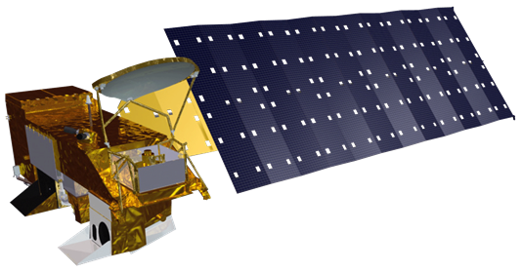
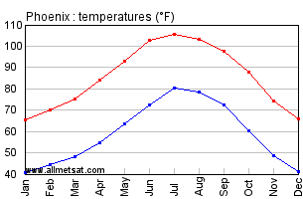
Earth Observations
Data
Acquisition
Study Period:
              2006 – 2015
              April – October
Aqua MODIS
Python/R
Subset
In situ
104 °F
Geodatabase
Maximum
Temperature
Average
Air Temperature
Minimum Temperature
Statistical Analysis
Notes:
The Aqua satellite was utilized to collect land surface temperature data during the months of April to October for 2006-2015.
Since we were only interested in days over 104 F, in situ air temperature data were taken from the Phoenix airport to locate those days.
Image Source: http://www.eldoradocountyweather.com/current/climate/phoenixclimate.html

Slide 6
Methods: LaSTMoV
Data
Acquisition
Land Surface Temperature MODIS Visualization
Compiled Python Script with R subset
Input: MODIS HDF files for study period
Shapefile of census tracts
Study period
              In situ air temperature data
Find days over 104 F
Delete MODIS files for days under 104 F
              MODIS Processing
  Convert to tiff
  Clip
  Convert to F
              R subset
  Associate Census Tracts with Temperature Values
  Table of percent cloud cover
Python/R
Subset
Geodatabase
Statistical Analysis
Notes:
LaSTMoV allows our end users to select their own study period, and it has the ability to compare months from multiple years.
LaSTMoV automatically downloads the in situ data from MesoWest API, uses that data to compile a list of days over 104 F, and delete MODIS data for days not over 104 F.
Once the script has a list of good days, the MODIS files for those days are converted to tiff format, clipped to Maricopa county, and converted from decimal number to F.
The script then calls a subsetted R script that will create a table of the percent cloud cover by census tract, and calculate the grand monthly average and standard deviation for each month.

Slide 7
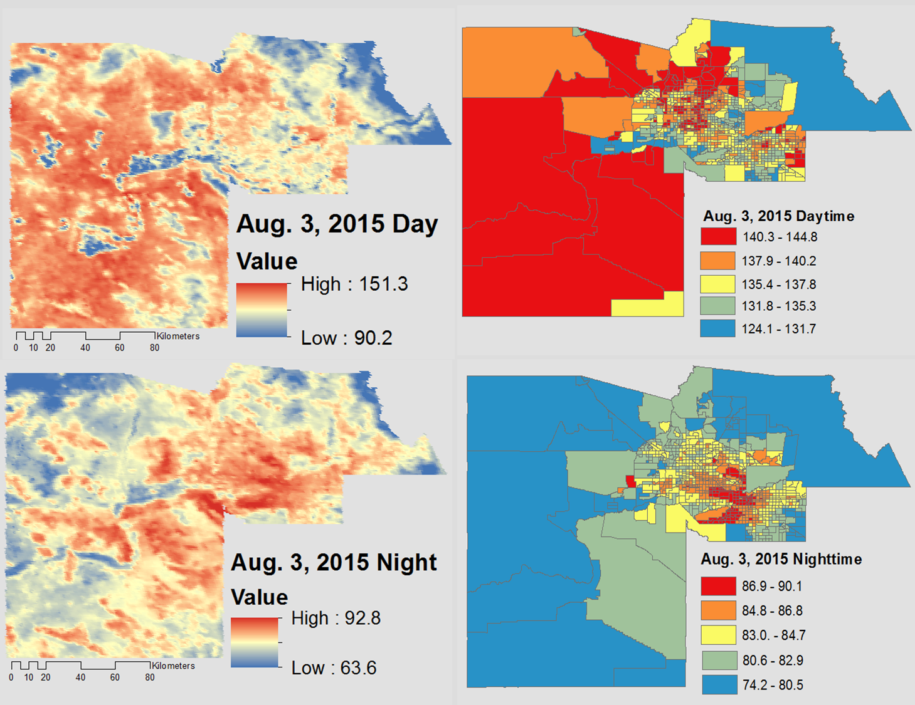
Outputs
Satellite Data
Python/R
Subset
Geodatabase
Statistical Analysis
Left: Aqua MODIS Version 5 daily Land Surface temperature at 1 Km resolution
Right: Mean temperatures by Census tract
Top: Daytime Layer of August 3, 2015 Bottom: Nighttime Layer of August 3, 2015
Notes:
From the original HDF file we needed to select the relevant layers to observe LST. These images you see on your left were pulled and clipped using the python tool last mov that specifically grab layers for lst day and lst night at 1Km resolution. The maps above give a good visualization of the heat intensity that the desert southwest experiences.
The census tract maps were then generated in R by attaching the mean temps per tract in a dbf file.
These images were pulled a few days before the hottest day of 2015. The hottest day and the days leading up had >50% cloud cover.
Why did we use census tracts?
Census tracts generally have a population size between 1,200 and 8,000 people, with an optimum size of 4,000 people.
A census tract usually cover a contiguous area; however, the spatial size of census tracts varies widely depending on the density of settlement.
the boundaries are maintained over longer periods of time which allows for easier statistical comparisons between census years.
Other layers that could be of potential use to future terms are the Quality Assurance (QA) Day (1) and Night (5) layers . These can be used to identify cloud cover and cloud shadow during the monsoon season.

Slide 8
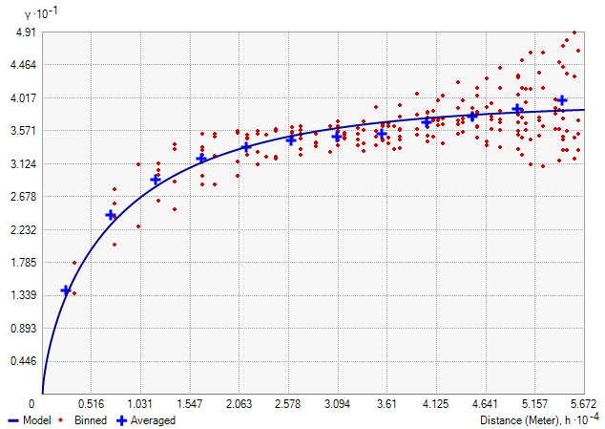
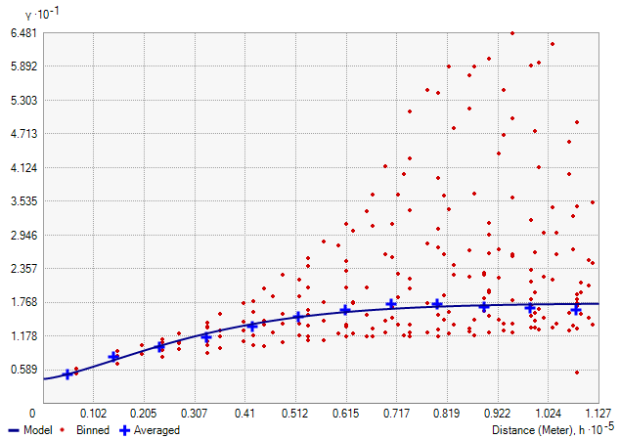
Semivariograms
August 3, 2015 Daytime
August 3, 2015 Nighttime
There is weaker spatial correlation during the night due to the UHI effect and geographic relief
Notes:
We are trying to determine the spatial cohesion of land surface temperature across Maricopa county
To do this we implored the use of the semivariogram function in Arcmap. The function was applied to the same day and night as shown in the images from the previous slide.
The semivariogram function quantifys the assumption that things nearby tend to be more similar than things that are farther apart.
This leads to the strength of statistical correlation as a function of distance.
semivariograms can be thought of as a dissimilarity function.
In the above semivariograms we can see that during the daytime the range is autocorrelated to about 46.41 Km whereas nighttime is poorly autocorrelated to about 7.17 Km. The spatial map for the semivariogram is generally cohesive for the daytime but, the night time is only spatially cohesive from the south west to the north east.

Slide 9
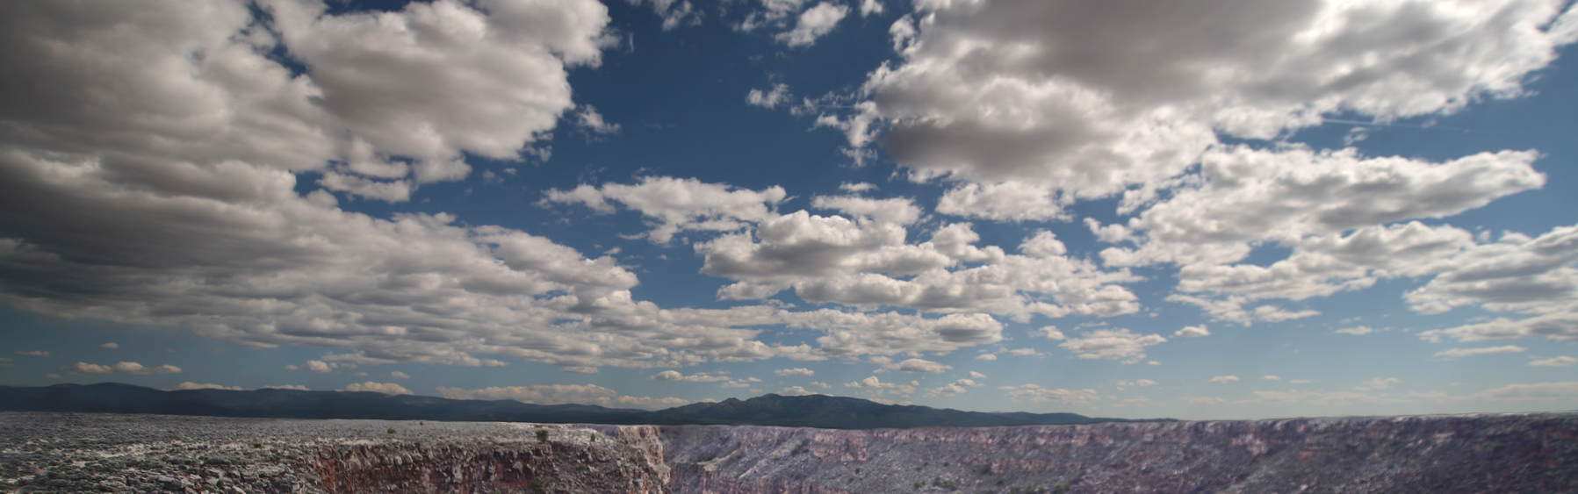
Errors and Uncertainties
Cloud cover
Near real-time data unavailable
Image Credit: LASZLO ILYES
Notes:
While a table is created displaying the percent cloud cover by census tract, there is not cloud cover filter for the LST maps, and all statistics are performed regardless of cloud cover.
The table allows the user to quantitatively examine the validity of a given map based on cloud cover.
The team set out to create near real-time data, but due to issues that arose with OPeNDAP, this was infeasible.
Image Source: http://www.greatbigcanvas.com/view/clouds-over-a-landscape-south-mountain-park-phoenix-maricopa-county-arizona,112396/

Slide 10
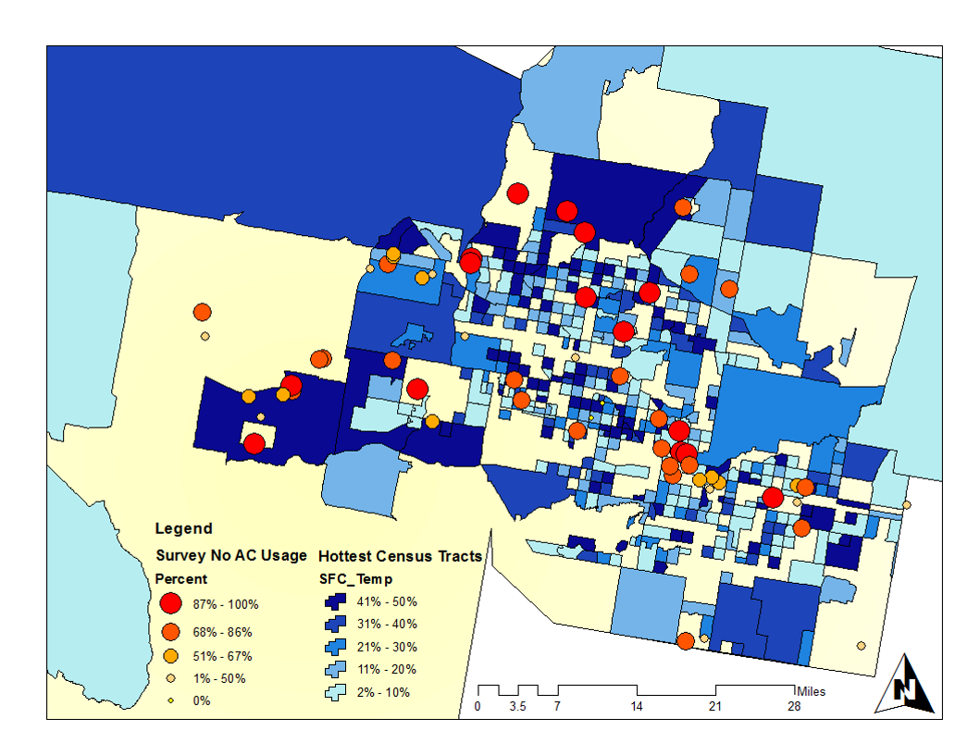
Future Work
Mask for cloud cover
Incorporate OPeNDAP
Automate term 1 statistics
Incorporate heat relief centers and survey results
Term 1 Results incorporating AC survey results
Notes:
This is a second term project, and a third term is planned to be carried out in Maricopa county during the summer.
Possible objectives for that third term include improving the heat maps by incorporating a cloud cover mask and using OPeNDAP to create near real-time products.
The first term of Arizona Health & Air Quality performed several statistical analyses, which we were unable to incorporate into our script due to time constraints. However, a third term would be able to automate these analyses.
The Maricopa County Department of Public Health maintains heat relief centers throughout Maricopa County. In addition, they have survey data on AC use in different communities. While the current term had access to that data, we did not have time to fully incorporate it into LaSTMoV. A third term could use this data to create vulnerability maps to help decision makers locate areas in need of assistance.

Slide 11
Advisors
Dave Hondula (Arizona State University)
Lance Watkins (Arizona State University)
Dr. Kenton Ross (NASA DEVELOP National Program)
Partners
Arizona Department of Health Services (ADHS)
Maricopa County Department of Public Health
Phoenix Heat Relief Network
National Weather Service Phoenix Forecast Office
Center for Policy Informatics (CPI) at Arizona State University
Others
Arizona Health and Air Quality I team: Rocky Garcia, Amy Stuyvesant, Emma Baghel, Geordi Alm, April Rascon, Bernardo Gracia

