Slide 1
Alaska Disasters
Utilizing NASA Earth Observations to Identify Oil Spills and Natural Seeps off the Northern Shore of Alaska
Will Manion (Project Lead)
Amy Ferguson
Jordan Vaa
Kristen Noviello
Katelyn Quinn
Nicole MacDonald
Notes:
The Alaska Disasters Team at Langley Research Center partnered with the US Coast Guard to utilize NASA Earth Observing Systems to improve their strategic oil spill response planning.

Slide 2
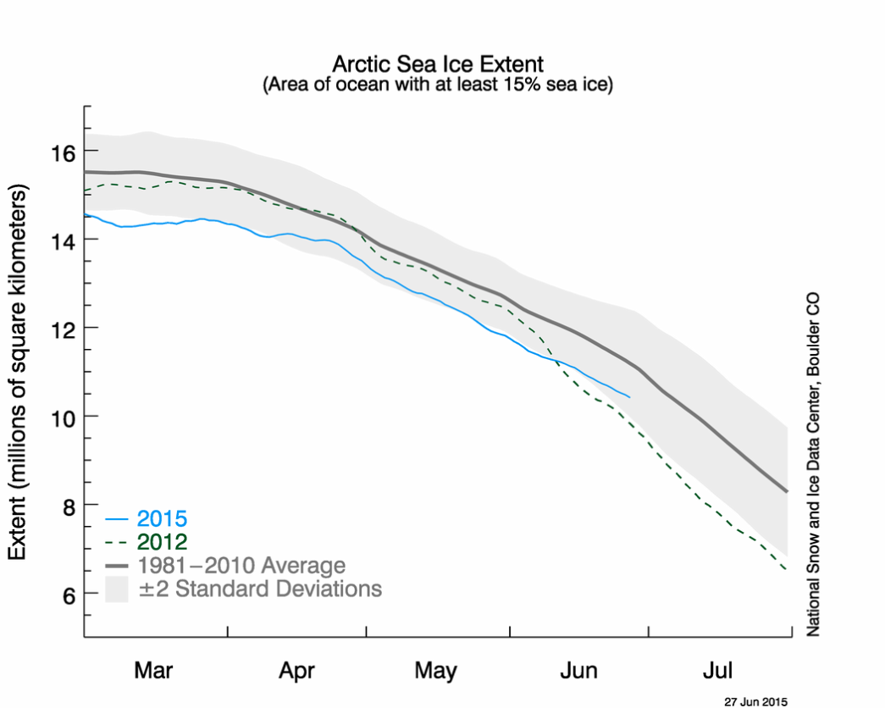
Background Information
Image Credit: NSIDC, 2015
Arctic sea ice maximum extent is the
lowest on satellite record
Notes:
Arctic sea ice reached its maximum extent this February and measured its lowest total area on satellite record. This decrease in sea ice is encouraging a surge in maritime transportation, tourism activities and energy
exploration in the region.
http://nsidc.org/news/newsroom/arctic-sea-ice-maximum-reaches-lowest-extent-record

Slide 3
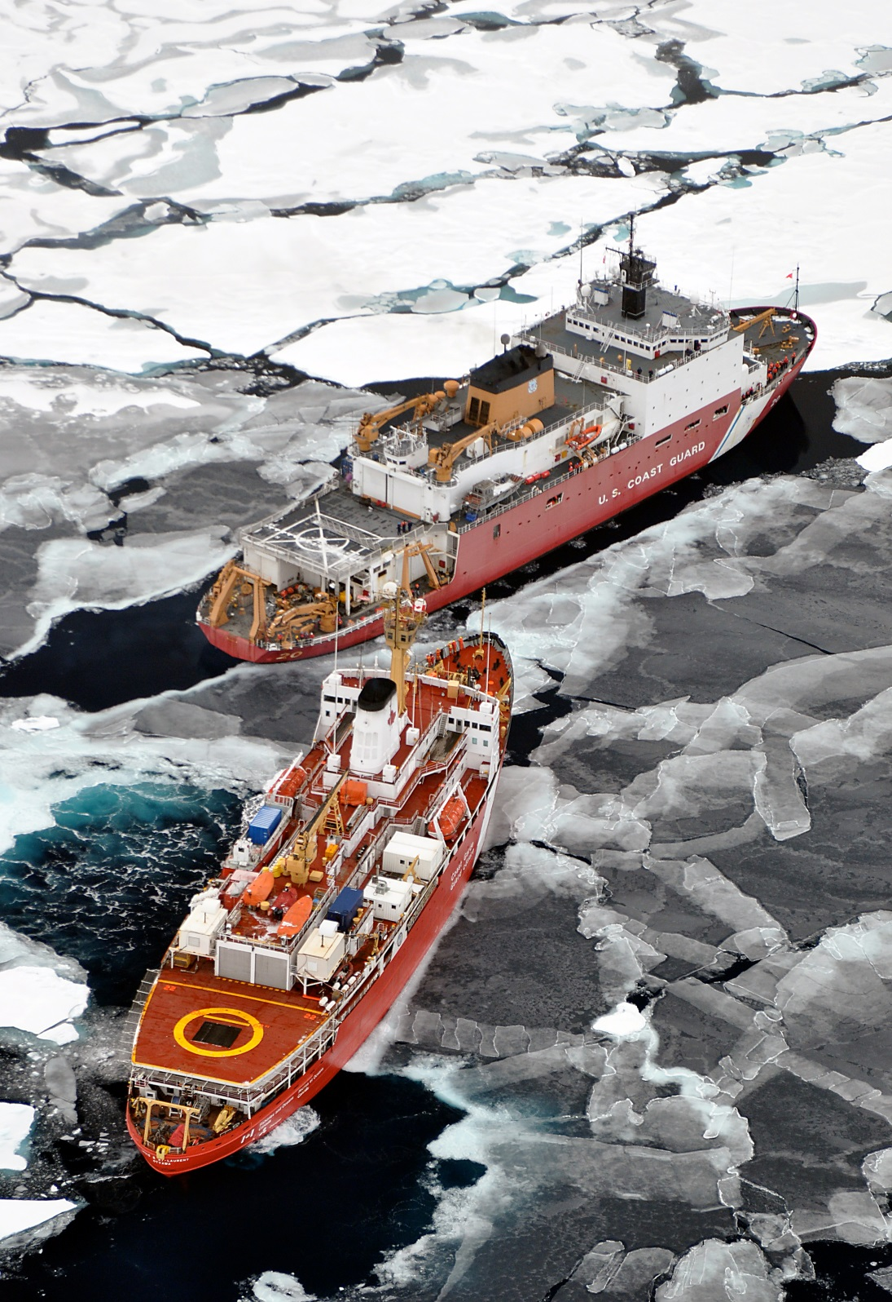
Background
Information
Oil spill risk increases
as transportation,
tourism and energy
exploration increases
Image Credit: NSIDC, 2015
Image Credit: USCG, 2009
Notes:
With increased activity, comes an increase in maritime risk, especially the risk of oil spill as shipping traffic surges.
Creative Commons, Photo Credit: Patrick Kelley, U.S. Coast Guard, https://www.flickr.com/photos/usgeologicalsurvey/4370266187/in/album-72157623467470824/

Slide 4
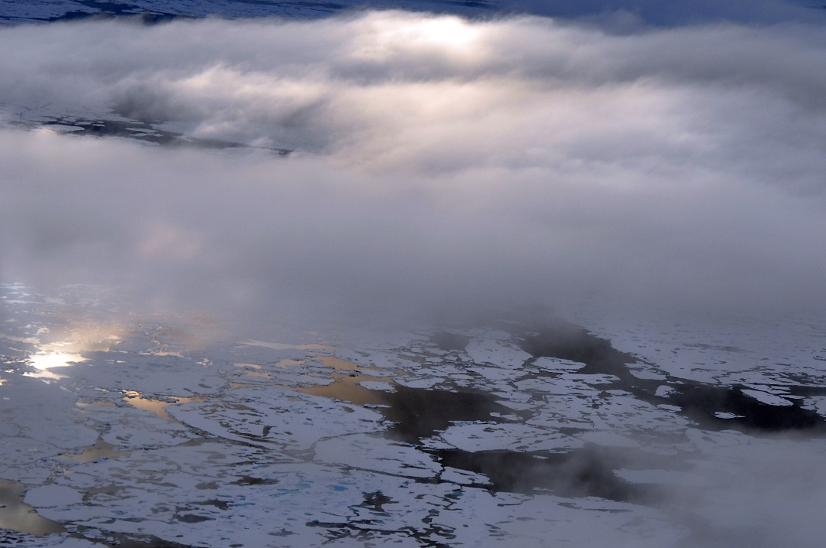
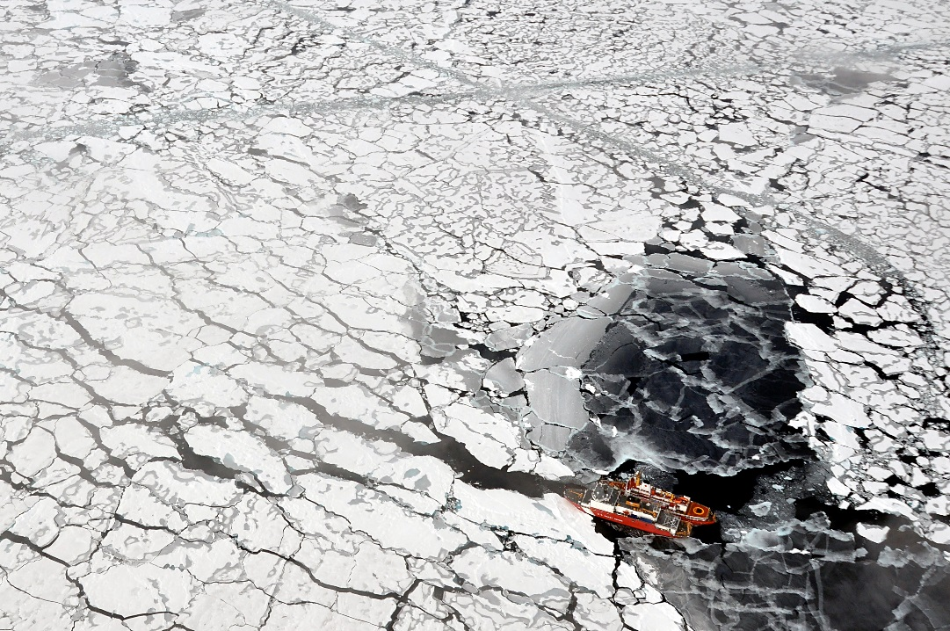
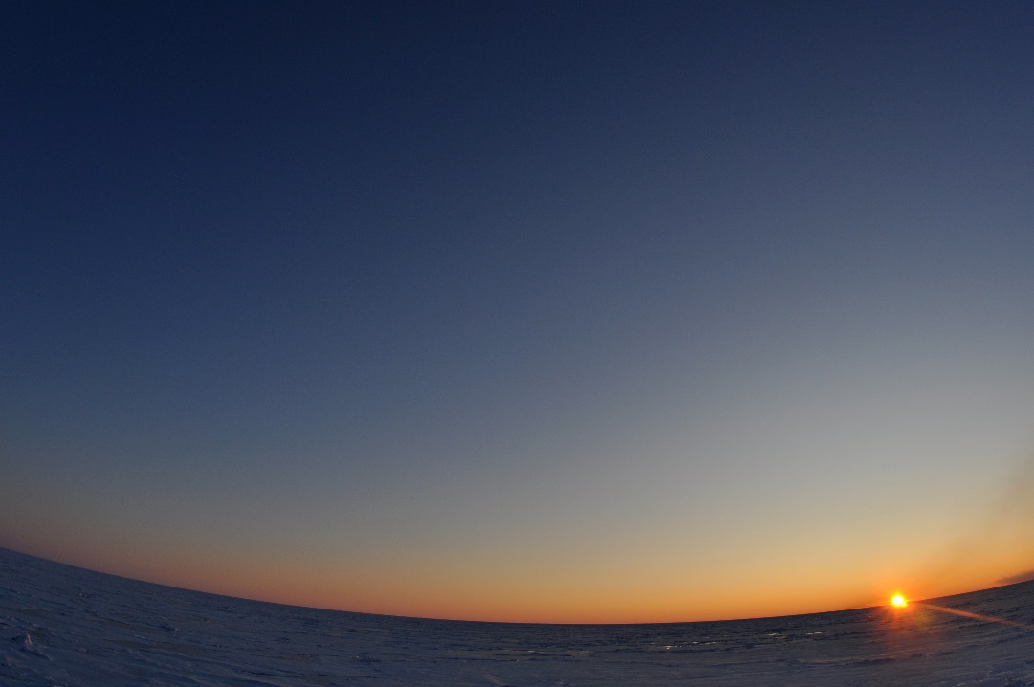
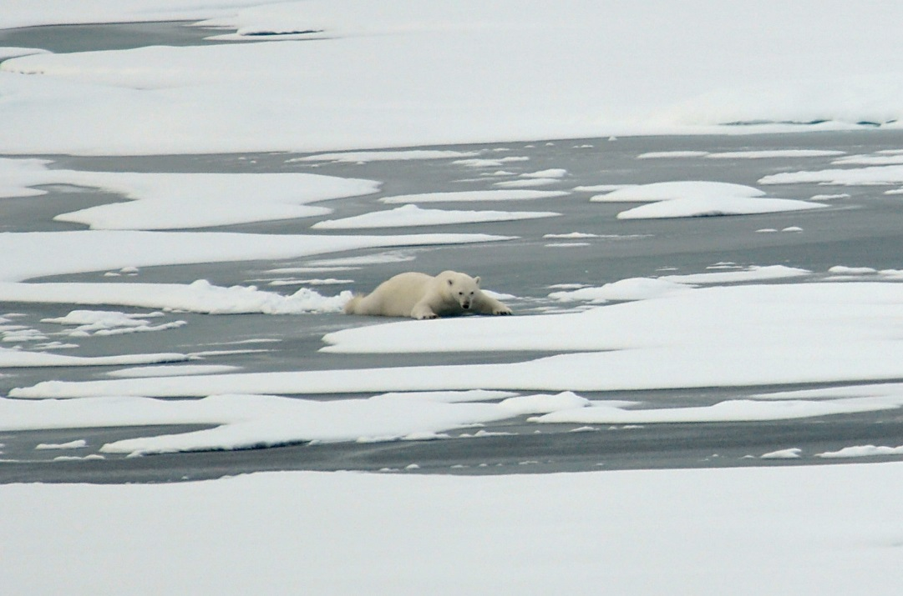
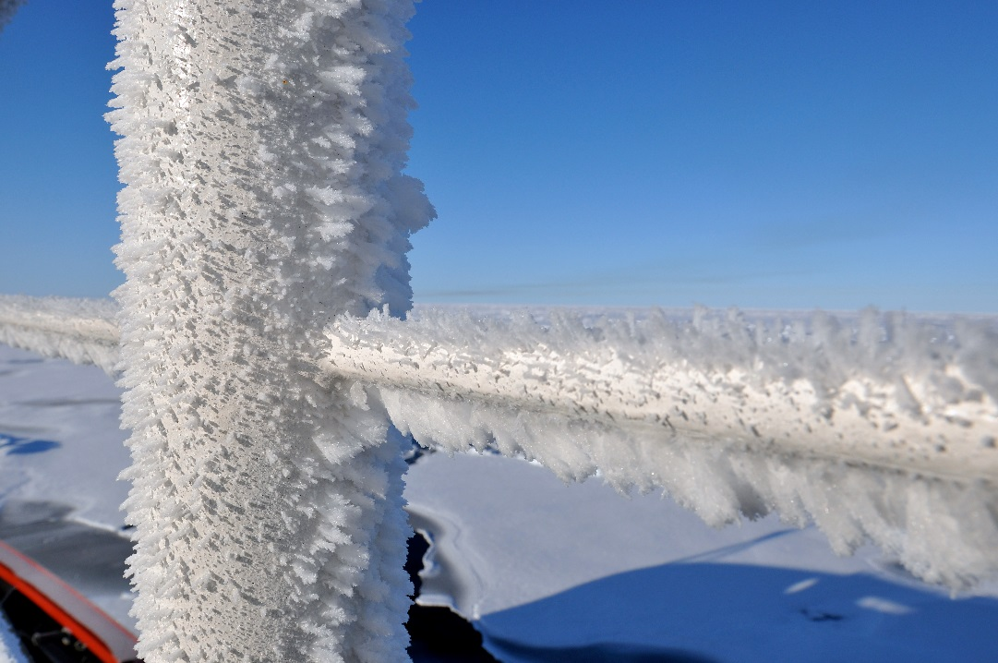
Community Concerns
Oil spill clean up is difficult in harsh Arctic environment
Oil behavior is poorly understood in freezing environments
Environmental impact is more severe in Arctic
Oil spills shut down valuable shipping channels
Image Credits: USCG, 2009
Notes:
Several challenges make oil spill response operations difficult and dangerous:
1. Weather: Clouds and fog reduce visibility and extreme weather hinders operations
2. Sea Ice: Blocks passages, damages vessels
3. Periods of extended darkness: Several months of darkness, Nov-Feb
4. Lack of Infrastructure: Remote location and undeveloped towns lack support infrastructure for emergency incidents
5. Freezing Temperatures: Freezing temperatures can cause wear to machinery and be dangerous to response personnel
Oil persists longer in freezing environments, making environmental impacts more severe.
Environmental impacts from an oil spill are more severe in the arctic due to its fragile ecosystem and harsh environmental conditions.
Oil behavior and fate in freezing environments is poorly understood. Oil spreads on and under ice; is absorbed in snow; is contained on and in ice; and spreads over ice-infested water.
Last, oil spills shut down valuable shipping lanes which can have an economic impact on the Arctic Nations’ industry.
Creative Commons, Public Domain, Photo Credit: Patrick Kelley, U.S. Coast Guard,
https://www.flickr.com/photos/usgeologicalsurvey/4370266339/in/album-72157623467470824/
https://www.flickr.com/photos/usgeologicalsurvey/4370264559/in/album-72157623467470824/
https://www.flickr.com/photos/usgeologicalsurvey/4371011748/in/album-72157623467470824/
https://www.flickr.com/photos/usgeologicalsurvey/4371011032/in/album-72157623467470824/
https://www.flickr.com/photos/usgeologicalsurvey/4370262379/in/album-72157623467470824/

Slide 5
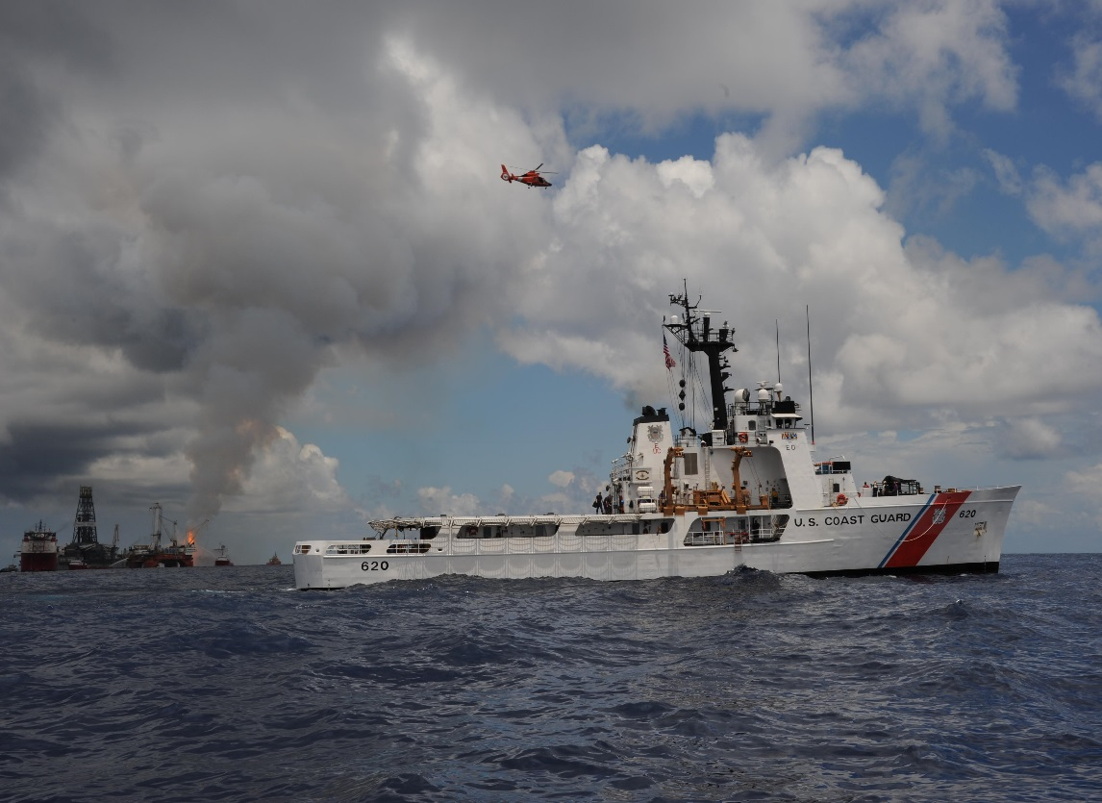
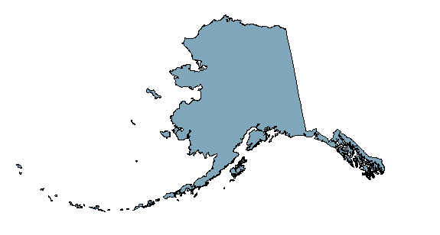
Project Partners
The United States Coast Guard is the lead agency for oil spill response in US coastal waters
NOAA manages the Arctic Emergency Response Management Application - Arctic ERMA
Image Credit: USCG, 2010
Notes:
The USCG is the lead response agency for oil spills in US coastal waters. They currently utilize the Arctic ERMA to visualize maritime situations and improve communication and coordination among their responders.
The Alaska Disasters partnered with the USCG Office of Marine Environmental Response Policy and the National Oceanic and Atmospheric Administration, Spatial Data Branch, to investigate how NASA EOS and ESA EO can assist their strategic oil spill response planning.
Creative Commons, U.S. Coast Guard photo by Petty Officer 1st Class Matthew Belson: https://www.flickr.com/photos/deepwaterhorizonresponse/4761356357/in/photolist-8fKcmZ-4yHSa2-p9pHKY-7X8Vjm-7Xjc7n-nCt5Lv-89mZXd-mpzivv-8w7yf8-uiFpB-r4sDBV-7WKZ5c-8oYDza-8p2Prd-87qSui-8bpe5b-8b1giF-8hwyTM-oRWkyF-nqYgBo-9CMP7A-8cXCAC-837X5D-4nxvGE-q78jK7-7KWbHw-s2J49o-8GiZN8-8GiZGv-6at2Tn-8vDqxr-7ZAW7N-9CJSeT-a4fVye-8tKcMh-82jBH1-8v95Ah-83VbB2-7ZVsXY-oX9Jzp-kam7jw-83uu44-mnJmKF-43xt2N-9d7wjz-rLMVK9-bMonWB-89JJea-8dj1VA-8zo4cR

Slide 6
Objectives
Identify
Identify natural oil seeps across coastal Alaska
Create a tool to facilitate fast visualization of an oil spill incident
Inject spatial dataset into Arctic Emergency Response Management Application
Create
Inject
Notes:
The objective of this study was to:
Identify: Map known natural oil seeps in order to give the USCG the ability to monitor and account for background pollution and to rule out anthropogenic sources.
Create: Python-based tool to retrieve imagery data in order to quickly visualize optical and radar information to detect, map, and monitor oil spills and natural oil seeps within the coastal area of Alaska.
Inject: Upload oil seeps dataset into the Arctic Emergency Response Management Application (ERMA) to improve USCG communication and coordination efforts.

Slide 7
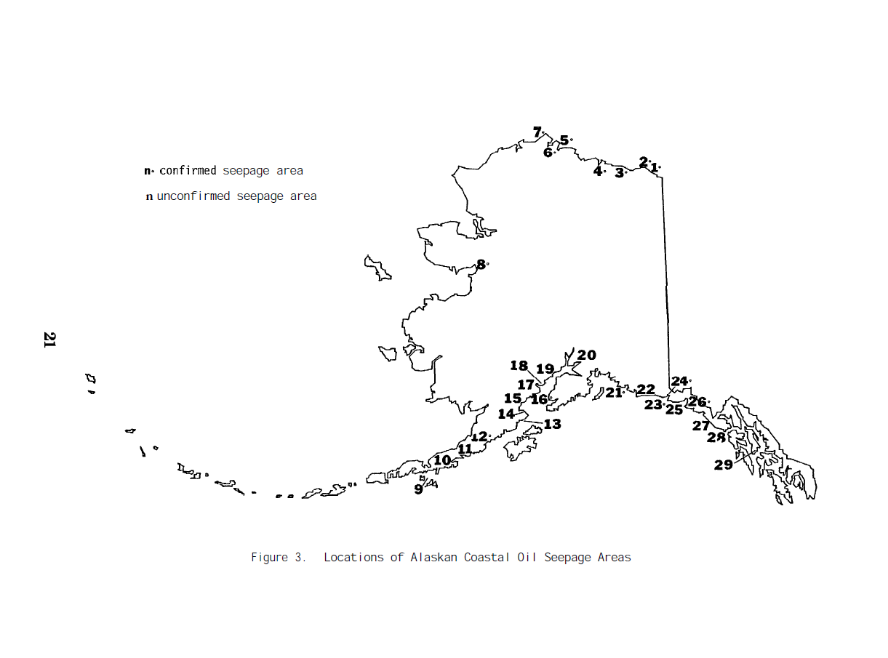
Methodology
Natural Oil Seeps Mapping
Becker and Manen, 1988
Notes:
Our team’s starting point was a report published in 1988 that identifies 29 natural oil seeps across coastal Alaska. Despite the age of the document, oil seeps are geologically stable, and it is unlikely that these oil seeps have changed from the date of publishing.

Slide 8
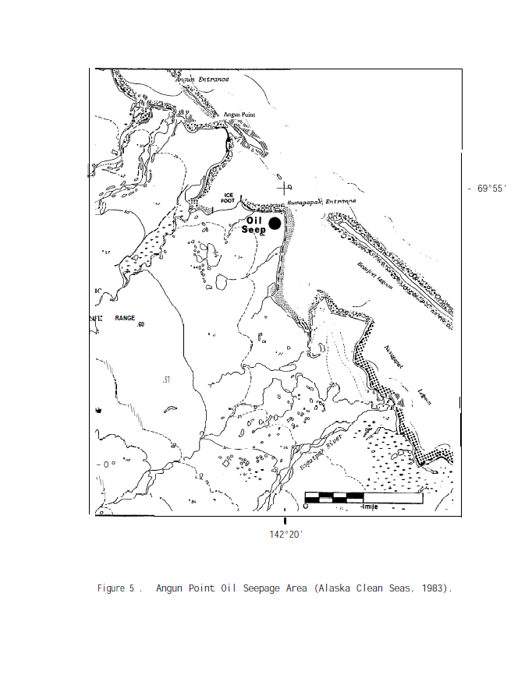
Methodology
1
Google Maps
3
Google Earth
Landsat 8
4
2
Becker and Manen (1988)
5
ArcGIS
Becker and Manen, 1988
Notes:
Using figures from the report, like the one shown on the slide, we first manually graphed its location.

Slide 9
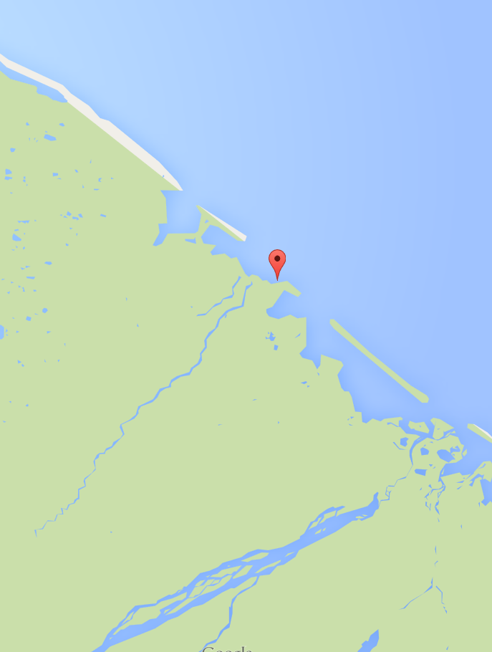
Methodology
1
Google Maps
3
Google Earth
Landsat 8
4
2
Becker and Manen (1988)
5
ArcGIS
Notes:
We then used Google Maps to refine its position, relying on its useful labeling of geographic features for assistance, especially rivers and streams.

Slide 10
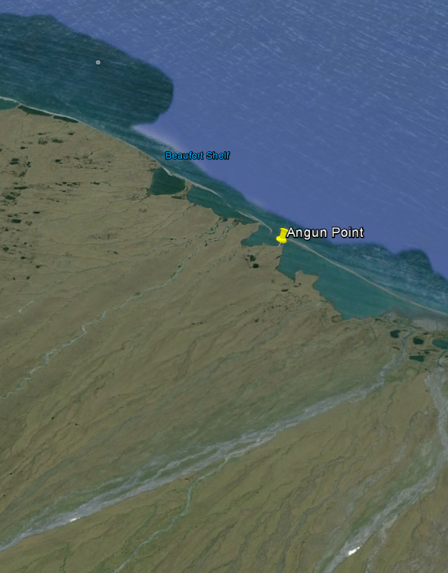
Methodology
1
Google Maps
3
Google Earth
Landsat 8
4
2
Becker and Manen (1988)
5
ArcGIS
Notes:
We then took a look at Google Earth to extract an exact lat/long grid.

Slide 11
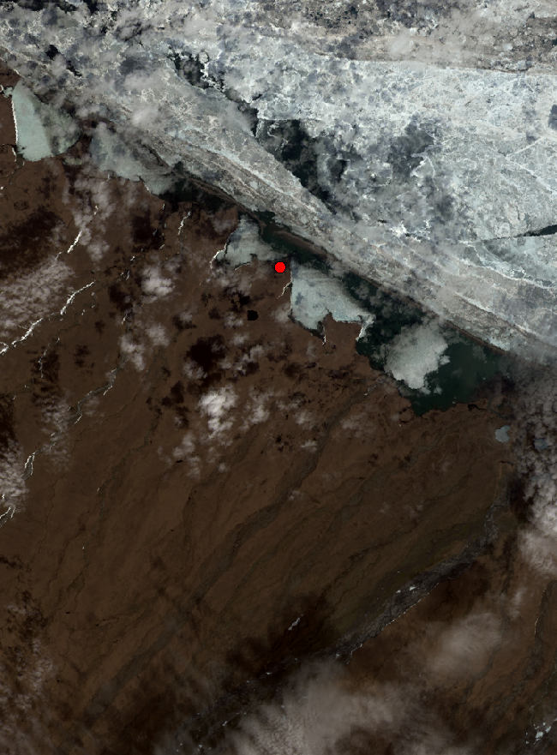
Methodology
1
Google Maps
3
Google Earth
Landsat 8 OLI/TIRS
4
2
Becker and Manen (1988)
5
ArcGIS
Notes:
The oil seep was then analyzed using high resolution Landsat 8 data.

Slide 12
Methodology
1
Google Maps
3
Google Earth
Landsat 8
4
2
Becker and Manen (1988)
5
ArcGIS
Notes:
The XY dataset was imported into ArcGIS, where all the individual points were plotted and projected to compile a final map.

Slide 13
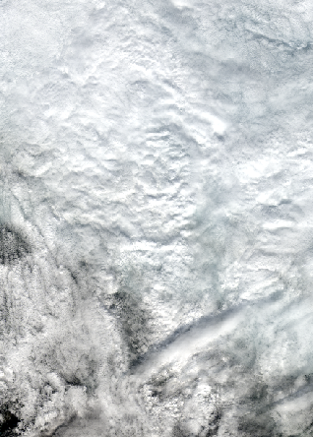
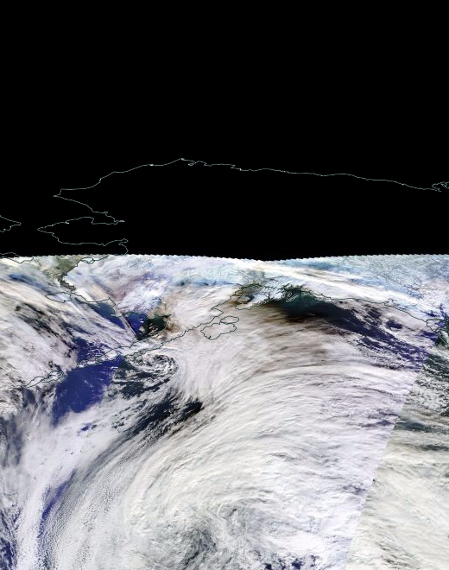
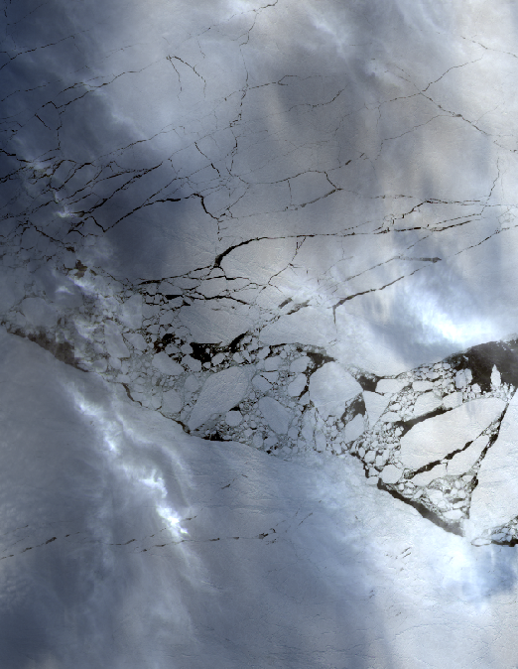
Limitations
Landsat 8 OLI/TIRS
LC80750102015169LGN00, True Color
Terra MODIS
02 JANUARY 2014, EOSDIS, True Color
Landsat 8 OLI/TIRS
LC80740102015050LGN00, True Color
Clouds
Darkness
Ice
Notes:
The three major challenges for remote sensing in the Arctic include, cloud cover, extended periods of darkness and ice-infested waters.
Cloud cover inhibits optical imagery.
The sun on the North Slope sets in mid-November and it remains below the horizon until the end of January, making optical imagery unavailable.
Ice-infested water complicates oil behavior and fate and conceals it from detection.

Slide 14

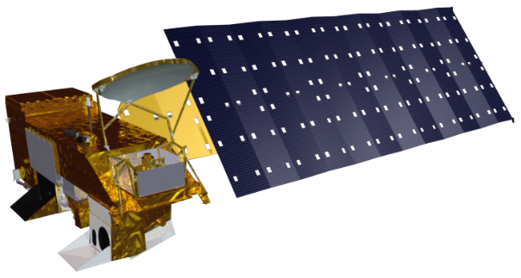

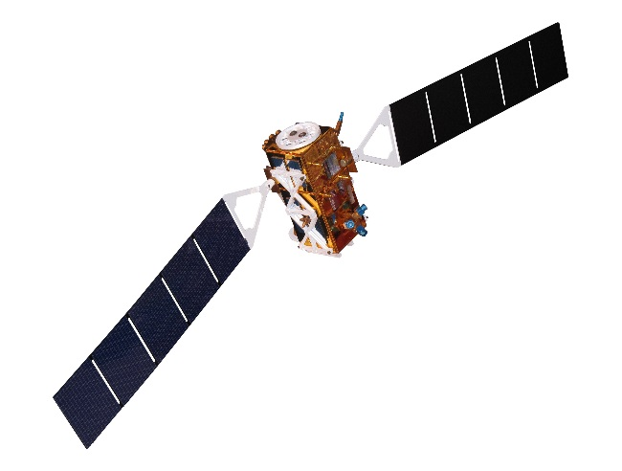
Earth Observing Systems
Remote sensing in the Arctic requires a combination of sensors to overcome individual limitations
All-weather
High Spatial Resolution
High Temporal Resolution
Aqua MODIS
Terra MODIS
Sentinel-1
Landsat 8
Notes:
Remotely sensing the presence of oil in an ice-infested region requires a mix of sensors, both passive and active, operating across the electromagnetic spectrum.
The ideal combination of sensors will overcome individual sensor limitations.
With this in mind, our team leveraged the European Space Agency’s Earth Observation system, Sentinel-1, for its all-weather capabilities using synthetic aperture radar, combined with Landsat 8 for its high spatial resolution and MODIS-Aqua and MODIS-Terra for its high temporal resolution.
Analyzed together, these sensors provide the most accurate visualization of an Arctic oil spill incident.
All-weather = Sentinel-1 (SAR)
High Spatial = Landsat-8 OLI/TIRS
High Temporal = Aqua/Terra MODIS

Slide 15
Methodology
Natural Oil Seeps Detection
Product not complete.
Notes:
We are still working on this component. As of 30 June, we decided to try to positively identify an oil seep using all available sensor data for the three best documented coastal sites from our oil seep map: Puale Bay, Oil Bay, and Controller Bay.

Slide 16
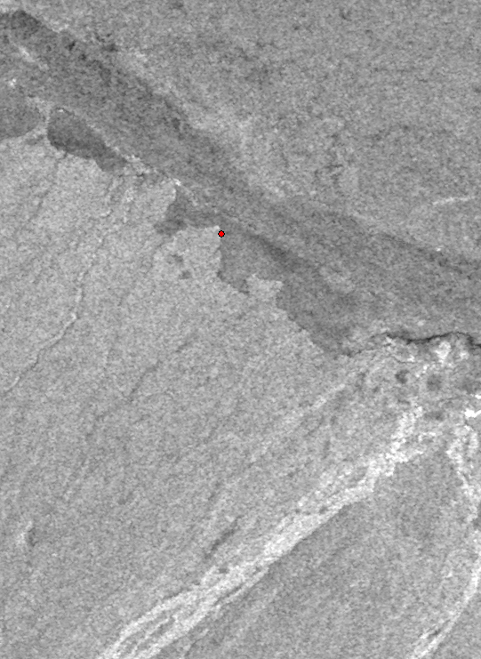
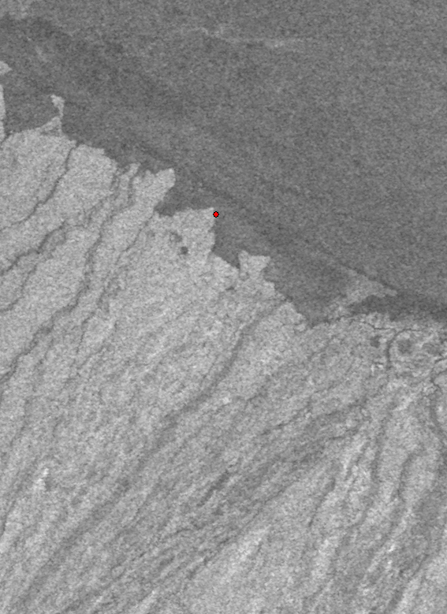
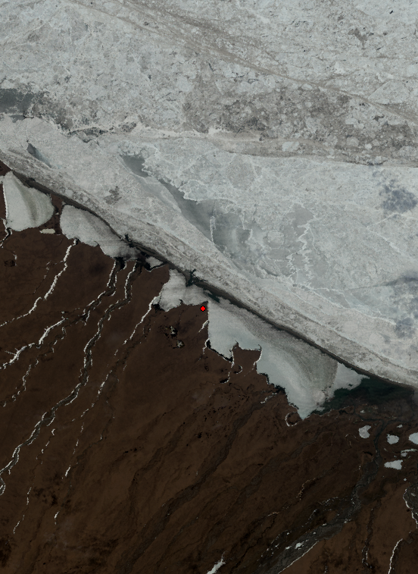
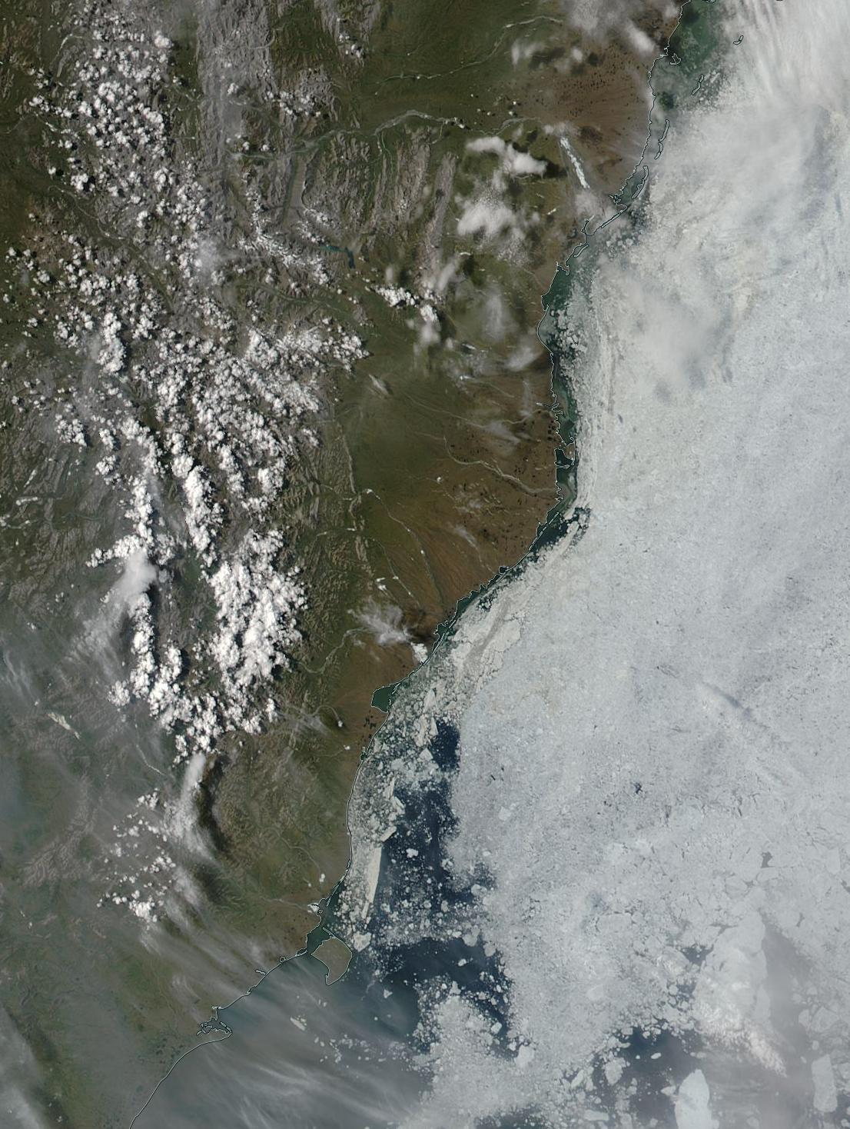
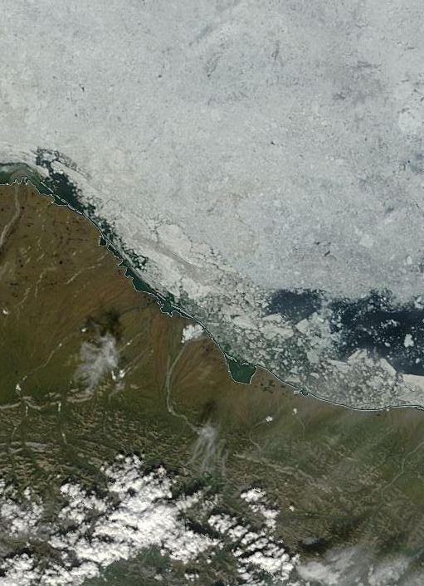
Methodology
Imagery Retrieval Tool
Terra MODIS
25 JUNE 2015, EOSDIS
Aqua MODIS
25 JUNE 2015, EOSDIS
Sentinel-1
s1a-ew-grd-hv-20150523t163403-20150523t163503-006051-007d22-002
Sentinel-1
s1a-ew-grd-hh-20150523t163403-20150523t163503-006051-007d22-001
Landsat 8 OLI/TIRS
LC80690112015159LGN00
Data Repositories
Sentinel-1 Scientific Data Hub
USGS EarthExplorer
Software
Python 2.7
Product
Graphical User Interface
Notes:
The second component of our project is a Python-based tool used to expedite the process of downloading spectral data from multiple repositories. This tool retrieves imagery on-demand for the user, all that is required is a lat/long and date range.

Slide 17
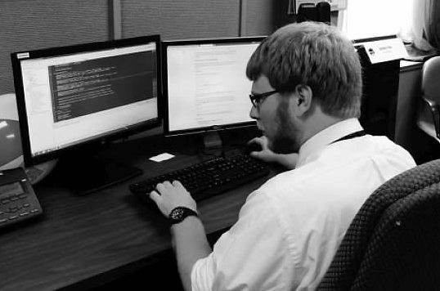
Methodology
Imagery Retrieval Tool
Data Repositories
Sentinel-1 Scientific Data Hub
USGS EarthExplorer
Software
Python 2.7
Product
Graphical User Interface
Image Credit: Ferguson, 2015
Notes:
The second component of our project is a Python-based tool used to expedite the process of downloading spectral data from multiple repositories. This tool retrieves imagery on-demand for the user, all that is required is a lat/long and date range.

Slide 18
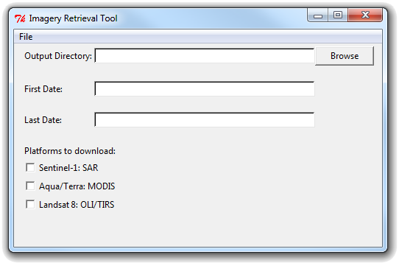
Methodology
Imagery Retrieval Tool
Data Repositories
Sentinel-1 Scientific Data Hub
USGS EarthExplorer
Software
Python 2.7
Product
Graphical User Interface
Notes:
The second component of our project is a Python-based tool used to expedite the process of downloading spectral data from multiple repositories. This tool retrieves imagery on-demand for the user, all that is required is a lat/long and date range.

Slide 19
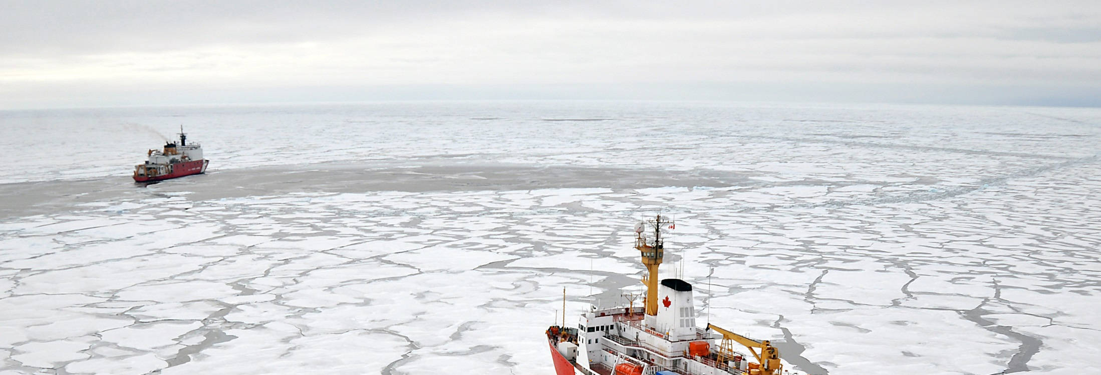
Results
Robust complement of geographic and spectral data for USCG strategic oil spill response planning
Rapid visualization capability for improved strategic and operational coordination efforts
Image Credit: USCG, 2009
Notes:
The project team provided the USCG with the ability to access a robust complement of geographic and spectral data for use in strategic oil spill response planning.
Additionally, the product’s implantation in Arctic ERMA allows for emergency response teams to access a fast visualization tool in order to accelerate response time.
Creative Commons, Photo Credit: Patrick Kelley, U.S. Coast Guard: https://www.flickr.com/photos/usgeologicalsurvey/4371016246/in/album-72157623467470824/

Slide 20
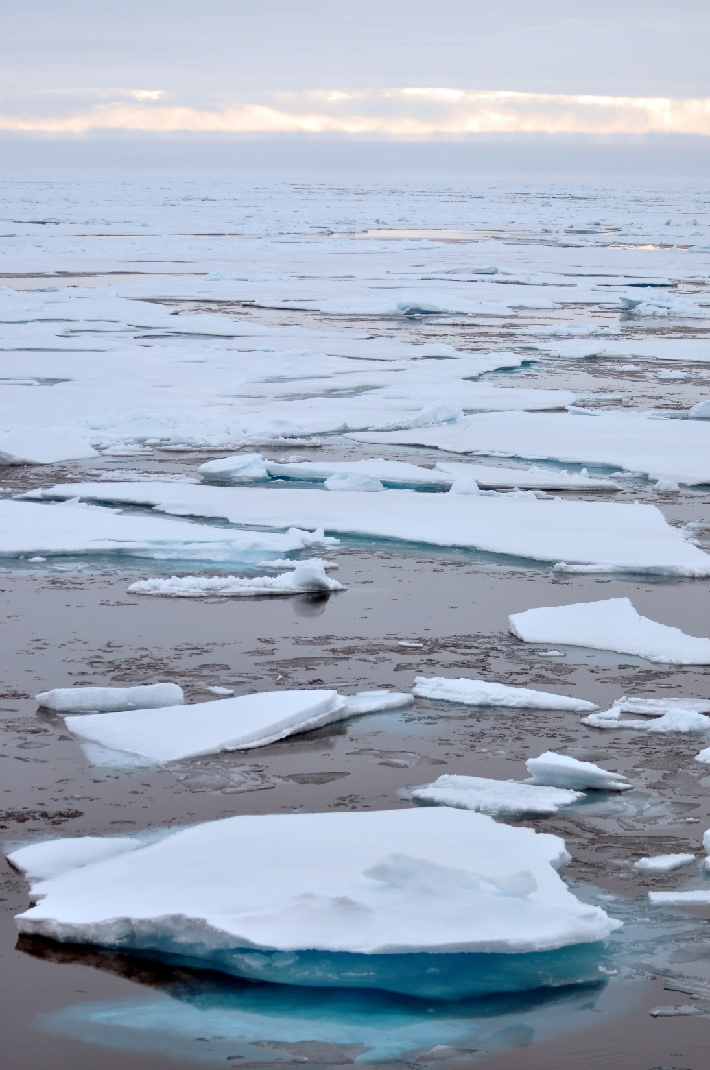
Future Work
Incorporate
optical and radar parameters
into GUI code to better refine oil detection methodology
Image Credit: USCG, 2009
Image Credit: AmericanPolar.org
Notes:
Future work for the project could incorporate optical and radar parameters into the GUI code to project and refine the data in a format that facilitates improved oil detection.
Creative Commons, Photo Credit: Patrick Kelley, U.S. Coast Guard: https://www.flickr.com/photos/usgeologicalsurvey/4370261777/in/album-72157623467470824/

Slide 21
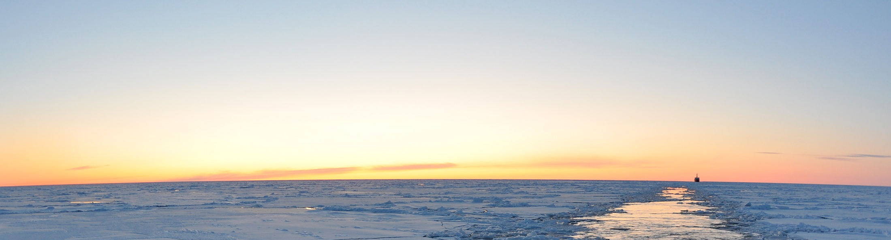
Acknowledgements
Advisors
Dr. Kenton Ross, NASA DEVELOP National Program
MST1 Justin Hoffer, United States Coast Guard Office of Marine Environmental Response Policy
Dr. Amy Merten, NOAA Office of Response and Restoration
Zachary Winters-Staszak, NOAA
Office of Response and Restoration
Jeff Ely, NASA DEVELOP National Program
Partners
Others
Image Credit: USCG, 2009
Notes:
We would like to thank Dr. Kenton Ross, our advisor for all his help and expertise with the Alaska Disasters project.
Additionally we would like to thank Petty Officer Justin Hoffer, our partner with the USCG for his information and communications with the project and its implementation.
We’d also like to thank Dr. Amy Merten and Zachary Winters-Staszak of the NOAA Office of Response and Restoration for their work in integrating the data map into ERMA, and Jeff Ely of the NASA DEVELOP Program for his help with the python script.
Creative Commons, Public Domain, Photo Credit: Patrick Kelley, U.S. Coast Guard
https://www.flickr.com/photos/usgeologicalsurvey/4371016084/in/album-72157623467470824/

