Slide 1
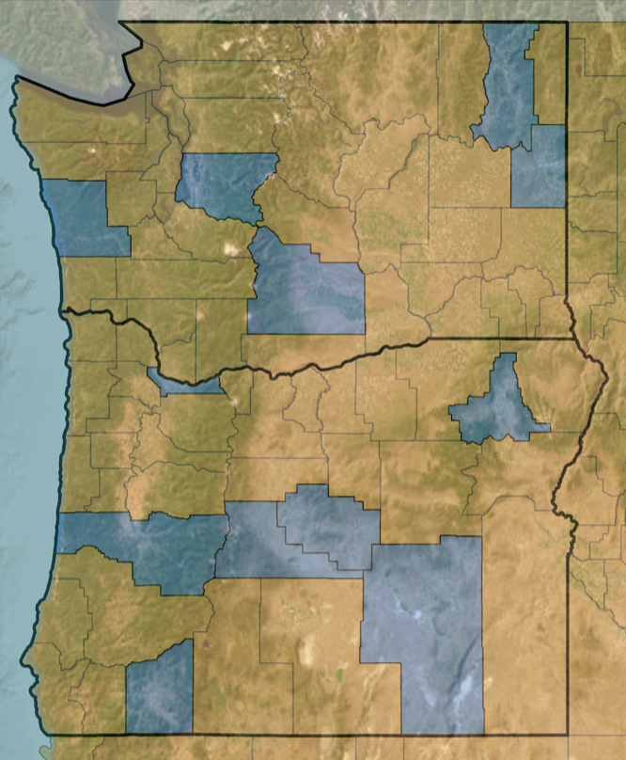
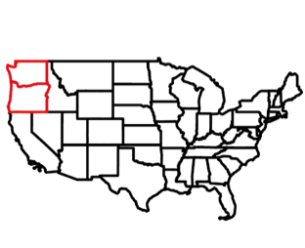
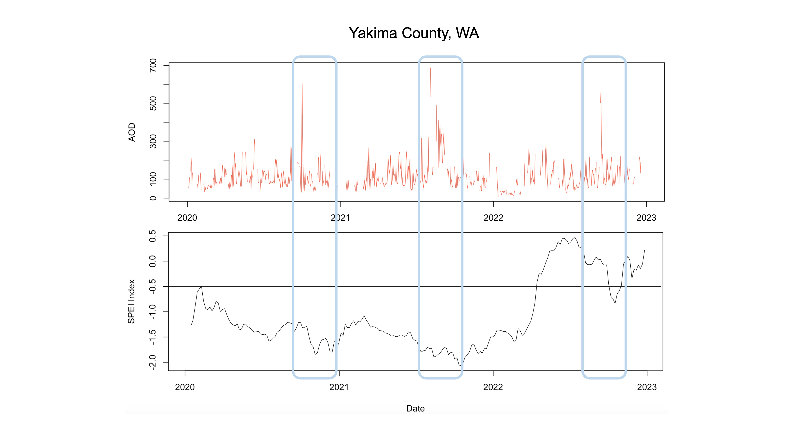
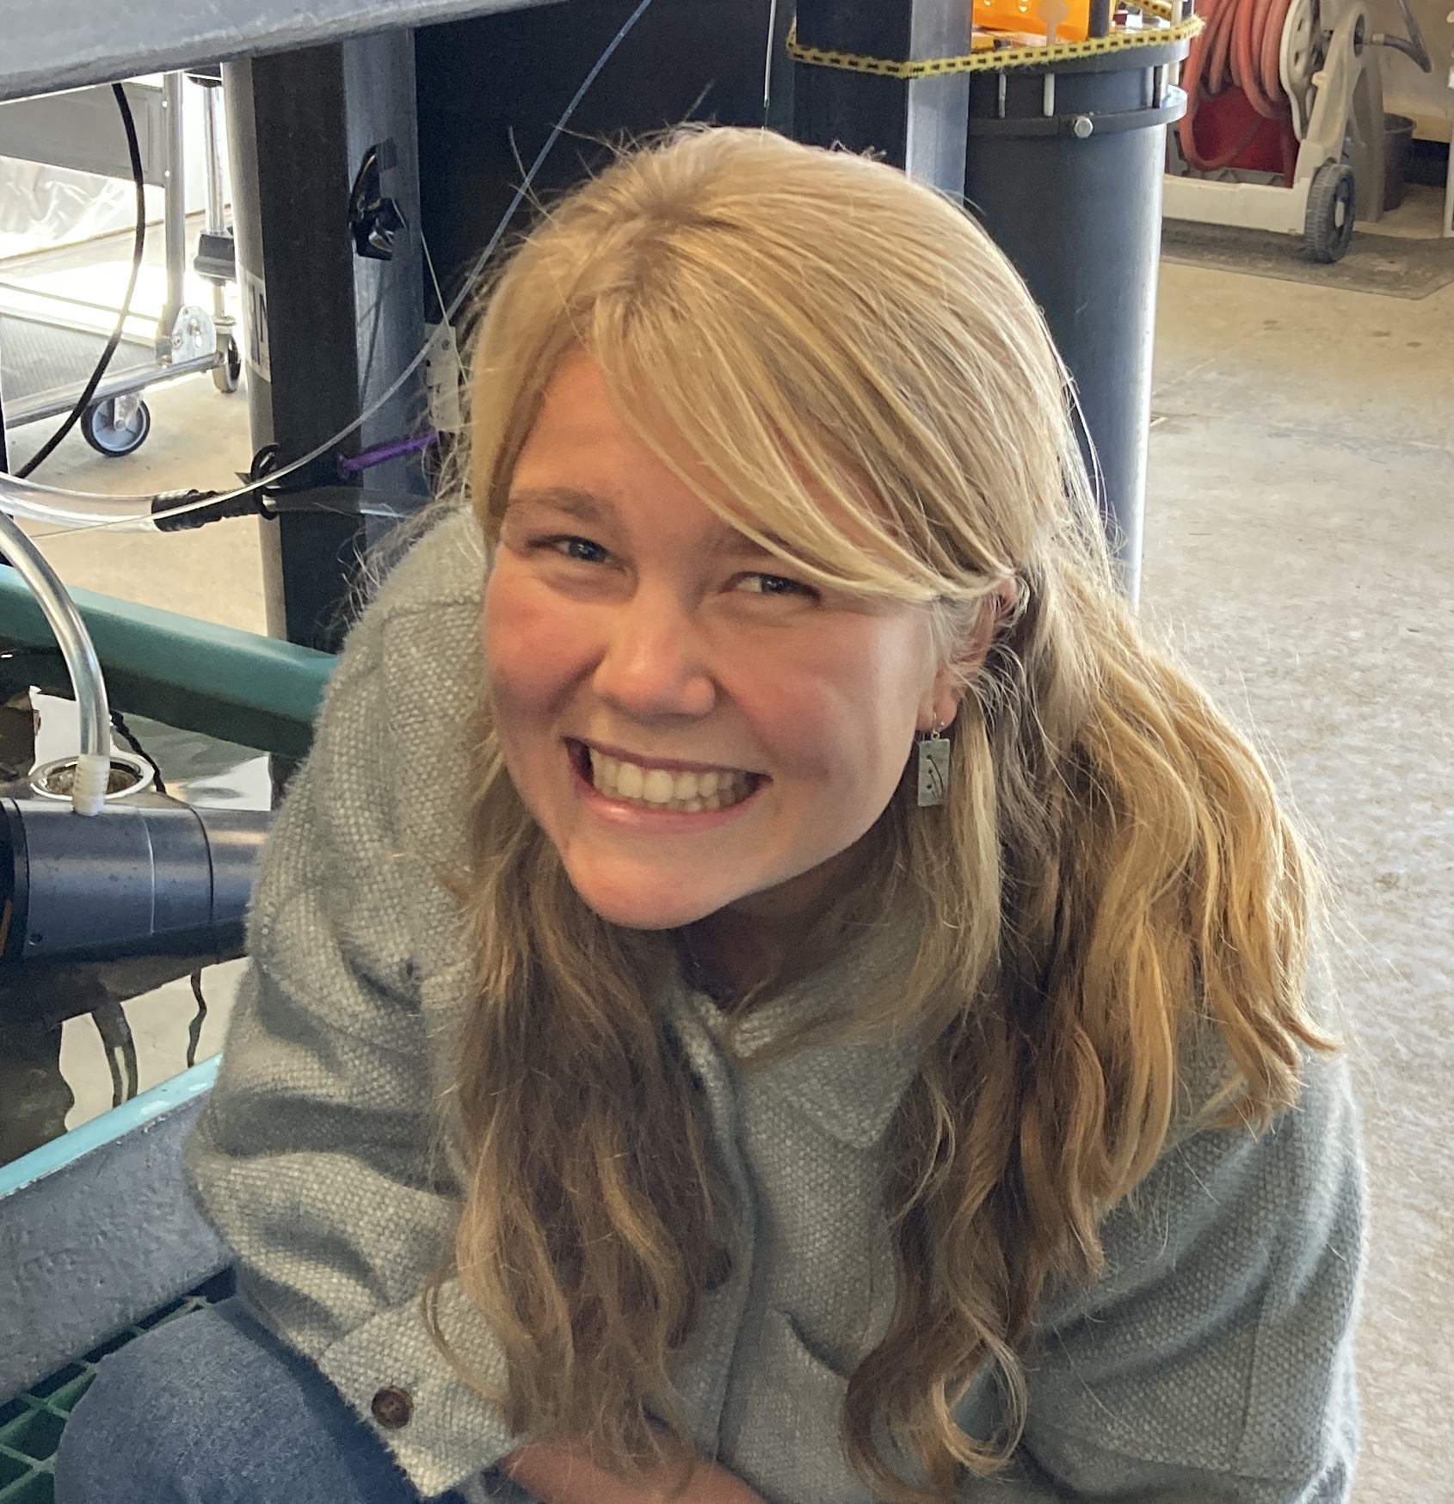
Pacific Northwest Health & Air Quality
Monitoring Trends in Air Quality during a Drought Case Study to Improve Public Health Response to Drought Threats
Study Area
Community Concerns
Earth Observations
Poor air quality exacerbates respiratory illness
Terra MODIS
Aqua MODIS
Methodology
Certain populations are more vulnerable to poor air quality
EPA PM2.5 and PM10
MODIS AOD
GRIDMET SPEI
R-Studio
Google Earth Engine
N
Basemap credit: Earthstar Geographics
Cleanup and extract data by counties with available data
Filter to study period date and study area site
0
100
km
Select AOD band from MODIS dataset
Select SPEI band from gridMET dataset
Counties of Interest
Increased mortality rates from higher particulate matter concentrations
Average PM10 by each monitoring station in each county
County Boundaries
Washington & Oregon State Boundaries
Mask clouds
Create timeseries and download as a CSV
Yakima County, WA
Statistics
Time Series
Maps
700
500
Takeaways
Aerosol Optical Depth
300
Earth observations demonstrate spatiotemporal trends in air quality
Dataset trend comparisons
100
0
2020
2021
2022
2023
0.5
Seasonal trends
Statistical analyses can show further correlation
0.0
-0.5
Standardized Precipitation-Evapotranspiration Index
-1.0
-1.5
Project Partners
-2.0
2020
2021
2022
2023
Oregon Health Authority, Public Health Division
Washington State Department of Health
NOAA National Integrated Drought Information System
University of Nebraska Medical Center Water, Climate, and Health Program
Team Members
Acknowledgements
Advisors – Molly Woloszyn (NOAA NIDIS), Dr. Jesse Berman (UMN School of Public Health), Dr. Babak Fard (UNMC Water, Climate, and Health Program), Ronald Leeper (NOAA NCEI-NCICS), Jared Rennie (NOAA NCEI)
Fellow – Katie Caruso
Special Thanks – Ryan Healey, Britnay Beaudry, Annie Britton, Kristen O'Shea, Steve Ansari, NCICS IT Department, and Dr. Kenton Ross
Abby Sgan
(Project Lead)
Greta Bolinger
Tallis Monteiro
Cristina Villalobos-Heredia
Taylor West
North Carolina – NCEI

