Slide 1
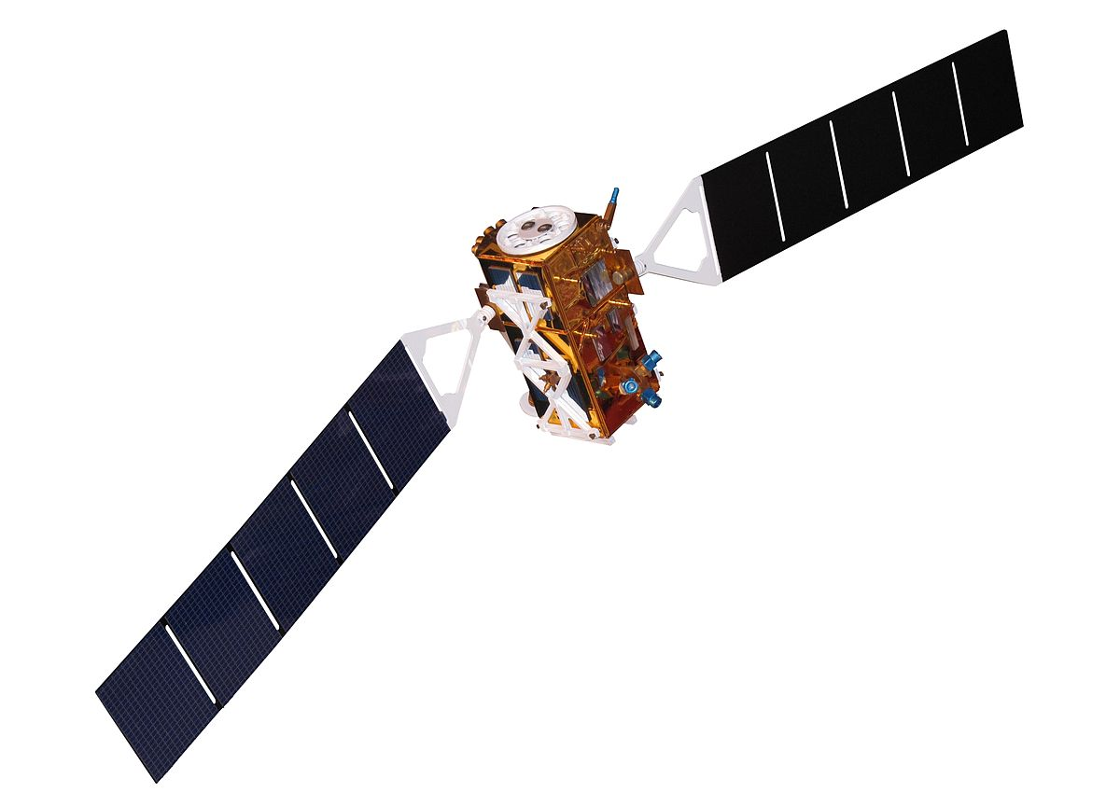
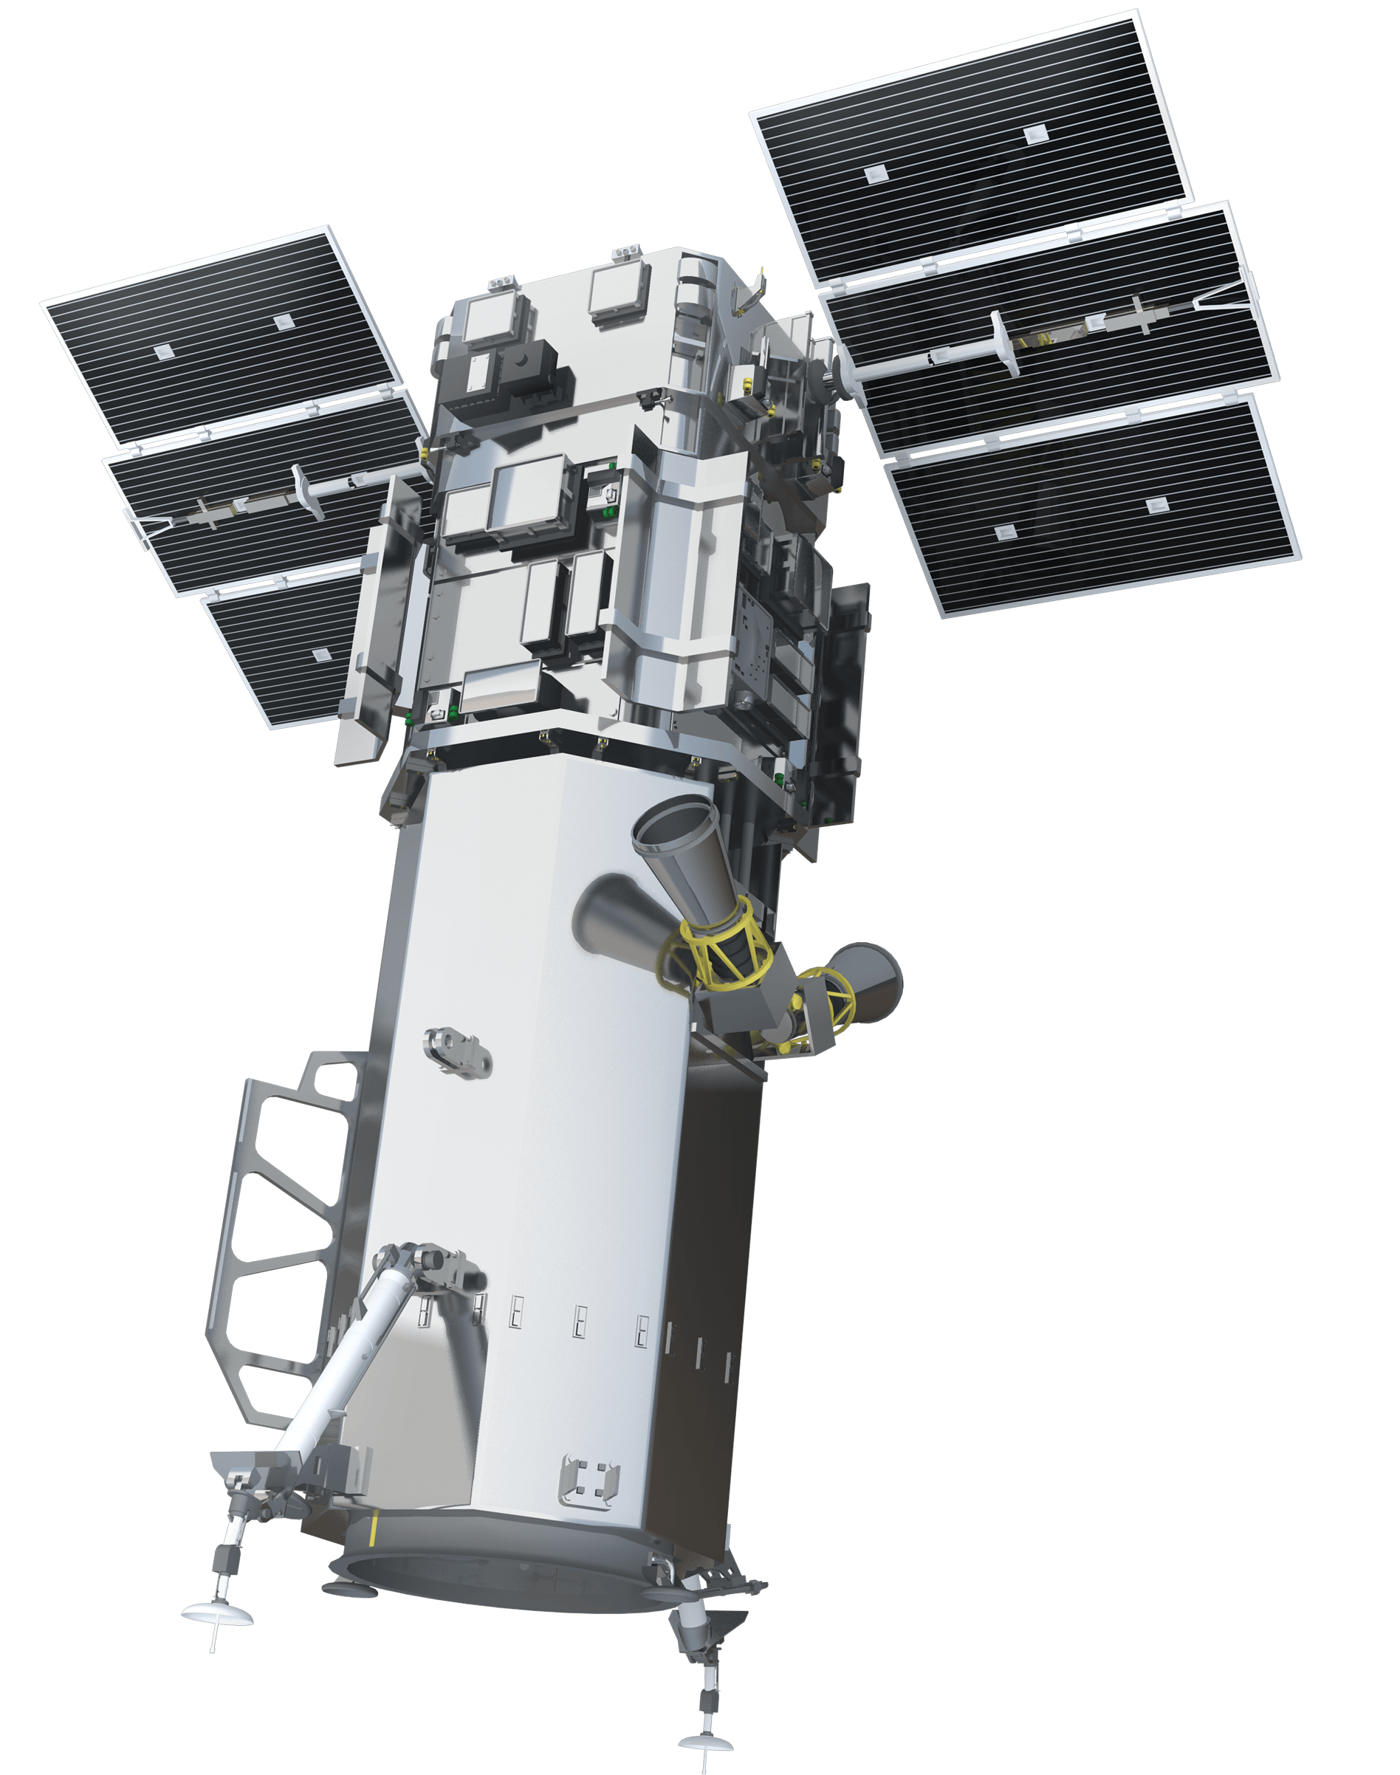
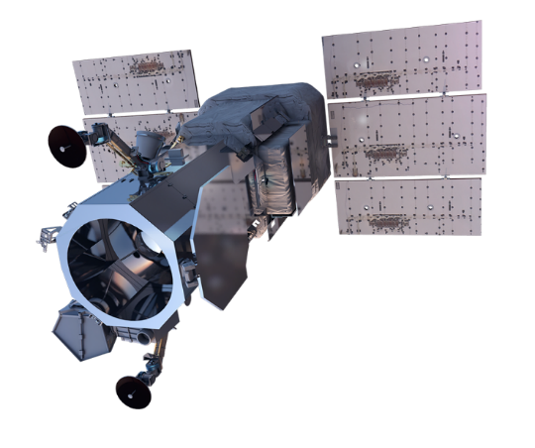
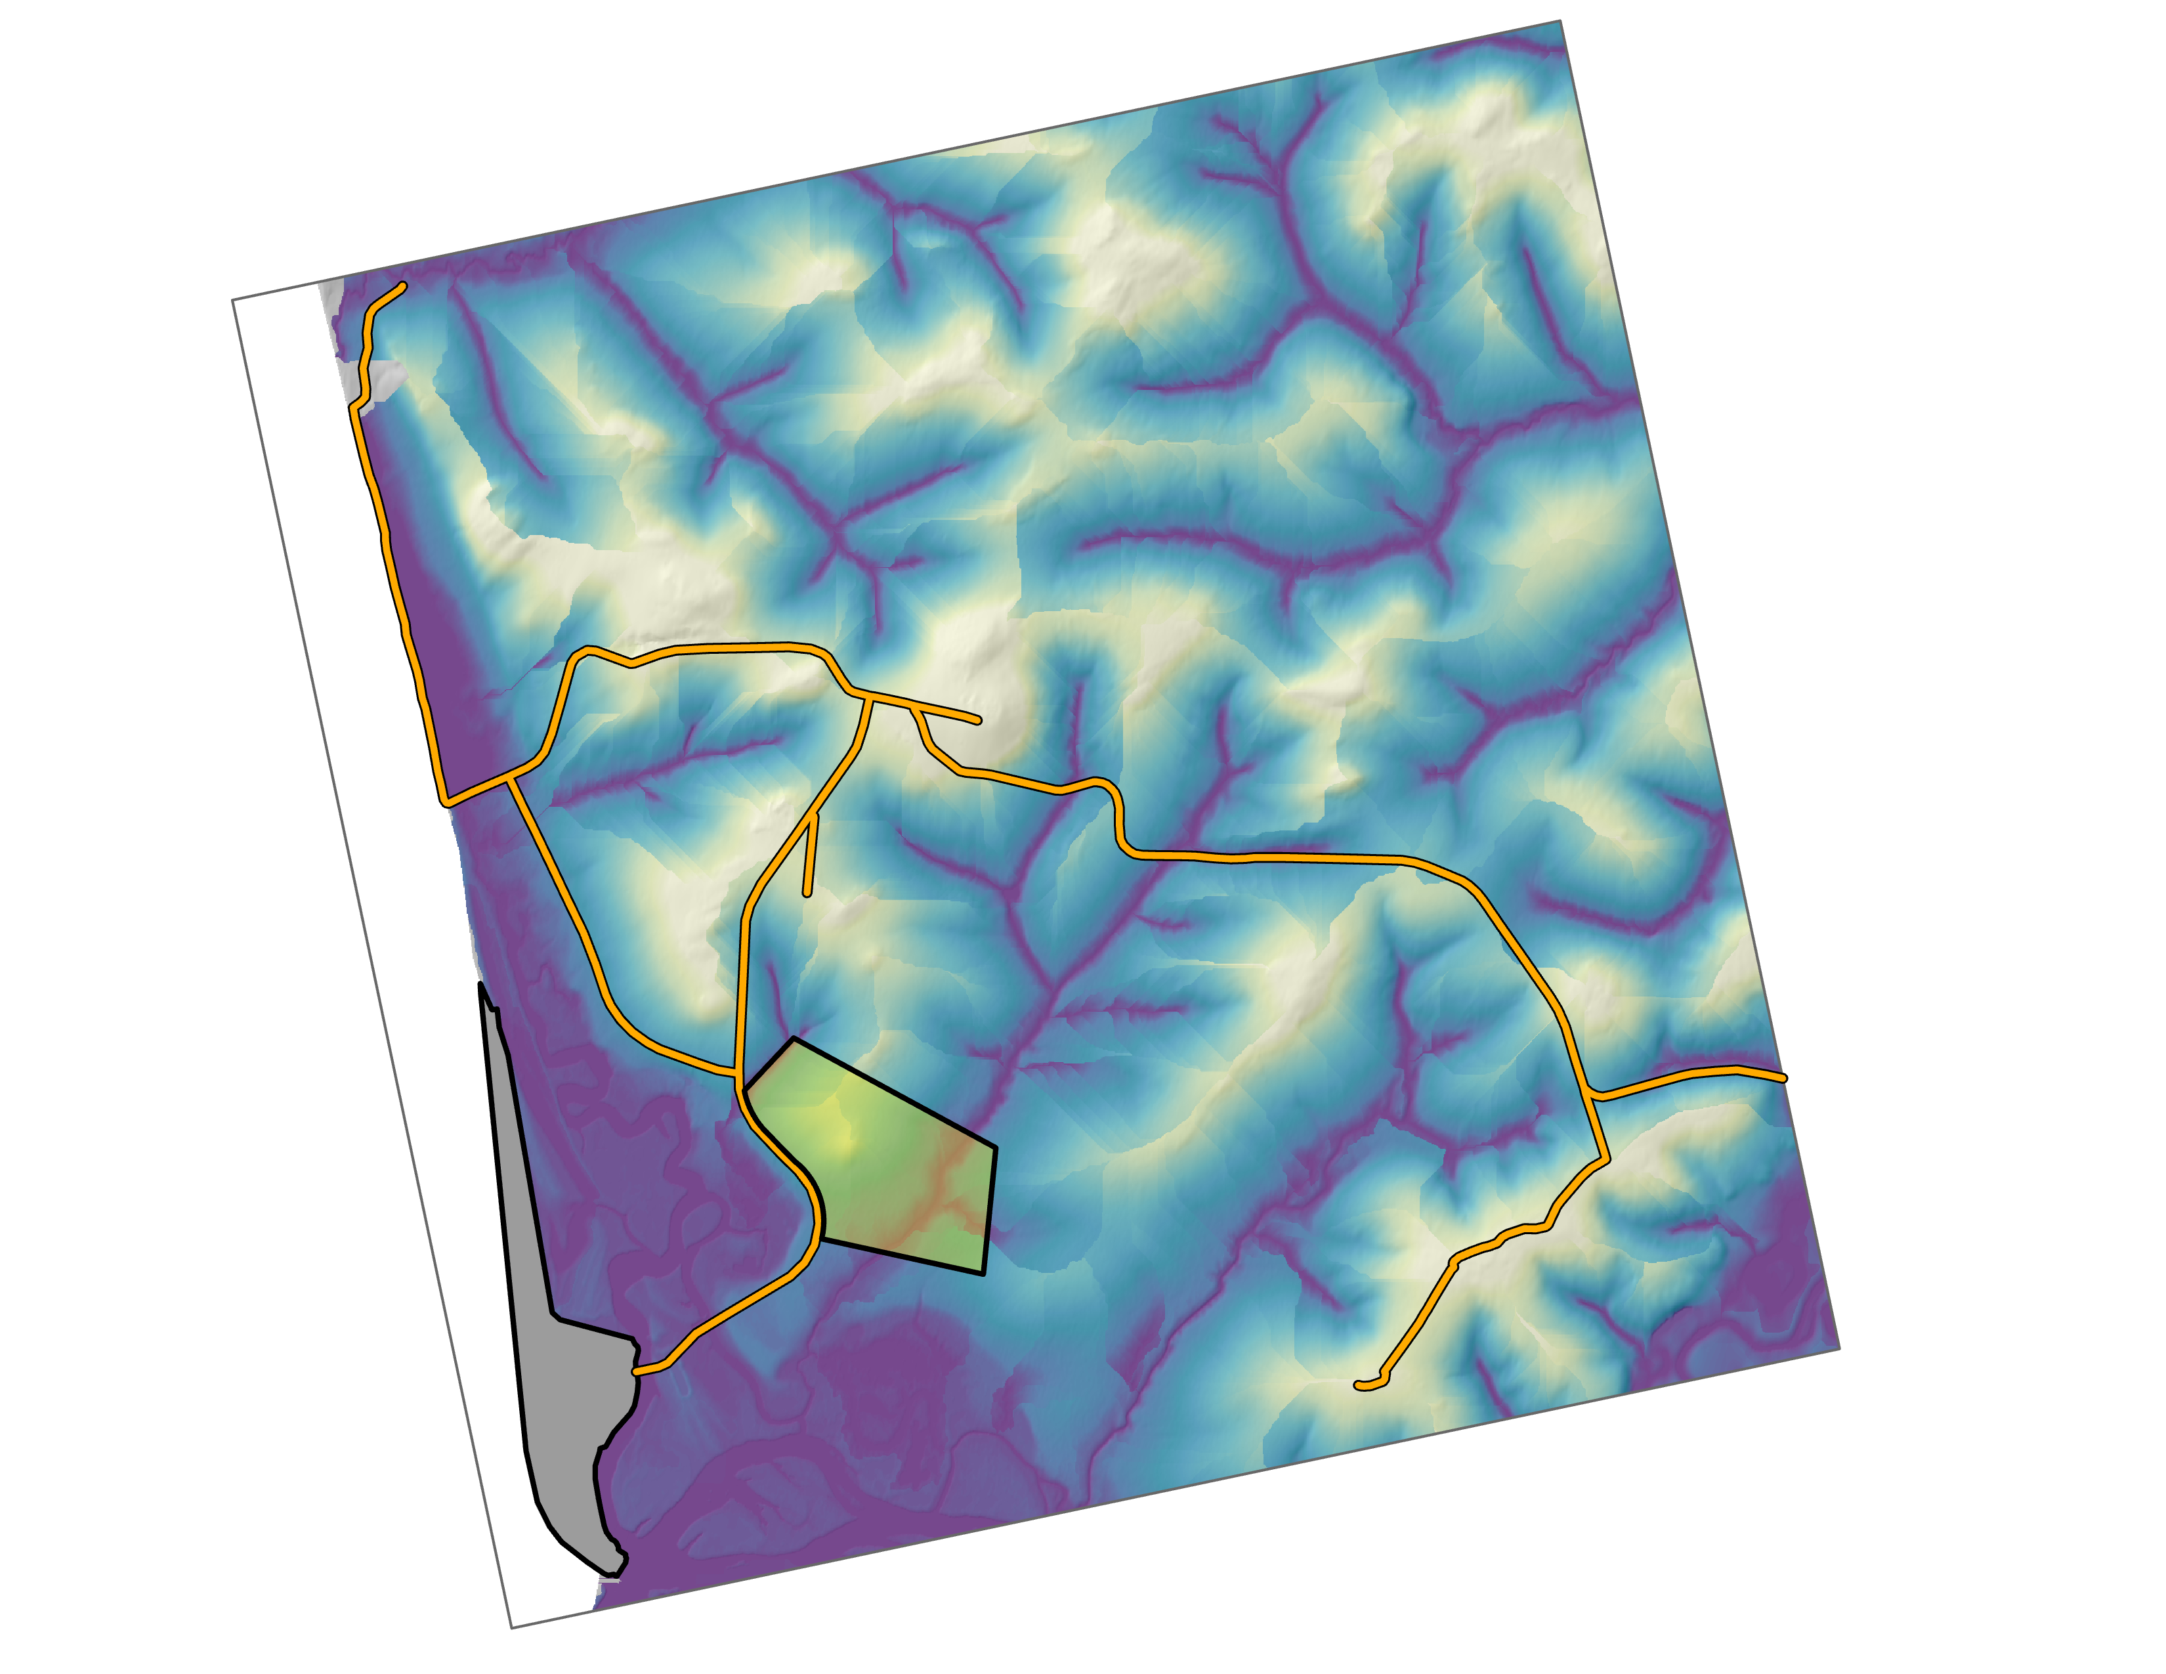
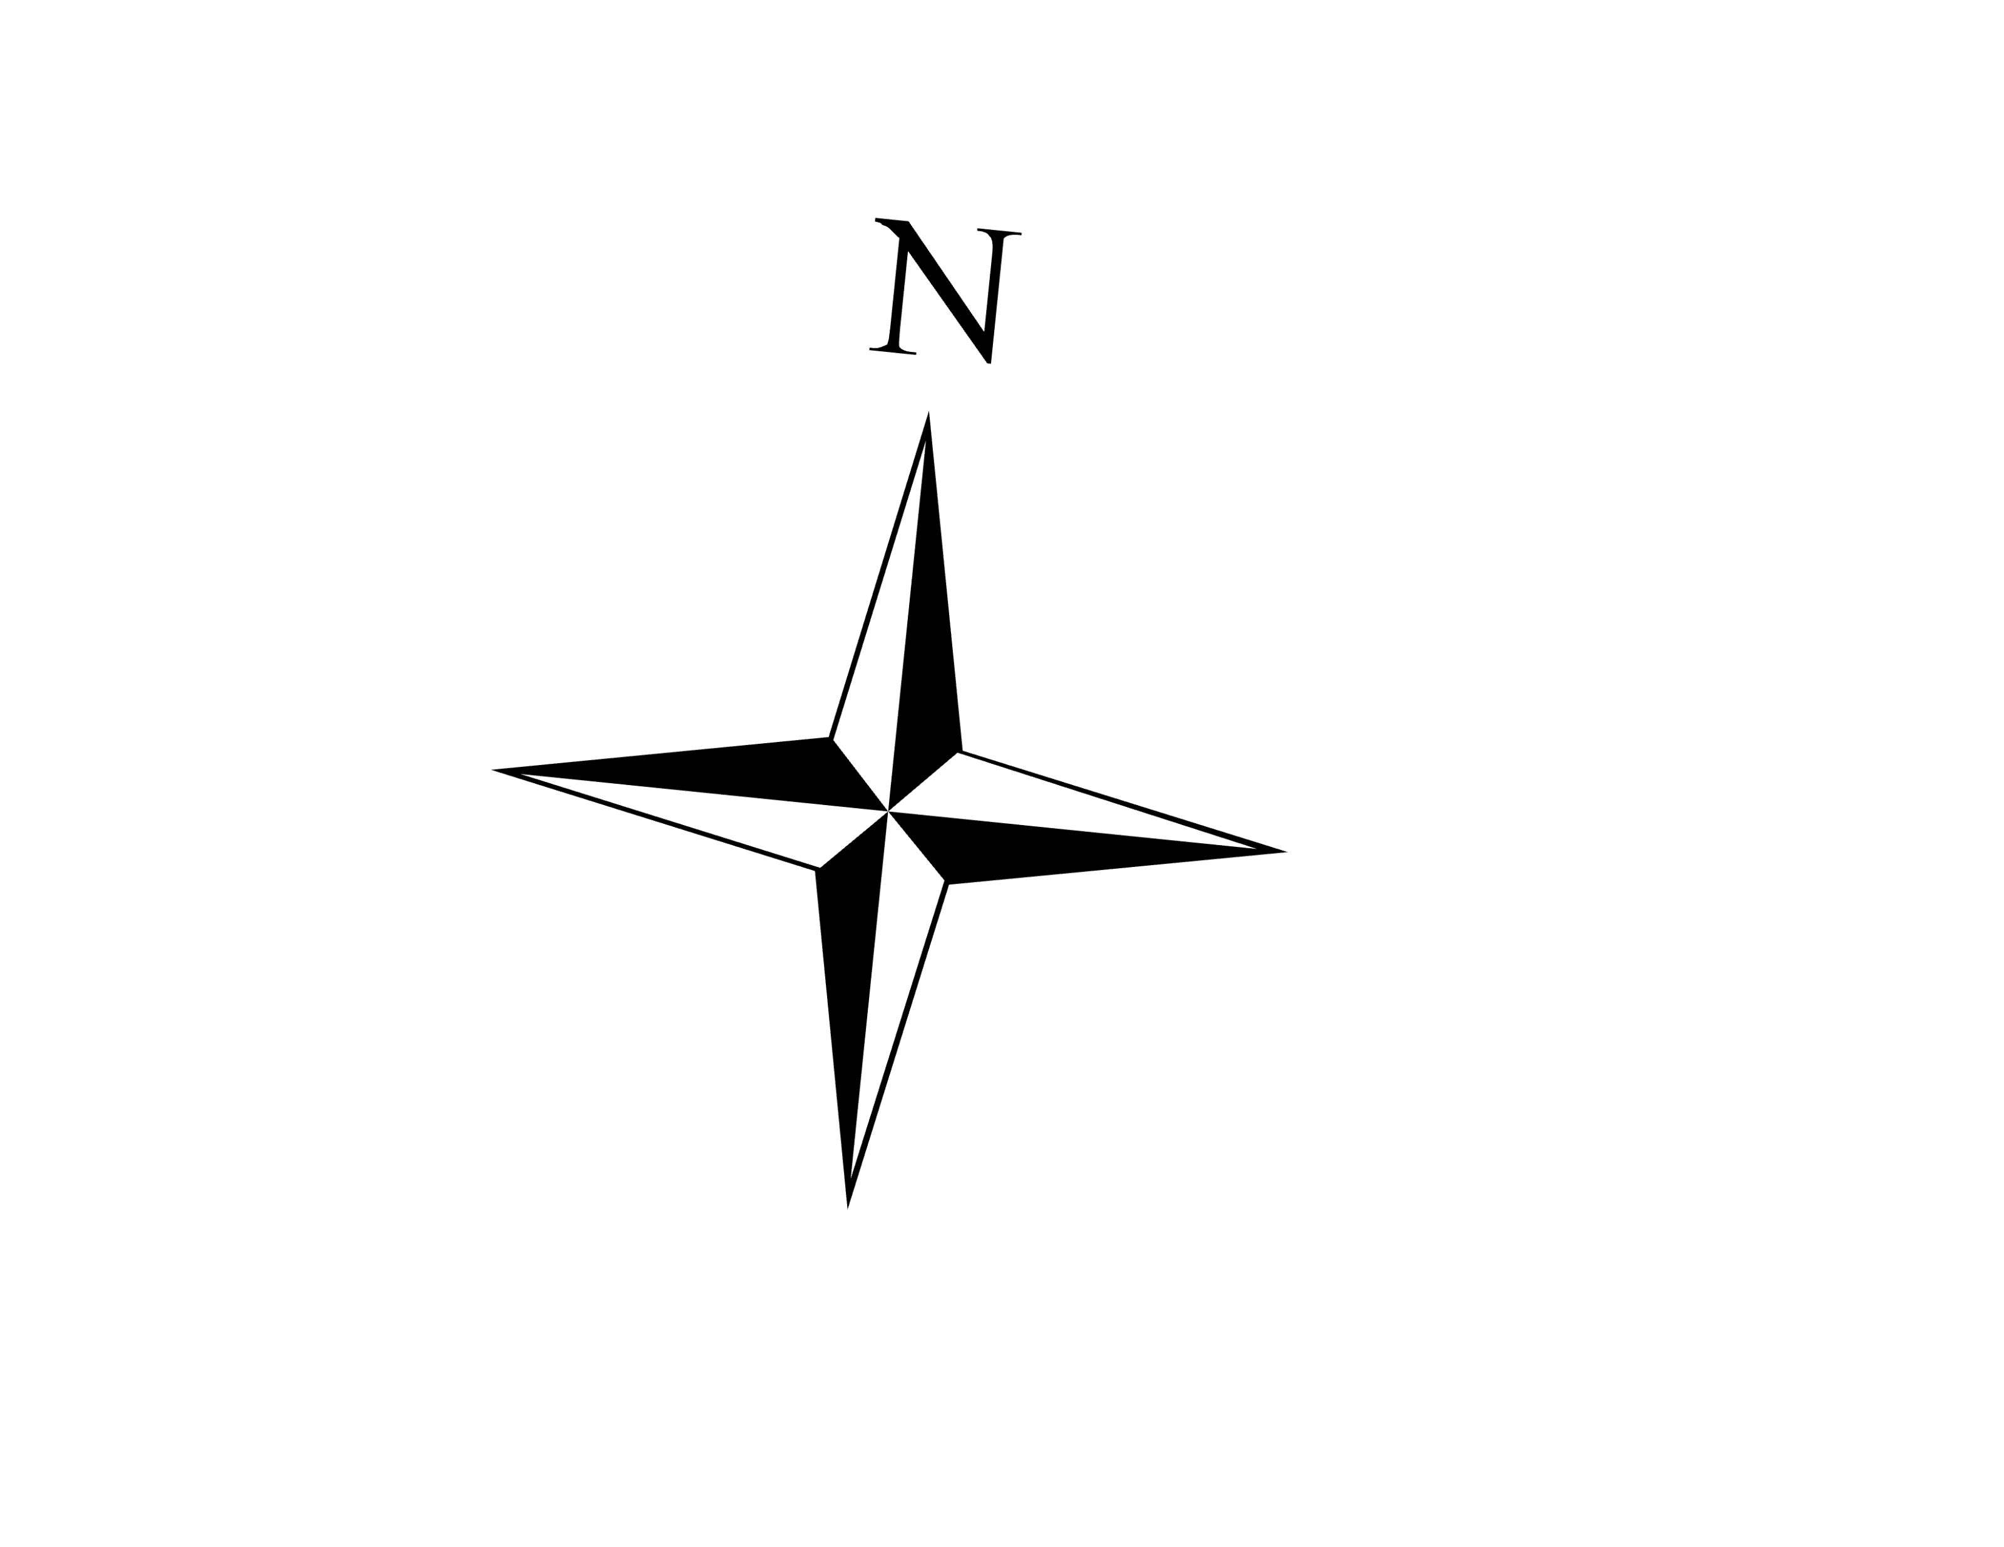
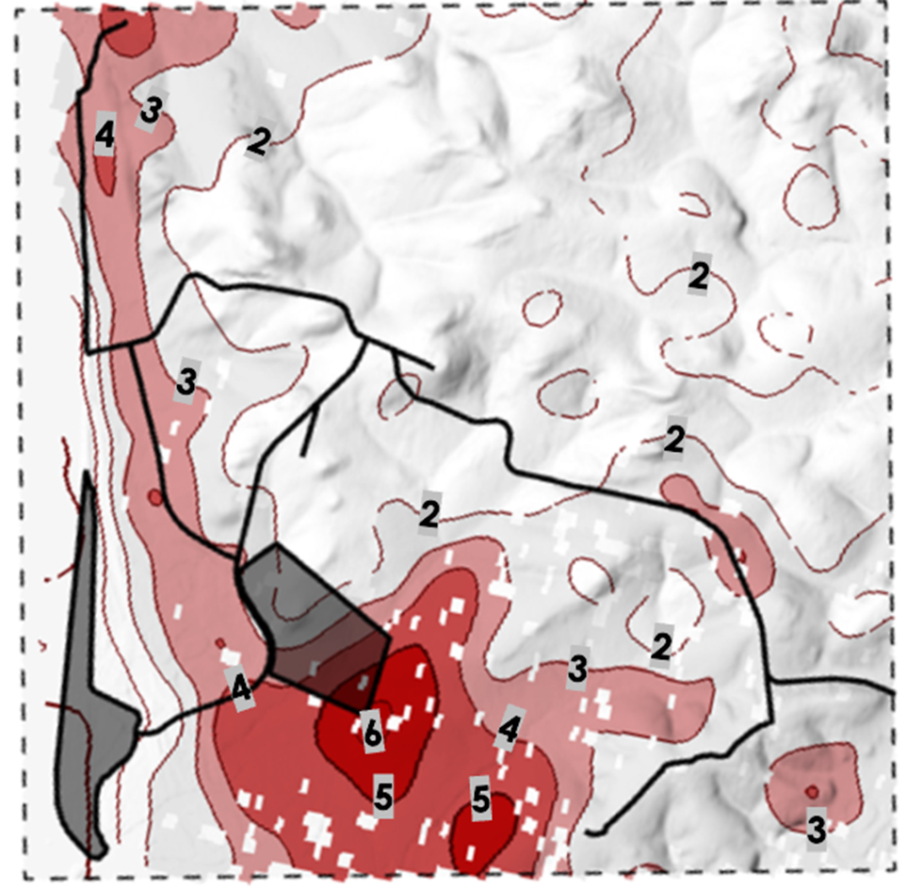
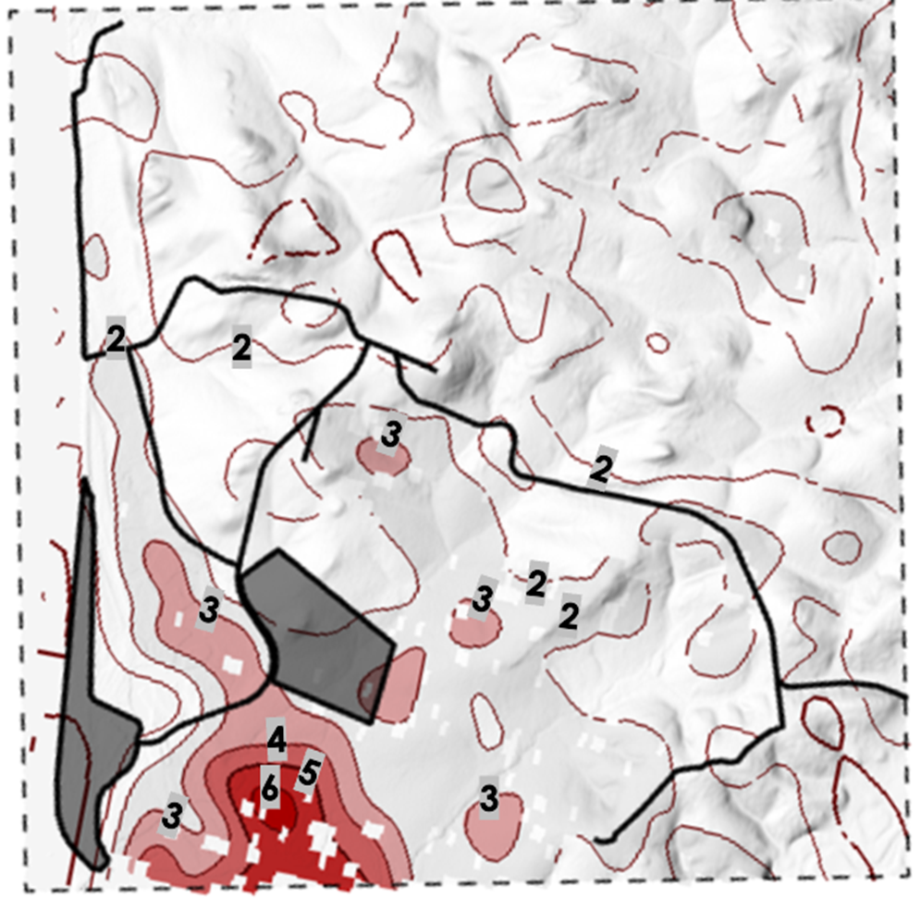
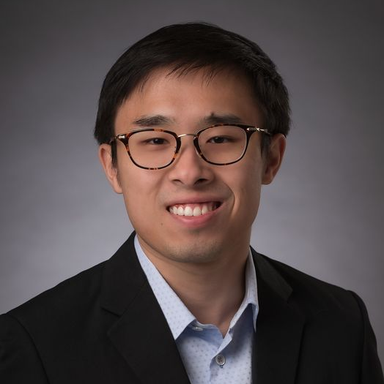
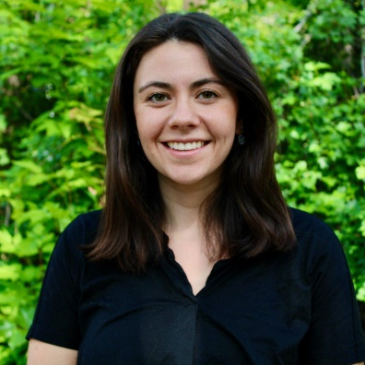
Unalakleet Climate
Analyzing Permafrost Degradation and Drainage Networks in Unalakleet, Alaska
Background
Earth Observations
Our team partnered with the National Renewable Energy Lab (NREL) to provide remote sensing support to aid the planned inland relocation of Unalakleet village. The town is experiencing severe coastal & riverine erosion, melting-induced flooding, and permafrost degradation.
Sentinel-1 C-SAR
WorldView-2
WorldView-3
Our work serves to provide guidance on construction and future expansion in the community
Methodology
Permafrost Analysis
Permafrost Analysis
Drainage Network Analysis
8th Most at-risk Alaskan community
$105M
Estimated in erosion damages in next 50 years
2^{ft} Erosion per year
Generate summer subsidence maps from Interferometric Synthetic Aperture Radar (InSAR)
Obtain Alaska Digital Elevation Model (DEM)
6th Worst erosion in Alaska
Visualize subsidence over time; time-series analysis
Apply Height Above Nearest Drainage (HAND) algorithm to DEM
Height Above Drainage Areas
Subsidence Gradient Contour Maps
186 m
186 m
0 m
Foothills Subdivision
Current Town
0
4
8 km
0
4
8 km
Roads
The left and right maps show summer subsidence (in cm) in 2019 and 2022, respectively. The foothills subdivision, current town, and roads are marked in dark grey. Darker red areas indicate regions of greater subsidence and regions of active freeze-thaw, with a higher risk for building infrastructure. Note that the subsidence values over an area are an average. Summer 2019 was an exceptionally warm season and shows the extent of subsidence that can occur as the climate warms.
0
4
8 km
Darker blue values indicate areas that are more likely to experience flooding and erosion. As you move away from the darker blue areas in the drainage, there is less risk for potential damage and instability to building infrastructure.
EXAMPLE
The team would like to thank everyone who made this project possible:​​
Partners: Georgina Davis and Aaron Cooke (NREL)
Advisors: Dr. Marguerite Madden (University of Georgia), Dr. Simon Zwieback and Dr. Franz Meyer (University of Alaska Fairbanks), Dr. Anna Liljedahl (Woodwell Climate Research Center), Dr. Chandi Witharana (University of Connecticut)
Fellow: Sarah Payne (NASA DEVELOP at Georgia – Athens)
Ian Lee
(Project Lead)
Clara Maxwell
Daniel Marsden
Jaweed Nazary
Athens – Georgia

