Slide 1
OKLAHOMA
Health & Air Quality
Mapping Air Quality Using NASA Earth Observations to Investigate Recent Increases in Ozone Concentrations
Carolina Rosales, Katherine Howell, Kjirsten Coleman, Robert Alward, & Vanessa Machuca
California – JPL
Notes:
Hello everyone and thank you for joining us for our Fall Closeout. My name is Carolina Rosales and I am joined by Kate Howell, Kjirsten Coleman, Robert Alward and Vanessa Machuca. We are the Oklahoma Health and Air Quality Team and have spent the past 10 weeks working on Mapping Air Quality Using NASA Earth Observations to Investigate Recent Increases in Ozone Concentrations in Oklahoma.

Slide 2
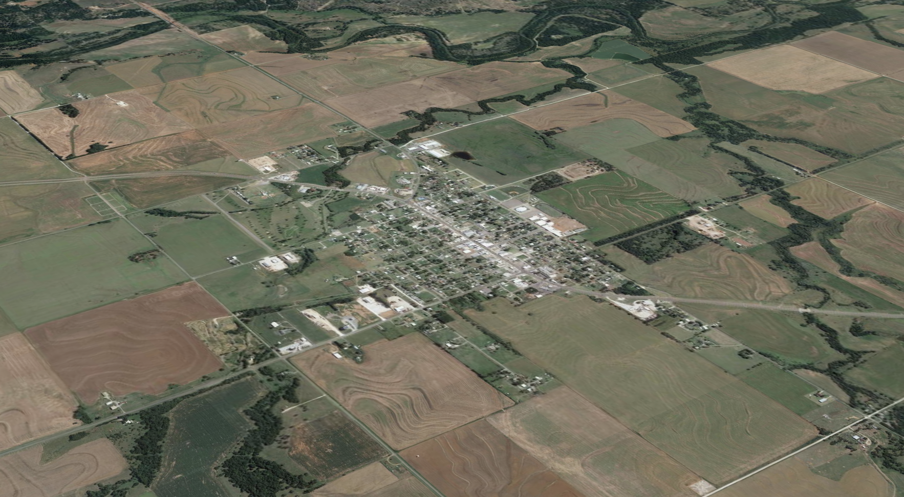
Community Concerns
Ozone spikes in Seiling, OK, in the summer of 2018
Ozone monitor
2011 spikes caused by drought – no obvious cause for 2018 spikes
Gaps in/sparse air quality monitoring network
Seiling, Oklahoma
Image Credit: Google Earth
Notes:
In the summer of 2018, an air quality monitor in the small town of Seiling, Oklahoma recorded spikes in ozone concentrations.
##### CLICK TO ANIMATE #####
These spikes were surprising.
Ozone spikes in urban areas like Oklahoma City and Tulsa are to be expected, but these high levels of pollution are rather surprising in rural Seiling.
Seiling is a small agricultural community located 2 hours northwest of bustling Oklahoma City.
In fact, the Seiling air quality monitor is considered a "background" monitor" meant to help policymakers and scientists in Oklahoma identify baseline ozone and particulate matter levels.
##### CLICK TO ANIMATE #####
Similar elevations in ozone concentrations occurred in 2011, but the state was able to pinpoint a strong drought as the cause. In the case of the 2018 spikes, state officials were left puzzled.
##### CLICK TO ANIMATE #####
While there are air quality monitors elsewhere in Oklahoma monitoring pollutants like ozone, NO2, and CO, there are considerable gaps in this air monitoring network. Data from these monitors was not enough to determine possible causes for these spikes.
----------Image Information Below----------
Image Credit: Google Earth
Image Source: NASA DEVELOP Team

Slide 3
Background Information
O₃
stratosphere
troposphere
O₃
VOCs
Tropospheric O₃ is primarily generated by the interaction of anthropogenic and natural emissions, and environmental factors
CO
NO_{x}
anthropogenic & natural sources
O₃
Notes:
Ozone occurs naturally throughout Earth's atmosphere. But ozone in the troposphere – the part of the atmosphere closest the surface – is primarily formed by the interaction between
##### CLICK TO ANIMATE #####
pollutants and environmental factors like sunlight. These pollutants – known as ozone precursors -, including carbon monoxide (CO), nitrogen oxides (NOx), and volatile organic compounds (VOCs), can arise in many ways:
Mobile sources like cars and cargo ships
Plants releasing volatile organic compounds
Energy sector activity, like oil refineries and power plants
Emissions from fires, including agricultural and wild fires
In this summertime, ozone spikes are likely to occur when emissions and ultraviolet light are at their peak.
##### CLICK TO ANIMATE #####
Given the variety of ways that ozone precursors can be generated, pinpointing the exact cause of a rise in ozone concentration can be a challenge. In the case of Seiling, possible causes include:
Traffic in nearby Oklahoma City
Oil, gas, and power plant activity, perhaps in Texas or in Southern Oklahoma
Fires, perhaps in New Mexico or Colorado. These could be wild fires, prescribed burns, or other types of fire events.
##### CLICK TO ANIMATE #####
Ozone in the troposphere is considered harmful to human health in concentrations above 0.07 parts per million (ppm). Ozone at these concentrations is associated with increased rates in lung cancer, asthma, and other lung-related diseases, as well as impaired cognitive function. It is crucial, then, to determine sources of ozone spikes and regulate them.
------------------------------Image Information Below ------------------------------
Clipart provided by PowerPoint

Slide 4
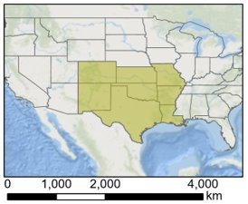
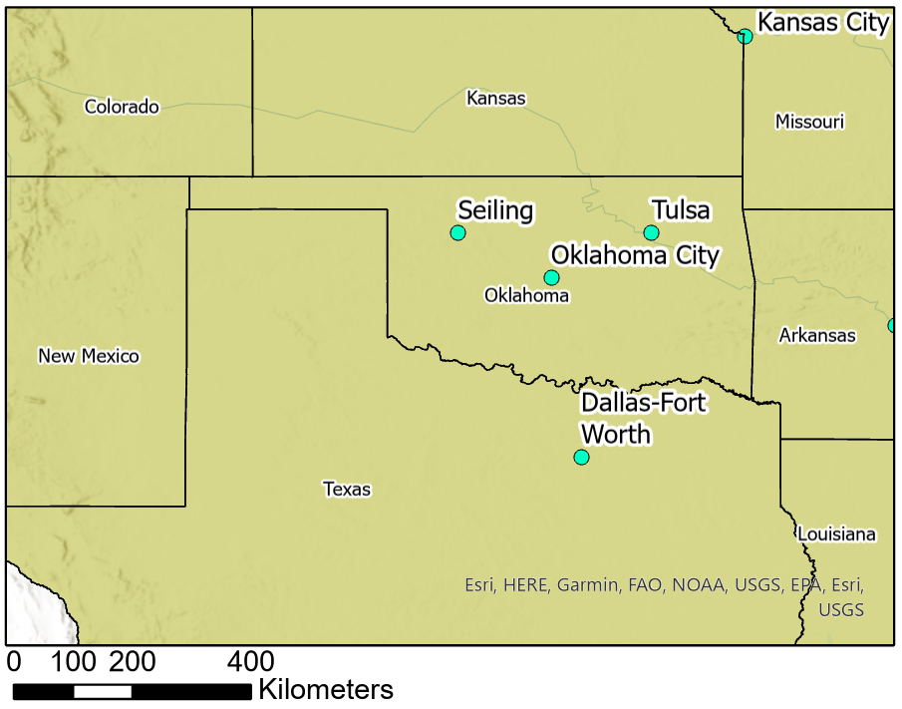
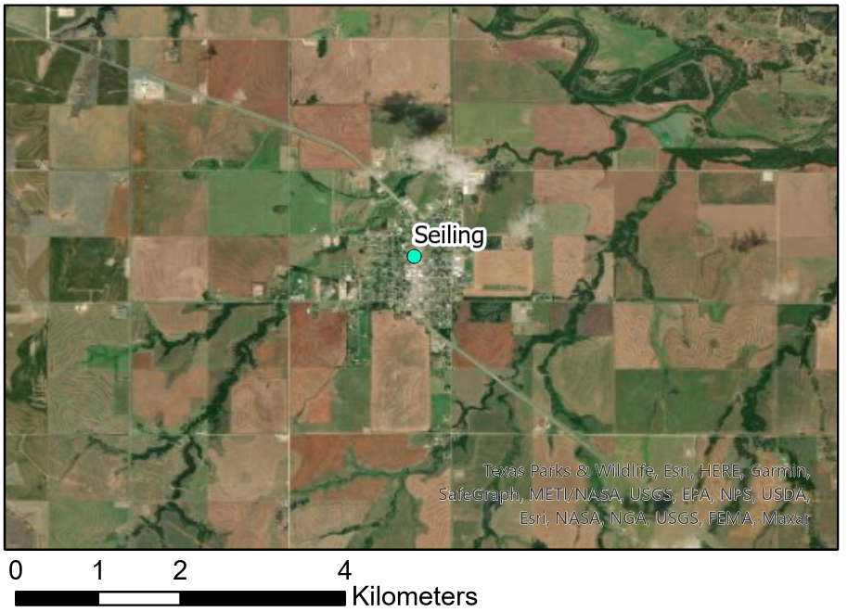
Study Area
N
km
km
Oklahoma and bordering states
Texas, New Mexico, Colorado, Kansas, Arkansas, Louisiana, Missouri
Legend
Spatial Reference
Name: GCS WGS 1984
GCS: GCS WGS 1984
Datum: WGS 1984
Map Units: Degree
United States
Major cities
Study area
Notes:
While these ozone spikes occurred in Seiling, we needed to expand out study area outside of the town to investigate possible spike causes.
Pollutants, like emissions from traffic and fires, often travel across large distances and may interact with the environment and other molecules to form new pollutants, such as ozone.
In order to discern the sources of these pollutants, our study area includes Oklahoma and the seven surrounding states: Texas, New Mexico, Colorado, Kansas, Missouri, Arkansas, and Louisiana.
Our total study area is shaded in green in the US map. Seiling is indicated in red and its immediate area indicated in orange.
Seiling is a small agricultural community located 2 hours northwest of bustling Oklahoma City.
------------------------------Image Information Below ------------------------------
Basemap Credit: Landsat 8
Basemap Sources: NASA/USGS

Slide 5
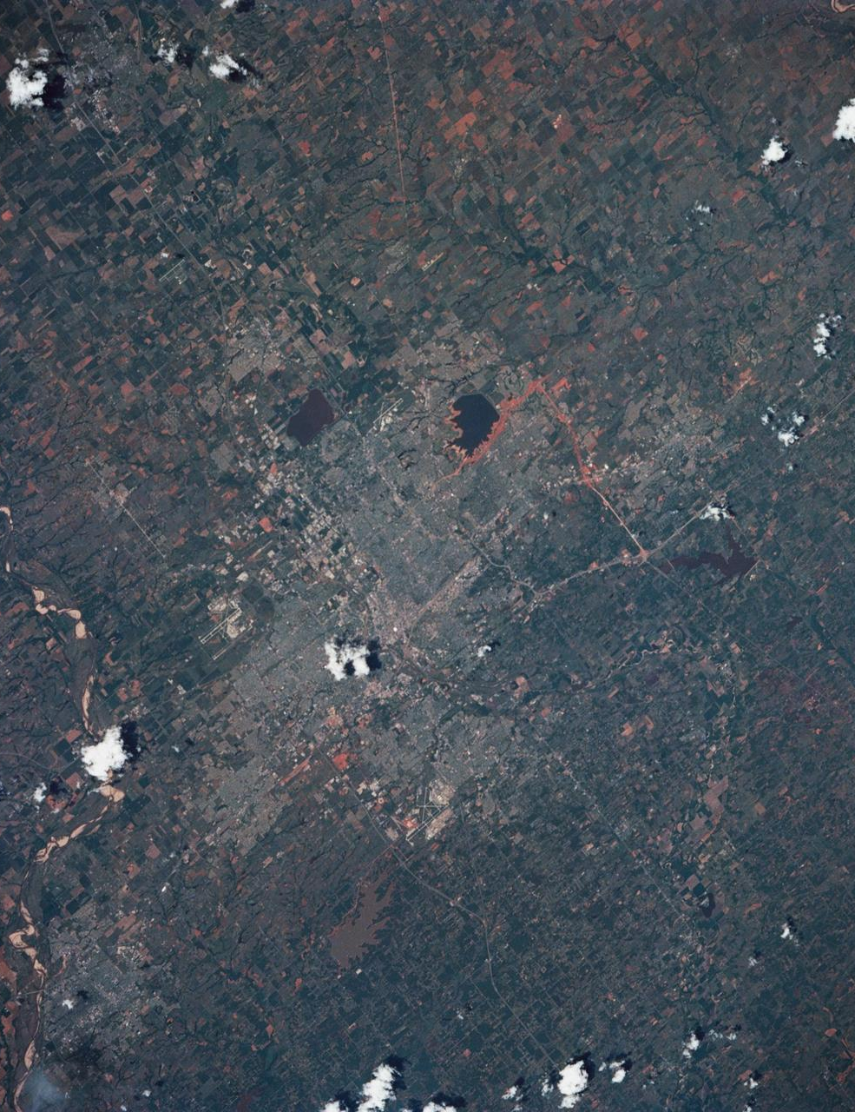
Partner
Oklahoma Department of Environmental Quality (DEQ)
Mission- “to protect and improve public health and our environment”
Air Quality Division
Responsibilities
Air monitoring
Air permits
Emissions inventory
Compliance and enforcement
Rules and planning
Image Credit: NASA Image Gallery
Notes:
We partnered with the air quality division at the Oklahoma Department of Environmental Quality, or DEQ, for this project.
##### CLICK TO ANIMATE #####
The Oklahoma DEQ collects air quality measurements at ground stations throughout the state. Specifically, the air quality division is responsible for carrying out the state's regulatory duties under state and federal law. Through the use of its programs and requirements, the air quality division aims to achieve the department's mission and make Oklahoma "an attractive place to live, work and play."
------------------------------Image Information Below ------------------------------
Image Credit: NASA
Image Source: https://images.nasa.gov/details-s39-85-029

Slide 6
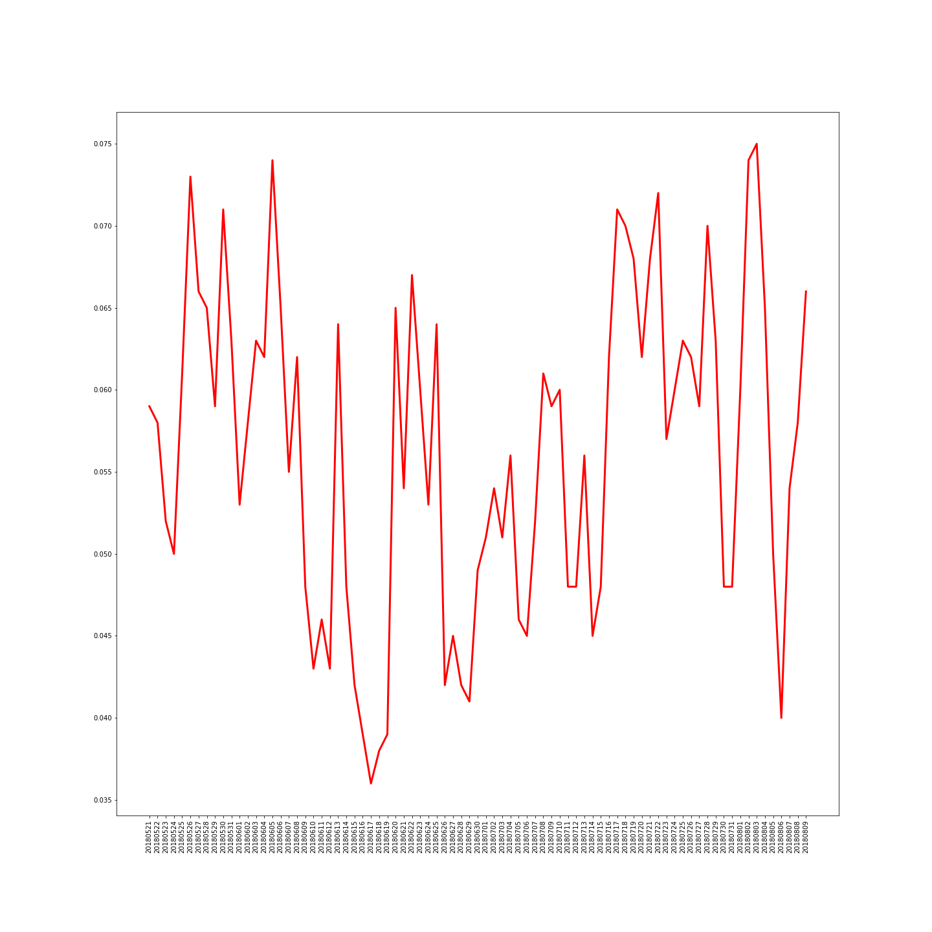
Study Period
0.070ppm
18
26
30
5
17
19
22
28
2
3
May
June
July
August
Summer 2018
Notes:
The study period shown is May through August of 2018. This encompasses the ten dates on which the levels of ozone detected by ground monitoring stations in Seiling were elevated.
##### CLICK TO ANIMATE #####
These were days when the 8-hr rolling average ozone concentration exceeded the EPA-set limit of 0.07 parts per million. Concentrations above this threshold are considered a public health risk. The graphic in red depicts the spike quantities and is overlayed on top of the study period to help visualize the spike number with respect to the EPA limit.
------------------------------Image Information Below ------------------------------
Clipart provided by PowerPoint

Slide 7
Objectives
Identify potential causes for ozone spikes in Seiling, Oklahoma, in the summer of 2018.
Compare and link in-situ and satellite-based air quality monitoring approaches.
Determine pollutant hotspots across Oklahoma and pinpoint gaps in the state’s ground monitoring network.
Notes:
We had three project objectives that we set out to accomplish.
##### CLICK TO ANIMATE #####
The first objective is to identify potential causes for ozone spikes in Seiling, Oklahoma, in the summer of 2018
##### CLICK TO ANIMATE #####
The second objective is to compare and link in-situ and satellite-based air quality monitoring approaches.
##### CLICK TO ANIMATE #####
The final objective is to determine pollutant hotspots across Oklahoma and pinpoint gaps in the state's ground monitoring network.
------------------------------Image Information Below ------------------------------
Clipart provided by PowerPoint

Slide 8
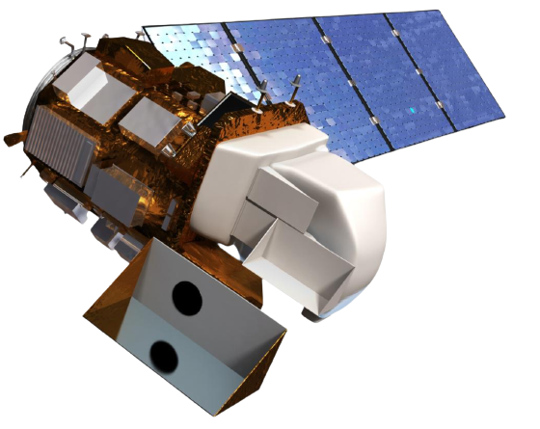
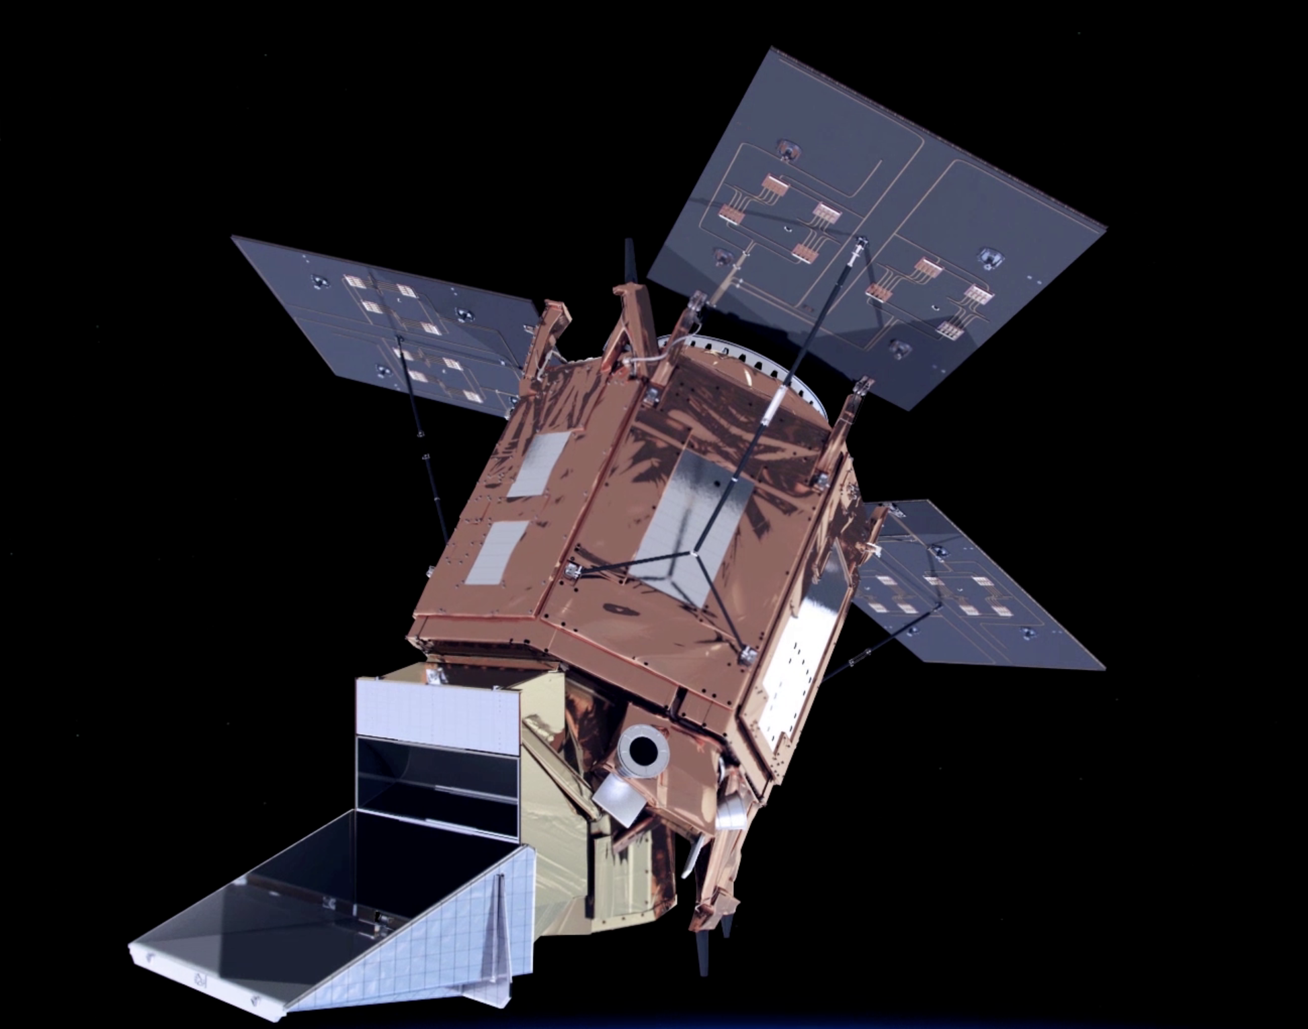
Satellites and Sensors
Terra
MODIS
Landsat 8
OLI
Sentinel-5P
TROPOMI
Aqua
MODIS
Image Credits: NASA (background), NASA (Terra, Aqua) USGS (Landsat 8),, ESA (Sentinel-5P)
Notes:
To investigate these ground ozone spikes, we used Earth observation data from three satellites. Pollutant data for ozone, nitrogen dioxide, carbon monoxide, formaldehyde and methane was derived from the Tropospheric Ozone Monitoring Instrument or TROPOMI on board the Sentinel-5P satellite. Aerosol optical depth and the burn product were derived from the Moderate Resolution Imaging Spectroradiometer or MODIS on board the Terra and Aqua satellites. Finally, the Operational Land Imager (OLI) on board Landsat 8 provided data to produce the normalizes difference vegetation index or NDVI.
------------------------------Image Information Below ------------------------------
Image Credit: NASA
Image Source: https://images.nasa.gov/details-iss042e013697
Terra and Aqua satellite images:
Image Credit: NASA
Image Source: DEVELOPedia
Landsat 8 satellite image:
Image credit: USGS, NASA/Goddard Space Flight Center Conceptual Image Lab
Image Source: https://www.usgs.gov/media/images/landsat-8
Sentinel-5P satellite image:
Image Credit: ESA
Image Source: https://www.esa.int/ESA_Multimedia/Videos/2017/07/Sentinel-5P

Slide 9
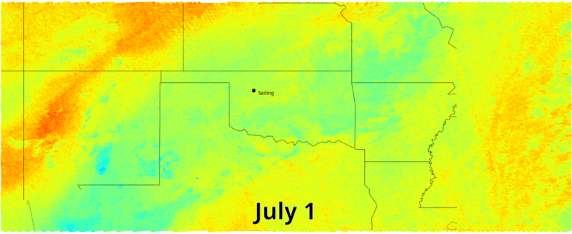
Methodology
Visualize Earth Observation Data
Data
Steps
Clip EO data to study area
Exclude missing values
Generate both static images and animations
TROPOMI
CO, HCHO, NO_{X,} O₃
MODIS
AOD, Burn product
Landsat 8 OLI
NDVI
Notes:
We visualized these 4 TROPOMI products as well as MODIS AOD and Landsat NDVI, using the same methodology:
Files were downloaded from NASA earth data portal or Google Earth Engine
For a given day, missing values were filtered out of each swath
Swaths were then clipped to match the study area, and plotted next to each other on a base map
Color bars are centered on the global mean of pollutant concentrations across all pixels for every day in the study period
Still images were generated for each day, and then still images were animated in ascending time order
Shown is an example of these visualizations. On top is an image of total column ozone on July 1, 2018. Below that is an animation of ozone across all days in July, 2018.
These visualizations allowed us to qualitatively asses the paths of pollutants leading up to ozone spike days. These contributed to objectives 1 and 3, as they illuminated possible sources of ozone and its precursors and gave a glimpse of what pollutant emissions were like between the spatial gaps in the Oklahoma air monitoring network.
------------------------------Image Information Below ------------------------------
Clipart provided by PowerPoint

Slide 10
Methodology
Track Ozone Spike Sources
Simulation Input
Meteorological data
Particle number and size
Starting point (place, time)
Back-trajectory length
Simulation Output
Hybrid Single-Particle Lagrangian Integrated Trajectory (HYSPLIT) Model
Notes:
We used the Hybrid Single-Particle Lagrangian Integrated Trajectory – or HYSPLIT – Model to generate back-trajectories of the ozone particles on spike days. HYSPLIT uses Lagrangian equations of motion paired with archived meteorological data to simulate where a particle on a given day and place traveled from. The model takes in a starting point, a starting date, and the back-trajectory length – how many days back we want the simulation to go. We ran HYSPLIT for five of the ten spike days identified by the DEQ.
For each spike we
Input meteorological data (GDAS 0.5 degree 3Hourly data) for the spike date and 4 days prior
Choose Seiling as the starting point, and chose 100m as the target height. 1000m was the top of the model.
Choose -96 hours for the trajectory length
Produced a back trajectory output
These simulations were key to determining possible sources and causes of the ozone spikes, thus fulfilling objective 1.
------------------------------Image Information Below ------------------------------
Clipart provided by PowerPoint

Slide 11
Methodology
Modeling Ground Ozone
Explanatory Variables
Response Variable
In-situ ozone
measurements in:
Human activities
oil/gas activity, power plants
Model 1: Study Area
Burned area
wildfires, agricultural fires
Model Results
Landcover, NDVI
Pollutants
NO₂, AOD (PM2.5 proxy), CO, CH₄
Model 2: Seiling
Meteorological data
humidity, wind speed, temperature, air pressure
Notes:
Finally, we developed models using earth observations and other factors to predict ground ozone concentrations for the entire study area, and for Seiling in particular.
We had two goals in generating and analyzing these models.
To understand what factors contributed the most ground level ozone concentrations
To create a foundation for future efforts to potentially build tools or perform more detailed analysis. This might help identify days in which there is likely to be high ozone, and justify the necessary response.
To build these models, we
Collected our variables
Set up the models for Seiling and the study area
Interpreted and drew conclusions from our work
We used both statistical and machine learning models.
W utilized open and accessible earth observation and land use data that based on literature review had been identified to be predictive of ground level ozone. Our explanatory variables included
Proximity to human activity like power plants, petroleum refineries, and natural gas plants.
Proximity to burned areas, indicative of recent wildfires and agricultural fires
Landcover, quantified using NDVI
Pollutants: NO2, AOD (a proxy for PM2.5), CO, and CH4
Meteorological factors: humidity, wind speed, temperature, pressure
The value of this data is the replicability of this study as it uses no proprietary data, the foundational chemistry and research behind the variables chosen and then ability to use information about a certain location to determine the predicted levels of ozone.
For the response variables, we modeled all of the ground ozone monitors in the study area (Model 1) as well as independently modeling Seiling (Model). We did this to understand the general predictors in and surrounding Oklahoma and to understand if Seiling offered specific differences compared to the general area.
We used both statistical models and machine learning based trees and boosting methods. This enabled us to view the statistical significance of the variables in the statistical models and feature importance in the machine learning models. Additionally we assessed the performance of the models using the mean square error of the predicted values vs. the actual response values for the test set. In this way, we assessed which models were most accurate, and determined which explanatory variables most influenced the response variables.
In this way, we addressed objective 2, linking ground data to earth observations.
------------------------------Image Information Below ------------------------------
Clipart provided by PowerPoint
Basemap Credit: ESRI
Basemap Source: ArcPro version 2.8
Image Credit: Google Earth
Image Source: NASA DEVELOP Team

Slide 12
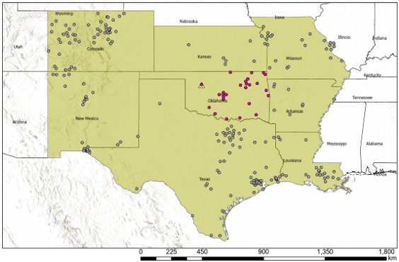
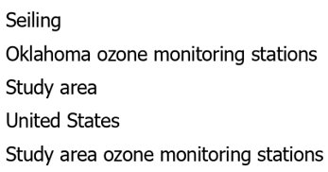
Methodology
Modeling Ground Ozone – Data Preparation
11 km
11 km
AQ monitor
Spatial Reference
Name: GCS WGS 1984
GCS: GCS WGS 1984
Datum: WGS 1984
Map Units: Degree
Notes:
Before generating the models described before, we needed to prepare one main dataset containing our explanatory and response variables.
We used the EPA AQS ground daily ozone values from May 10th – August 10th 2018
First we selected all the AQS ozone monitors in our study area, as defined previously
Next, we collocated each EO product with the ground monitors on each day in our study time frame.
Spatially join the average EO pollutant concentration across pixels whose centers fall within an 11km x 11km (0.1deg x 0.1 deg) box around the sensor
Due to the lower resolution (0.25 deg) of weather data from GLDAS, avg weather variables were selected using the same process, but using 22km x 22km box.
------------------------------Image Information Below ------------------------------
Clipart provided by PowerPoint
Map created by DEVELOP team
Basemap credit: ESRI
Basemap source: ArcPro version 2.8

Slide 13
Results: Spike Day Investigations
18
26
30
5
17
19
22
28
2
3
May
June
July
August
Run HYSPLIT for target spike day
Visualize O₃, NO₂, HCHO, and CO along back trajectory
Compare
Notes:
We selected a subset of 5 spike days for our investigation that occurred in the summer of 2018. For each date we ran the HYSPLIT back-trajectory model. We then visualized the EO pollutant data for each date and the 5 days preceding, and we visually compared our results.

Slide 14
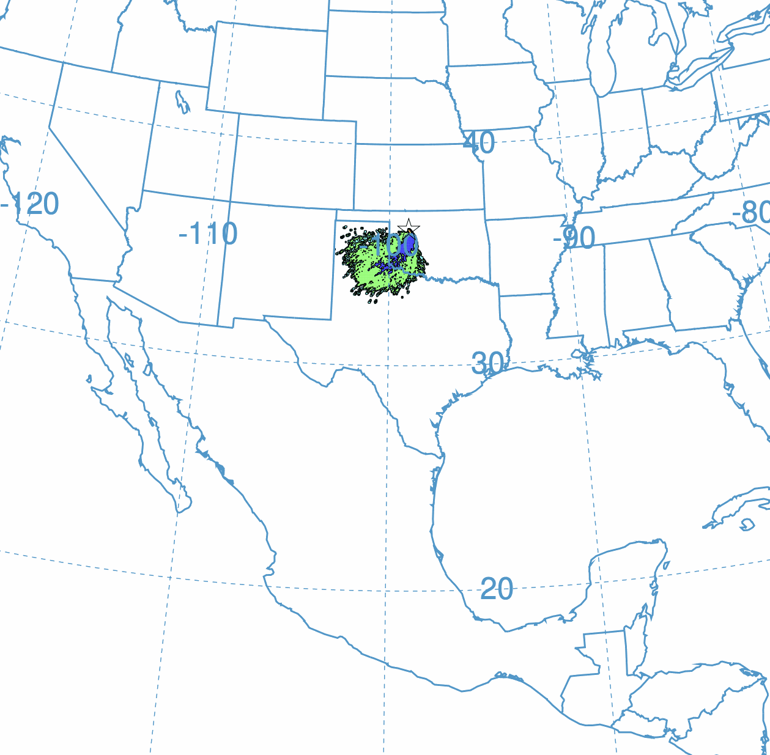
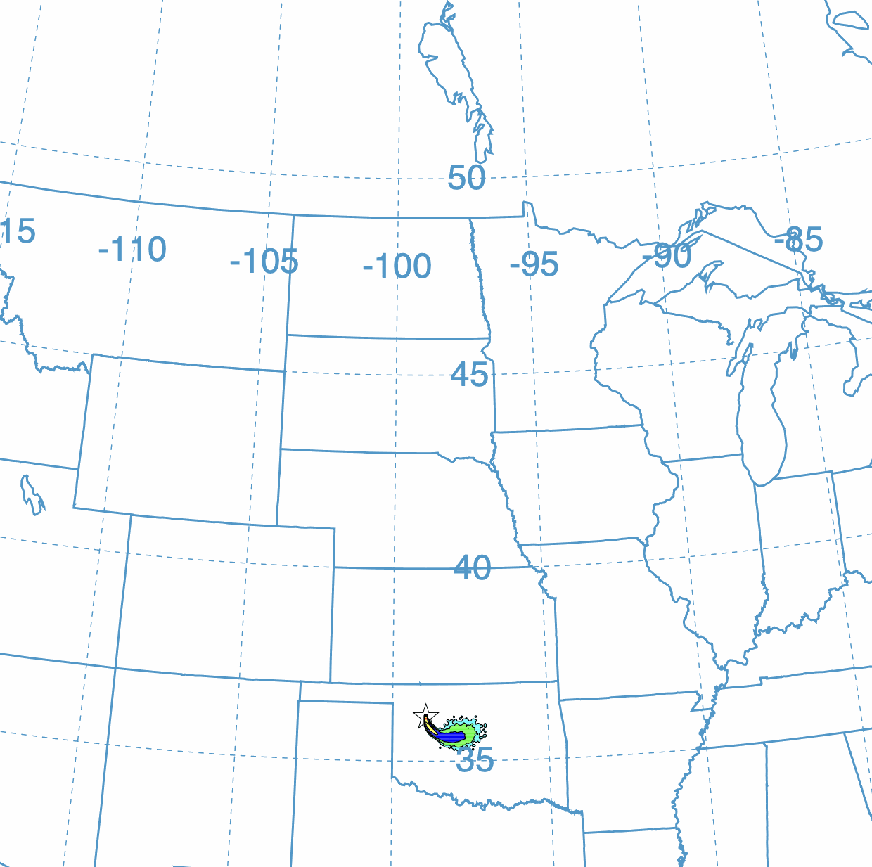
Results – HYSPLIT Spike days
1000 Particle Backward Trajectory Simulation
May 26th – May 22nd
Jul 19th – July 15th
Aug 3rd – Jul 30th
Jun 5th – Jun 1st
Jul 28th – Jul 24th
Particle Concentration
>1.0E-14 /m³
>1.0E-16 /m³
>1.0E-18 /m³
>1.0E-20 /m³
Notes:
To investigate the spike days which were identified by the DEQ and shown in the previous slide, we used the HYSPLIT software to model the back-trajectory of particles based on meteorological data inputs.
##### CLICK TO ANIMATE #####
Here are the results for each spike day beginning with May 26th.
##### CLICK TO ANIMATE #####
The animation shows particles moving backward toward their theoretical origin for four days.
##### CLICK TO ANIMATE #####
Here is the still image from the previous 12 hours before the particles passed through Seiling. We can compare it to the particle trajectories from other spike days.
##### CLICK TO ANIMATE #####
Here we have the June 5th spike day.
##### CLICK TO ANIMATE #####
We can see the particle back-trajectory.
##### CLICK TO ANIMATE #####
Now we can have a look at July 19th
##### CLICK TO ANIMATE #####
and the back trajectory
##### CLICK TO ANIMATE #####
(pause for animation and describe)
##### CLICK TO ANIMATE #####
Moving on to July 28th
##### CLICK TO ANIMATE #####
The results of the back-trajectory model
##### CLICK TO ANIMATE #####
(pause for animation and describe)
##### CLICK TO ANIMATE #####
And finally we come to the August 3rd spike
##### CLICK TO ANIMATE #####
(pause for animation and describe).
##### CLICK TO ANIMATE #####
Now taking a look at all of the results together. The back-trajectories were varied for each spike day, however in the final 12 to 24 hours of particle movement we see a similar trajectory which is seen here. Most of the particles pass through a region of Oklahoma and Texas, roughly between Oklahoma City, Dallas, and Amarillo, which is known for oil and gas activity. This result aligns with our understanding of ozone precursors being generated by anthropogenic sources, particularly nitrogen dioxide. To understand this result we further investigated the atmospheric EO data corresponding to these geographic areas which I will discuss on the next slide.

Slide 15
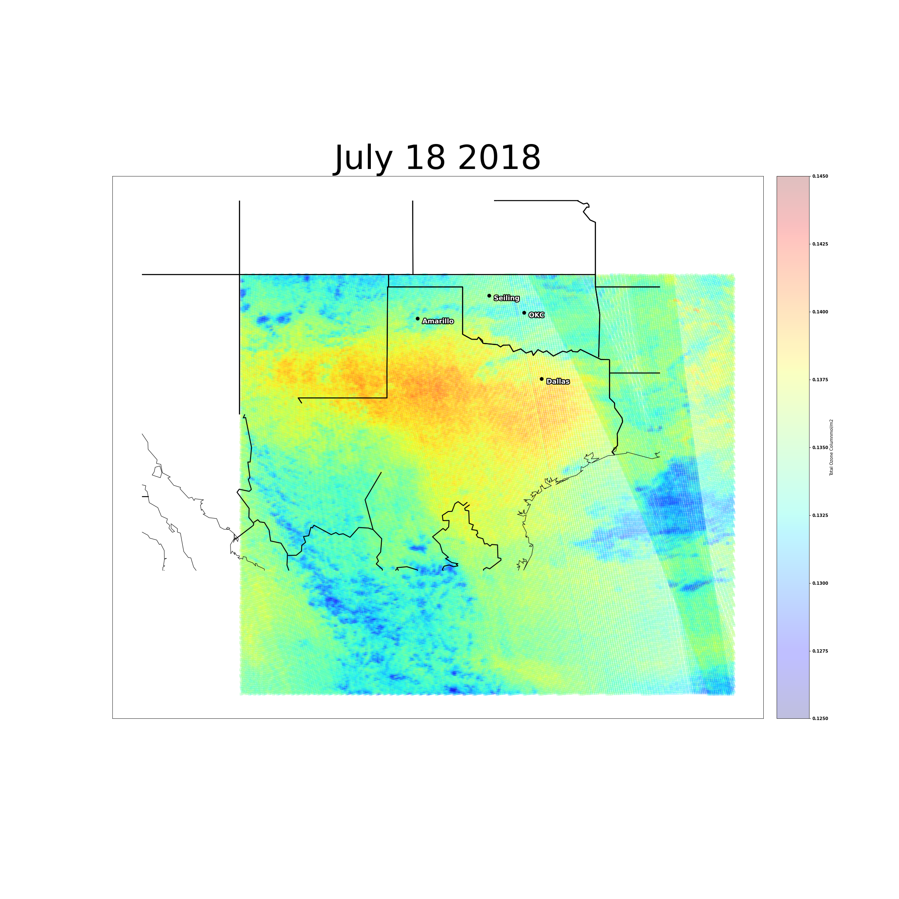
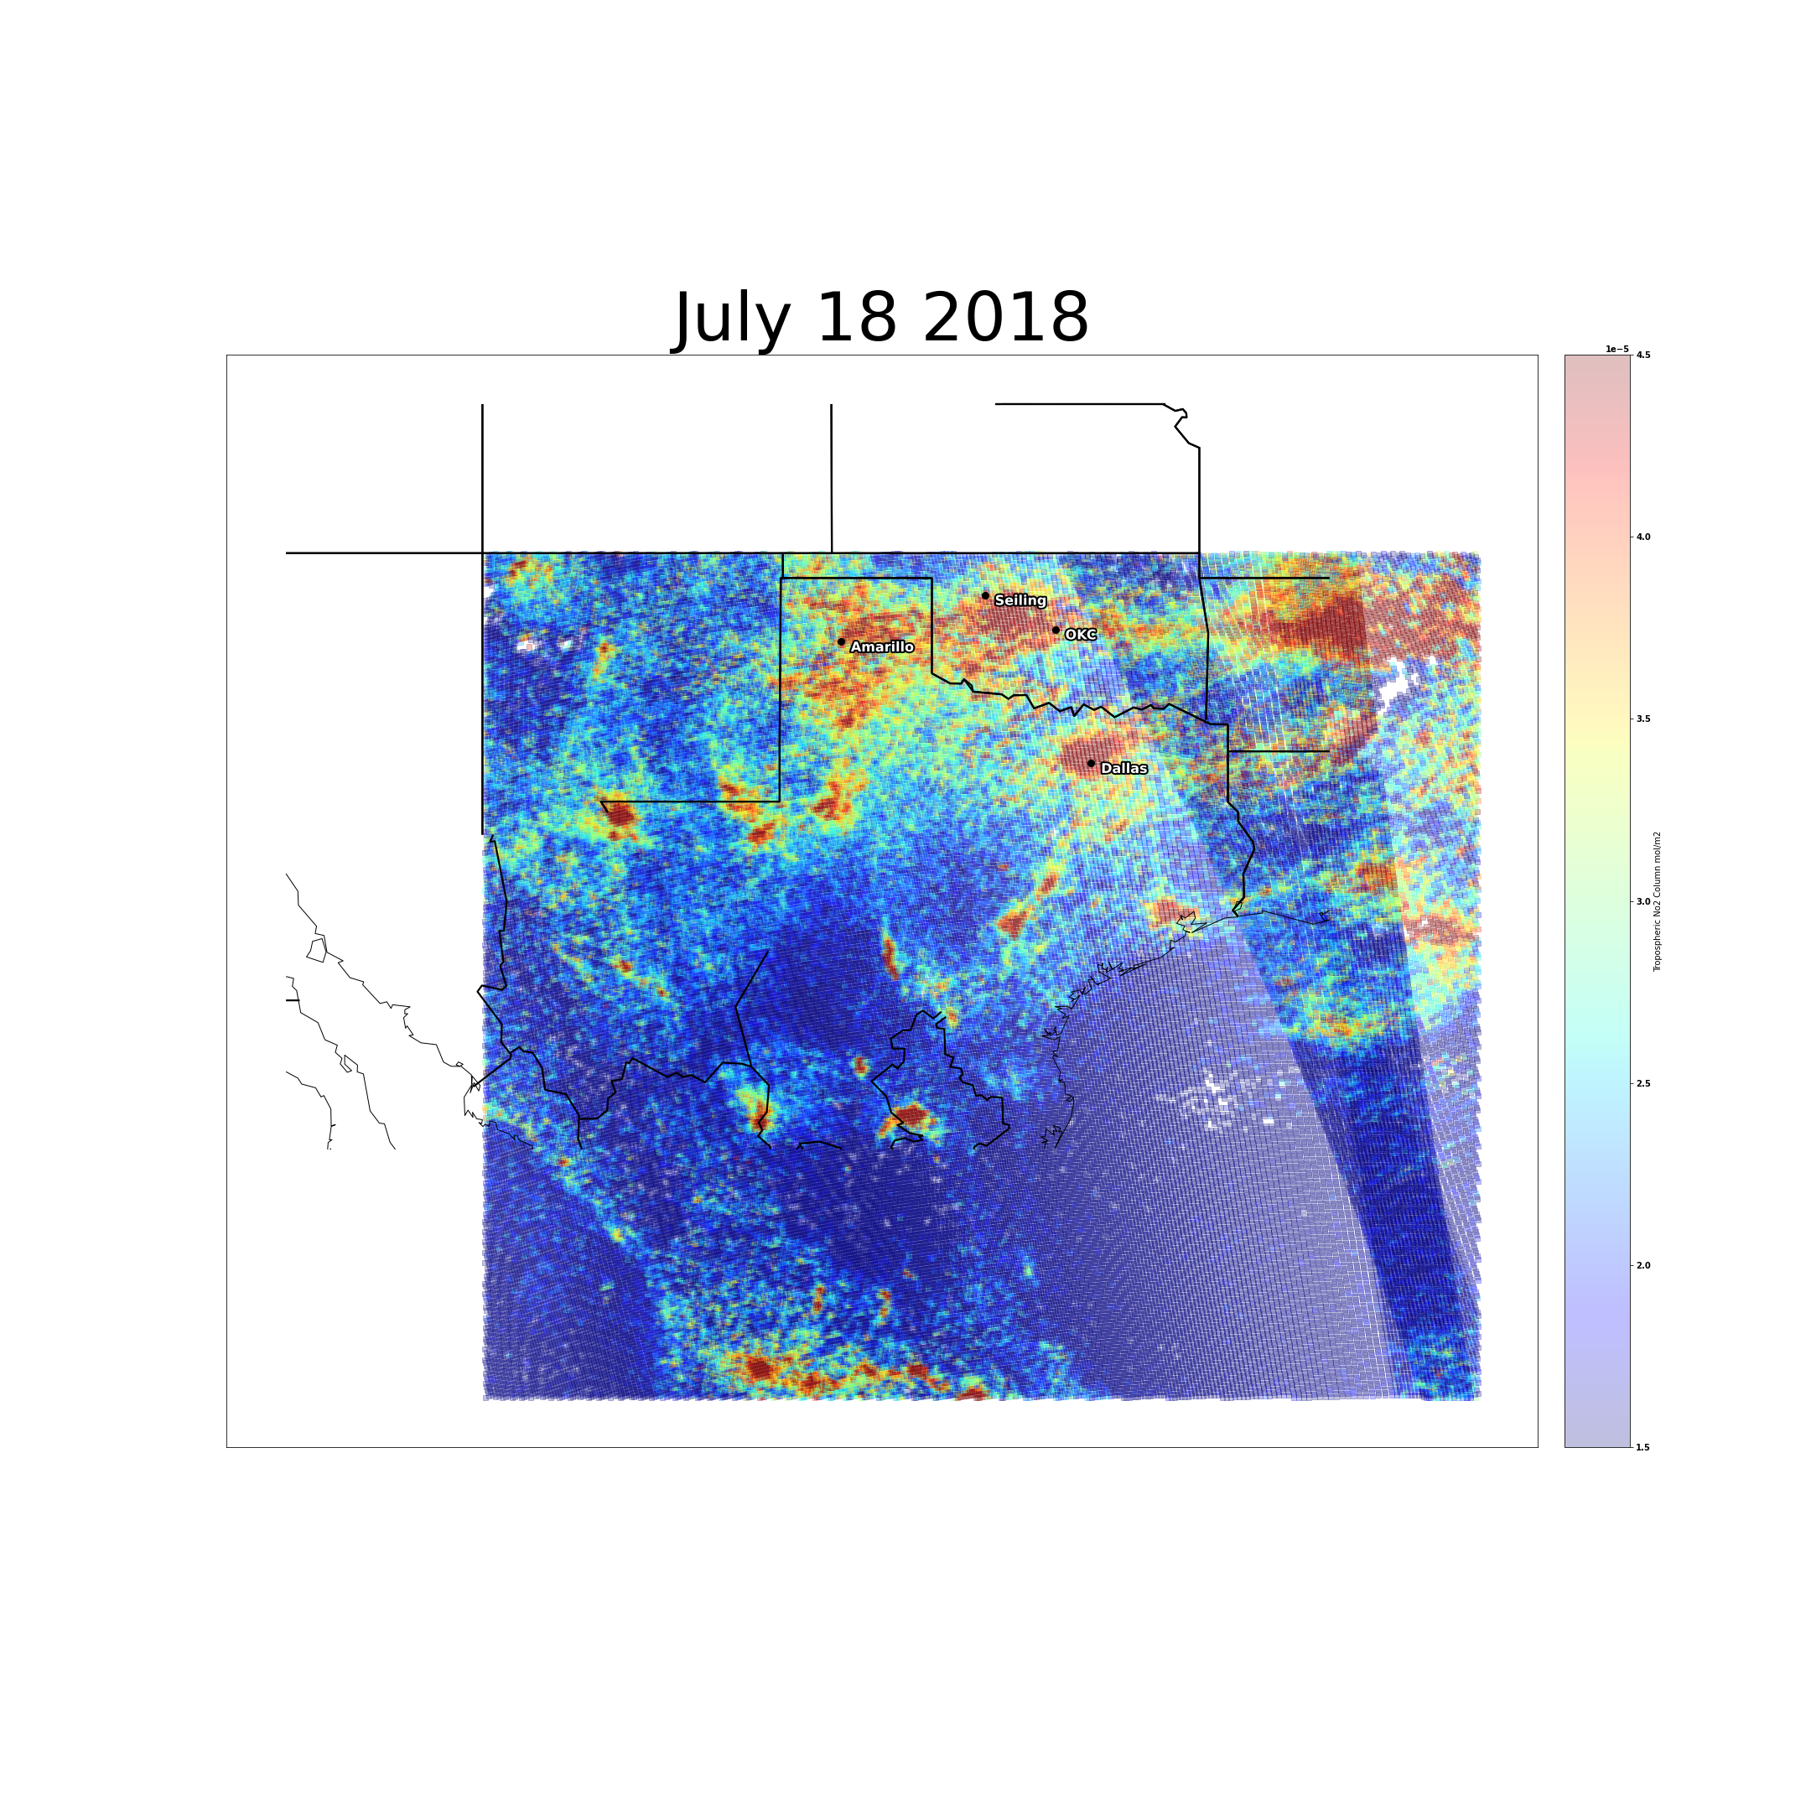
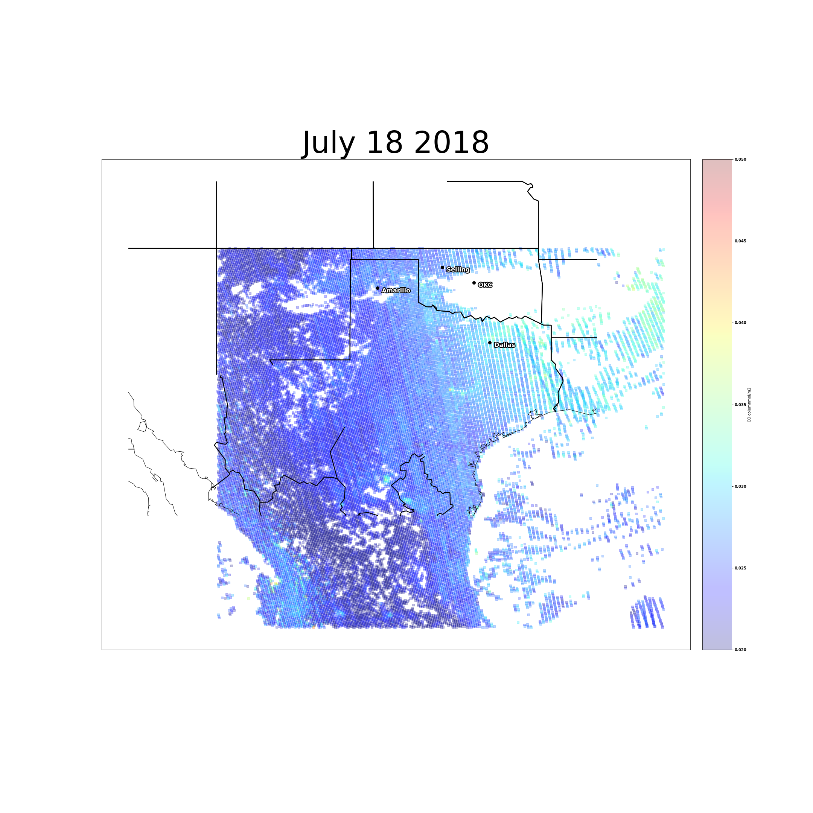
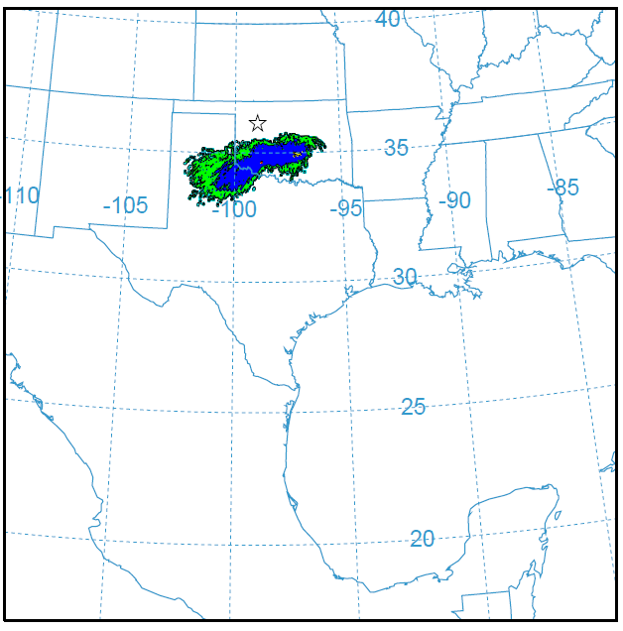
Results: July 18
O₃
NO₂
CO
0.145
0.135
0.125
4.5e-5
3.0e-5
1.5e-5
0.050
0.035
0.020
Pollutant Concentration [mol/m2 ]
Ozone hotspot in Northern Texas, and persistent NO₂ hotspots in cities like Dallas and Oklahoma City
Notes:
We will now take a closer look at July 18 and 19. On the bottom left is the concentration plot of particles and to the right are the EO visualizations of ozone, nitrogen dioxide, and carbon monoxide.
##### CLICK TO ANIMATE #####
Notice the ozone hot spot in northern Texas in the top left earth observation visualization. This aligns quite well with the HYSPLIT visualization in the bottom left corner, where we see high particle concentration in northern Texas on July 18.
##### CLICK TO ANIMATE #####
There are also persistent nitrogen dioxide spikes around large cities like Dallas and Oklahoma city. The carbon monoxide visualizations, though, is less conclusive on this date. However, on other spike dates, there were more interesting results.

Slide 16
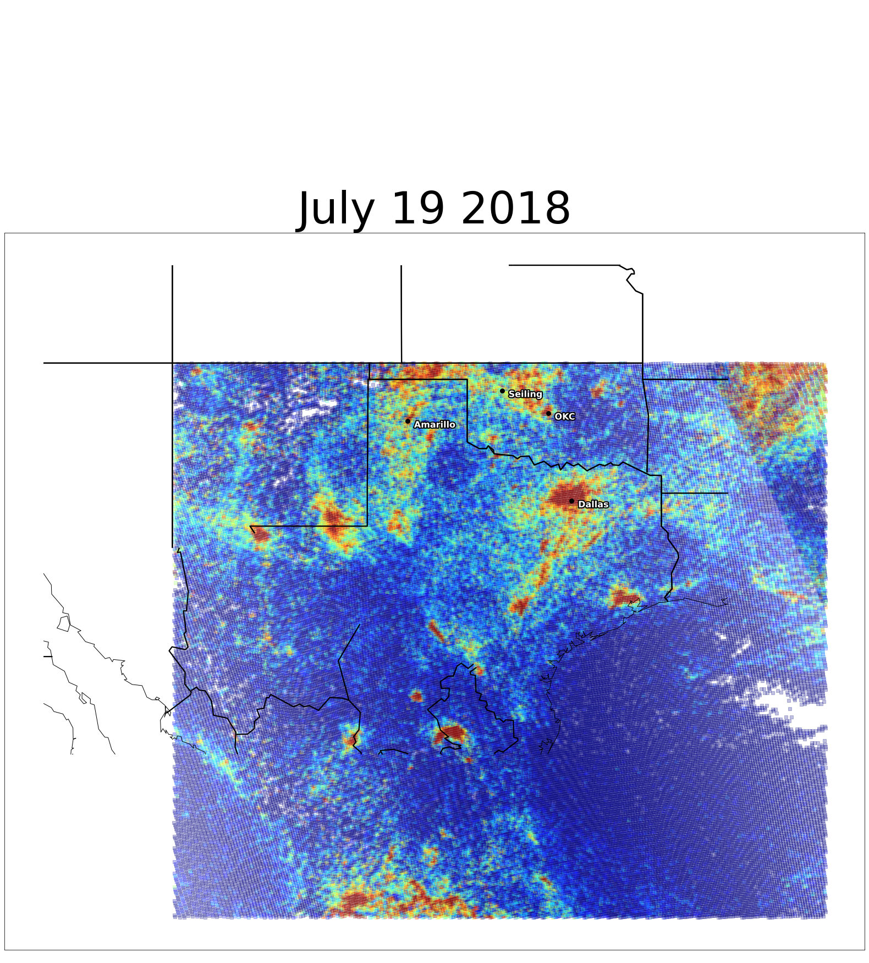
Results: July 19
O₃
NO₂
CO
0.145
0.135
0.125
4.5e-5
3.0e-5
1.5e-5
0.050
0.035
0.020
Pollutant Concentration mol/m²
Ozone decrease in Texas, persistent NO₂ hotspots in Dallas and Oklahoma City, constant CO levels in study area
Notes:
Here we take a look at the results from another spike day, July 19th. On the bottom left is the concentration plot of particles and to the right are the EO visualizations of ozone, nitrogen dioxide, and carbon monoxide. Here the ozone concentration has significantly decreased from the study area (is a lighter orange) while the NO2 visual still shows a concentration of the precursor in the metropolitan areas of Dallas and Oklahoma City, although lower than the previous date. The carbon dioxide visualization is also more conclusive on this date, depicting constant levels of the gas in Oklahoma and surrounding states.

Slide 17
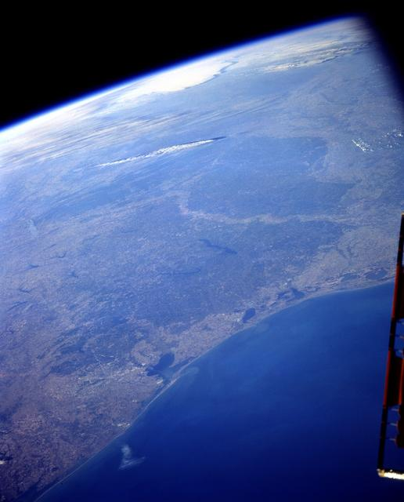
Results: Ground Ozone Model
The Random Forest model was the most accurate
MSE of .38 (83% lower than worst model)
The most statistically significant terms from the models were latitude, temperature, humidity, and ozone x humidity
EO data were significant predictors in the majority of models
Fire predictors, windspeed, and dominant land cover type to not contribute to variance significantly
Image Credit: NASA
Notes:
Overall the machine learning models were more accurate than the statistical models due to their ability to infer complex interactions and non-linear relationships between the variables.
The Random Forest Model in particular was most accurate, with an MSE of 0.38 (83% lower than the worst model).
The second best model was the XG boost with an MSE of 0.53.
Within the statistical models, robust linear regression had the lowest MSE due to its reduction of outlier influence.
In the forest model and XG boost models
Humidity was the most important feature
Longitude, date, and earth observations (other pollutant concentrations) were the next most predictive
Across all models
The most statistically significant terms were temperature, humidity, and the interaction between ozone and humidity (ozone x humidity)
Earth observations (other pollutant concentrations) were also significant predictors ozone, which makes sense given how ozone is formed
Fire predictors, windspeed, and land did not contribute to variance significantly, which would be due to lack of fire predictors and data.
------------------------------Image Information Below ------------------------------
Image Credit: NASA
Image Source: https://images.nasa.gov/details-STS103-501-104

Slide 18
Conclusions
Possible spike causes and sources identified
Sources outside of OK boundaries
Satellite and ground data linked
Atmospheric pollutants and low humidity most contribute to ozone levels in Oklahoma
Potential new monitor locations determined
NO₂ O3, and CO monitors to the Southeast of Seiling
The value of a geostationary satellite for monitoring air quality
Image Credit: Google Earth
Notes:
In conclusion, we were able to identify possible causes and sources of the ozone spike seen in Seiling during the summer of 2018. These included:
NO2 generated in Oklahoma City
Particles transported from Texas oil and gas activity by wind
Nearby wild fires
Certain days exhibit an unfortunate combination of transported particles and environmental conditions ideal for ozone formation
We linked satellite and ground data by created models to predict ground ozone using earth observations and other datasets. These models yielded some informative results:
Be warry of days with low humidity
Higher latitude = higher ozone
EO products that show higher levels indicate there will also be higher levels of ozone
Often due to precursors
Based on our findings, we have some recommendations for new air quality monitor locations
NO2, O3, and CO monitors to the Southeast of Seiling
An emphasis on NO2, since it has a long a lifespan (whereas CO dissipates within hours)
We also have some big picture takeaways on earth observations in general.
Establishing more geostationary satellites to monitor air quality would be quite useful for capturing a more detailed pictures of pollutant movement, particularly given how quickly conditions can change. This is especially true for pollutants that dissipate within hours, like CO.
EO values , specifically NO2, show high levels qualitatively with ozone on ground – these two species are, as we already know, highly linked.
------------------------------Image Information Below ------------------------------
Google Earth

Slide 19
Uncertainties and Limitations
Low temporal resolution of earth observation and ground data
Translation between total column ozone and surface ozone
Uncertainty in time lag between EO and ground data
Notes:
We encountered three main limitations and uncertainties in our work.
The earth observation and ground data all were of low temporal resolution, making more detailed analysis challenging. This is particularly notable in air quality work where we are dealing with rapidly changing conditions in a fluid medium.
The earth observation data captures ozone concentration across all levels of the atmosphere – termed total column ozone. That data is then processed using atmospheric models to infer tropospheric ozone. As we discussed in the background slide, it is tropospheric ozone that we are most concerned with – in particular, surface ozone. The ground monitors are measuring surface ozone. Translating total column ozone to tropospheric and, further, to surface ozone is a challenge in air quality work.
Early on in the project, we compared time series graphs of ground ozone measurement to those to earth observations and found a time lag between the two. We ran analyses to quantify that time lag. There was great uncertainty in the exact value of that time lag. In the interest of time, we did not investigate this further.
------------------------------Image Information Below ------------------------------
Clipart provided by PowerPoint

Slide 20
Future Work
Spatiotemporal model to predict spikes
Correlations
Determine optimal lag time
Emissions transport analysis automation
Notes:
There multiple directions that future work could go in.
Correlations with other ground monitors with time delays would enable not only EO data to be predictive but also include other ground level ozone and pollution levels
Determining optimal observation time lag could improve model performance. This could improve alignment with meteorological data, and thus to provide better predictive ability
Emission transport analysis with chemical decomposing would also better represent the true lifetimes and movements of the specific pollutants
Develop a model that can capture spatiotemporal variation. Ex: current model assesses value of weather, EO pollutant concentrations, etc. in predicting ground ozone in the same location. Autoregressive models would help assess the value of prior days concentrations, weather, etc. in predicting ground ozone in the same location. A spatial autoregressive model would allow us to investigate how nearby pollutant concentrations on prior days affect ground ozone in a specific location.
------------------------------Image Information Below ------------------------------
Clipart provided by PowerPoint

Slide 21
Partners
Carrie Schroeder, Emissions Inventory Section Manager
Grant Loney, Emissions Inventory Section, Environmental Programs Specialist
Thomas Richardson, P.E., Rules & Planning Section, Professional Engineer
Cecelia Kleman, Technical Resources & Projects Section, Environmental Programs Specialist
Camas Frey, Enforcement Section Manager
Daniel Ross, Monitoring Section West, Environmental Programs Specialist
Advisors
Dr. Le Kuai, NASA Jet Propulsion Laboratory, California Institute of Technology
Dr. Heidar Thrastarson, NASA Jet Propulsion Laboratory, California Institute of Technology
Ben Holt, NASA Jet Propulsion Laboratory, California Institute of Technology
NASA DEVELOP
Erica Carcelén, NASA DEVELOP Fellow
This material contains modified Copernicus Sentinel data 2018, processed by ESA.

Slide 22
Appendix/ Backup Slides

Slide 23
Results: July 18-19
O₃
NO₂
CO
0.145
0.135
0.125
4.5e-5
3.0e-5
1.5e-5
0.050
0.035
0.020
July 19
Pollutant Concentration mol/m²
0.145
0.135
0.125
4.5e-5
3.0e-5
1.5e-5
0.050
0.035
0.020
July 18
Notes:
Here we take a look at the results from one spike day, July 19th. On the left is the concentration plot of particles and to the right are the EO visualizations of ozone, nitrogen dioxide, and carbon monoxide. We can see a few trends here particularly with the location of ozone on July 18 and the persistence of nitrogen dioxide spikes around large cities like Dallas and Oklahoma city. The carbon monoxide visualizations are less conclusive on the date, however on other spike dates there were more interesting results.

Slide 24
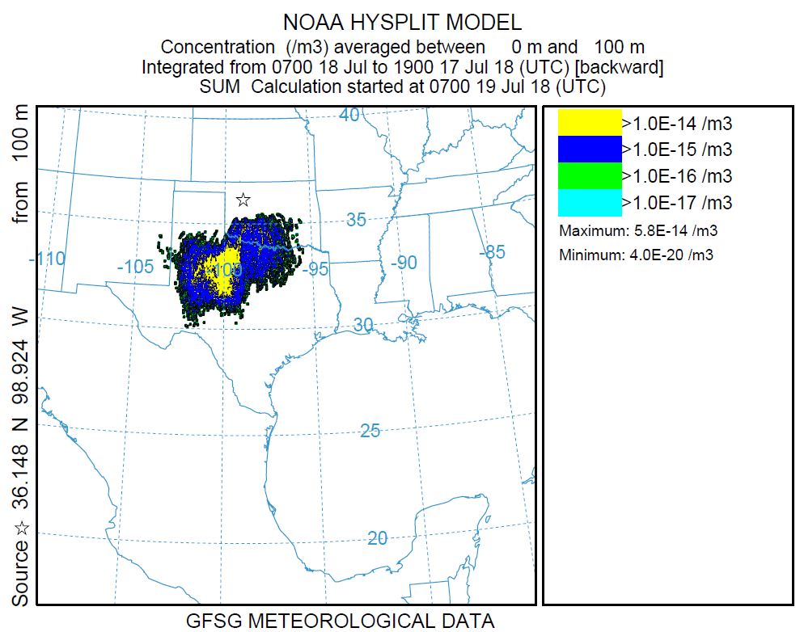
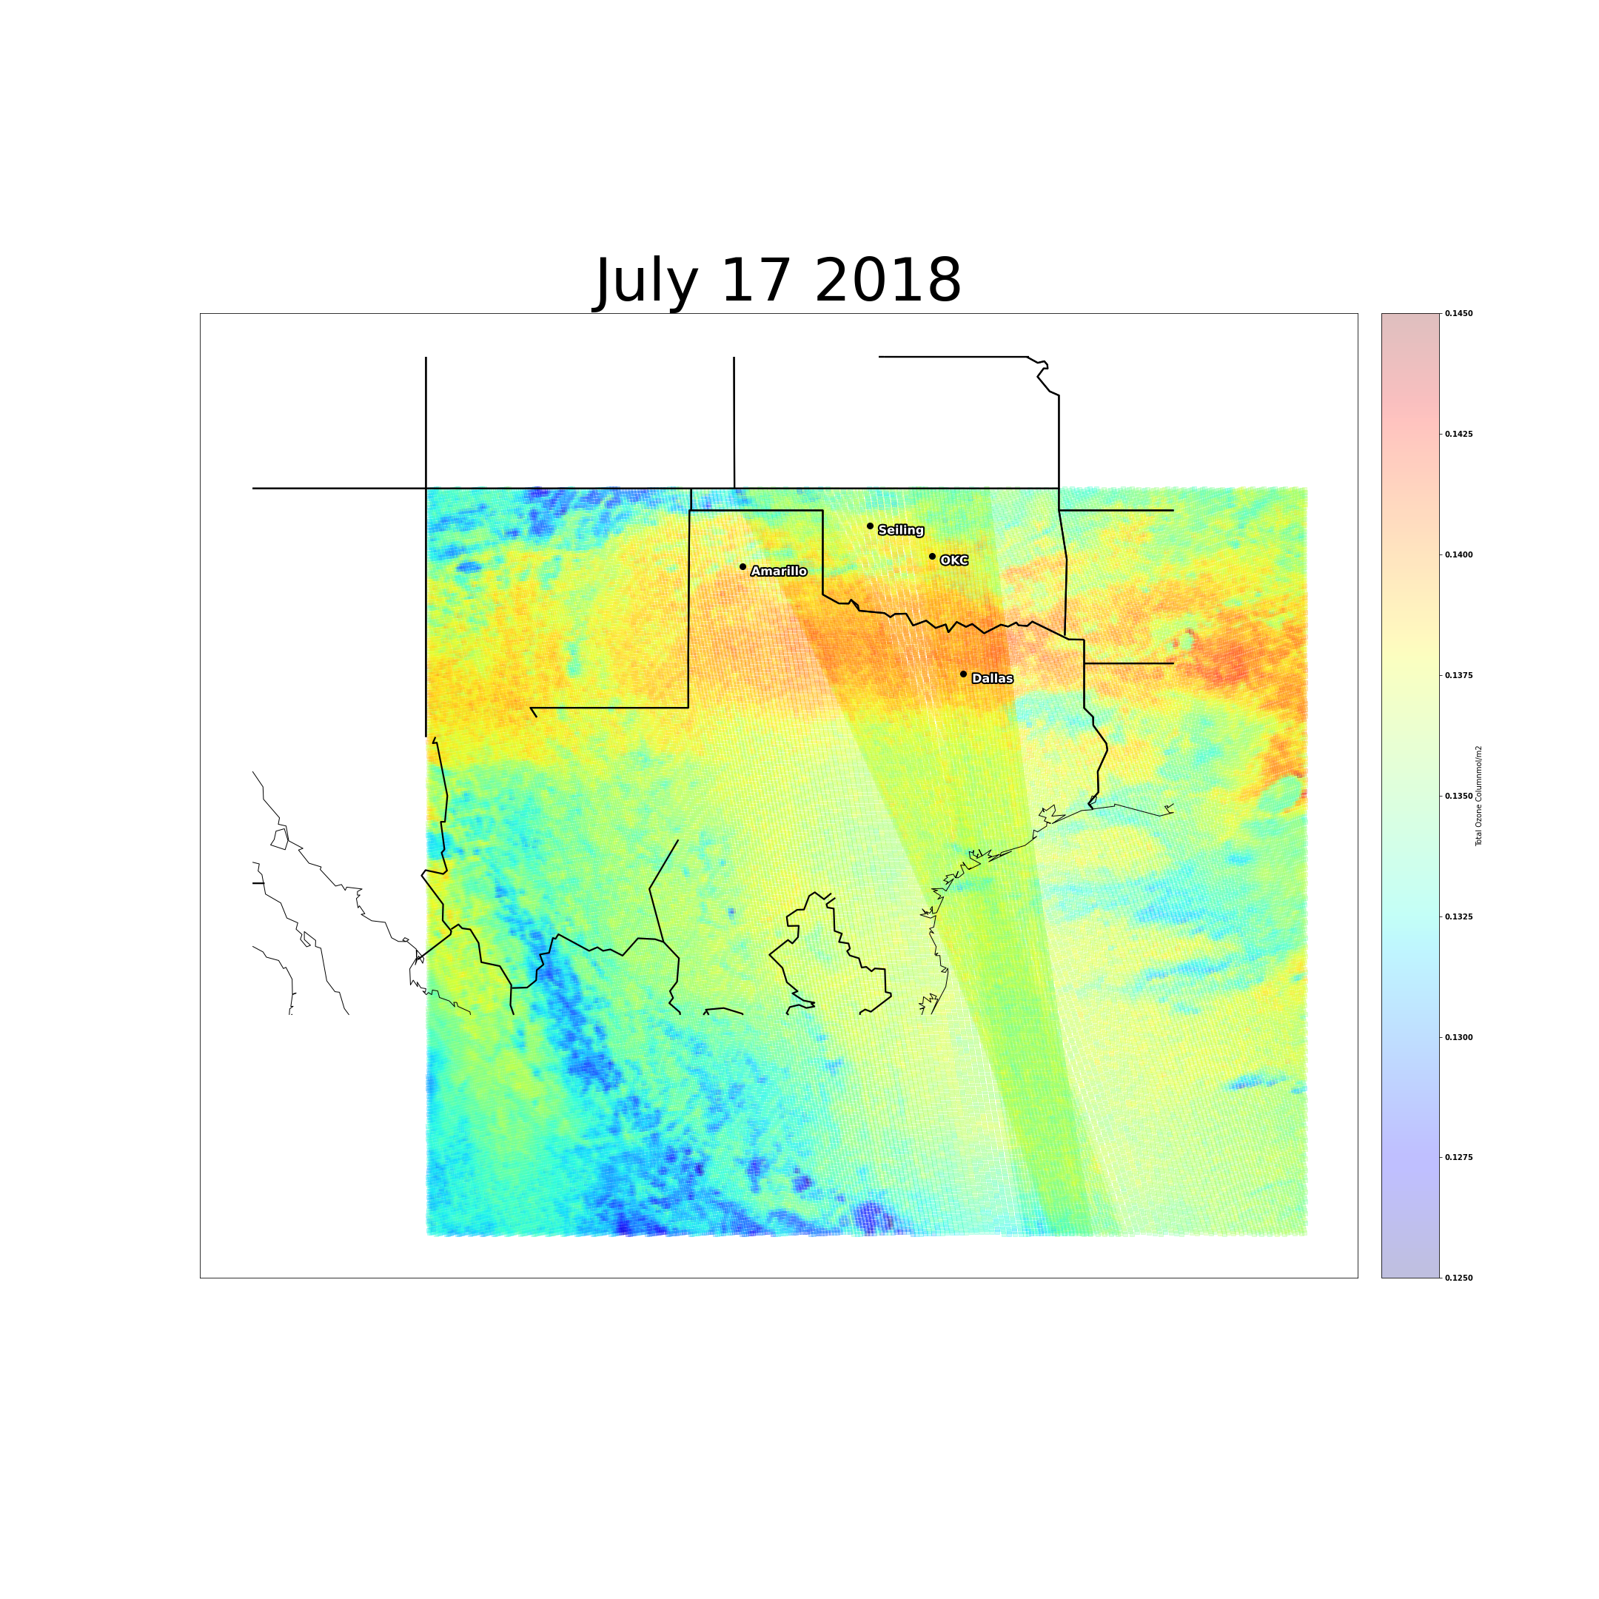
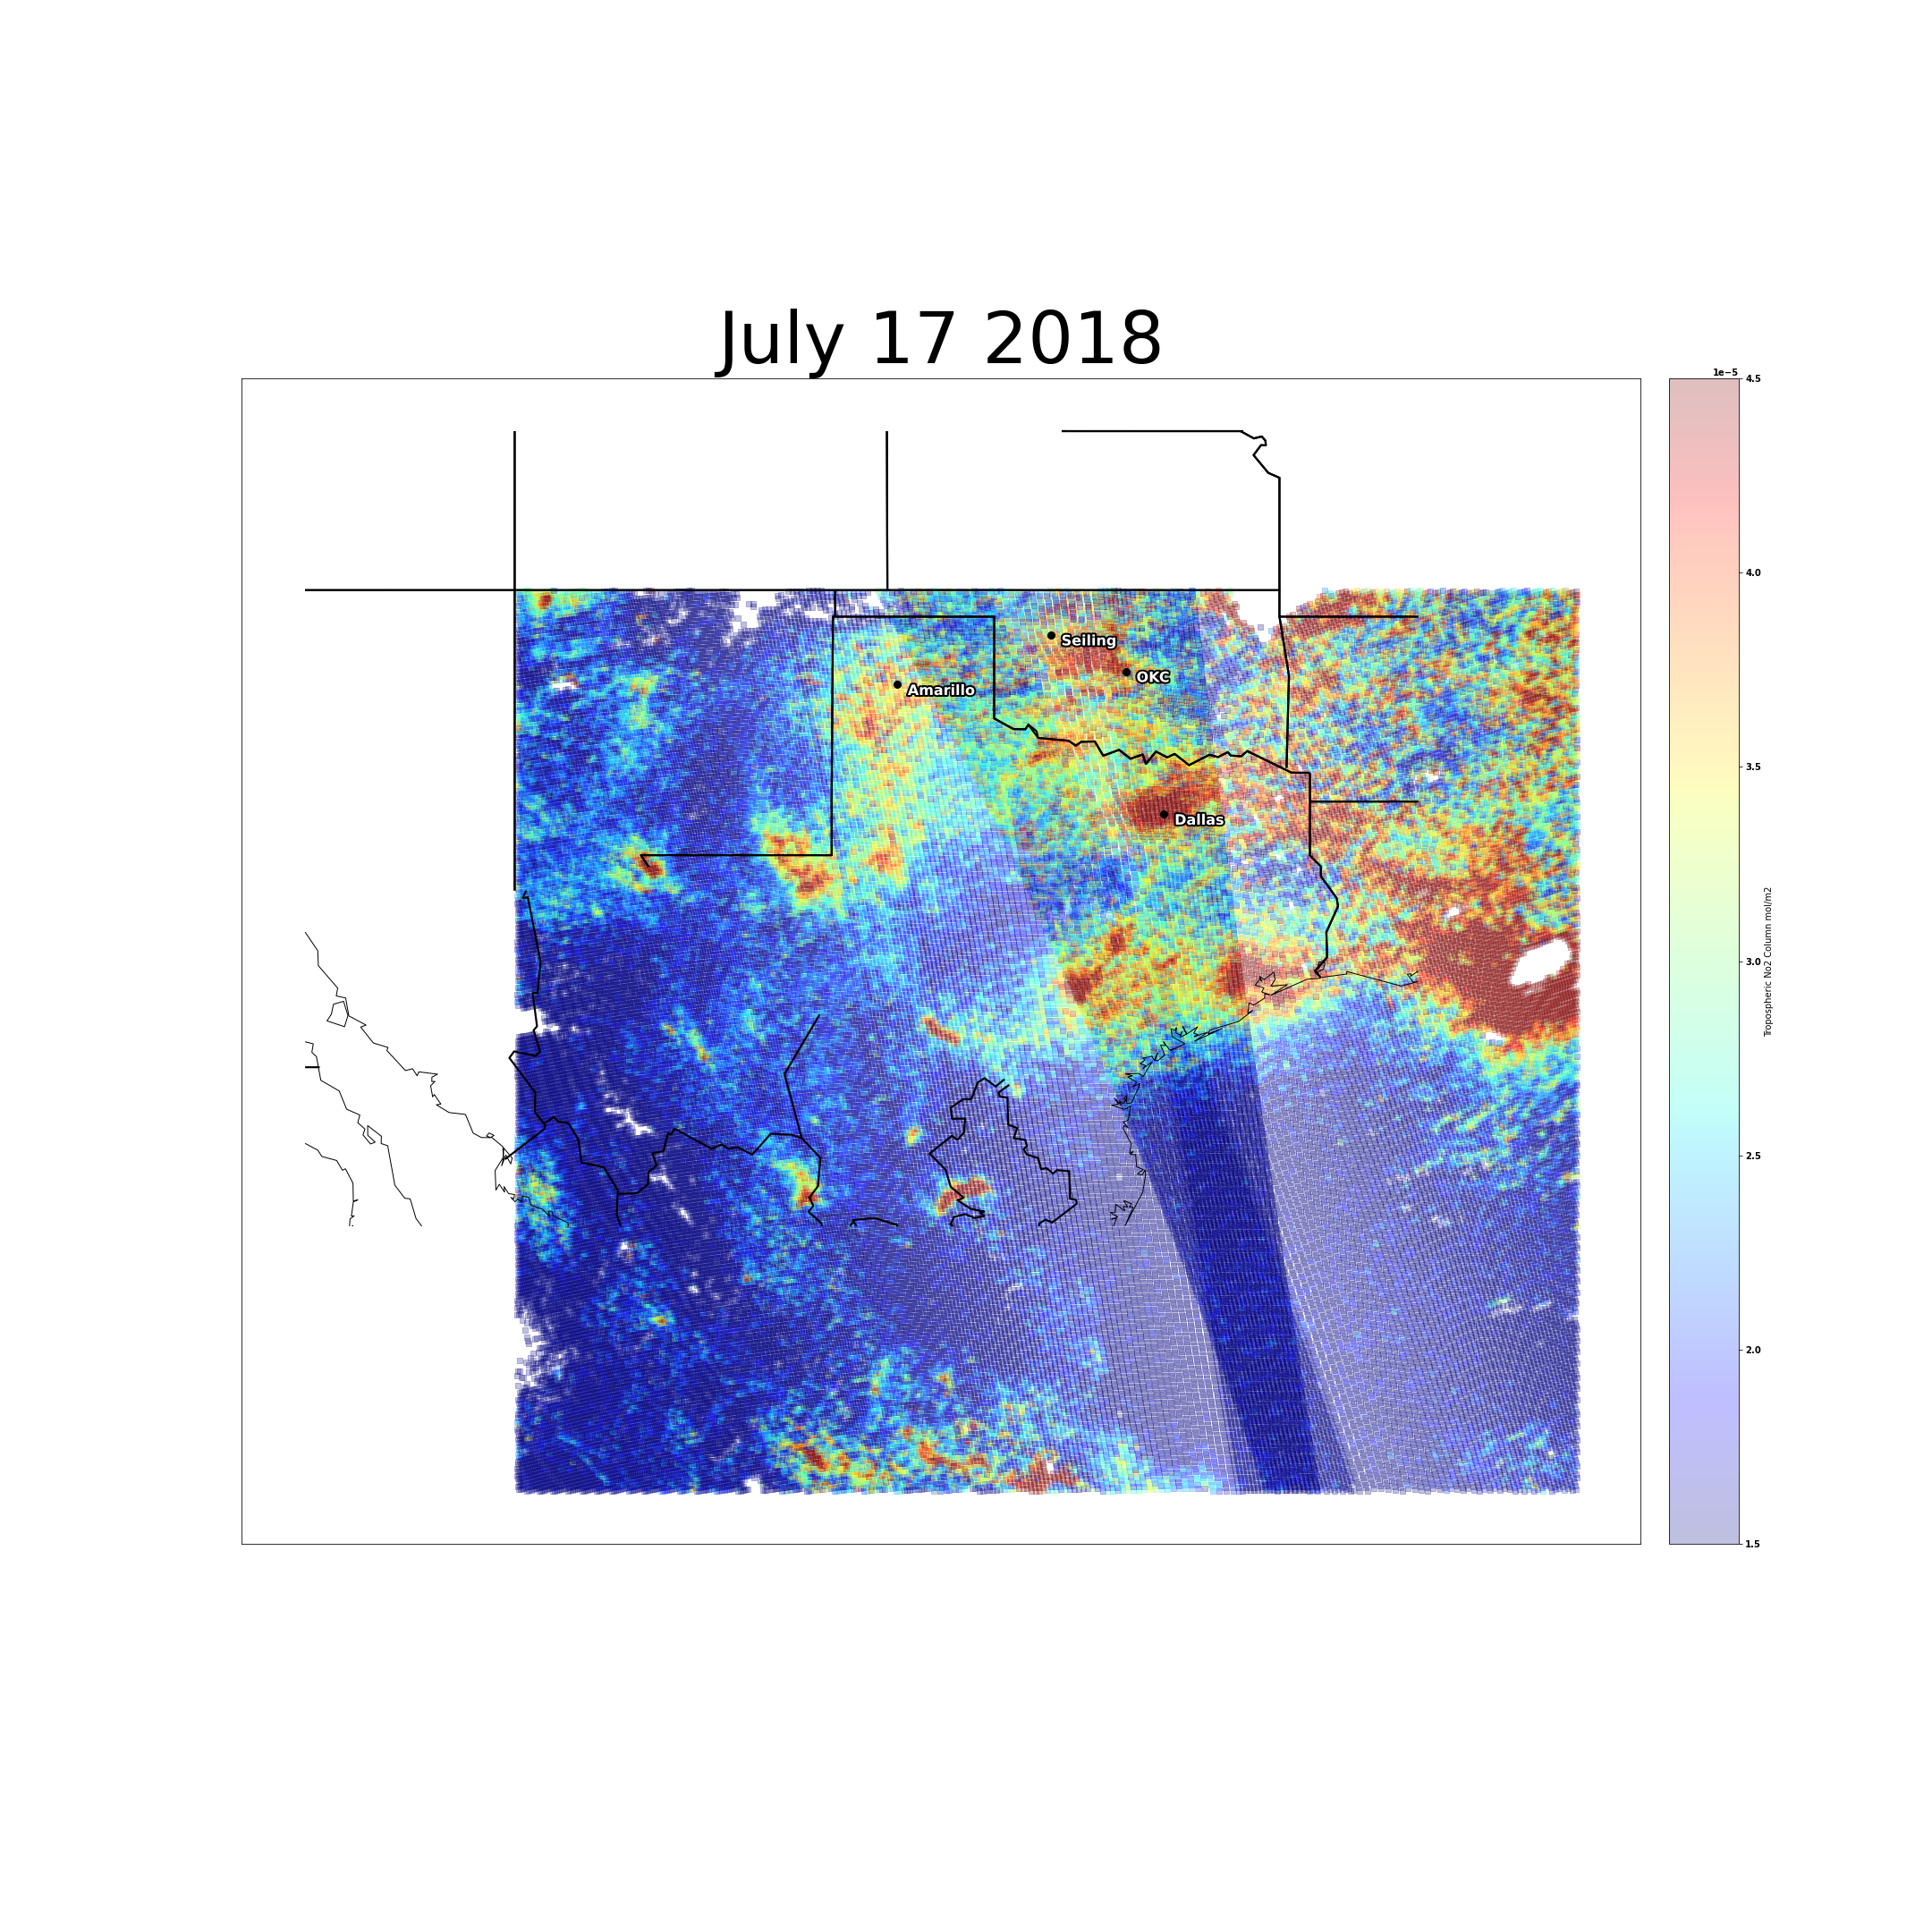
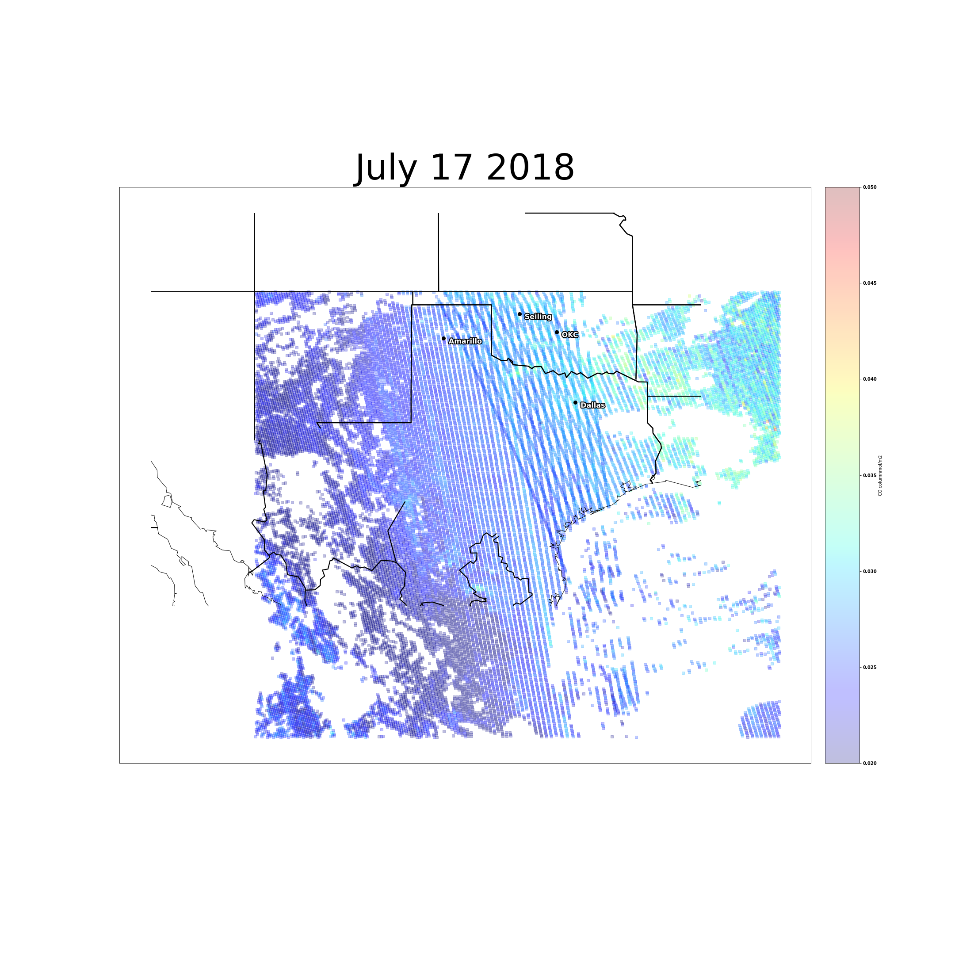
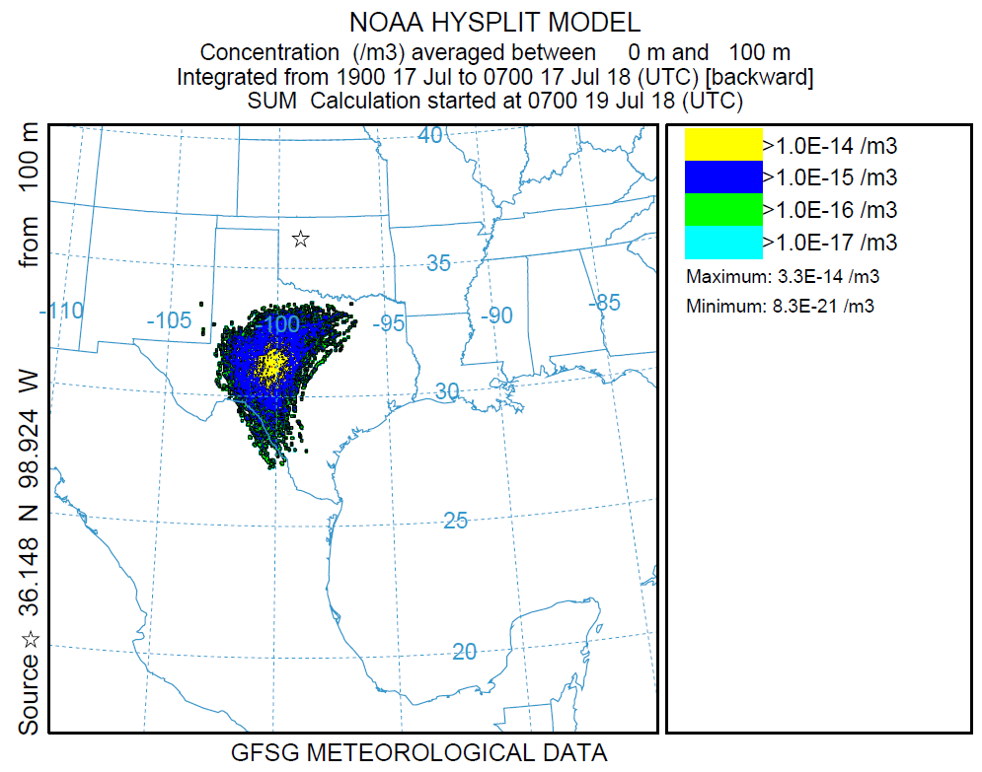
Results: July 18-17
O3
NO2
CO

Slide 25
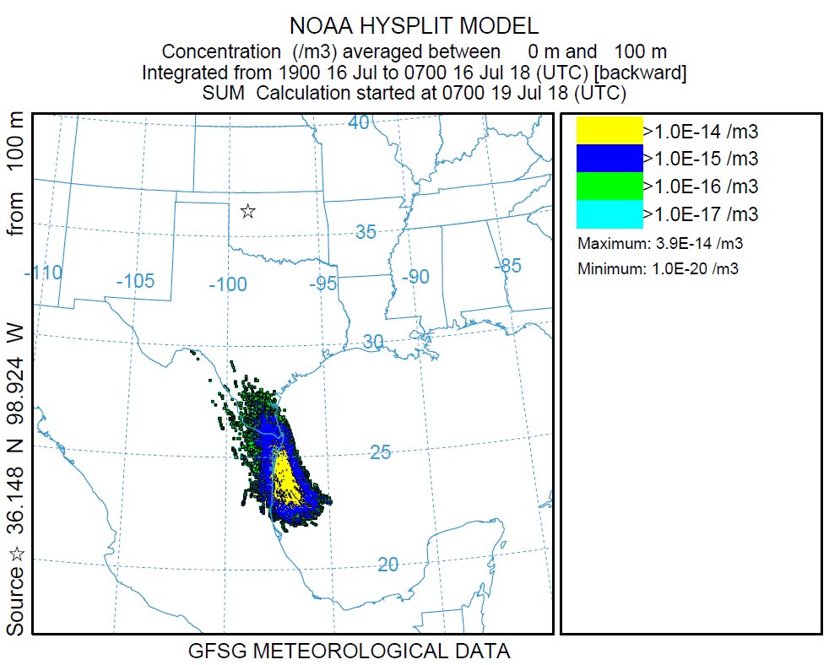
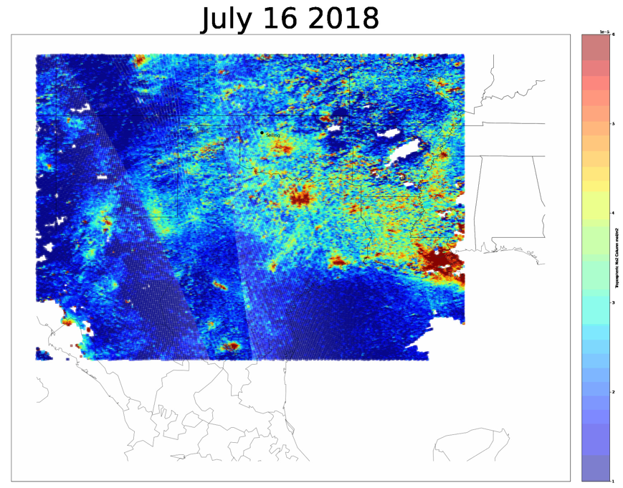
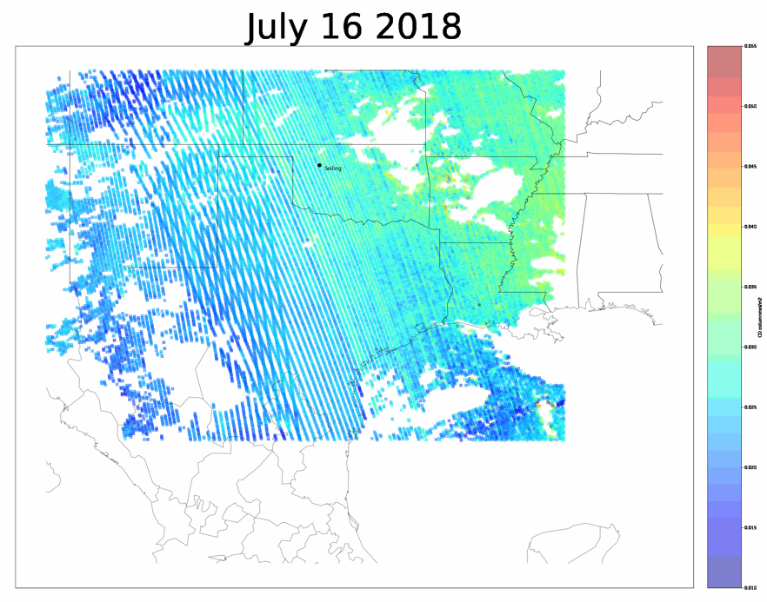
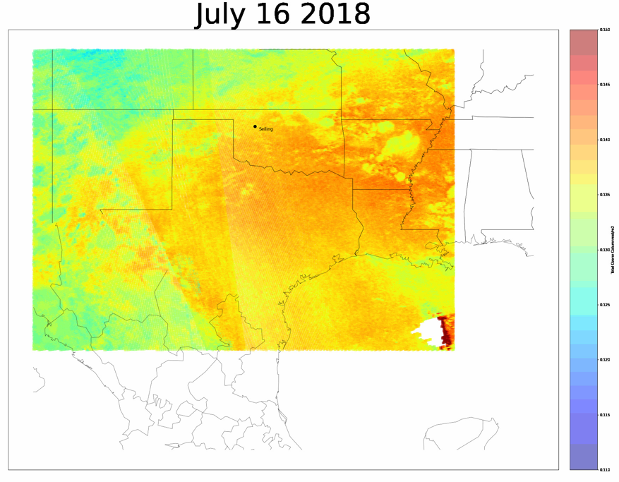
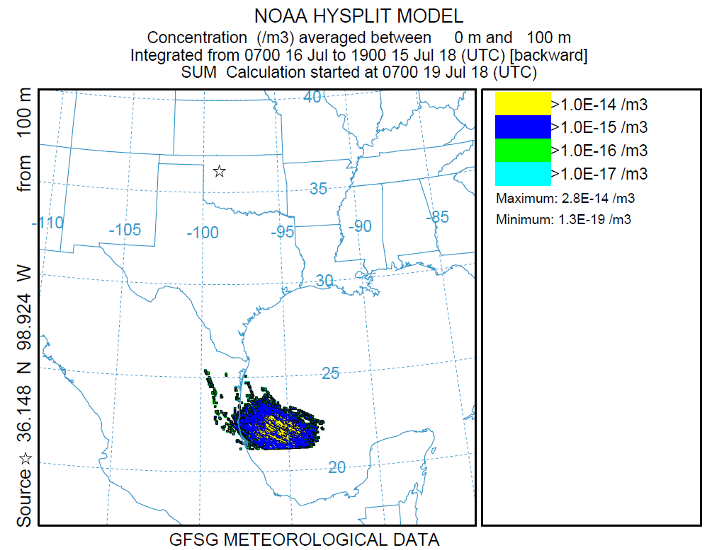
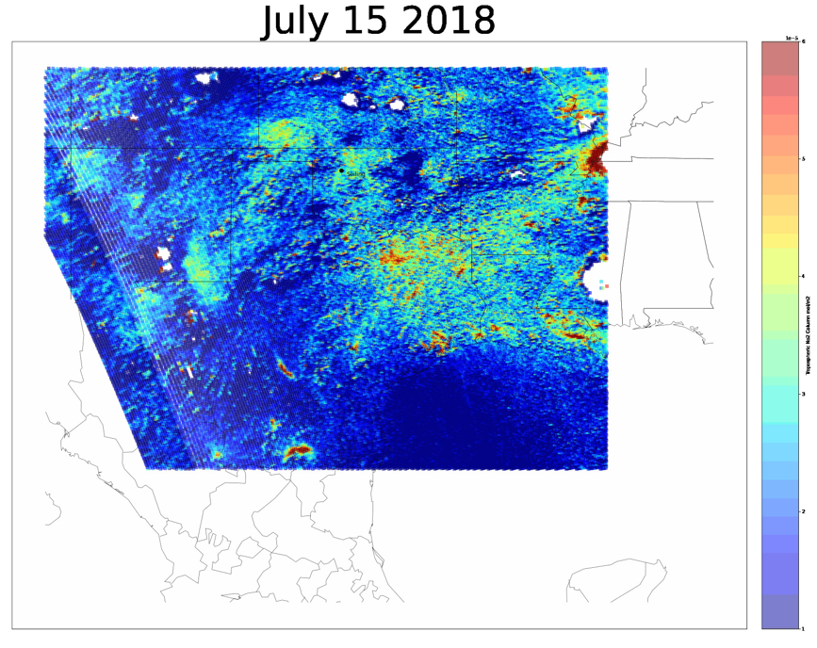
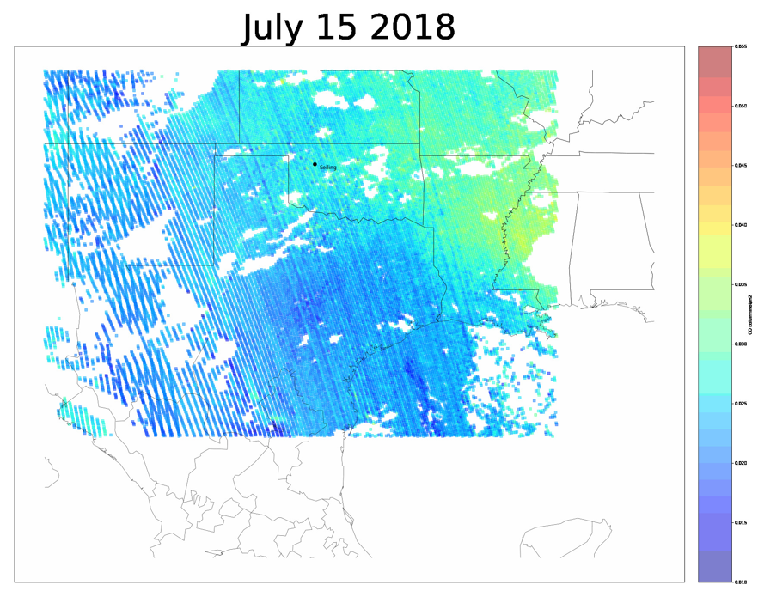
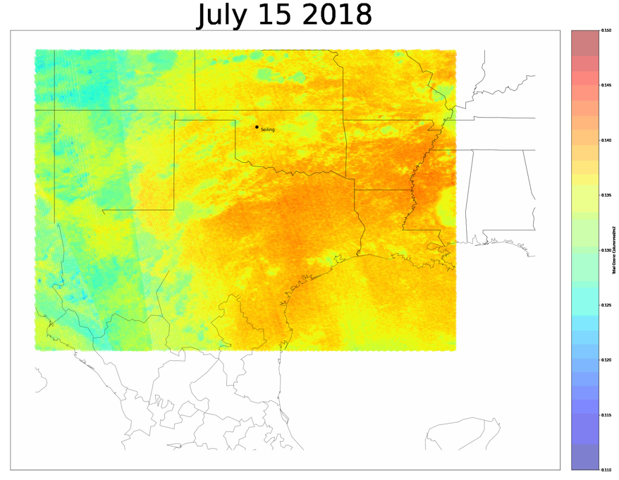
Results: July 17-15
O3
NO2
CO

Slide 26
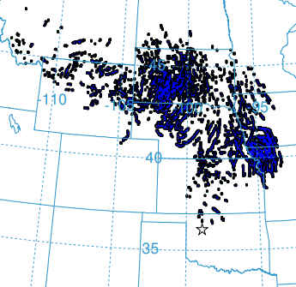
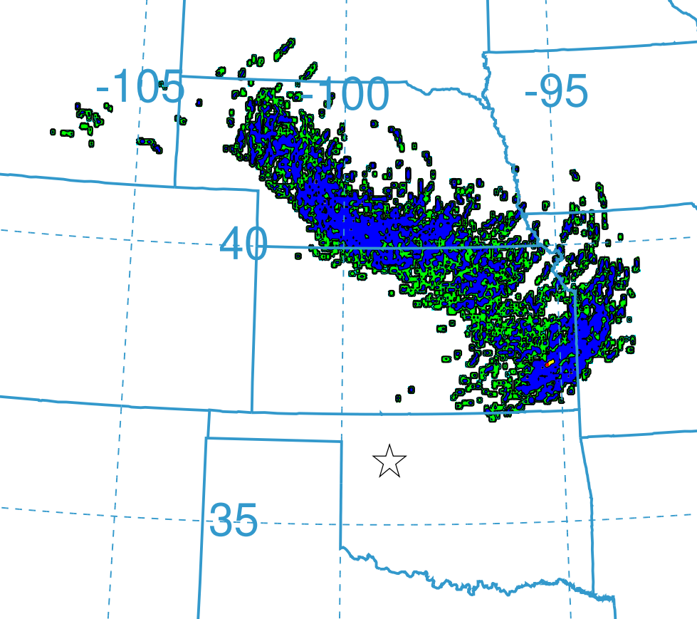
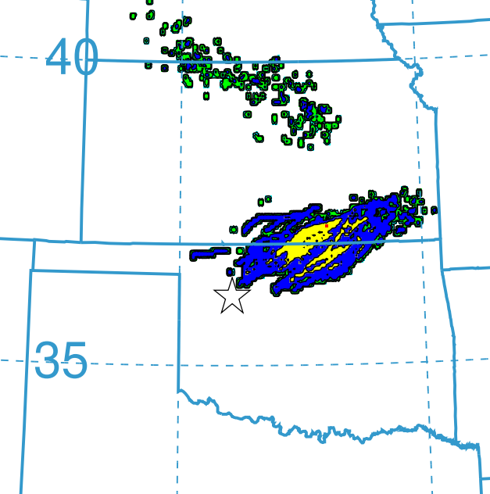
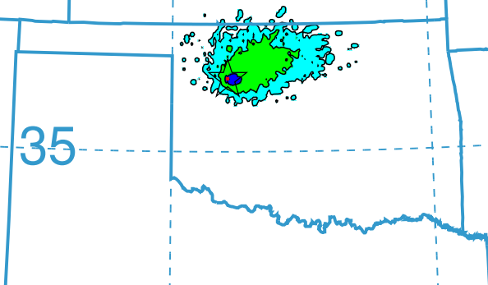
Results: HYSPLIT
1000 Particle Backward Trajectory Simulation
HYSPLIT simulation of the backwards spread of particles from Seiling, OK
Particle Concentration
>1.0E-14 /m³
>1.0E-16 /m³
>1.0E-18 /m³
>1.0E-20 /m³
July 28
July 27
July 26
July 25
Notes:
Notes - Robert
What are we seeing in this model
What does that mean

Slide 27
Results: EO Visualizations
Tropospheric NO₂ July _ 2018
1e-5
- 6
- 5
- 4
Tropospheric NO₂ mo/m²
- 3
- 2
- 1
Corresponding with an NO₂ plume in mid-July, starting in Northern Missouri

Slide 28
Results: EO Visualizations
Total Column Ozone July 1 – July 23, 2018
0.145
large ozone plume observed in late July coming in from the Northeast
0.140
0.135
Total Column Ozone mo/m²
0.130
0.125
0.120
July 31

